Slide 1

Concepts in Enterprise Resource Planning
Fourth Edition
Chapter Four
Production and Supply Chain Management Information Systems

Slide 2
Objectives
After completing this chapter, you will be able to:
Describe the steps in the production planning process of a high-volume manufacturer such as Fitter Snacker
Describe Fitter Snacker’s production and materials management problems
Describe how a structured process for Supply Chain Management planning enhances efficiency and decision making
Describe how production planning data in an ERP system can be shared with suppliers to increase supply chain efficiency
Concepts in Enterprise Resource Planning, Fourth Edition
Concepts in Enterprise Resource Planning, Fourth Edition

Slide 3
Introduction
Supply Chain Management (SCM) in an ERP system
Fitter Snacker is part of a supply chain
FS’s SCM problems and how ERP can help fix them
Concepts in Enterprise Resource Planning, Fourth Edition

Slide 4
Production Overview
To meet customer demand efficiently, Fitter Snacker must:
  Develop a forecast of customer demand
  Develop a production schedule to meet the estimated demand
ERP system is a good tool for developing and executing production plans
Goal of production planning is to schedule production economically
Concepts in Enterprise Resource Planning, Fourth Edition

Slide 5
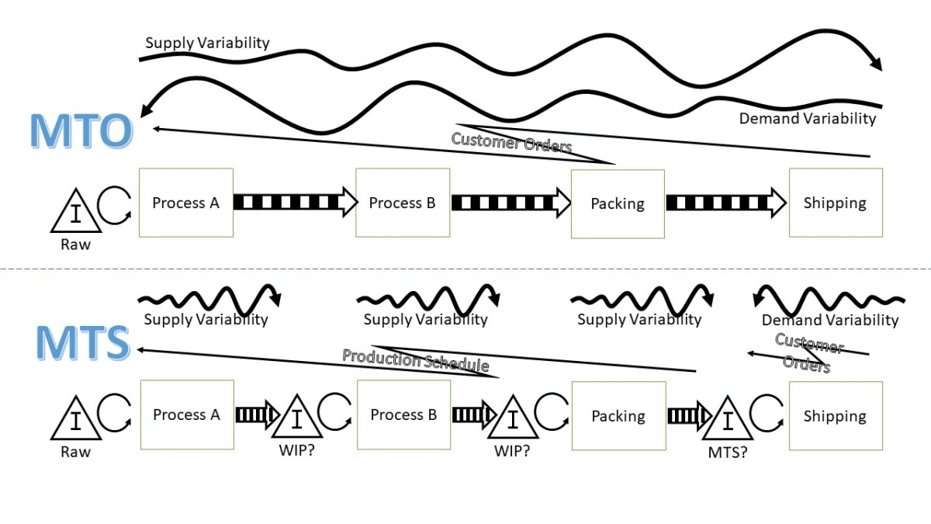
Production Overview (cont’d.)
Three general approaches to production
  Make-to-stock (MTS)
  Make-to-order (MTO)
  Assemble-to-order (ATO)
Concepts in Enterprise Resource Planning, Fourth Edition

Slide 6
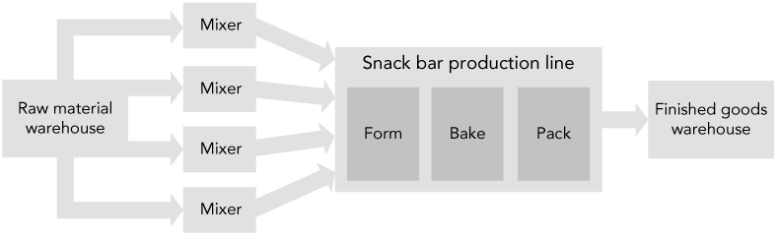
Fitter Snacker’s Manufacturing Process
Fitter Snacker uses make-to-stock production
Figure 4-1 Fitter Snacker’s manufacturing process
Concepts in Enterprise Resource Planning, Fourth Edition

Slide 7
Fitter Snacker’s Manufacturing Process (cont’d.)
Snack bar line can produce 200 bars a minute, or 12,000 bars per hour
Each bar weighs four ounces
Product 48,000 ounces/hour, or 3,000 lbs/hour
Entire production line operates on one shift a day
Fitter Snacker’s production sequence
  Capacity: number of bars that can be produced
Concepts in Enterprise Resource Planning, Fourth Edition

Slide 8
Fitter Snacker’s Production Problems
Fitter Snacker has problems deciding how many bars to make and when to make them
Communication problems
  FS’s Marketing and Sales personnel do not share information with Production personnel
  Production personnel find it hard to deal with sudden increases in demand
    Might cause shortages or stockout
Concepts in Enterprise Resource Planning, Fourth Edition

Slide 9
Fitter Snacker’s Production Problems (cont’d.)
Inventory problems
  Production manager lacks systematic method for:
    Meeting anticipated sales demand
    Adjusting production to reflect actual sales
Accounting and purchasing problems
  Standard costs: normal costs of manufacturing a product
  Production and Accounting must periodically compare standard costs with actual costs and then adjust the accounts for the inevitable differences
Concepts in Enterprise Resource Planning, Fourth Edition

Slide 10
The Production Planning Process
Three important principles for production planning:
  Work from sales forecast and current inventory levels to create an “aggregate” (“combined”) production plan for all products
  Break down aggregate plan into more specific production plans for individual products and smaller time intervals
  Use production plan to determine raw material requirements
Concepts in Enterprise Resource Planning, Fourth Edition

Slide 11
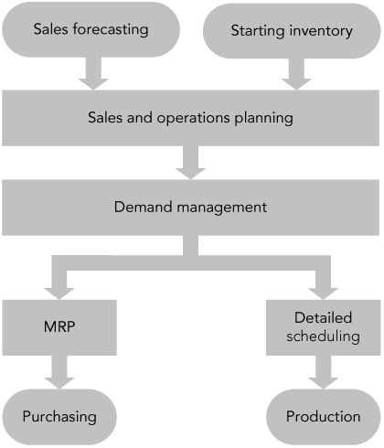
The SAP ERP Approach to Production Planning
Figure 4-2 The production planning process
Concepts in Enterprise Resource Planning, Fourth Edition

Slide 12
Sales Forecasting
SAP’s ERP system takes an integrated approach
  Whenever a sale is recorded in Sales and Distribution (SD) module, quantity sold is recorded as a consumption value for that material
Simple forecasting technique
  Use a prior period’s sales and then adjust those figures for current conditions
To make a forecast for Fitter Snacker:
  Use previous year’s sales data in combination with marketing initiatives to increase sales
Concepts in Enterprise Resource Planning, Fourth Edition

Slide 13
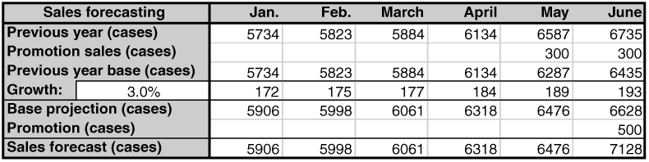
Sales Forecasting (cont’d.)
Figure 4-3 Fitter Snacker’s sales forecast for January through June
Concepts in Enterprise Resource Planning, Fourth Edition

Slide 14
Sales and Operations Planning
Sales and operations planning (S&OP)
  Input: sales forecast provided by Marketing
  Output: production plan designed to balance market demand with production capacity
    Production plan is the input to the next step, demand management
Concepts in Enterprise Resource Planning, Fourth Edition

Slide 15
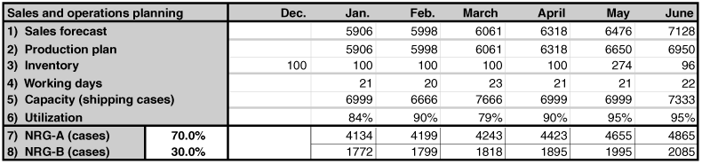
Sales and Operations Planning (cont’d.)
Figure 4-5 Fitter Snacker’s sales and operations plan for January through June
Concepts in Enterprise Resource Planning, Fourth Edition

Slide 16
Sales and Operations Planning (cont’d.)
In SAP ERP, sales forecast can be made using:
  Historical sales data from the Sales and Distribution (SD) module
  Input from plans developed in Controlling (CO) module
CO module
  Profit goals for company can be set
  Sales levels needed to meet the profit goals can be estimated
Concepts in Enterprise Resource Planning, Fourth Edition

Slide 17
Sales and Operations Planning (cont’d.)
Rough-cut planning: common term in manufacturing for aggregate planning
  Disaggregated to generate detailed production schedules
Once SAP ERP system generates a forecast, the planner can view the results graphically
Rough-cut capacity planning applies simple capacity-estimating techniques to the production plan to see if the techniques are feasible
Concepts in Enterprise Resource Planning, Fourth Edition

Slide 18
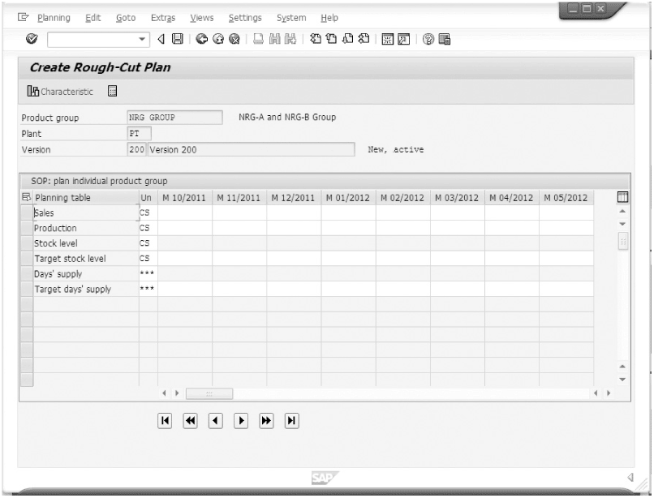
Sales and Operations Planning (cont’d.)
Figure 4-6 Sales and operations planning screen in SAP ERP
Concepts in Enterprise Resource Planning, Fourth Edition

Slide 19
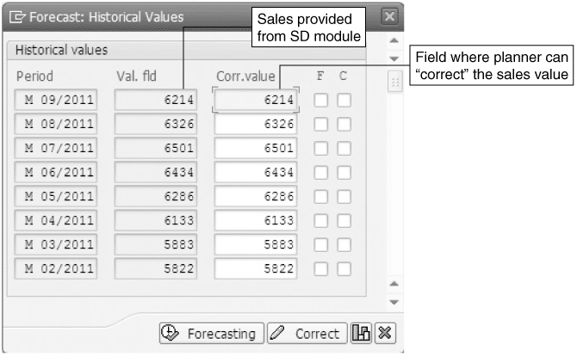
Figure 4-7 Historical sales figures in SAP
Concepts in Enterprise Resource Planning, Fourth Edition

Slide 20
Sales and Operations Planning (cont’d.)
Historical sales screen allow planner to correct sales values
Do not account for external factors, such as unusual weather
Sales figures forecasting represent best estimate of demand
Concepts in Enterprise Resource Planning, Fourth Edition

Slide 21
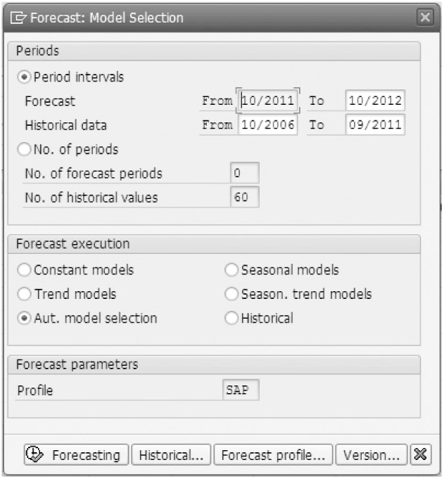
Figure 4-8 Forecasting model options in SAP ERP
Concepts in Enterprise Resource Planning, Fourth Edition

Slide 22
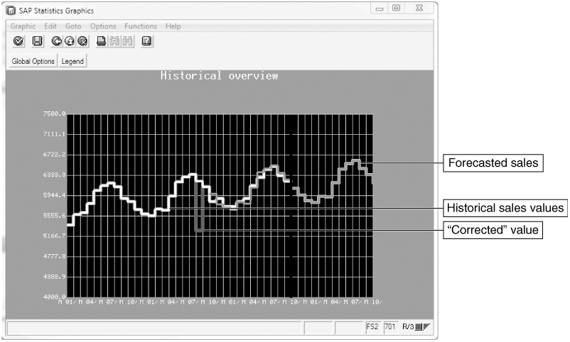
Sales and Operations Planning (cont’d.)
Figure 4-9 Forecasting results presented graphically in SAP ERP
Concepts in Enterprise Resource Planning, Fourth Edition

Slide 23
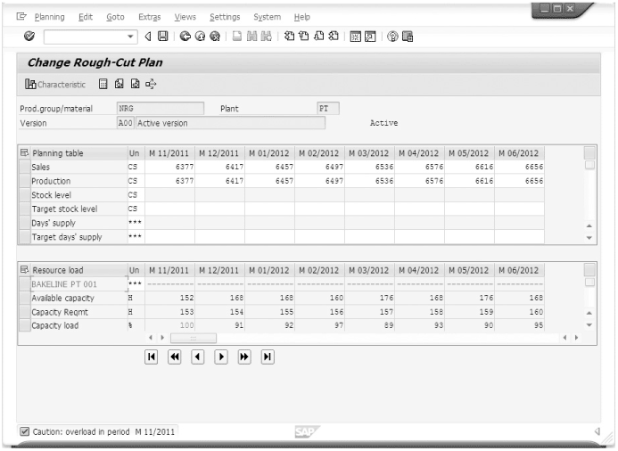
Figure 4.10 Sales and operation plan with rough-cut capacity calculation in SAP ERP
Concepts in Enterprise Resource Planning, Fourth Edition

Slide 24
Sales and Operations Planning (cont’d.)
Disaggregating the sales and operations plan
  Companies typically develop sales and operations plans for product groups
  SAP ERP system allows any number of products to be assigned to a product group
  Sales and operation plan disaggregated
    Production plan quantities specified for the group are transferred to the individual products that make up the group
Concepts in Enterprise Resource Planning, Fourth Edition

Slide 25
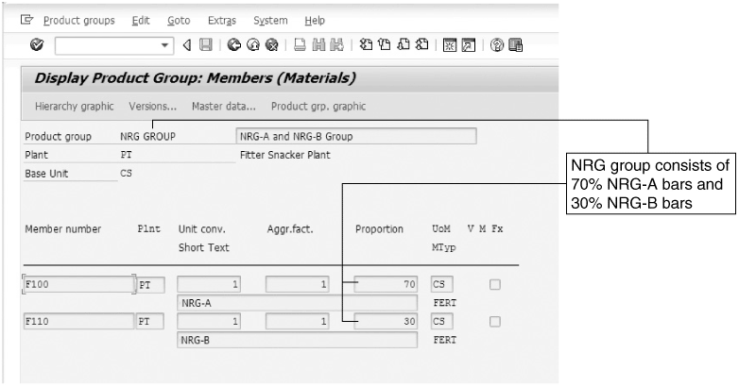
Sales and Operations Planning (cont’d.)
Figure 4-11 Product group structure in SAP ERP
Concepts in Enterprise Resource Planning, Fourth Edition

Slide 26
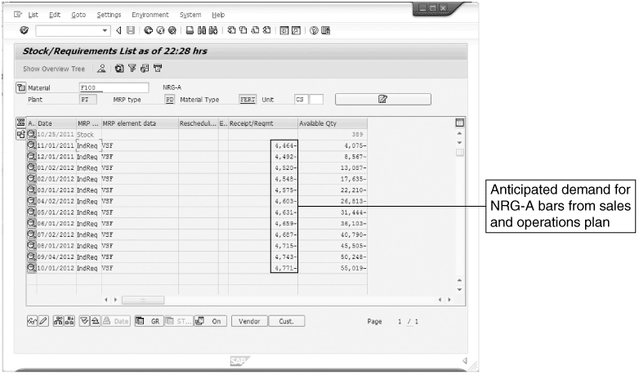
Sales and Operations Planning (cont’d.)
Figure 4-12 Stock/Requirements List for NRG-A bars after disaggregation
Concepts in Enterprise Resource Planning, Fourth Edition

Slide 27
Demand Management
Links the sales and operations planning process with detailed scheduling and materials requirements planning processes
Output: master production schedule (MPS)
  Production plan for all finished goods
For Fitter Snacker, MPS is an input to detailed scheduling, which determines what bars to make and when to make them
Concepts in Enterprise Resource Planning, Fourth Edition

Slide 28
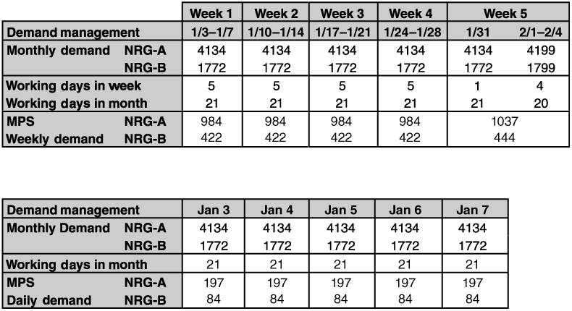
Demand Management (cont’d.)
Figure 4-14 Fitter Snacker’s production plan for January: The first five weeks of production are followed by a day-by-day disaggregation of week 1
Concepts in Enterprise Resource Planning, Fourth Edition

Slide 29
Materials Requirements Planning (MRP)
Determines required quantity and timing of the production or purchase of subassemblies and raw materials needed to support MPS
Bill of material (BOM): list of the materials (including quantities) needed to make a product
Concepts in Enterprise Resource Planning, Fourth Edition

Slide 30
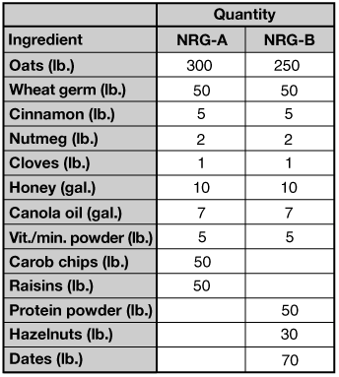
Figure 4-15 Fitter’s factory calendar for August
Concepts in Enterprise Resource Planning, Fourth Edition

Slide 31
Materials Requirements Planning (MRP) (cont’d.)
Figure 4-16 The bill of material (BOM) for Fitter Snacker’s NRG bars
Concepts in Enterprise Resource Planning, Fourth Edition

Slide 32
Materials Requirements Planning (MRP) (cont’d.)
Lead times and lot sizing
  Lead time: cumulative time required for the supplier to receive and process the order, take the material out of stock, package it, load it on a truck, and deliver it to the manufacturer
  Lot sizing: determining production quantities and order quantities
MRP record: standard way of viewing the MRP process on paper
Concepts in Enterprise Resource Planning, Fourth Edition

Slide 33
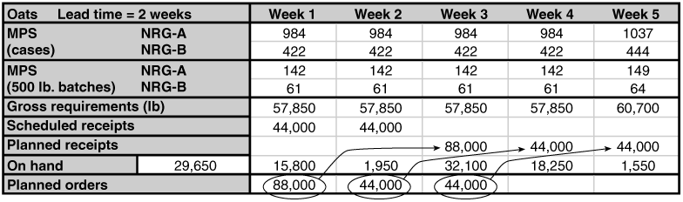
Materials Requirements Planning (MRP) (cont’d.)
Figure 4-17 The MRP record for oats in NRG bars, weeks 1 through 5
Concepts in Enterprise Resource Planning, Fourth Edition

Slide 34
Materials Requirements Planning in SAP ERP
MRP list shows results of MRP calculations
MRP process creates planned orders to meet dependent requirements
Stock/Requirements List shows:
  Planned orders
  Purchase requisitions (PurRqs)
  Purchase orders (POitem)
Planner can convert a planned order to a purchase order from Stock/Requirements List by double-clicking the planned order line
Concepts in Enterprise Resource Planning, Fourth Edition

Slide 35
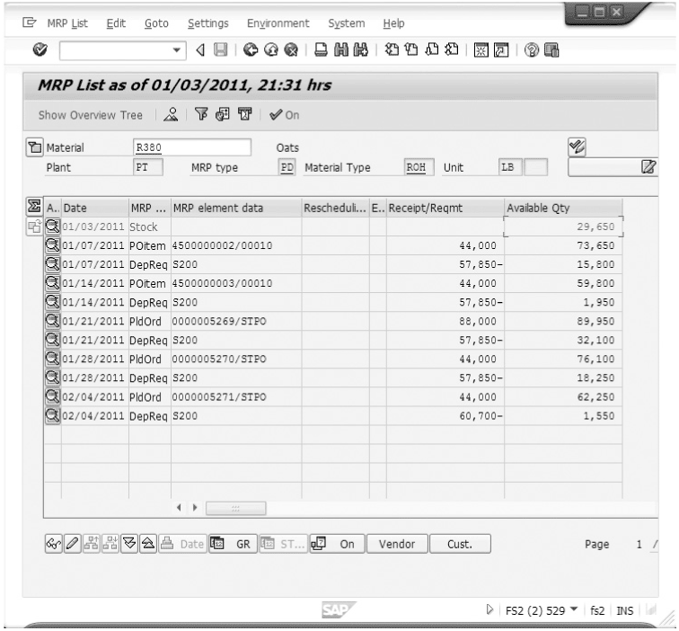
Materials Requirements Planning in SAP ERP (cont’d.)
Figure 4-18 The MRP list in SAP ERP
Concepts in Enterprise Resource Planning, Fourth Edition

Slide 36

Materials Requirements Planning in SAP ERP (cont’d.)
Figure 4-19 The Stock/Requirements List in SAP ERP
Concepts in Enterprise Resource Planning, Fourth Edition

Slide 37
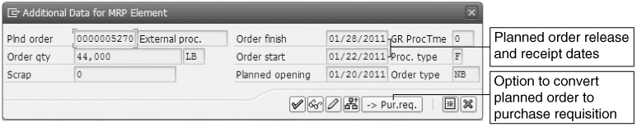
Figure 4-20 Conversion of a planned order to a requisition
Concepts in Enterprise Resource Planning, Fourth Edition

Slide 38
Materials Requirements Planning in SAP ERP (cont’d.)
Integrated information system allows Purchasing to make the best decision on a vendor based on relevant, up-to-date information
Once Purchasing employee decides which vendor to use, the purchase order is transmitted to vendor
  System can be configured to fax order to vendor, transmit it electronically through EDI (electronic data interchange), or send it over the Internet
Concepts in Enterprise Resource Planning, Fourth Edition

Slide 39
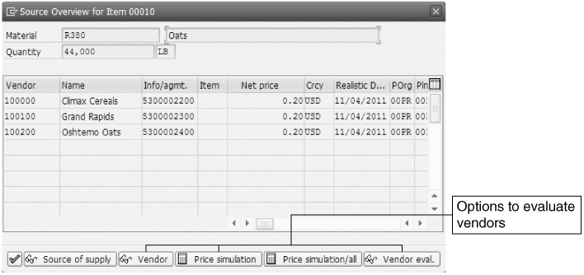
Figure 4-21 Source Overview screen for supplier selection
Concepts in Enterprise Resource Planning, Fourth Edition

Slide 40
Detailed Scheduling
Detailed plan of what is to be produced, considering machine capacity and available labor
One key decision in detailed production scheduling
  How long to make the production runs for each product
  Production run length requires a balance between setup costs and holding costs to minimize total costs to the company
Concepts in Enterprise Resource Planning, Fourth Edition

Slide 41
Detailed Scheduling (cont’d.)
Fitter Snacker uses repetitive manufacturing
Repetitive manufacturing environments usually involve production lines that are switched from one product to another similar product
  Production lines are scheduled for a period of time, rather than for a specific number of items
Concepts in Enterprise Resource Planning, Fourth Edition

Slide 42
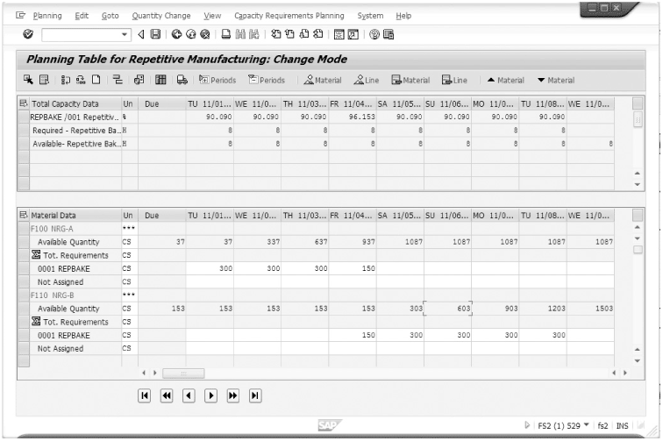
Detailed Scheduling (cont’d.)
Figure 4-22 Repetitive manufacturing planning table in SAP ERP
Concepts in Enterprise Resource Planning, Fourth Edition

Slide 43
Detailed Scheduling (cont’d.)
Production runs should be decided by evaluating the cost of equipment setup and holding inventory
Integrated information system simplifies this analysis
  Automatically collects accounting information that allows managers to better evaluate schedule trade-offs in terms of costs to company
Concepts in Enterprise Resource Planning, Fourth Edition

Slide 44
Providing Production Data to Accounting
In the manufacturing plant, ERP packages do not directly connect with production machines
Data can be entered into SAP ERP through a PC on the shop floor, scanned by a barcode reader or radio frequency identification (RFID) technology, or a mobile device
In an integrated ERP system, the accounting impact of a material transaction can be recorded automatically
Concepts in Enterprise Resource Planning, Fourth Edition

Slide 45
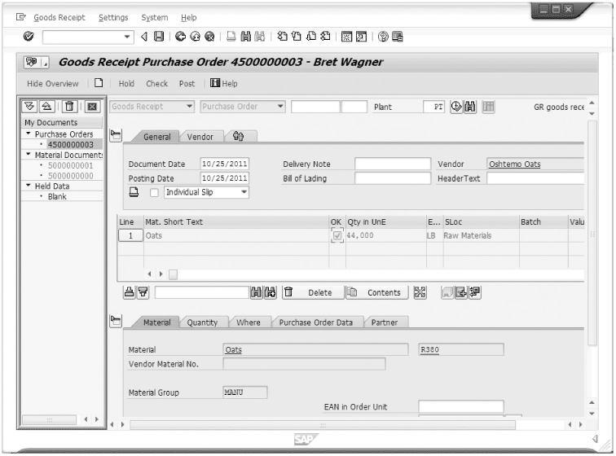
Providing Production Data to Accounting (cont’d.)
Figure 4-23 Goods receipt screen in SAP ERP
Concepts in Enterprise Resource Planning, Fourth Edition

Slide 46
Providing Production Data to Accounting (cont’d.)
Once FS accepts shipment, Receiving must notify SAP ERP system of the arrival and acceptance of the material
  Goods receipt transaction
Receiving department must match goods receipt with purchase order that initiated it
When receipt is successfully recorded, SAP ERP system immediately records the increase in inventory levels for the material
Concepts in Enterprise Resource Planning, Fourth Edition

Slide 47
ERP and Suppliers
Fitter Snacker is part of a supply chain
  Starts with farmers growing oats and wheat
  Ends with a customer buying an NRG bar from a retail store
ERP systems can play a key role in collaborative planning
Concepts in Enterprise Resource Planning, Fourth Edition

Slide 48
ERP and Suppliers (cont’d.)
Working with suppliers in a collaborative fashion requires trust among all parties
  Company opens its records to its suppliers
  Suppliers can read company’s data because of common data formats
Advantages
  Reductions in paperwork
  Savings in time
  Other efficiency improvements
Concepts in Enterprise Resource Planning, Fourth Edition

Slide 49
The Traditional Supply Chain
Supply chain: all activities that occur between the growing or mining of raw materials and the appearance of finished products on the store shelf
Traditional supply chain
  Information is passed through the supply chain reactively as participants increase their product orders
  Inherent time lags cause problems
Concepts in Enterprise Resource Planning, Fourth Edition

Slide 50
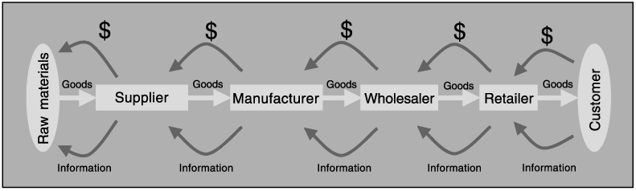
The Traditional Supply Chain (cont’d.)
Figure 4-24 Supply chain management (SCM) from raw materials to consumer
Concepts in Enterprise Resource Planning, Fourth Edition

Slide 51
The Traditional Supply Chain (cont’d.)
EDI and ERP
  Before ERP systems were available, companies could be linked with customers and suppliers through electronic data interchange (EDI) systems
  Well-developed ERP system can facilitate SCM
    Needed production planning and purchasing systems already in place
  With ERP system, sharing production plans along the supply chain can occur in real time
Concepts in Enterprise Resource Planning, Fourth Edition

Slide 52
The Measures of Success
Performance measurements
  Metrics
  Show the effects of better supply chain management
Cash-to-cash cycle time
  Time between paying for raw materials and collecting cash from customer
SCM costs
  Include cost of buying and handling inventory, processing orders, and information systems support
Concepts in Enterprise Resource Planning, Fourth Edition

Slide 53
The Measures of Success (cont’d.)
Initial fill rate
  Percentage of the order that the supplier provided in the first shipment
Initial order lead time
  Time needed for the supplier to fill the order
On-time performance
  If supplier agreed to requested delivery dates, tracks how often supplier actually met those dates
Concepts in Enterprise Resource Planning, Fourth Edition

Slide 54
Summary
ERP system can improve the efficiency of production and purchasing processes
  Efficiency begins with Marketing sharing a sales forecast
  Production plan is created based on sales forecast and shared with Purchasing so raw materials can be ordered properly
Concepts in Enterprise Resource Planning, Fourth Edition

Slide 55
Summary (cont’d.)
Companies can do production planning without an ERP system, but an ERP system increases company’s efficiency
  ERP system that contains materials requirements planning allows Production to be linked to Purchasing and Accounting
  This data sharing increases a company’s overall efficiency
Concepts in Enterprise Resource Planning, Fourth Edition

Slide 56
Summary (cont’d.)
Companies are building on their ERP systems and integrated systems philosophy to practice supply chain management (SCM)
  SCM: company looks at itself as part of a larger process that includes customers and suppliers
  Using information more efficiently along the entire chain can result in significant cost savings
  Complexity of the global supply chain
    Developing a planning system that effectively coordinates information technology and people is a considerable challenge
Concepts in Enterprise Resource Planning, Fourth Edition

