Slide 1

Concepts in Enterprise Resource Planning
Fourth Edition
Chapter Eight
RFID, Business Intelligence (BI), Mobile Computing, and the Cloud

Slide 2
Objectives
After completing this chapter, you will be able to:
Define RFID and its role in logistics and sales
Define business intelligence (BI), and provide examples of its uses
Explain how in-memory computing will change the use of BI
Discuss the importance of mobile applications to businesses
Describe cloud computing and why it is becoming important for ERP providers
Concepts in Enterprise Resource Planning, Fourth Edition
Concepts in Enterprise Resource Planning, Fourth Edition

Slide 3
Objectives (cont’d.)
Explain how the service-oriented architecture (SOA) concept has changed ERP development
Describe Web services, and outline the unique components of NetWeaver
Define software as a service (SaaS), and identify the advantages and disadvantages of using this software delivery model
Concepts in Enterprise Resource Planning, Fourth Edition
Concepts in Enterprise Resource Planning, Fourth Edition

Slide 4
Introduction
An Enterprise Resource Planning (ERP) system allows a company to accomplish tasks that cannot be done well, if at all, without such a system
Traditionally:
  ERP systems have been software applications that are run on a company’s own computer systems
  Focus of ERP has been on managing business transactions
Concepts in Enterprise Resource Planning, Fourth Edition

Slide 5
Introduction (cont’d.)
Technologies, such as radio frequency identification (RFID), are increasing the amount of data that is contained in ERP systems
Business intelligence technologies are turning data in ERP systems into valuable information
Cloud computing and mobile technologies are changing where ERP data is stored and how it is delivered
Concepts in Enterprise Resource Planning, Fourth Edition

Slide 6
Radio Frequency Identification (RFID) Technology
Radio frequency identification technology
  Known commonly as RFID
  Becoming an increasingly efficient tool for tracking items through a supply chain
RFID device
  Can be attached to products
  A small package (or tag) made up of a microprocessor and an antenna
Concepts in Enterprise Resource Planning, Fourth Edition

Slide 7
Radio Frequency Identification (RFID) Technology (cont’d.)
RFID reader
  Can determine location of an item with an RFID tag
  Emits radio waves and receives signals back from the tag
  Sometimes called an interrogator
Advantages of RFID technology:
  Does not need a line-of-sight connection
  Can withstand most environmental stresses
Concepts in Enterprise Resource Planning, Fourth Edition

Slide 8
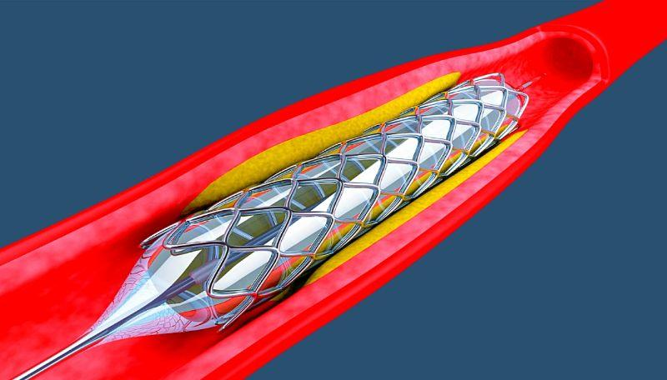
Radio Frequency Identification (RFID) Technology (cont’d.)
Walmart is on the leading edge of the move to integrate RFID technology into the supply chain
Pharmaceutical firms are evaluating the use of RFID technology
RFID technology is being employed to track medical devices
  Spectrum Health’s Meijer Heart Center is using RFID technology to track stents
Concepts in Enterprise Resource Planning, Fourth Edition

Slide 9
Business Intelligence/Business Analytics
Business intelligence (BI)
  Also referred to as business analytics
  A range of different applications and technologies used to extract and analyze large amounts of data to aid in decision making
  Includes data-mining tools and querying tools
    Often interactive and visual
There has been significant growth in the BI market in recent years
Concepts in Enterprise Resource Planning, Fourth Edition

Slide 10
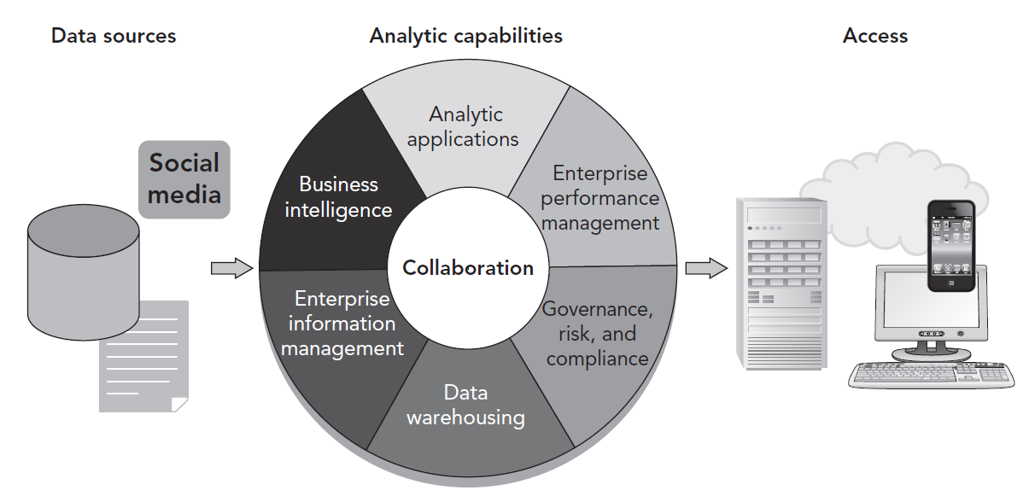
Figure 8-1 SAP Business Intelligence (BI) framework
Concepts in Enterprise Resource Planning, Fourth Edition

Slide 11
Business Intelligence/Business Analytics (cont’d.)
Analytic applications and business intelligence
  Similar sets of data analysis tools
Analytic applications
  Data analysis tools applied to specific industries
Enterprise performance management
  Concept of developing strategic goals for the organization
  Gathering data to evaluate how the organization is performing in relation to those goals
Concepts in Enterprise Resource Planning, Fourth Edition

Slide 12
Business Intelligence/Business Analytics (cont’d.)
Governance, risk, and compliance category
  A group of activities focused on ensuring an organization is functioning ethically and legally
Data warehousing
  Technology used to store the large volumes of data used in the analysis
Enterprise information management
  Describes the business and technology functions that manage information as a corporate asset
Concepts in Enterprise Resource Planning, Fourth Edition

Slide 13
In-Memory Computing
Data in a data warehouse are structured as multidimensional data cubes
  Allow for relationships in the data to be analyzed quickly
Two main challenges with using a multidimensional cube structure
  A significant level of technical expertise is needed to construct a cube
  A multidimensional cube necessarily restricts how the data can be analyzed
Concepts in Enterprise Resource Planning, Fourth Edition

Slide 14
In-Memory Computing (cont’d.)
Accessing data from memory much faster than accessing data from a hard disk
Reason why data warehouses use disk memory: storage capacity
  Hard disks can store one thousand times more data than memory for a comparable cost
Data compression provided by column storage
  Makes it possible to store large volumes of data in memory without aggregation
  Multidimensional cubes are not required
Concepts in Enterprise Resource Planning, Fourth Edition

Slide 15
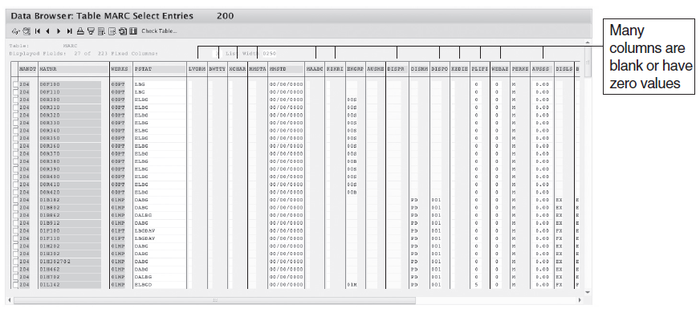
Figure 8-2 Material master data table
Concepts in Enterprise Resource Planning, Fourth Edition

Slide 16
In-Memory Computing (cont’d.)
Both SAP’s and Oracle’s in-memory solutions are designed to analyze “big data”
Big data
  Enormous amount of data that is now available for BI use from all the available sources, including:
    ERP systems, Web sites, corporate databases, scientific research, Twitter, and other social networking applications
BI analytics was the top technology priority for CIOs in 2012
Concepts in Enterprise Resource Planning, Fourth Edition

Slide 17
Mobile Computing
Increasing use of smartphones, tablet computers, and other mobile computing devices
Mobile applications need to be developed for different kinds of smartphones, with different operating systems
Companies need to make many decisions about the use of mobile devices by employees
Mobile devices provide users with information and can also be sources of information
Concepts in Enterprise Resource Planning, Fourth Edition

Slide 18
From Internet-Enabled to Cloud Computing
Cloud computing
  Delivery of a software product to a user via the Internet
  The user typically accesses the cloud product through a Web browser or a lightweight (meaning small and simple) application for a computer or mobile device
Cloud computing is not a completely new concept
  It represents the latest stage of the development of computing and the Internet
Concepts in Enterprise Resource Planning, Fourth Edition

Slide 19
SAP and the Internet
1996: SAP introduced its joint Internet strategy with Microsoft
Internet Transaction Server (ITS)
  A server-based software system that enabled efficient communication between an SAP ERP system and the Internet
  Core of SAP’s first effort to integrate the Internet with its products
Concepts in Enterprise Resource Planning, Fourth Edition

Slide 20
SAP and the Internet (cont’d.)
May 1999: SAP announced mySAP.com
  A new strategy designed to completely realign the company and its product portfolio
  Goal: combine e-commerce solutions with SAP’s existing ERP applications, using cutting-edge Web technology
2000: SAP began building on the mySAP.com vision
  Added the capability for electronic marketplaces and corporate portals
Concepts in Enterprise Resource Planning, Fourth Edition

Slide 21
NetWeaver
2004: SAP introduced its first version of SAP NetWeaver
  A collection of components that support business transactions over the Internet
  Provide seamless connectivity of diverse applications
SAP’s enterprise service-oriented architecture (enterprise SOA)
  Goal of making all of its business applications service based
Concepts in Enterprise Resource Planning, Fourth Edition

Slide 22
NetWeaver (cont’d.)
Web services
  Combination of software tools that enables an organization’s various systems and applications to communicate with other applications
SAP’s NetWeaver
  A Web services platform that allows various vendor applications to share data over the Internet
Concepts in Enterprise Resource Planning, Fourth Edition

Slide 23
NetWeaver (cont’d.)
One benefit of adopting SOA
  Ability to quickly add new applications, making the organization more responsive
  Use of open standards
Implementing SOA is not easy
Return on an SOA investment is often difficult to determine
Concepts in Enterprise Resource Planning, Fourth Edition

Slide 24
NetWeaver Tools and Capabilities
SAP’s NetWeaver platform is a collection of modules, including:
  Enterprise Portal
  Mobile Infrastructure
  Business Intelligence
  Master Data Management
  Exchange Infrastructure
Concepts in Enterprise Resource Planning, Fourth Edition

Slide 25
NetWeaver Tools and Capabilities (cont’d.)
SAP Enterprise Portal gives users complete access to all their work on a single screen
  All information is available through the Web services provided by NetWeaver
NetWeaver’s Mobile Infrastructure module allows users to access and work with data through mobile devices such as smartphones and pagers
Concepts in Enterprise Resource Planning, Fourth Edition

Slide 26
NetWeaver Tools and Capabilities (cont’d.)
Business Intelligence (BI) works with any database management software and any operating system that is running NetWeaver
Master Data Management provides data consistency within a company’s SAP system
NetWeaver’s Exchange Infrastructure module allows different applications to share data
Concepts in Enterprise Resource Planning, Fourth Edition

Slide 27
NetWeaver at Work for Fitter
Examining how NetWeaver can help Fitter
Fitter has an SAP ERP system
Fitter’s two top salespeople, Amy Sanchez and Donald Brown, are busy selling NRG bars directly to customers and to distributors
Concepts in Enterprise Resource Planning, Fourth Edition

Slide 28
SaaS: Software As A Service
A software delivery model
A software product is hosted by a company—such as SAP—on its servers and is accessed by customers via a Web browser
Sometimes described as a utility
A subset of cloud computing
Concepts in Enterprise Resource Planning, Fourth Edition

Slide 29
SAP Business ByDesign
An example of SaaS for the ERP market
First released in 2007
A full ERP system delivered to customers via the cloud
For small to medium-sized companies:
  Lowers the total cost of ownership of the software
  Enables a rapid and smooth implementation
Concepts in Enterprise Resource Planning, Fourth Edition

Slide 30
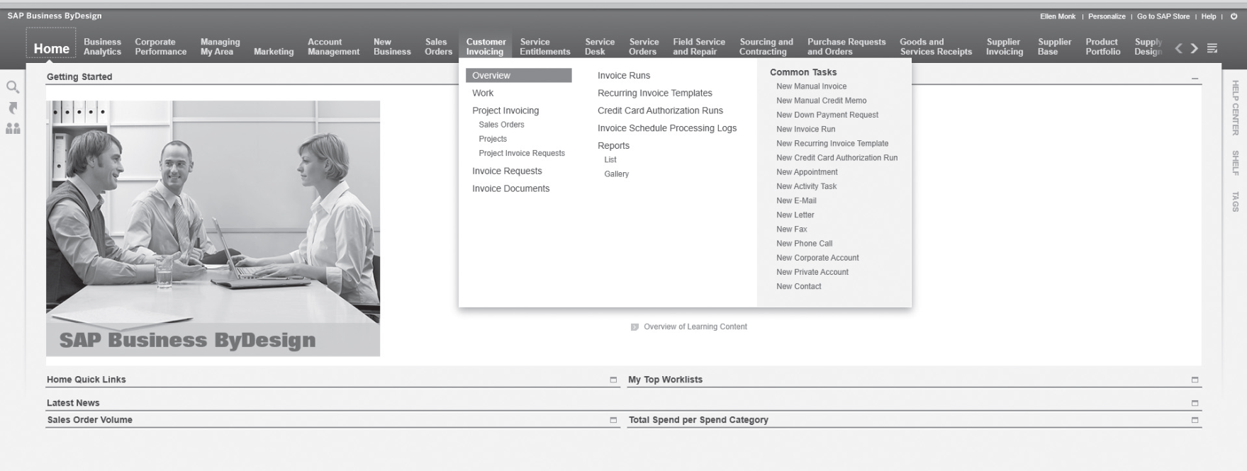
Figure 8-4 SAP Business ByDesign main screen
Concepts in Enterprise Resource Planning, Fourth Edition

Slide 31
SAP Business ByDesign (cont’d.)
PlaNet Finance
  A small organization that offers microloans to customers in 30 international offices
  Finds Business ByDesign is a good fit for its needs
Concepts in Enterprise Resource Planning, Fourth Edition

Slide 32
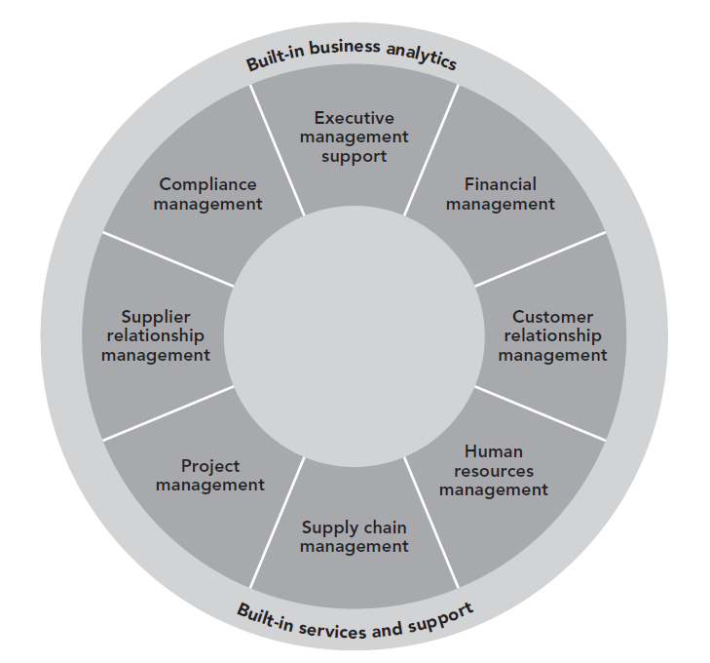
FIGURE 8-5 SAP Business ByDesign’s key capabilities
Concepts in Enterprise Resource Planning, Fourth Edition

Slide 33
Advantages of Using SaaS
Initial affordability
  Lower cost to implement software provided through SaaS
Shorter implementation time
  Implementation time usually shorter as the user does not have to worry about technical issues
Lower support costs and complexity
  Do not need to hire additional IT personnel to implement new systems and applications
Concepts in Enterprise Resource Planning, Fourth Edition

Slide 34
Disadvantages of Using SaaS
Security
Bandwidth/response time
Flexibility
No frills
Technical, not business focus
Concepts in Enterprise Resource Planning, Fourth Edition

Slide 35
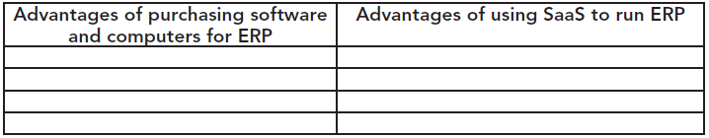
FIGURE 8-7 Arguments for purchasing ERP system and software versus using SaaS
Concepts in Enterprise Resource Planning, Fourth Edition

Slide 36
Option 1: Buying Computers and Software Rights for an ERP System
Estimated costs to set up its own ERP system:
  Database server
  Application server
  PCs
  Computer maintenance
  Licensing rights
  Installation
  User training
  Ongoing consulting
  Network and database administrator
Concepts in Enterprise Resource Planning, Fourth Edition

Slide 37
Option 2: Using an SaaS Provider to Deliver ERP Software
Estimated costs for using an SaaS provider to deliver ERP software:
  PCs
  Computer maintenance
  Software through the SaaS provider
  User training
Concepts in Enterprise Resource Planning, Fourth Edition

Slide 38
Calculate the NPV and Make a Recommendation
You will set up a spreadsheet to total all the costs of each option
In each scenario, you must deal with the net present value (NPV) of money
NPV
  A way to figure out whether an investment is profitable
  In this case, to compare outlay of funds from one method to another
  Addresses the time value of money
Concepts in Enterprise Resource Planning, Fourth Edition

Slide 39
Calculate the NPV and Make a Recommendation (cont’d.)
When calculating two different investment options, NPV calculation allows:
  Different future expenses or earnings to be calculated as an equivalent amount in the present time
NPV can be calculated over a number of years
  In example: we need a five-year outlay of funds for the ERP project
Concepts in Enterprise Resource Planning, Fourth Edition

Slide 40
Calculate the NPV and Make a Recommendation (cont’d.)
In an Excel spreadsheet, the syntax of NPV calculation:
=NPV (hurdle rate percentage, range of values)
  Values in range can be positive or negative numbers
  Hurdle rate
    Rate of discount over the period
    Minimum acceptable rate of return on a project that a company will accept
Concepts in Enterprise Resource Planning, Fourth Edition

Slide 41
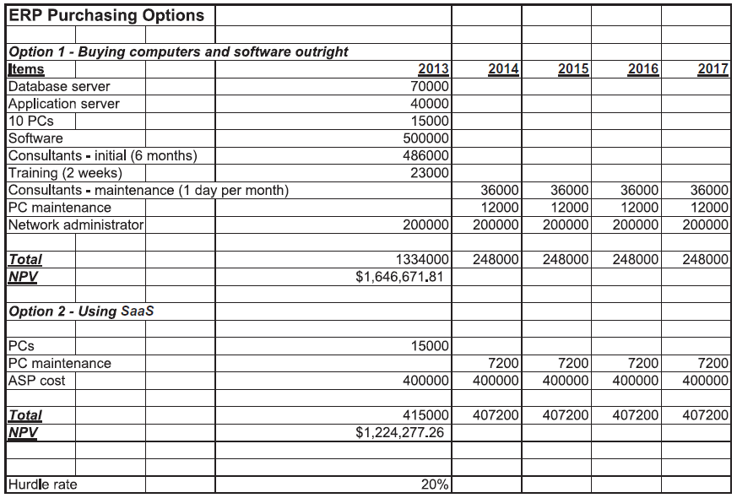
Figure 8-8 Cost comparisons: buying versus SaaS
Concepts in Enterprise Resource Planning, Fourth Edition

Slide 42
Calculate the NPV and Make a Recommendation (cont’d.)
Perform the following steps:
  Calculate the cost of the two methods of implementing an ERP system for five years
  Consider using different hurdle rates for each option
    Why might varying hurdle rates be applicable for this decision?
  Write a memo, with your spreadsheet attached, to the CIO
    Answer this question: Which method should Fitter choose, and why?
Concepts in Enterprise Resource Planning, Fourth Edition

Slide 43
Summary
Technologies such as radio frequency identification (RFID) and smartphones are fueling explosive growth in the amount of data available for businesses to process
Business intelligence (BI) tools are growing in sophistication and power
  Technologies such as in-memory computing will provide greater speed and flexibility to BI users
Mobile computing technology is increasing the use of ERP and BI data
Concepts in Enterprise Resource Planning, Fourth Edition

Slide 44
Summary (cont’d.)
Cloud computing is the delivery of a software product to a user via the Internet
Web services and service-oriented architecture offer a combination of software tools that enables various programs within an organization to communicate with other applications
SAP’s Web services platform is NetWeaver
  A collection of components that support business transactions over the Internet by providing seamless connectivity of diverse applications through the Internet
Concepts in Enterprise Resource Planning, Fourth Edition

Slide 45
Summary (cont’d.)
Software as a service (SaaS) is a software delivery model in which a software product is hosted by a company—such as SAP—on its servers and is accessed by customers via a Web browser
  SaaS model allows companies to use ERP without a large initial investment
  SaaS solutions allow for more rapid improvements in the software through user communities
  There are some risks associated with using an SaaS provider
Concepts in Enterprise Resource Planning, Fourth Edition

