Slide 1
Chapter 11
Managing Systems Implementation

Slide 2
Learning Objectives (1 of 2)
After this chapter, you will be able to:
Explain quality assurance and three techniques to help improve the finished product
Outline application development
Apply structured development
Apply object-oriented development
Apply agile development
Explain coding
Explain unit, integration, and system testing

Slide 3
Learning Objectives (2 of 2)
Differentiate between program, system, operations, and user documentation
Explain the role of online documentation
Describe the five tasks involved in system installation

Slide 4
Quality Assurance (1 of 5)
Competitive business environment
Companies are intensely concerned with the quality of their products and services
Objective
Avoid problems or identify them ASAP
Poor quality can result from:
Inaccurate requirements
Design problems and coding errors
Faulty documentation and ineffective testing

Slide 5
Quality Assurance (2 of 5)
Software engineering
Application of engineering principles to creation of complex, long-lived applications
Software Engineering Institute (SEI) at Carnegie Melon University
Provides quality standards and suggested procedures
Capability Maturity Model (CMM) aims to improve software quality, reduce development time, and cut costs

Slide 6
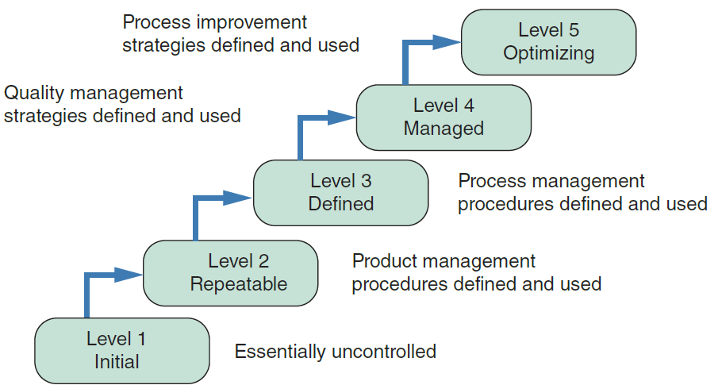
Quality Assurance (3 of 5)
FIGURE 11-2 The CMM has five maturity levels, from Level 1 (Initial), which is essentially uncontrolled development, to Level 5 (Optimizing), in which process improvement strategies are defined and used.

Slide 7
Quality Assurance (4 of 5)
Systems engineering
Builds upon software engineering
Also includes other parts of the overall system, such as hardware, networks, and interfaces

Slide 8
Quality Assurance (5 of 5)
International Organization for Standardization (ISO)
Establishes internationally recognized quality standards for products and services
ISO 9000-3:2004
Provides a quality assurance framework for developing and maintaining software
ISO standards
Specified while purchasing software
Used to guide in-house software development efforts

Slide 9
Application Development (1 of 7)
Application development
Process of constructing the programs and code modules that serve as the building blocks of the information system
Objective: translate the design into program and code modules that will function properly
Development options
Structured analysis, object-oriented (O-O) analysis, and agile methods

Slide 10
Application Development (2 of 7)
Review the systems design
Tasks involved in creating systems design
Break down complex business operations using functional decomposition diagrams (FDDs)
Create data flow diagrams (DFDs)
Develop an object-oriented model of new system
Select a development strategy
Design the user interface
Construct entity-relationship diagrams (ERDs)
Consider an overall system architecture

Slide 11
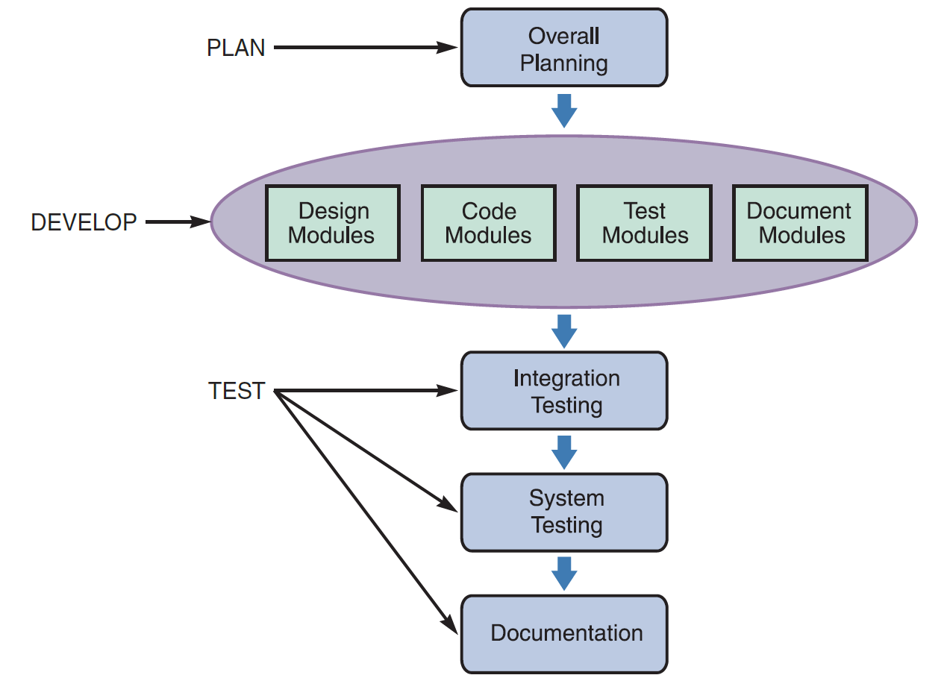
Application Development (3 of 7)
Application development tasks
Traditional methods
Overall strategy must be established
Individual modules must be designed, coded, tested, and documented
FIGURE 11-5 The main steps in application development.

Slide 12
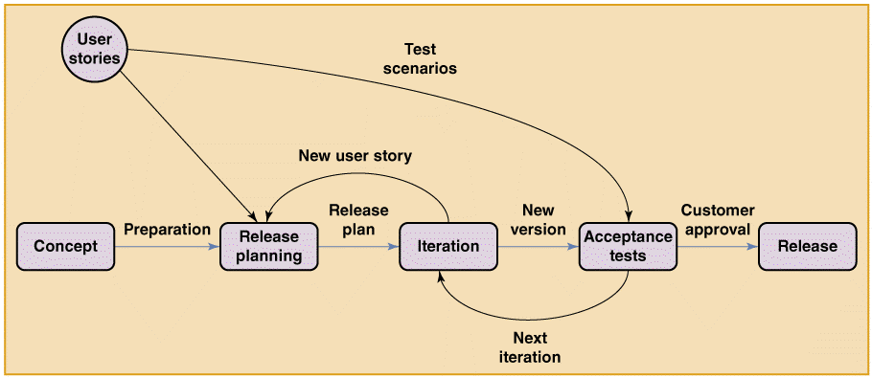
Application Development (4 of 7)
Agile methods
Objective: create a system through an iterative process of planning, designing, coding, and testing
FIGURE 11-6 Simplified model of an Extreme Programming (XP) project. Note the emphasis on iteration and testing.

Slide 13
Application Development (5 of 7)
Systems development tools
Entity-relationship diagrams: show the interaction among system entities and objects
Flowcharts: represent logical rules and interaction graphically
Pseudocode: helps describe program actions that can be implemented in any programming language
Decision tables and decision trees: model business logic for an information system

Slide 14
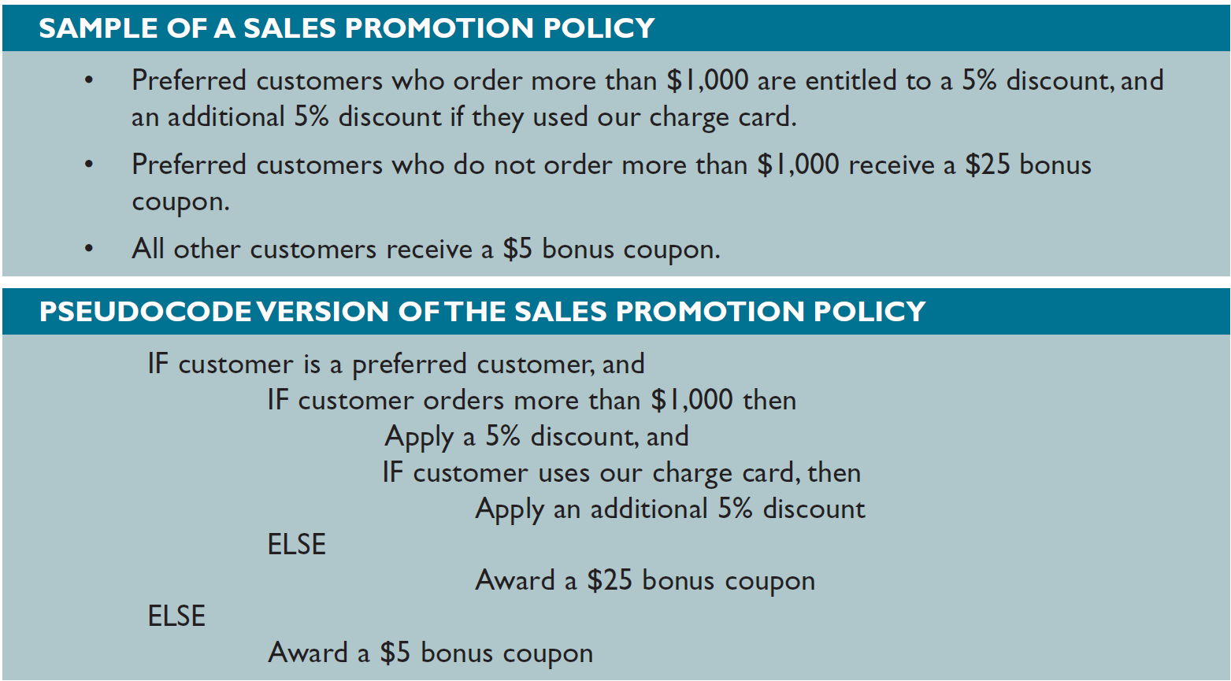
Application Development (6 of 7)
FIGURE 11-7 Sample of a sales promotion policy with logical rules (top) and a pseudocode version of the same policy (bottom). Notice the alignment and indentation of the logic statements in the pseudocode.

Slide 15
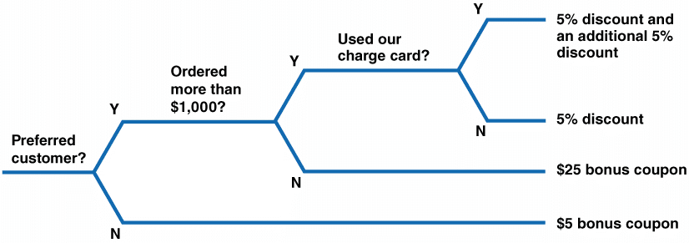
Application Development (7 of 7)
FIGURE 11-8 Sample decision tree that reflects the sales promotion policy in Figure 11-7. Like a decision table, a decision tree shows the action to be taken based on certain properties.

Slide 16
Structured Development (1 of 7)
Partitioning
System broken down into subsystems and modules
Structure charts
Display program modules and relationships
Module: represented by a rectangle
Types of modules
Control: higher-level module
Subordinate: lower-level modules
Library: reusable code

Slide 17
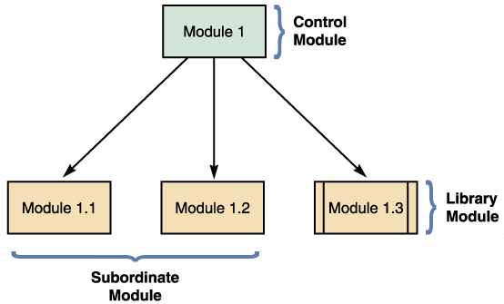
Structured Development (2 of 7)
FIGURE 11-9 An example of structure chart modules.

Slide 18
Structured Development (3 of 7)
Data couple: represented by an arrow with an empty circle
Shows data that one module passes to another
Control couple
Represented by an arrow with a filled circle
Shows a status flag

Slide 19
Structured Development (4 of 7)
Condition: indicates that a control module determines which subordinate modules will be invoked
Represented by a line with a diamond on one end
Loop: indicates that one or more modules are repeated
Represented by a curved arrow

Slide 20
Structured Development (5 of 7)
Cohesion and coupling
Cohesion measures a module’s scope and processing characteristics
A module that performs a single function or task has a high degree of cohesion
Coupling describes the degree of interdependence among modules
Modules that are independent are loosely coupled
In tightly coupled modules, one module is linked to internal logic contained in another module

Slide 21
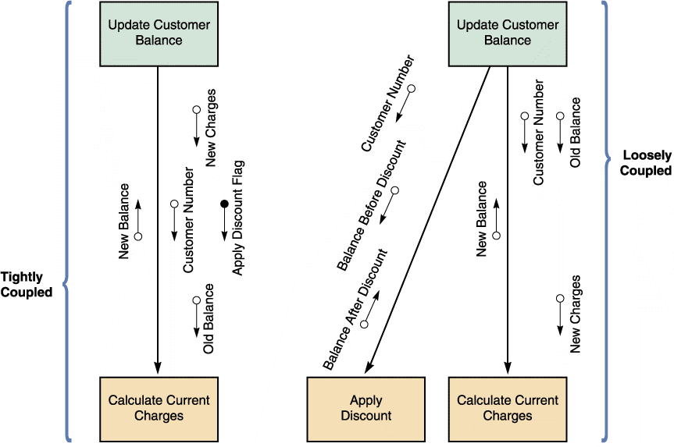
Structured Development (6 of 7)
FIGURE 11-15 An example of tightly coupled and loosely coupled structure charts.

Slide 22
Structured Development (7 of 7)
Drawing a structure chart
Step 1: review DFDs
Step 2: identify the program modules and relationships
Step 3: add couples, loops, and conditions
Analyze the structure chart
Ensure it is consistent with all previous documentation

Slide 23
Object-Oriented Development (1 of 3)
Characteristics
Individual object instances belong to classes of objects with similar characteristics
The relationship and interaction among classes are described using a class diagram
Class diagrams include class attributes and methods
Object relationship diagrams provide an overview of object interaction

Slide 24
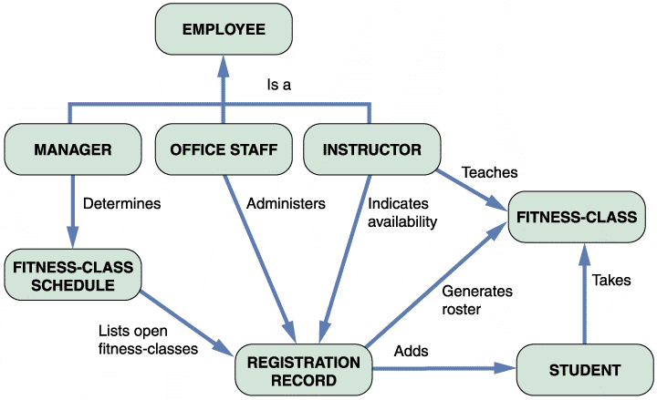
Object-Oriented Development (2 of 3)
FIGURE 11-18 An object-relationship diagram for a fitness center.

Slide 25
Object-Oriented Development (3 of 3)
Implementation of object-oriented designs
Objective: translate object methods into program code modules and determine what event or message will trigger the execution of each module
Object-oriented cohesion and coupling
Classes should be as loosely coupled as possible
An object’s methods should also be loosely coupled and highly cohesive

Slide 26
Agile Development (1 of 3)
Highly iterative process
Development team is in constant communication with the primary user (customer)
Based on a quick and nimble development process that easily adapts to change
Focuses on small teams, intense communication, and rapid development iterations

Slide 27
Agile Development (2 of 3)
Extreme programming (XP)
Uses pair programming
Involves two programmers working on the same task on the same computer, where one programs while the other watches
Test-driven development (TDD)
Focuses on end results from the beginning
Prevents programmers from straying from goals
User stories
Short, simple requirements definitions

Slide 28
Agile Development (3 of 3)
Iterations and releases
Release plans are to be developed by teams
User stories are implemented in a series of iteration cycles
An iteration planning meeting is held at the beginning of each cycle
Iteration cycles continue until all user stories have been implemented, tested, and accepted

Slide 29
Coding
Turning program logic into specific instructions
Transform program logic into code statements
Programming environments
Commonly used programming languages
Visual Basic, Python, and Java
HTMLXML, JavaScript, and Swift
Integrated development environment (IDE)
Makes it easier to program interactive software

Slide 30
Testing (1 of 3)
Each program is tested to ensure that it functions correctly
Program is compiled using a CASE tool or language compiler, which helps detect syntax errors
Desk checking helps spot logic errors
Organizations require a structured walkthrough or code review

Slide 31
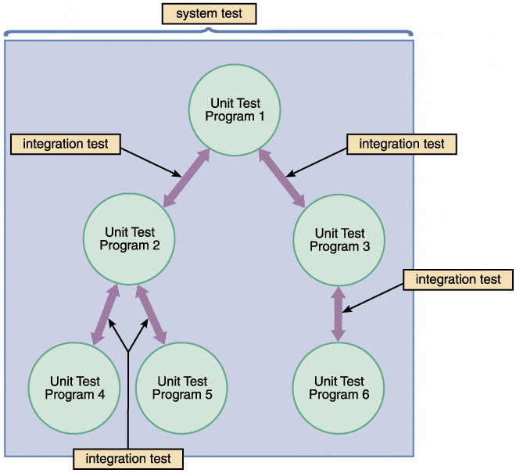
Testing (2 of 3)
Unit testing
Testing of an individual program or module
Aims to identify and eliminate:
Execution errors
Logic errors
Test data should contain both accurate and erroneous data
FIGURE 11-21 The first step in testing is unit testing, followed by integration testing, and then system testing.

Slide 32
Testing (3 of 3)
Integration testing
Testing two or more programs that depend on each other to make sure that the programs work together properly
System testing
Perform a final test of entire system
Acceptance tests: key to user and management approval

Slide 33
Documentation (1 of 2)
Describes an information system
Helps the users, managers, and IT staff who must interact with it
Program documentation
Describes the inputs, outputs, and processing logic for all program modules
System documentation
Describes the system’s functions and how they are implemented

Slide 34
Documentation (2 of 2)
Operations documentation
Contains information needed for processing and distributing online and printed output
User documentation
Consists of instructions and information for users who will interact with the system
Online documentation
Provides immediate help when users have questions or encounter problems

Slide 35
Installation (1 of 17)
After system testing is complete, the results are presented to the management
Test results should be described
Status of all required documentation should be updated
Input from users who participated in system testing should be summarized
Detailed time schedules, cost estimates, and staffing requirements for making the system fully operational should be provided

Slide 36
Installation (2 of 17)
Installation tasks
Prepare a separate operational and test environment
Perform system changeover
Perform data conversion
Carry out a post-implementation tasks

Slide 37
Installation (3 of 17)
Operational and test environments
Operational environment: actual system operation environment
Test environment: environment that analysts and programmers use to develop and maintain programs
A separate test environment is necessary to maintain system security and integrity and protect the operational environment

Slide 38
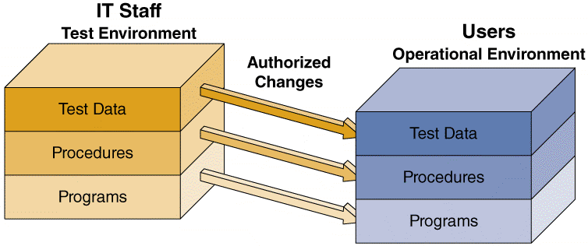
Installation (4 of 17)
FIGURE 11-25 The test environment versus the operational environment. Notice that access to the test environment is limited to IT staff, while the operational environment is
restricted to users.

Slide 39
Installation (5 of 17)
System changeover
Process of putting the new information system online and retiring the old system
Can be rapid or slow, depending on the method
Types
Direct cutover
Parallel operation
Pilot operation
Phased operation

Slide 40
Installation (6 of 17)
Direct cutover
Enables changeover when the new system becomes operational
Least expensive changeover method
IT group has to operate and maintain only one system at a time

Slide 41
Installation (7 of 17)
Parallel operation
Both the old and the new information systems operate fully for a specified period
Advantage: lower level of risk
The old system can be used as a backup
Not practical if the old and new systems are incompatible

Slide 42
Installation (8 of 17)
Pilot operation
Implements the complete new system at a selected location of the company
Pilot site: group that uses the new system first
Reduces the risk of system failure
Less expensive than a parallel operation

Slide 43
Installation (9 of 17)
Phased operation
Implements the new system in stages, or modules
Combines direct cutover and parallel operation to reduce risks and costs
Only a part of the system is given to all users
Risk of errors or failures is limited to the implemented module only
Less expensive than full parallel operation

Slide 44
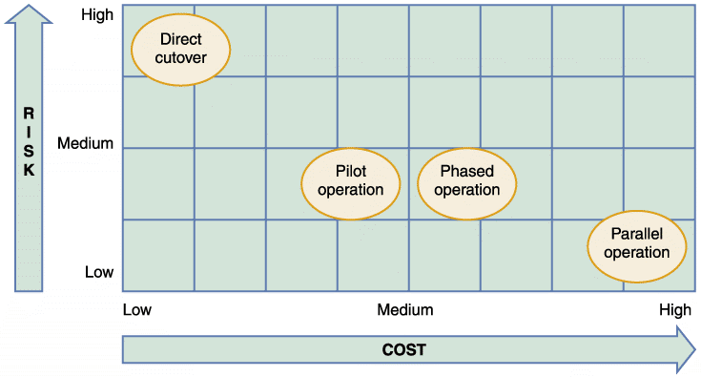
Installation (10 of 17)
FIGURE 11-27 Relative risk and cost characteristics of the four changeover methods.

Slide 45
Installation (11 of 17)
Data conversion
Process in which existing data is loaded on to a new system
Strategies
Automate data conversion process if possible
Old systems may be able to export data in ASCII or ODBC (Open Database Connectivity)
If a standard format is not available, develop a program to extract the data and convert it to an acceptable format

Slide 46
Installation (12 of 17)
Security and controls
Maintain strict input controls during the conversion process
Ensure that all system control measures are in place and operational to protect data from unauthorized access and to help prevent erroneous input
Ensure that error-free data is fed into the new system

Slide 47
Installation (13 of 17)
Training plan
Identify who should receive training and what training is required
Organization should be observed carefully to determine how the system will support business operations, and who will be involved or affected
Main groups for training
Users
Managers
IT staff

Slide 48
Installation (14 of 17)
Vendor training
Required if the system includes the purchase of hardware or software
Webinars, podcasts, and tutorials
Web-based training options
Outside training
Viable alternative if vendor training is not practical

Slide 49
Installation (15 of 17)
Training tips
Train people in groups, with separate training programs for distinct groups
Select most effective place to conduct training
Provide for learning by hearing, seeing, and doing
Rely on previous trainees
Interactive training
Effective training is interactive, self-paced, and multimedia-based

Slide 50
Installation (16 of 17)
Online training
Sophisticated training systems offer interactive sessions
Training material should include a reference section
A full-scale test, or simulation must be conducted after the training is complete

Slide 51
Installation (17 of 17)
Post-implementation tasks
Prepare a post-implementation evaluation
Assesses overall quality
Deliver a final report to management
Marks the end of systems development work

Slide 52
Summary (1 of 5)
Systems implementation phase
Consists of application development, testing, installation, and evaluation of the new
Each systems development approach has its own set of tools
Charts and diagrams
System developers can use more generic tools to help them translate the system logic into properly functioning program modules

Slide 53
Summary (2 of 5)
Cohesion measures a module’s scope and processing characteristics
Coupling measures relationships and interdependence among modules
There are three steps used to create a structure chart
In agile development, the customer creates user stories describing required features and priority levels

Slide 54
Summary (3 of 5)
Programmers perform desk checking, code review, and unit testing tasks during application development
In addition to system documentation, analysts and technical writers also prepare operations and user documentation
An operational environment for new information system is established separate from the test environment

Slide 55
Summary (4 of 5)
System changeover is the process of putting the new system into operation
Data conversion often is necessary when installing a new information system
Everyone who interacts with the new information system should receive training appropriate to their skills

Slide 56
Summary (5 of 5)
A post-implementation evaluation assesses and reports on the quality of the new system and the work done by the project team
The final report to management includes the final system documentation, describes any future system enhancements that already have been identified, and details the project costs

