Slide 1
Chapter 12
Managing Systems Support and Security

Slide 2
Learning Objectives (1 of 3)
After this chapter, you will be able to:
Describe user support activities
Define the four types of maintenance
Explain seven strategies and techniques for maintenance management
Describe techniques for system performance management
Explain system security concepts and common attacks against the system

Slide 3
Learning Objectives (2 of 3)
Explain three tasks related to risk management concepts
Assess system security at six levels: physical security, network security, application security, file security, user security, and procedural security
Describe backup and disaster recovery

Slide 4
Learning Objectives (3 of 3)
List six factors indicating that a system has reached the end of its useful life
List future challenges and opportunities for IT professionals

Slide 5
User Support (1 of 3)
Successful systems often need the most support
Users want to learn features
User training
IT Department may develop a user training package
Training users about system changes is similar to initial training
Objective: show users how the system can help them perform their jobs

Slide 6
User Support (2 of 3)
Help or service desks
Show people how to use resources effectively
Provide answers to technical or operational questions
Make users more productive by teaching them how to meet their own information needs
Boost productivity using remote control software
Allows IT staff to take over a user’s workstation and provide support and troubleshooting

Slide 7
User Support (3 of 3)
Outsourcing issues
Offshore call centers can trim expenses and free up valuable human resources for product development
Customers may shop elsewhere if the quality of tech support decreases
Critical factors
Phone wait times
Performance of support staff
Online support tools

Slide 8
Maintenance Tasks (1 of 6)
Ongoing maintenance expenses can determine the economic life of a system
Operational costs
Maintenance expenses
Maintenance activities

Slide 9
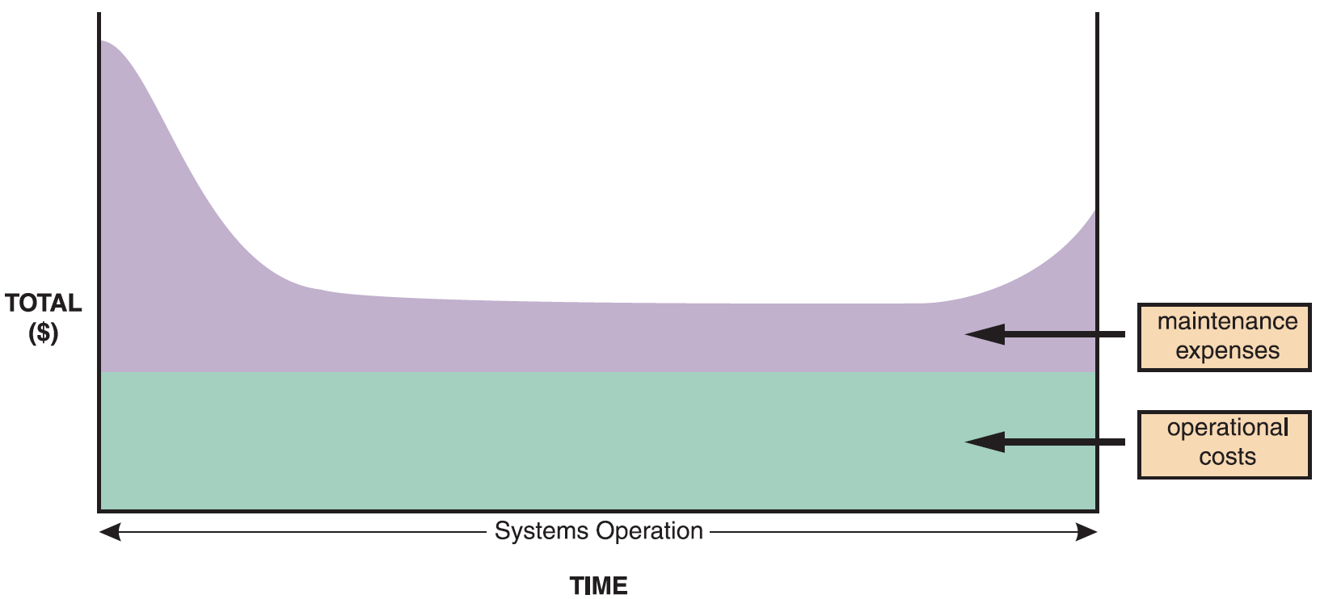
Maintenance Tasks (2 of 6)
Figure 12-2 The total cost of operating an information system includes operational and maintenance costs. Operational costs (green) are relatively constant, while maintenance costs (purple) vary over time.

Slide 10
Maintenance Tasks (3 of 6)
Corrective maintenance
Diagnoses and corrects errors in an operational system
Standard procedures are set for minor errors
Worst-case situation is a system failure
Requires a patch
When the system is operational again, the maintenance team determines the cause, analyzes the problem, and designs a permanent solution

Slide 11
Maintenance Tasks (4 of 6)
Adaptive maintenance
Adds enhancements to an operational system and makes the system easier to use
Procedure for minor adaptive maintenance is similar to routine corrective maintenance
Users submit requests that are evaluated and prioritized by the systems committee
Can be more difficult than new systems development
Enhancements must work within constraints of existing system

Slide 12
Maintenance Tasks (5 of 6)
Perfective maintenance
Changing an operational system to make it more efficient, reliable, and maintainable
Cost-effective during the middle of the system’s operational life
Performed using software reengineering
Software reengineering: uses analytical techniques to identify potential quality and performance improvements in an information system
The more a program changes, the more it becomes inefficient and difficult to maintain

Slide 13
Maintenance Tasks (6 of 6)
Preventive maintenance
Requires analysis of areas where trouble is likely to occur
IT department initiates preventive maintenance
Results in:
Increased user satisfaction
Decreased downtime
Reduced TCO
Competes for IT resources

Slide 14
Maintenance Management (1 of 6)
The maintenance team
System administrator: manages computer and network systems
Systems analysts: locates problem sources
Programmers: applications, systems, and database programmers
Organizational issues: organizations have groups that perform maintenance and new systems development

Slide 15
Maintenance Management (2 of 6)
Maintenance requests
Involve a series of steps
Initial determination
Consideration by the system review committee
Task completion and user notification
Establishing priorities
Systems review committees separates maintenance requests from new systems development requests or evaluate all projects together

Slide 16
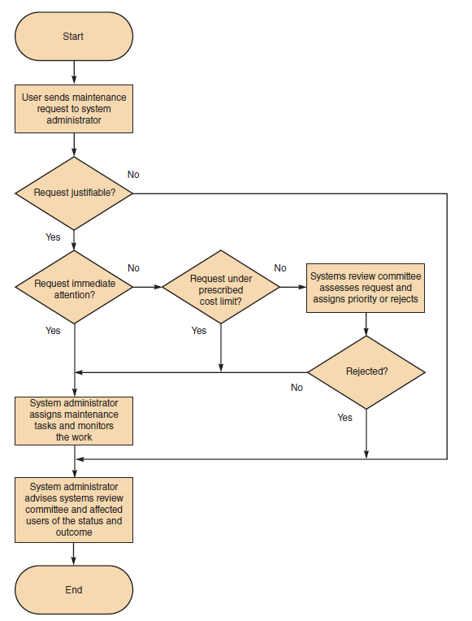
Maintenance Management (3 of 6)
FIGURE 12-7: Although the procedure varies from company to company, the chart shows a typical process for handling maintenance requests.

Slide 17
Maintenance Management (4 of 6)
Configuration management
Controls changes in system requirements during software development
Becomes critical as enterprise-wide information systems grow more complex
Important to systems with multiple versions running in different hardware and software environments
Helps in organizing and handling documentation

Slide 18
Maintenance Management (5 of 6)
Maintenance releases
Documents and installs changes as a new version
Maintenance release methodology: retains all noncritical changes and implements them simultaneously
All changes are tested together, resulting in fewer versions and lesser expense
New features of upgrades are available less often
Service packs: maintenance releases provided by commercial software suppliers

Slide 19
Maintenance Management (6 of 6)
Version control
Process of tracking system releases or versions
Prior release is archived and restored in case the new version fails
Firms use commercial applications that handle version control for complex systems
Baselines
Measure characteristics at a specific time
Types: functional, allocated, and product

Slide 20
System Performance Management (1 of 4)
Fault management
Includes monitoring the system for signs of trouble, logging all system failures, diagnosing the problem, and applying corrective action
Performance and workload measurement
System performance is measured using benchmark testing and metrics

Slide 21
System Performance Management (2 of 4)
Response time
Overall time between a request for system activity and the delivery of the response
Bandwidth and throughput
Kbps (kilobits per second), Mbps (megabits per second), and Gbps (gigabits per second)
Examples of standards of metrics
Arrivals, busy, completions, queue length
Service time, think time, utilization, wait time

Slide 22
System Performance Management (3 of 4)
Turnaround time: applies to centralized batch processing operations
Measures the time between submitting a request for information and the fulfillment of the request
Used to measure the quality of IT services
Management uses current performance and workload data as input for the capacity planning process

Slide 23
System Performance Management (4 of 4)
Capacity planning
Monitors current activity and performance levels
Anticipates future activity and forecasts resources required to provide desired service
Uses what-if analysis
Requires detailed information and an accurate forecast of future business activities
Objective: provide effective support

Slide 24
System Security (1 of 4)
Vital part of every computer system
System security concepts
CIA triangle: shows main elements used to develop a security policy
Confidentiality
Integrity
Availability

Slide 25
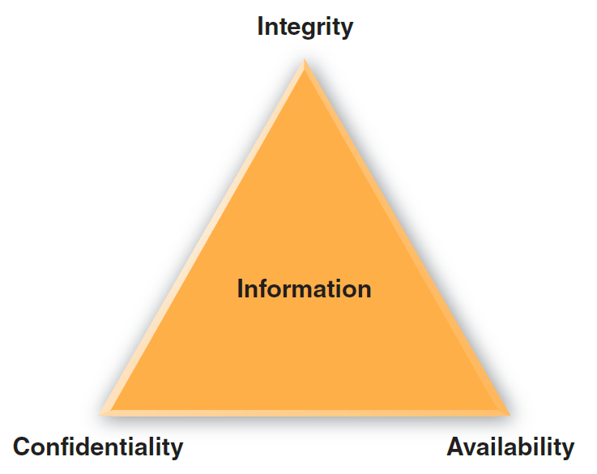
System Security (2 of 4)
Figure 12-14 System security must provide information confidentiality, integrity, and availability (CIA).

Slide 26
System Security (3 of 4)
Risk management
Risk identification
List and classify assets and analyze possible threats
Identify vulnerabilities and how they might be exploited
Risk assessment
Risks need to be calculated and prioritized
Risk control
Strategies: avoidance, mitigation, transference, and acceptance

Slide 27
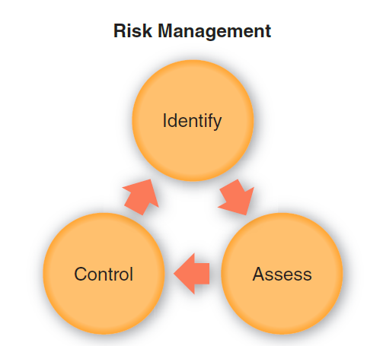
System Security (4 of 4)
Figure 12-15 Risk management requires continuous risk identification, assessment, and control.

Slide 28
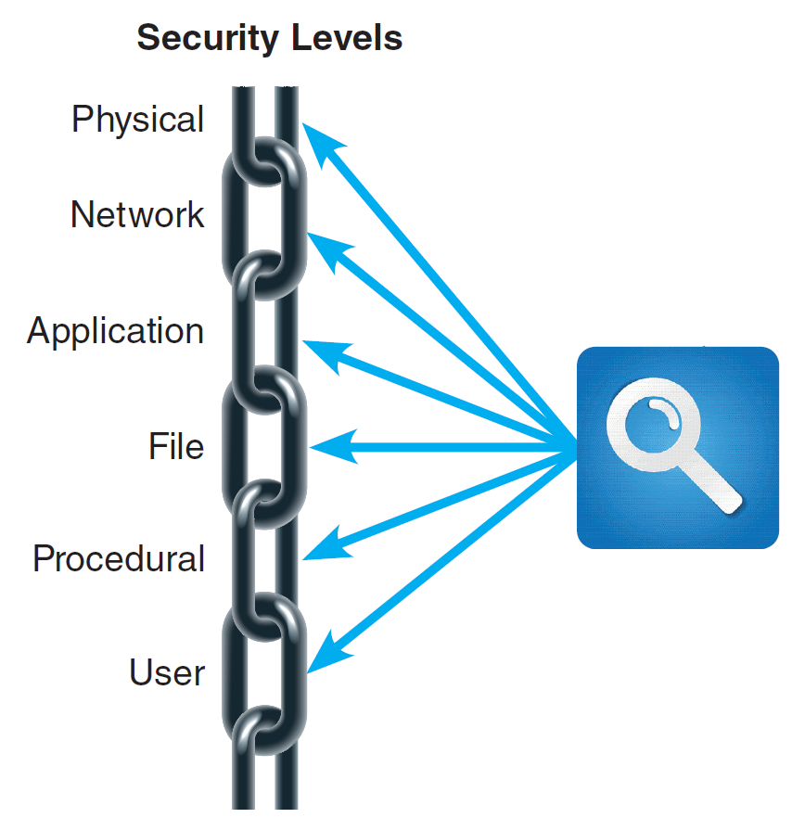
Security Levels (1 of 12)
System security involves six separated but interrelated levels
Figure 12-19 Each security link has a specific focus, and the overall chain is only as strong as the weakest link.

Slide 29
Security Levels (2 of 12)
Physical security
Operations center security
Each entrance must be equipped with a suitable security device
Servers and desktop computers
Install locks on server racks to avoid unauthorized placement of keystroke loggers
Tamper evident cases and BIOS-level passwords can be used

Slide 30
Security Levels (3 of 12)
Portable computers
Select an operating system with strong protection
Mark case with company name and address
Consider devices that have a built-in fingerprint reader, facial recognition, and use the Universal Security Slot (USS)
Back up all vital data before using the computer outside the office and link the system to a tracking software
Use location services
Be alert to high-risk situations while traveling
Establish stringent password protection policies

Slide 31
Security Levels (4 of 12)
Network security
Encrypt network traffic: private key encryption and public key encryption
Wireless networks: WPA2 strengthens the level of wireless protection
Private networks can be used when speed is necessary
Virtual Private Networks (VPN) establish secure connections for a large number of computers

Slide 32
Security Levels (5 of 12)
Ports and services can be affected by port scans and denial of service (DOS) attacks
A port routes incoming traffic to the correct application and a service monitors a particular port
Firewalls allow or block network traffic from each network interface based on preset rules
Network intrusion detection system (NDIS) alerts the administrator when it detects suspicious network traffic patterns

Slide 33
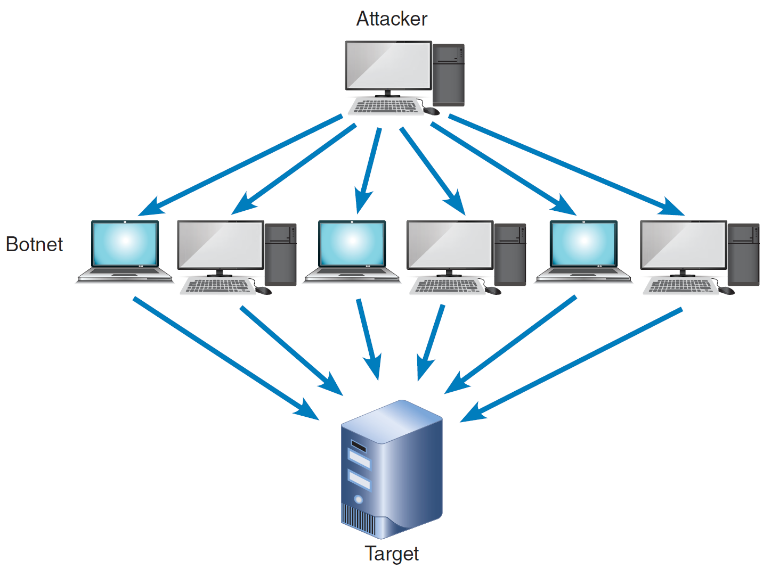
Security Levels (6 of 12)
FIGURE 12-22: In a DoS attack, an attacker sends numerous authentication requests with false return addresses. The server tries unsuccessfully to send out authentication approval and is eventually disabled by the floor of requests. More sophisticated DoS attacks are distributed (DDoS), as shown in this figure. Instead of a single computer, the attacker uses an army of botnets (computers unknowingly infected with malware that are difficult to trace) to attack the target.

Slide 34
Security Levels (7 of 12)
Application security
Services that are not needed must be disabled
Unnecessary or improperly configured service could create a security hole
Hardening removes unnecessary accounts, services, and features
Application permissions: must be configured to be run by users who have specific rights
Input validation helps safeguard data integrity and security

Slide 35
Security Levels (8 of 12)
Patches and updates are used to repair security holes, reduce vulnerabilities, and update the system
Software logs document all events and help understand past attacks and prevent future intrusions

Slide 36
Security Levels (9 of 12)
File security
Encryption: scrambles the contents of a file or document to protect it from unauthorized access
Permissions: describe the rights a user has to a particular file or directory on a server
User groups: administrators can create user groups and assign file permissions

Slide 37
Security Levels (10 of 12)
User security
Identity management: controls and procedures necessary to identify legitimate users and system components
Password protection: policies need to specify a set minimum length, complexity, and a limit on invalid attempts
Social engineering: intruder uses social interaction to gain unauthorized access to a computer system

Slide 38
Security Levels (11 of 12)
User resistance: users need to understand and be a part of the organization’s commitment to security
New technologies can be used to enhance security and prevent unauthorized access
Security token is a physical device that authenticates legitimate users

Slide 39
Security Levels (12 of 12)
Procedural security (operational security)
Policies and controls that ensure secure operations
Defines how particular tasks are to be performed
Includes safeguarding procedures that would be valuable to an attacker
Organization must explain procedures and issue reminders that will make security issues a priority

Slide 40
Backup and Recovery (1 of 2)
Backup policies
Backup media: includes tape, hard drives optical and online storage
Offsiting: storing backup away from main location
Cloud-based storage is growing rapidly
Backup types: full, differential, incremental, and continuous
Retention periods: backups are stored for a specific time beyond which they are either destroyed or reused

Slide 41
Backup and Recovery (2 of 2)
Business continuity issues
A disaster recovery plan should be created along with a test plan
Often part of a business continuity plan (BCP): defines how critical business functions can continue during a major disruption

Slide 42
System Retirement
Factors
Maintenance increasing steadily
Operational costs or times increasing rapidly
Software package provides the same or additional services more efficiently
New technology offers a way to perform the same or additional functions more efficiently
Maintenance changes or additions are difficult and expensive to perform
Users request significant new features

Slide 43
Future Challenges and Opportunities (1 of 3)
Trends and predictions
Cybercrime will increase significantly
Smartphones and tablets will become the dominant computing platform
Software-as-a-Service will become the norm
Cloud computing will become the principal computing infrastructure
Insourcing will increase
Large enterprises may require suppliers to certify green credentials and sourcing policies

Slide 44
Future Challenges and Opportunities (2 of 3)
Strategic planning for IT professionals
System analysts should work backwards from goals to develop intermediate milestones
IT credentials and certification
Professional organizations and IT industry leaders offer continuing educational courses and credentialed certifications
Critical thinking skills
System analysts should possess soft skills and critical thinking skills

Slide 45
Future Challenges and Opportunities (3 of 3)
Cyberethics
As computers permeate more and more of our lives, the decisions made by IT professionals can have serious implications
Situations may arise involving ethical considerations that are not easy to resolve
Ethical, social, and legal aspects of IT are topics that today’s systems analyst should be prepared to address

Slide 46
Summary (1 of 3)
Systems support and security
Implementation of an information system until the system no longer is used
Types of system maintenance
Corrective, adaptive, perfective and preventative
Maintenance team
Systems analysts and programmers

Slide 47
Summary (2 of 3)
Configuration management and system performance measurements
Necessities of maintenance management
Security is a vital part of every computer system
Risk management identifies, analyzes, anticipates and reduces risk to an acceptable level
Data backup and recovery plans are essential

Slide 48
Summary (3 of 3)
All information systems eventually become obsolete
Intense competition is predicted in the future
IT professionals should have a strategic career plan
Long-term goals
Intermediate milestones

