Slide 1
Toolkit A
Communication Tools

Slide 2
Learning Objectives
After this chapter, you will be able to:
Apply successful communication strategies
Follow guidelines for effective written communications
Follow guidelines for effective oral communications
Deliver successful presentations
Manage and strengthen your communication skills

Slide 3
Successful Communication Strategies (1 of 3)
Why, who, what, when and how
Important questions
Why: the reason behind the communication and what needs to be accomplished
Who: who are the targets and what is their information needs
What: what is expected and when to go into detail
When: when to speak and when to remain silent
How: how to communicate effectively

Slide 4
Successful Communication Strategies (2 of 3)
Cultural context
Cultural factors include geography, background, educational level, and societal differences
Differences and corporate culture must be considered when asking and answering questions
Know your subject
One’s credibility and effectiveness depend on the support one receives on his/her views
Adopt a specific preparation strategy

Slide 5
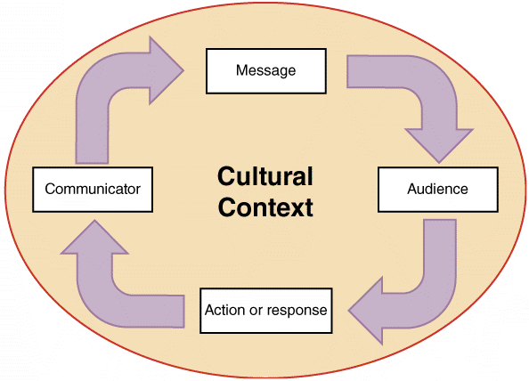
Successful Communication Strategies (3 of 3)
FIGURE A-1 Every communication takes place within an overall cultural context.

Slide 6
Written Communications (1 of 11)
Writing style
Know the audience
Use active voice whenever possible
Keep writing clear, concise, and well-organized
Use an appropriate style
Use lists and short, easy-to-understand words
Avoid repeating the same word too often
Check spelling and grammar
Conduct a careful review

Slide 7
Written Communications (2 of 11)
Readability
Analyzes ease of comprehension by measuring specific characteristics of syllables, words, and sentences
Readability measures
Flesch Reading Ease score: measures the average sentence length and the average number of syllables per word and rates the text on a 100-point scale
Flesch-Kincaid Grade Level score: formula used produces a rating keyed to a U.S. grade-school level

Slide 8
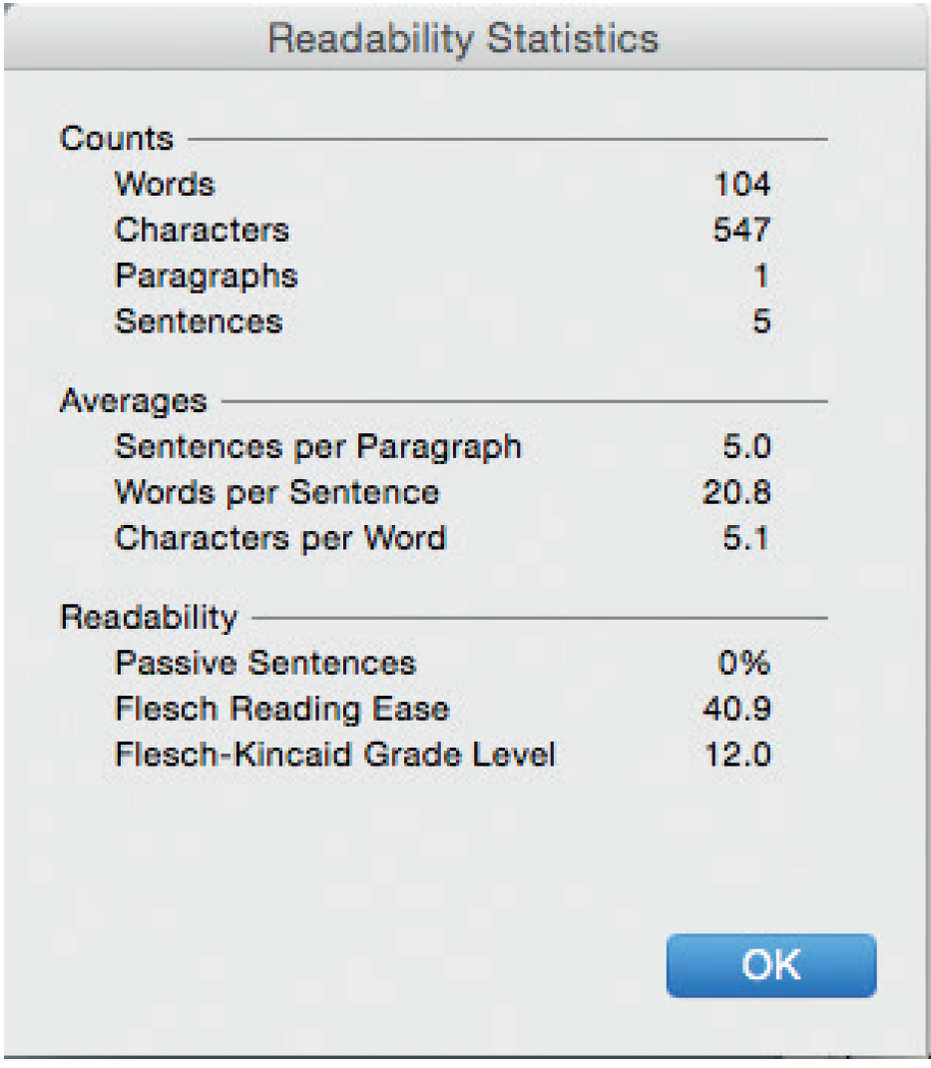
Written Communications (3 of 11)
FIGURE A-3 Two popular readability measurement tools are the Flesch Reading Ease score and the Flesch-Kincaid Grade Level score. Source: Microsoft Word

Slide 9
Written Communications (4 of 11)
Email, memos, and letters
Email is less formal than other written correspondence
Rules of good grammar, correct spelling, and clear writing apply
Create a distribution list that includes specific members and their email addresses
External communications often require letters printed on company letterhead
Using a template provides a consistent look and makes writing easier

Slide 10
Written Communications (5 of 11)
Social media at work
The backdrop
Social media is used in corporate marketing plans to create excitement, call attention to products, and reach out to a socially aware market
Advantages
IT professionals can network with others, find out about new technology, meet colleagues, discuss career issues, and maintain a Web-based presence
Risk
Know and understand company policies

Slide 11
Written Communications (6 of 11)
Three ways to get fired
Bragging about a new marketing strategy before it has been publicly announced
Being somewhere or doing something that might degrade the company’s image
Launching an angry verbal attack
Other issues
Use a “need to know” approach
Avoid blanket messaging and broadcasting
Consider appropriateness of the content
Exercise good judgement and common sense

Slide 12
Written Communications (7 of 11)
Netiquette: Internet and etiquette
Rules and tips
Always fill in the subject field with a brief description of the contents
Be brief and professional
Use spellcheck
Don’t forward jokes or chain letters without the permission of the recipient
Don’t overuse humor or sarcasm that might work in a face-to-face situation but not in an e-mail
Don’t type in all caps

Slide 13
Written Communications (8 of 11)
Don’t use colored fonts, background, or images
Don’t use the return receipt request feature unless there is a valid business reason to do so
If you have large attachment files, try to zip or compress them before sending
If sending to a group, use a blind carbon copy (Bcc)
Never give out or include personal information without the individuals specific approval to do so
Remember that there are copyright laws
When replying, don’t include all the earlier messages unless there is a reason to do so

Slide 14
Written Communications (9 of 11)
Workgroup software
Enhances employee productivity and teamwork
Enables users in organizing tasks, schedules, and documents
Examples: Google Docs and Adobe Acrobat

Slide 15
Written Communications (10 of 11)
Reports
Reports required during systems development
Preliminary investigation report
System requirements document
System design specification
Final report to management
Status reports, activity reports, proposals, and departmental business plans
PDF files are flexible, compatible, and more secure than other documents

Slide 16
Written Communications (11 of 11)
Report sections
Introduction
Executive summary
Findings
Recommendations
Costs and benefits
Appendix

Slide 17
Oral Communications (1 of 6)
Oral presentations are required
End of the preliminary investigation
Conclusion of the systems analysis phase
Define the audience
Chances of success improve when the presentation is designed as per the expectations of the audience

Slide 18
Oral Communications (2 of 6)
Define the objectives
Inform management about the status of the current system
Describe findings concerning the current system problems
Explain the alternative solutions developed
Provide detailed cost and time estimates for the alternative solutions
Recommend the best alternative and explain the reasons

Slide 19
Oral Communications (3 of 6)
Organize the presentation
Stages in a presentation: introduction, information, and summary
Discuss topics in logical order

Slide 20
Oral Communications (4 of 6)
Prepare presentation aids
Visual aids help present information
Presentations can be enhanced by using aids such as overhead transparencies and videotapes
Ensure content is clear and easy to understand
Presentation software
Microsoft PowerPoint and Apple Keynote
Preparing effective presentations require time
Practice
Rehearse well and avoid using a script

Slide 21
Oral Communications (5 of 6)
The presentation
Sell yourself and your credibility
Control the presentation
Maintain the pace of the presentation
Define technical terms
Answer questions appropriately
Listen carefully and respond straightforward
Try to anticipate questions
Use effective speaking techniques
Speak clearly and confidently

Slide 22
Oral Communications (6 of 6)
Suggestions for nervous speakers
Control the environment
Think of nervousness as normal pressure
Avoid meaningless filler words
Practice
Online presentations
Communication between presenter and the audience may occur

Slide 23
Managing Your Communication Skills
Individuals can improve communication skills by practicing constantly
Some people find it difficult to stand in front of a group and deliver a presentation
Toastmasters offers a friendly environment where members:
Critique speech in a positive manner
Identify strengths
Offer suggestions about what might be improved

Slide 24
Summary (1 of 3)
Success depends on ability to communicate effectively
Ensure written work is free of grammatical, punctuation, and spelling errors
Use readability measurement tools
Flesch Reading Ease score and the Flesch-Kincaid Grade Level score
Social media allows informal, interactive, and immediate communication

Slide 25
Summary (2 of 3)
Various reports are required during the systems development phase
Formats vary
One may have to deliver presentations to different audiences at different times
When delivering presentations, one is selling ideas and credibility

Slide 26
Summary (3 of 3)
Every IT professional should have a strategic plan
Manage and improve written and oral communication skills

