Slide 1
Toolkit B
CASE Tools

Slide 2
Learning Objectives
After this chapter, you will be able to:
Explain the role of CASE tools in systems analysis and design
Explain CASE tool terms and concepts
Explain integrated development environment (IDE)
Explain application life cycle management (ALM) solutions
Describe CASE tool trends, and how they relate to object-oriented analysis and agile methods

Slide 3
Overview (1 of 4)
Every type of work requires specific tools to do the job properly
Carpenters use hammers, drills, or screwdrivers
Chefs use measuring cups, knives, or spatulas
System development is no different
CASE tools reduce costs, speed up development, and provide comprehensive documentation for future maintenance or enhancements

Slide 4
Overview (2 of 4)
CASE tools history
Traditional code was written in procedural programming languages such as COBOL
Modern languages are non-procedural or event driven programming languages
Easier to implement object-oriented design
The CASE tool marketplace includes a wide variety of vendors and products
No one tool dominates the market

Slide 5
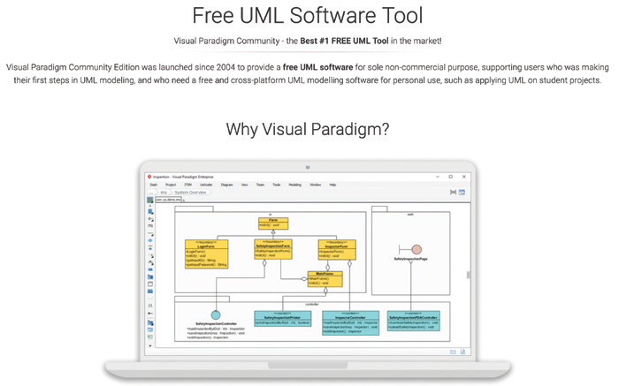
Overview (3 of 4)
FIGURE B-2 Visual Paradigm offers a free UML diagramming tool.
Source: http://www.visual-paradigm.com/solution/freeumldesigntool/

Slide 6
Overview (4 of 4)
Selection of a CASE tool depends on:
Type of project
Size and scope of the project
Possible budgetary and time constraints
Preferences and experience of the system development team

Slide 7
Terms and Concepts (1 of 6)
Repository
Database that serves as a central storage location for all information about the system being developed
Once a data element has been defined in the repository, it can be accessed and used by processes and other information systems

Slide 8
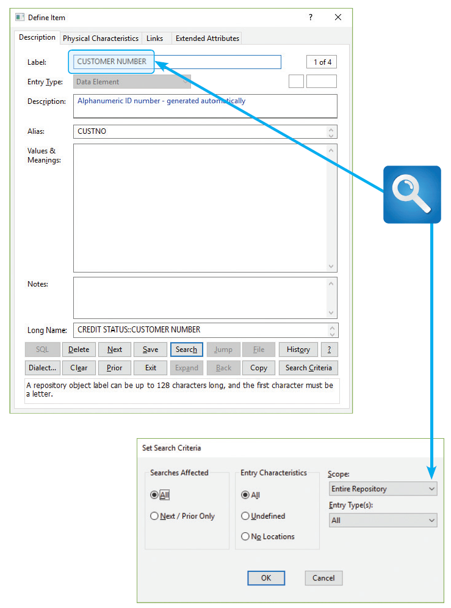
Terms and Concepts (2 of 6)
FIGURE B-4 A Visible Analyst repository search for the data element named CUSTOMER NUMBER. The results will show all instances of the data element.
Source: Visible Systems Corporation

Slide 9
Terms and Concepts (3 of 6)
Modeling tools
Unified Modeling Language diagrams and functional decomposition diagrams
Data flow diagrams
Object diagrams
Entity-relationship diagrams
Structure charts

Slide 10
Terms and Concepts (4 of 6)
Documentation tools
Used to check for inconsistent or incomplete information in forms, reports, and diagrams
Engineering tools
Forward engineering: translating business processes into applications
Reverse engineering: helps break down an existing application into diagrams, structure charts, and source code

Slide 11
Terms and Concepts (5 of 6)
Construction tools
Application generator (code generator): used to develop computer programs rapidly by translating a logical model into code
Screen generator (form painter): helps design a custom interface, create screen forms, and handle data entry format and procedures
Report generator (report writer): tool for designing formatted reports rapidly

Slide 12
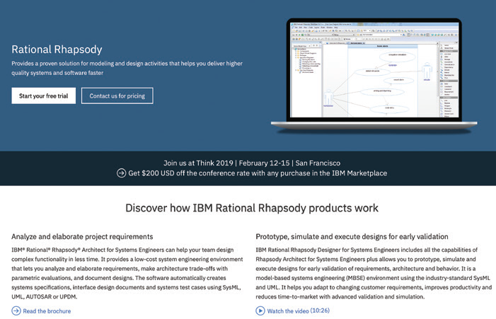
Terms and Concepts (6 of 6)
FIGURE B-5 IBM Rational Rhapsody can generate source code from UML diagrams.
Source: https://www.ibm.com/us-en/marketplace/rational-rhapsody/details

Slide 13
Development Environments (1 of 3)
Mix of software tools, methods, and physical resources used to create an information system
Integrated development environment (IDE) uses built-in tools provided by the vendor
Application life cycle management environment
Start-to-finish approach to planning, designing, developing, deploying, managing, and maintaining an information system

Slide 14
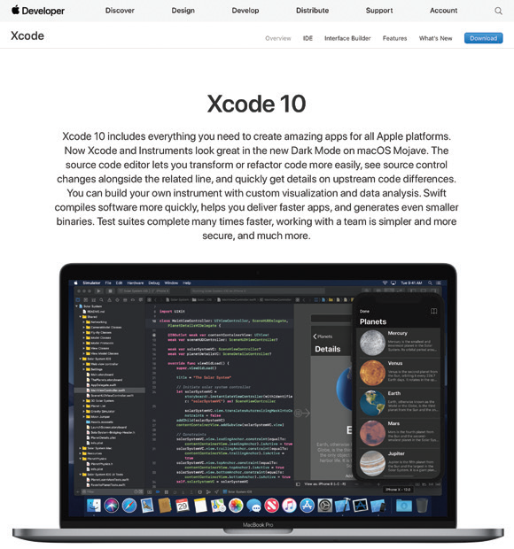
Development Environments (2 of 3)
FIGURE B-9 Xcode is free IDE for all of Apple’s platforms.
Source: https://developer.apple.com/xcode/

Slide 15
Development Environments (3 of 3)
Pros and cons of integrated development tools
Highly effective in a specific software environment
Built into the vendor’s software package
Nonspecific CASE tools can be used in any development environment
Disadvantage: each IDE is different
Learning curve and skills might not be transferable

Slide 16
Trends (1 of 5)
New products and features
CASE software constantly offers more features
Framework: organizes and documents system development tasks
Helps transform business processes into an information system
Microsoft Visio: models networks, business processes, and diagrams
Cloud-based development environments
Example: Heroku platform

Slide 17
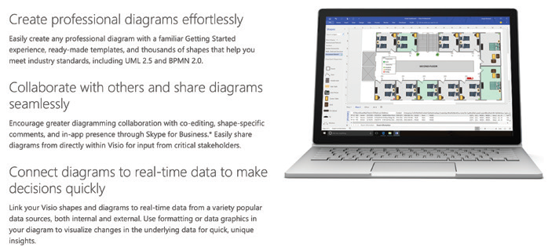
Trends (2 of 5)
FIGURE B-11 Microsoft Visio can create many different types of diagrams.
Source: https://products.office.com/en-us/visio/visio-professional-business-and-diagram-software

Slide 18
Trends (3 of 5)
Method-specific CASE tools
Each development approach has a set of tools that works especially well for that method
Structured development relies heavily on DFDs and structure charts
Object-oriented methods use diagrams, such as use case, class, sequence, and state transition
Agile methods use spiral or other iterative models
Structured analysis
Traditional approach: time tested and easy to understand

Slide 19
Trends (4 of 5)
Object oriented analysis and design (OOAD)
O-O CASE and UML-based modeling tools provide seamless development from planning to actual coding
Include modular design and reusable code
Agile methods
Wide range of modeling tools including CASE tools

Slide 20
Trends (5 of 5)
CASE tools will continue to evolve and become more powerful
System developers may choose simpler, low-tech methods and techniques as modeling tools

Slide 21
Summary (1 of 2)
CASE stands for computer-aided systems engineering
CASE tools help design and construct information systems
Modern languages are non-procedural
C++ and Java
Repository: main source of system documentation
Identifies new elements and adds them

Slide 22
Summary (2 of 2)
Forward engineering: translating business processes and functions into applications
Reverse engineering helps examine and break down an existing application
IDE uses a built-in CASE tool included by vendors
Vendors are calling attention to ALM concepts and tools
Vendors will continue to add features
Cloud-based toolsets will continue to grow

