Slide 1
Toolkit C
Financial Analysis Tools

Slide 2
Learning Objectives (1 of 2)
After this chapter, you will be able to:
Explain cost-benefit analysis and classify costs and benefits into various categories, including tangible or intangible, direct or indirect, fixed or variable, and developmental or operational
Explain chargeback methods and how they are used

Slide 3
Learning Objectives (2 of 2)
Use payback analysis to calculate the length of time that it takes for a project to pay for itself
Use return on investment analysis to measure a project’s profitability
Use present value analysis to determine the value of a future project measured in current dollars

Slide 4
Costs and Benefits (1 of 7)
Systems analysts review project costs and benefits at the end of each SDLC phase
Helps management decide on continuing
Cost-benefit analysis: comparing anticipated costs to anticipated benefits
Performed throughout the SDLC to determine the economic feasibility
Requires considering project benefits compared to total cost of ownership (TCO)

Slide 5
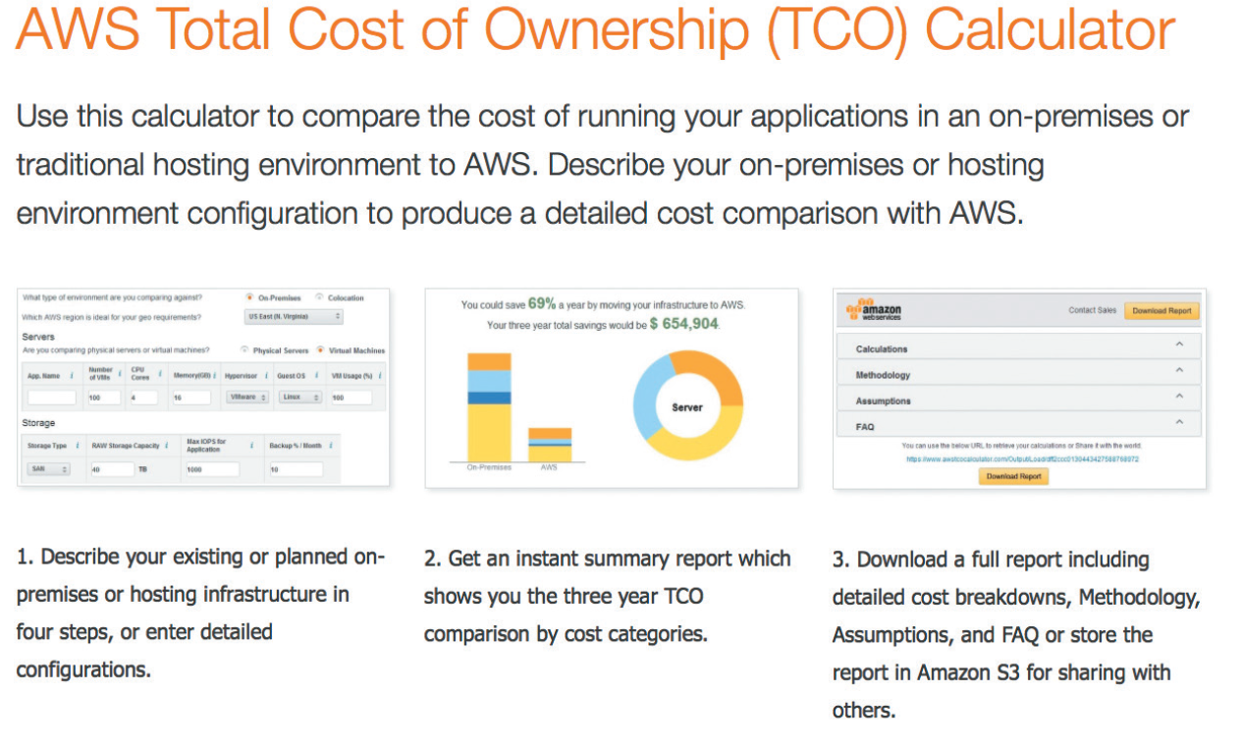
Costs and Benefits (2 of 7)
FIGURE C-1 Amazon.com offers a calculator to compare the TCO of running applications on-premises or in the cloud using AWS.
Source: Amazon Web Services, Inc.

Slide 6
Costs and Benefits (3 of 7)
Cost classifications
Tangible costs: specific dollar value can be assigned
Interest charges paid on borrowed money
Intangible costs: dollar value cannot be calculated easily
Cost of customer dissatisfaction
Direct costs: can be associated with the development of a specific system
Salaries of project team members

Slide 7
Costs and Benefits (4 of 7)
Indirect costs (overhead expenses): cannot be attributed to development of a particular information system
Salaries of network administrators
Fixed costs: constant and do not depend on a level of effort
Salaries and hardware rental charges
Variable costs: vary depending on activity
Costs of printer paper, supplies, and telephone charges

Slide 8
Costs and Benefits (5 of 7)
Developmental costs: incurred once, at the time the system is developed or acquired
Salaries of people involved in systems development
Operational costs: incurred after the system is implemented and continue while the system is in use
System maintenance and ongoing training

Slide 9
Costs and Benefits (6 of 7)
Managing information systems costs and charges
Direct costs are easier to identify and predict
Chargeback methods: use accounting entries to allocate the indirect costs of running the IT department
No charge method
Fixed charge method
Variable charge method based on resource usage
Variable charge method based on volume

Slide 10
Costs and Benefits (7 of 7)
Benefit classifications
Tangible or intangible, fixed or variable, and direct or indirect
Alternative benefit classification related to the nature of the benefits
Positive benefits increase revenues, improve services, or contribute to the organization as a direct result of the new information system
Cost-avoidance benefits: expenses that would be necessary if the new system were not installed

Slide 11
Payback Analysis (1 of 5)
Process of determining how long it takes for an information system to pay for itself
Payback period: time taken to recover cost
Steps to perform payback analysis
Determine initial development cost of the system
Estimate annual benefits
Determine annual operating costs
Compare total development and operating costs to accumulated value of the benefits produced by the system

Slide 12
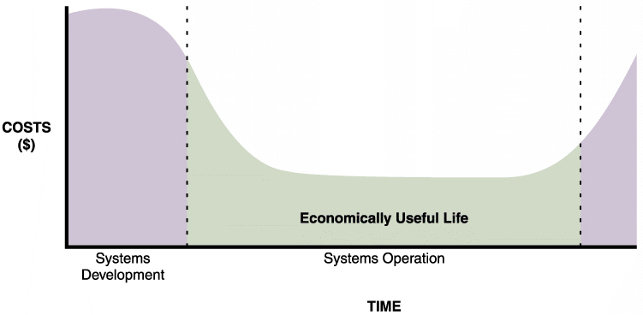
Payback Analysis (2 of 5)
FIGURE C-2 The costs of a typical system vary over time. At the beginning, system costs are high due to initial development expenses. Costs then drop during systems operation. Maintenance
costs begin to increase until the system reaches the end of its economically useful life.

Slide 13
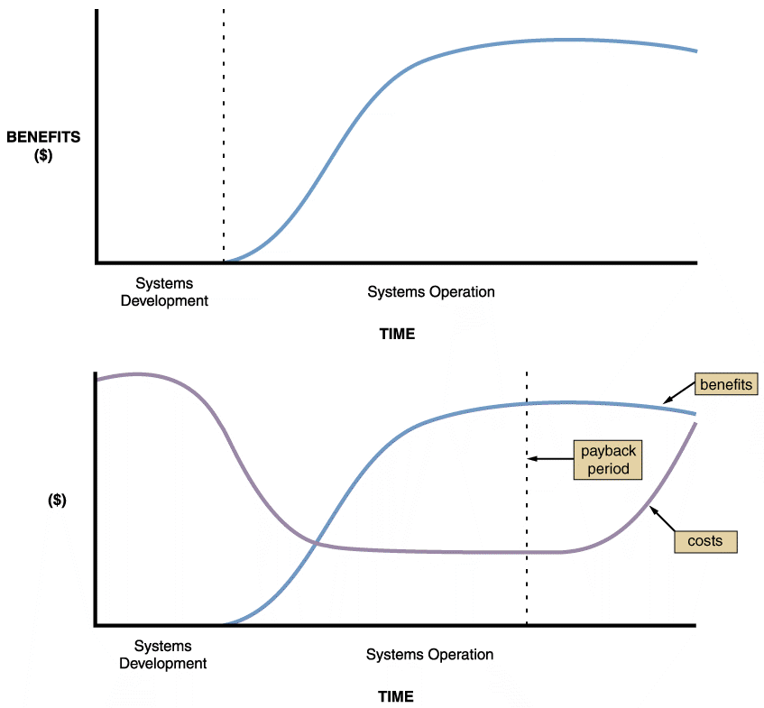
Payback Analysis (3 of 5)
FIGURE C-3 Benefits of an information system change over time, as shown in the upper graph. The lower graph shows costs and benefits plotted on the same graph. The dashed line indicates the payback period, when accumulated benefits equal accumulated costs.

Slide 14
Payback Analysis (4 of 5)
Using a spreadsheet to compute payback analysis
Design worksheet and label rows and columns
Enter cost and benefit data and formulas
Payback analysis requires a formula to display cumulative totals, year by year
Verify the spreadsheet operates properly
Create a line chart displaying cumulative costs, benefits, and payback period

Slide 15
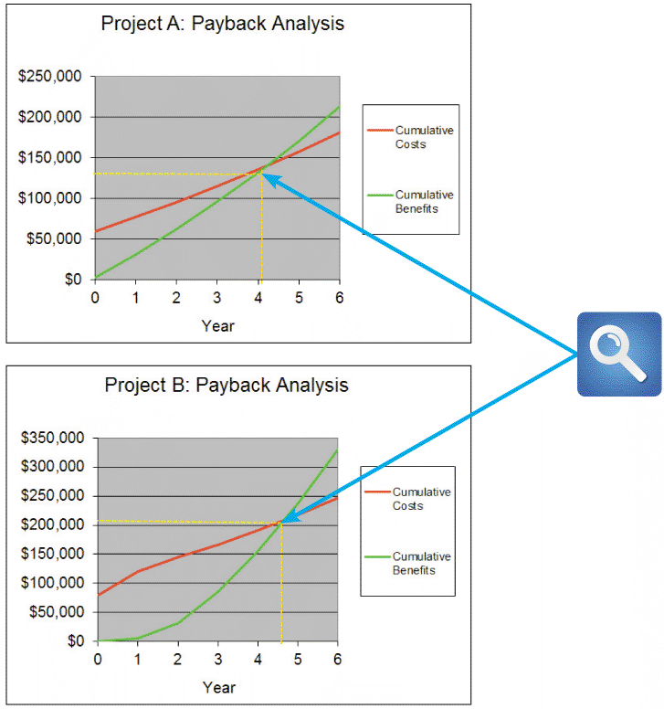
Payback Analysis (5 of 5)
FIGURE C-6 Microsoft Excel can be used to show the payback period by creating a chart of cumulative costs and benefits. Note that Project A has a shorter payback period than Project B.

Slide 16
Return on Investment Analysis (1 of 2)
Percentage rate that measures profitability
Compares the total net benefits (return) received from a project to the total costs (investment) of the project
ROI = (total benefits – total costs) / total costs
Considers costs and benefits over a longer time span than payback analysis
Projects are usually expected to meet or exceed a minimum ROI

Slide 17
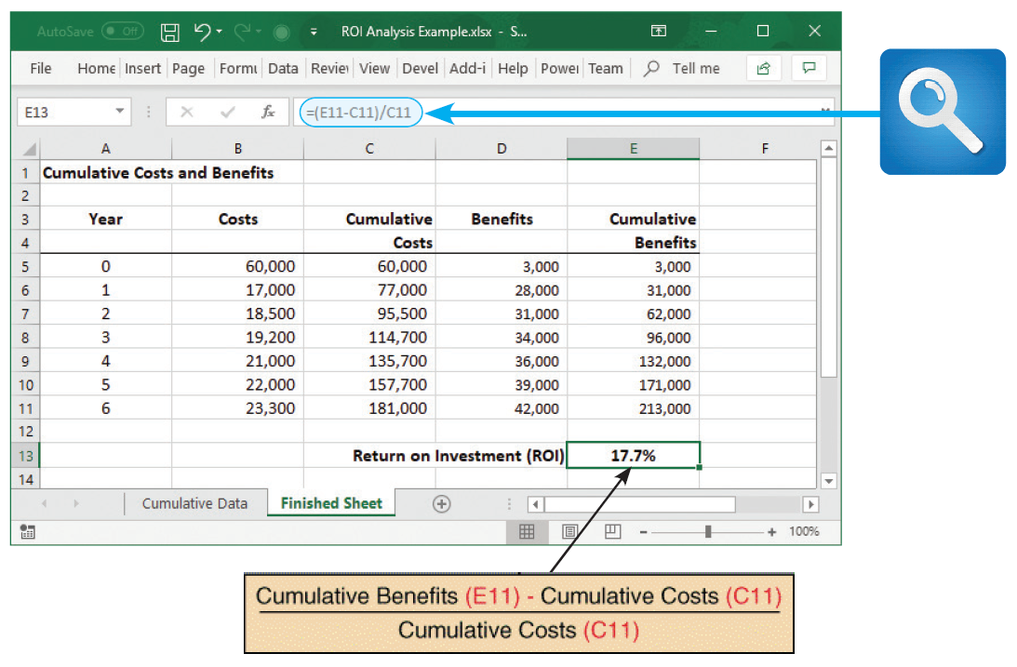
Return on Investment Analysis (2 of 2)
Using a spreadsheet to compute ROI
FIGURE C-8 Sample ROI worksheet. Notice that cell E13 contains the ROI formula.

Slide 18
Present Value Analysis (1 of 4)
Based on the concept of time value of money
Present value of a future dollar
Amount of money that, when invested today at a certain interest rate, grows to exactly one dollar at a certain point in the future
Present value tables: contain adjustment factors for various interest rates and numbers of years

Slide 19
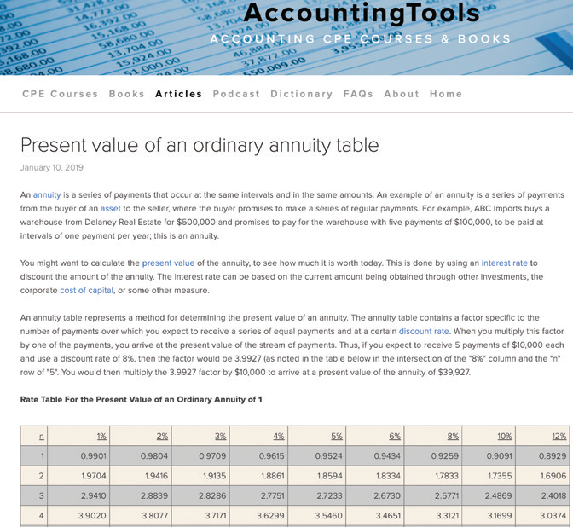
Present Value Analysis (2 of 4)
FIGURE C-10 Many online sources contain comprehensive present value tables.
Source: https://www.accountingtools.com/articles/2017/5/16/present-value-of-an-ordinary-annuity-table

Slide 20
Present Value Analysis (3 of 4)
Using a spreadsheet to calculate present value
There are two ways to calculate present value using a spreadsheet program such as Microsoft Excel
Using external factors
Using a built-in formula

Slide 21
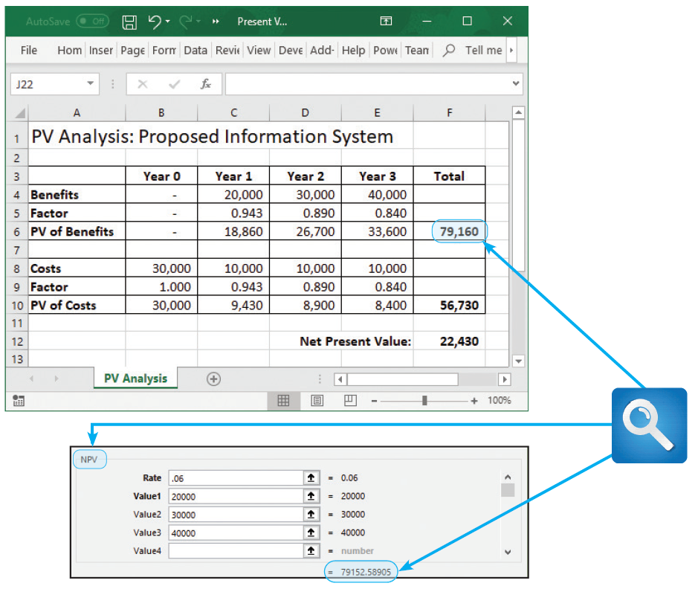
Present Value Analysis (4 of 4)
FIGURE C-12 The top screen shows how to use discount factors to calculate present value in a Microsoft Excel spreadsheet. In this case, the present value of benefits is $79,160. The bottom screen shows an example of the NPV function, which is a menu-driven formula that is built into Excel. The slight difference between the values is because Excel uses more decimal places.

Slide 22
Summary (1 of 2)
A systems analyst must be concerned with economic feasibility throughout the SDLC
Various tools are used
Classification of project costs
Tangible or intangible, direct or indirect, fixed or variable, and developmental or operational
Common chargeback approaches
No charge, fixed charge, variable based on resource usage, or variable based on volume

Slide 23
Summary (2 of 2)
Classification of system benefits
Tangible or intangible, fixed or variable, direct or indirect, and positive or cost-avoidance
Approaches to cost-benefit analysis
Payback analysis
Return on investment analysis
Present value analysis

