Slide 1
Toolkit D
Internet Resource Tools

Slide 2
Learning Objectives (1 of 2)
After this chapter, you will be able to:
Describe the characteristics of the Internet and the World Wide Web
Plan an Internet search strategy, review your information requirements, use the proper search tools and techniques, evaluate the results, and consider copyright and data integrity issues
Use search engines to locate the information you require

Slide 3
Learning Objectives (2 of 2)
Demonstrate advanced search techniques, including Boolean logic and Venn diagrams
Describe Internet communication channels, including social networking, forums, newsletters, blogs, podcasts, videos, webinars, mailing lists, chat rooms, instant messaging, and text messaging

Slide 4
The Internet and the World Wide Web
The Internet
Provides assistance with technical problems
Helps individuals advance their careers
Provides access to training, education, and communication with other IT professionals
Provides access to the World Wide Web
The web contains billions of webpages, which are text and multimedia documents
Web browser: software program that displays webpages delivered by a web server

Slide 5
Planning an Internet Research Strategy (1 of 4)
Four-step plan can be used to navigate efficiently and confidently towards objectives
Review information requirements
Use proper search tools and techniques
Evaluate results
Consider copyright and data integrity issues

Slide 6
Planning an Internet Research Strategy (2 of 4)
Review information requirements
Understand what is being searched
Think about the topic
Use proper search tools and techniques
Decisions need to be made on selecting:
Search engines or subject directories
Commercial sites, IT publications, professional associations, forums, or other areas
Expertise in using Internet tools and resources increases with experience

Slide 7
Planning an Internet Research Strategy (3 of 4)
Evaluate the results
Ask questions when accessing content
Is the author identifiable and an expert on the subject?
Does the information come from a commercial source that is offering its own solution?
Is the information specific enough?
How old is the information? Is the topic static or dynamic?
Is the information easy to access and navigate?

Slide 8
Planning an Internet Research Strategy (4 of 4)
Consider copyright and data integrity issues
Before copying or downloading search results, ensure that:
Material can legally be used
Content is free of threats

Slide 9
Search Engines (1 of 6)
Search engine: uses key words to locate information on the Internet
Workhorses of information gathering
Meta-search engine: applies multiple search engines simultaneously

Slide 10
Search Engines (2 of 6)
Search engine concepts
Search engines use a spider or crawler
Spider (crawler): software program that travels from site to site indexing contents of pages based on keywords
Issue: sponsored links
Pay for performance arrangement

Slide 11
Search Engines (3 of 6)
Indexed search engines organize and rank results of a search
Examples: Google and Bing
Each engine has its own search algorithms, features, and user interface

Slide 12
Search Engines (4 of 6)
Search techniques
Refine the topic
Translate the question into an effective search query
Review the search results and evaluate the quality of the results
Organize the results of the search

Slide 13
Search Engines (5 of 6)
Advanced search techniques
Search within returned results and specific areas
Boolean logic: relationships among search terms based on logical operators such as OR, AND, and NOT
A phrase is more specific than an AND operator because it specifies exact placement
Most search engines provide an advanced search feature that offers a fill-in form

Slide 14
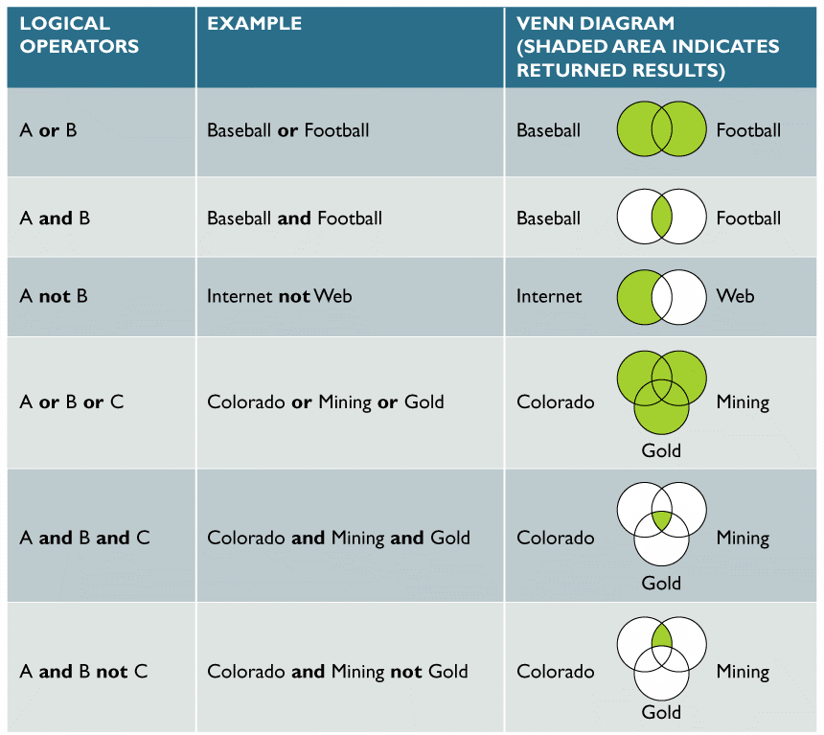
Search Engines (6 of 6)
FIGURE D-1 Examples of logical operators OR, AND, and NOT. The shaded areas represent the returned results. OR is the most inclusive term, returning results if any of the terms appear. AND requires all keywords to appear. NOT excludes results even if they are found in the same document.

Slide 15
Internet Communication Channels (1 of 6)
Social networking
Sites such as Facebook, Twitter, and LinkedIn have gained enormous popularity
Allows one to connect to an extended network
Forums
Offer online discussions addressing many subjects
Individuals can tap into the knowledge and opinions of others in a large online community

Slide 16
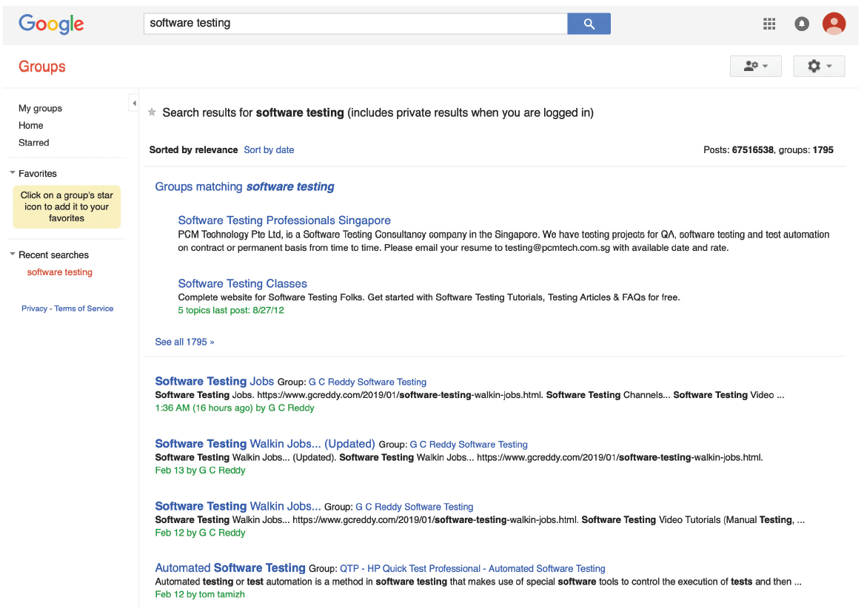
Internet Communication Channels (2 of 6)
FIGURE D-4 Google Groups allows you to participate in numerous discussion groups on every imaginable topic and to create new groups.
Source: https://groups.google.com

Slide 17
Internet Communication Channels (3 of 6)
Newsletters, blogs, podcasts, and videos
Many online magazines offer free email newsletters
Blogs: web-based, logs or journals
Podcast: audio blog
Online video services
Example: YouTube

Slide 18
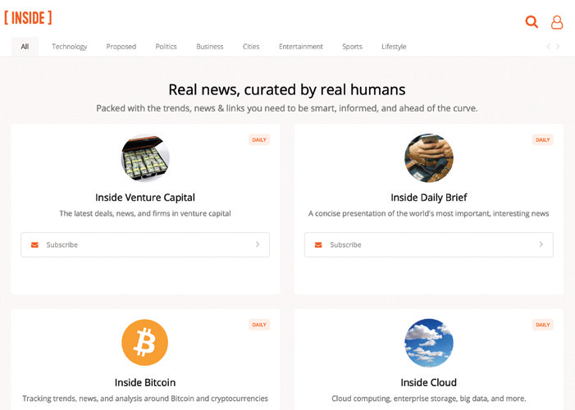
Internet Communication Channels (4 of 6)
FIGURE D-5 Inside offers numerous free newsletters.
Source: http://www.inside.com

Slide 19
Internet Communication Channels (5 of 6)
Really Simple Syndication (RSS) Feeds
Older format for publishing frequently updated content to users who subscribe
Feed reader (aggregator): software used to read RSS feed
Mailing lists
Provides a forum for people who want to exchange information about specific topics
List server (listserv): directs email to people who subscribe to the mailing list

Slide 20
Internet Communication Channels (6 of 6)
Chat rooms (channels)
Online meeting place where users can interact and converse in real time
Used in conjunction with webinars
Instant messaging (IM) and text messaging
Instant messaging allows online users to exchange messages immediately
Texts messages are sent across mobile phones or wireless devices

Slide 21
Summary (1 of 2)
The Internet integrates networks on a worldwide scale
Allows access to the World Wide Web
An Internet research strategy should use the four-step approach
Primary research tool: search engines

Slide 22
Summary (2 of 2)
Many analysts use social networking as an online tool to expand personal and professional contacts
IT professional can use the IT community to research a topic or seek background information
Online learning helps IT workers to remain current in their chosen areas

