Slide 1
3D Integral Calculator
Gabriele Fazio 994848

Slide 2
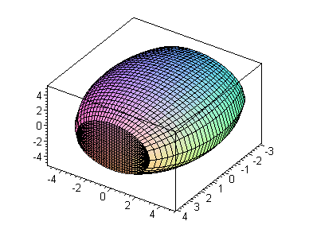
Objective
Evaluating 3D integrals of generic functions over generic domains
Quick estimate of the
value
Easy implementation
system

Slide 3
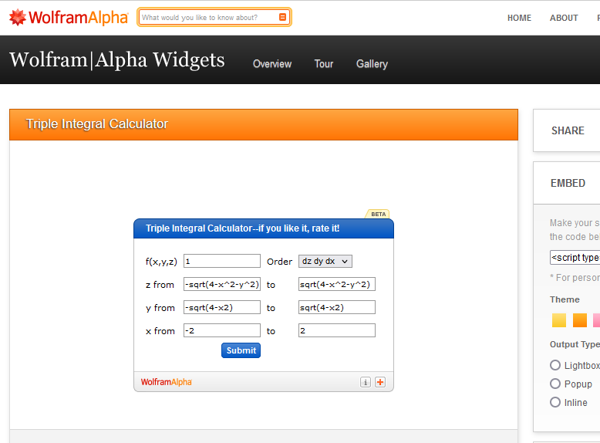
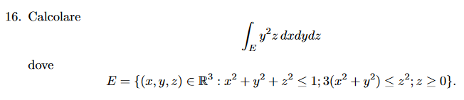
Target
Students: checking calculations
Professionals: testing tool

Slide 4
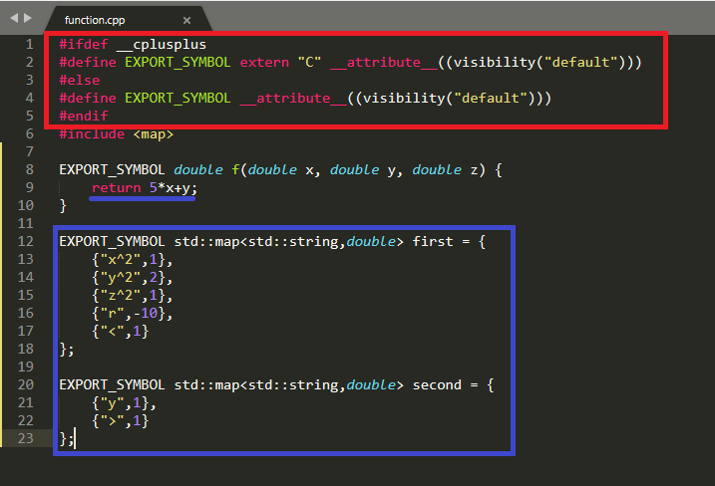
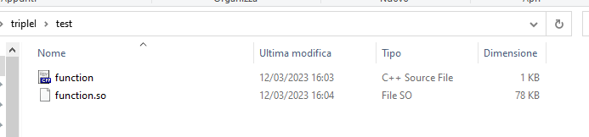
Usage
Implement a
function and
compile it

Slide 5
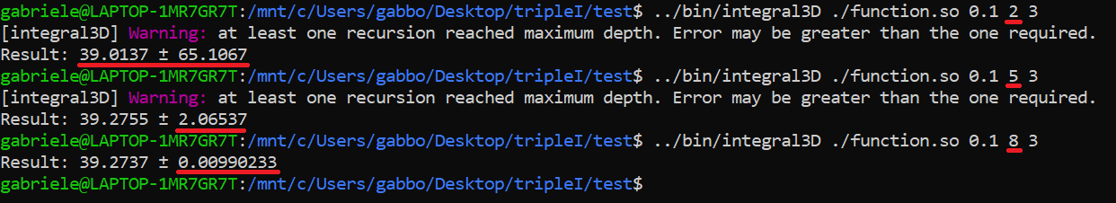
Usage
Execution and parameters optimization
$ [integral3D] [function.so] [error] [MAXN] [MAXR]

Slide 6
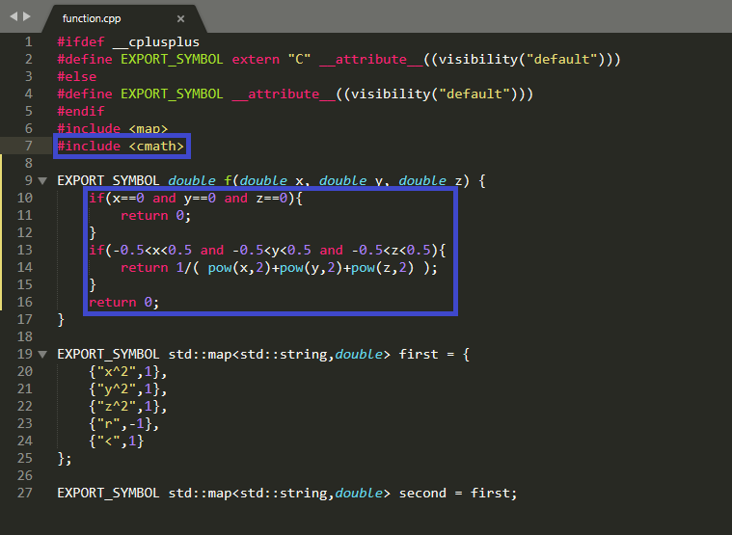
Advanced Usages
High adaptability
(cons are that non
continuous functions
may have worse
approximation)

Slide 7
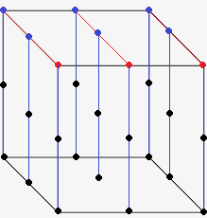

Theory: Romberg’s Algorithm
Base step is trapezoid rule,
recursively over the 3
dimensions (z→y→x).

Slide 8

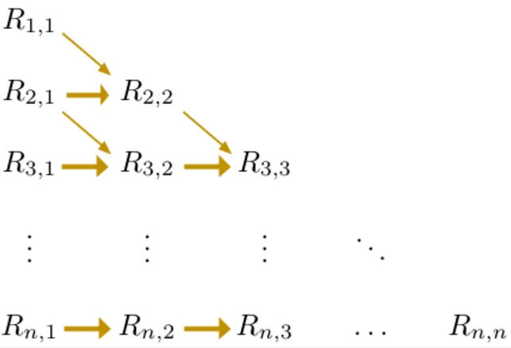
Theory: Romberg’s Algorithm
Base step is trapezoid rule
Successive steps by
Richardson's Extrapolation

Slide 9
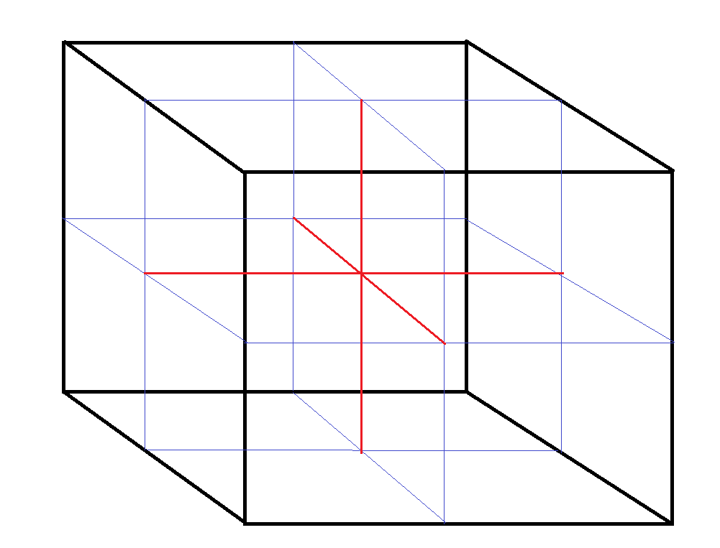
Theory: Adaptive Quadrature
If the error is greater than tolerance
the process is split into
smaller subproblems

Slide 10
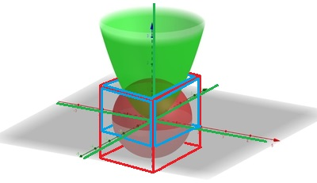
Implementation detail
Having two 2nd grade
polynomial inequalities
the integral is made
over the intersection
of the two parallelepiped
such that each is the
least parallelepiped that
contains the given domain

Slide 11
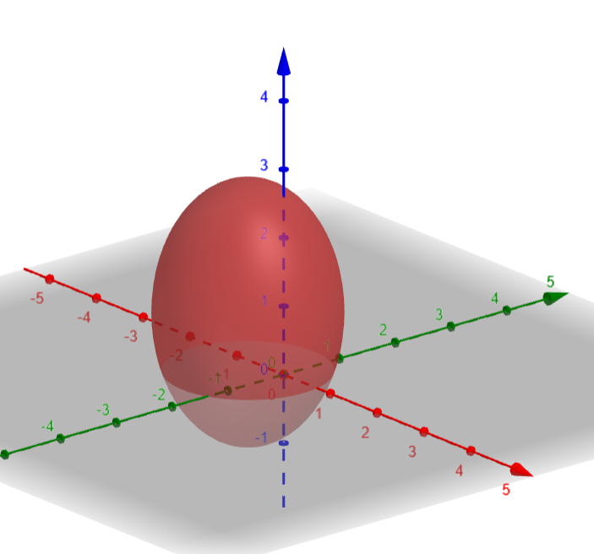
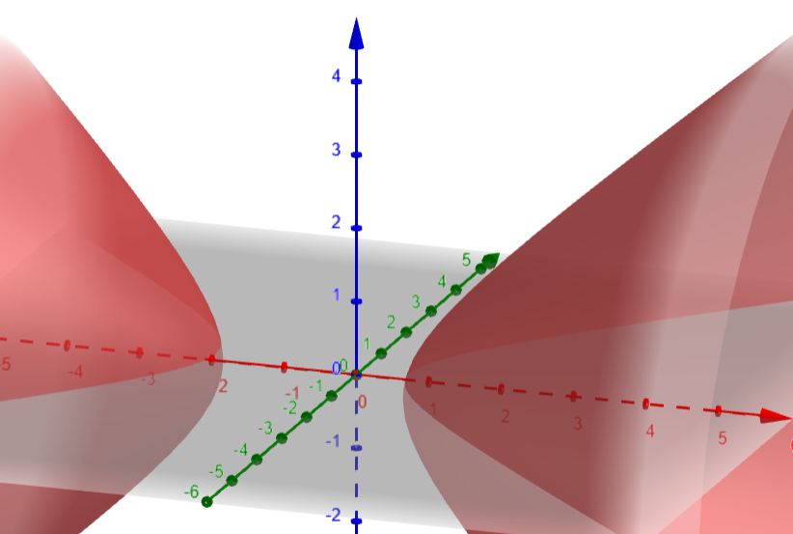
Domain choice (for the x)
A>0 (the exterior of the domain
is considered) → (-∞,+∞)

Slide 12
Domain choice
Disuguaglianza nella forma:
Ax²+ax+By²+by+Cz²+cz+r>(<=)0

Slide 13
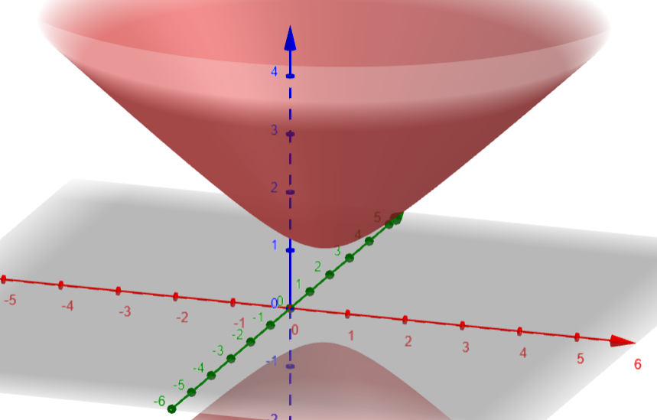
Domain choice(A<0)
B o C < 0
→ (-∞,+∞)

Slide 14
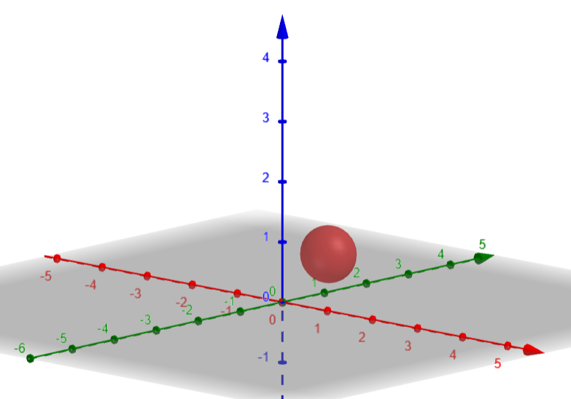
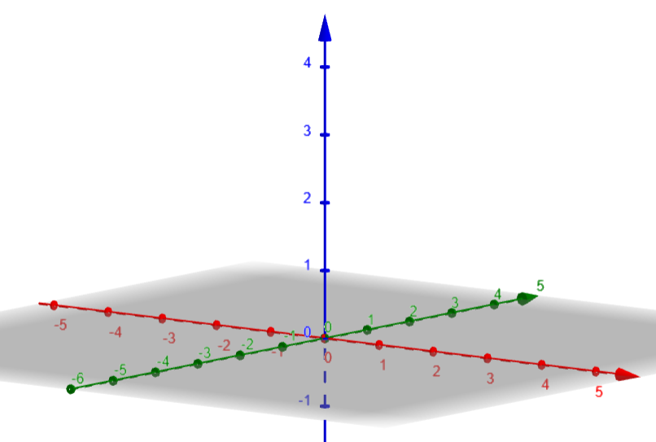
Domain choice(A<0)
B e C < 0:
- a^2-4Ak>0→ Interval
- a^2-4Ak<0→ ∅

Slide 15
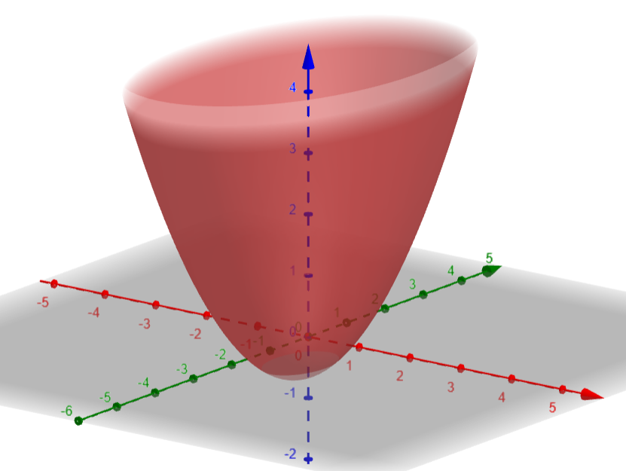
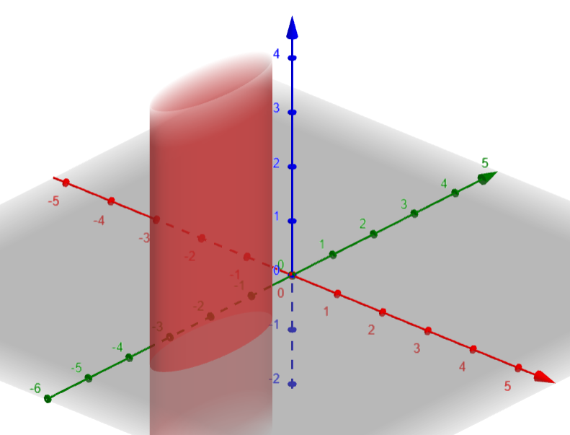
Domain choice(A<0)
B<0, C=0:
- c≠0→ (-∞,+∞)
- c=0→ Interval

Slide 16
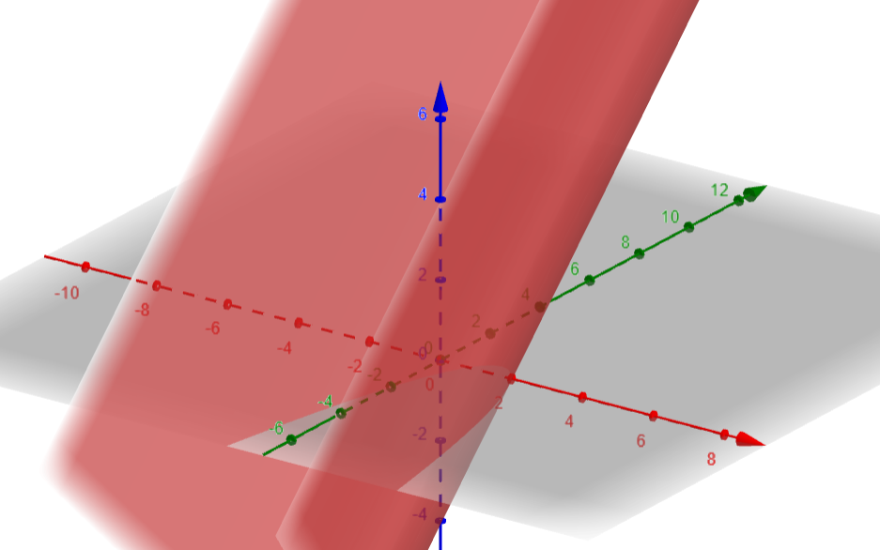
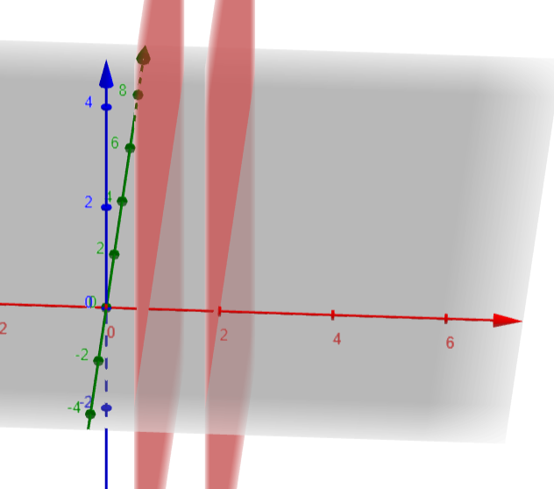
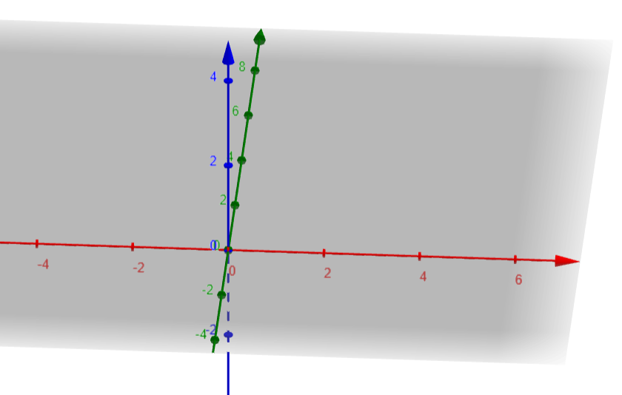
Domain choice(A<0)
B e C=0:
- (b o c)≠0→ (-∞,+∞)
- b,c=0 (a^2-4Ar>0)→ Interval
- b,c=0 (a^2-4Ar>0)→∅

Slide 17
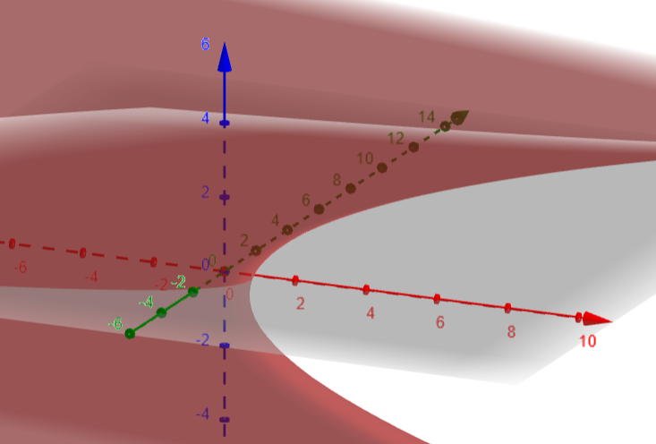
Domain choice(A=0)
B o C>0
→ (-∞,+∞)

Slide 18
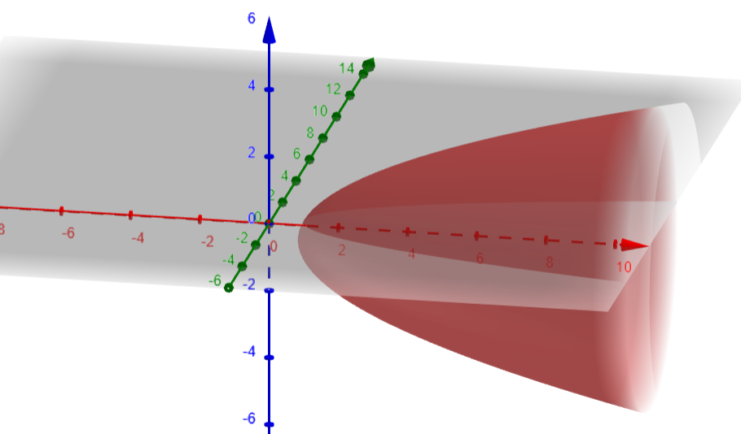
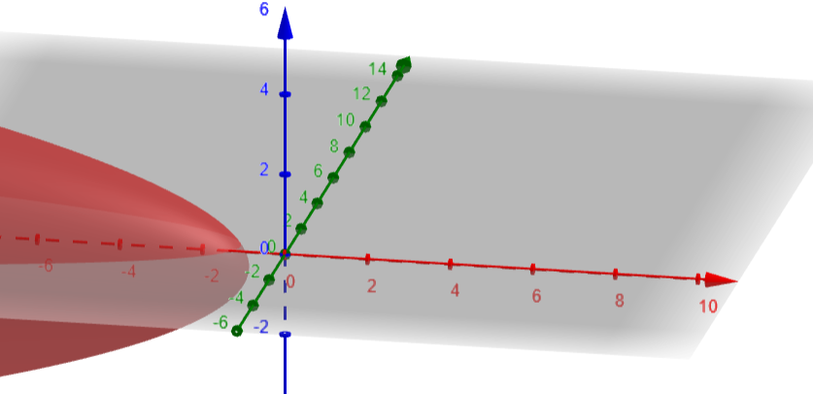
Domain choice(A=0)
B e C<0:
- a>0→ (-k/a,+∞)
- a<0→ (-∞, k/a)

Slide 19
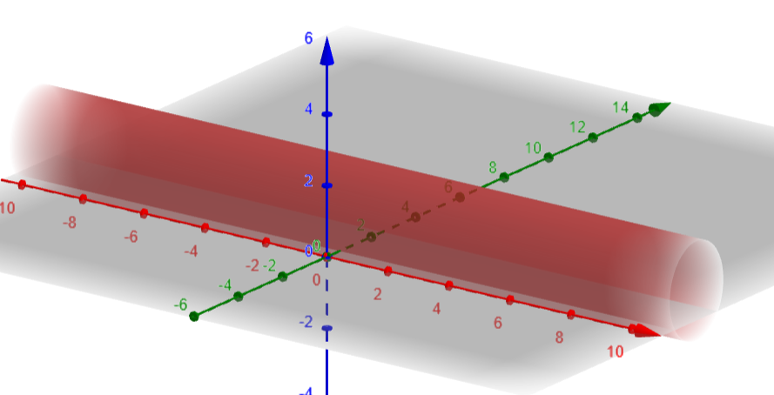
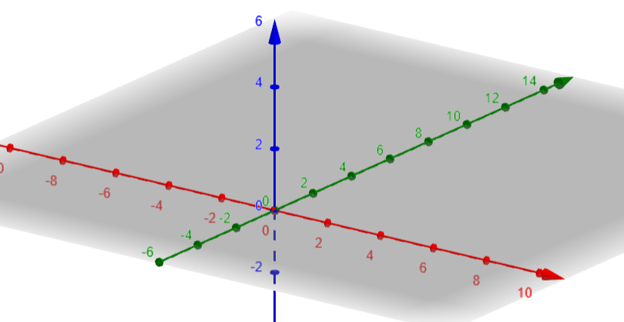
Domain choice(A=0)
B e C<0:
- k<0→ (-∞,+∞)
- k>0→ ∅

Slide 20
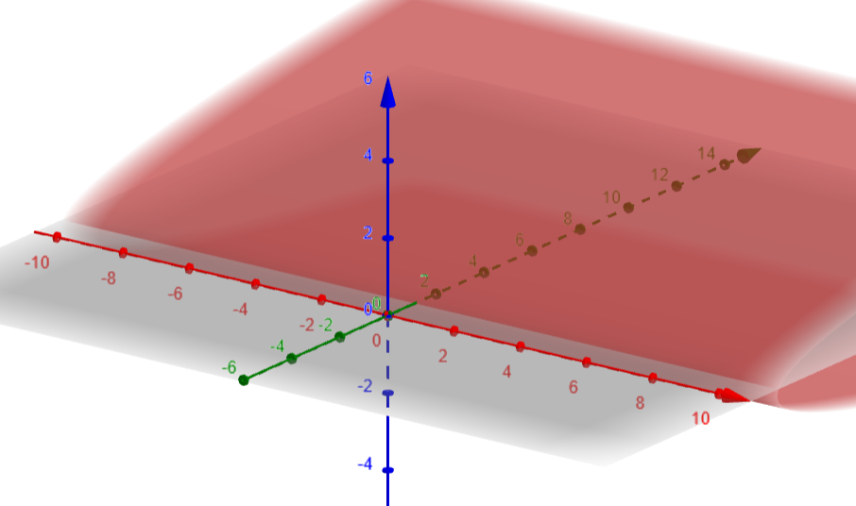
Domain choice(A=0)
B=0 e C<0:
- b<0→ (-∞,+∞)
- b>0→ ∅

Slide 21
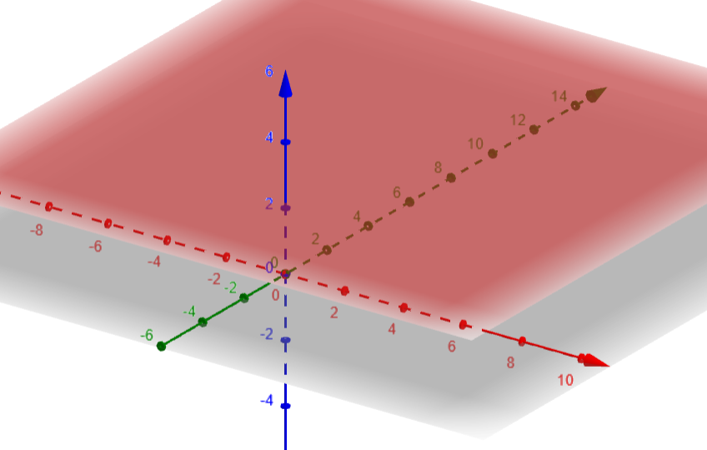
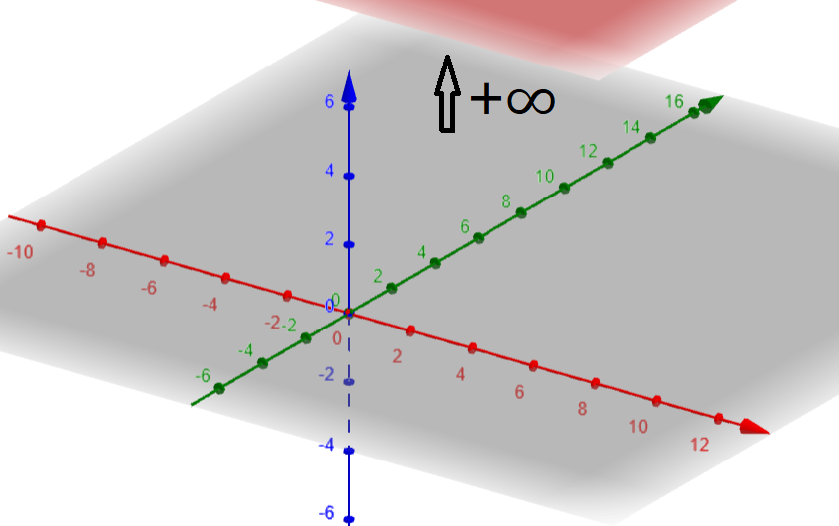
Domain choice(A=0)
B e C=0:
- b o c≠0→ (-∞,+∞)
- b e c=0 e a=0:
- r>0→(-∞,+∞)
- r<0→∅

Slide 22
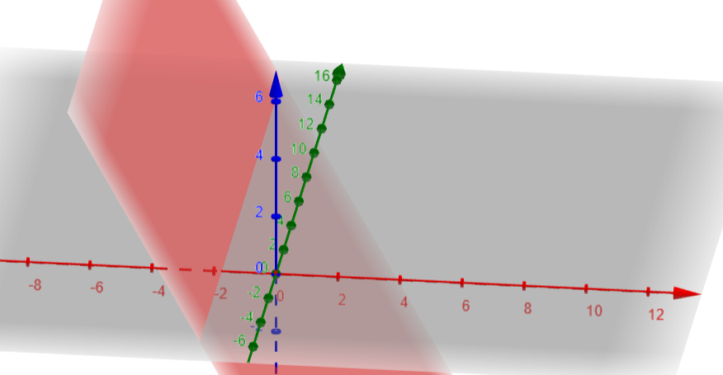
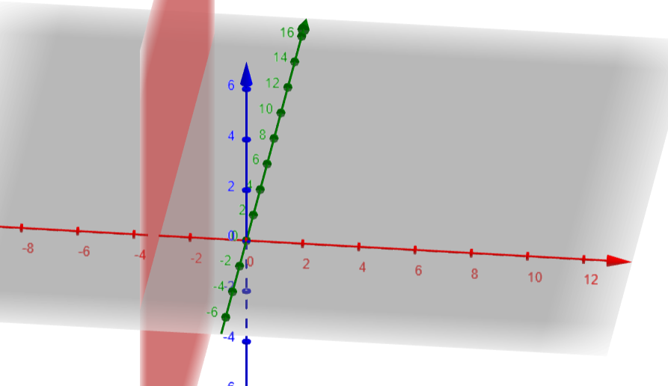
Domain choice(A=0)
B=0 e C<0 e a≠0:
- b o c≠0→ (-∞,+∞)
- b>0→ (-∞,k) o (k,+∞)

Slide 23
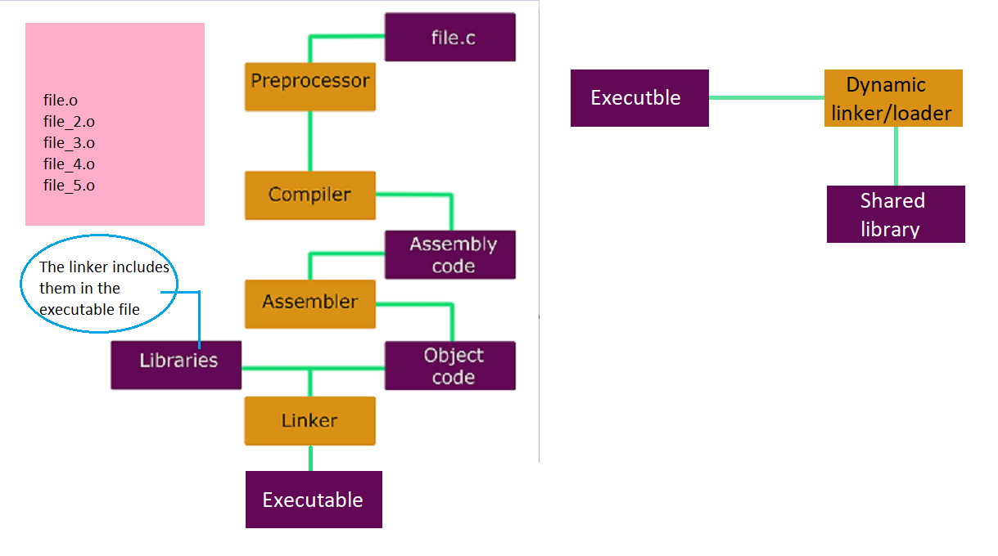
Dynamically linking

Slide 24

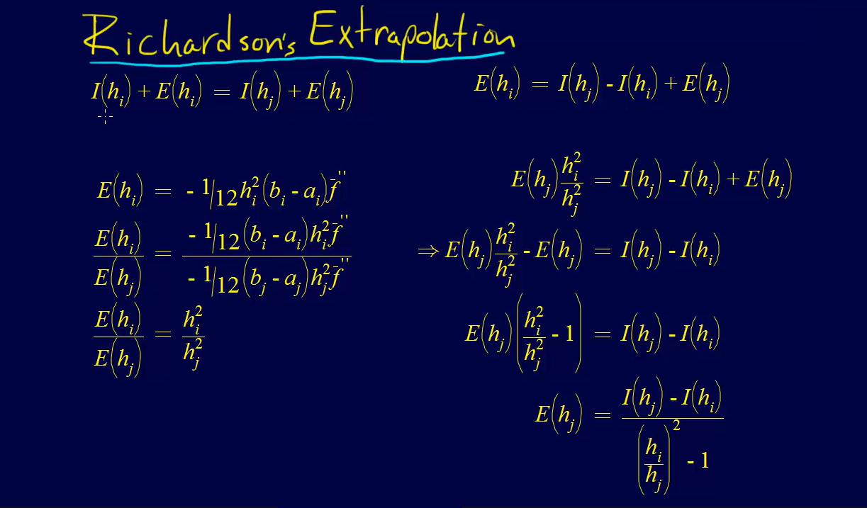
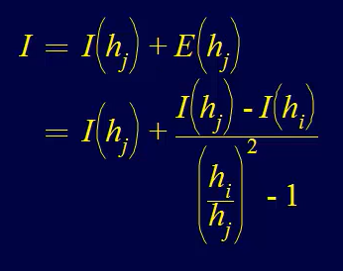

Slide 25
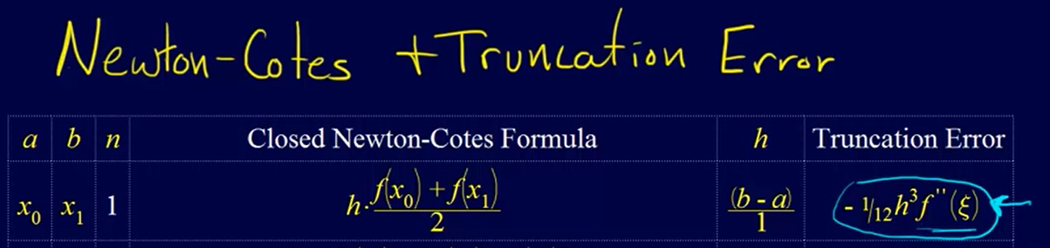
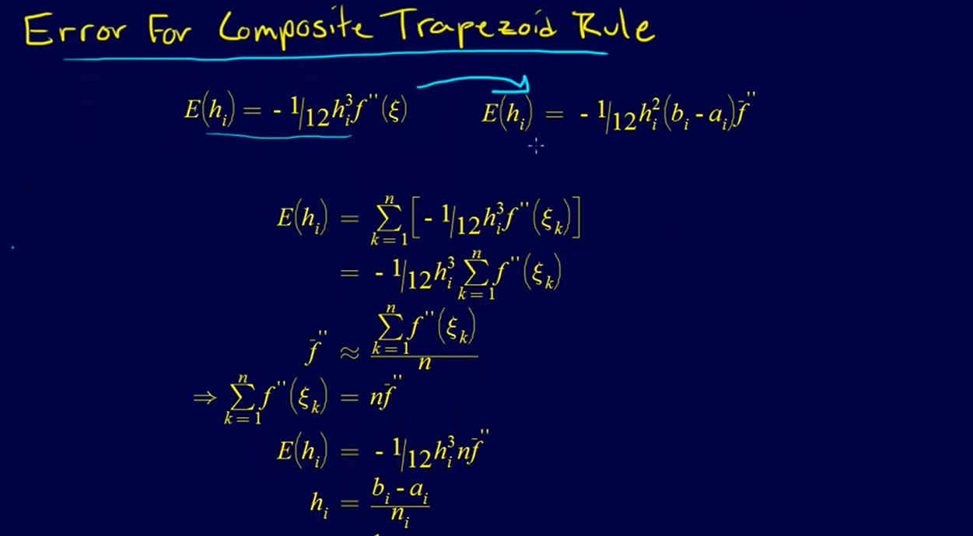
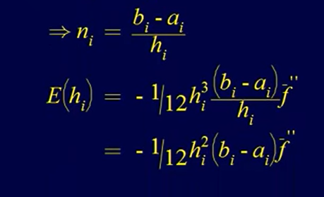

Slide 26
Thanks for the attention
Gabriele Fazio 994848

