Slide 1
ResultTrail.
Project, architecture
and design decisions
An illustrated walkthrough of the working MVP
AI4Elections 2026 • 4 November 2026
Notes:
Project sources: resulttrail/README.md; docs/PROBLEM_STATEMENT.md. Screenshots are from the illustrative ResultTrail website during October-November 2026. Figures and records shown are fictional. Technical status reflects the repository and hosted preview inspected on 4 November 2026.

Slide 2
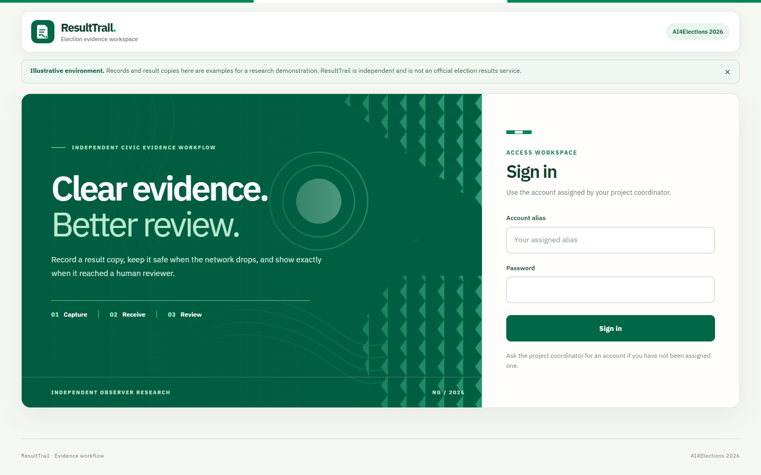
RESULTTRAIL / PROJECT DEEP DIVE
Why we built it
•
A result copy can be recorded while connectivity is weak, then sent later.
•
A local save, a server receipt and a reviewer approval mean different things.
•
A reviewer needs the figures, source image and decision history together.
Purpose: preserve the handoff from field capture to human review.
02
Notes:
Project sources: docs/PROBLEM_STATEMENT.md; docs/system-card.md. Screenshots are from the illustrative ResultTrail website during October-November 2026. Figures and records shown are fictional. Technical status reflects the repository and hosted preview inspected on 4 November 2026.

Slide 3
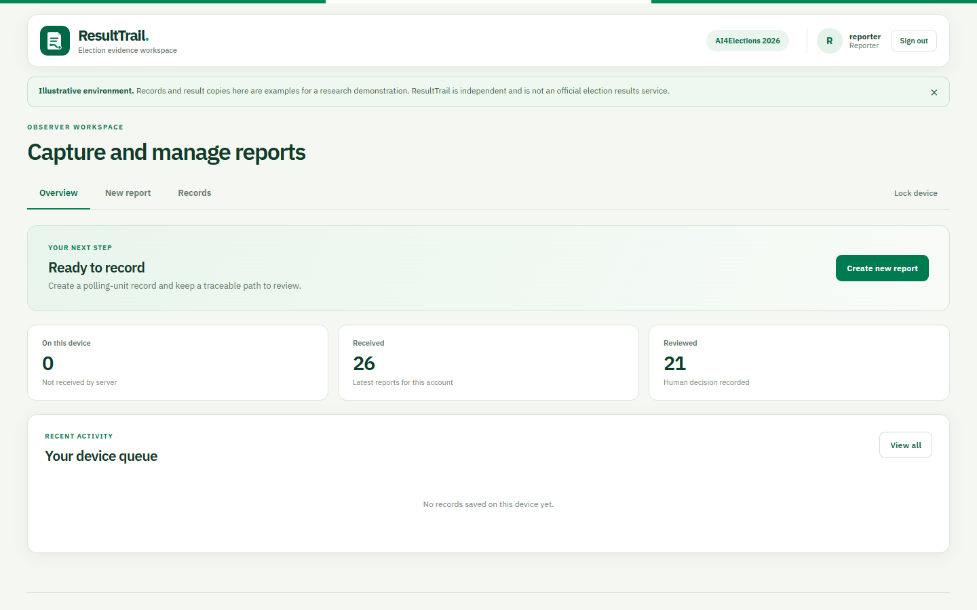
RESULTTRAIL / PROJECT DEEP DIVE
What the MVP does
•
Observer: capture a fictional result copy, encrypt it locally, sync and follow its status.
•
Reviewer: inspect evidence, check arithmetic, record a decision and export an approved version.
•
The system does not authenticate a paper copy, declare results or detect fraud.
The site is an independent research demonstration using illustrative records.
03
Notes:
Project sources: docs/system-card.md; docs/SAFETY_AND_LIMITATIONS.md. Screenshots are from the illustrative ResultTrail website during October-November 2026. Figures and records shown are fictional. Technical status reflects the repository and hosted preview inspected on 4 November 2026.

Slide 4
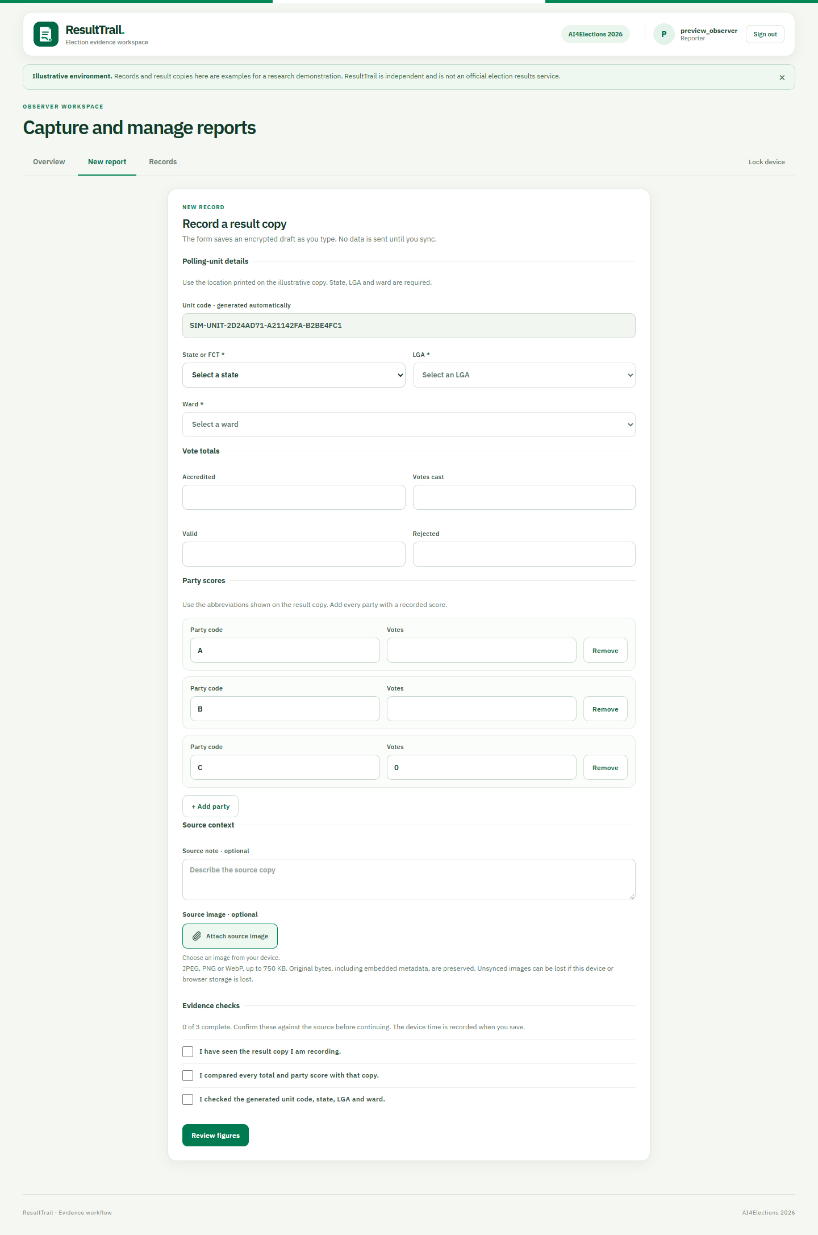
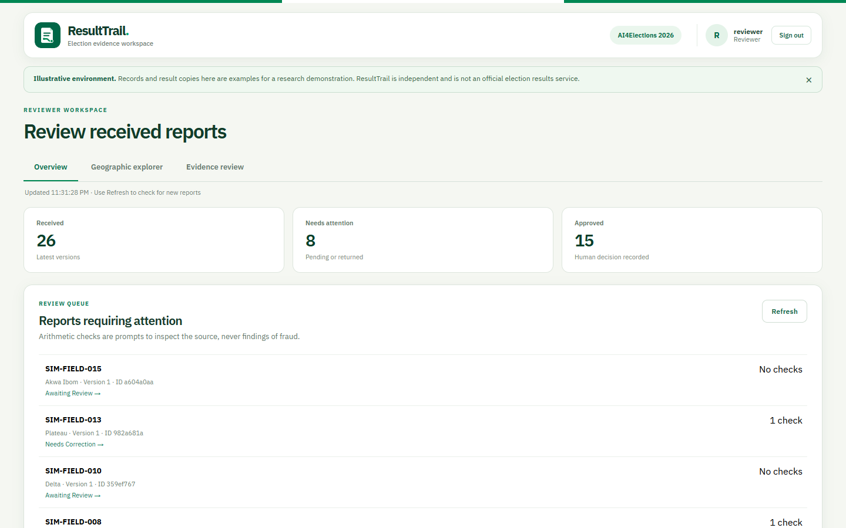
RESULTTRAIL / PROJECT DEEP DIVE
Two pathways, one evidence trail
OBSERVER
REVIEWER
Captures and syncs each version
Reviews the latest received version
04
Notes:
Project sources: client/src/components/ReporterView.tsx; client/src/components/ReviewerView.tsx. Screenshots are from the illustrative ResultTrail website during October-November 2026. Figures and records shown are fictional. Technical status reflects the repository and hosted preview inspected on 4 November 2026.

Slide 5
RESULTTRAIL / PROJECT DEEP DIVE
System architecture
BROWSER PWA
CLOUDFLARE WORKER
D1 DATABASE
React + TypeScript
Auth, validation, receipts
Versions, reviews, images
→
→
Encrypted IndexedDB vault
Role and tenant checks
Sessions and exports
Static assets and /api routes share the same origin; the Worker serves the public site and D1 holds shared state.
05
Notes:
Project sources: cloud/wrangler.jsonc; cloud/README.md; client/src/App.tsx. Screenshots are from the illustrative ResultTrail website during October-November 2026. Figures and records shown are fictional. Technical status reflects the repository and hosted preview inspected on 4 November 2026.

Slide 6
RESULTTRAIL / PROJECT DEEP DIVE
Why a hosted Worker and D1
•
The website runs when the developer laptop is off.
routes: resulttrail.ng
assets: ../client/dist
API: /api/* → Worker
DB binding: D1
•
The Worker serves the PWA and handles authenticated /api calls.
•
D1 keeps received versions and reviewer decisions across devices.
Compromise: a small, low-cost hosted stack; backups and key custody still require operating discipline.
06
Notes:
Project sources: cloud/wrangler.jsonc; cloud/README.md. Screenshots are from the illustrative ResultTrail website during October-November 2026. Figures and records shown are fictional. Technical status reflects the repository and hosted preview inspected on 4 November 2026.

Slide 7
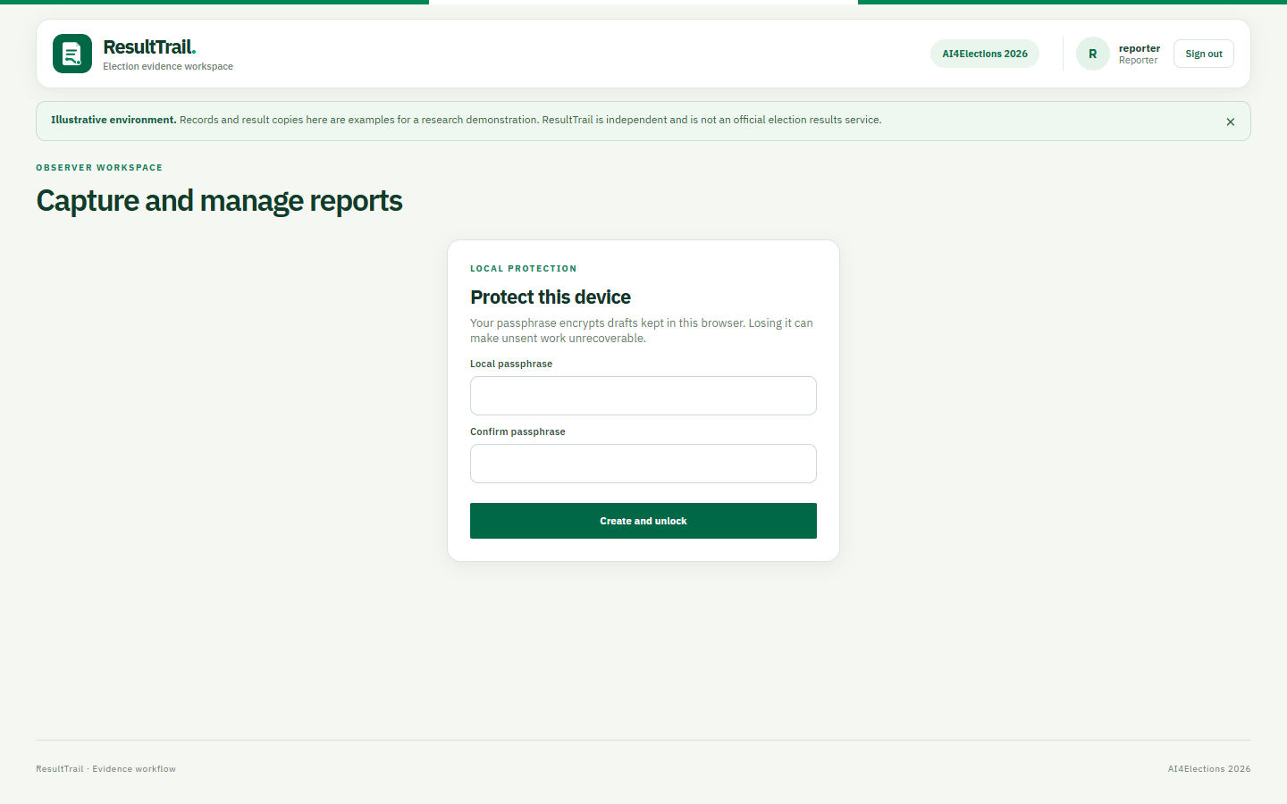
RESULTTRAIL / PROJECT DEEP DIVE
Offline drafts and the device vault
•
A separate passphrase derives a wrapping key with PBKDF2.
•
Drafts and queued records use AES-GCM in IndexedDB.
•
Unsent data stays on that device until sync.
Tradeoff: browser storage is convenient, but eviction or a lost passphrase can destroy unsent work.
07
Notes:
Project sources: client/src/storage.ts:66-154; docs/system-card.md. Screenshots are from the illustrative ResultTrail website during October-November 2026. Figures and records shown are fictional. Technical status reflects the repository and hosted preview inspected on 4 November 2026.

Slide 8
RESULTTRAIL / PROJECT DEEP DIVE
Reporter capture is source-led
•
The unit code is generated; state, LGA and ward are required.
•
Totals and every party score are entered explicitly.
•
The checklist asks for source comparison before saving.
Party rows are dynamic: the current form supports 2–26 parties.
08
Notes:
Project sources: client/src/components/ReporterView.tsx; resulttrail/README.md. Screenshots are from the illustrative ResultTrail website during October-November 2026. Figures and records shown are fictional. Technical status reflects the repository and hosted preview inspected on 4 November 2026.

Slide 9
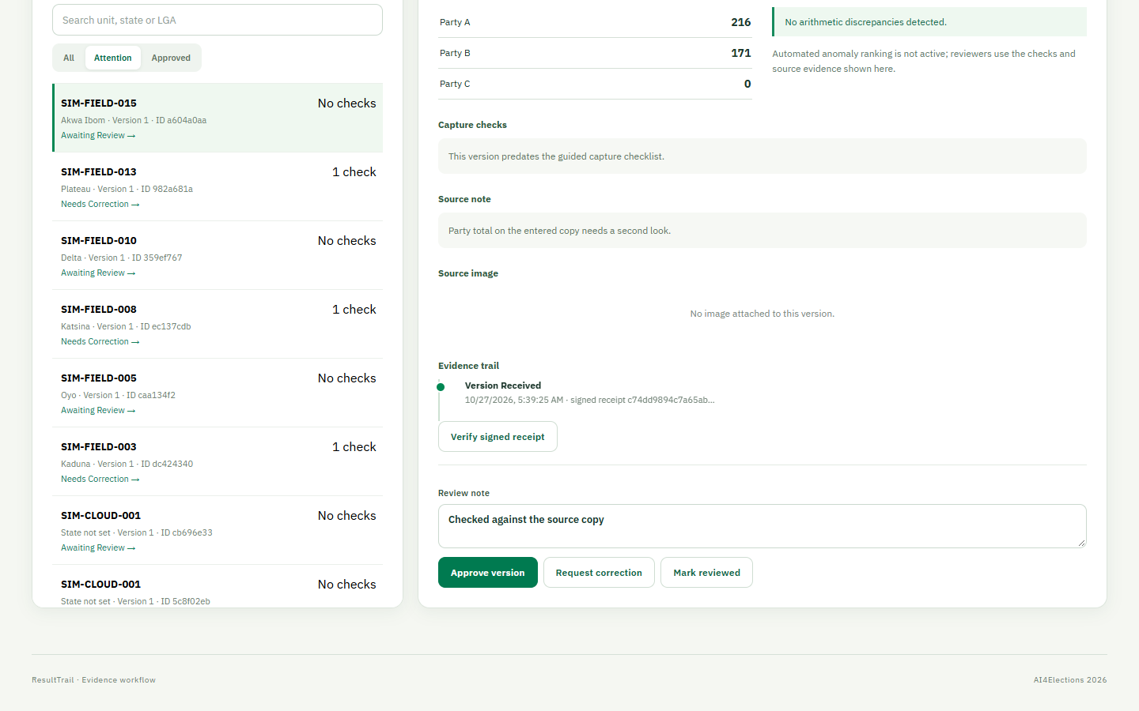
RESULTTRAIL / PROJECT DEEP DIVE
Arithmetic checks assist the reviewer
•
The app compares valid + rejected with cast.
•
It checks party-vote sum and whether cast exceeds accredited.
•
A flagged difference asks for inspection; it is not an accusation.
No automated anomaly ranking is active in the product.
09
Notes:
Project sources: cloud/src/index.ts:66-72; docs/MODEL_CARD.md. Screenshots are from the illustrative ResultTrail website during October-November 2026. Figures and records shown are fictional. Technical status reflects the repository and hosted preview inspected on 4 November 2026.

Slide 10
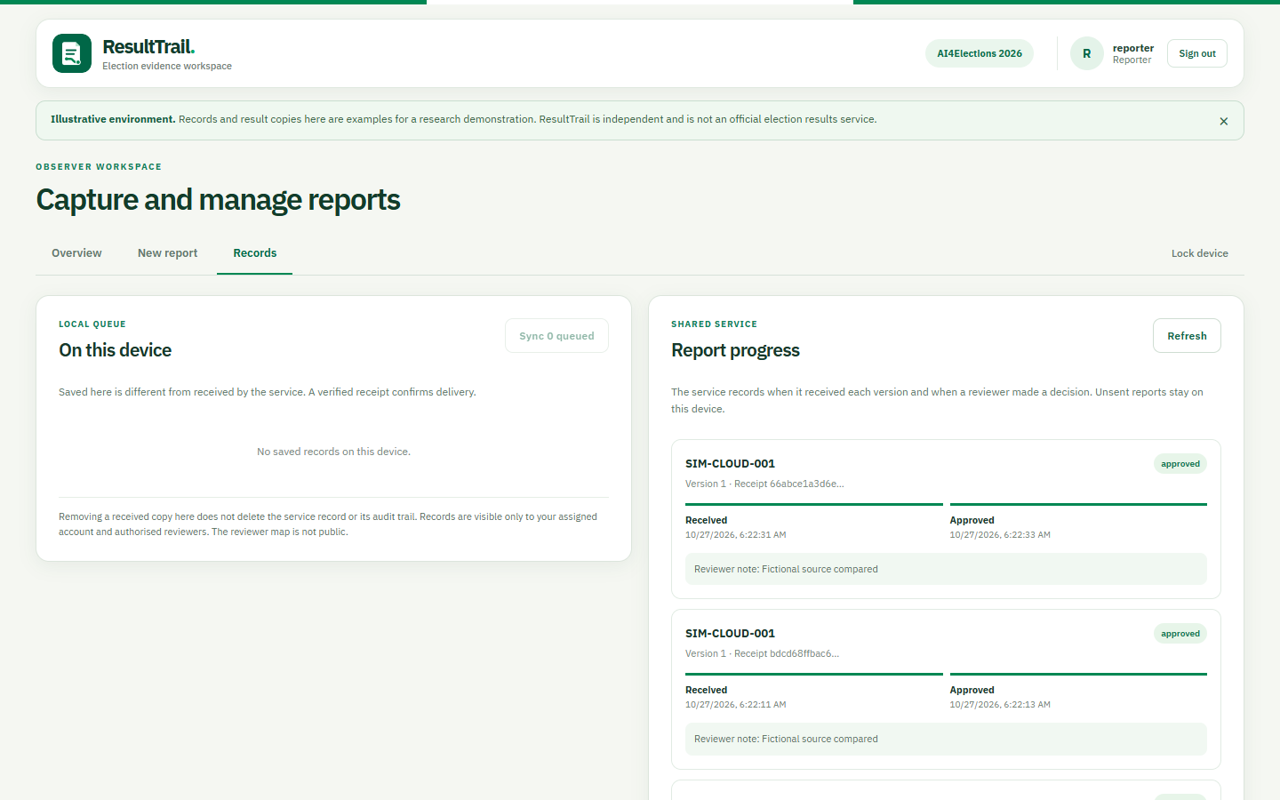
RESULTTRAIL / PROJECT DEEP DIVE
Local save is not server delivery
•
On this device is the encrypted local queue.
•
Sync sends a saved version when online.
•
Report progress shows receipt and reviewer feedback.
The UI makes the delivery boundary visible to the reporter.
10
Notes:
Project sources: client/src/components/ReporterView.tsx; client/src/api.ts. Screenshots are from the illustrative ResultTrail website during October-November 2026. Figures and records shown are fictional. Technical status reflects the repository and hosted preview inspected on 4 November 2026.

Slide 11
RESULTTRAIL / PROJECT DEEP DIVE
Signed receipts answer “did it arrive?”
EXCERPT FROM CLIENT/SRC/API.TS (LINES OMITTED)
const payloadDigest = hex(await crypto.subtle.digest(
'SHA-256', canonical(payload) as BufferSource))
if (payloadDigest !== receipt.body.digest)
throw new Error('Receipt does not match the local data')
const valid = await crypto.subtle.verify('Ed25519', key,
decode(receipt.signature) as BufferSource,
canonical(receipt.body) as BufferSource)
•
Server signs the tenant, report ID, version, digest and receive time.
•
Browser verifies the digest and signature before showing “Server received”.
11
Notes:
Project sources: client/src/api.ts:42-52; cloud/src/index.ts:115-136; docs/system-card.md. Screenshots are from the illustrative ResultTrail website during October-November 2026. Figures and records shown are fictional. Technical status reflects the repository and hosted preview inspected on 4 November 2026.

Slide 12
RESULTTRAIL / PROJECT DEEP DIVE
D1 schema preserves the trail
account + session
Assigned identities, roles, tenants, session state
result_version
Immutable payload, digest, reporter, signed receipt
evidence_photo
One original image per report version, hash and signature
review_action
Human decision, note and time linked to a version
export_package
Approved minimized package and signature
(tenant, report_id, version) identifies a stored result version.
12
Notes:
Project sources: cloud/migrations/0001_init.sql; cloud/migrations/0002_evidence.sql. Screenshots are from the illustrative ResultTrail website during October-November 2026. Figures and records shown are fictional. Technical status reflects the repository and hosted preview inspected on 4 November 2026.

Slide 13
RESULTTRAIL / PROJECT DEEP DIVE
The API enforces the workflow
POST /api/results reporter only
POST /api/results/:id/evidence original reporter
POST /api/review/:id/decision reviewer only
POST /api/exports approved version
•
A repeated identical version returns its existing receipt.
•
Changed content at the same ID and version conflicts.
•
A correction must use the next version from the original reporter.
13
Notes:
Project sources: cloud/src/index.ts:102-260; docs/system-card.md. Screenshots are from the illustrative ResultTrail website during October-November 2026. Figures and records shown are fictional. Technical status reflects the repository and hosted preview inspected on 4 November 2026.

Slide 14
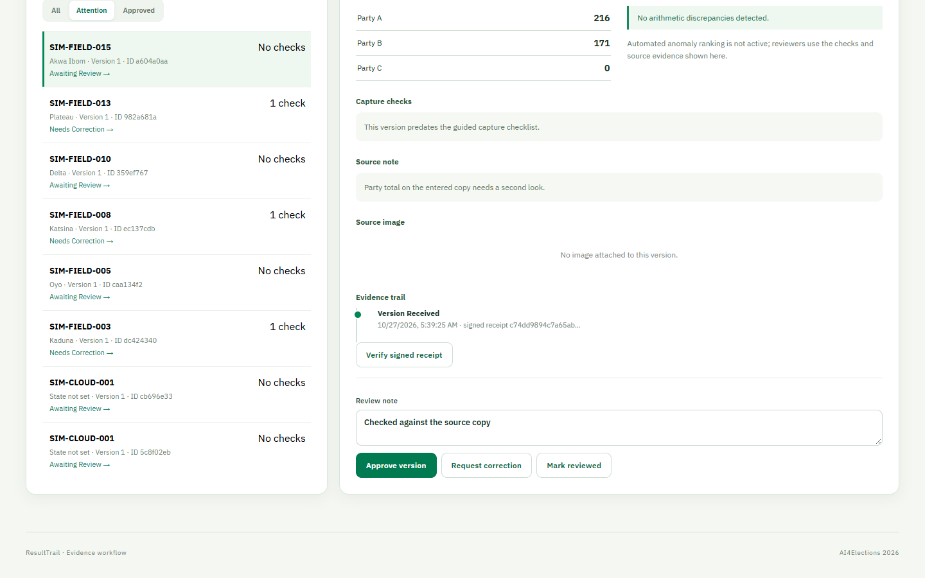
RESULTTRAIL / PROJECT DEEP DIVE
Human review remains the decision point
•
Reviewer compares the source and enters a note.
•
Approve, request correction or mark reviewed.
•
A correction creates a new version; earlier versions remain.
Only an approved latest version can produce the PDF with its embedded signed package.
14
Notes:
Project sources: cloud/src/index.ts:210-260; client/src/components/ReviewerView.tsx. Screenshots are from the illustrative ResultTrail website during October-November 2026. Figures and records shown are fictional. Technical status reflects the repository and hosted preview inspected on 4 November 2026.

Slide 15
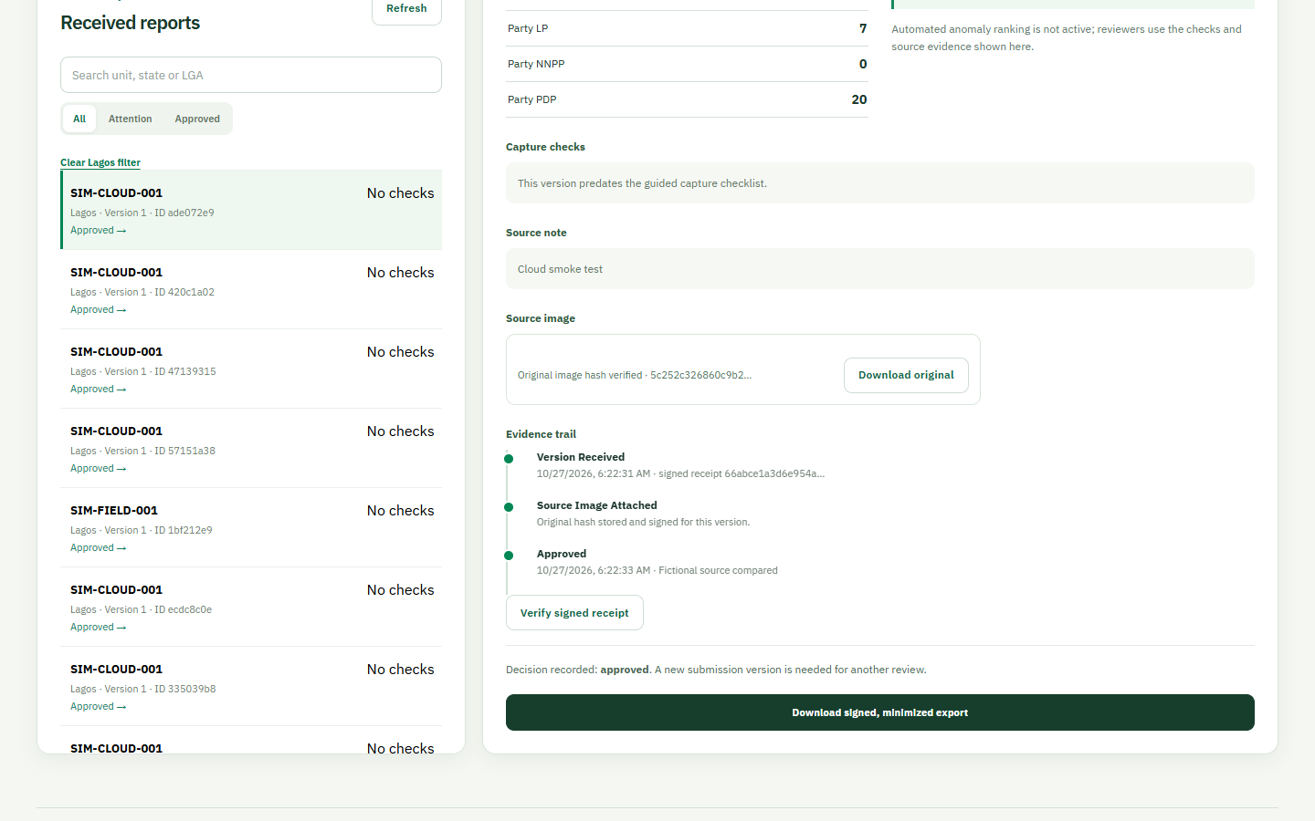
RESULTTRAIL / PROJECT DEEP DIVE
Source images are bound to a version
•
The original image is encrypted with the unsent draft, then uploaded after receipt.
•
JPEG, PNG or WebP; maximum 750 KB.
•
A SHA-256 hash establishes byte identity after upload, not photo authenticity.
OCR uses a temporary processed copy; the evidence bytes and hash remain unchanged.
15
Notes:
Project sources: cloud/src/index.ts:161-203; docs/system-card.md; docs/AI_AND_IMAGE_PLAN.md. Screenshots are from the illustrative ResultTrail website during October-November 2026. Figures and records shown are fictional. Technical status reflects the repository and hosted preview inspected on 4 November 2026.

Slide 16
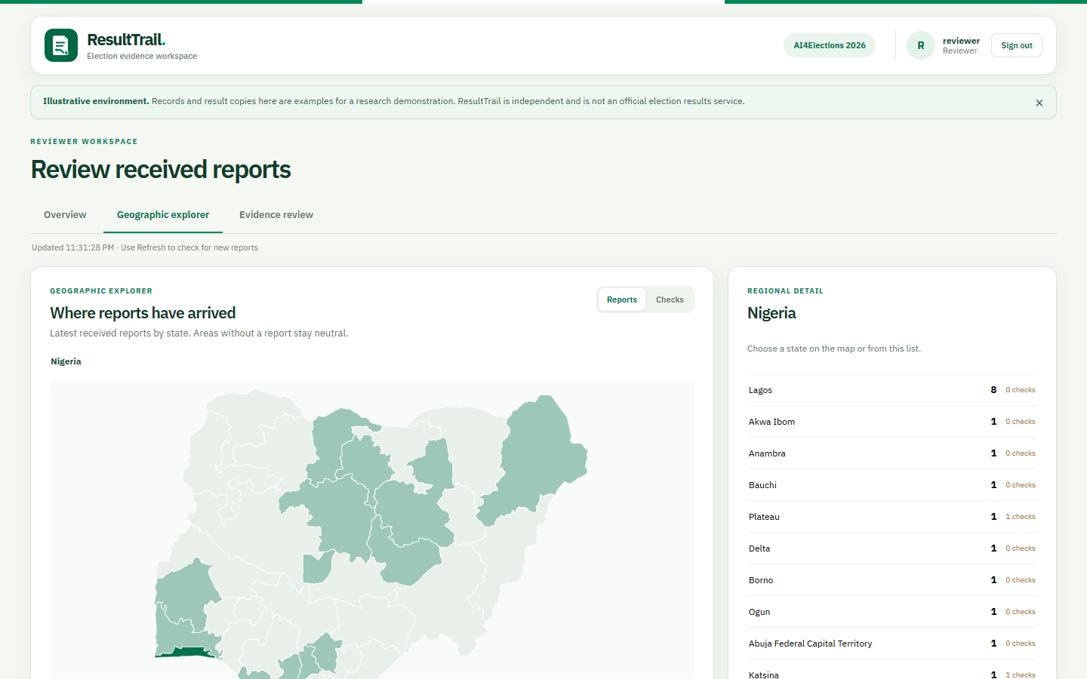
RESULTTRAIL / PROJECT DEEP DIVE
The map shows report coverage
•
Reviewers can find received reports geographically.
•
Reports and Checks are separate layers.
•
Shading is not a result or turnout map.
16
Notes:
Project sources: client/src/components/GeoExplorer.tsx; docs/geodata.md. Screenshots are from the illustrative ResultTrail website during October-November 2026. Figures and records shown are fictional. Technical status reflects the repository and hosted preview inspected on 4 November 2026.

Slide 17
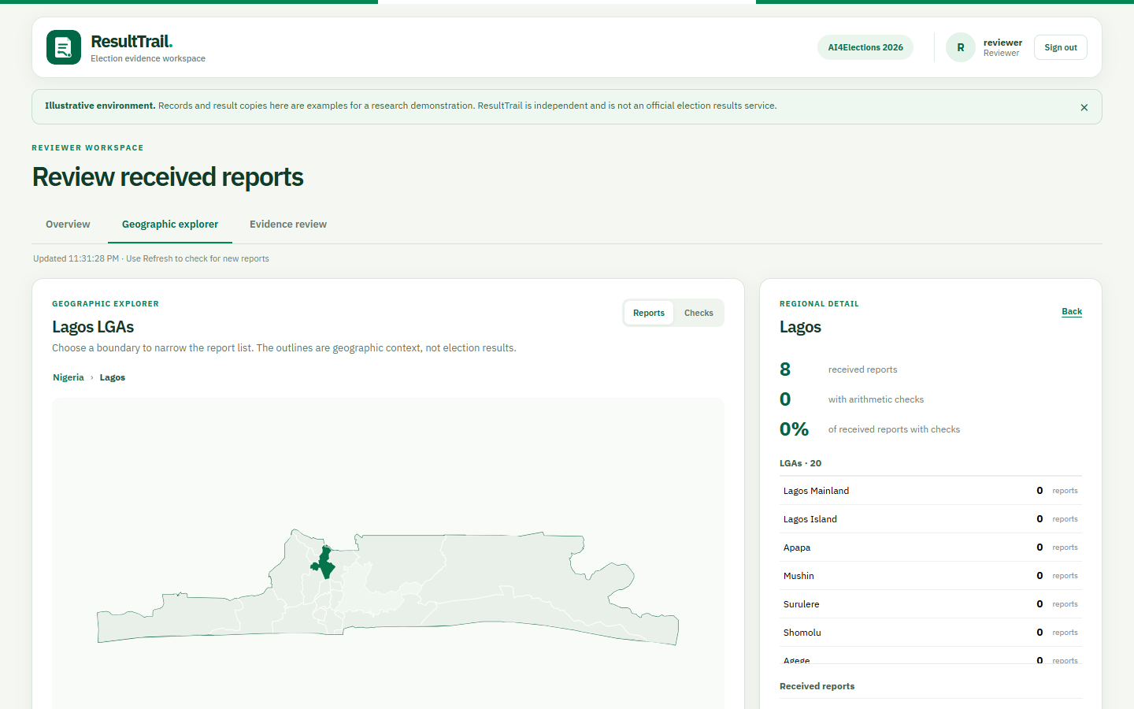
RESULTTRAIL / PROJECT DEEP DIVE
State drill-down: Lagos
•
State outlines lead to LGA outlines.
•
The regional panel summarizes received reports and checks.
•
Choose Ikeja on the map or in the list.
17
Notes:
Project sources: client/src/components/GeoExplorer.tsx; docs/geodata.md. Screenshots are from the illustrative ResultTrail website during October-November 2026. Figures and records shown are fictional. Technical status reflects the repository and hosted preview inspected on 4 November 2026.

Slide 18
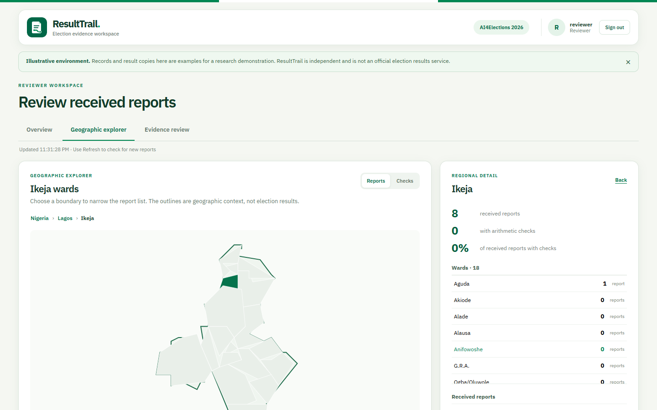
RESULTTRAIL / PROJECT DEEP DIVE
LGA drill-down: Ikeja
•
Ward outlines load after selecting an LGA.
•
A ward row shows its report count.
•
Select Aguda to narrow the view.
18
Notes:
Project sources: client/src/components/GeoExplorer.tsx; docs/geodata.md. Screenshots are from the illustrative ResultTrail website during October-November 2026. Figures and records shown are fictional. Technical status reflects the repository and hosted preview inspected on 4 November 2026.

Slide 19
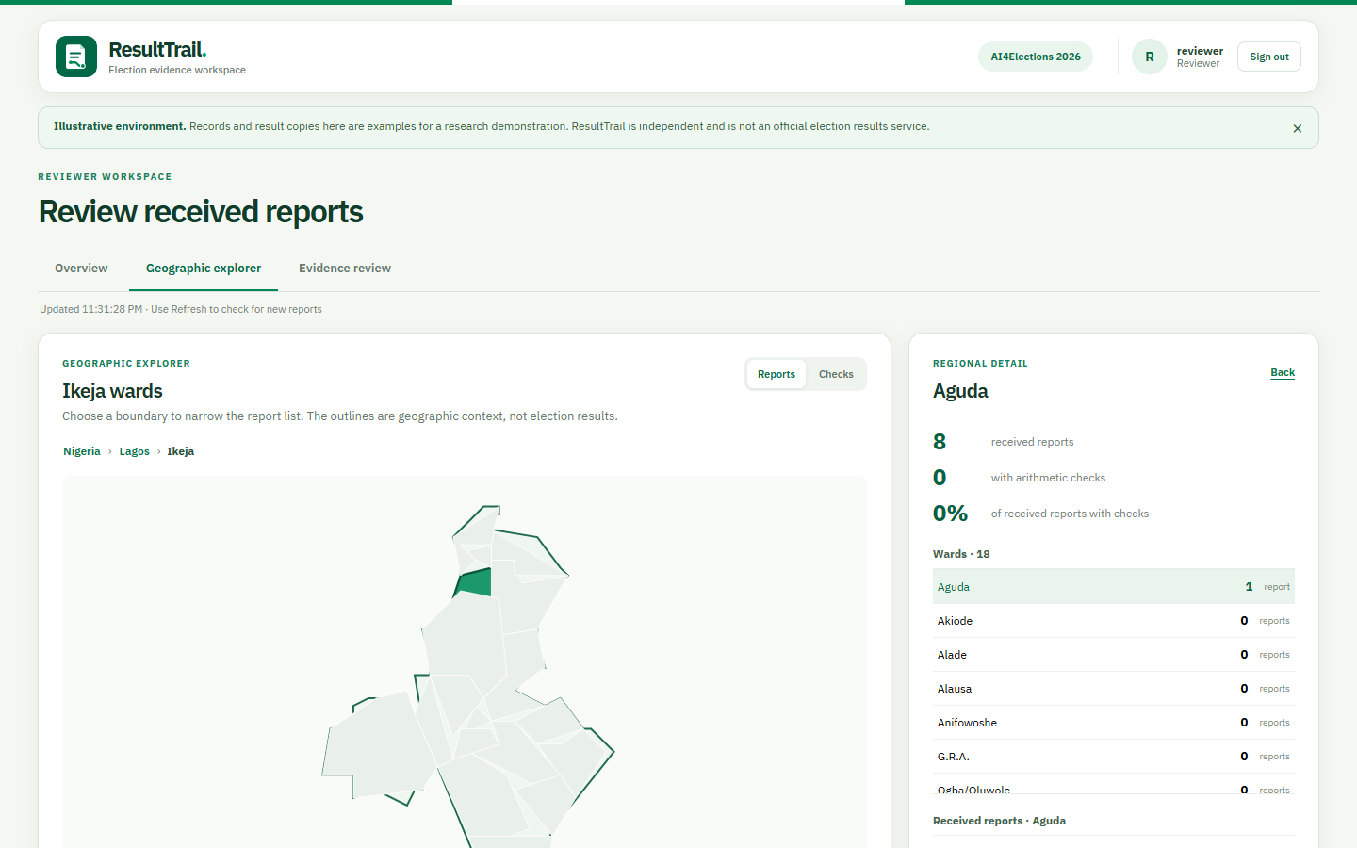
RESULTTRAIL / PROJECT DEEP DIVE
Ward selection: Aguda
•
The selected ward is highlighted.
•
Its received reports appear below the regional list.
•
Boundaries are context, not official electoral claims.
19
Notes:
Project sources: client/src/components/GeoExplorer.tsx; docs/geodata.md. Screenshots are from the illustrative ResultTrail website during October-November 2026. Figures and records shown are fictional. Technical status reflects the repository and hosted preview inspected on 4 November 2026.

Slide 20
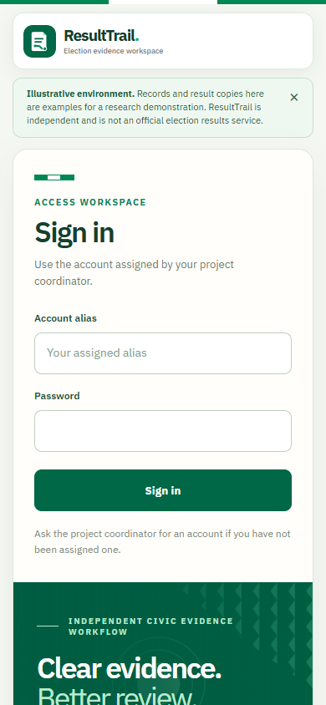
RESULTTRAIL / PROJECT DEEP DIVE
UI design and Nigerian visual cues
•
Flag green and white anchor the palette.
•
The patterned sign-in panel adds a local visual cue.
•
IBM Plex Sans and Newsreader balance form clarity with a distinctive voice.
•
The layout stacks for a narrow phone screen.
The role and workflow stay explicit across desktop and mobile layouts.
20
Notes:
Project sources: client/src/App.css; client/src/index.css; client/public/field-pattern.svg; client/src/App.tsx. Screenshots are from the illustrative ResultTrail website during October-November 2026. Figures and records shown are fictional. Technical status reflects the repository and hosted preview inspected on 4 November 2026.

Slide 21
RESULTTRAIL / PROJECT DEEP DIVE
Technology choices and compromises
React + Vite PWA
One responsive web client; no app-store install
Browser storage can be evicted
Worker + D1
Public site and shared backend at low cost
Operational backups still matter
Web Crypto
Local AES-GCM; Ed25519 verification
Key loss and device compromise remain risks
GeoJSON layers
State → LGA → ward context
Ward boundaries are operational
21
Notes:
Project sources: client/package.json; cloud/package.json; cloud/wrangler.jsonc; docs/geodata.md; docs/system-card.md. Screenshots are from the illustrative ResultTrail website during October-November 2026. Figures and records shown are fictional. Technical status reflects the repository and hosted preview inspected on 4 November 2026.

Slide 22
RESULTTRAIL / PROJECT DEEP DIVE
Automated ranking remains off
54 / 84
55 / 84
Review-worthy cases found by the peer baseline
Found by peer baseline + Isolation Forest
Gain: 0.0119 recall. The predeclared gate was 0.05. More research is warranted.
OCR assistance is available separately; it is optional and requires explicit human action.
22
Notes:
Project sources: docs/MODEL_CARD.md; docs/synthetic-evaluation.json; docs/METHODOLOGY_AND_EVALUATION.md. Screenshots are from the illustrative ResultTrail website during October-November 2026. Figures and records shown are fictional. Technical status reflects the repository and hosted preview inspected on 4 November 2026.

Slide 23
RESULTTRAIL / PROJECT DEEP DIVE
A stronger AI experiment
1 Build varied training cases
More sizes, parties, regions, valid extremes and transcription errors.
2 Keep test cases separate
Split by scenario and source template before tuning; reserve a new untouched holdout.
3 Tune on validation only
Compare features, peer groups, Isolation Forest settings and score fusion.
4 Measure reviewer value
Same 20% review budget; target +0.05 recall with no extra critical misses.
More test rows improve confidence in a score; more representative training rows may improve the model.
23
Notes:
Project sources: server/evaluate.py; docs/MODEL_CARD.md; docs/AI_AND_IMAGE_PLAN.md; https://scikit-learn.org/stable/modules/generated/sklearn.ensemble.IsolationForest.html; https://scikit-learn.org/stable/common_pitfalls.html. Screenshots are from the illustrative ResultTrail website during October-November 2026. Figures and records shown are fictional. Technical status reflects the repository and hosted preview inspected on 4 November 2026.

Slide 24
RESULTTRAIL / PROJECT DEEP DIVE
Current limits and next build steps
CURRENT LIMITS
NEXT STEPS
•
No independent field or security validation.
•
Independent phone-photo OCR evaluation.
•
Measured mobile storage and low-bandwidth tests.
•
Image capture works offline, but the hosted image cap remains 750 KB.
•
An independently held-out ranking experiment.
•
No public result or fraud declaration.
•
A consented manual-versus-OCR entry study.
A real deployment would need a named operating partner, trained reviewers, privacy review and security testing.
24
Notes:
Project sources: docs/AI_AND_IMAGE_PLAN.md; docs/SAFETY_AND_LIMITATIONS.md; docs/system-card.md. Screenshots are from the illustrative ResultTrail website during October-November 2026. Figures and records shown are fictional. Technical status reflects the repository and hosted preview inspected on 4 November 2026.

Slide 25
RESULTTRAIL / PROJECT DEEP DIVE
How to demonstrate ResultTrail
•
Record a fictional result while offline; show the encrypted local queue.
•
Reconnect and sync; verify the signed receipt and progress timeline.
•
As reviewer, open the map, inspect evidence and record a human decision.
•
Download the approved PDF and verify its embedded signed package.
Source code, methodology, system card, data sheet and user guide are in the public repository.
25
Notes:
Project sources: resulttrail/README.md; docs/USER_GUIDE.pdf; docs/system-card.md. Screenshots are from the illustrative ResultTrail website during October-November 2026. Figures and records shown are fictional. Technical status reflects the repository and hosted preview inspected on 4 November 2026.

Slide 26
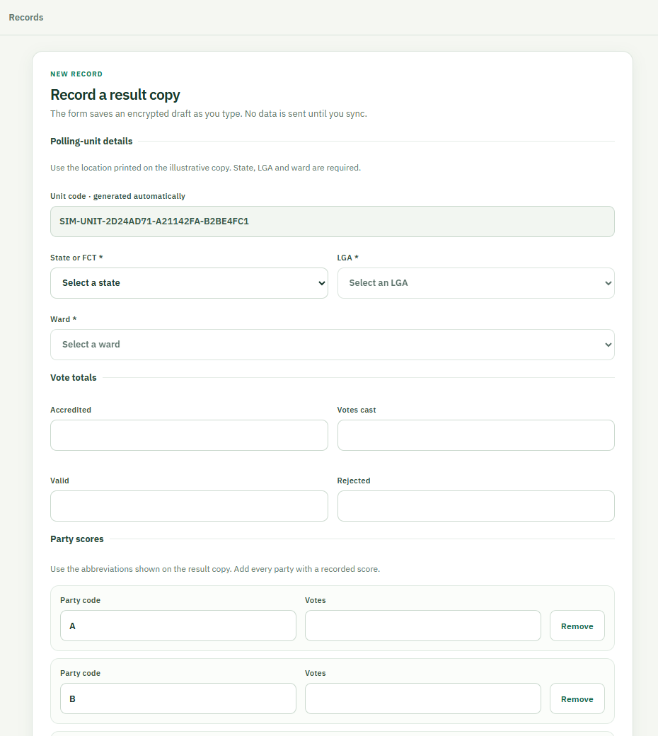
RESULTTRAIL / PROJECT DEEP DIVE
Current reporter capture
•
A new SIM-UNIT code is generated and cannot be edited.
•
State, LGA and ward are required before submission.
•
Party rows expand beyond three; an oversized image shows an error.
•
The attached original is encrypted with the unsent draft.
26
Notes:
Project sources: client/src/components/ReporterView.tsx; docs/USER_GUIDE.pdf. Screenshots are from the illustrative ResultTrail website during October-November 2026. Figures and records shown are fictional. Technical status reflects the repository and hosted preview inspected on 4 November 2026.

Slide 27
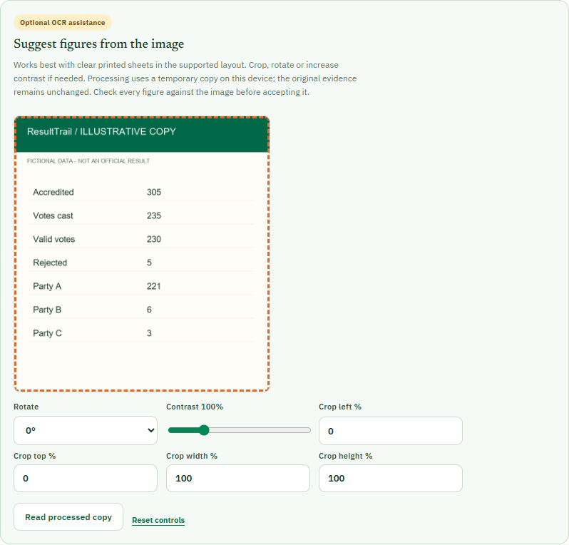
RESULTTRAIL / PROJECT DEEP DIVE
Reporter OCR prepares a temporary copy
•
The user can crop, rotate and adjust contrast before reading.
•
Processing happens in the browser with pinned same-origin Tesseract assets.
•
The stored evidence image and SHA-256 digest do not change.
27
Notes:
Project sources: client/src/components/ReporterView.tsx; client/src/ocr.ts; docs/RELEASE_STATUS_2026-11-04.md. Screenshots are from the illustrative ResultTrail website during October-November 2026. Figures and records shown are fictional. Technical status reflects the repository and hosted preview inspected on 4 November 2026.

Slide 28
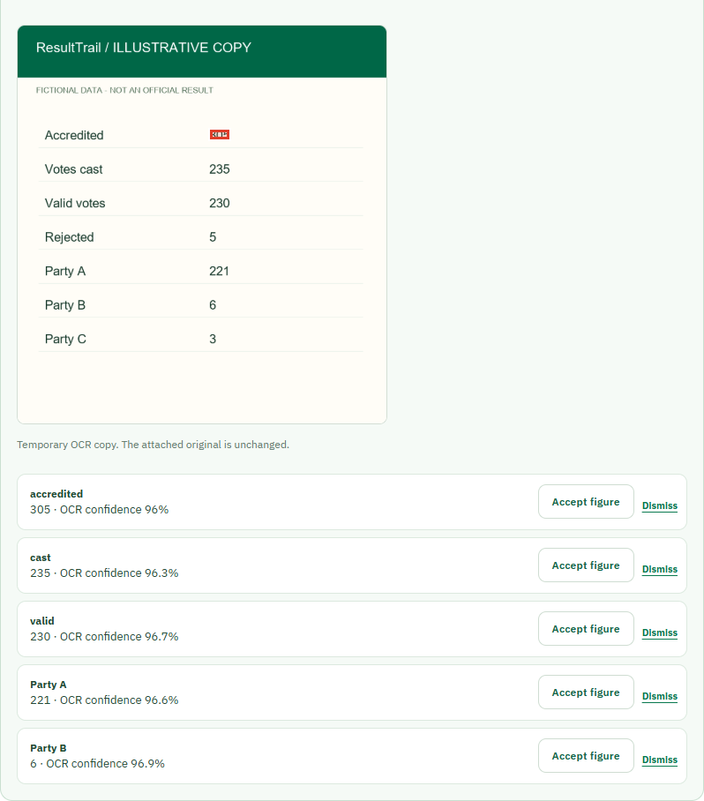
RESULTTRAIL / PROJECT DEEP DIVE
OCR suggestions need individual acceptance
•
A proposed number highlights its source region.
•
Accept figure fills only that field; Dismiss leaves it unchanged.
•
The user still checks required fields, totals and parties before saving.
Confidence is a model score, not a guarantee of correctness.
28
Notes:
Project sources: client/src/components/ReporterView.tsx; docs/VALIDATION_PACKET.md. Screenshots are from the illustrative ResultTrail website during October-November 2026. Figures and records shown are fictional. Technical status reflects the repository and hosted preview inspected on 4 November 2026.

Slide 29
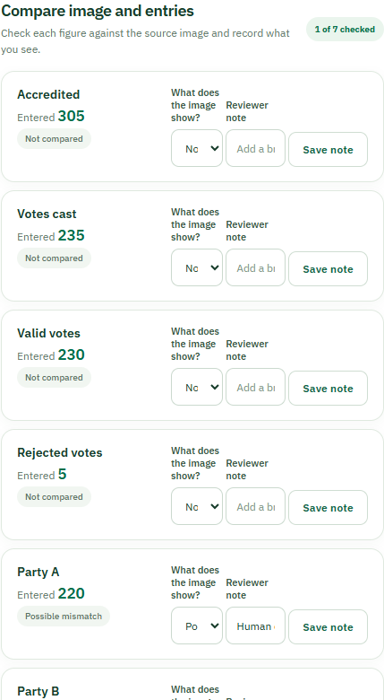
RESULTTRAIL / PROJECT DEEP DIVE
Reviewer comparisons preserve human judgment
•
Each field can be marked match, possible mismatch or unreadable.
•
A short note records what the reviewer saw in the image.
•
Later decisions supersede earlier assessments without erasing history.
•
A comparison never edits submitted figures.
29
Notes:
Project sources: client/src/components/ReviewerView.tsx; docs/RELEASE_STATUS_2026-11-04.md. Screenshots are from the illustrative ResultTrail website during October-November 2026. Figures and records shown are fictional. Technical status reflects the repository and hosted preview inspected on 4 November 2026.

Slide 30
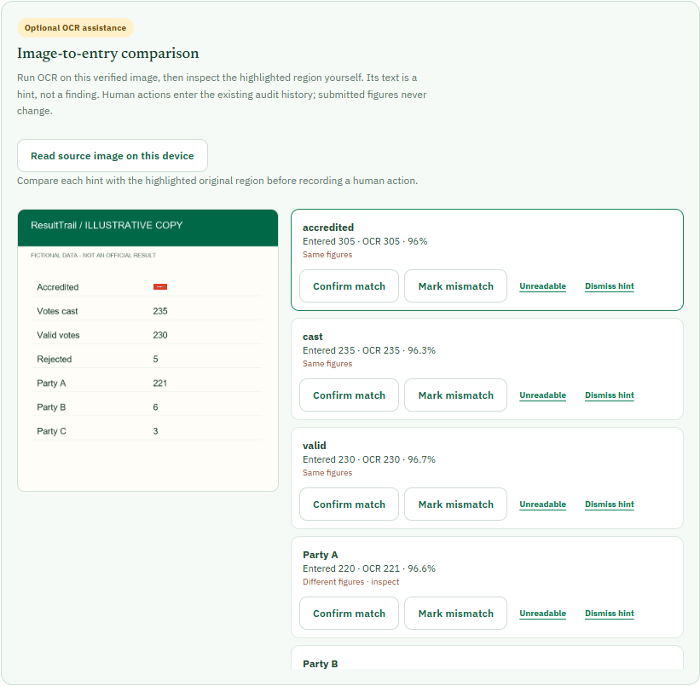
RESULTTRAIL / PROJECT DEEP DIVE
Reviewer OCR points to image regions
•
OCR runs only when a verified source image is present.
•
A hint highlights the region it read on the original.
•
The reviewer confirms, marks a mismatch, says unreadable or dismisses.
•
OCR does not approve a version or make a fraud finding.
30
Notes:
Project sources: client/src/components/ReviewerView.tsx; docs/RELEASE_STATUS_2026-11-04.md. Screenshots are from the illustrative ResultTrail website during October-November 2026. Figures and records shown are fictional. Technical status reflects the repository and hosted preview inspected on 4 November 2026.

Slide 31
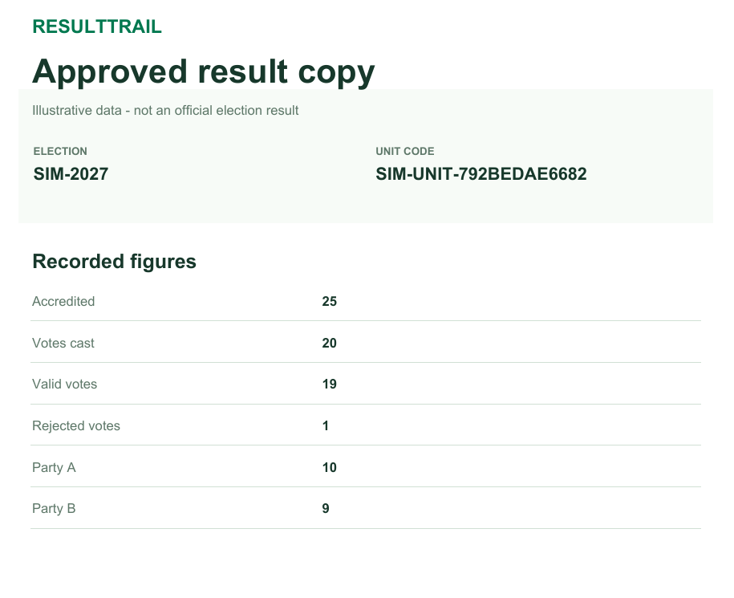
RESULTTRAIL / PROJECT DEEP DIVE
Approved result PDF and signed attachments
•
The PDF shows minimized approved figures for ordinary readers.
•
It embeds the exact Ed25519-signed JSON package and public key.
•
The visible PDF pages are not digitally signed.
•
Verification checks the embedded JSON, then compares it with the page.
31
Notes:
Project sources: client/src/signedExportPdf.ts; client/scripts/check-export-pdf.mjs; docs/RELEASE_STATUS_2026-11-04.md. Screenshots are from the illustrative ResultTrail website during October-November 2026. Figures and records shown are fictional. Technical status reflects the repository and hosted preview inspected on 4 November 2026.

Slide 32
RESULTTRAIL / PROJECT DEEP DIVE
What is working, and what still needs evidence
WORKING DEMO
NEXT VALIDATION
•
Hosted reporter-to-reviewer workflow.
•
Independent fictional phone photographs across image conditions.
•
Offline encrypted capture, sync and signed receipts.
•
Observed first-time use on ordinary phones and slow links.
•
Optional OCR, human review, map and approved PDF.
•
Retention, rate-limit and key-recovery procedures for a real pilot.
Automated ranking and historical comparisons remain disabled; no field validation is claimed.
32
Notes:
Project sources: docs/RELEASE_STATUS_2026-11-04.md; docs/VALIDATION_PACKET.md. Screenshots are from the illustrative ResultTrail website during October-November 2026. Figures and records shown are fictional. Technical status reflects the repository and hosted preview inspected on 4 November 2026.

