Slide 1

Uber Data Analysis: Key Business Insights
A deep dive into booking, revenue, and performance metrics across vehicle types and locations.

Slide 2
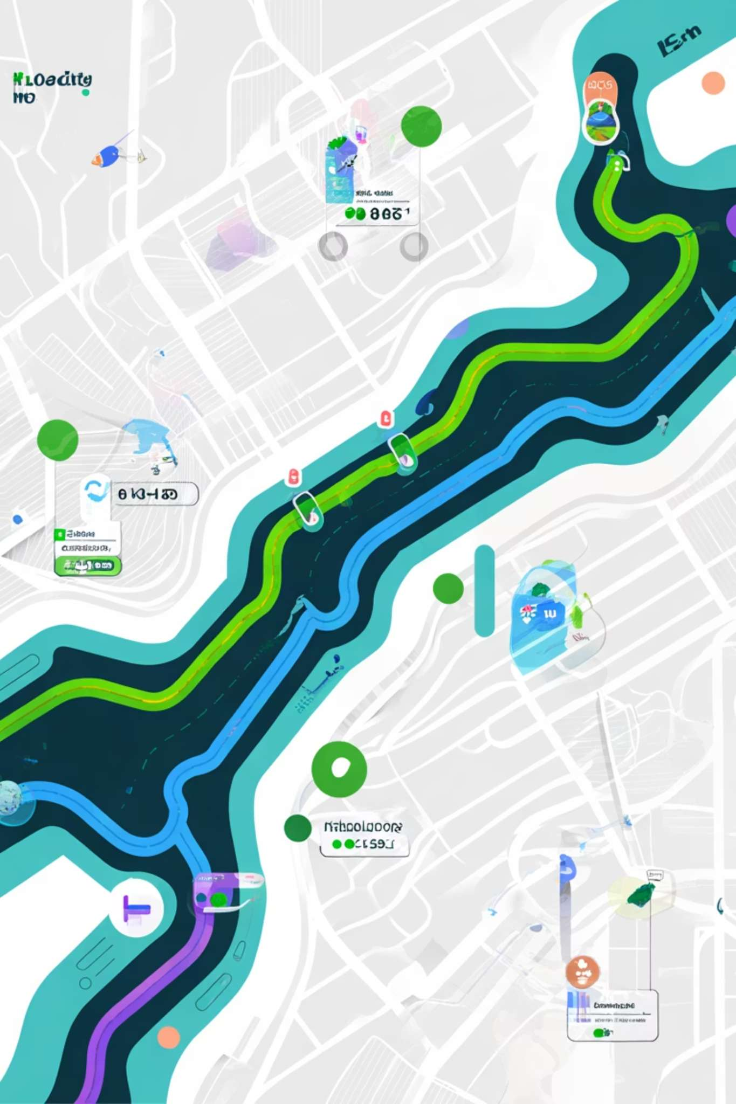
Chapter 1: Overall Performance
Booking and Distance Overview
92,551
56,815
2.5M
Completed Bookings
Lost Bookings
Total Distance (km)
Highest volume on Jan 21, 2025 (516 completed).
316 lost bookings also recorded on peak day.
2,512,975.19 km traveled by all vehicles.
24.64
Average Distance (km)
Average distance per trip across the period.

Slide 3

Revenue Snapshot: Total and Vehicle Share
₹5.18 Cr
Auto
Go Mini
Go Sedan
Bike
Premier Sedan
eBike
Total Revenue Generated
Uber XL
Overall earnings during the analysis period.
Auto generated the highest revenue: ₹1.28 Crore.

Slide 4


Chapter 2: Vehicle Performance
Auto Leads Across Key Metrics
Auto is the top performer in distance, bookings, and revenue.
Auto
Go Mini
Go Sedan
Bookings: 37,351
Bookings: 29,748
Bookings: 27,107
Distance: 625,615 km
Distance: 501,200 km
Distance: 450,793 km
Revenue: ₹1.28 Cr
Revenue: ₹1.03 Cr
Revenue: ₹93.7 Lakh

Slide 5

Monthly and Quarterly Revenue Trends
Revenue shows volatility, with Q4 slightly leading the quarters.
Monthly Peaks & Troughs
Quarterly Performance
Highest
Highest
March (₹45.68 Lakh)
Q4 (₹13.08M)
Lowest
Lowest
February (₹39.70 Lakh)
Q2 (₹12.80M)

Slide 6

Chapter 3: Customer & Payment Insights
Top Customers and Preferred Payment Method
Revenue Drivers
Payment Preference
Top 10 customers contribute significantly to overall revenue.
C7828101
₹7,683
C7186567
₹6,101
₹2.33 Cr
C2536937
₹6,019
C9494011
₹5,966
C3446144
₹5,589
UPI Dominance
Highest revenue generated via UPI payments.
UPI also recorded the most cancellations, mainly due to 'incomplete ride' reasons (e.g., vehicle breakdown).

Slide 7

Rider Segmentation and Behavior
First-Time Riders
Returning Riders
Regular Riders
48,000 completed rides.
5,650 completed rides.
11,000 completed rides.
Rider behavior peaks in January (12.5K rides) and Q3 (33,004 rides).

Slide 8


Chapter 4: Cancellation Analysis
Main Reasons for Ride Cancellations
Customer Cancellations
Incomplete Rides
Driver Cancellations
Understanding cancellation root causes is critical for service improvement and loss reduction.

Slide 9

Chapter 5: Location and Time Dynamics
Busiest Areas and Peak Hours
Peak Time Slots
Top Locations
Afternoon Rush
Khandsa (Pickup)
3 PM – 6 PM
949 bookings, 16,275 km traveled.
Evening Commute
6 PM – 9 PM
Ashram (Drop)
Busiest areas concentrated in major urban zones.
936 bookings, 16,326 km traveled.

Slide 10
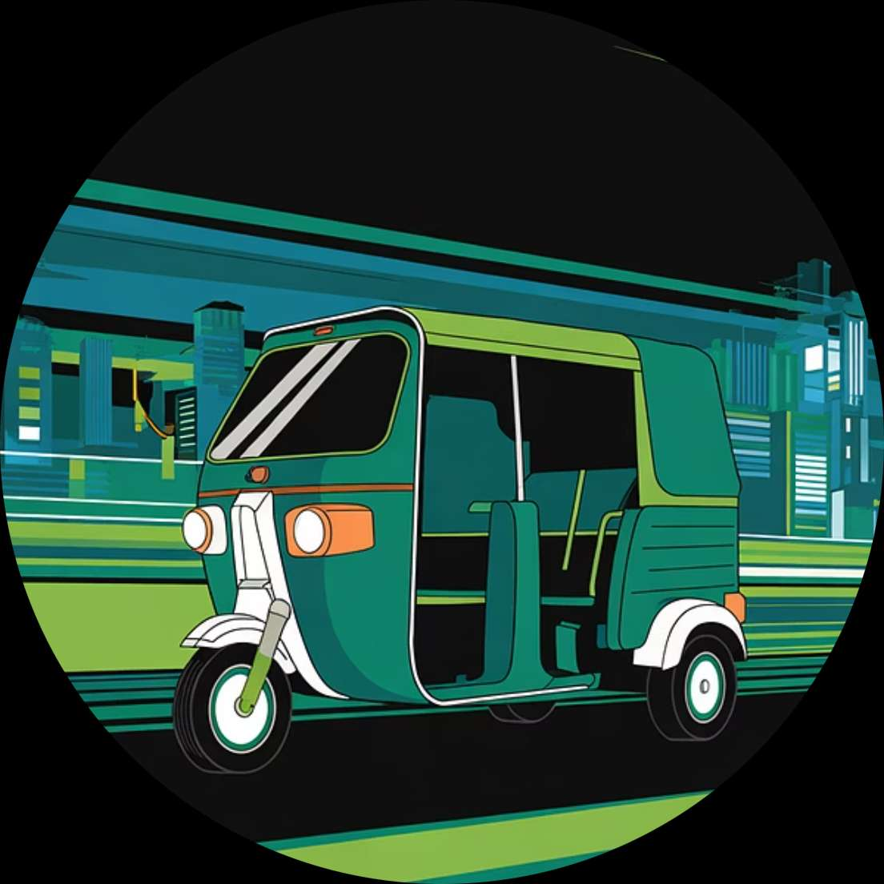


Strategic Performance Insights
Filtering data reveals optimal vehicle and location combinations for revenue.
Auto Performance
Raj Nagar Extension
Strong Secondary Zones
Best at 6 PM – 9 PM.
Top revenue zone (₹26,587).
Munirka and Vaishali (₹24K+).
Key Takeaway: Focus on Auto in Peak Evening Hours in High-Density Zones.

