Slide 1

CS 545 Software Engineering
MCA Second Year
Autumn 2026-27
Project Presentation
On
HOTEL MANAGEMENT SYSTEM
    Presented by
    [Aakash :Roll no:20252651001]
[Sahil Kumar : Roll no:20252651044]
[Sonu Jha :Roll no:20252651056]
[Manish Saxena :Roll no:20252651033]
[Vedansh Raghuwanshi :Roll no:20252651062]

Slide 2
Problem and objectives
The problem
Objectives
Bookings kept in notebooks and spreadsheets lead to double-booked rooms
Staff cannot see which rooms are free for a date range
Extra charges and payments are tracked by hand, so balances go wrong
Managers have no quick view of occupancy and revenue
Manage rooms, guests and bookings in one web app
Prevent double bookings automatically
Track charges, payments and balances per booking
Give admins and staff role-based, secure access
Show live occupancy and revenue on a dashboard

Slide 3
Proposed solution
Secure login
Rooms and guests
Smart booking
JWT sign-in with admin and staff roles. Only admins delete records or manage staff.
Add, edit and remove rooms and guest profiles with validation.
Pick dates, see only free rooms, and get overlap and capacity checks.
Billing
Front desk flow
Dashboard
Automatic nightly total, extra charges, payments and outstanding balance.
Reserve, check in, check out or cancel with one click.
Occupancy, arrivals, departures, revenue and a monthly chart.

Slide 4
System architecture
View
Routes
Controller
Model
Database
React + Tailwind
Pages and components
Express router
JWT and role guards
Auth, bookings,
stats, generic CRUD
Mongoose schemas
User, Room, Guest,
Booking, Service
MongoDB
Request: the browser calls the REST API at /api. Response: JSON returns through the same path.
Separation of concerns: models own data rules, controllers own business logic, views only display and collect input.

Slide 5
Technology and implementation
Frontend
React 18, Vite, React Router, Tailwind CSS
How it works
Overlap query blocks a room that is already booked for the dates
Total = nights x room price, plus any extra charges
Passwords hashed with bcrypt; JWT expires after one day
One generic CRUD controller serves rooms and guests
Central error handler returns clear messages
MongoDB aggregation builds the dashboard statistics
Backend
Node.js, Express.js, JSON Web Tokens, bcrypt
Database
MongoDB with Mongoose ODM
Pattern
MVC with a REST API

Slide 6
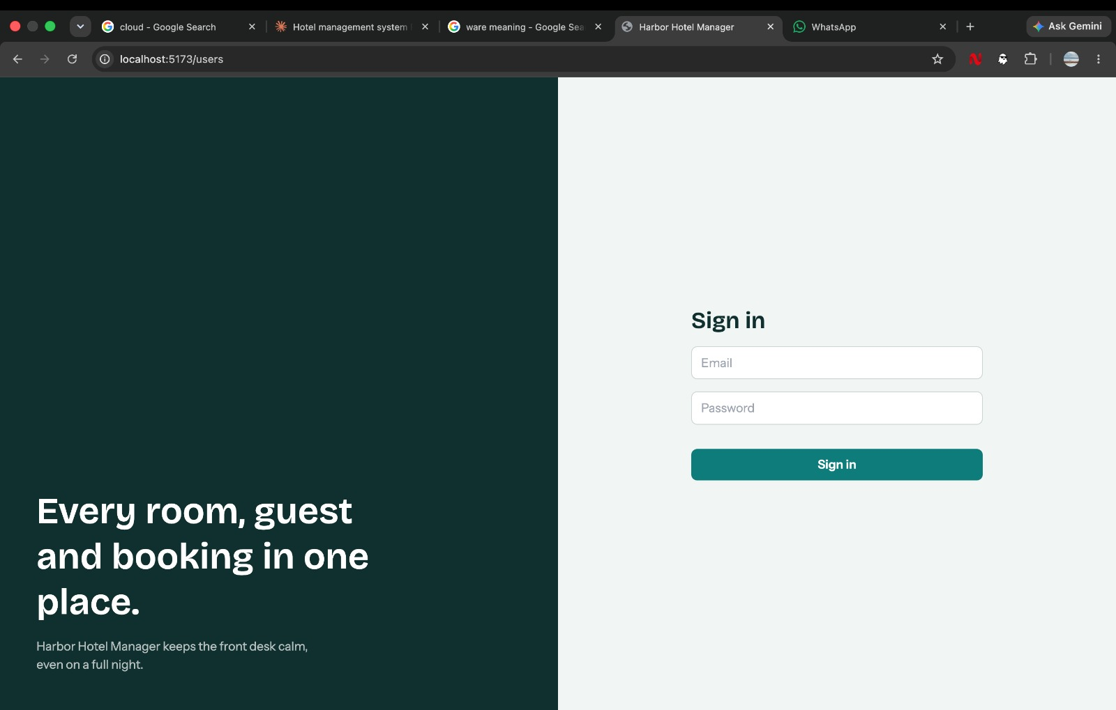
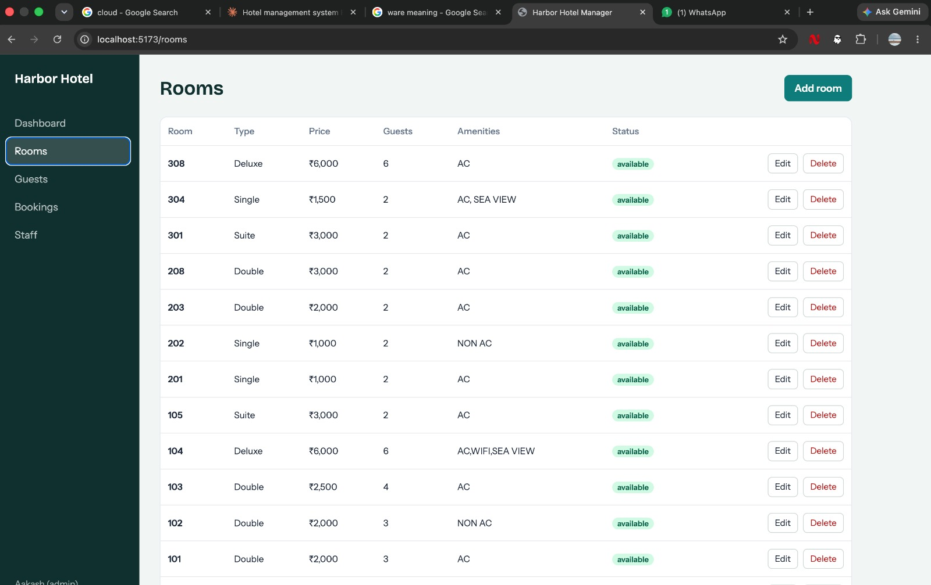
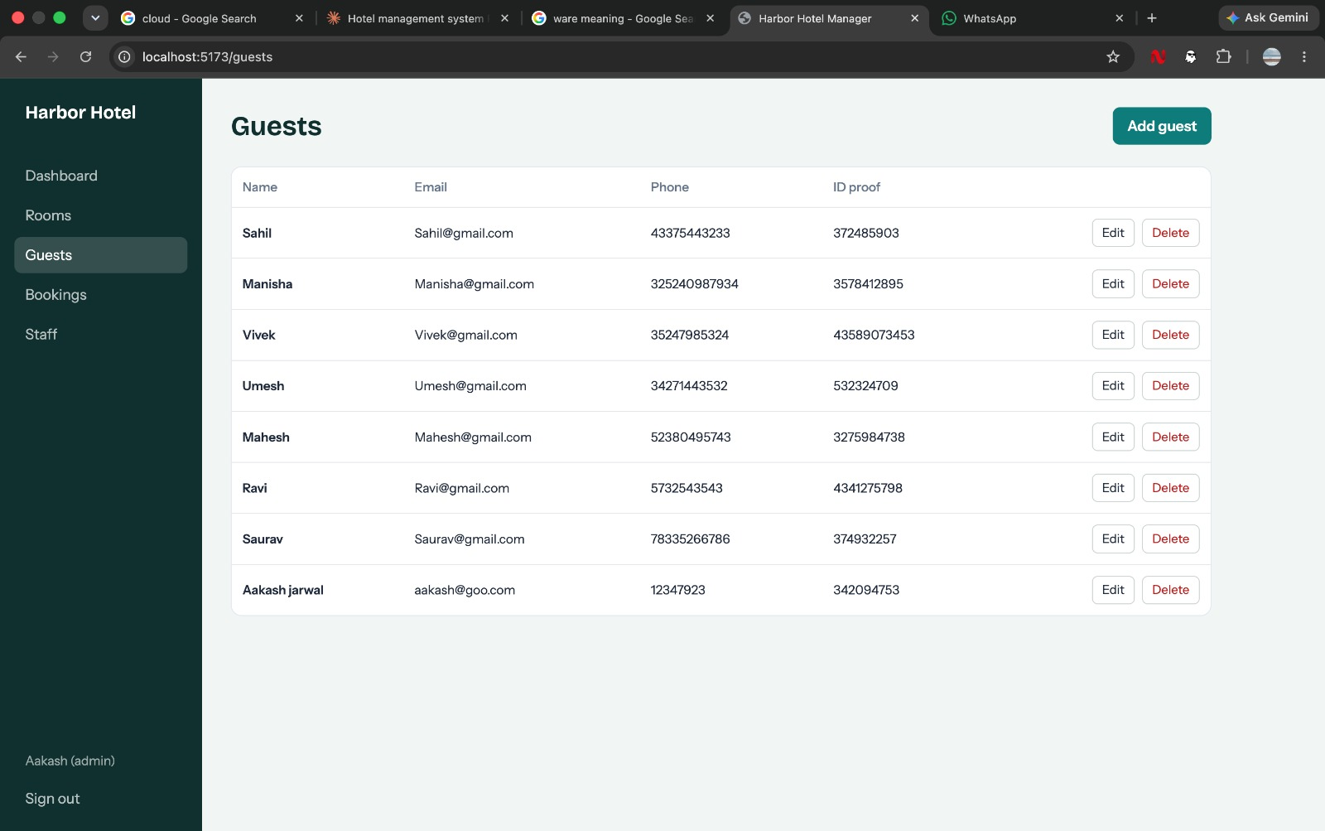
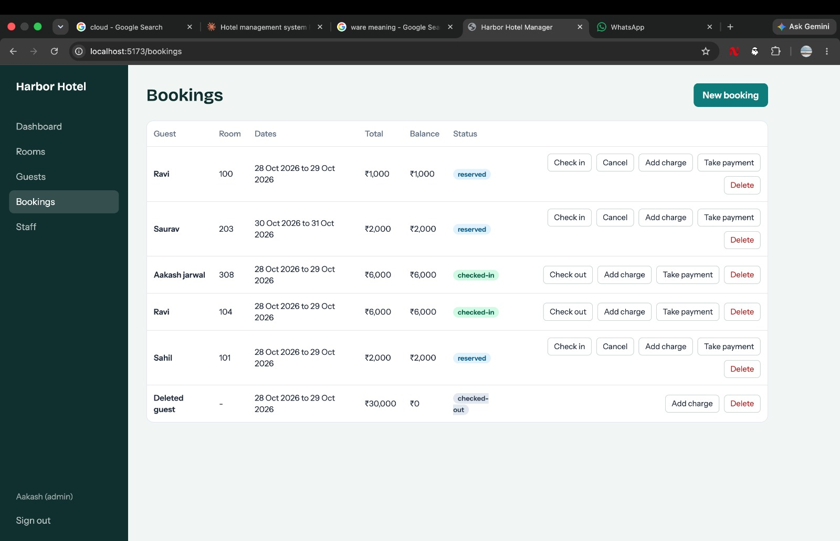
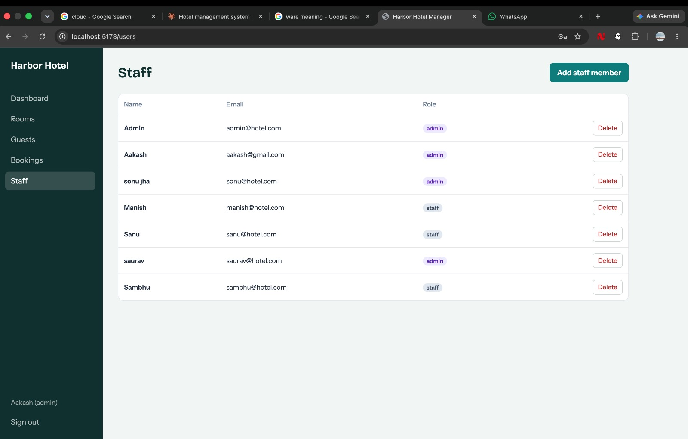
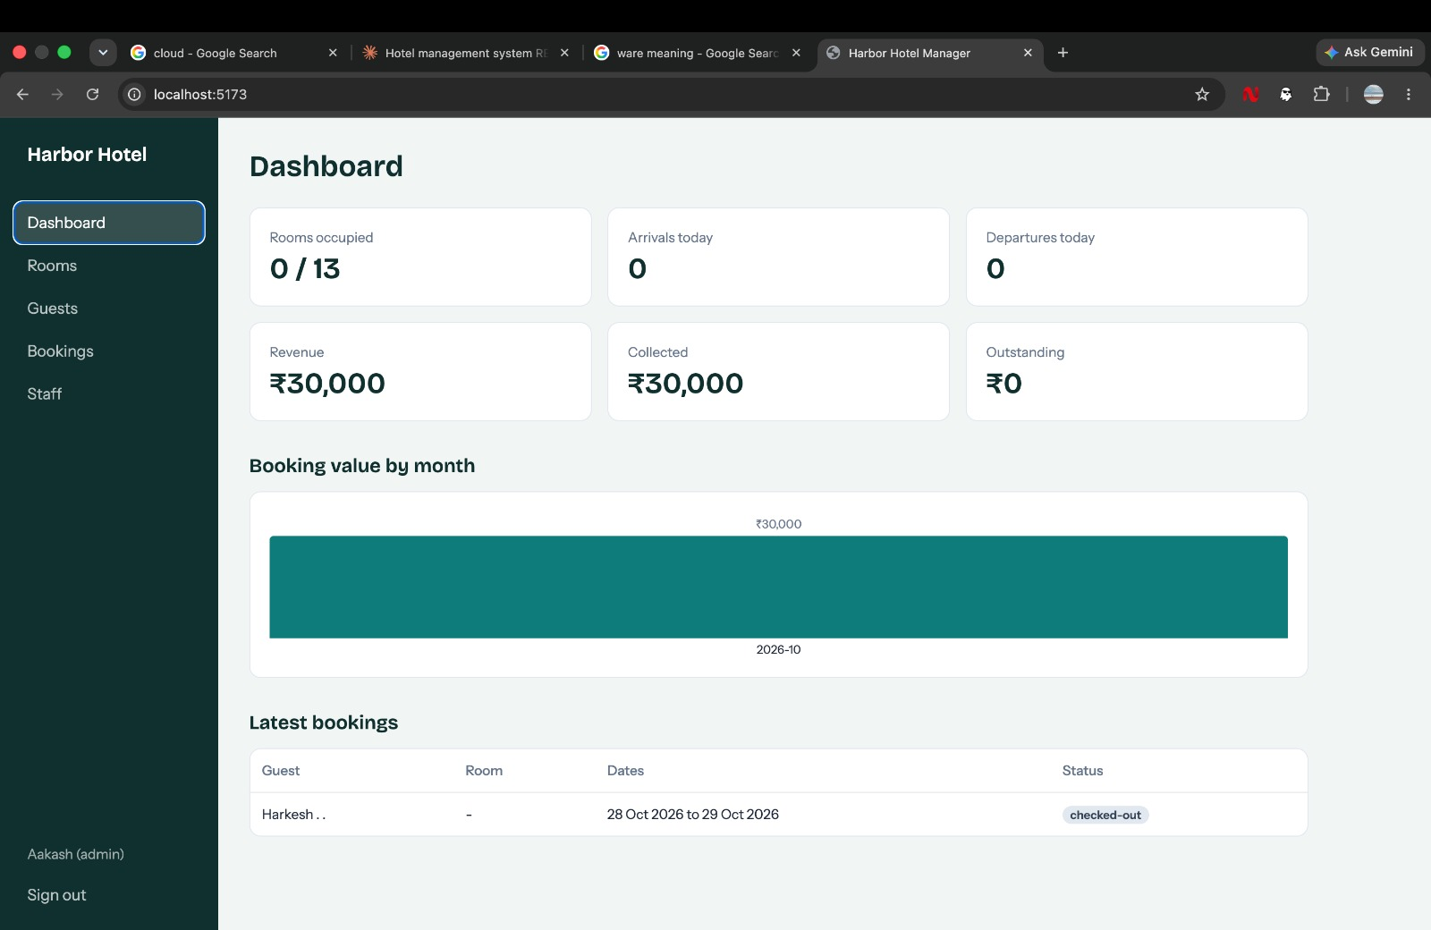
Screenshots and demonstration
Sign In
Guests
Rooms
Bookings
Staff
Dashboard
Live demo flow
2. Add rooms and guests
3. Create a booking
4. Check in, add charge, take payment
5. Check out, review dashboard
1. Sign in

Slide 7
Testing and results
Test case | Input | Expected result
Valid login | Admin email and password | Token issued, dashboard opens
Wrong password | Incorrect password | 401 error, message shown
Overlapping booking | Same room, overlapping dates | 409 error, booking rejected
Over capacity | Guests above room capacity | 400 error, booking rejected
Available rooms search | Date range with an existing booking | Booked room left out of list
Staff delete attempt | Staff user deletes a record | 403, admins only
Delete room in use | Room with active booking | 409, deletion blocked
Payment and balance | Charge then payment | Balance = total minus paid

Slide 8
Conclusion
What we delivered
Future scope
A complete hotel management web app: secure staff access, room and guest records, conflict-free bookings, billing with payments, and a live dashboard.
The MVC structure keeps the code easy to read, test and extend.
Invoice PDFs and email confirmations
Online payment gateway
Room photos and a public booking page
Housekeeping tasks and a calendar view
Automated test suite and cloud deployment

