Slide 1
Project Name : Beta Deel
Project Mentor : Dr. Anshu Industry Mentor : vikas
(B-310) (Assistant Professor) (Gym Fitness & Mentor)
Team members :
Sonu Bharti (2301010323)
Ritik Sharma (2301010342)
Hridanshu(2301010304)
Yashwant (2301010329)

Slide 2
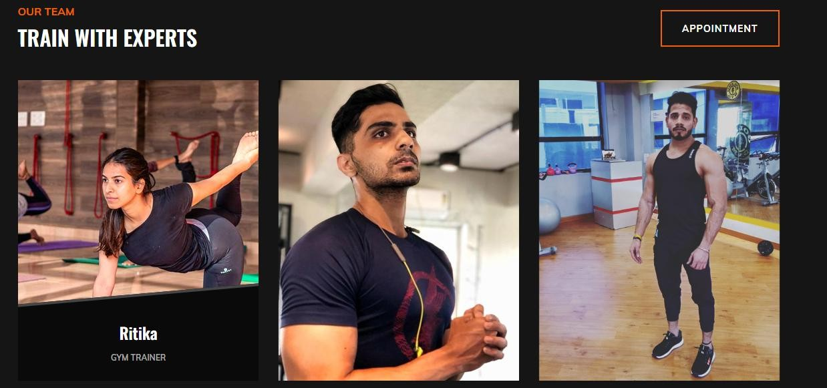
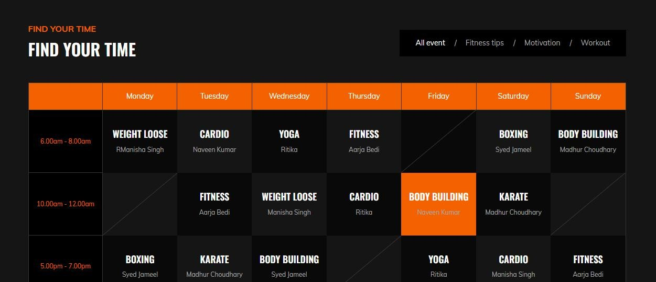
Objective of Project
- Integrate a BMI calculator for health-conscious users.
- Display up-to-date class schedules.
- Enable seamless user registration and communication.
- Ensure platform scalability for future enhancements like personal trainer booking or diet plans.

Slide 3
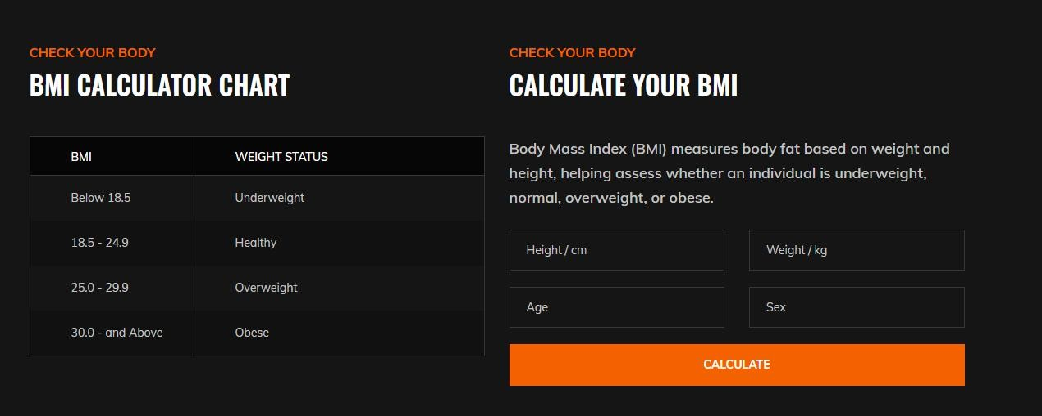
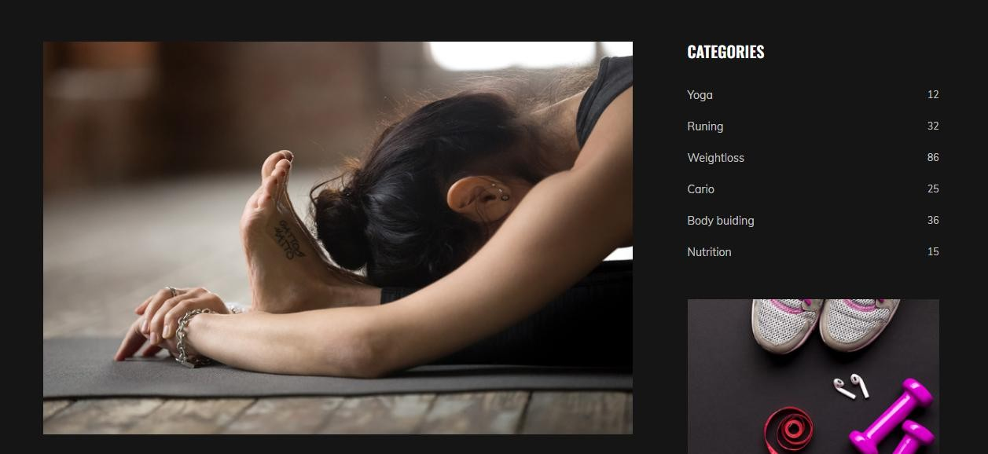
Problem Statements
Digital Infrastructure Gaps in Gym
Many gyms lack modern, responsive websites.
No centralized system for managing fitness services (e.g., class schedules, BMI tools, registration).
Outdated digital presence limits user engagement and business reach.
2. User Experience Challenges
Poor website design: Non-responsive, outdated, difficult navigation.

Slide 4
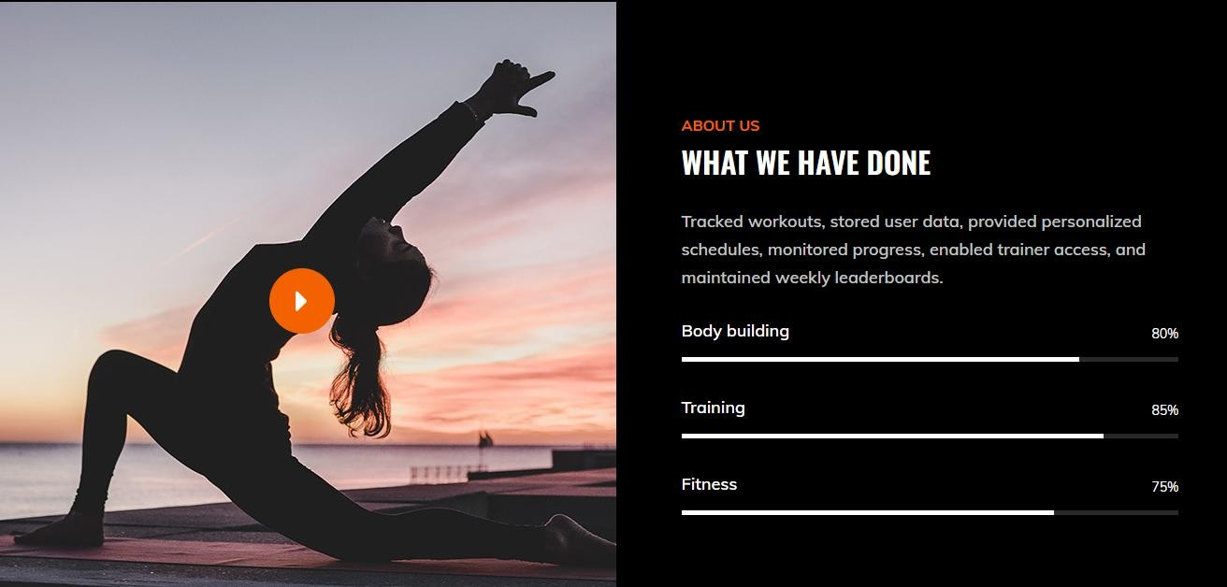
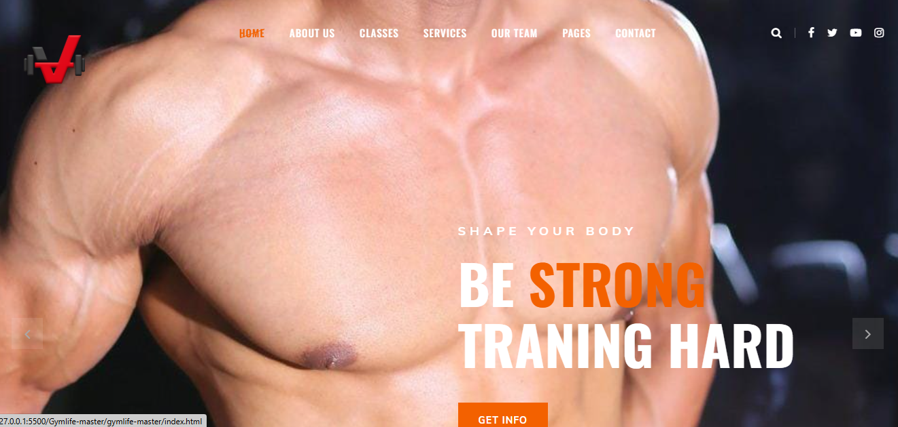
No real-time communication with staff or updatesUsers struggle to find essential info (class schedules, membership plans, contact options).
Lack of integrated health tools (BMI calculators, fitness dashboards, progress tracking).
Manual registration leads to delays, errors, and frustration. on schedules.

Slide 5
3. Operational Inefficiencies for Gym Owners
Limited digital marketing tools → low user acquisition.
Manual admin processes → high workload and error-prone.
Inability to personalize services due to lack of data tracking.
4. Disconnect Between Users and Existing Fitness Apps
Popular apps (e.g., MyFitnessPal) are not built for integration with specific gyms.
Gyms cannot offer localized, personalized digital experiences using third-party apps.

Slide 6
5. Missed Business Opportunities
Poor online visibility and lack of SEO optimization.
Inefficient scheduling and booking systems reduce client retention.
No data-driven decision-making due to lack of analytics.
6. Security & Accessibility Concerns
Legacy systems lack modern security standards.
No compliance with accessibility norms (e.g., screen reader support, contrast settings).

Slide 7
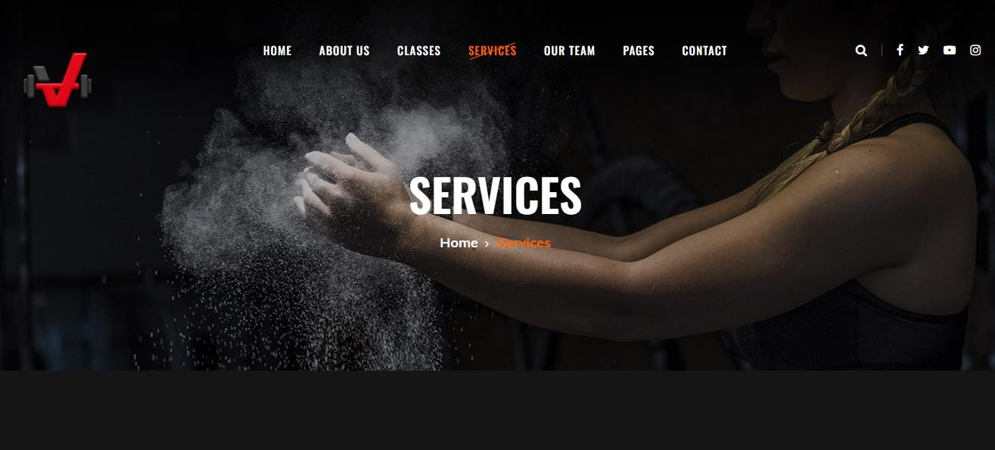
Tools & Technologies Used
Frontend: HTML, CSS, JavaScript
Backend: Node.js, Express.js
Development Tools: VS Code
Version Control: GitHub

Slide 8
Summary of features of the web project
Feature | Beta Deel | Traditional Gym Sites | Fitness Aggregators (e.g., FitOn, MyFitnessPal)
BMI Calculator | ✔️ Integrated and interactive | ❌ Not available | ✔️ Available but not gym-specific
Custom Scheduling | ✔️ Real-time, dynamic | ✔️ Often outdated/static | ❌ Not supported
Responsive Design | ✔️ Fully mobile-optimized | ❌ Often non-responsive | ✔️ Mobile-first
User Registration | ✔️ Seamless and online | ✔️ Manual or basic forms | ❌ Registration not gym-specific
Future Expandability | ✔️ Modular and scalable (AI, cloud, wearables) | ❌ Rigid and outdated systems | ❌ Limited to app features, not gym integration

