Slide 1

INSERTION SORT
PREPARED BY:
SONU SAH

Slide 2

contents
1.What is Sorting?
3.Insertion sort
5.Merits and Demerits
2.Types of Sorting
4.Algorithm and Example

Slide 3

WHAT IS SORTING?
→Arranging the elements of an array so that they are placed in some relevant order which may be ascending or descending.
→It can be done on key references which can be numbers , alphabets etc.
→If we have an array A[]={5,2,3,1,0},then the sorted array(ascending order) can be given as : A[]={0,1,2,3,5}
→Examples of sorting in real world:
Phonebook : The contact are saved(sorted) alphabetically.

Slide 4
TYPES OF SORTING
1.Internal sorting
●The sorting is done within the computer main memory and all the data to be sorted is stored in main memory.
●In it , the storage device used is only main memory(RAM).
●It is performed when the data to be stored is small enough to fit in main memory.
EXAMPLE : Insertion sort , Quick sort , Bubble sort , etc.
2.External sorting
●The sorting is done in external file disk and data is stored outside the main memory like on disk and only loaded into memory in small chunks.
●It is usually applied when the data can’t be fit in main memory entirely.
●In it , the storage device used are RAM(main) and Hard-disk (secondary).
EXAMPLE : Merge sort , External radix sort, Four tape sort.

Slide 5
WHAT IS INSERTION SORT?
→It is an example of internal sort.
→It is implemented by inserting a particular data item in its proper position.
→Any unsorted data item is kept on swapping with its previous data items until its proper position is not found.
→The number of swapping makes the previous data items shift for the new data items to take its position in order.
→Once the data item is inserted , the next data item is chosen for next insertion.
→The process continues until all data items are sorted.

Slide 6
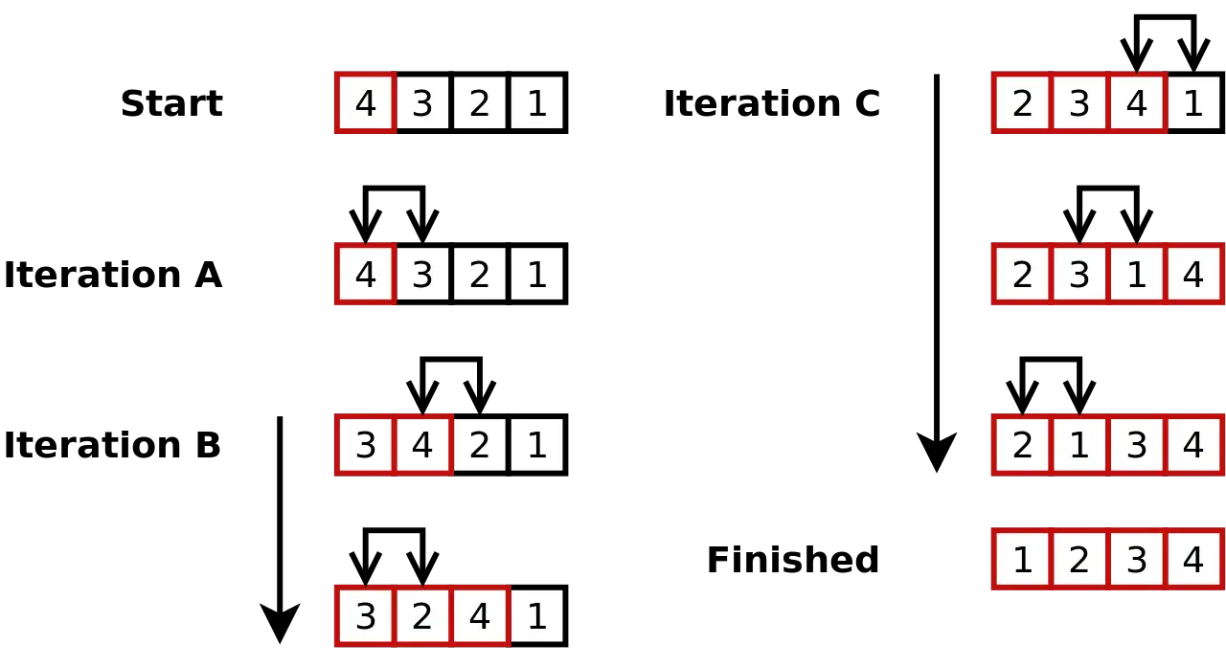
EXAMPLE 1
Descending to Ascending

Slide 7
ALGORITHM
STEP1:If it is the first element , it is already sorted. Return 1
STEP2:Pick next element
STEP3:Compare with all elements in the sorted sub-list.
STEP4:If the element in the sorted array is smaller than the current element , then move to the next element . Else , shift greater elements in the array towards the right.
STEP5:Insert the value
STEP6:Repeat until list is sorted.

Slide 8
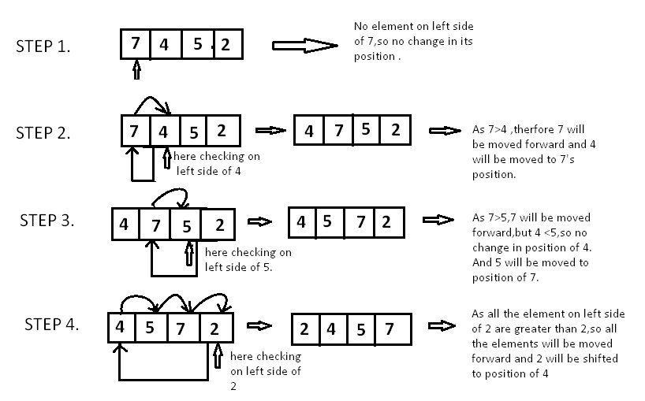
EXAMPLE 2

Slide 9
MERITS DEMERITS
●Simple
●Efficient for smaller data sets
●Doesn’t require extra memory
●Less efficient for larger data sets.
●Not as quick as merge sort and quick sort.

Slide 10

THANK YOU

