Slide 1
Exception Handling in Java

Slide 2
Exception
The Exception Handling in Java is one of the powerful mechanism to handle the runtime errors so that normal flow of the application can be maintained.
An exception is an unwanted or unexpected event, which occurs during the execution of a program i.e., at run time, that disrupts the normal flow of the program’s instructions.

Slide 3
Error vs Exception
Error: An Error indicates serious problem that a reasonable application should not try to catch.
Exception: Exception indicates conditions that a reasonable application might try to catch.
Exception Handling is a mechanism to handle runtime errors such as ClassNotFoundException, IOException, SQLException, RemoteException, etc.

Slide 4
Advantage of Exception Handling
The core advantage of exception handling is to maintain the normal flow of the application. An exception normally disrupts the normal flow of the application that is why we use exception handling.
statement 1;
statement 2;
statement 3;
statement 4;
statement 5;//exception occurs
statement 6;
statement 7;
statement 8;
statement 9;
statement 10;
Suppose there are 10 statements in your program and there occurs an exception at statement 5, the rest of the code will not be executed i.e. statement 6 to 10 will not be executed. If we perform exception handling, the rest of the statement will be executed. That is why we use exception handling in Java.

Slide 5
Types of Java Exceptions
There are mainly two types of exceptions: checked and unchecked. Here, an error is considered as the unchecked exception. According to Oracle, there are three types of exceptions:
Checked Exception
Unchecked Exception
Error

Slide 6
1) Checked Exception
The classes which directly inherit Throwable class except RuntimeException and Error are known as checked exceptions e.g. IOException, SQLException etc. Checked exceptions are checked at compile-time.
2) Unchecked Exception
The classes which inherit RuntimeException are known as unchecked exceptions e.g. ArithmeticException, NullPointerException, ArrayIndexOutOfBoundsException etc. Unchecked exceptions are not checked at compile-time, but they are checked at runtime.
3) Error
Error is irrecoverable e.g. OutOfMemoryError, VirtualMachineError, AssertionError etc.

Slide 7
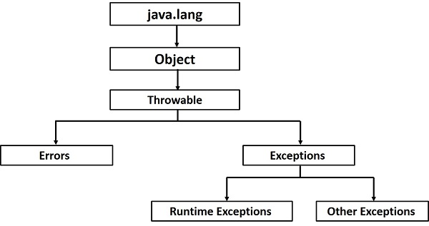
Hierarchy of Java Exception classes: The java.lang.Throwable class is the root class of Java Exception hierarchy which is inherited by two subclasses: Exception and Error. A hierarchy of Java Exception classes are given below:

Slide 8
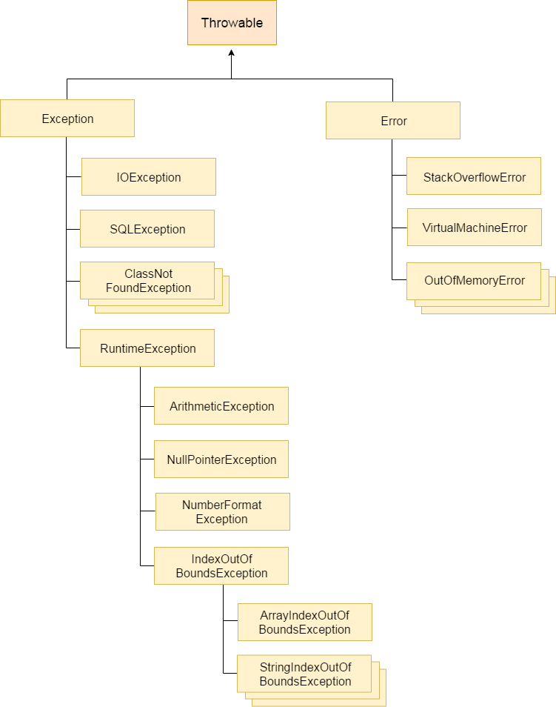

Slide 9
Java Exception Keywords
try: The "try" keyword is used to specify a block where we should place exception code. The try block must be followed by either catch or finally. It means, we can't use try block alone.
catch: The "catch" block is used to handle the exception. It must be preceded by try block which means we can't use catch block alone. It can be followed by finally block later.
finally: The "finally" block is used to execute the important code of the program. It is executed whether an exception is handled or not.
throw: The "throw" keyword is used to throw an exception.
throws: The "throws" keyword is used to declare exceptions. It doesn't throw an exception. It specifies that there may occur an exception in the method. It is always used with method signature.

Slide 10
How Programmer handles an exception?
Customized Exception Handling : Java exception handling is managed via five keywords: try, catch, throw, throws, and finally. Briefly, here is how they work. Program statements that you think can raise exceptions are contained within a try block. If an exception occurs within the try block, it is thrown. Your code can catch this exception (using catch block) and handle it in some rational manner. System-generated exceptions are automatically thrown by the Java run-time system. To manually throw an exception, use the keyword throw. Any exception that is thrown out of a method must be specified as such by a throws clause. Any code that absolutely must be executed after a try block completes is put in a finally block.

Slide 11
Java Exception Handling Example
public class JavaExceptionExample{
public static void main(String args[]){
try{
//code that may raise exception
int data=100/0;
}catch(ArithmeticException e){System.out.println(e);}
//rest code of the program
System.out.println("rest of the code...");
}
}
Output:
Exception in thread main java.lang.ArithmeticException:/ by zero rest of the code...

Slide 12
Common Scenarios of Java Exceptions
A scenario where ArithmeticException occurs
int a=50/0;//ArithmeticException
A scenario where NullPointerException occurs
String s=null;
System.out.println(s.length());//NullPointerException
A scenario where NumberFormatException occurs
String s="abc";
int i=Integer.parseInt(s);//NumberFormatException
A scenario where ArrayIndexOutOfBoundsException occurs
int a[]=new int[5];
a[10]=50; //ArrayIndexOutOfBoundsException

Slide 13
Points to remember
In a method, there can be more than one statements that might throw exception, So put all these statements within its own try block and provide separate exception handler within own catch block for each of them.
If an exception occurs within the try block, that exception is handled by the exception handler associated with it. To associate exception handler, we must put catch block after it. There can be more than one exception handlers. Each catch block is a exception handler that handles the exception of the type indicated by its argument. The argument, ExceptionType declares the type of the exception that it can handle and must be the name of the class that inherits from Throwable class.
For each try block there can be zero or more catch blocks, but only one finally block.
The finally block is optional. It always gets executed whether an exception occurred in try block or not . If exception occurs, then it will be executed after try and catch blocks. And if exception does not occur then it will be executed after the try block. The finally block in java is used to put important codes such as clean up code e.g. closing the file or closing the connection.

Slide 14
Java Multi-catch block
A try block can be followed by one or more catch blocks. Each catch block must contain a different exception handler. So, if you have to perform different tasks at the occurrence of different exceptions, use java multi-catch block.
At a time only one exception occurs and at a time only one catch block is executed.
All catch blocks must be ordered from most specific to most general, i.e. catch for ArithmeticException must come before catch for Exception.

Slide 15
public class MultipleCatchBlock1 {
public static void main(String[] args) {
try{
int a[]=new int[5];
a[5]=30/0;
}
catch(ArithmeticException e)
{
System.out.println("Arithmetic Exception occurs");
}
catch(ArrayIndexOutOfBoundsException e)
{
System.out.println("ArrayIndexOutOfBounds Exception occurs");
}
catch(Exception e)
{
System.out.println("Parent Exception occurs");
}
System.out.println("rest of the code");
}
}

Slide 16
public class MultipleCatchBlock2 {
public static void main(String[] args) {
try{
int a[]=new int[5];
System.out.println(a[10]);
}
catch(ArithmeticException e)
{
System.out.println("Arithmetic Exception occurs");
}
catch(ArrayIndexOutOfBoundsException e)
{
System.out.println("ArrayIndexOutOfBounds Exception occurs");
}
catch(Exception e)
{
System.out.println("Parent Exception occurs");
}
System.out.println("rest of the code");
}
}

Slide 17
public class MultipleCatchBlock3 {
public static void main(String[] args) {
try{
int a[]=new int[5];
a[5]=30/0;
System.out.println(a[10]);
}
catch(ArithmeticException e)
{
System.out.println("Arithmetic Exception occurs");
}
catch(ArrayIndexOutOfBoundsException e)
{
System.out.println("ArrayIndexOutOfBounds Exception occurs");
}
catch(Exception e)
{
System.out.println("Parent Exception occurs");
}
System.out.println("rest of the code");
}
}

Slide 18
public class MultipleCatchBlock4 {
public static void main(String[] args) {
try{
String s=null;
System.out.println(s.length());
}
catch(ArithmeticException e)
{
System.out.println("Arithmetic Exception occurs");
}
catch(ArrayIndexOutOfBoundsException e)
{
System.out.println("ArrayIndexOutOfBounds Exception occurs");
}
catch(Exception e)
{
System.out.println("Parent Exception occurs");
}
System.out.println("rest of the code");
}
}

Slide 19
class MultipleCatchBlock5{
public static void main(String args[]){
try{
int a[]=new int[5];
a[5]=30/0;
}
catch(Exception e){System.out.println("common task completed");}
catch(ArithmeticException e){System.out.println("task1 is completed");}
catch(ArrayIndexOutOfBoundsException e){System.out.println("task 2 completed");}
System.out.println("rest of the code...");
}
}

Slide 20
Nested try Statements
The try statement can be nested. That is, a try statement can be inside the block of another try.
Each time a try statement is entered, the context of that exception is pushed on the stack.
If an inner try statement does not have a catch handler for a particular exception, the stack is unwound and the next try statement’s catch handlers are inspected for a match.
This continues until one of the catch statements succeeds, or until all of the nested try statements are exhausted.
If no catch statement matches, then the Java run-time system will handle the exception. Here is an example that uses nested try statements:

Slide 21
// An example of nested try statements.
class NestTry {
public static void main(String args[]) {
try {
int a = args.length;
/* If no command-line args are present,
the following statement will generate
a divide-by-zero exception. */
int b = 42 / a;
System.out.println("a = " + a);
try { // nested try block
/* If one command-line arg is used,
then a divide-by-zero exception
will be generated by the following code. */
if(a==1) a = a/(a-a); // division by zero
/* If two command-line args are used,
then generate an out-of-bounds exception. */
if(a==2) {
int c[] = { 1 };
c[42] = 99; // generate an out-of-bounds exception
}
} catch(ArrayIndexOutOfBoundsException e) {
System.out.println("Array index out-of-bounds: " + e);
}
} catch(ArithmeticException e) {
System.out.println("Divide by 0: " + e);
}
}
}

Slide 22
printStackTrace()
The printStackTrace() method in Java is a tool used to handle exceptions and errors. It is a method of Java's throwable class which prints the throwable along with other details like the line number and class name where the exception occurred. printStackTrace() is very useful in diagnosing exceptions.

Slide 23
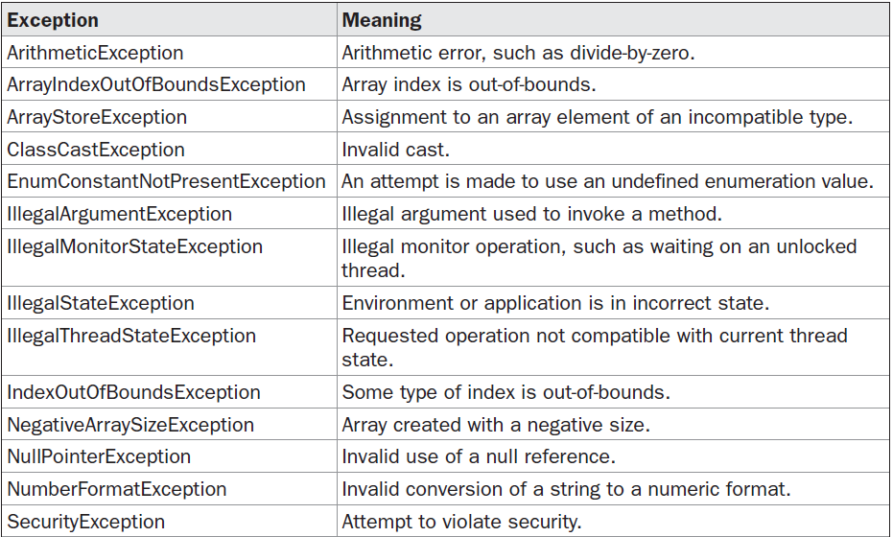
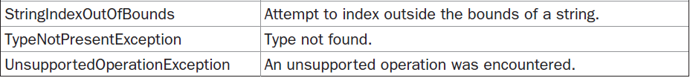
Built-in exceptions

Slide 24
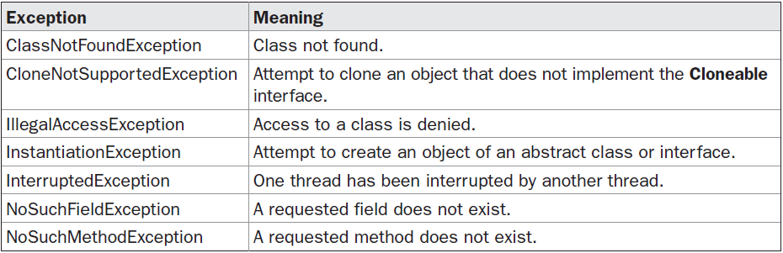
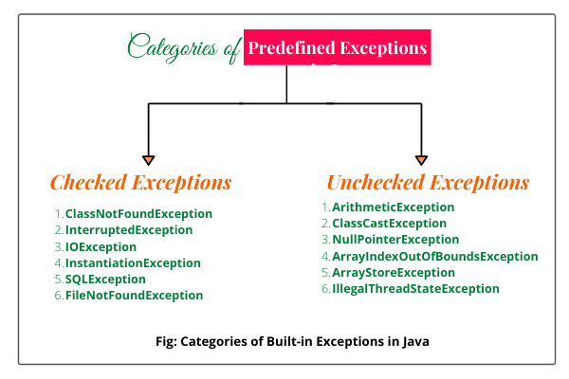

Slide 25
throws
throws is a keyword in Java which is used in the signature of method to indicate that this method might throw one of the listed type exceptions. The caller to these methods has to handle the exception using a try-catch block. ..
Syntax: type method_name(parameters) throws exception_list
exception_list is a comma separated list of all the exceptions which a method might throw.

Slide 26
In a program, if there is a chance of raising an exception then compiler always warn us about it and compulsorily we should handle that checked exception, Otherwise we will get compile time error saying unreported exception XXX must be caught or declared to be thrown. To prevent this compile time error we can handle the exception in two ways:
By using try catch
By using throws keyword
We can use throws keyword to delegate the responsibility of exception handling to the caller (It may be a method or JVM) then caller method is responsible to handle that exception.

Slide 27
throw
The throw keyword in Java is used to explicitly throw an exception from a method or any block of code. We can throw either checked or unchecked exception. The throw keyword is mainly used to throw custom exceptions.
throw Instance Example: throw new ArithmeticException("/ by zero");
But this exception i.e, Instance must be of type Throwable or a subclass of Throwable. For example Exception is a sub-class of Throwable and user defined exceptions typically extend Exception class.

Slide 28
The flow of execution of the program stops immediately after the throw statement is executed and the nearest enclosing try block is checked to see
if it has a catch statement that matches the type of exception.
If it finds a match, controlled is transferred to that statement otherwise next enclosing try block is checked and so on.
If no matching catch is found then the default exception handler will halt the program

Slide 29
Custom Exception
It is also called as user defined exception.
A programmer may create his/her own exception class by extending the exception class and can customize the exception according to his/her needs.
Using Java custom exception, the programmer can write their own exceptions and messages.

