Slide 1
POLITICAL BIAS
IN NEWS ARTICLES
Can politicians' tweets teach a computer to spot left and right news?
Sonu Akash Soundararajan PES1UG24AM908
Rahul Saran Sharma PES1UG24AM218
UE24CS352A MACHINE LEARNING | SECTION D | TEAM 16
Notes:
Good morning. We are Team 16. I am Sonu Akash and this is Rahul Saran. Our project asks a simple question: if a computer reads thousands of tweets written by American politicians, can it learn to tell whether a news article leans left or right? I will cover the problem, the data, how we tested, and our first results. Rahul will then cover the news articles and our other improvements.

Slide 2
THE PROBLEM
News outlets lean left or right, and readers often cannot tell
Labelling articles by hand is slow, so labelled news is rare
Politicians' tweets come with a free label: the author's party
So we learn party language from tweets, then read the news
OUR QUESTION
Can a model trained on tweets tell if an article leans Democratic or Republican?
INTRODUCTION
02
Notes:
Why does this matter? Most news has some political lean, and readers often do not notice it. A tool that flags the lean would help people read more critically. The hard part is labels: someone has to read each article and decide. Tweets by members of Congress solve that, because we already know each author's party. So the idea is to learn which words sound Democratic or Republican from tweets, and then use that on news articles.

Slide 3
THE REFERENCE PAPER
OUR GOALS
86.7%
Paper: Naive Bayes on held-out tweets
Rebuild their three models: two Naive Bayes and a linear SVM
Test fairly: each politician's tweets stay on one side of the split
Choose settings without looking at the test set
Test on 1,001 public news articles, not 100 private ones
63%
Paper: SVM on 100 news articles
Crain and Erhan, Categorizing News Articles on Political Bias, Stanford CS229, 2021
BACKGROUND
03
Notes:
We follow a Stanford student project by Crain and Erhan from 2021. They trained simple models on about 104 thousand tweets and reported 86.7 percent accuracy on tweets, but only 63 percent on 100 news articles. We found three issues. Their test tweets came from the same people as the training tweets. They picked one setting by checking the test set. And their 100 articles were never released. Our goals are to rebuild their models, fix those three issues, and measure honestly.

Slide 4
THE DATA
121,976
tweets
450
House members
64%
of tweets are by Democrats
1,001
news articles to test on
Tweets: public congresstweets archive, 3 January to 1 April 2021, same as the paper
Each tweet is labelled with its author's party, D or R
News: 402 left and 599 right AllSides articles (Baly et al., 2020)
Since 64% of tweets are D, always guessing D already scores about 61 to 64%
DATA
04
Notes:
Our tweets come from a public archive of every tweet by members of Congress. We used the same three months as the paper and kept House members only: about 122 thousand tweets from 450 people. Each tweet gets its author's party as the answer. For news we used a public dataset from AllSides, which rates articles as left, centre or right; we kept left and right, 1,001 test articles. One thing to remember: 64 percent of the tweets are from Democrats, so a lazy model that always says Democrat already gets about 61 to 64 percent. Any real model must beat that.

Slide 5
HOW IT WORKS
01
COLLECT
02
CLEAN
03
COUNT
04
LEARN AND TEST
Download the tweets and match each author to a party
Make three versions: all words, no punctuation, no # or @
Turn each tweet into word counts, or yes/no flags per word
Train Naive Bayes and an SVM, then score them on unseen data
METHOD
05
Notes:
Here is the whole process in four steps. One, collect the tweets and attach the party. Two, clean the text, in three versions like the paper: keep everything, remove punctuation, or also remove hashtags and at-mentions. Three, turn each tweet into numbers: how often each word appears, or simply whether it appears. Four, train the models. Naive Bayes, which we wrote ourselves, counts how often each word appears for each party. The SVM draws the best dividing line between the two parties. Then we score them on data they have never seen.

Slide 6
TESTING FAIRLY
RANDOM SPLIT (PAPER)
441 of 442
test members also appear in training
The model can memorise names, handles and pet phrases
GROUPED SPLIT (OURS)
0
test members appear in training
Learn from 360 members, test on 90 new ones
Settings chosen by 5-fold grouped cross-validation on training data only
METHOD
06
Notes:
This is the most important slide. The paper shuffled all tweets randomly into train and test. That means the same politician is in both. In our random split, 441 of the 442 people in the test set were also in training, so the model can simply recognise the person, for example their name or their district hashtag, instead of learning politics. We split by person: 360 members for training, 90 completely new members for testing, with no overlap. We also chose every setting using only the training data, by testing on held-out groups of people inside it, never on the test set.

Slide 7
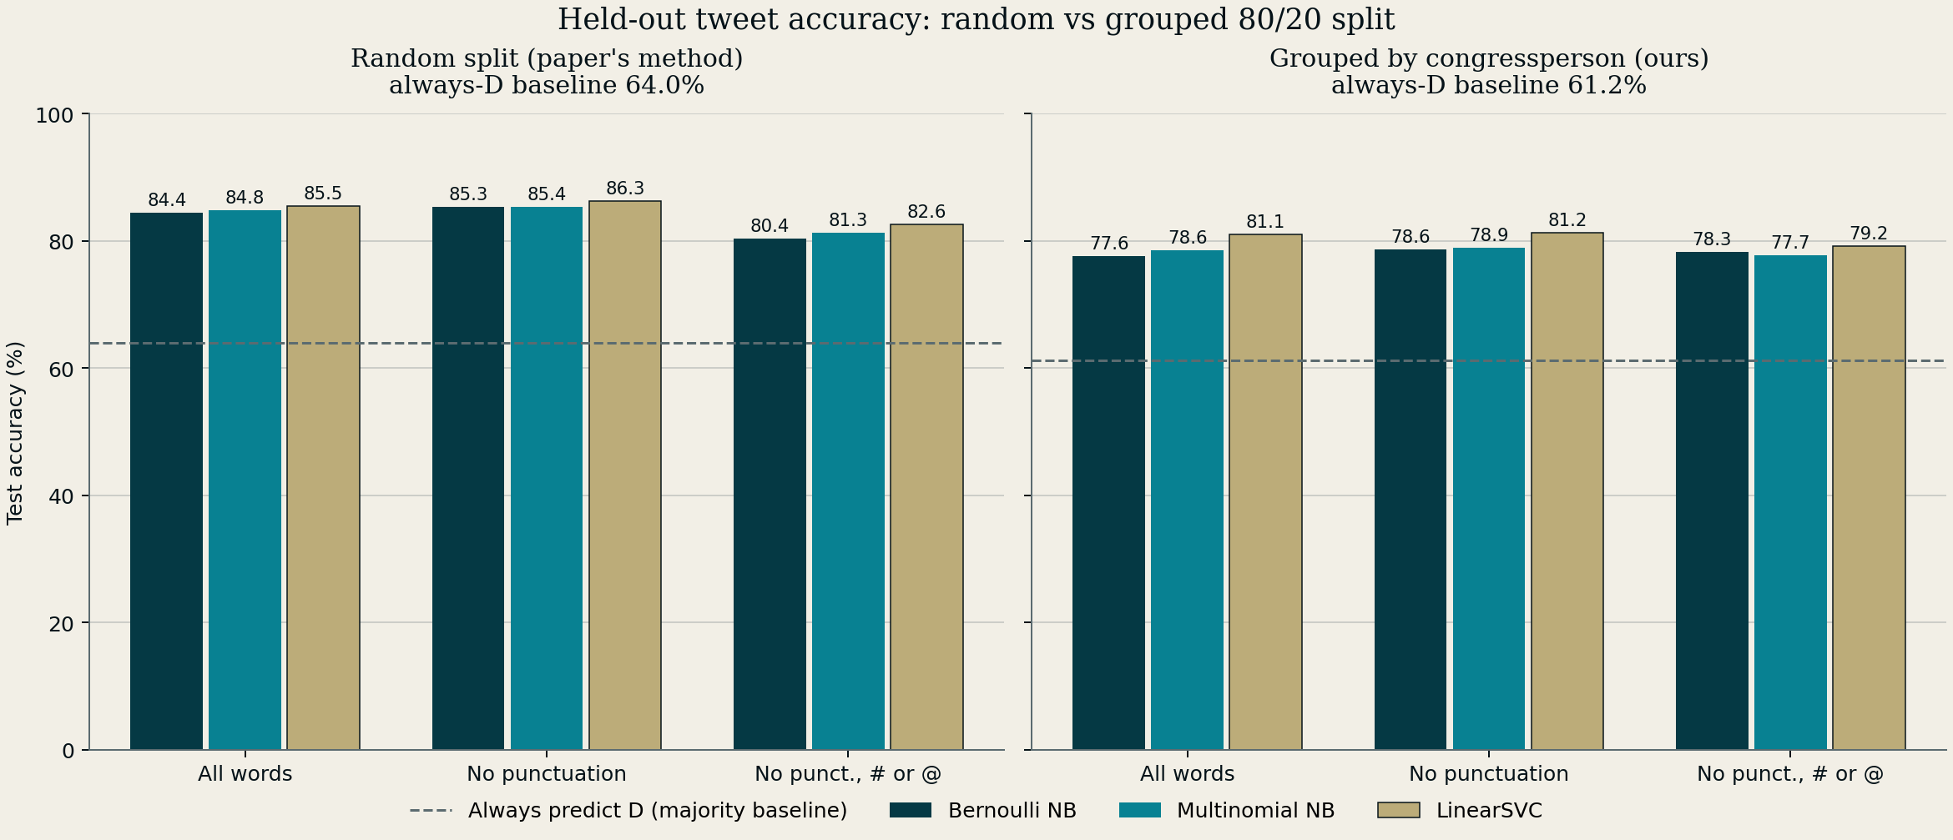
EXPERIMENT 1: TWEETS
Random split: 80 to 86%, close to the paper
Grouped split: best is 81.2% (SVM)
Every model beats always guessing D (61.2%)
5.0 points
average boost from the random split
RESULTS
07
Notes:
Experiment 1 repeats the paper's tweet test. On the left, the random split: our models score 80 to 86 percent, close to the paper's numbers, so our rebuild works. On the right, the fair split by person: everything drops, and the best model, the SVM, gets 81.2 percent. On average the random split adds 5 accuracy points, up to 6.8 points. So part of the paper's score came from recognising people. The good news: all models are still well above the 61 percent you get by always guessing Democrat, so they do learn real political language.

Slide 8
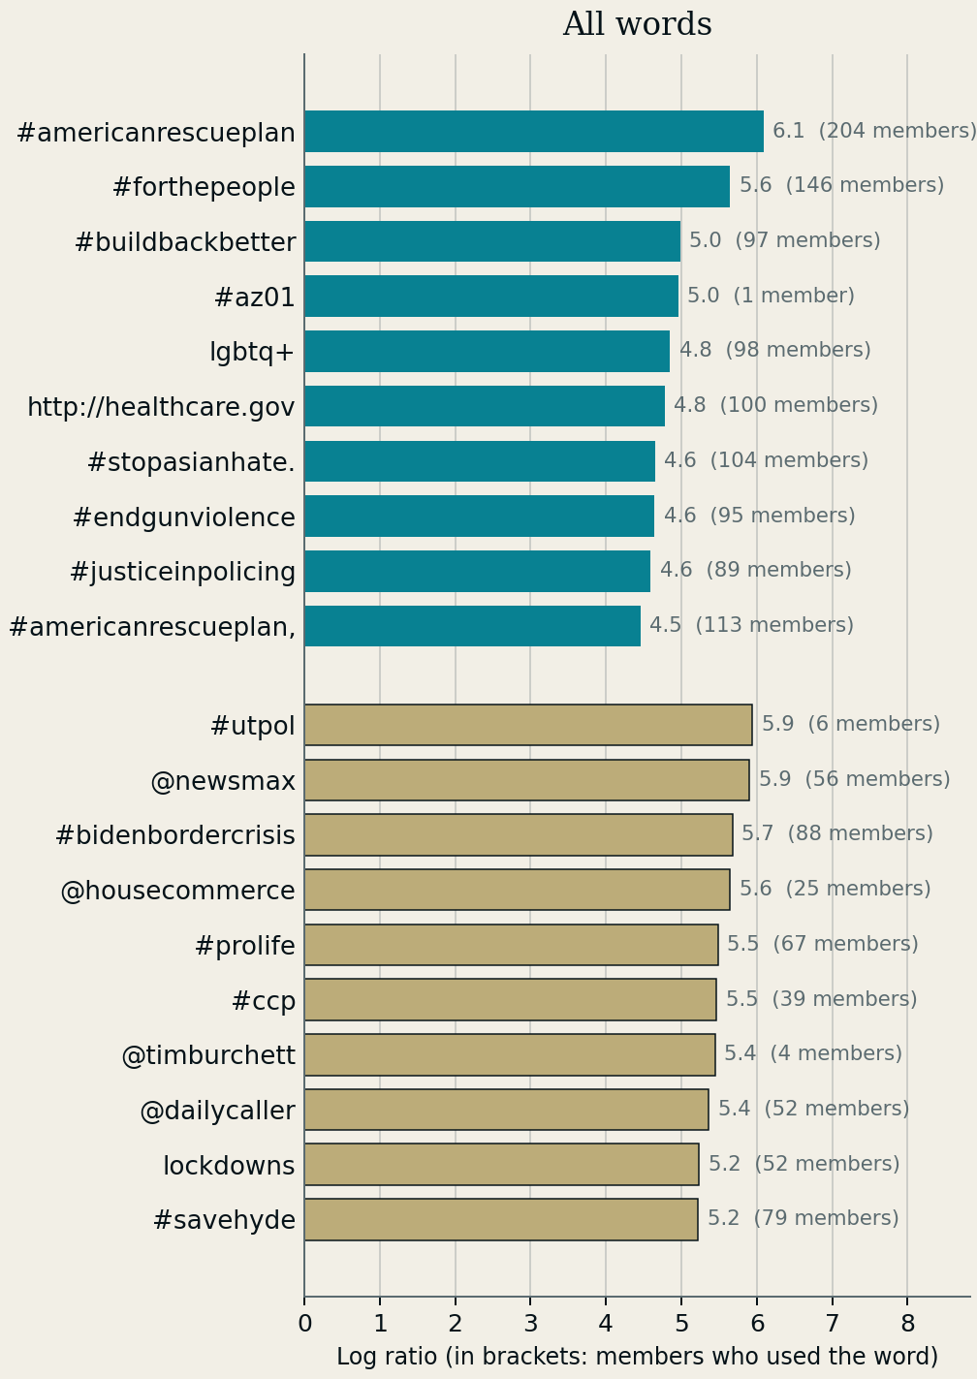
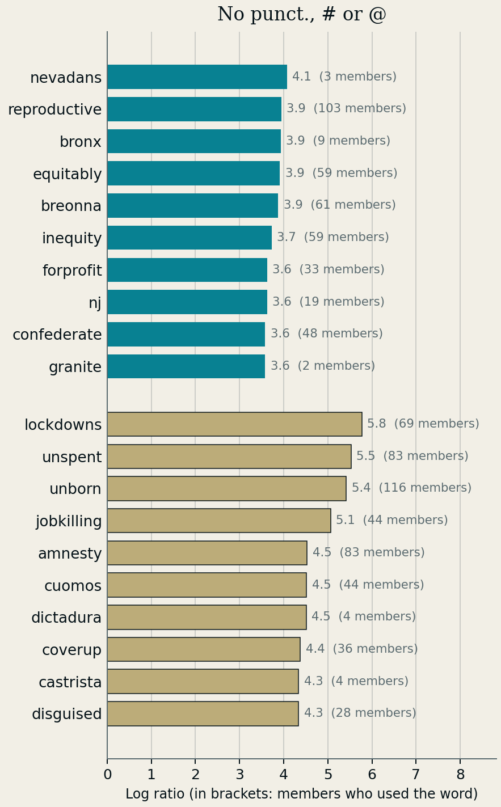
EXPERIMENT 2: TELLING WORDS
With # and @ kept, the top words are hashtags and account names
Some belong to one person: #az01 was used by 1 member
Without them, real topics appear: reproductive, inequity, unborn, amnesty
Turquoise is Democratic, gold is Republican
RESULTS
08
Notes:
Experiment 2 asks which words the model finds most Democratic or most Republican. Turquoise bars are Democratic words, gold bars are Republican words. With all words kept, the top of the list is hashtags and account names, like the American Rescue Plan hashtag or at-Newsmax. Some are used by just one person: the az01 hashtag is one member's district. That is the memorising problem from the last slide. When we remove hashtags and mentions, real policy words appear: reproductive and inequity on the Democratic side, unborn, amnesty and lockdowns on the Republican side.

Slide 9
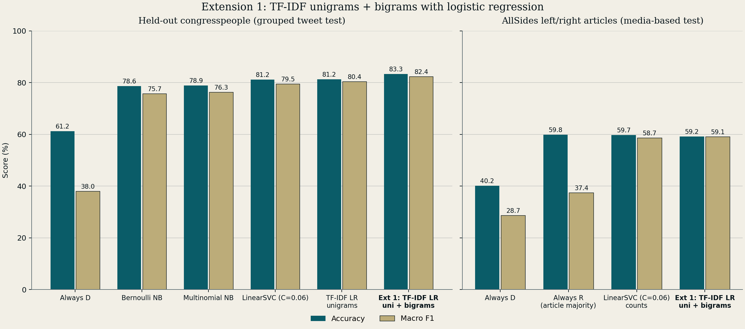
EXTENSION 1: TF-IDF
Words every politician uses count less; word pairs are added
New members: 83.3% accuracy, our best tweet model
News: 59.2%, no better than always guessing R (59.8%)
+2.9 points
balanced score on new members (82.4 vs 79.5)
EXTENSIONS
09
Notes:
Our first improvement. TF-IDF gives less weight to words that every politician uses, and we also add pairs of words, so short phrases count. A logistic regression model then makes the decision, and we tuned it on training data only. On new members it is our best tweet model: 83.3 percent accuracy, and 2.9 points better on a balanced score that treats both parties equally. But to be honest, on news articles it gets 59.2 percent, which is no better than always guessing Republican. Better on tweets does not mean better on news. Rahul will now look at why.

Slide 10
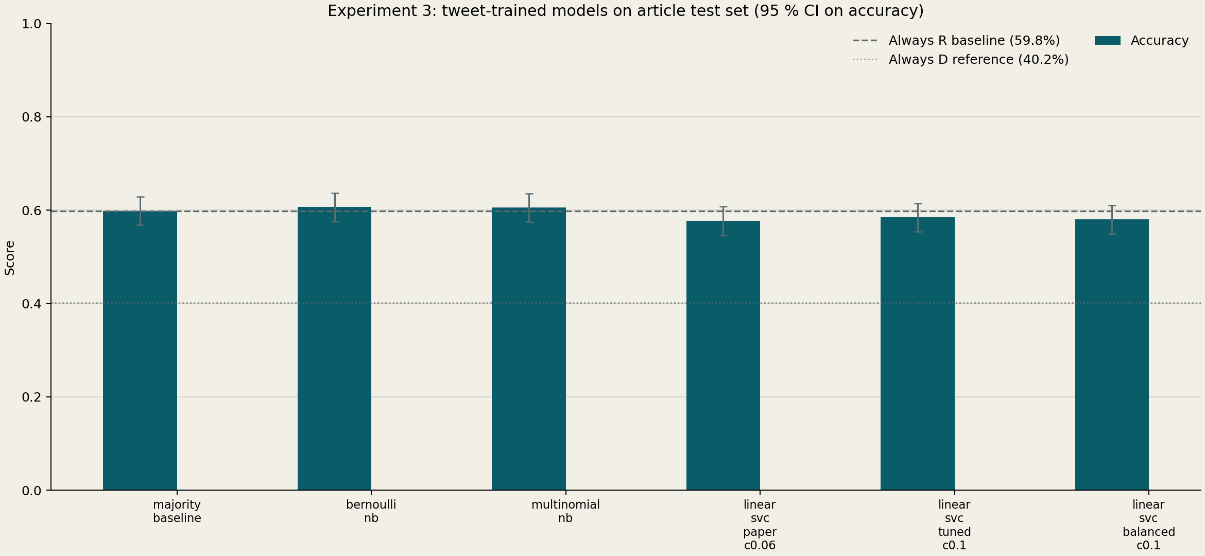
EXPERIMENT 3: TWEETS TO NEWS
Paper SVM: 63% on 100 private articles.
Our tuned tweet SVM: 58.4%, below the always-Right baseline of 59.8%.
Bernoulli and Multinomial Naive Bayes reach 60.6% and 60.5%.
1,001
public unseen articles
RESULTS
10
Notes:
This is our direct test of whether tweet-trained models transfer to news. The paper reports 63% for SVM on 100 private articles. On 1,001 public articles, our tuned tweet SVM scores 58.4%, below the 59.8% always-Right baseline. Bernoulli and Multinomial Naive Bayes are slightly above that baseline at 60.6% and 60.5%.

Slide 11
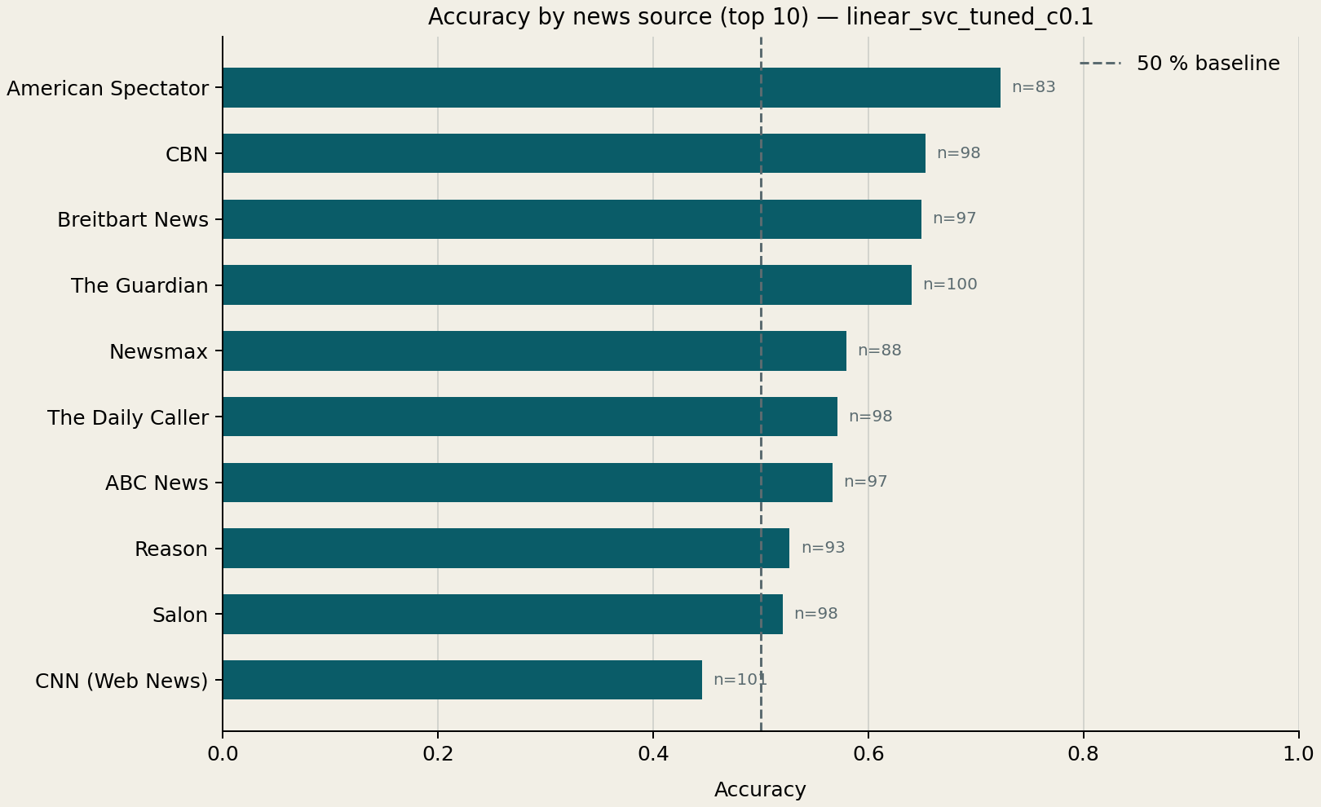
WHERE THE MODEL STILL FAILS
Accuracy changes sharply across outlets. CNN is below the 50% line.
A report can be labelled by its outlet even when the wording is neutral.
Words such as conservative and spending can pull a prediction the wrong way.
ANALYSIS
11
Notes:
Transfer errors vary by outlet. CNN is below the 50% line in this chart, while some outlets are substantially higher. Examples include a CNN report on spending cuts classified as Right and a Salon article mentioning conservative politics classified as Right. This suggests that labels inherited from an outlet do not always match the language of one article.

Slide 12
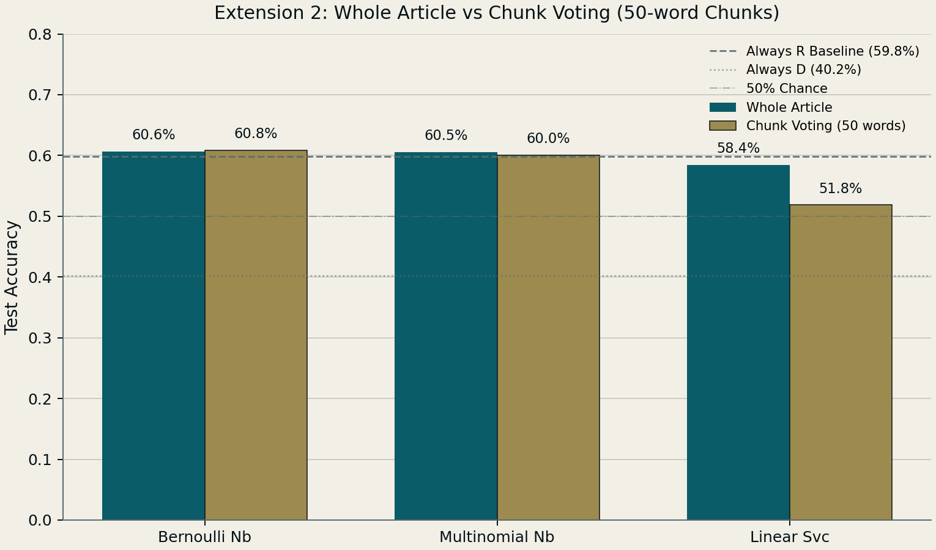
EXTENSION 2: CHUNK VOTING
Split each article into chunks, score each chunk, then average the scores.
Bernoulli Naive Bayes changes only from 60.6% to 60.8%.
LinearSVC falls from 58.4% to 51.8%.
Chunking does not reliably close the tweet-to-news gap.
50 words
chunk size chosen on validation data
EXTENSIONS
12
Notes:
We selected 50-word chunks using the training validation data. Chunk voting gives Bernoulli Naive Bayes a small accuracy increase from 60.6% to 60.8%, but it drops tuned LinearSVC from 58.4% to 51.8%. The result is mixed, so we do not claim that chunking is a general improvement.

Slide 13
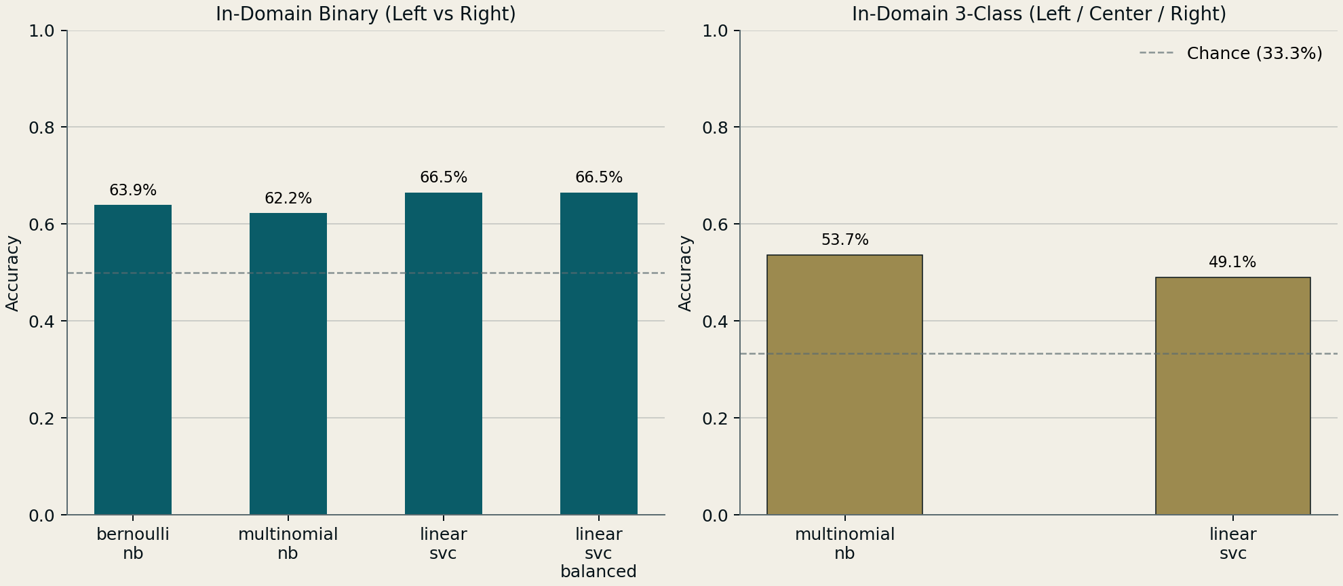
EXTENSION 3: TRAIN ON ARTICLES
Train on 19,102 AllSides articles, then test on 1,001 unseen articles.
LinearSVC reaches 66.5% accuracy and 65.8% macro F1.
The three-class task is harder: the best model reaches 53.7%.
+6.7 points
over the always-Right baseline
EXTENSIONS
13
Notes:
Training on news articles reduces the domain mismatch. LinearSVC scores 66.5% accuracy and 65.8% macro F1, which is 6.7 percentage points above the 59.8% always-Right baseline. The three-class Left, Center, Right version remains harder: Multinomial Naive Bayes is best there at 53.7% accuracy.

Slide 14
LIVE DEMO: THREE STEPS
01
1. EASY CORRECT CASE
02
2. SHOW A FAILURE
03
3. PASTE A SENTENCE
Score the Breitbart article with the article-trained model.
Use the CNN article, then switch to the tweet SVM for comparison.
Show the uncertain free-text result. The CLI is ready as a fallback.
DEMO
14
Notes:
Follow docs/demo_script.md. First, score the Breitbart article, where the article-trained model correctly predicts Right. Second, show the CNN example that the article model predicts as Right, then switch to the tweet-trained SVM, which predicts Left. Third, paste the prepared free-text sentence and point out the near-even result. Keep this slide and the live walk-through to these three steps.

Slide 15
RESULTS AT A GLANCE
83.3%
best tweet accuracy, Extension 1
66.5%
best article accuracy, Extension 3
59.8%
always-Right article baseline
The paper's random split inflated tweet accuracy by 5.0 points; holding out whole politicians gives the honest number.
Training and testing within the same domain gives the clearest improvement.
RESULTS
15
Notes:
These numbers use different test settings, so they should not be compared as if they came from the same task. Extension 1 reaches 83.3% on the grouped tweet test. Extension 3 reaches 66.5% on the article test. The article majority baseline is 59.8%, so in-domain article training provides the clearest gain on that task.

Slide 16
LIMITATIONS AND NEXT STEPS
Labels come from politicians and media outlets, so an individual text may not match its label.
Tweet-trained models do not transfer reliably to article language.
The three-class article task peaks at 53.7% accuracy.
Next: collect article-level labels and test on later time periods and new outlets.
CONCLUSIONS
16
Notes:
Our labels are proxies: a politician's party or an outlet's AllSides label. They cannot describe every individual tweet or article perfectly. Tweet-trained models also transfer poorly to news. The three-class article task reaches 53.7% at best. Future work should collect article-level labels and evaluate across time periods and outlets that were not part of development.

Slide 17
THANK YOU
Political bias classification from tweets and news articles
Notes:
Thank the audience and invite questions. Keep the demo and results files ready in case a question needs a quick example or an exact number.

