Slide 1
Adaptive Traffic Signal Control Using Multi-Agent RL
Sonu Dixit

Slide 2
Problem Formulation
Environment = Whole traffic Network
Every junction is an Agent, working in a common environment.
Every agent can experience a part(local data) of environment.
Agent Description
State:
Congestion at each incoming lane
Congestion at immediate Neighbors incoming lanes
Current Phase
Action : Green signal duration {20,25,30,….65,70}
Reward : Change in congestion at its lanes and neighbors lanes after performing action
Objective : Maximize discounted sum of rewards

Slide 3
Data For Training:
PTV Vissim Simulation for modelling Traffic behaviour
Queue Counters for getting congestion in a lane at particular time
Self Designed Network

Slide 4
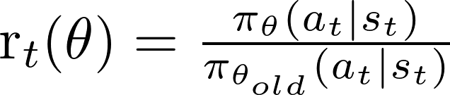

Algorithm Used
PPO, Advantage Actor critic
Entropy Loss included as well
Buffer of 100 latest samples

Slide 5
Algorithm
Start Simulation
For every Agent that needs to take action
Get s,a,r,s’. put into buffer
if buffer has enough samples
3. K times:
4. Sample minibatch(32) from buffer
5. Train actor(current_policy) on this data
6. Train Critic on whole buffer
7. Set old_policy = current_policy
8. Empty buffer
Actor Critic Network Details
Both are simple Dense Network, 2 Hidden layers (64 nodes each)
PPO loss epsilon = 0.2
Entropy loss coefficient = 0.01
Two actor networks( old, new), 1 critic network for every agent

Slide 6
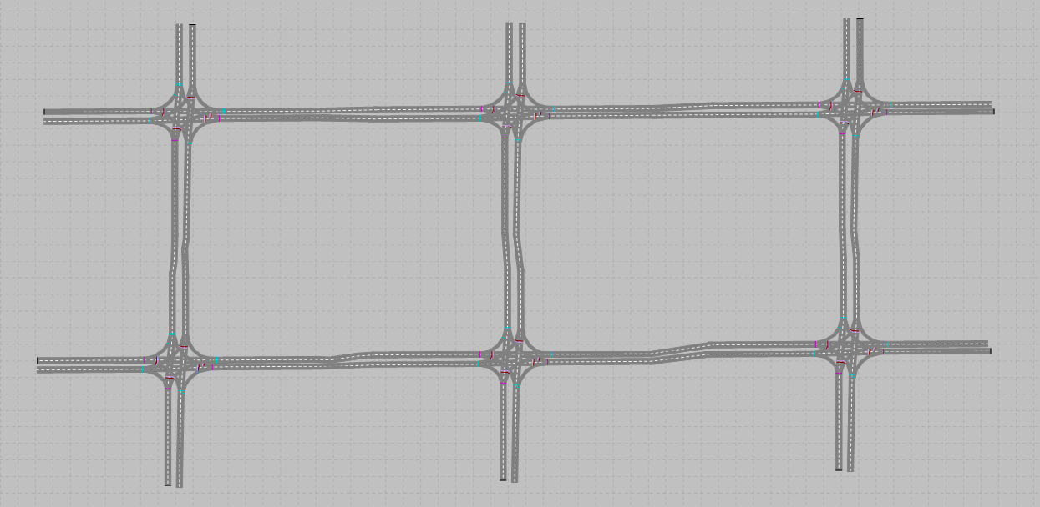
Traffic Network for experimentation
6 junctions, 8 signals(que_counters) per junction
10 Vehicle Input points
Left, Straight, Right = 0.25, 0.50, 0.25
6
3
4
1
2
5

Slide 7
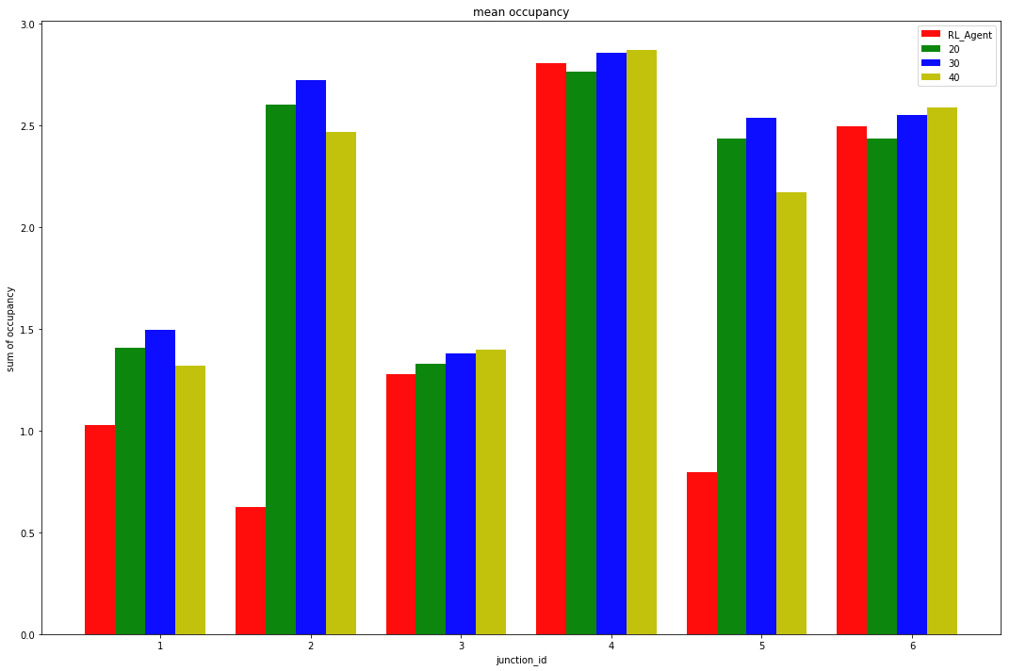
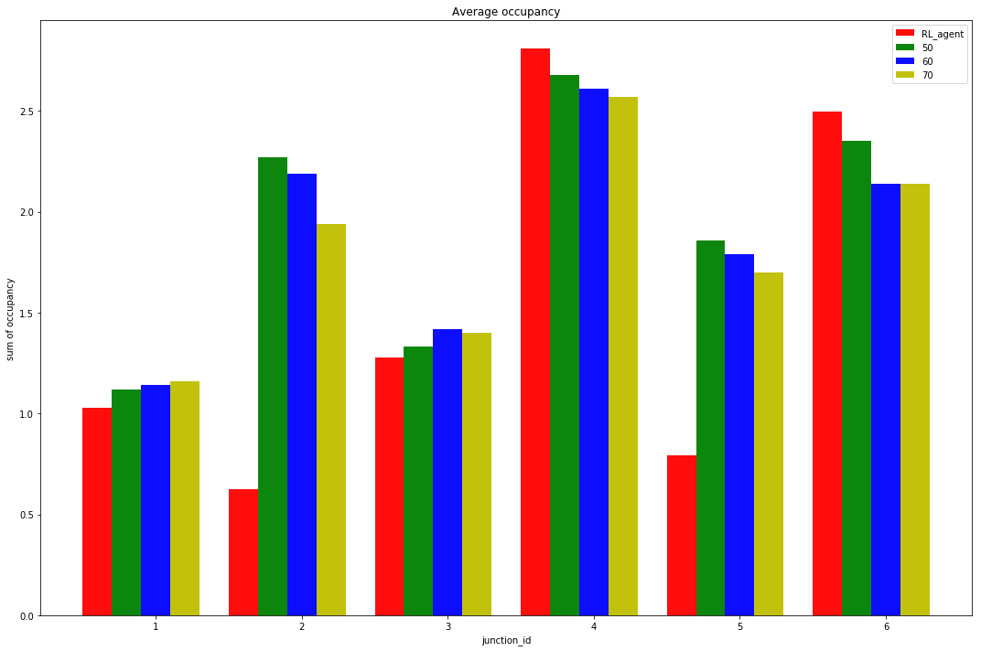
Experimentation and Results
1k vehicles per hour at every incoming lane
Avg Occupancy Comparison with fixed time algorithms

Slide 8
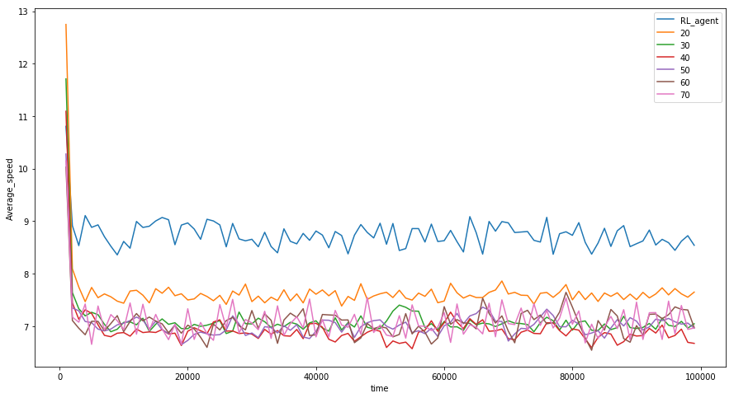
Experimentation and Results
1k vehicles per hour at every incoming lane,
Avg Speed Comparison, calculated in 1000secs interval

Slide 9
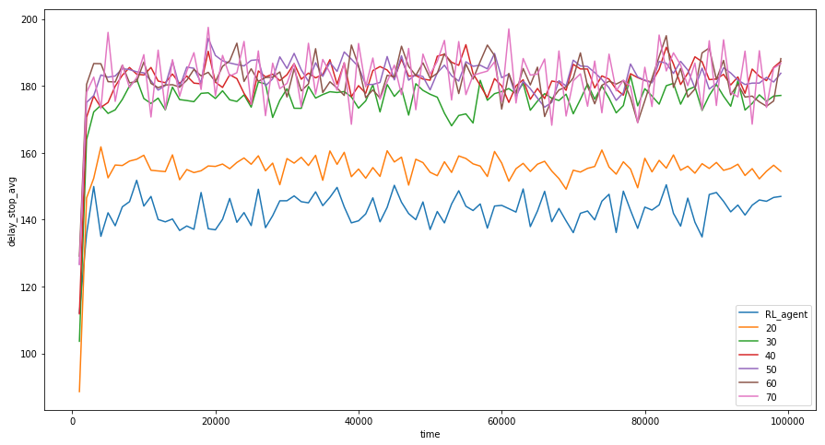
Experimentation and Results
1k vehicles per hour at every incoming lane,
Delay Stop Avg, calculated in 1000secs interval

Slide 10
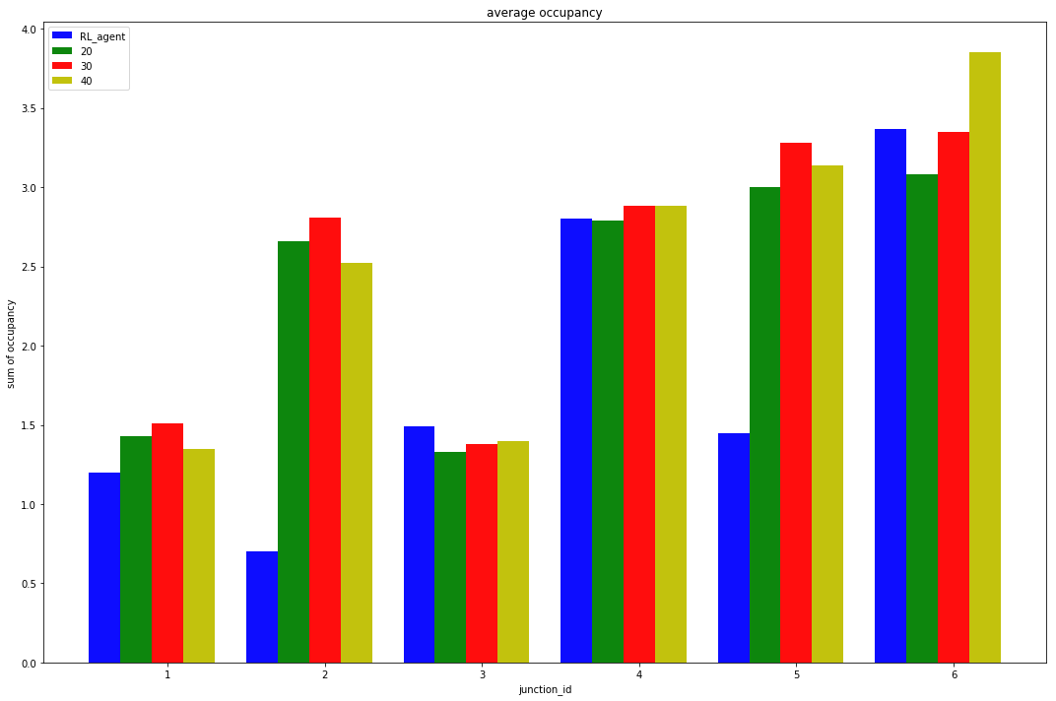
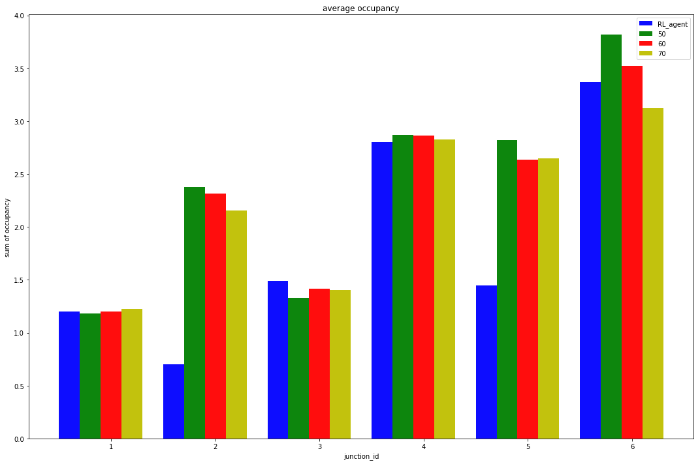
Experimentation and Results
2k vehicles per hour at every incoming lane
Avg Occupancy Comparison with fixed time algorithms

Slide 11
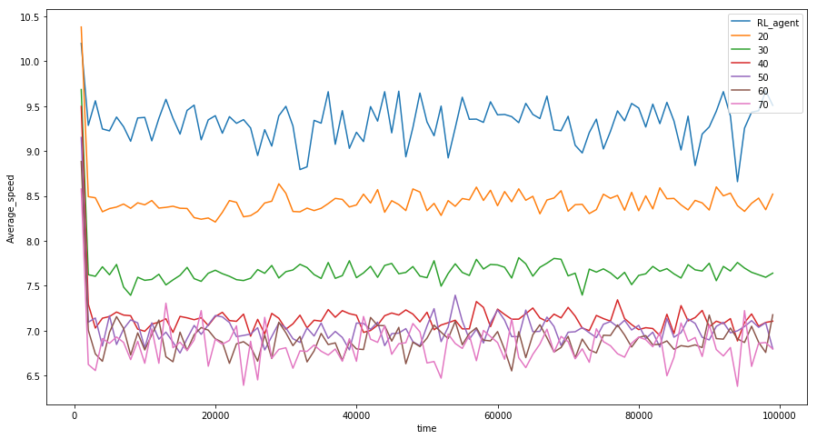
Experimentation and Results
2k vehicles per hour at every incoming lane,
Avg Speed Comparison, calculated in 1000secs interval

Slide 12
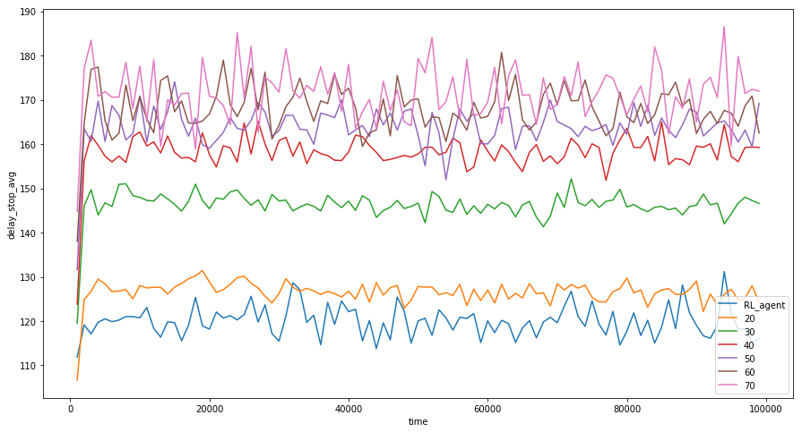
Experimentation and Results
2k vehicles per hour at every incoming lane,
Delay Stop Avg, calculated in 1000secs interval

Slide 13
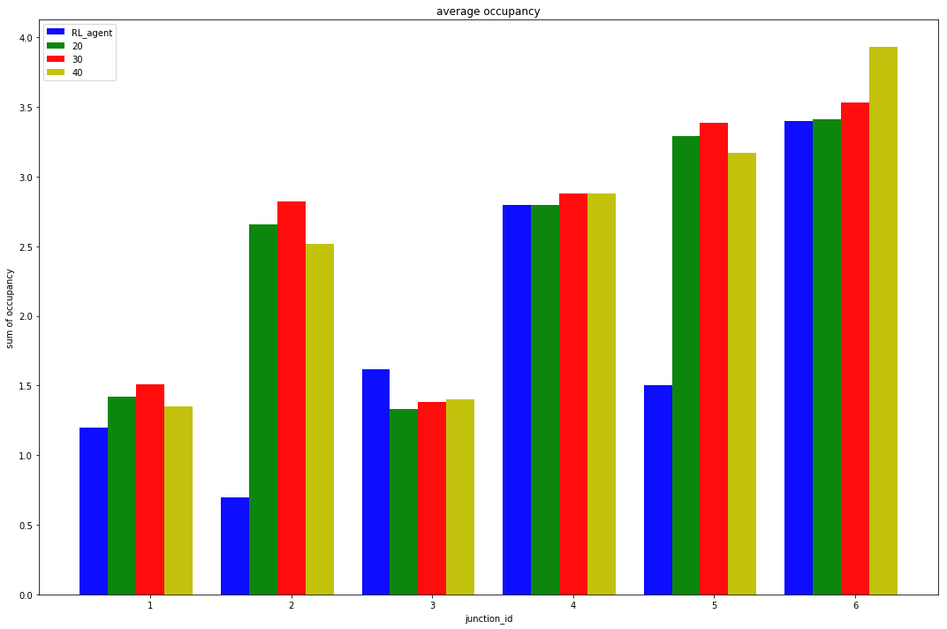
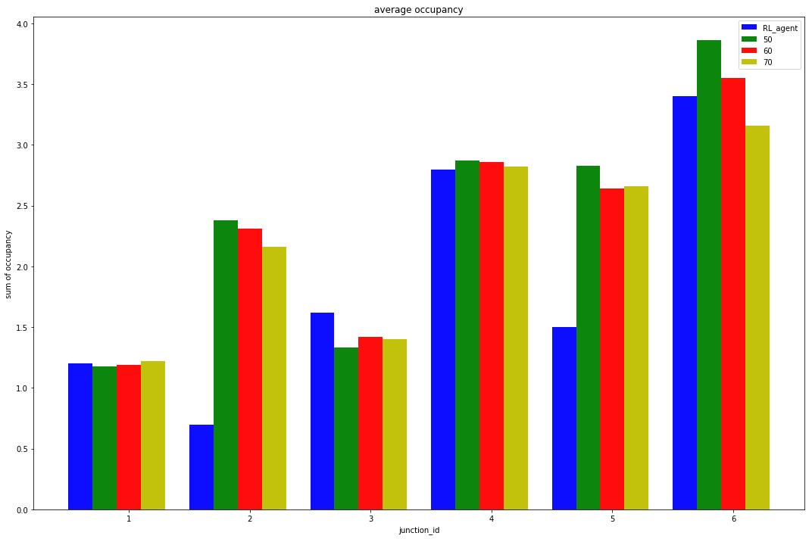
Experimentation and Results
3k vehicles per hour at every incoming lane
Avg Occupancy Comparison with fixed time algorithms

Slide 14
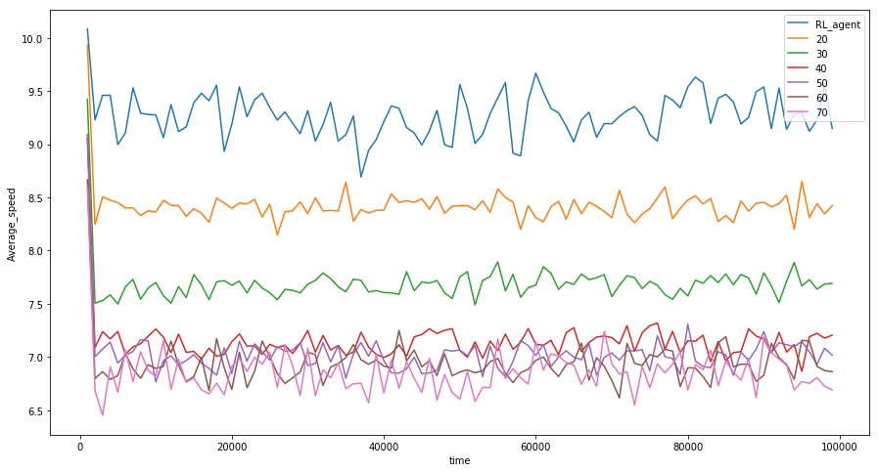
Experimentation and Results
3k vehicles per hour at every incoming lane,
Avg Speed Comparison, calculated in 1000secs interval

Slide 15
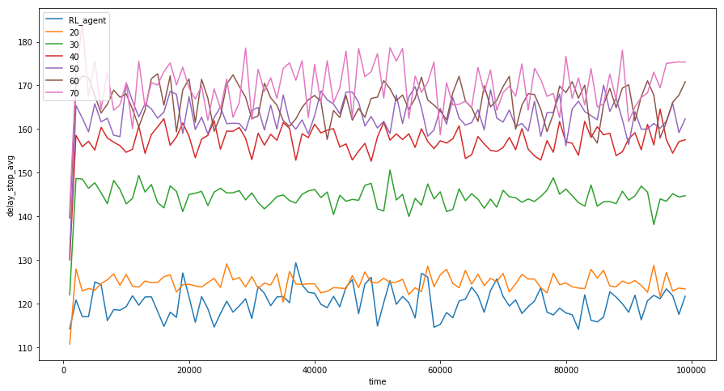
Experimentation and Results
3k vehicles per hour at every incoming lane
Delay Stop Avg, calculated in 1000secs interval

Slide 16
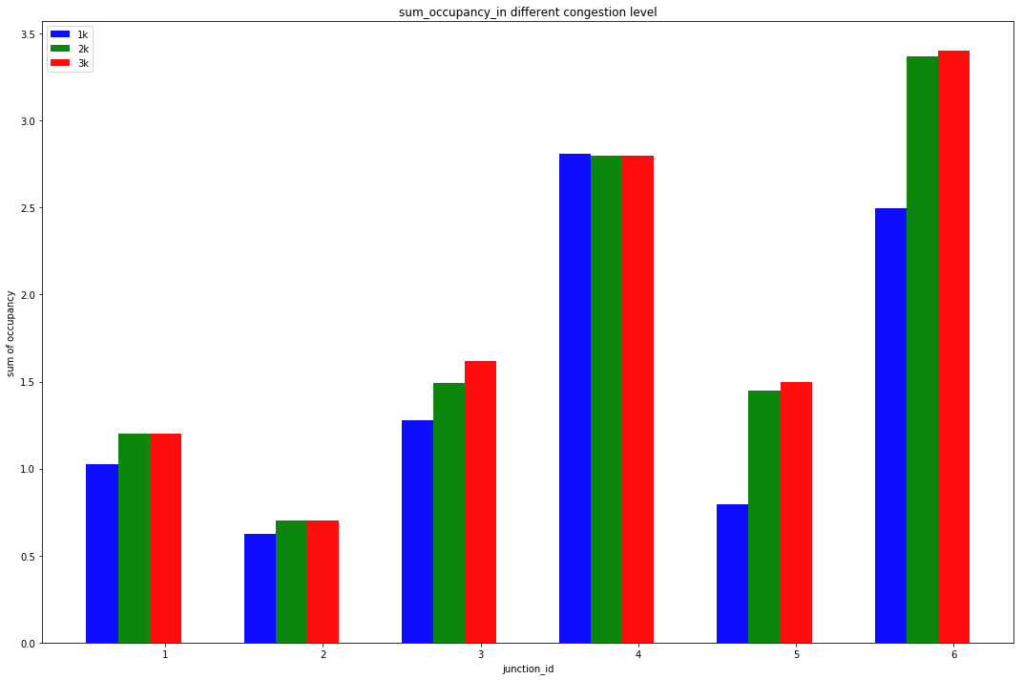
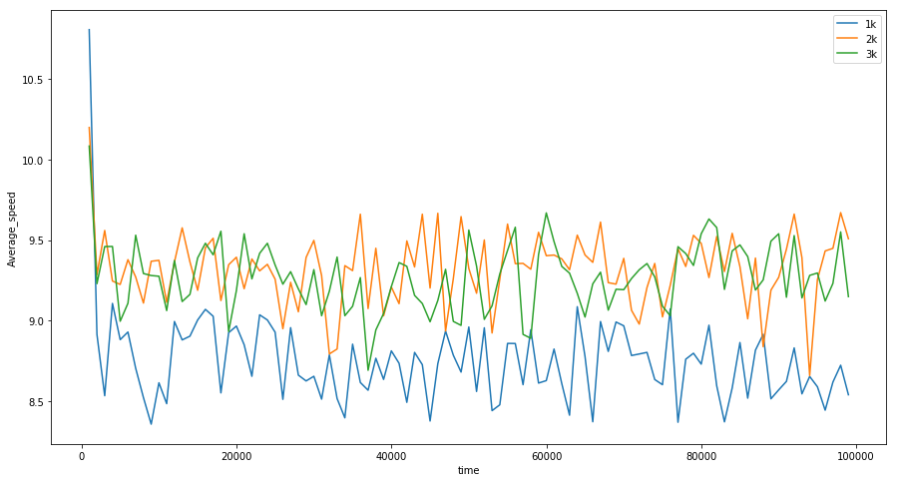
RL Agent Performance Comparison at different vehicle incoming density

Slide 17
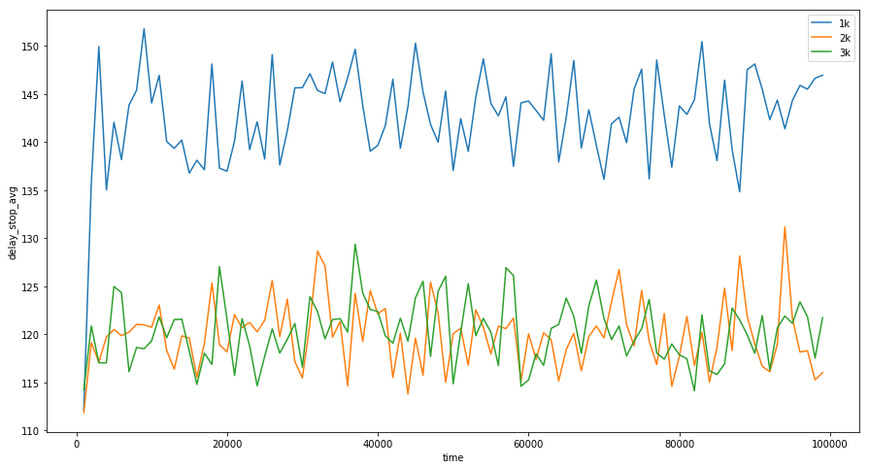
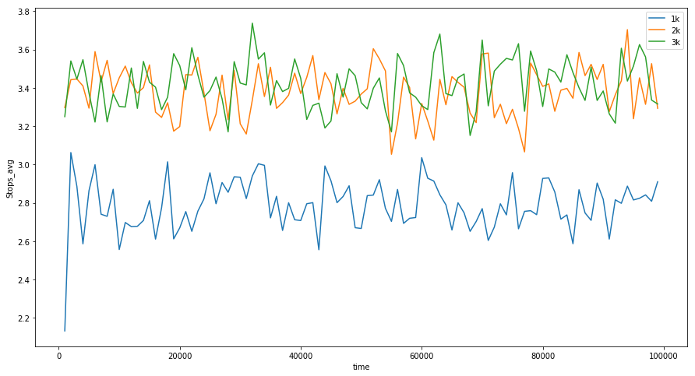
RL Agent Performance Comparison at different vehicle incoming density

Slide 18
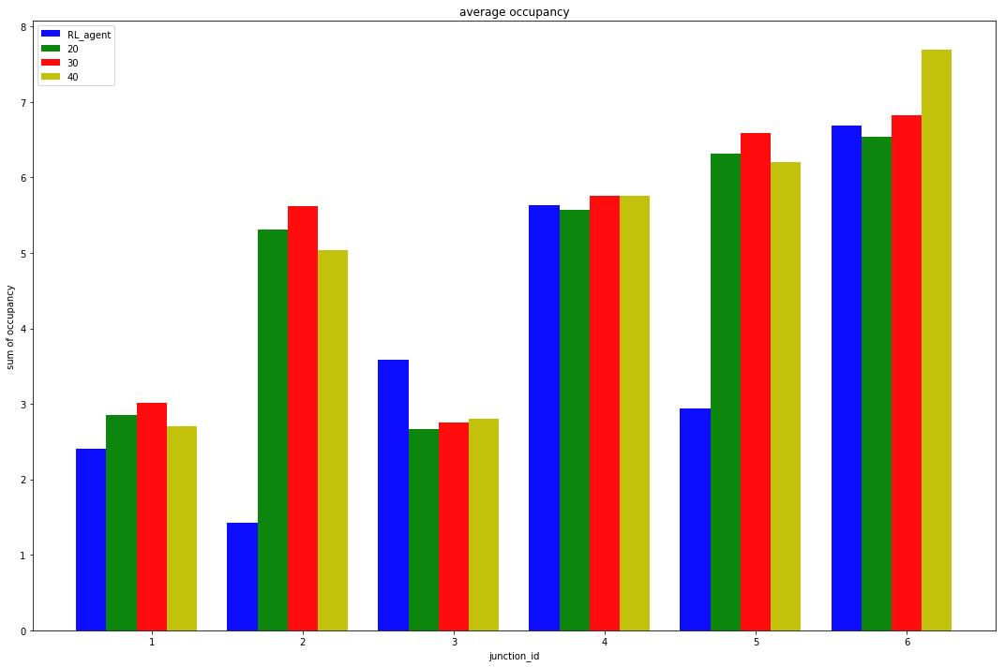
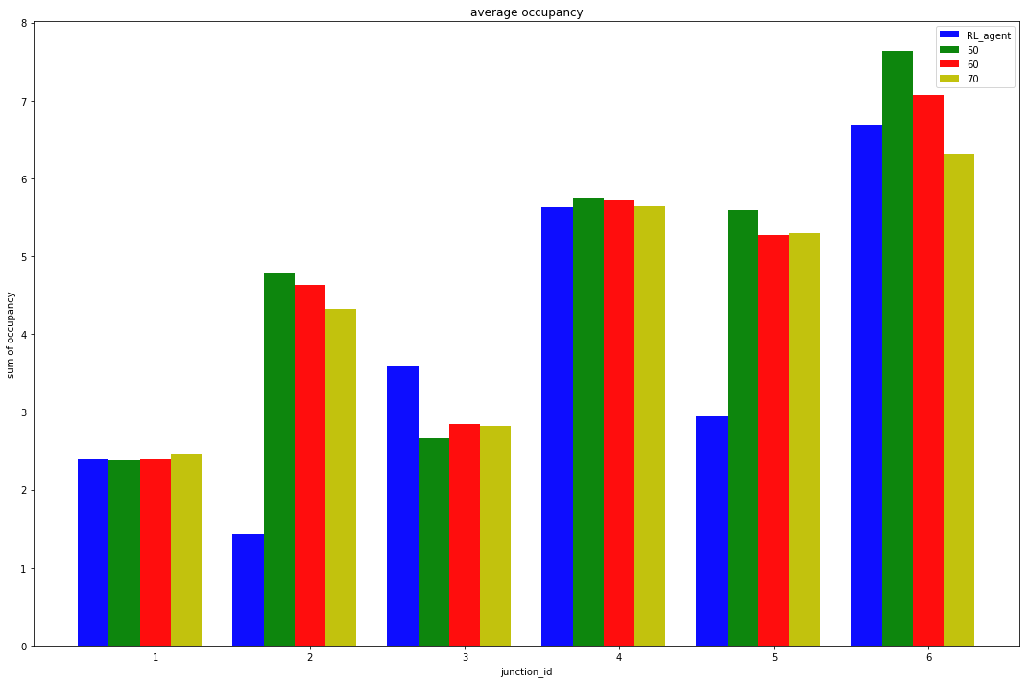
Experimentation and Results
Random vehicle input density:
Changing after every 50 minutes
Selected in range {500,1000,………,3000,3500} vehicles per hour
Asymmetric vehicle incoming density at every junction
Avg Occupancy Comparison with fixed time algorithms
Agent was never trained in this kind of changing environment.
Still it has generalized reasonably well.

Slide 19
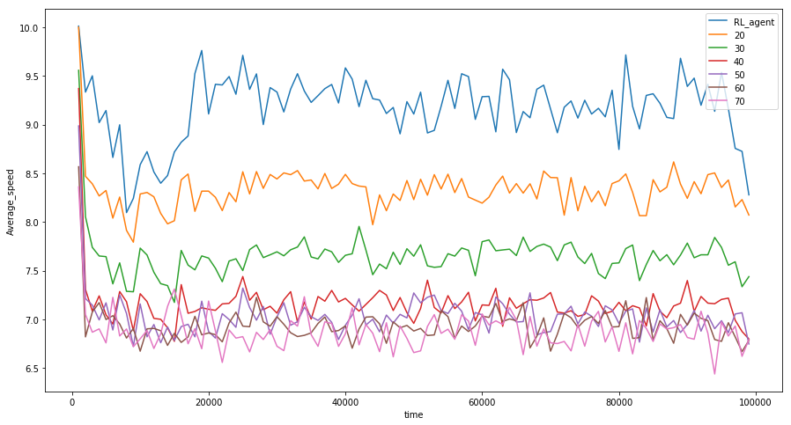
Experimentation and Results
Random vehicle input density:
Changing after every 50 minutes
Selected in range {500,1000,………,3000,3500} vehicles per hour
Asymmetric vehicle incoming density at every junction
Avg Speed Comparison with fixed time algorithms
Agent was never trained in this kind of changing environment.
Still it has outperformed all fixed time algorithms.

Slide 20
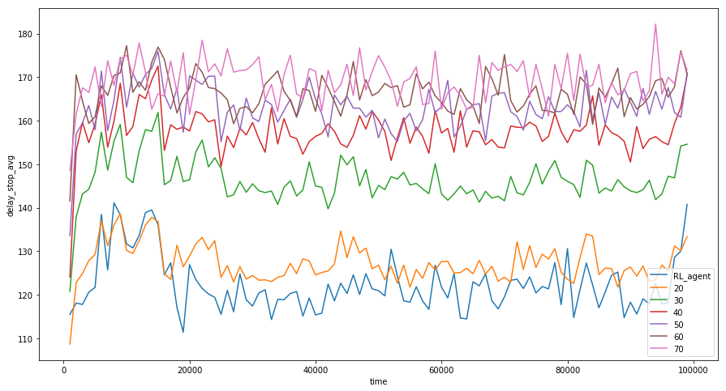
Experimentation and Results
Random vehicle input density:
Changing after every 50 minutes
Selected in range {500,1000,………,3000,3500} vehicles per hour
Asymmetric vehicle incoming density at every junction
Avg Delay Stop time Comparison with fixed time algorithms
Agent was never trained in this kind of changing environment.

Slide 21
Phasing Analysis
For Asymmetric Network simple phasing performs better.

Slide 22
References
Proximal Policy Optimization Algorithms (John Schulman, Filip Wolski, Prafulla Dhariwal, Alec Radford, Oleg Klimov )
Multi-agent reinforcement learning for traffic signal control, Prabuchandran K.J. , Hemanth Kumar A.N , Shalabh Bhatnagar

