Slide 1
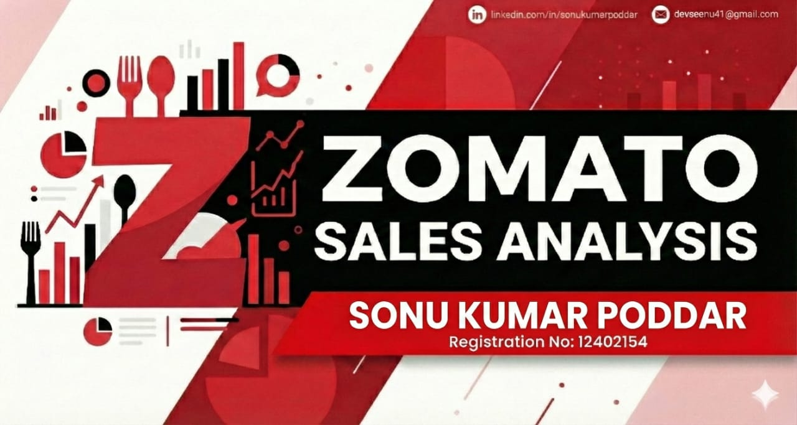

Slide 2
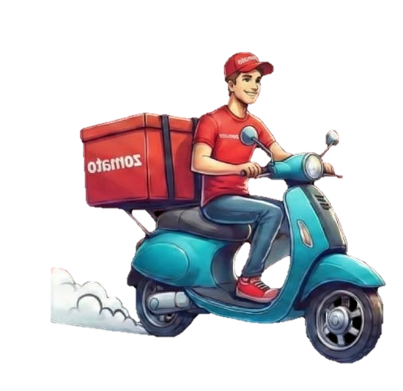
Table of Content:-
Zomato
Introduction.
Problem statement.
Tools and Technology Used.
Analysing Problem .
Recommended 1st Problem Solution.
Recommended 2nd Problem Solution.

Slide 3
Introduction
Zomato
HELLO EVERYONE
I AM SONU KUMAR
REGISTRATION NO: 12402154
As an aspiring data analyst, this project focuses on Zomato’s restaurant dataset, where Python, Power BI and Exploratory Data Analysis (EDA) are used to uncover meaningful business insights. The goal is to understand restaurant performance across cities, cuisines and service features, and to translate raw data into clear, data‑driven recommendations for improving customer satisfaction and platform growth.

Slide 4
Problem Statement
Zomato
Zomato wants to understand how to improve restaurant performance and customer satisfaction across its platform, using existing listing and rating data.
1st :- The company needs to know : In which cities and cuisine categories it should focus its efforts, based on where most restaurants and orders are concentrated but average ratings remain low.
2nd :- How much impact online delivery and table‑booking features have on customer engagement and ratings, and what share of partner restaurants have still not adopted these features.

Slide 5

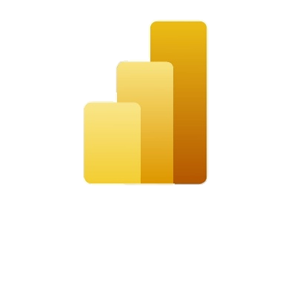


Tools Used:-
Zomato
Python:-For data cleaning and formatting.
Power BI :- For Visualization.
Sql :- Extracting hidden patterns and information.
Github :- Project Handling.
Click to view repository or right click > open hyperlink

Slide 6
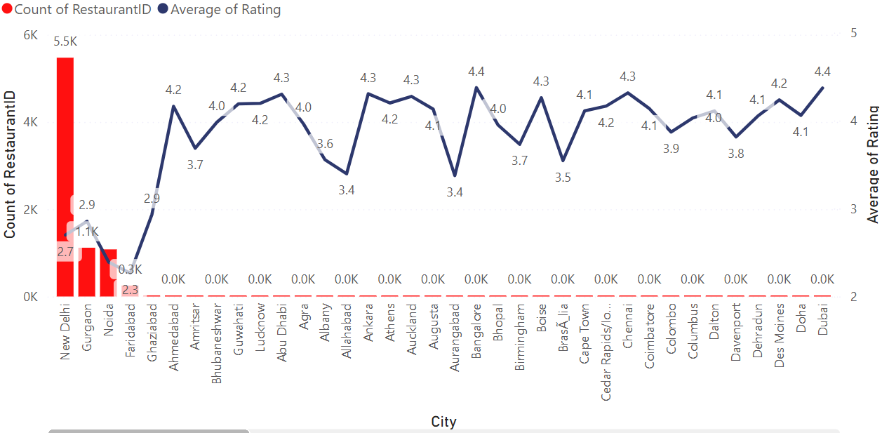
Highest Restaurant Cities With Lowest Ratings
Zomato
By this chart we can simply observe that cities like New Delhi , Noida and Gurgaon are the cities with highest no. of restaurants but with lowest average ratings.

Slide 7
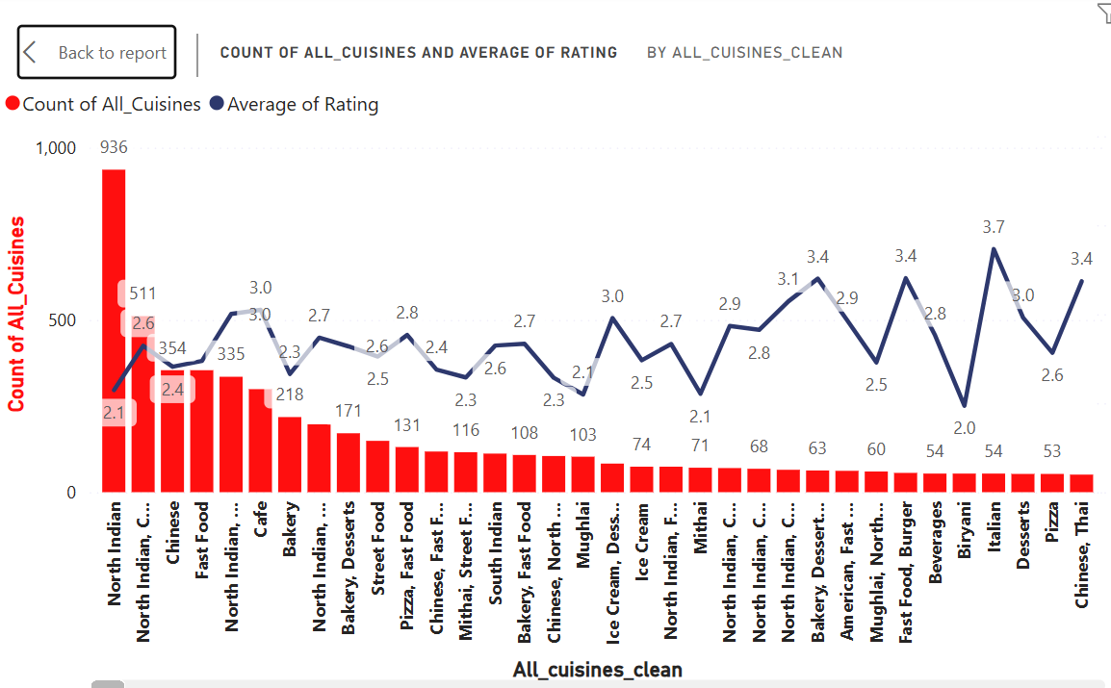
Cuisine Improvisation:-
Zomato
In this line and stacked column chart it is clearly shown that cuisines variety in North Indian is very high (936) but with very low rating 2.1 and nom of Italian Cuisine is very low (54) but has very high rating upto 3.7.

Slide 8
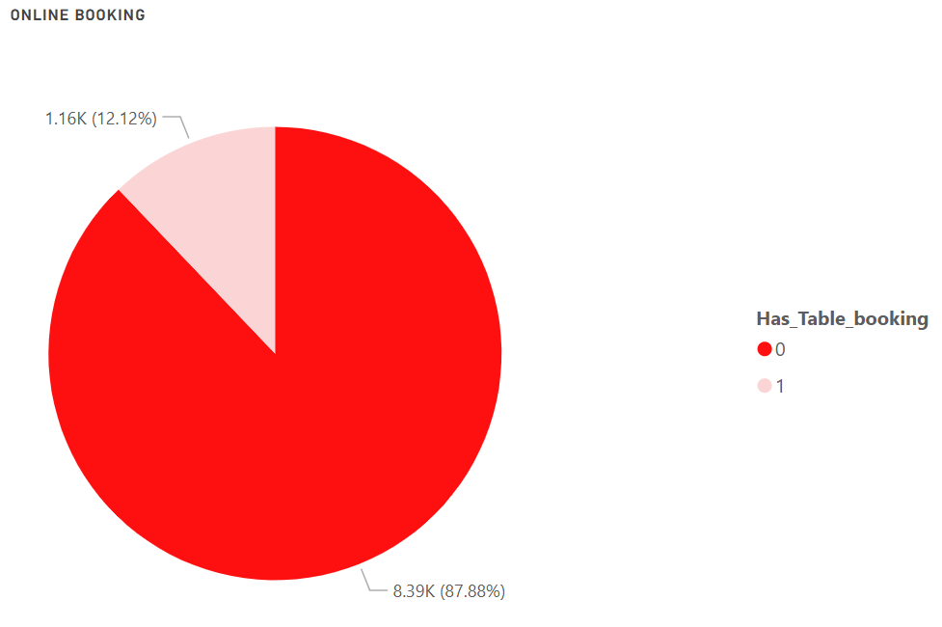
Table Booking Impact:-
Zomato
In this pie chart we can easily see that nom of restaurants which have adopted table booking feature is only 12.12% on the other side remaining 87.88% of restaurants does not have enabled the table booking feature.

Slide 9
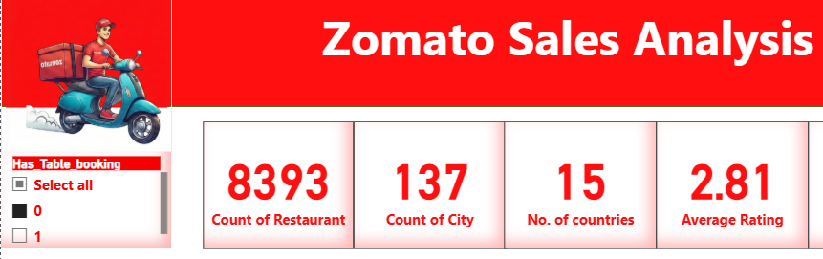
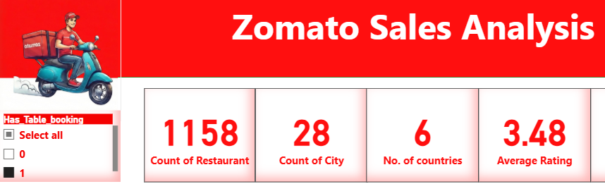
Ratings Comparison b\w Enabled and Non Enabled Table Booking restaurants
Zomato
Non Table Booking
Table booking
Ratings of Table booking restraunts is higher than non table booking.

Slide 10
Recommended 1st solution:-
Zomato
As we can see nom of restaurants are very large in New Delhi (5473) , Noida (1080) and Gurgaon (1118) which is 70% contribution to all sales for Zomato.
But restaurants in all these cities lags in average rating which is 2.65 and main cuisines which are responsible in these restaurants is North Indian which has average rating of 2.1.
So company should guide and aware their restaurant partners in city like New Delhi , Noida and Gurgaon for not only focusing in quantity of cuisines but also focus on quality in North Indian cuisines .
Quantity of cuisines is needed to increase in Italian food which has highest rating 3.7.

Slide 11
Recommended 2nd Solution:-
Zomato
Nom of restaurants which have adopted table booking feature is only 12.12% on the other side remaining 87.88% of restaurants does not have enabled the table booking feature and the ratings of restaurants which has enabled is comparatively higher than the other non enables restaurants .
So company should motivate the their restaurant partners by giving more benefits to enable the online table booking feature for more average ratings and traffic in their workplace which will enhance the profit for both Zomato and the restraunt owners.

Slide 12
THANKYOU :)
Zomato
ANY QUERY?

