Slide 1
SOCIAL MEDIA WEBSITE for college students using REACT.JS/ FIREBASE
SUBMITTED BY: AYUSH KARN (2K19/CO/454)
SONU K KUSHWAHA(2K19/CO/383)
Submitted to: Sonal Gandhi

Slide 2
OBJECTIVE
Social Media plays a crucial role in connecting people and developing relationships, not only with key influencers and journalists covering your company's sector, but also provides a great opportunity to establish customer service by gathering input, answering questions and listening to their feedback.
In this project we have tried to make a social media platform for specific group of people i.e. College Students. In this website we have used React.JS Front end Development and Firebase is used as the Backend for the project.
The innovative idea for this project is that we have created it for a specific target audience rather than a general target audience. On this website every user will be anonymous but their identity will be verified before the account is created. The main reason for keeping the user anonymous is because we have seen students struggling to ask question, talk about things, ask doubts for subject related thing and because of this thing we have decided to keep the identity anonymous. If someone doesn’t know who is asking the doubt then it will be easier for both the parties i.e. person asking and the person answering.

Slide 3
OBJECTIVE
For example during the placement session everyone starts practicing questions and many doubts come up but very few people have someone in their life that they can frankly ask questions to clear doubts and this is where our anonymous social media website comes in. We also have few other things planned for the future of this website like inclusion of code editor and all.
These are the functionality we will be working on as of now.
• Sign Up
• Log In and Log Out
• Posting a Doubt
• Upvoting a Doubt for more reach
• Add Caption to the Post
• Comment on a Post
• Firebase Authentication
• Interactive Interface

Slide 4

Chapter 1.2: Brief Intro of all the API’s and components used (description)
HTML5
CSS3
JavaScript
Hypertext Markup Language is the standard markup language for documents designed to be displayed in a web browser. It can be assisted by technologies such as Cascading Style Sheets and scripting languages such as JavaScript
Cascading Style Sheets is a style sheet language used for describing the presentation of a document written in a markup language such as HTML. CSS is a cornerstone technology of the World Wide Web, alongside HTML and JavaScript
JavaScript, often abbreviated as JS, is a programming language that conforms to the ECMAScript specification. JavaScript is high-level, often just-in-time compiled, and multi-paradigm. It has curly-bracket syntax, dynamic typing, prototype-based object-orientation, and first-class functions

Slide 5



Chapter 1.2: Brief Intro of all the API’s and components used (description)
React.js
Node.js
FireBase
React is an open-source, front end, JavaScript library for building user interfaces or UI components. It is maintained by Facebook and a community of individual developers and companies. I have used react.js for writing my program. In react we have to write code in JSX format and later it gets converted to respective JavaScript by Babel Compiler
Node.js is an open-source, cross-platform, back-end, JavaScript runtime environment that executes JavaScript code outside a web browser. I have used node.js for creating a runtime environment for my project
Firebase is a platform developed by Google for creating mobile and web applications. It was originally an independent company founded in 2011. In 2014, Google acquired the platform and it is now their flagship offering for app development. I have used Firebase in this project for hosting my website and I am planning to use the database feature of Firebase in future for maintaining the database for my app

Slide 6
Innovative Component (USE OF FIREBASE as our DATABSE)
Authentication
.
Firebase Authentication provides backend services, easy-to-use SDKs, and out-of-the-box user interface libraries to authenticate users of your application. Normally, what takes months to build i.e. authentication. We can do it in less than 10 lines of code using FIREBASE
Firebase Database Query
Firebase has simplified the process of retrieving specific database data through queries. Queries are created by chaining one or more filtering methods
1
2
Firebase Realtime Database
Realtime Database is essentially a NoSQL cloud-storage that can be connected with the application to provide real time access to the data across different platforms. One of the advantages is that the database can work offline, caching the data in device memory, and after reconnecting to the internet, synchronizing it.
4
Cloud Firestore
Cloud Firestore is another cloud-hosted real-time NoSQL database. Unlike Firebase Realtime Database, Cloud Firestore is designed for enterprise use, which entails scalability, complex data models, and advanced querying options. There are SDKs for working with server-side code of both databases. These are available for Python, Node.js, Golang, Ruby, PHP, Java, .NET, and C#.
3
Google Analytics
Google Analytics comes first as it’s a well-known tool integrated into Firebase platform. Google Analytics provides valuable metrics about your user retention, user engagement rates, or any other type of user behavior data. In terms of Firebase, the reporting capabilities are unlimited and free. You can choose which events to track, and integrate it with analytical partners that names 52 companies on the integration page.
Working on NoSQL
We have already worked on SQL database and with this project we will be working on NOSQL to develop ERD, DFD, UCD, SRS will add up the knowledge of SE syllabus on NoSQL database too.
6
5

Slide 7
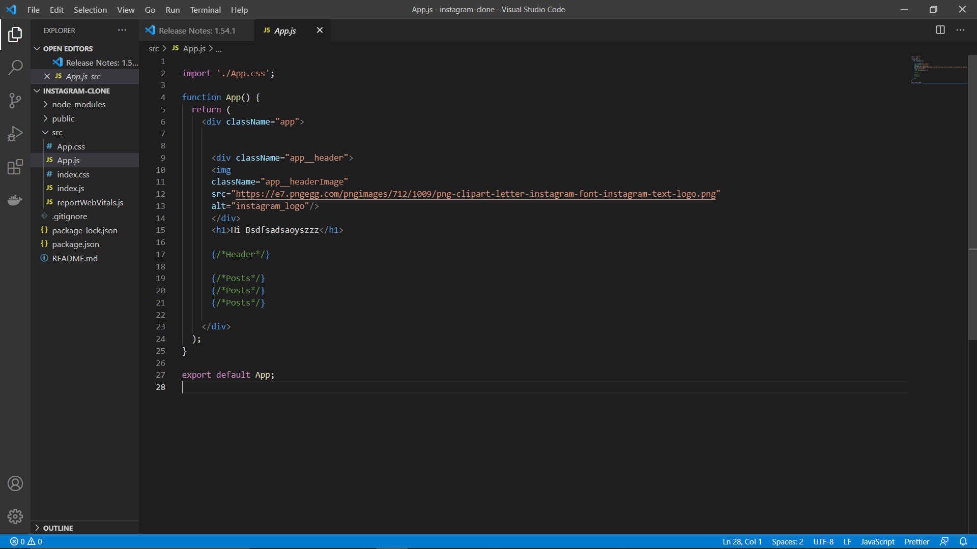
Work Done so far
Working on the front- end
Place your screenshot here
We are currently working on the front end
part of the website and as soon as the front end
completes we will move to the backend of the
project i.e. connecting it to firebase and working
on creating database schema for the project.

Slide 8
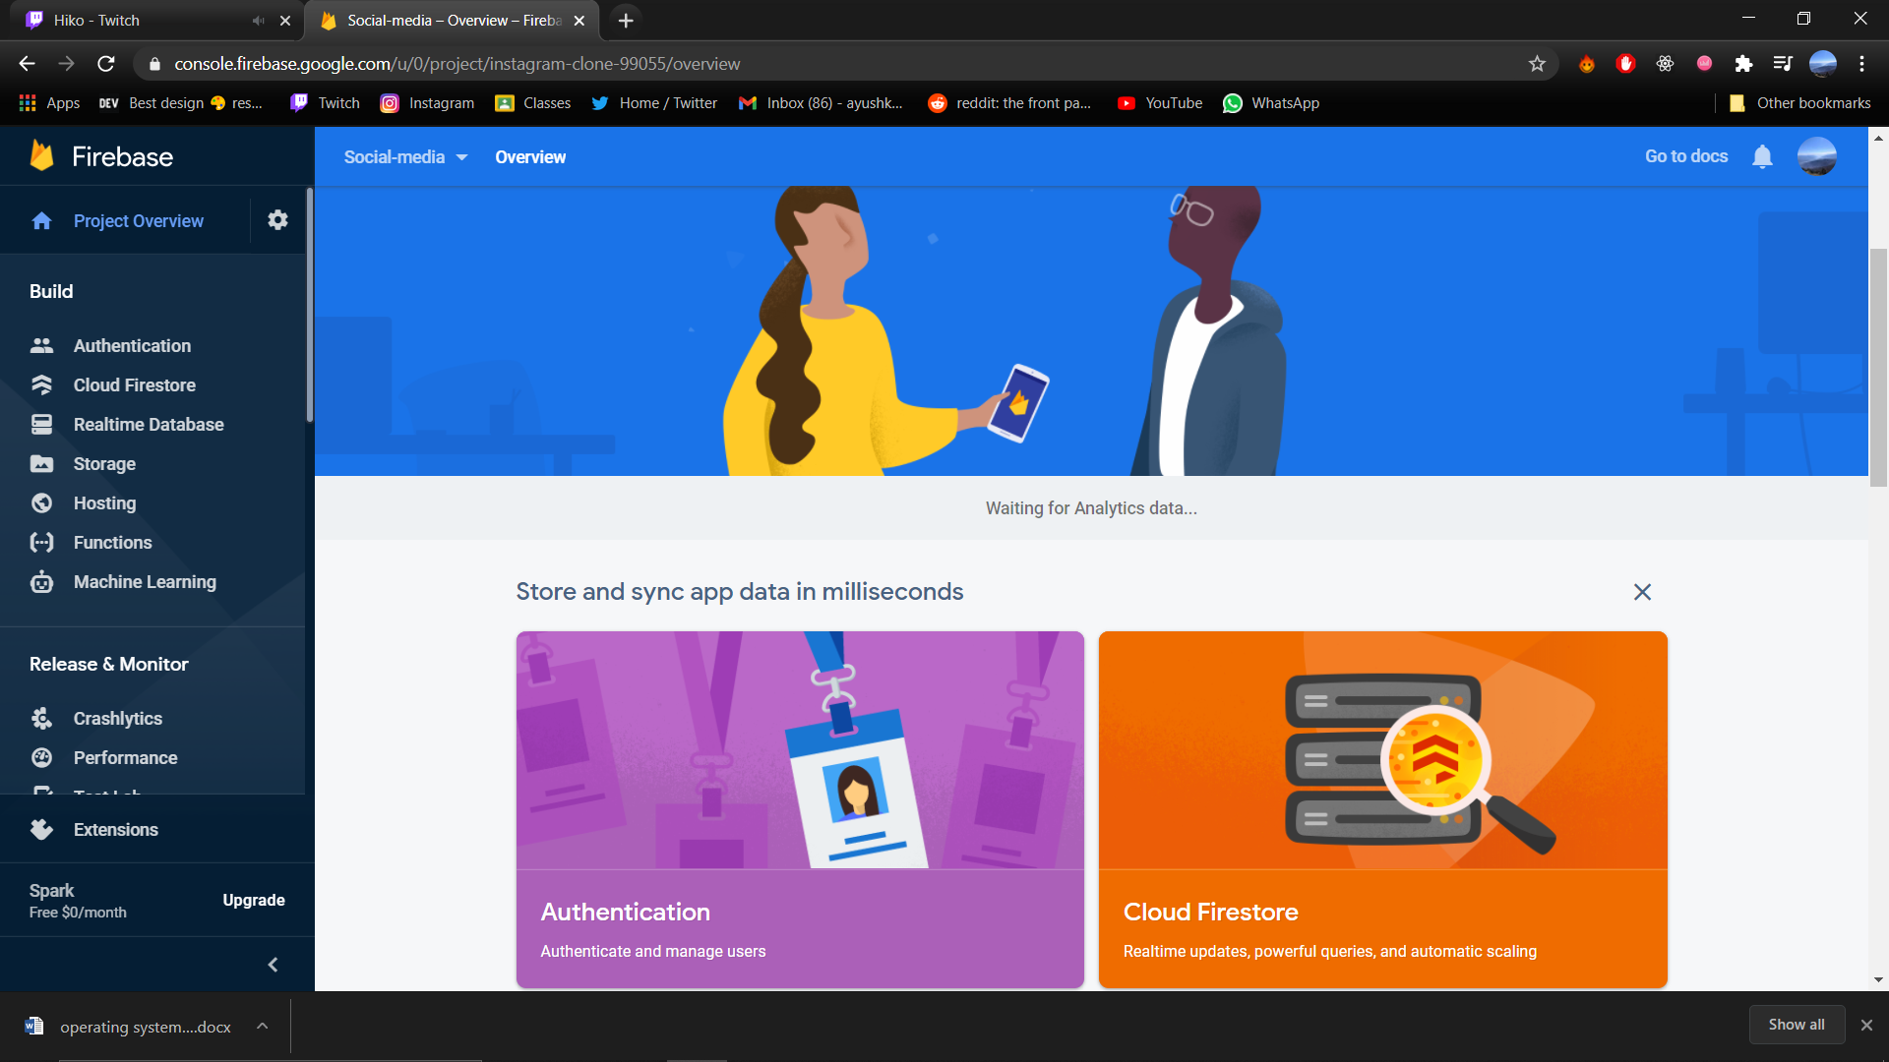
Work in future
Working on the back- end
Place your screenshot here
We will be connecting the website to the backend using firebase. All the functionality that has been discussed in previous slides will be added to the later stage

Slide 9
REFERENCES
[1] Singh H S., Singh U. “Study on Google Firebase for Website Development (The real time database)” International Journal of Engineering Technology Science and Research, Volume 4, Issue 3 March 2017
[2] Khawas C. , Shah P. “Application of Firebase in Android App Development-A Study” International Journal of Computer Applications Volume 179(46):, June 2018
[3] Yeshwin A., Sahoo A. , Shoby P. “A Research Paper on a Pet-Friendly Application using Flutter and Firebase” International Journal for Research in Applied Science & Engineering Technology (IJRASET
)Volume 8 Issue XII Dec 2020
[4] B. Traversy, “React JS Crash Course 2021” Jan 2021. [YouTube]
[5] V. Singh “Introduction to Firebase” Medium.com Dec 2018 [Medium.com]
[6] Firebase Documentation (https://firebase.google.com/docs)

