Slide 1
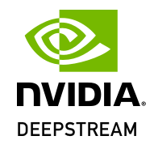
Exploring NVIDIA DeepStream IVA
Harnessing the Power of Deep Learning for Intelligent Video Analytics

Slide 2
Contents
Introduction
Software dependencies
Installation guide
Key features
DeepStream architecture
Working of NVIDIA DeepStream
Usage scenarios & customization
Pros & Cons
Conclusion

Slide 3
Introduction
NVIDIA DeepStream is a powerful platform for building AI-powered video analytics applications.
Designed for real-time processing and analysis of video streams.
DeepStream can handle all sorts of video streams, from local files to network streams like RTSP.
Definition:
DeepStream is a GStreamer-based SDK for creating vision AI applications with AI for image processing and object detection.
GStreamer is an open-source multimedia framework that facilitates the construction of flexible and modular pipelines for tasks such as audio and video processing, streaming, and multimedia application development.

Slide 4
Software Dependencies
NVIDIA GPU Driver
CUDA(Compute Unified Device Architecture) Toolkit
cuDNN (CUDA Deep Neural Network library)
TensorRT (TensorRT Inference Server)
DeepStream SDK
Libraries and Frameworks
Operating System
  Compatible with Linux-based operating systems(Ubuntu is commonly used)

Slide 5
Installation Guide
NVIDIA GPU Driver
CUDA(Compute Unified Device Architecture) Toolkit
cuDNN (CUDA Deep Neural Network library)
TensorRT (TensorRT Inference Server)
DeepStream SDK
Libraries and Frameworks

Slide 6
Key features
Real-Time Video Analytics
GPU Acceleration
Scalability
Multi-Sensor Support
Deep Learning Integration
Pre-Trained Models
GStreamer Integration
Edge AI Capabilities
SDK and API Support
Customizable Workflows
Hardware Acceleration Support
Monitoring and Analytics
Rich Set of Plugins
Community and Ecosystem

Slide 7
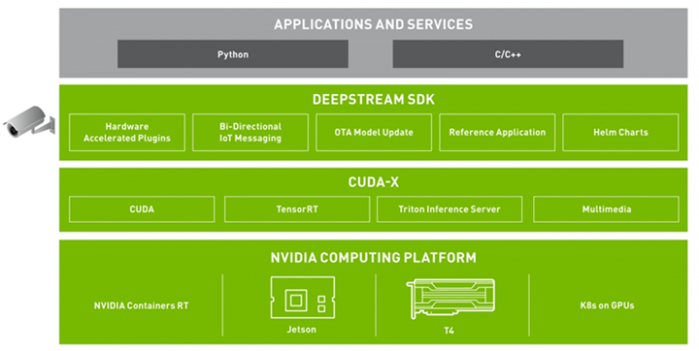
Deepstream Architecture

Slide 8
Deepstream Architecture(Cont...)
NVIDIA DeepStream has a modular and scalable architecture designed for building AI-powered video analytics applications. The architecture involves several components that work together to enable real-time video processing and analysis.
Application
  The application layer represents the user-developed code or application that leverages the DeepStream SDK. This is where developers define specific use cases, configure the pipeline, and interact with the results of video analytics.
DeepStream SDK
  The DeepStream SDK provides a set of libraries, APIs, and tools that allow developers to build and deploy video analytics applications. It includes modules for video input/output, deep learning inference, metadata processing, and other essential functionalities.

Slide 9
Deepstream Architecture(Cont...)
CUDA-X
  DeepStream builds on top of several NVIDIA libraries from the CUDA-X stack such as CUDA, TensorRT, Triton Inference server and multimedia libraries. TensorRT accelerates the AI inference on NVIDIA GPU. DeepStream abstracts away these libraries in DeepStream plugins, making it easy for developers to build video analytic pipelines without having to learn all the individual libraries.
NVIDIA Computing Platforms
  DeepStream is optimized for NVIDIA GPUs; the application can be deployed on an embedded edge device running Jetson platform or can be deployed on larger edge or datacentre GPUs like T4.

Slide 10
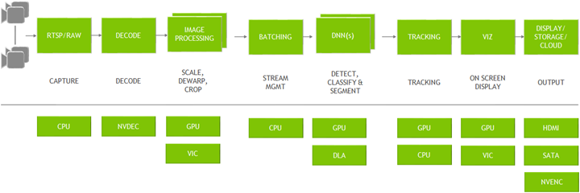
Working of NVIDIA Deepstream
Figure: Graph architecture of NVIDIA DeepStream

Slide 11
Working of NVIDIA Deepstream (Cont...)
Data Ingestion
  DeepStream begins by ingesting video data from various sources, such as cameras, video files, or network streams. It supports multiple input streams simultaneously.
GStreamer Pipeline
  GStreamer, a multimedia framework, is used to construct a flexible and modular pipeline for video processing. This pipeline comprises interconnected elements that handle tasks like video decoding, pre-processing, deep learning inference, and post-processing.
Pre-processing
  Incoming video frames undergo pre-processing to ensure they are in the appropriate format for deep learning inference. This may include resizing, normalization, and color format conversion.
Deep Learning Inference
  The pre-processed video frames are passed through deep learning models for inference. NVIDIA DeepStream supports integration with popular deep learning frameworks such as TensorFlow and PyTorch. Both pre-trained models and custom models can be used for tasks like object detection, classification, and tracking.

Slide 12
Working of NVIDIA Deepstream (Cont...)
TensorRT Optimization
  TensorRT, an optimization library from NVIDIA, is often integrated into the pipeline. It optimizes deep learning models for deployment on NVIDIA GPUs, enhancing the efficiency of inference. TensorRT performs tasks such as precision calibration, layer fusion, and kernel auto-tuning.
Analytics and Object Detection
  GStreamer, a multimedia framework, is used to construct a flexible and modular pipeline for video processing. This pipeline comprises interconnected elements that handle tasks like video decoding, pre-processing, deep learning inference, and post-processing.
Post-processing
  The analytics results undergo post-processing to refine and interpret the information. This may include non-maximum suppression for object detection or filtering out irrelevant information.
Event Triggering:
  Based on the analytics results, DeepStream can trigger events or actions. For example, it can generate alerts for detected anomalies, count the number of objects, or trigger other automated responses.

Slide 13
Working of NVIDIA Deepstream (Cont...)
Output Visualization
  The final processed video frames, along with analytics results, can be visualized in real-time. Visualization may include drawing bounding boxes around detected objects, displaying object labels, or overlaying additional information on the video stream.
Integration with Applications
  GStreamer, a multimedia framework, is used to construct a flexible and modular pipeline for video processing. This pipeline comprises interconnected elements that handle tasks like video decoding, pre-processing, deep learning inference, and post-processing.
Edge and Cloud Deployment
  DeepStream can be deployed at the edge on devices with NVIDIA GPUs as well as in data centre environments. This flexibility allows for the implementation of intelligent video analytics solutions in various scenarios.
Monitoring and Management
  DeepStream provides tools for monitoring the performance of video analytics applications. This includes tracking resource utilization, latency, and other metrics, aiding in optimization and troubleshooting.

Slide 14
Working of NVIDIA Deepstream (Cont...)
Extensibility and Customization
  Developers can extend the functionality of DeepStream by incorporating custom plugins, adapting it to specific use cases, and integrating additional features as needed.

Slide 15
Experimentation
Experiment overview
Run an object detection application in deepstream.
Configuration
No of sources: 30
Input stream: Sample video
Algorithm used: ResNet10
Requirements
Trained model(ResNet10) need to be converted to .caffemodel format for deepstream to be able to use it.

Slide 16
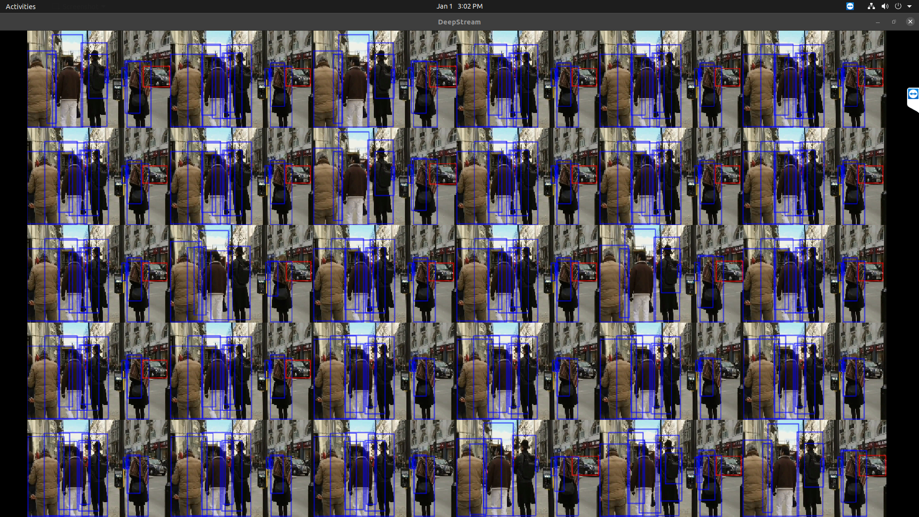
Experimentation(Cont...)
Results on running the application
Fig: Deepstream output stream(30 streams) – sample video

Slide 17
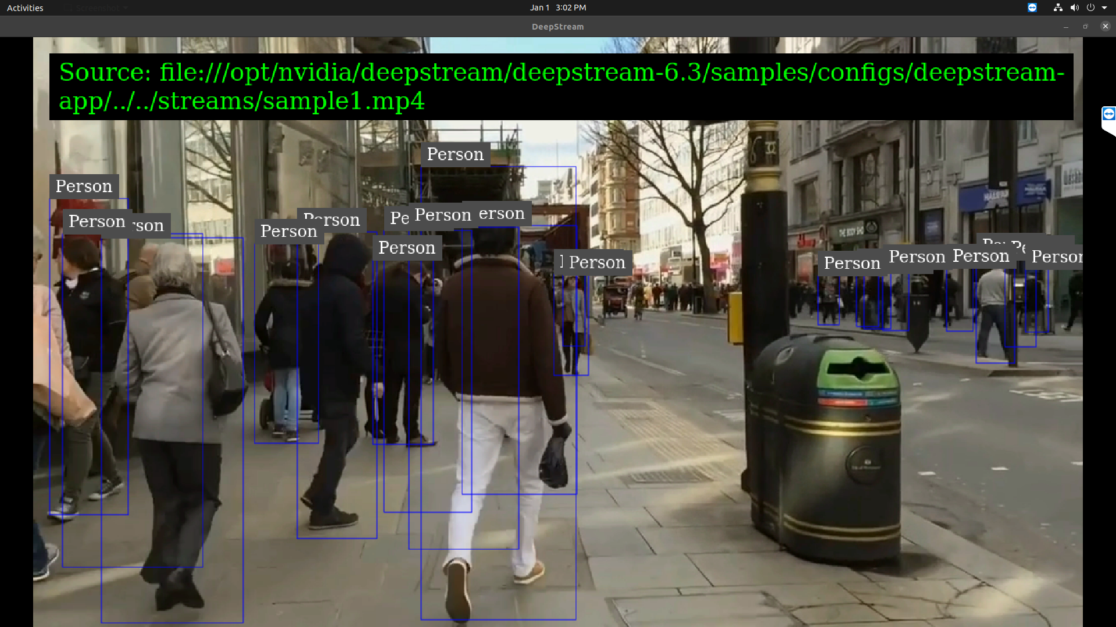
Fig: Deepstream output stream(single stream) – sample video

Slide 18
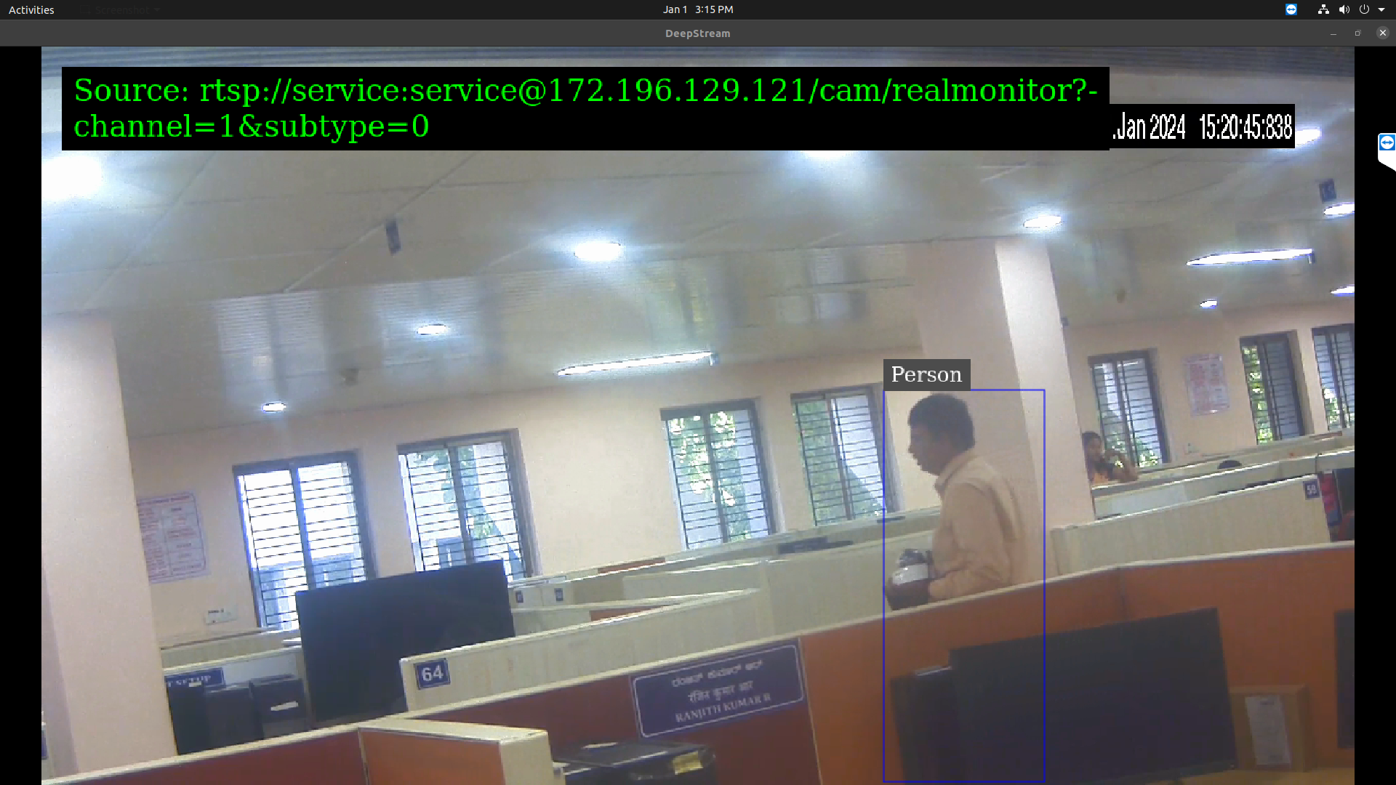
Fig: Deepstream output stream(single stream) – rtsp stream

Slide 19
Resource Utilization
No. of stream | RAM | Volatile GPU
1 | 1322MiB | 2 - 3 %
6 | 1567MiB | 13 – 17 %
36 | 2853MiB | 17 – 19 %
72 | 4406MiB | 22 – 24 %

Slide 20
Pros of DeepStream
High Performance
  DeepStream is optimized for real-time video analytics, offering high performance and low latency for processing video streams.
Scalability:
  The framework is designed to scale horizontally, making it suitable for deployment on a variety of hardware, including edge devices and high-performance servers.
Ease of Integration
  DeepStream provides APIs and SDKs that make it relatively easy to integrate with various deep learning frameworks and libraries, allowing developers to leverage pre-trained models.
Modularity
  The modular architecture of DeepStream allows users to easily add or customize components, making it flexible and adaptable to different use cases.
Comprehensive Toolkit:
  DeepStream comes with a comprehensive set of tools, plugins, and pre-built applications that cover a wide range of video analytics tasks, reducing the development effort for specific use cases.

Slide 21
Cons of DeepStream
Resource Intensive
  Running complex video analytics applications can be resource-intensive, requiring powerful hardware and GPUs, which may limit its deployment on certain edge devices with resource constraints.
Limited Model Support
  Although DeepStream supports integration with various deep learning frameworks, the range of supported models might be limited compared to general-purpose deep learning frameworks.
Dependency on NVIDIA Hardware
  DeepStream heavily relies on NVIDIA GPUs and CUDA technology, which may limit its compatibility with non-NVIDIA hardware or environments.
Customization Complexity
  While DeepStream offers modularity, making extensive customizations or building entirely new components may involve a complex development process, especially for users with limited experience in video analytics.

Slide 22
Conclusion

