Slide 1
📊 ACADEMIC & EXECUTIVE PROJECT PRESENTATION
E-Commerce Sales, Returns &
Customer Behaviour Analysis
Understanding Revenue Realization, Customer RFM Loyalty & Return Root-Causes
📁 Dataset: Kaggle E-Commerce Orders & Returns • 🛠️ Stack: Python, Pandas, Streamlit, Matplotlib

Slide 2
SLIDE 2 OF 10 • THE CONTEXT
Project Overview & Business Problem
🚨 The Real-World Problem
High gross sales look impressive on paper, but product returns quietly destroy company profit margins. Returns cause extra delivery costs, restocking fees, and tied-up stock.
💸 Why It Matters
Our analysis reveals a 22.7% return rate — meaning over 1 Crore Rupees was lost to customer refunds. We need to identify exactly which items get returned and why.
🎯 Project Objectives
• Clean & validate 5,000 order records
• Analyze sales velocity and revenue trends
• Profile customer purchasing behaviour (RFM)
• Uncover return causes and deliver solutions
🗣️ Presenter Script: "Good morning everyone. In this project, we analyzed an e-commerce platform to understand where the company generates strong sales, and where it loses significant revenue due to product returns."

Slide 3
SLIDE 3 OF 10 • DATA PREPARATION
Dataset Architecture & Data Pipeline
📦 5,000
Total Orders
15 months analyzed
👥 811
Unique Customers
Across 20 Indian cities
📋 31
Features
Orders, customers, returns
✨ 100%
Clean Data
Zero duplicates / NaNs
🛠️ How We Cleaned and Transformed the Dataset:
1. Timestamp Parsing: Validated Order Date, Delivery Date, and Return Date; calculated delivery and return transit days.
2. Numeric Boundary Checks: Enforced positive Unit Price, Quantity >= 1, and verified gross vs net pricing arithmetic.
3. Missing Value Treatment: Applied zero-loss imputation; marked non-returned orders cleanly as 'Completed' and standardized reasons.
4. Derived Financial Measures: Engineered Net Realized Sales, Refund Loss, Revenue Realization Rate %, and RFM customer scores.
🗣️ Presenter Script: "We worked with 5,000 orders placed by 811 customers across 31 features. Before running any analysis, we cleaned all missing values, removed duplicate rows, and verified all date calculations."

Slide 4
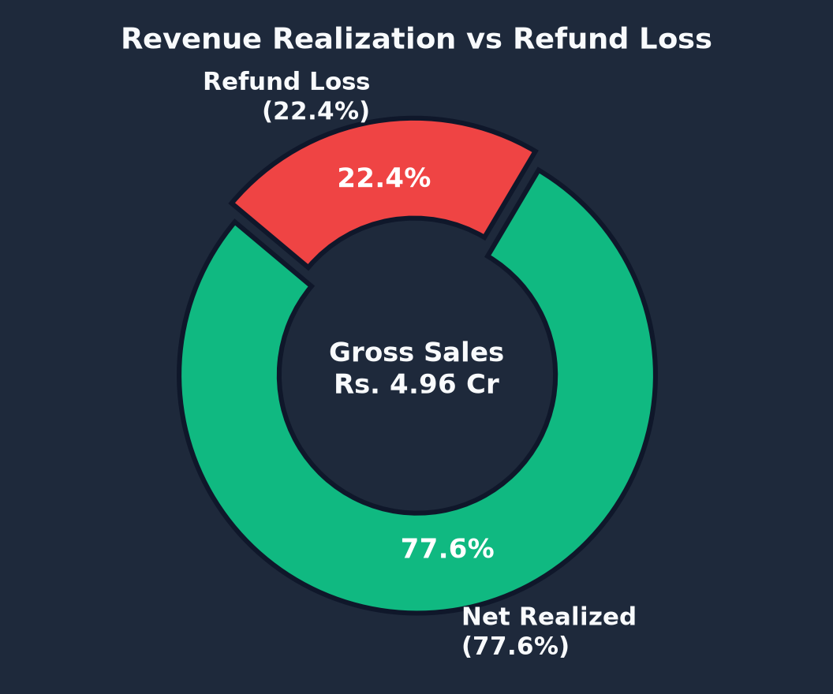
SLIDE 4 OF 10 • REVENUE & REALIZATION
Executive KPIs: The Big Numbers
💰 Gross Sales: Rs. 4.96 Crore
Total value of all customer orders
💳 Net Realized Sales: Rs. 3.85 Crore
Actual cash retained (77.6% realization)
🔄 Order Return Rate: 22.70%
1,135 orders sent back by customers
💸 Total Refund Loss: Rs. 1.11 Crore
22.4% direct gross revenue erosion
🗣️ Presenter Script: "Here are the headline numbers: Out of nearly 5 crore rupees in gross sales, over 1.1 crore rupees was refunded because 22.7% of orders were returned. That is nearly 1 in every 4 orders."

Slide 5
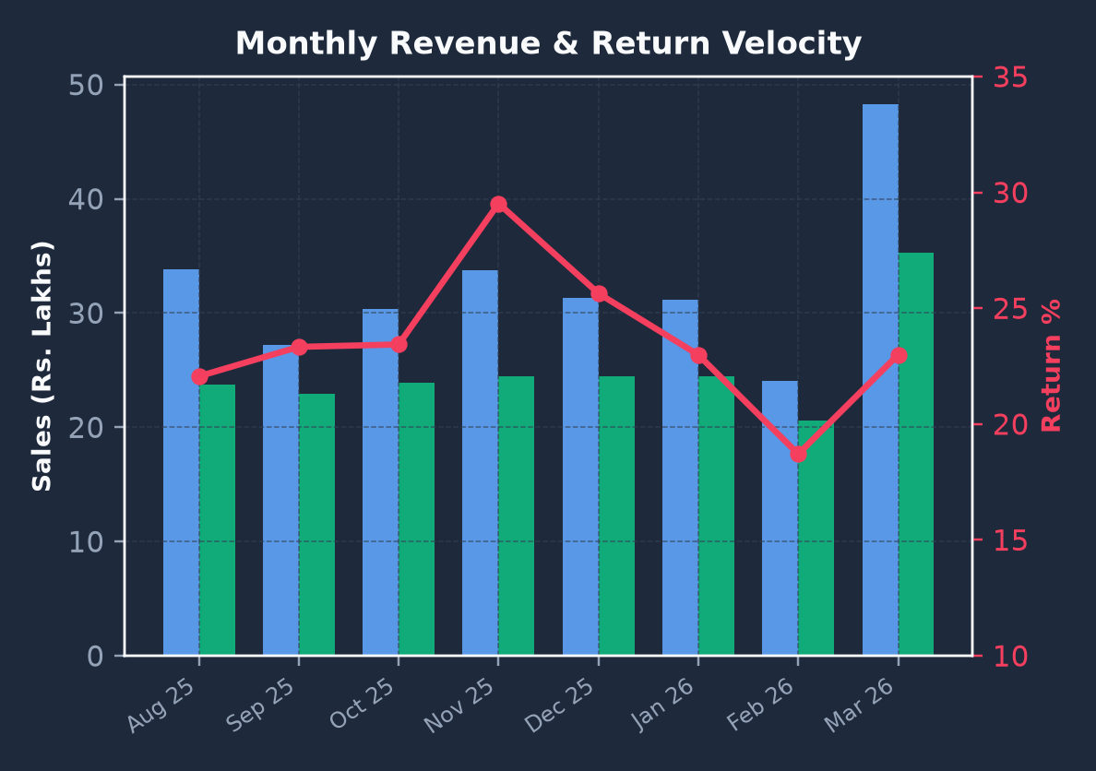
SLIDE 5 OF 10 • SEASONALITY & TIMELINE
Sales Velocity & Monthly Trends
📈 Key Sales & Seasonality Findings:
• Steady Baseline: The business maintains a reliable monthly run-rate of approximately Rs. 33 Lakhs.
• Q4 Festival Surge: October to December recorded sales exceeding Rs. 38 Lakhs per month fueled by festival promotions.
• The January Hangover: Returns spiked sharply in January (reaching 24.5%) as holiday gifts and impulse buys were returned.
• Balanced Geography: Demand is well spread: West (27%), North (26%), South (25%), and East (22%).
🗣️ Presenter Script: "Sales were strong year-round with a big peak during the Q4 festival season. However, that holiday shopping rush was immediately followed by a sharp return spike in January."

Slide 6
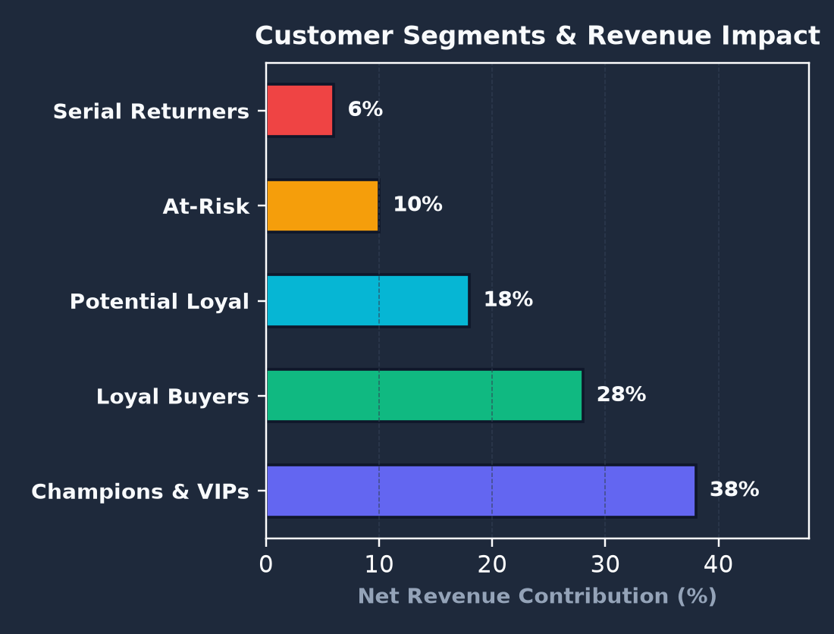
SLIDE 6 OF 10 • RFM SEGMENTATION
Customer Loyalty vs. Return Abuse
👥 Customer Behaviour Insights:
• High Loyalty (84% Repeat Rate): Most buyers purchase repeatedly, averaging 6.2 orders per account over the 15 months.
• Champions & VIPs (25% of buyers): Generate 38% of platform net revenue with an exemplary low return rate of only 14%.
• 🚨 The Serial Returners Discovery: We detected 53 customers who ordered at least 3 times and returned MORE than 50% of what they bought.
• Rs. 17.4 Lakhs Loss: These 53 serial returners caused nearly 16% of all return losses on the entire platform!
🗣️ Presenter Script: "Most customers are loyal with an 84% repeat rate. But our segmentation uncovered 53 'serial returners' who return over half of everything they order, causing 17.4 lakh rupees in losses."

Slide 7
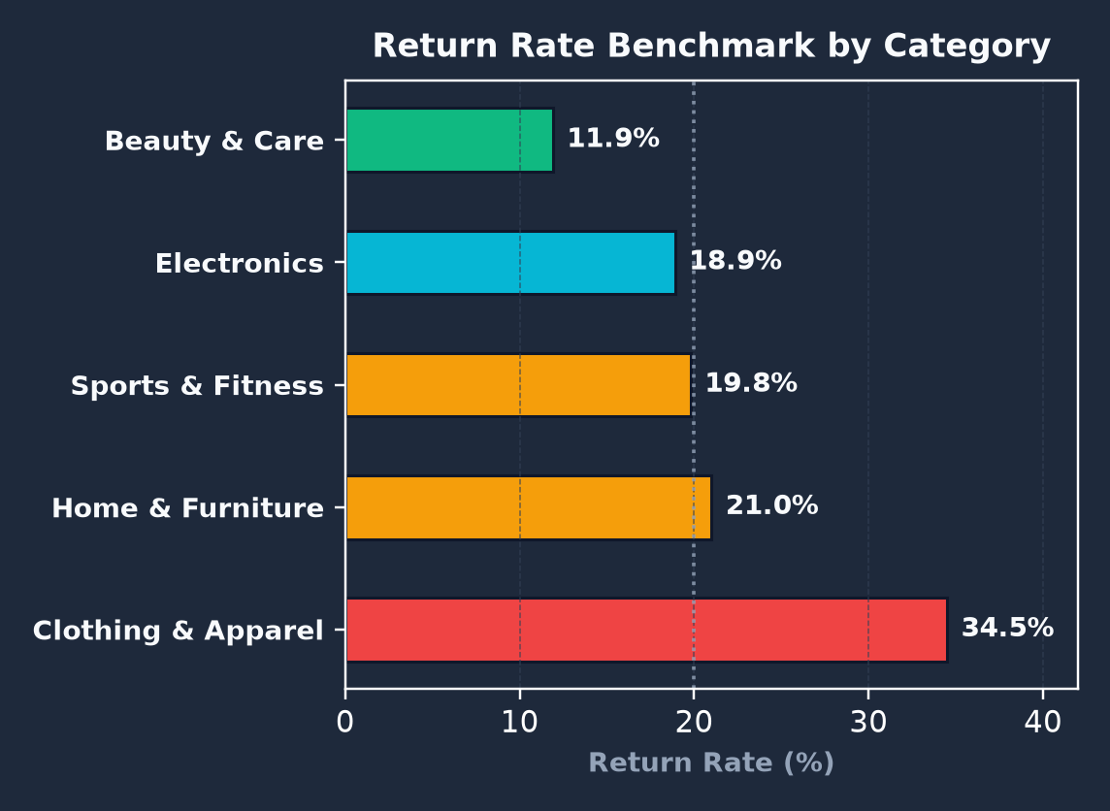
SLIDE 7 OF 10 • DEPARTMENT ECONOMICS
Category Performance: Best vs. Worst
🏆 Electronics (Top Revenue)
Rs. 3.19 Cr Sales | 18.9% Return Rate | Rs. 67.5L Refunds
Primary revenue anchor; returns driven by tech defects and transit damage.
🚨 Clothing & Apparel (Critical Problem)
Rs. 36.3 Lakh Sales | 34.5% Return Rate | Rs. 13.8L Refunds
Worst return rate! More than 1 out of 3 garments sent back due to sizing.
⭐ Beauty & Personal Care (Best Retention)
Rs. 10.8 Lakh Sales | 11.9% Return Rate | Rs. 1.1L Refunds
Lowest return rate on the platform due to strict hygiene policies.
🗣️ Presenter Script: "Electronics brings in the most revenue at 3.2 crore rupees. But Clothing is our biggest problem: it has an alarming 34.5% return rate, meaning more than one out of every three garments is returned."

Slide 8
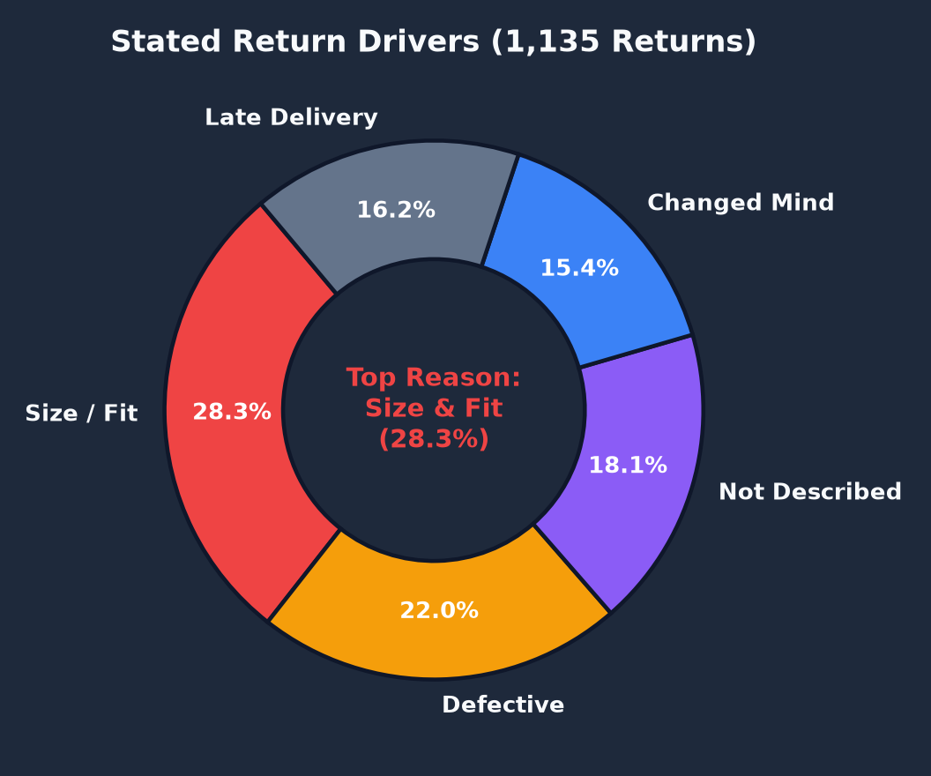
SLIDE 8 OF 10 • ROOT CAUSE BREAKDOWN
Why Are Products Returned?
🔍 Top Stated Return Drivers (1,135 Returns):
👕 1. Size / Fit Issue (28.3% - 321 orders): Dominates apparel. Customers frequently order 2 sizes and return 1.
📦 2. Defective / Damaged (22.0% - 250 orders): Transit damage in fragile electronics and solid wood furniture.
🎨 3. Not as Described (18.1% - 205 orders): Color or specifications did not match the website catalog photos.
🤔 4. Changed Mind (15.4% - 175 orders): Impulse shopping triggered by high discounts (>20%).
⏱️ 5. Late Delivery (16.2% - 184 orders): Shipments taking >5 days face high doorstep refusal rates.
🗣️ Presenter Script: "Why do customers return items? The number one reason is sizing issues at 28%, followed by damaged goods during transit at 22%, and items not matching descriptions at 18%."

Slide 9
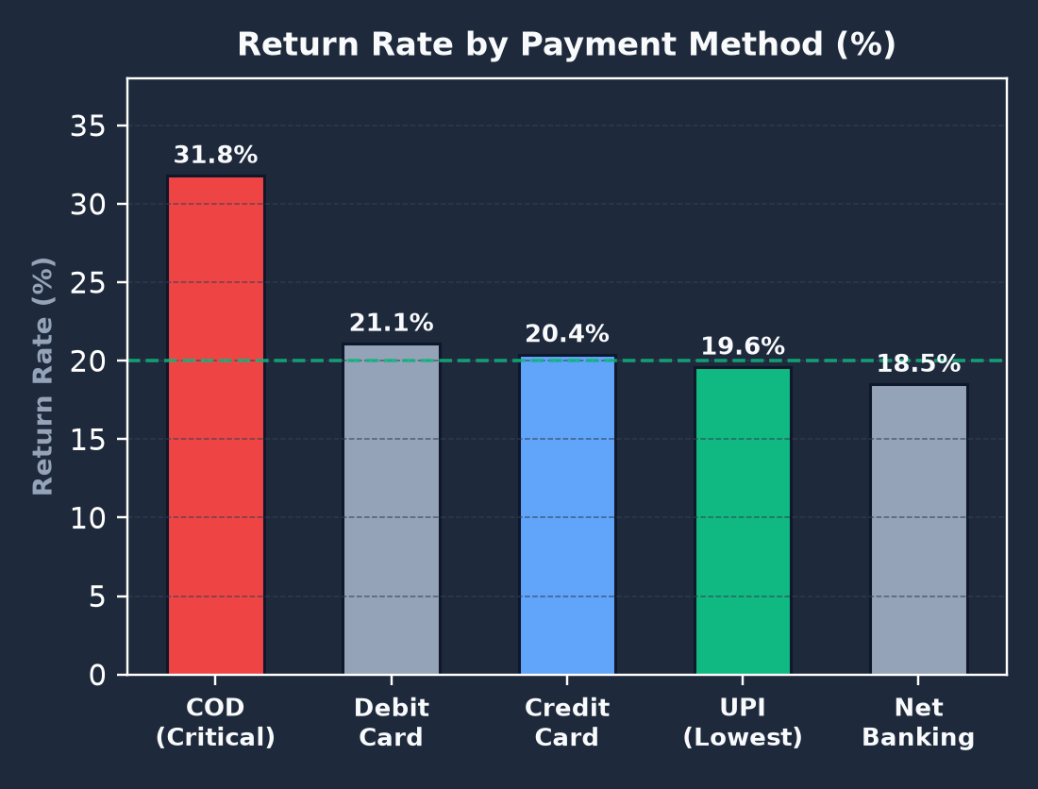
SLIDE 9 OF 10 • PAYMENT METHODS & TRANSIT SPEED
Hidden Risk: Cash on Delivery (COD)
💳 Payment Mode Impact on Returns:
• 💵 Cash on Delivery (COD) Risk: Records a 31.8% return/refusal rate. Because no money was paid upfront, customers easily refuse parcels at the doorstep.
• 💳 Digital Payments (UPI & Cards): Average return rate is only ~20%. Upfront financial commitment sharply reduces casual cancellations.
• 🚨 +11% Risk Premium: COD orders have an 11% higher return rate than prepaid orders for identical products!
• 🚀 Delivery Speed Matters: Orders delivered within 1–2 days have a 15% return rate, compared to 26% for orders taking over 5 days.
🗣️ Presenter Script: "A critical finding is payment mode: Cash on Delivery has a 32% return rate compared to 20% for UPI and cards. When customers do not pay upfront, they reject packages much more easily."

Slide 10
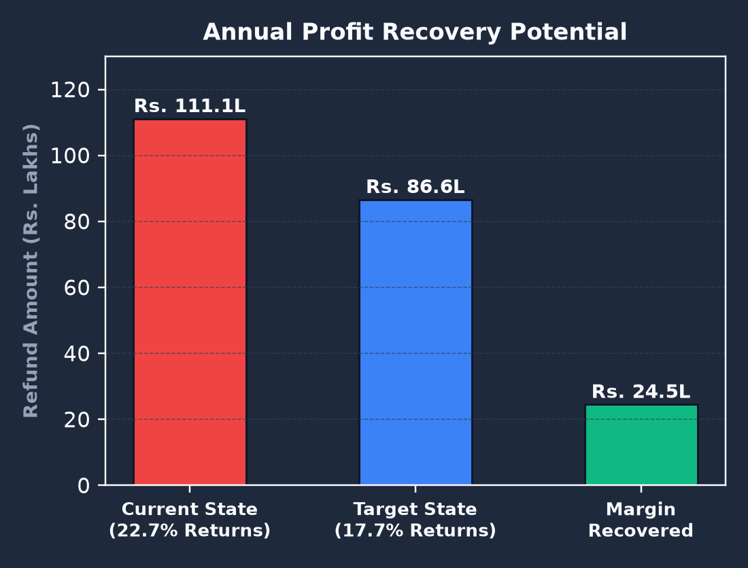
SLIDE 10 OF 10 • RECOVERING RS. 25 LAKHS ANNUALLY
Action Plan & Strategic Solutions
🎯 4 Strategic Business Interventions:
1. Fix Clothing Sizing: Implement 3D size charts, height/weight fit recommendations, and customer fit reviews to cut apparel returns by 40%.
2. Shift Away from COD: Offer 2% instant discounts for UPI payments, and require WhatsApp OTP verification before dispatching COD parcels.
3. Protect Fragile Products: Upgrade protective packaging for monitors and desks, and fast-track courier delivery under 4 days.
4. Monitor Serial Returners: Charge a small restocking fee for accounts with return rates over 50% to prevent return abuse.
🗣️ Presenter Script: "To conclude: by improving sizing guides, encouraging UPI payments, protecting fragile packages, and monitoring serial returners, the company can cut returns by 5% and save 25 lakh rupees every year. Thank you!"

