Slide 1
Semaphore
[A Beginner’s Guide]
Presented by: Sonu Kumar
Date : 27.09-2023
Keen & Able Computers Pvt Ltd

Slide 2
Agenda
Semaphore
Used for
Support Database
Semaphore pros and cons over Ansible Tower
User Guide:
Key Store
Repository
Environment
Inventory
Task Template
Simple Demo

Slide 3
Semaphore
It is the modern UI for Ansible. It helps in easily running the Ansible Playbook, getting notification about failures, and controlling access to the deployment system.
It is written in pure Golang.
It is available for Windows, Mac OS, Linux.
It is responsible for the based Web UI for running Ansible playbook.

Slide 4
Used for:
Semaphore is used for build, deploy, and rollback.
It manages the Environment, Inventory, Repository and Access Key.
It is used to run the playbook from the browser.
It also runs the playbook by schedule.
View details logs of any playbook run at any time.

Slide 5
Support Database:
MySQL
PostgreSQL
BoltDB

Slide 6
Semaphore pros and cons over Ansible Tower
Free and open source.
Easy to setup
Simple and clean UX
Lack of premium feature.

Slide 7
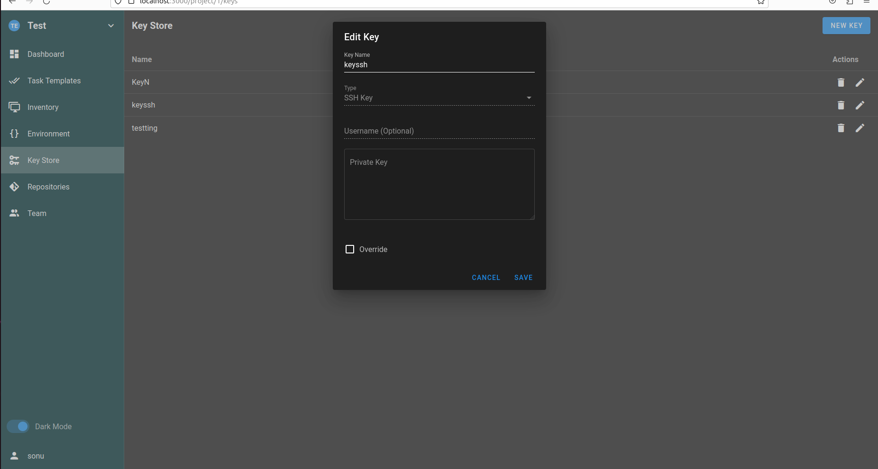
User Guide: Key Store
It is used to store the credentials for accessing remote repositories, accessing the remote hosts, sudo credentials and Ansible vaults password.
SSH
Login with Password
None

Slide 8
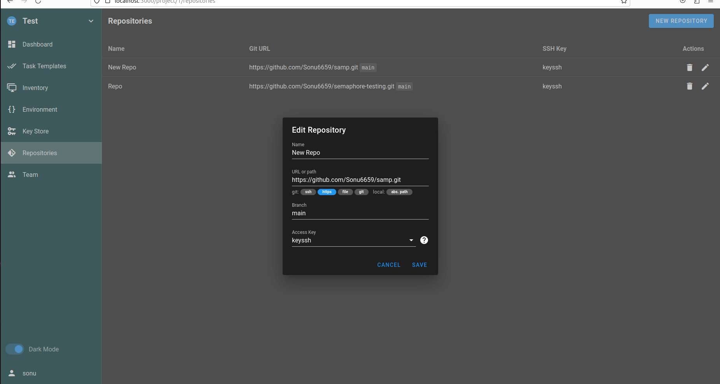
Repositories
Repositories are the place where key store and manage the content like playbook and roles.
All tasks must be required by the repositories in order to run the playbook.

Slide 9
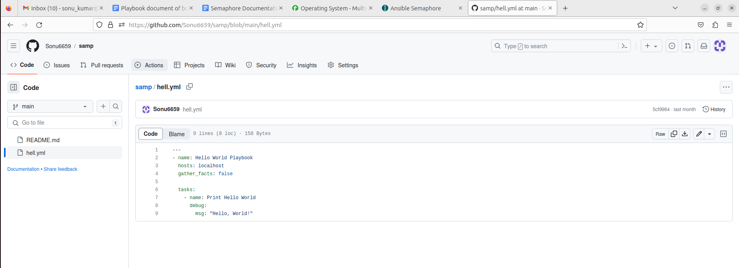
Git Repository

Slide 10
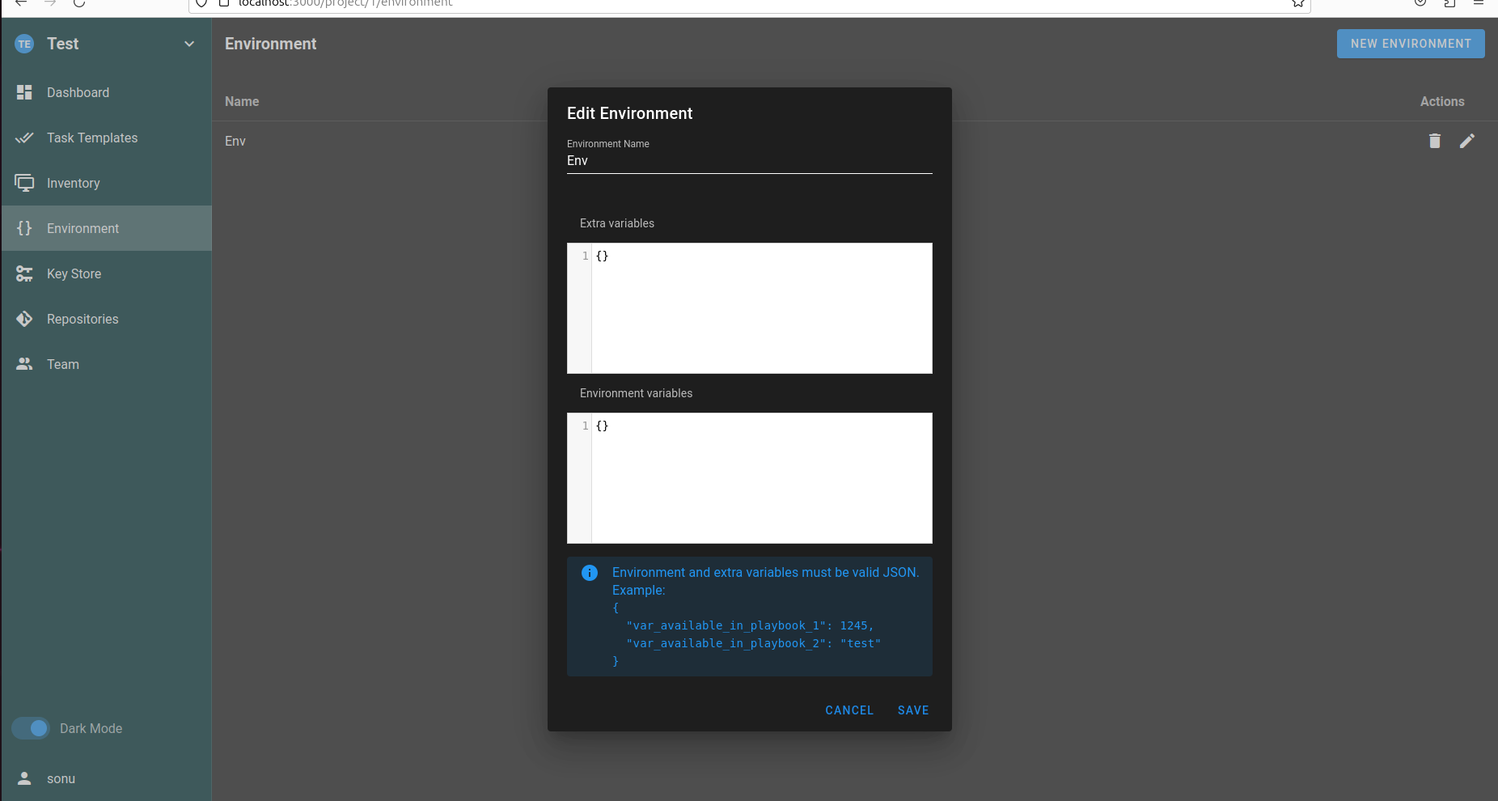
Environment
In this where we have to store the additional variable for an inventory and must be stored in a JSON file.

Slide 11
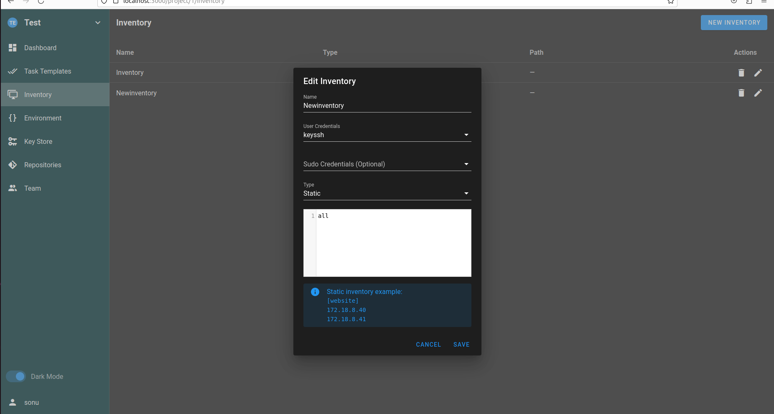
Inventory
It is a place of file where it contains all the lists of Ansible hosts. It also stores the variable that can be used in the playbook.
It stores the file in JSON, YAML.

Slide 12
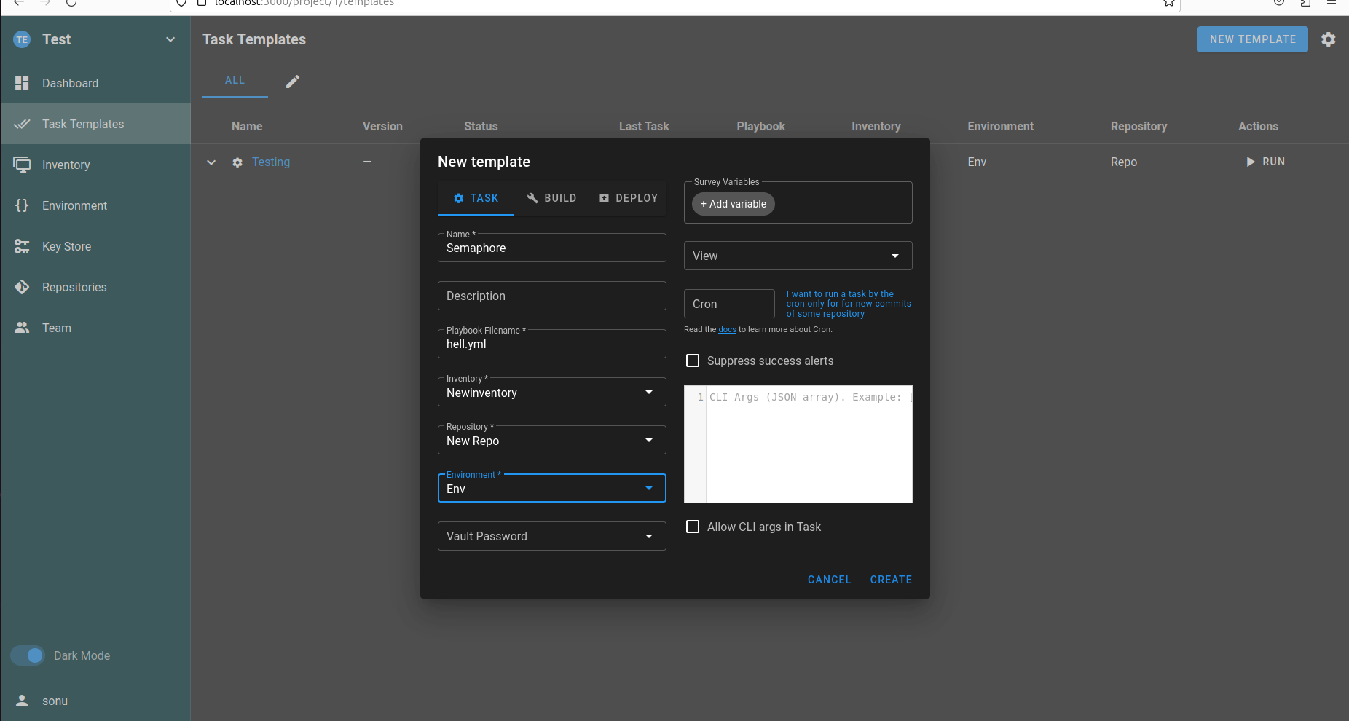
Task Templates
It define how we run the playbook with the parameters:
Inventory Name
Playbook file name
Inventory
Environment
Playbook repositories
Vault password file
Extra CLI argument.

Slide 13
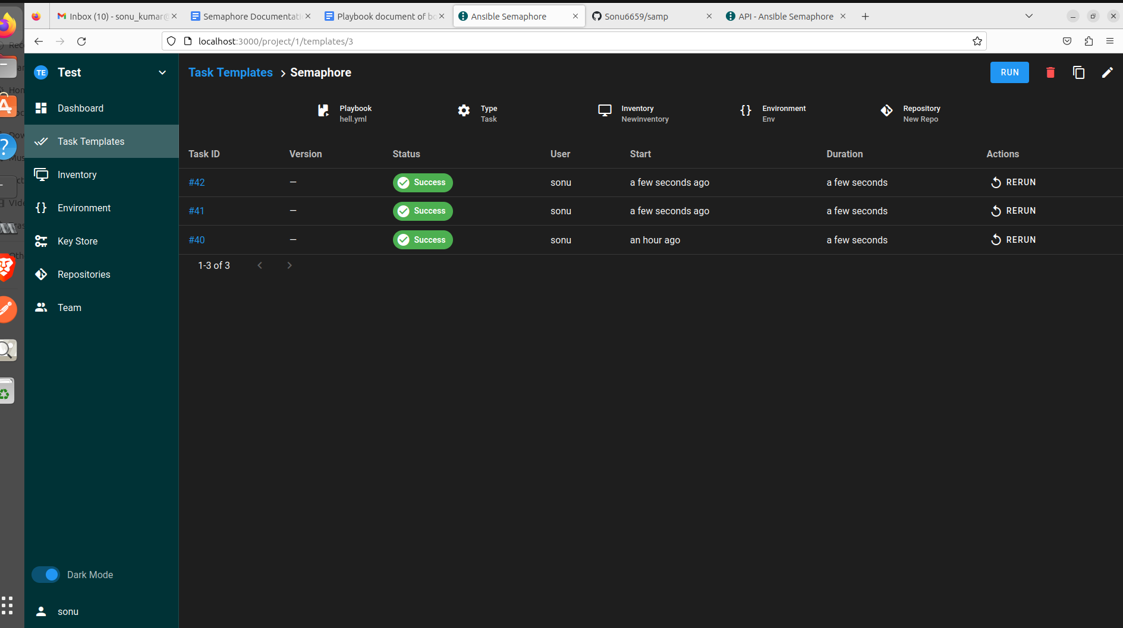

Slide 14
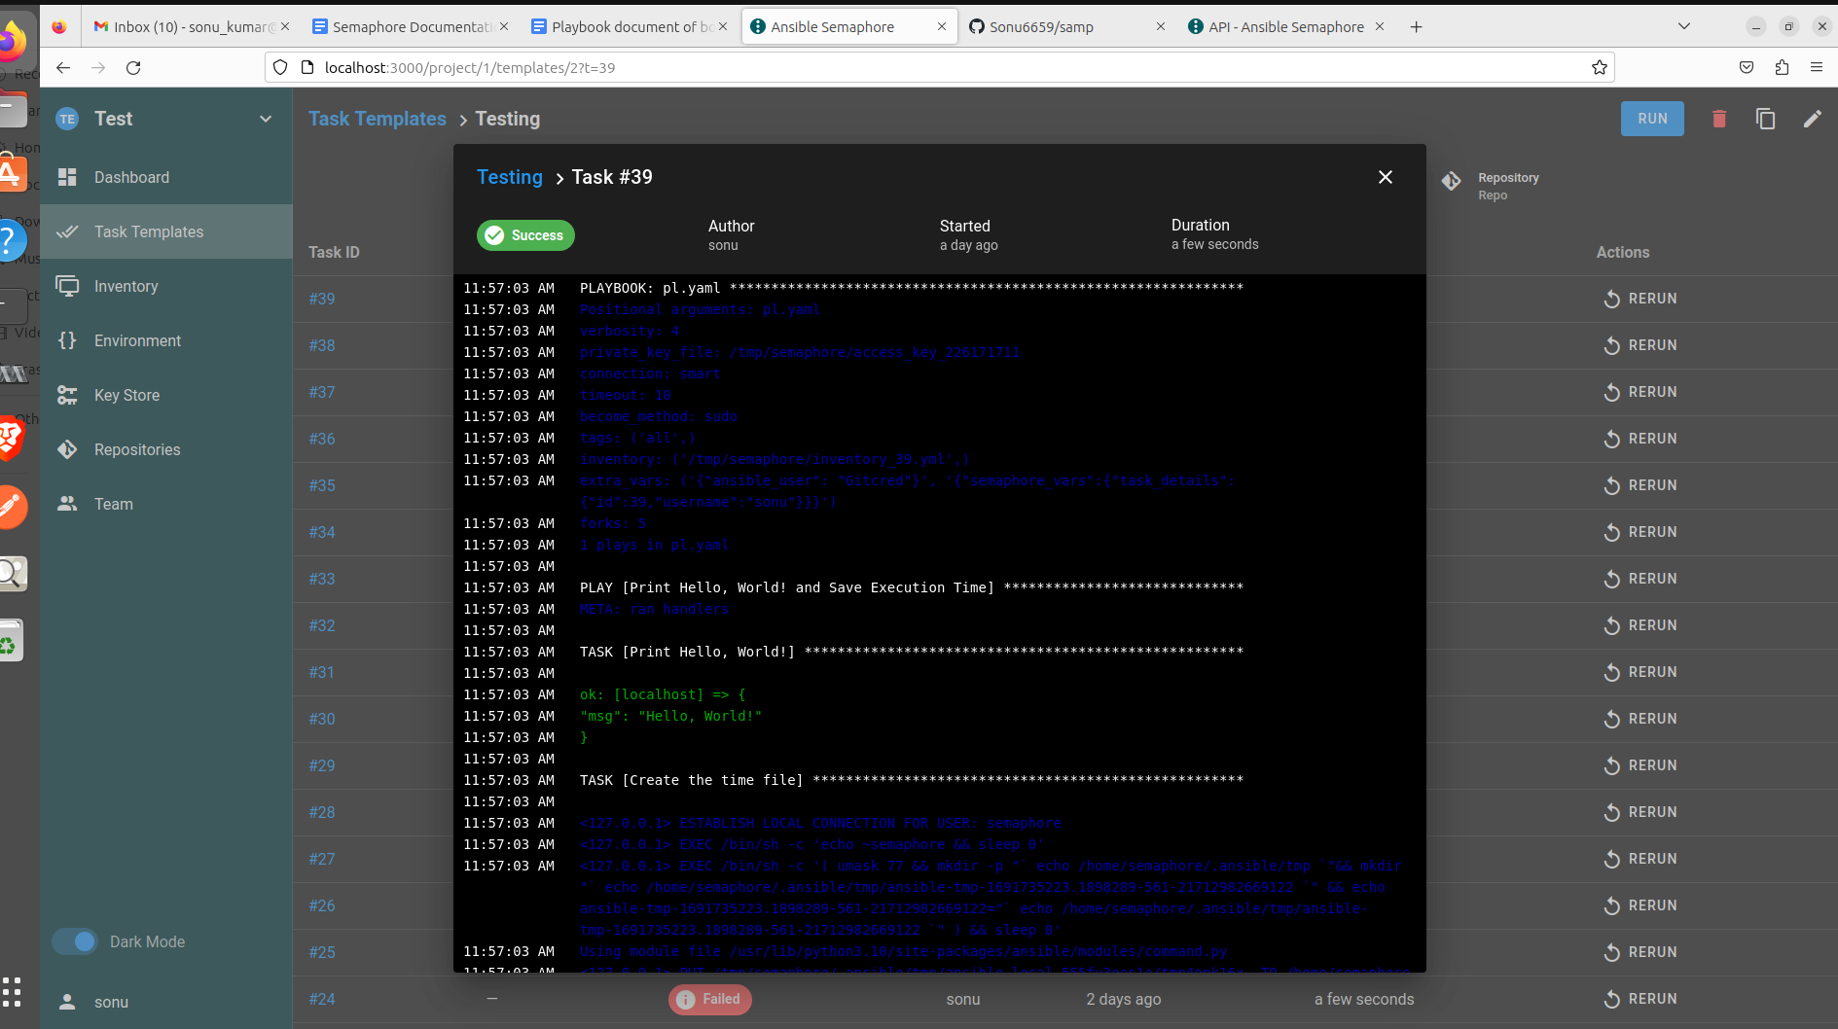
Demo output

Slide 15
Thank You…

