Slide 1



ABC Wireless Inc.
GROUP MEMBERS:
Snehitha Anpur
Niharika Kolliboyana
Avinash Ravipudi
Sony Kiran Devarapalli

Slide 2

PRESENTATION OUTLINE
CUSTOMER RETENTION AND GROWTH
CHURN RATE
APPROACHES
CUSTOMERS LIKELY TO CHURN
GRAPHICAL ANALYSIS
HOW DO WE FIX THE LEAKY BUCKET?

Slide 3
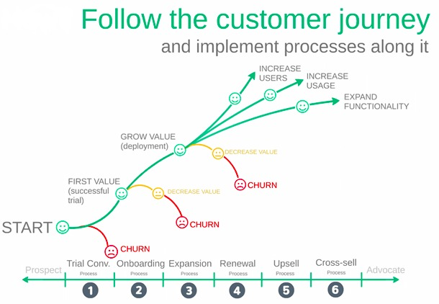
CUSTOMER RETENTION AND GROWTH
Company With Highest Retention Rate
Average Revenue Per User
Priority Of Customer Churn To The Company
Ideal Relationship
Churn At Different Stages

Slide 4
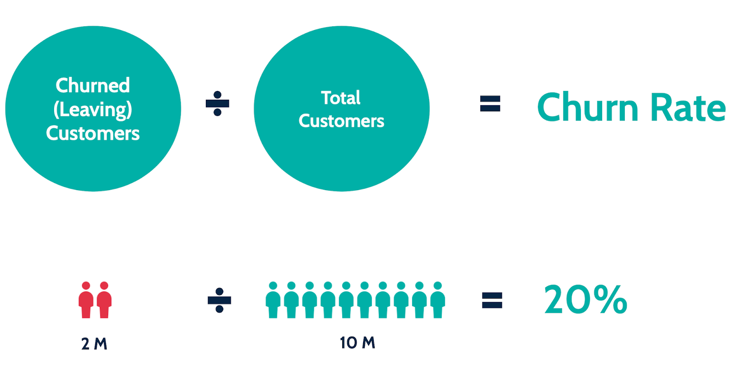
CHURN RATE
Churn Rate Impact On Lifetime Value Of Customers.
Churn Rate Of ABC Wireless Inc.
Average Customer Lifespan(ACL).

Slide 5

APPROACHES
Untargeted Approach
Targeted Approach

Slide 6
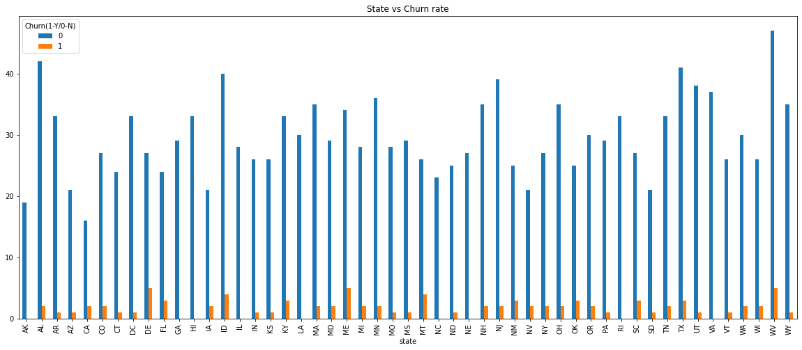
GRAPHICAL ANALYSIS

Slide 7
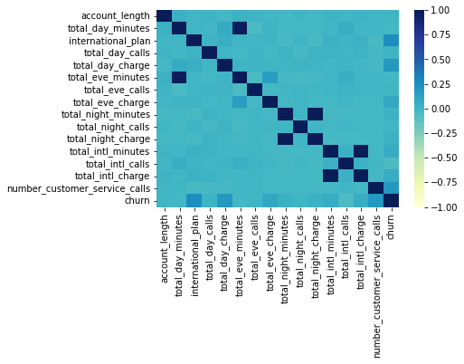
CUSTOMERS LIKELY TO CHURN
No International Plan.
High International Charges.
No Proper Customer Service.
Long International Call Duration.
High Day And Evening Charges.

Slide 8

HOW DO WE FIX THE LEAKY BUCKET?
Flexible Packages Based On The Locations.
Loyalty Reward Program.
Improve Network Coverage.
Improve Customer Service.

Slide 9


THANK YOU

