Slide 1
Development Tools Installation
Java Installation: Use Java 8
- https://www.oracle.com/technetwork/java/javase/downloads/jdk8-downloads-2133151.html
- Setup JAVA_HOME
- Update PATH
Maven installation: Use Maven 3.x.x
- http://maven.apache.org/download.cgi
- Setup M2_HOME
- Update PATH
IntelliJ Installation: Use Commercial version because the community version does not support Spring, Java EE, etc.
- https://www.jetbrains.com/idea/download/#section=windows

Slide 2
Development Tools Installation
Alternative: Eclipse or STS
- https://spring.io/tools
Install Postman: Will use Postman for testing
- https://www.getpostman.com/downloads/

Slide 3
Set-up TLS
keytool -genKey -alias myserver -keystore serverkeystore.jks -storetype jks -keypass password -storepass password -keyalg RSA

Slide 4
Basic Authentication
https://tools.ietf.org/html/rfc7617
Base64 encoding
https://tools.ietf.org/html/rfc7235#section-4.1

Slide 5
MySQL & Workbench installation
Use MySQL DB for our application
Download the server for Windows from https://dev.mysql.com/downloads/file/?id=488055
Install MySQL
Youtube link: https://www.youtube.com/watch?v=WuBcTJnIuzo

Slide 6
Create Database
Start the DB
Start MySQL Workbench
Create a connection to the DB
Create a DB
CREATE DATABASE api_security_db
Change to the newly created DB
USE api_security_db;
Create a new user with a password. This user will be used to connect from our application
CREATE USER 'springuser'@'%' IDENTIFIED BY 'ThePassword';
Give all the privileges to the new libraryUser on the newly created database library_db
GRANT ALL ON api_security_db.* TO 'springuser'@'%';

Slide 7
Create Database
Create USERS Table
CREATE TABLE USERS (
USERNAME VARCHAR(128) PRIMARY KEY,
PASSWORD VARCHAR(128) NOT NULL,
ENABLED CHAR(1) NOT NULL CHECK (ENABLED IN ('Y','N'))
);
Insert a User in the table
INSERT INTO `api_security_db`.`users` (`USERNAME`, `PASSWORD`, `ENABLED`)
VALUES ("sanjay", "$2y$12$4bavRcFDK8vjIUweLwetZuxnsBGcQqETtoX866/Ztli9Xjsc8PHbm",
'Y');

Slide 8
Authorities
Authorization means Restricting unauthorized access of data/resource
GrantedAuthority – Permission the user is granted
Create Authorities Table
CREATE TABLE AUTHORITIES (
AUTHORITY_ID INT PRIMARY KEY,
USERNAME VARCHAR(128) NOT NULL,
AUTHORITY VARCHAR(128) NOT NULL
);
ALTER TABLE AUTHORITIES ADD CONSTRAINT AUTHORITIES_UNIQUE UNIQUE (USERNAME, AUTHORITY);
ALTER TABLE AUTHORITIES ADD CONSTRAINT AUTHORITIES_FK1 FOREIGN KEY (USERNAME) REFERENCES USERS (USERNAME);

Slide 9
Creating Authorities table
Insert authorities data in the table
INSERT INTO `api_security_db`.`AUTHORITIES`(`AUTHORITY_ID`,`USERNAME`,`AUTHORITY`)
VALUES (1, "admin", "ADMIN");
INSERT INTO `api_security_db`.`AUTHORITIES`(`AUTHORITY_ID`,`USERNAME`,`AUTHORITY`)
VALUES (2, "user1", "USER");

Slide 10
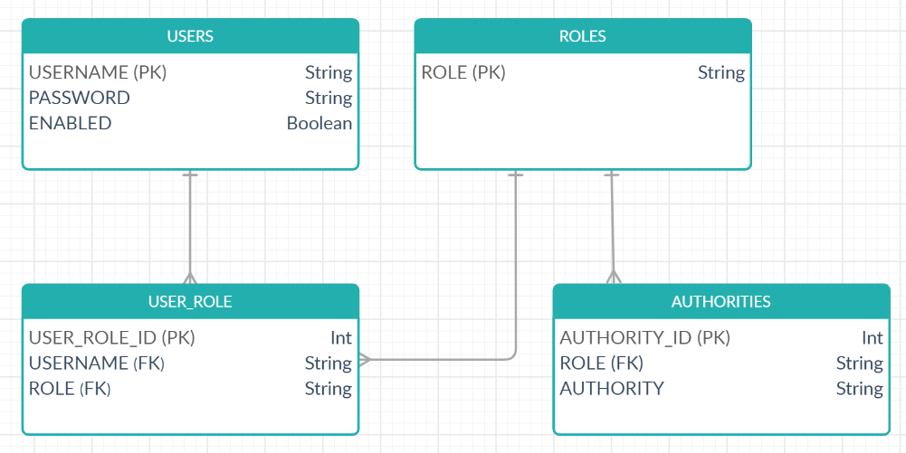
Roles and Authorities DB Changes
ERD for new tables

Slide 11
Roles and Authorities DB Changes
Drop Authorities table
Create Roles Table
CREATE TABLE ROLES (
ROLE VARCHAR(128) NOT NULL PRIMARY KEY
);
Create User_Role Table
CREATE TABLE USER_ROLE (
USER_ROLE_ID INT PRIMARY KEY,
USERNAME VARCHAR(128) NOT NULL,
ROLE VARCHAR(128) NOT NULL
);

Slide 12
Roles and Authorities DB Changes
ALTER TABLE USER_ROLE ADD CONSTRAINT USER_ROLE_UNIQUE UNIQUE (USERNAME, ROLE);
ALTER TABLE USER_ROLE ADD CONSTRAINT USER_ROLE_FK1 FOREIGN KEY (USERNAME) REFERENCES USERS (USERNAME);
ALTER TABLE USER_ROLE ADD CONSTRAINT USER_ROLE_FK2 FOREIGN KEY (ROLE) REFERENCES ROLES (ROLE);
Create Authorities Table
CREATE TABLE AUTHORITIES (
AUTHORITY_ID INT PRIMARY KEY,
ROLE VARCHAR(128) NOT NULL,
AUTHORITY VARCHAR(128) NOT NULL
);
ALTER TABLE AUTHORITIES ADD CONSTRAINT AUTHORITIES_UNIQUE UNIQUE (ROLE, AUTHORITY);
ALTER TABLE AUTHORITIES ADD CONSTRAINT AUTHORITIES_FK1 FOREIGN KEY (ROLE) REFERENCES ROLES (ROLE);

Slide 13
Roles and Authorities DB Changes
Insert records
INSERT INTO `api_security_db`.`roles` (`ROLE`) VALUES ("ROLE_ADMIN");
INSERT INTO `api_security_db`.`roles` (`ROLE`) VALUES ("ROLE_USER");
INSERT INTO `api_security_db`.`USER_ROLE` (`USER_ROLE_ID`,`USERNAME`,`ROLE`) VALUES (1, "admin", "ROLE_ADMIN");
INSERT INTO `api_security_db`.`USER_ROLE` (`USER_ROLE_ID`,`USERNAME`,`ROLE`) VALUES (2, "user1", "ROLE_USER");
INSERT INTO `api_security_db`.`AUTHORITIES` (`AUTHORITY_ID`,`ROLE`,`AUTHORITY`) VALUES (1, "ROLE_ADMIN", "ADD_BOOK");
INSERT INTO `api_security_db`.`AUTHORITIES` (`AUTHORITY_ID`,`ROLE`,`AUTHORITY`) VALUES (2, "ROLE_ADMIN", "CREATE_BOOK");
INSERT INTO `api_security_db`.`AUTHORITIES` (`AUTHORITY_ID`,`ROLE`,`AUTHORITY`) VALUES(3,"ROLE_USER","GET_BOOK");

Slide 14
Okta – Creating Account
https://developer.okta.com/
Create free account

Slide 15
Okta
Place a request to Okta support for enabling User Consent screen: https://support.okta.com/help/open_case?_&_ga=2.256318283.1338688018.1605059643-1267278169.1604905057
Delete Grants: https://dev-481755.okta.com/api/v1/users/{userId}/grants
Set Header: Authorization = SSWS {{api-token}}
Redirect URI for Postman: https://www.getpostman.com/oauth2/callback
Auth URL: https://{your-okta-domain}/oauth2/default/v1/authorize
Access Token URL: https://dev-481755.okta.com/oauth2/default/v1/token

Slide 16
Github
Auth URL: https://github.com/login/oauth/authorize
Access Token URL: https://github.com/login/oauth/access_token
Scope: user

