Slide 1
Distributed Database with YugabyteDB and CockroachDB Advanced Database INFO-H-415
Sony Shrestha
Aayush Paudel
Shofiyyah Nadhiroh
MD Kamrul Islam

Slide 2
Distributed Database
Database that runs and stores data across multiple computers, as opposed to doing everything on a single machine.
Typically, distributed databases operate on two or more interconnected servers on a computer network.

Slide 3
Features of Distributed Database
Data partitioning
A distributed database system can partition data across multiple nodes or servers to improve scalability and performance.
Data replication
A distributed database system can replicate data across multiple nodes or servers to improve fault tolerance and availability.
Distributed query processing
A distributed database system can perform queries across multiple nodes or servers to improve performance and efficiency.
Distributed transaction processing
A distributed database system can support transactions that span multiple nodes or servers, while ensuring data consistency and integrity.
Consensus protocols
A distributed database system can use consensus protocols, such as Paxos or Raft, to ensure agreement and coordination among different nodes or servers.
Distributed locking mechanisms
A distributed database system can use distributed locking mechanisms, such as two-phase locking or timestamp ordering, to ensure data consistency and avoid conflicts.

Slide 4
Advantages of Distributed Database
Scalability
DDBSs can easily add more nodes to accommodate more data or users.
Availability
DDBSs are highly available, as the failure of one node does not mean that the entire system is down.
Performance
DDBSs can distribute the workload across multiple nodes, which can improve performance.

Slide 5
YugabyteDB

Slide 6
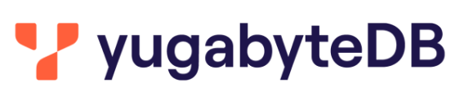
YugabyteDB
Distributed SQL Database
PostgreSQL compatible
Open source
Can run across hybrid and multi-cloud environments
With automatic sharding, distribution and load balancing, it is possible to scale out and scale back in with zero disruption in minutes
Is cloud and platform agnostic
Suitable for mission critical applications

Slide 7
YugabyteDB
Yugabyte was first developed as closed source commercial software
However, by 2019, its founders realised the power of the open source community and made it available under the Apache 2.0 license.
YugabyteDB was developed by former Facebook software engineers

Slide 8
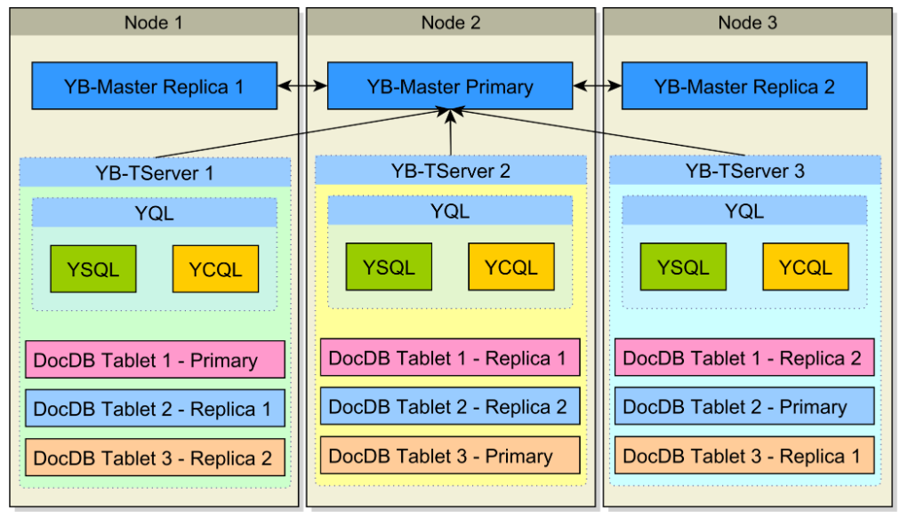
Architecture
It uses auto-sharding by default, so data is scattered automatically across multiple nodes
In order to allow all database nodes to accept writes, one node becomes the Leader (Primary) of a given table record while the other nodes become Followers (Replicas) of that table row.
YB-Master service
stores the table metadata and the mapping between the table rows and the nodes that store the Leader Tablet and the Replica Tablets that store the entry for that particular table row.
Is run on three nodes, one called YB-Master Leader while others two being YB-Master Followers.
The Leader election is done using the Raft Consensus Protocol
If a cluster has more than three nodes, the other database nodes that don’t host the YB-Master service will just cache the database metadata locally.
YB-TServer
Each database node stores a YB-TServer service, which is responsible for executing queries and statements and storing the underlying data.
Has two main components:
the YQL query engine
the DocDB storage engine

Slide 9
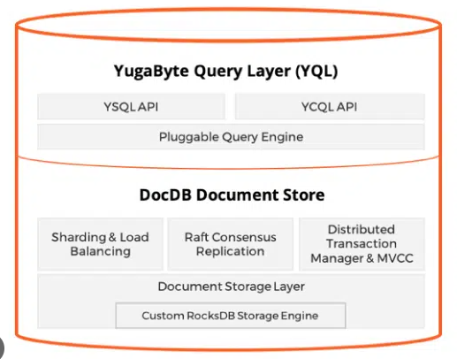
Architecture
YQL Query Engine
The YQL query engine provides two APIs
YSQL – SQL query engine based on PostgreSQL
YCQL – a semi-relational API based on Cassandra Query Language
DocDB Storage Engine
YugabyteDB makes use of a distributed document storage called DocDB which stores the table records as documents in a LSM (Log Structured Merge) tree structure.

Slide 10
Write Operation
1. Query Language Processing
2. Forwarding to the tablet leader
3. Preparing the batch for replication
4. Raft Replication
5. Applying update to storage engine on the leader
6. Responding to the client
5. Applying update to storage engine on followers

Slide 11
CockroachDB

Slide 12
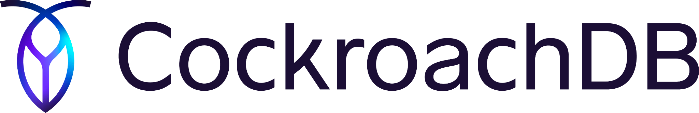
CockroachDB
CockroachDB is an open-source distributed relational database system.
Designed for high scalability and resilience, providing strong consistency and ACID guarantees across a distributed architecture.
Named after the cockroach's resilience to failure, reflecting the system's ability to withstand disruptions.

Slide 13
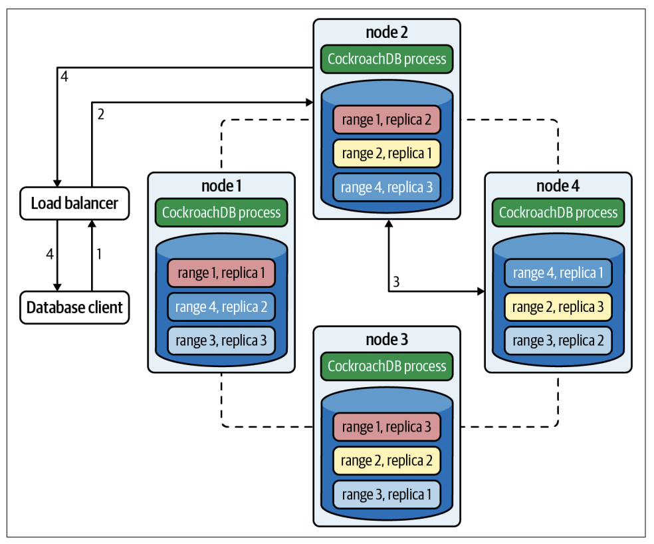
Cluster Architecture
Shared-nothing architecture ensures high availability and scalability
PostgreSQL wire protocol enables compatibility with existing PostgreSQL applications
Load balancers distribute connections for improved performance
Leaseholder nodes manage data access and replication for consistency
Key range-based data distribution enhances fault tolerance

Slide 14
CockroachDB Layers
SQL: Translate client SQL queries to KV operations.
Transactional: Allow atomic changes to multiple KV entries.
Distribution: Present replicated KV ranges as a single entity.
Replication: Consistently and synchronously replicate KV ranges across many nodes. This layer also enables consistent reads using a consensus algorithm.
Storage: Read and write KV data on disk.

Slide 15
Implementation
1. Installation of YugabyteDB and CockroachDB
2. Multi-node setup
3. Installation of YCSB
4. Configure db properties
5. Configure workload
6. Benchmarking

Slide 16
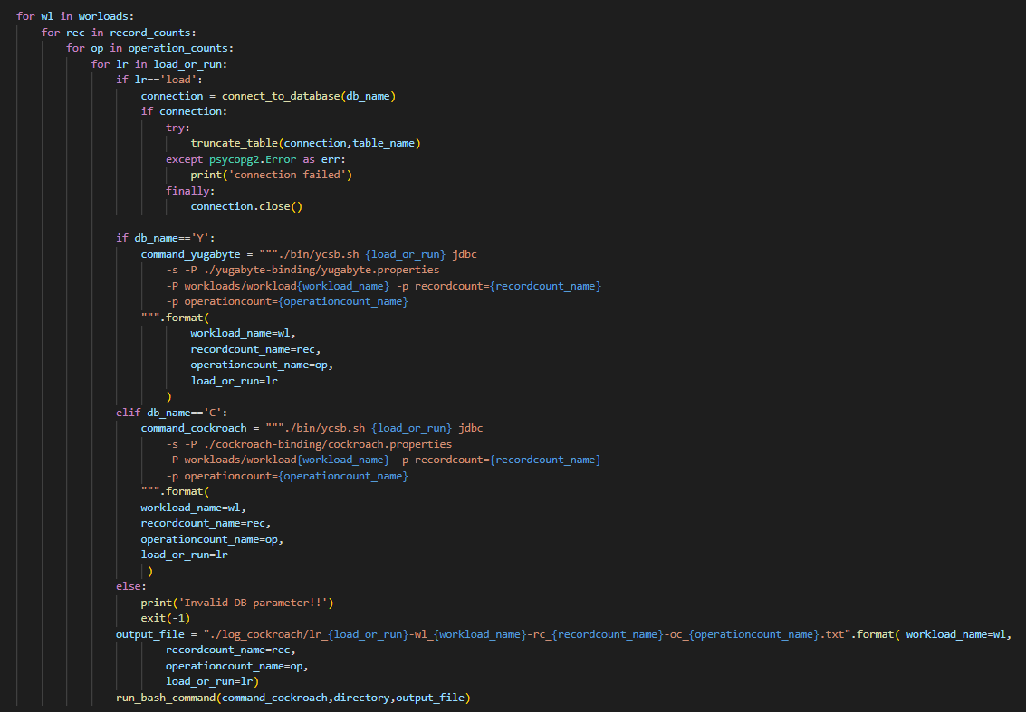

Slide 17
Yahoo Cloud Serving Benchmark (YCSB)

Slide 18
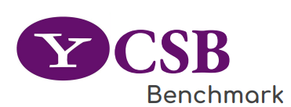
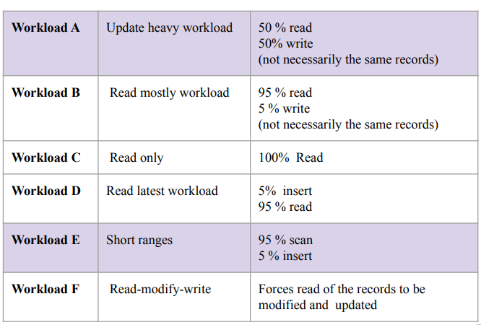
Benchmarking with YCSB
Insert a new record
Update a record replacing its value
Read either a randomly chosen field or all of them
Scan records in order, starting at a randomly chosen record key
Delete a single record
Two phases
Load Phase
Run Phase
Can parameterize
Record Count
Operation Count
Benchmark Result includes
Runtime
Throughput [ops/sec]
Latency

Slide 19
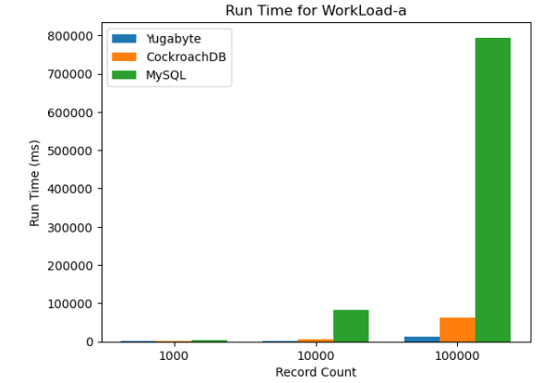
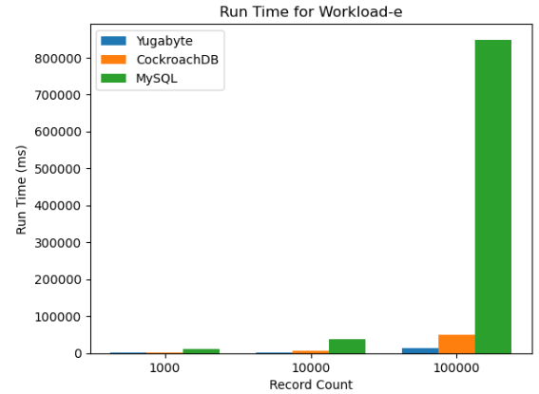
Load Phase
Run Time for Workload-a and Workload-e
Run Time (during load phase) measures the amount of time needed to load data into database.
Best Performer - Yugabyte
Worst Performer - MySQL

Slide 20
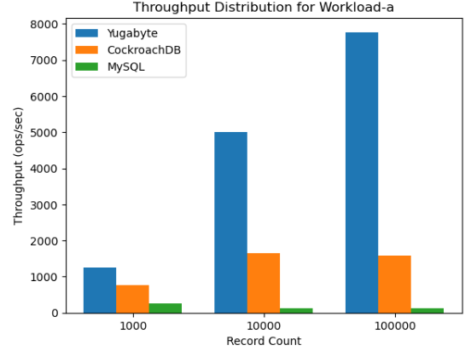
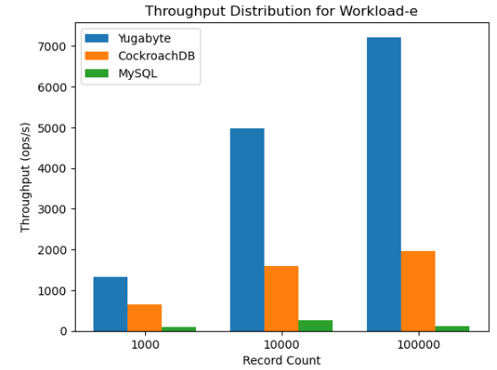
Load Phase
Throughput Distribution for Workload-a and Workload-e
Throughput Distribution measures the number of operations (transactions) performed per second.
Best Performer - Yugabyte
Worst Performer - MySQL

Slide 21
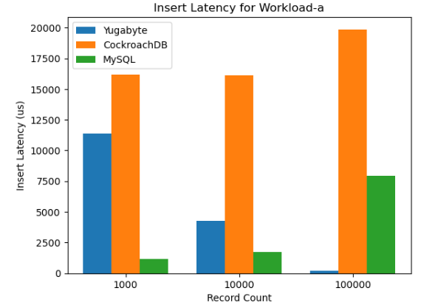
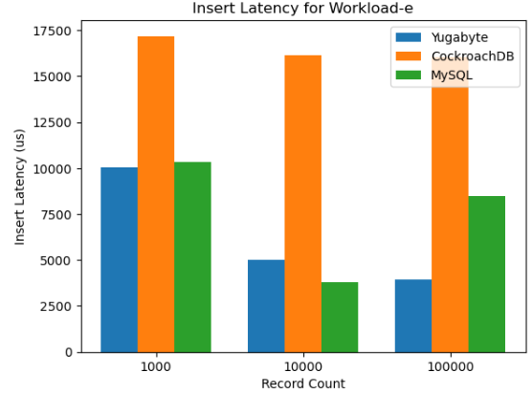
Load Phase
Insert Latency for Workload-a and Workload-e
Insert Latency measures the time delay between the initiation of an insert operation and its completion.
Best Performer – Yugabyte (for high record count) /MySQL (for low record count)
Worst Performer - CockroachDB

Slide 22
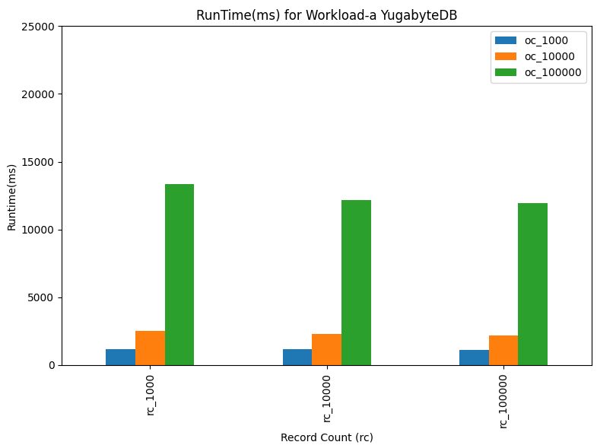
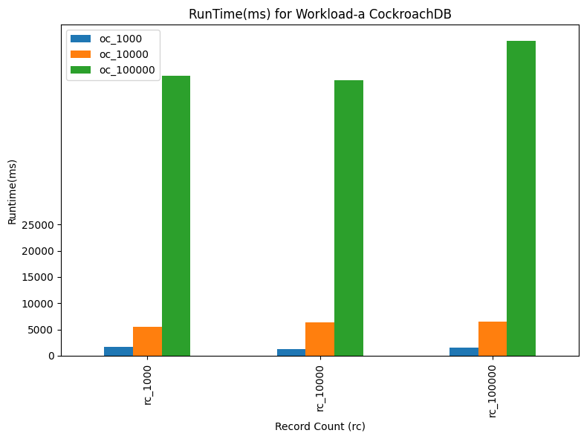
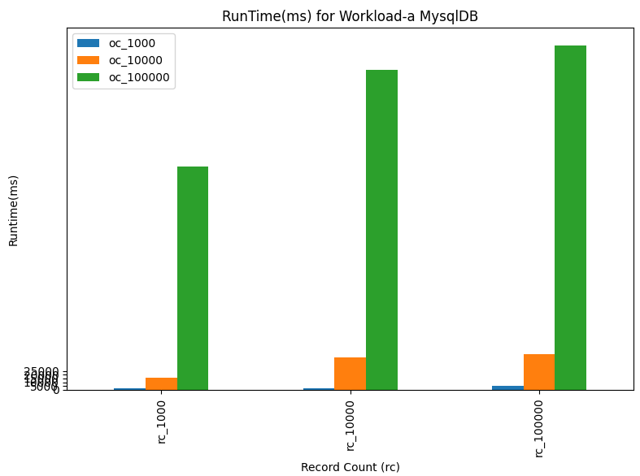
Run Phase
Run Time for Workload-a
Run Time (during run phase) measures the amount of time needed to execute different operations in database (read, scan, update, delete)
Best Performer - Yugabyte
Worst Performer - MySQL

Slide 23
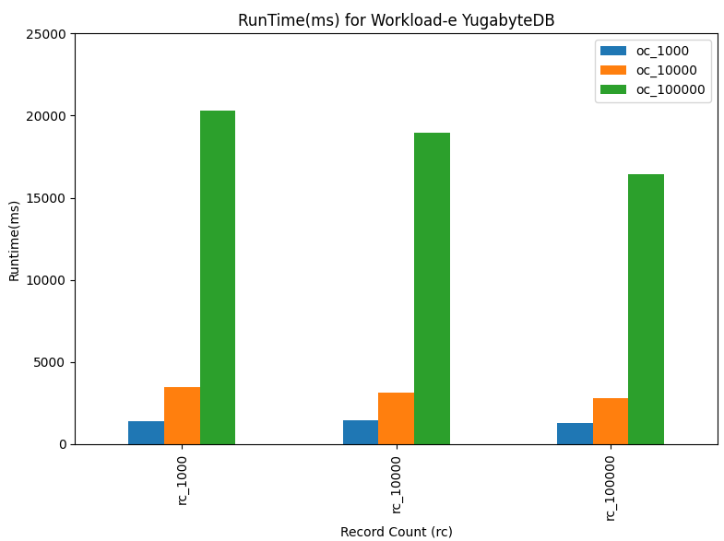
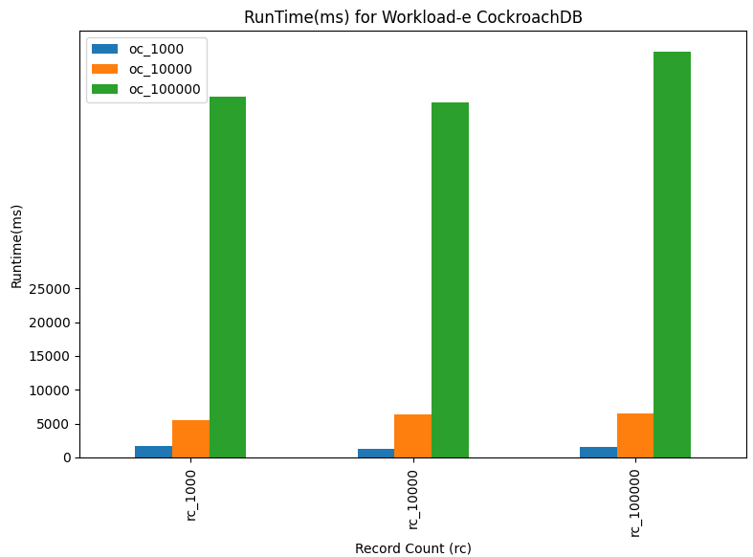
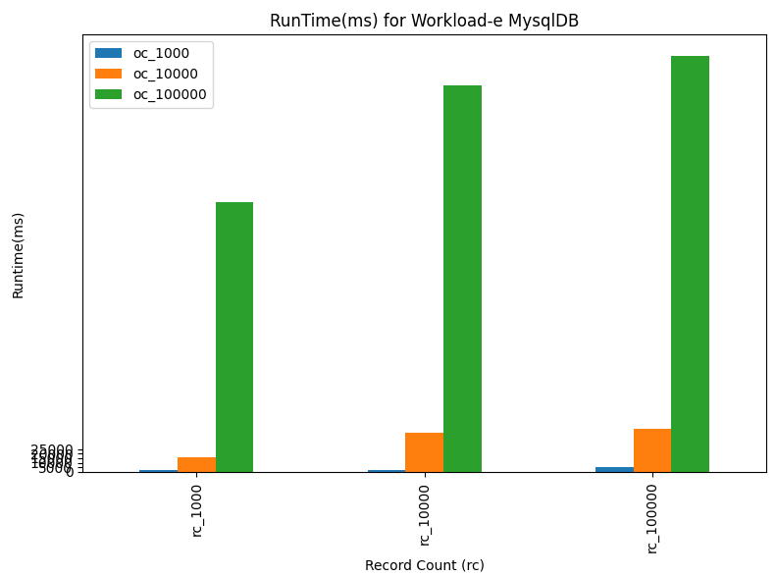
Run Phase
Run Time for Workload-e
Run Time (during run phase) measures the amount of time needed to execute different operations in database (read, scan, update, delete)
Best Performer - Yugabyte
Worst Performer - MySQL

Slide 24
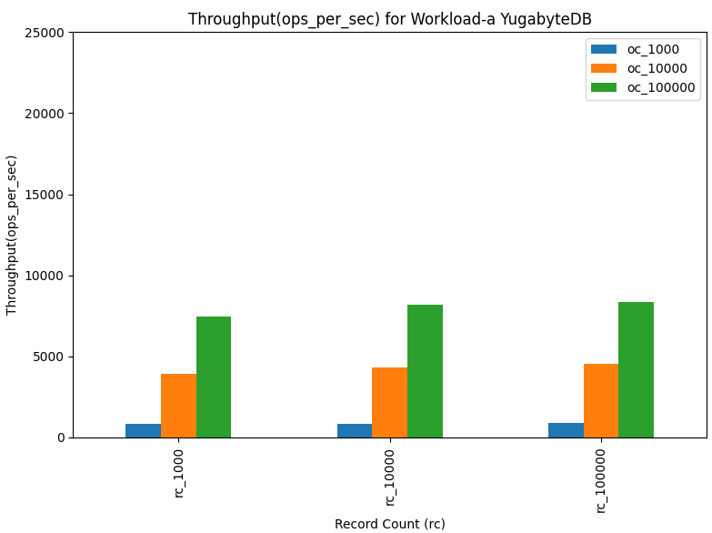
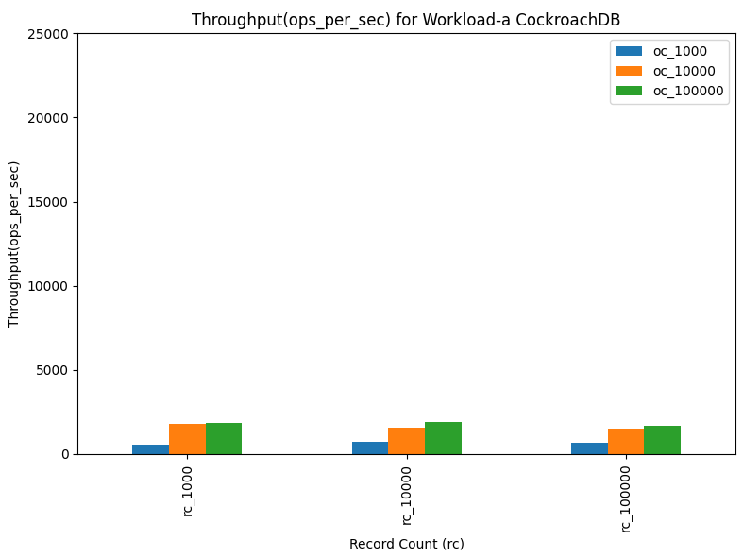
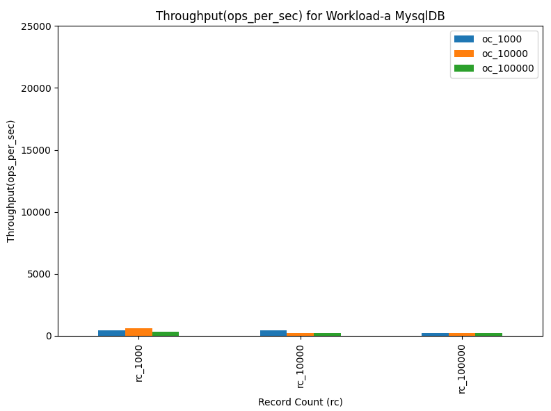
Run Phase
Throughput Distribution for Workload-a
Throughput Distribution measures the number of operations (transactions) performed per second.
Best Performer - Yugabyte
Worst Performer - MySQL

Slide 25
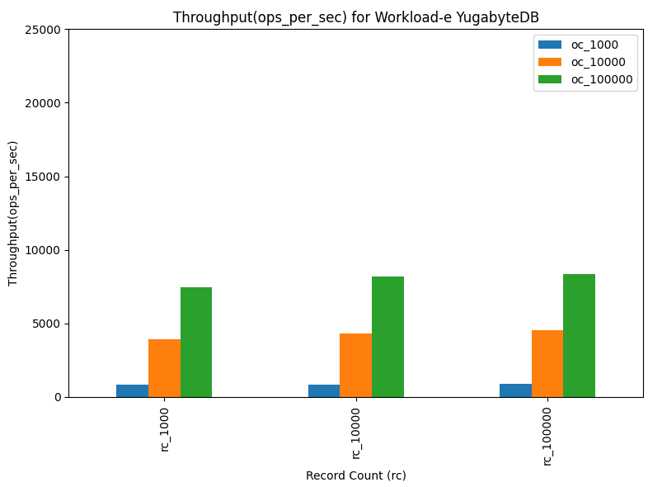
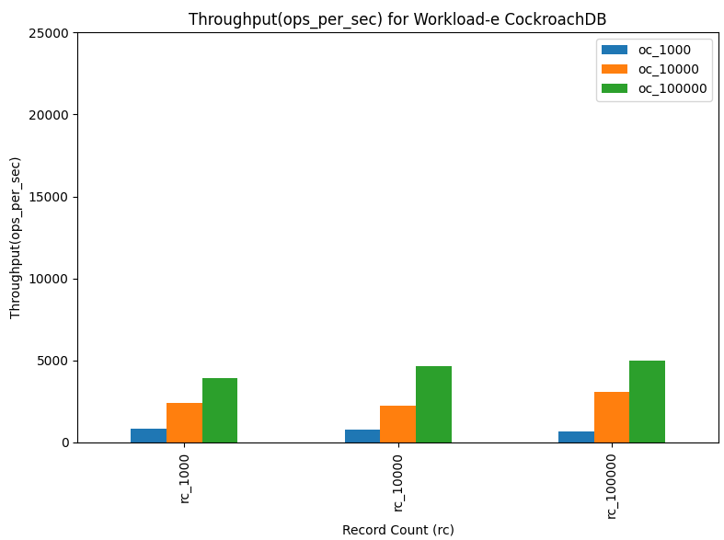
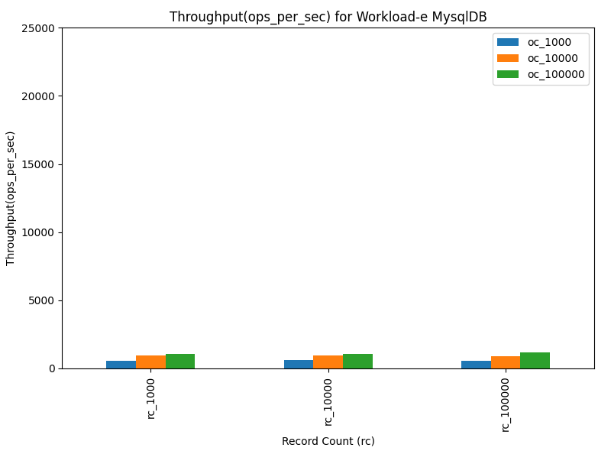
Run Phase
Throughput Distribution for Workload-e
Throughput Distribution measures the number of operations (transactions) performed per second.
Best Performer - Yugabyte
Worst Performer - MySQL

Slide 26
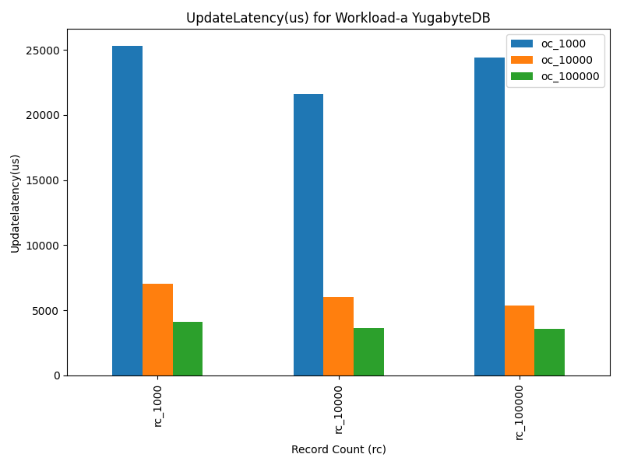
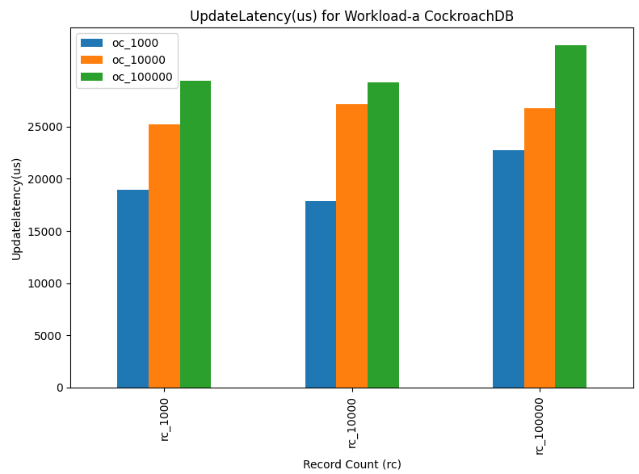
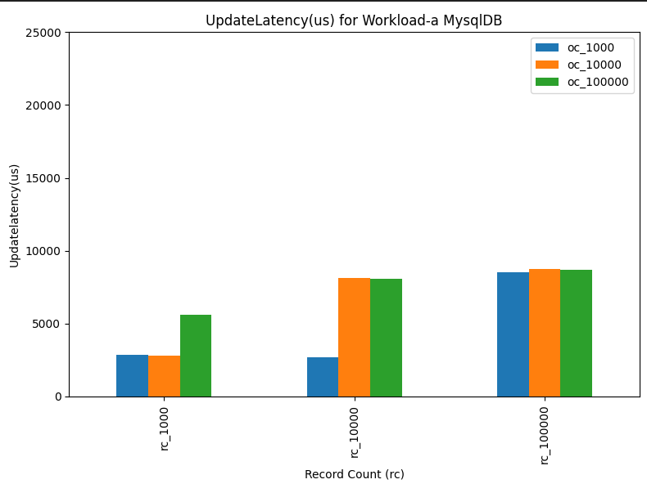
Run Phase
Update Latency for Workload-a
Update Latency measures the time delay between the initiation of an update operation and its completion.
Best Performer
YugabyteDB (for higher operation count), MySQL (consistent performance)
Worst Performer
CockroachDB (for high operation count)
YugabyteDB (for low operation count)

Slide 27
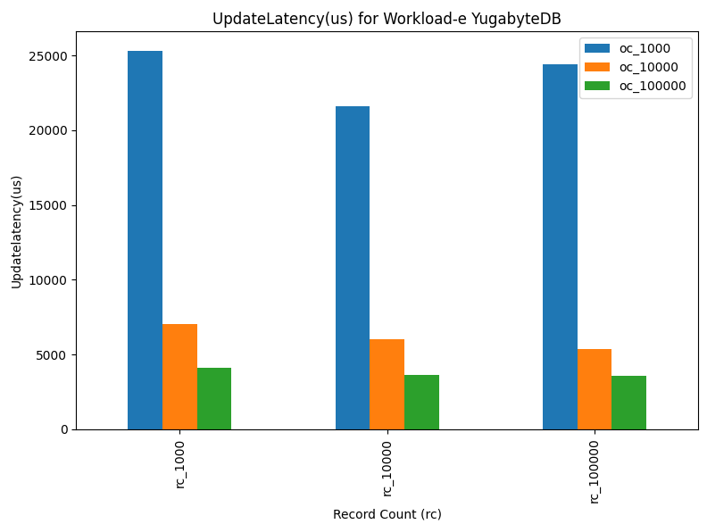
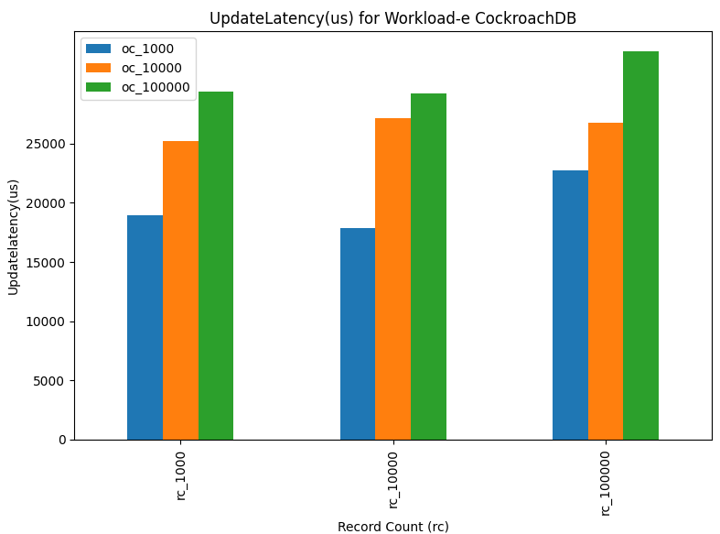
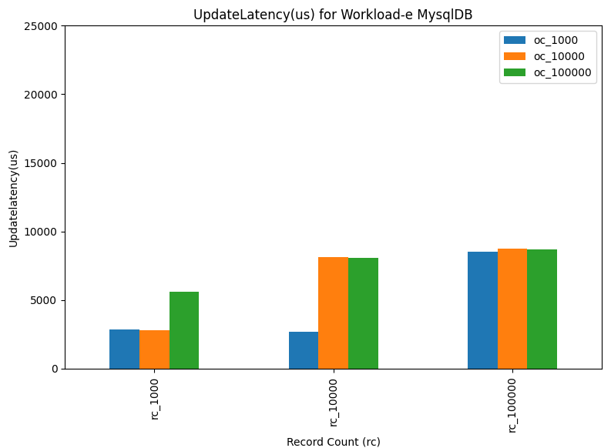
Run Phase
Update Latency for Workload-e
Update Latency measures the time delay between the initiation of an update operation and its completion.
Best Performer
YugabyteDB (for higher operation count), MySQL (consistent performance)
Worst Performer
CockroachDB (for high operation count)
YugabyteDB (for low operation count)

Slide 28
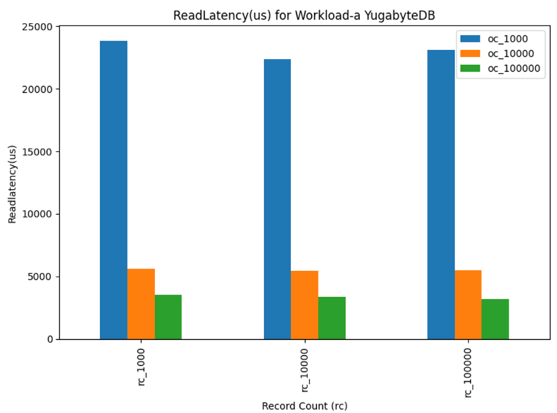
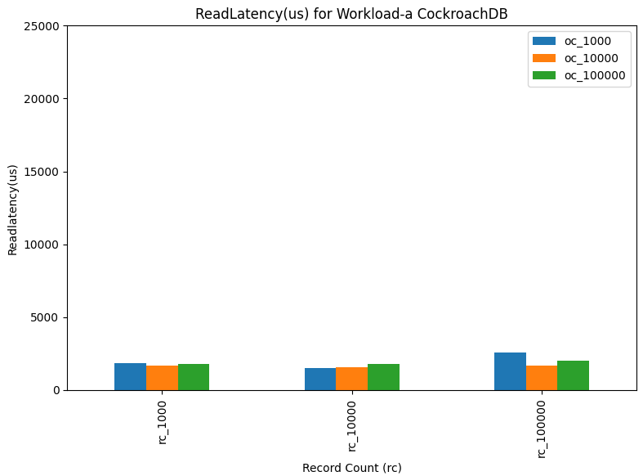
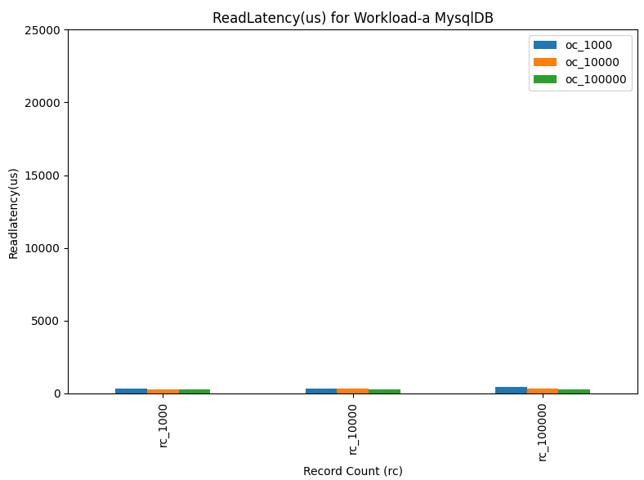
Run Phase
Read Latency for Workload-a
Read Latency measures the time delay between the initiation of a read operation and its completion.
Best Performer - MySQL
Worst Performer – Yugabyte
Consistent Performer - CockroachDB

Slide 29
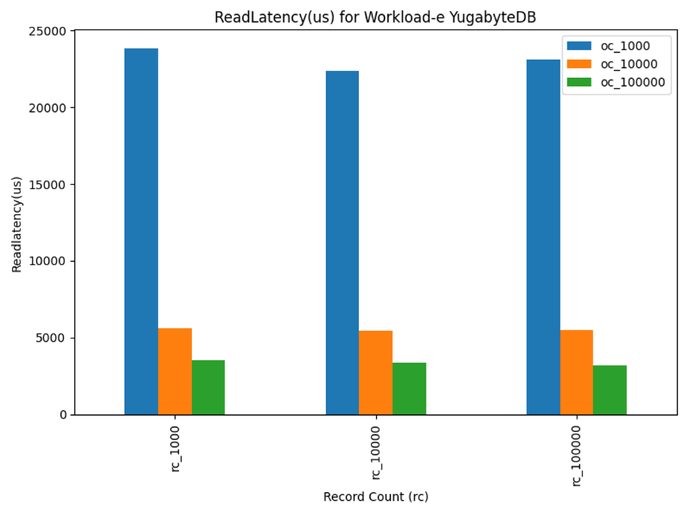
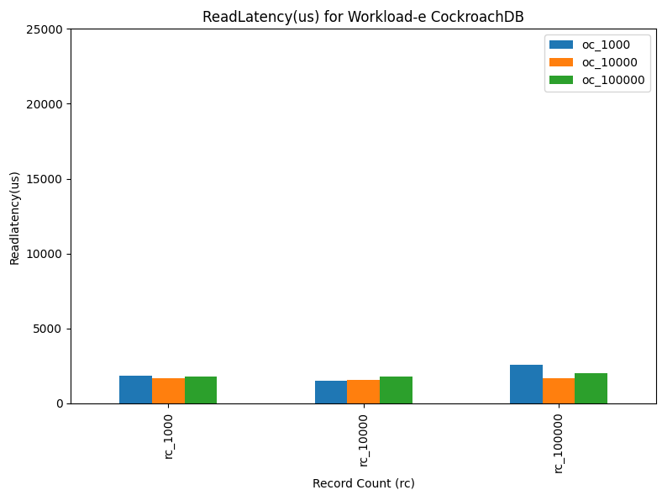
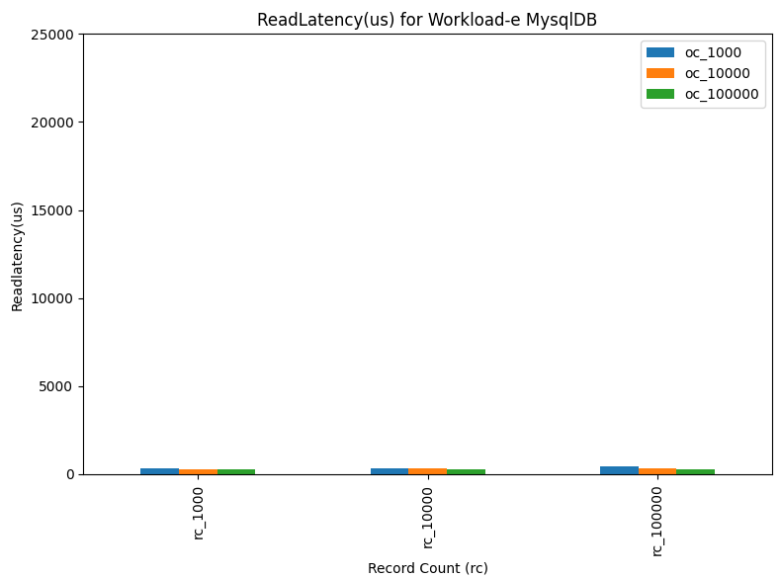
Run Phase
Read Latency for Workload-e
Read Latency measures the time delay between the initiation of a read operation and its completion.
Best Performer - MySQL
Worst Performer – Yugabyte
Consistent Performer - CockroachDB

Slide 30
YugabyteDB: High Read Latency
YugabyteDB
Provides linearizable consistency
A read operation might have to wait for any ongoing writes to be fully replicated and for the leader to confirm its status, which can add to the read latency.
CockroachDB
Provides serializable isolation
The system might serve reads with less strictness, as long as it can ensure the final result of transactions will be as if they had been processed one after another, which can reduce read latency.

Slide 31
Use Case: E-commerce Platform
Read Operation: 50%
Read Operation is the most frequently performed operation in e-commerce platforms.
A read operation occurs every time a user browses products, views details, or checks inventory.
Scan Operation: 25%
Scan operations, which involve searching and filtering products, are also quite common in ecommerce platforms, but less frequent than simple reads.
Users often filter products based on categories, prices, or other attributes.
Insert Operation: 10%
Insert operations occur when new products are added to the catalog.
This happens less frequently than reads or scans.
Update Operation: 10%
Update operations are necessary for changing product details or inventory levels.
They are as frequent as inserts but are crucial for maintaining accurate and current data.
Delete Operation: 5%
Delete operations are the least frequently performed operation.
Products are removed from listings less often than they are added, viewed, or updated.

Slide 32
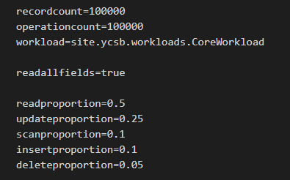
Use Case: Workload Configuration

Slide 33
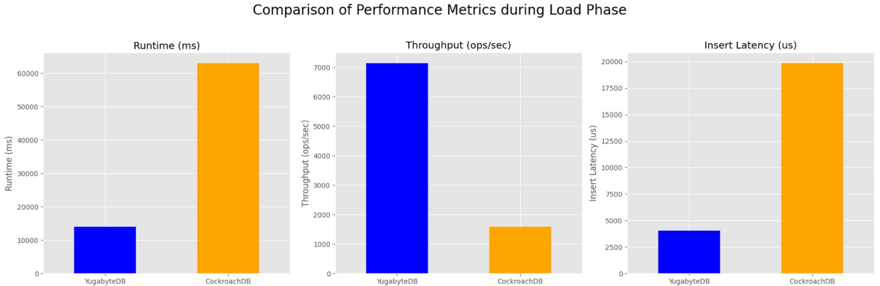
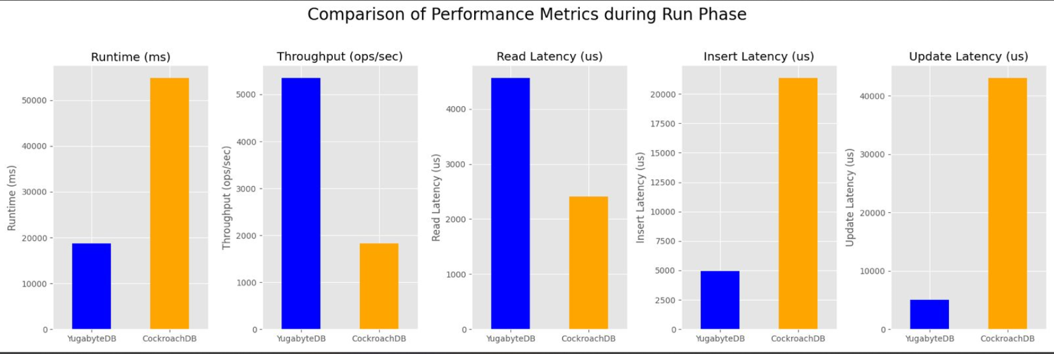

Slide 34
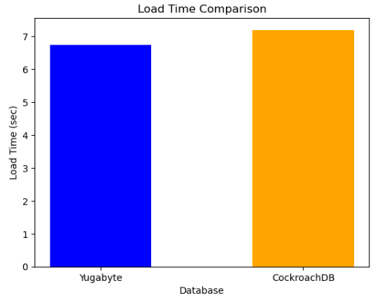
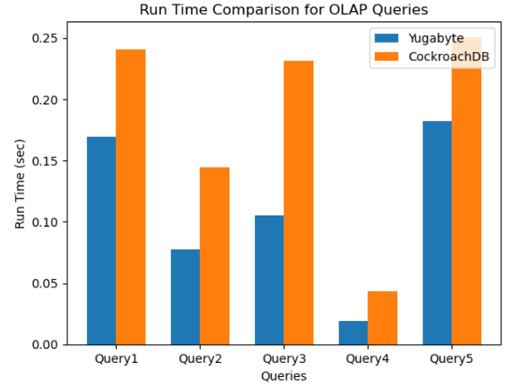
Performance Test in OLAP Queries
Tables Loaded
Products (10,000 records)
Customers (30,000 records)
Sales (100,000 records)
OLAP Queries executed
Total Sales by Category for a Given Year
Monthly Sales Trend for a Specific Product
Top 10 Customers by Sales Volume
Stock Analysis
Sales Performance by Region

Slide 35
THANK YOU

