Slide 1
Database System Architecture INFO-H417
Sony Shrestha
Aayush Paudel
Hadi El Yakhni
Iyoha Peace Osamuyi

Slide 2
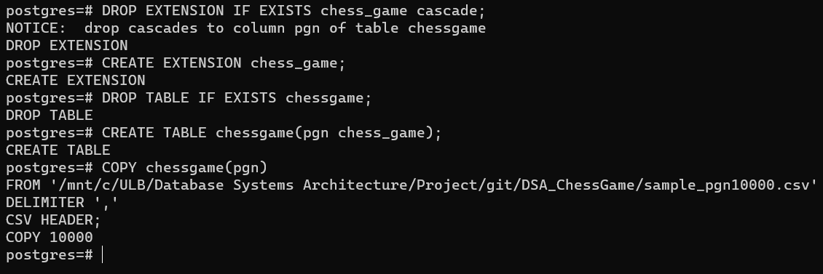
Creation of Extension
Validation
We created extension called chess_game with data type
chess_board
chess_game
Python script was prepared to generate PGN Notation which was later on dumped into table containing field with chess_game data type
fig: Create extension, table and load data into table with chess game data type

Slide 3
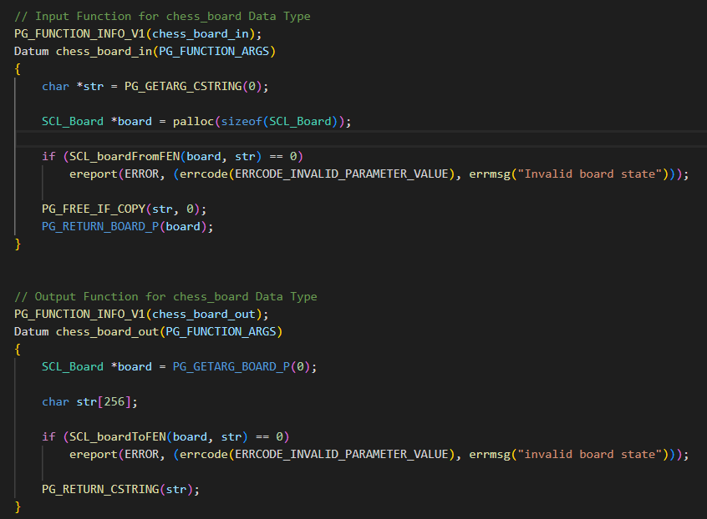
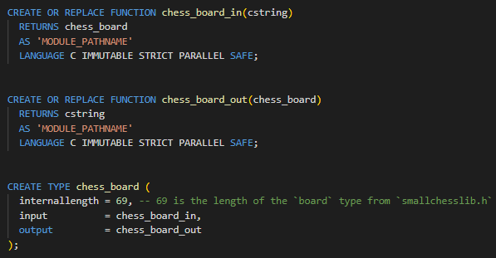
Data Type: Chess Board
Implementation
We made use of SCL_boardFromFEN function provided in header file to convert string fen notation to chess_board data type
fig: Declaration of chess_board_in and chess_board_out function, chess_board datatype in SQL
fig: Logic for chess_board_in and chess_board_out function

Slide 4
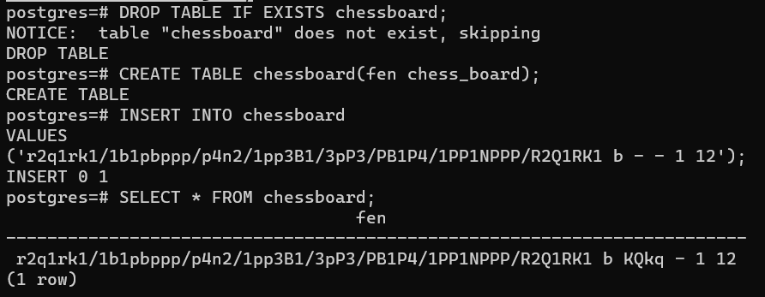
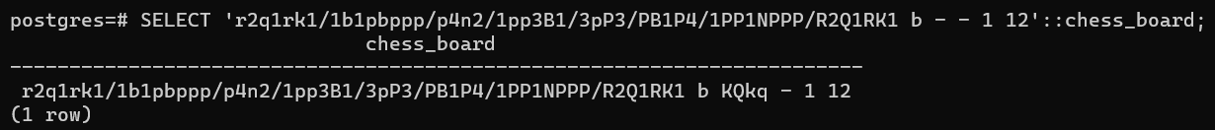
Data Type: Chess Board
Validation
Creation of chess_board data type was validated in two ways
Validate creating table with chess_board data type followed by insert and select statement
Validate type cast operation from string to chess_board data type
fig: Create table with chess_board data type followed by insert and select statement
fig: Validate type cast operation from string to chess_board data type

Slide 5
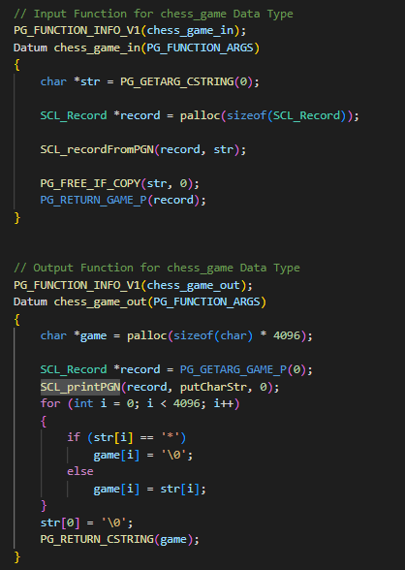
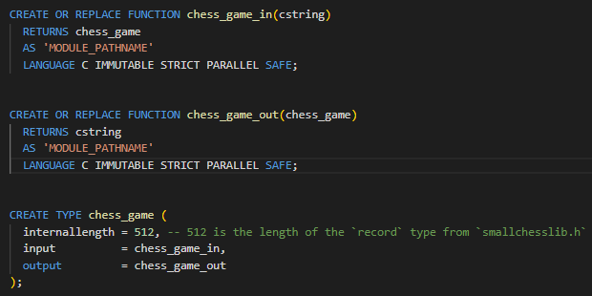
Data type: Chess Game
Implementation
We made use of SCL_printPGN function provided in header file to convert string fen notation to chess_board data type
fig: Declaration of chess_game_in and chess_game_out function, chess_game datatype in SQL
fig: Logic for chess_game_in and chess_game_out function

Slide 6
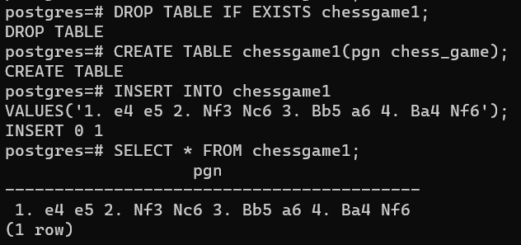
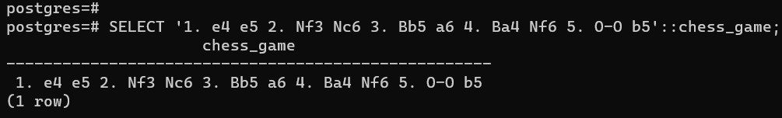
Data type: Chess Game
Validation
Creation of chess_game data type was validated in two ways
Validate creating table with chess_game data type followed by insert and select statement
Validate type cast operation from string to chess_game data type
fig: Create table with chess_game data type followed by insert and select statement
fig: Validate type cast operation from string to chess_game data type

Slide 7
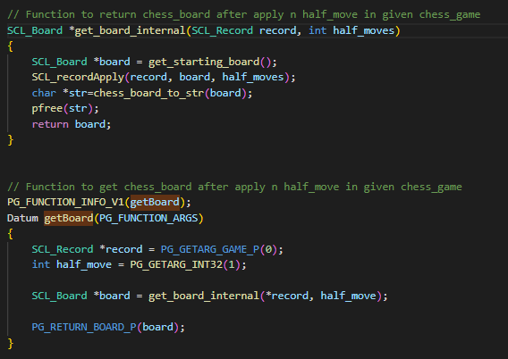
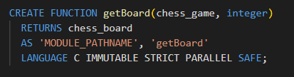
Function: getBoard()
Implementation
getBoard(chessgame, integer) -> chessboard
This function returns the board state at a given half-move
It makes use of SCL_recordApply function of header file to get board state after applying n half moves in given chess game
fig: Declaration of getBoard() function in SQL
fig: Logic for getBoard() function

Slide 8
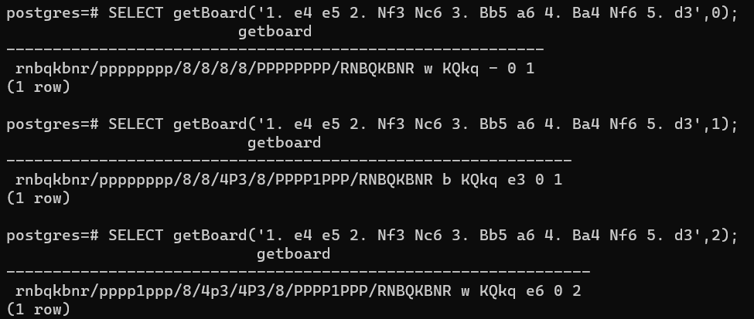
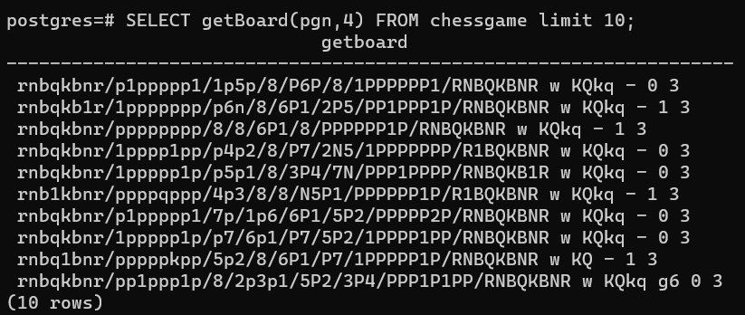
Function: getBoard()
Validation
Creation of getBoard() function was validated in following ways
Validate if getBoard() function is returning correct value for static chess game and chess board passed
Validate if getBoard() function can be used to query table containing field with chess game data type
fig: Get board state (fen) after 0,1 and 2 half moves have been applied to given chess_game
fig: Get board state (fen) after 4 moves have been applied to games provided in table

Slide 9
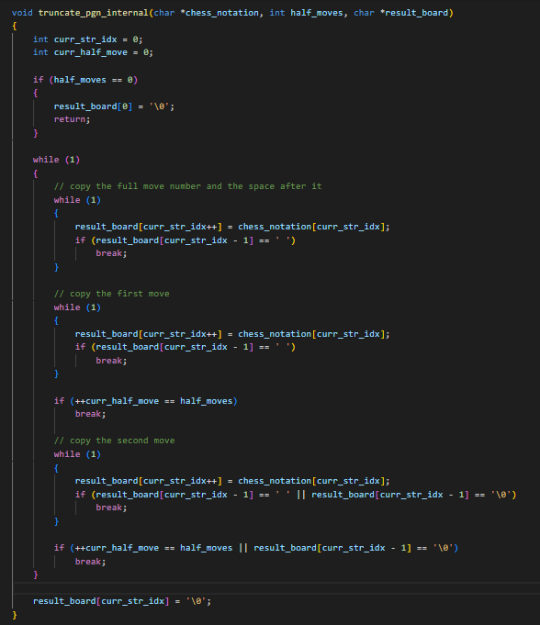
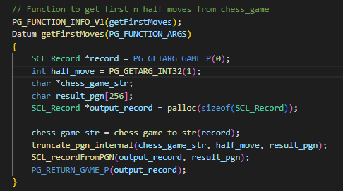

Function: getFirstMoves()
Implementation
getFirstMoves(chessgame, integer) -> chessgame
This function returns the chessgame truncated to its first N half-moves.
We created a function which will extract subset of chess game, given the number of half moves
fig: Logic for getFirstMoves() function
fig: Declaration of getFirstMoves() function in SQL
fig: Function that extracts subset of chessgame, given the number of half moves

Slide 10
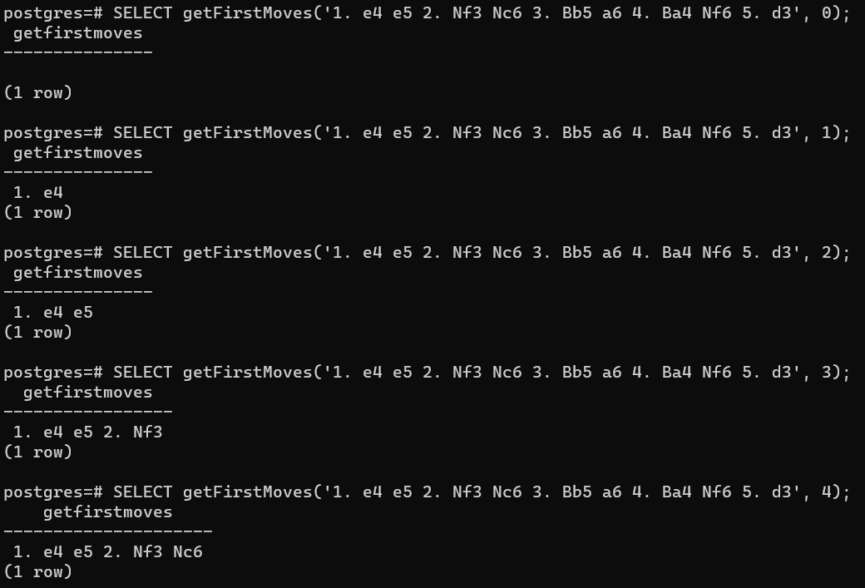
Function: getFirstMoves()
Validation
Creation of getFirstMove function was validated in following ways
Validate if getFirstMove function is returning correct value for static chess game and num of half moves passed
Validate if getFirstMove function can be used to query table containing field with chess game data type
fig: Get chess_game truncated to 0-4 half moves

Slide 11
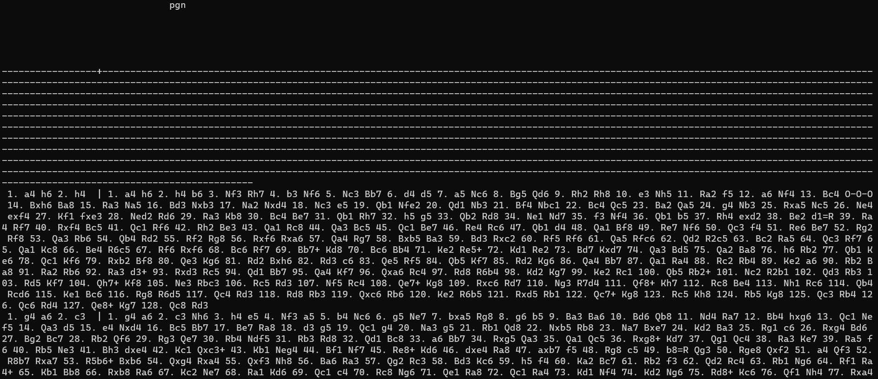
fig: Get chess_game truncated to 3 half moves for all the games provided in chessgame table

Slide 12

Function: hasOpening()
Implementation
hasOpening(chessgame, chessgame) -> b
This function returns true if the first chess game starts with the exact same set of moves as the second chess game.
Since, while querying table using this function, index needs to be picked, logic for this function was written in SQL instead of writing it in C using operators defined for B-Tree
fig: Declaration of hasOpening() function in SQL

Slide 13
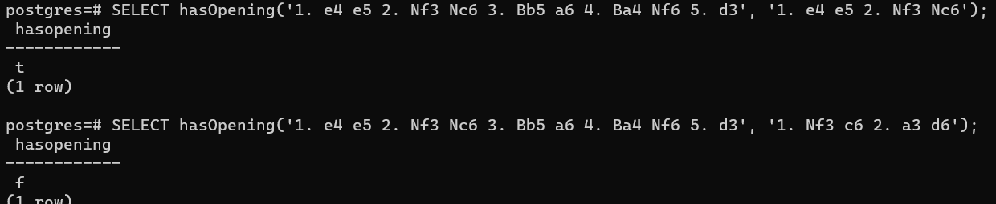
Function: hasOpening()
Validation
Creation of hasOpening() function was validated in following ways
Validate if hasOpening() function is returning correct value for static chess games passed
Validate if hasOpening() function can be used to query table containing field with chess game data type
fig: Check if chessgame provided as first parameter has same opening as provided in second parameter

Slide 14
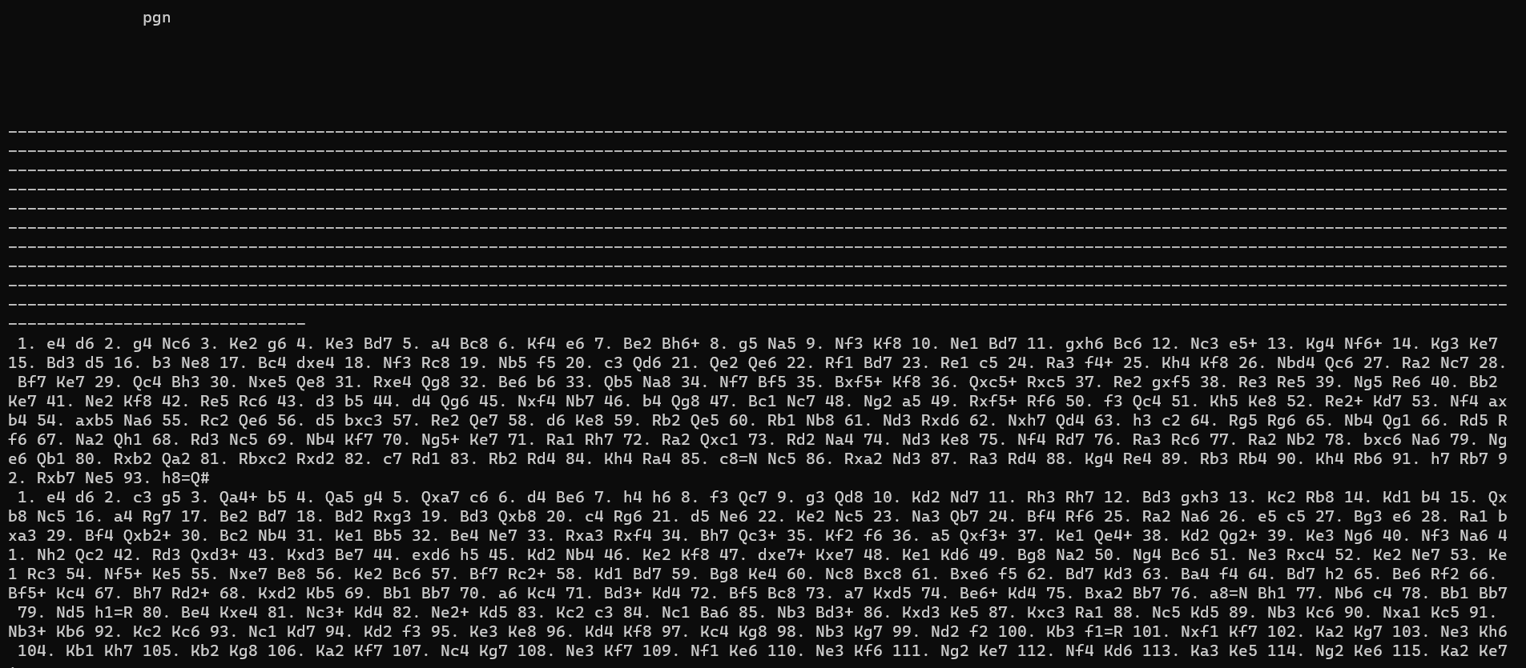
fig: Get all games from chessgame table which has opening ‘1. e4 d6’

Slide 15
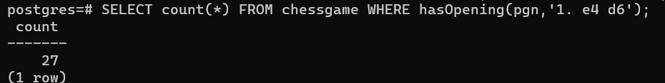
fig: Count the number of games from chessgame table which has opening ‘1. e4 d6’

Slide 16
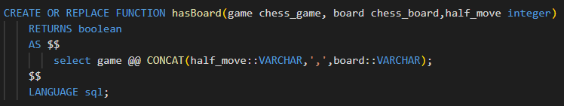
Function: hasBoard()
Implementation
hasBoard(chessgame, chessboard, integer) -> bool
This function returns true if the chessgame contains the given board state in its first N half-moves comparing only the state of the pieces and without considering the move count, castling right, en passant pieces.
Since, while querying table using this function, gin index needs to be picked, logic for this function was written in SQL instead of writing it in C using operators defined for GIN Index
fig: Declaration of hasBoard() function in SQL

Slide 17
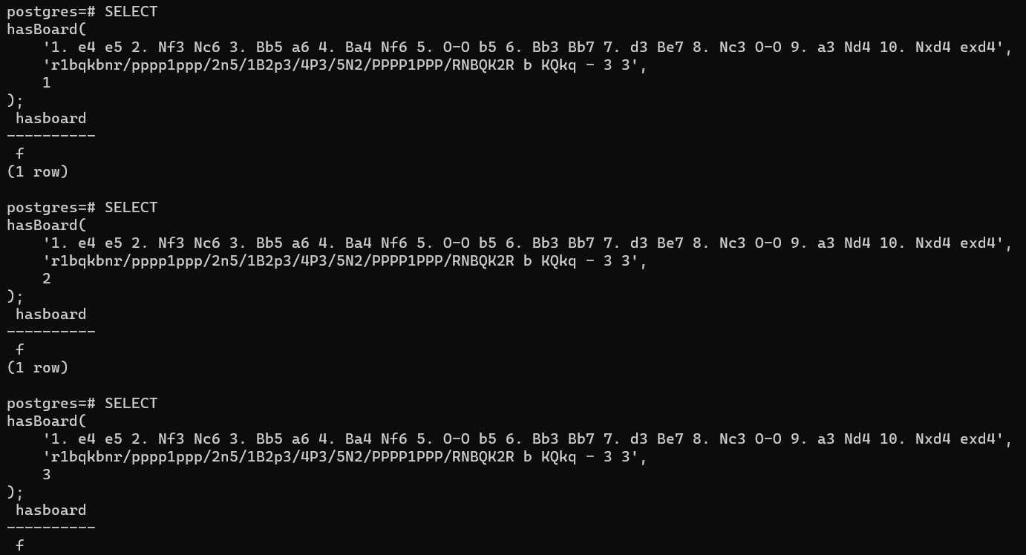
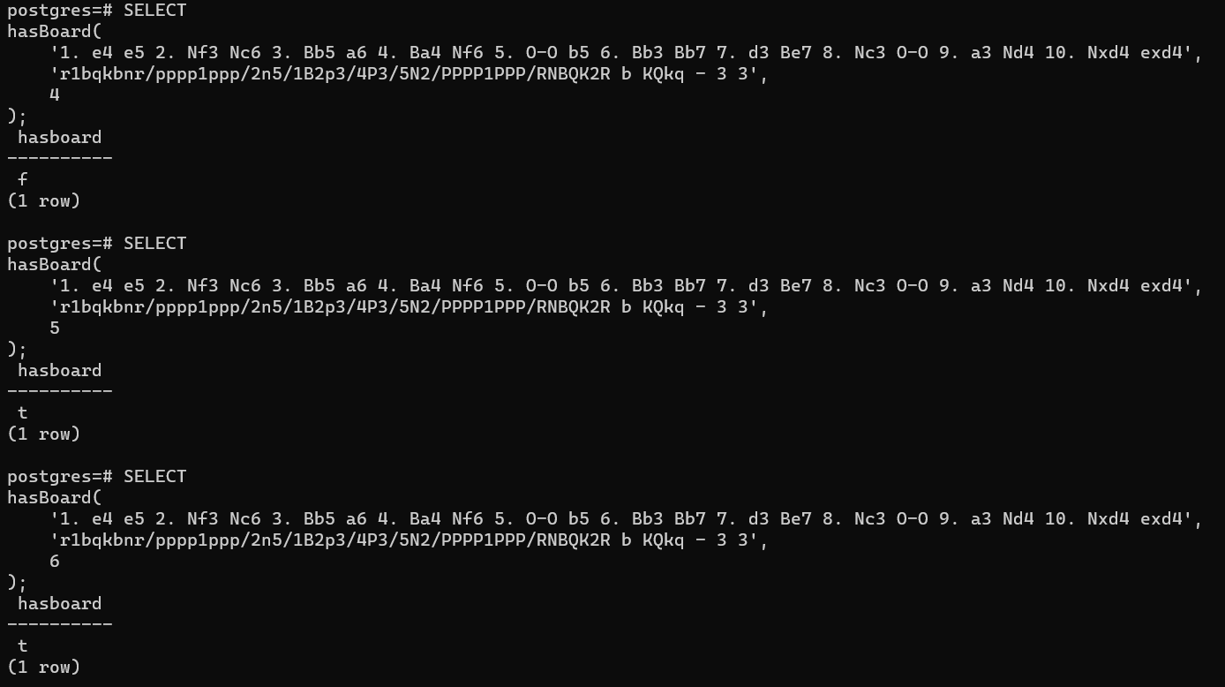
Function: hasBoard()
Validation
Creation of hasBoard() function was validated in following ways
Validate if hasBoard() function is returning correct value for static chess game, chess board and number of half moves passed
Validate if hasBoard() function can be used to query table containing field with chess game data type
Confirm that only chess board state should be considered
fig: Check if chess game has given chess board in first 1,2 and 3 half moves
fig: Check if chess game has given chess board in first 4,5 and 6 half moves

Slide 18
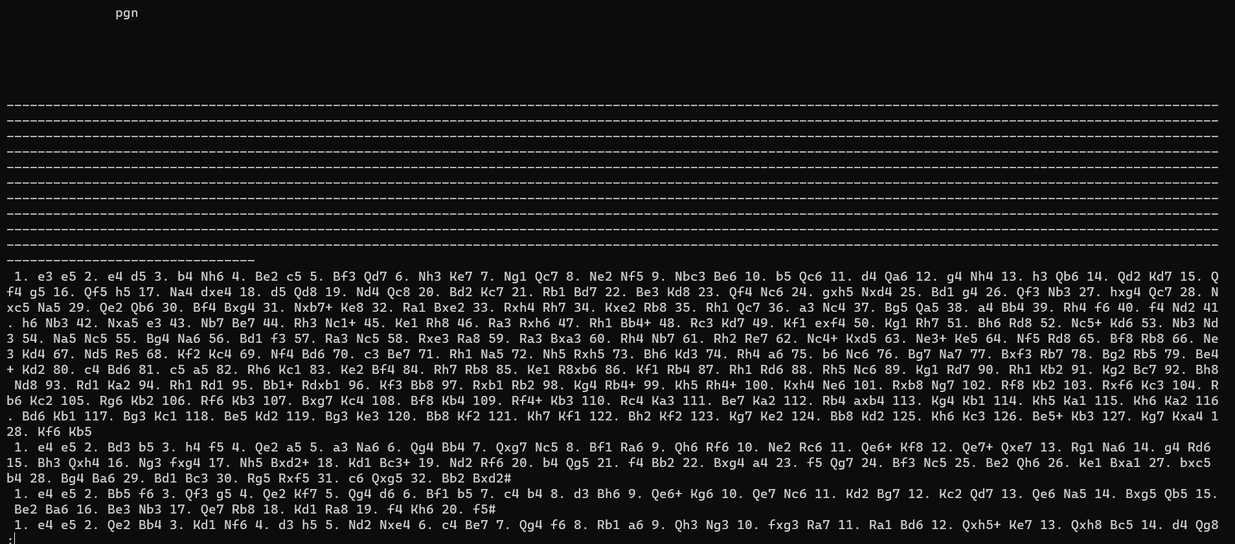
fig: Return all games from chessgame table which has given board state within first 5 half moves

Slide 19
fig: Return the number of games from chessgame table which has given board state within first 5 half moves

Slide 20
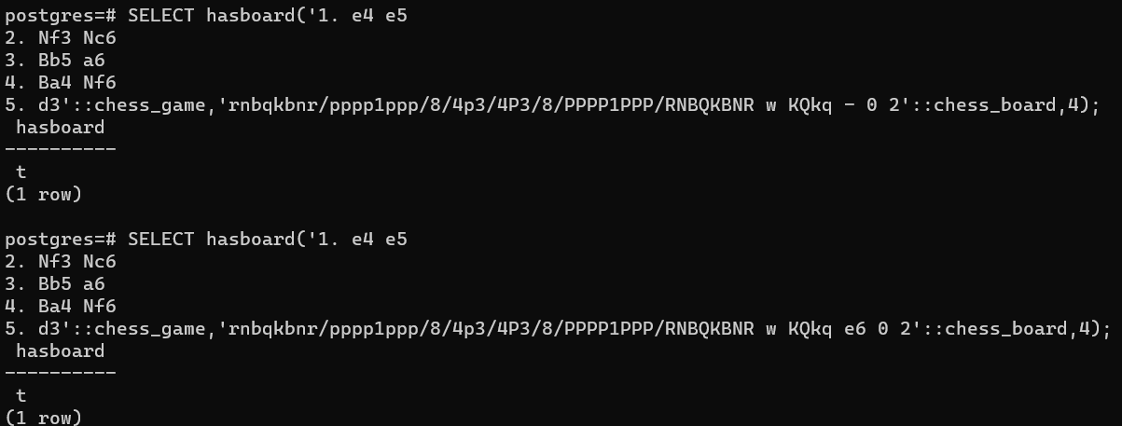
fig: Validate that only board state is considered, anything apart from that is ignored

Slide 21
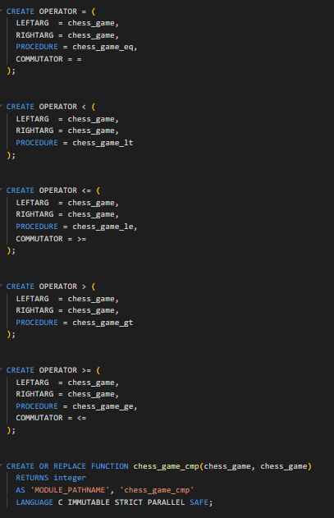
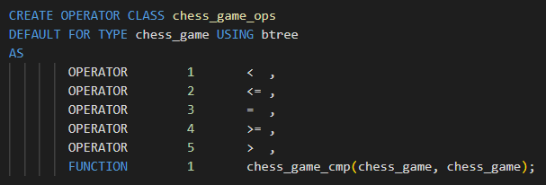
Index: B-Tree
Implementation
For implementation of B-Tree, we created
five operators <,<=,=,>,>=
five functions to implement above operators
Compare function to compare two chess games
fig: Declaration of Operator Class for B-Tree index in SQL
fig: Declaration of Operators and chess game compare function for B-Tree index in SQL

Slide 22
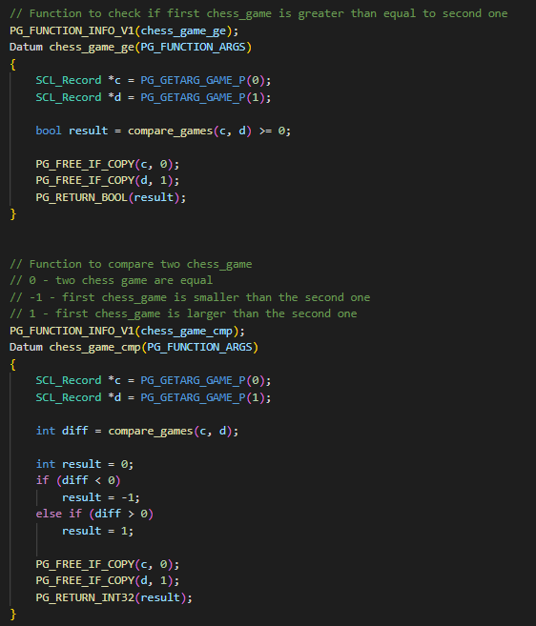
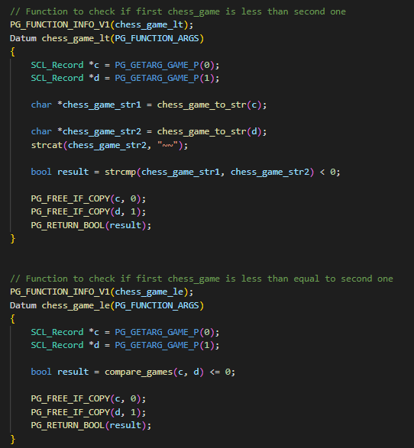
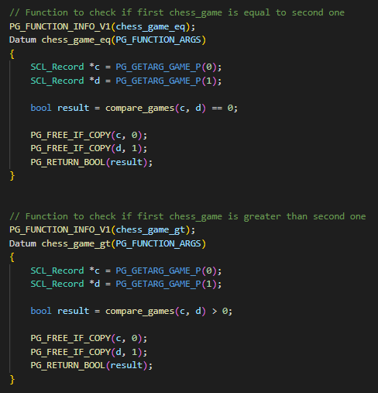
fig: Logic for functions used by operators defined for B-Tree

Slide 23
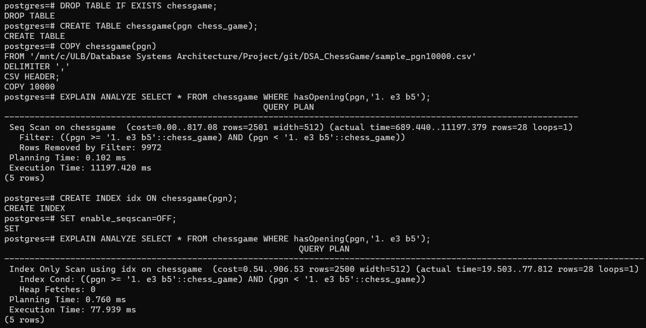
Index: B-Tree
Validation
Creation of B-Tree index was validated in following ways
Check if we are able to create B-Tree index on chess_game datatype
Check if B-Tree index is being picked by hasOpening() function
fig: Validation of creation of B-Tree index along with its use by hasOpening() function

Slide 24
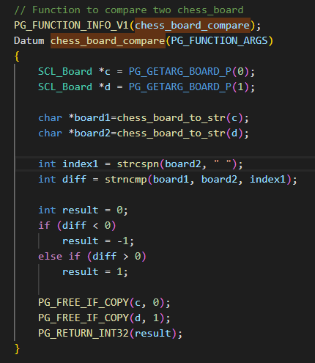
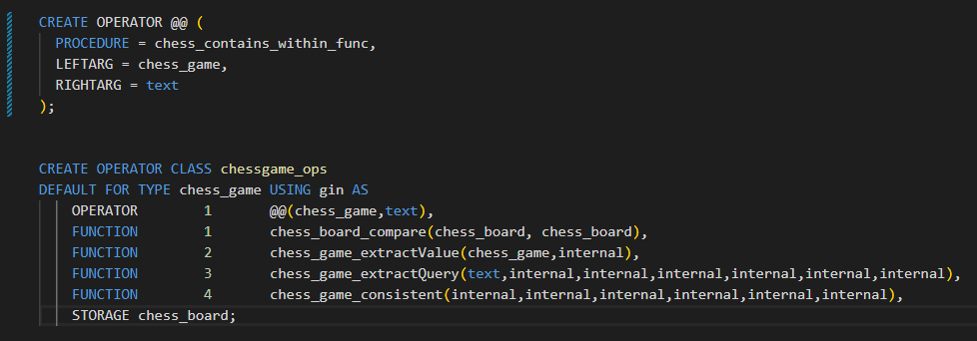
Index: GIN
Implementation
For implementation of GIN Index, we created
Operator @@ which checks if given board state is present in chess game within n half moves
One function to implement @@ operator
Compare function to compare two chess boards
Other functions like chess_game_extractValue, chess_game_extractQuery, chess_game_consistent
fig: Declaration of Operator Class for GIN index in SQL
fig: Logic for comparing two chess boards

Slide 25
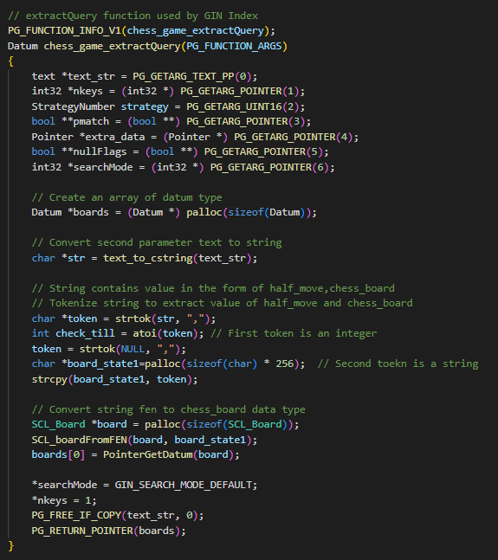
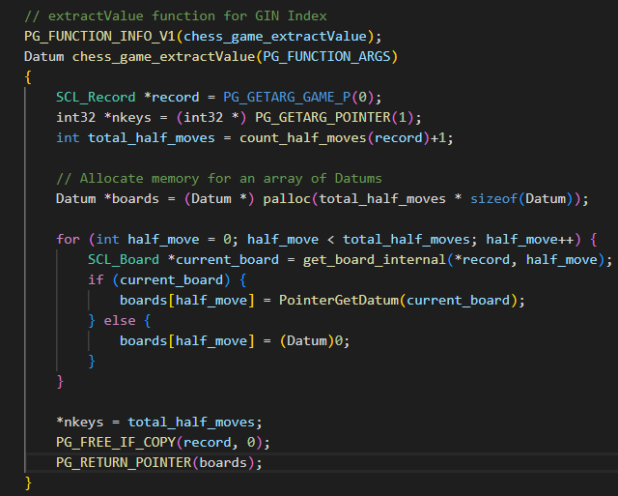
fig: Logic for extractValue function
fig: Logic for extractQuery function

Slide 26
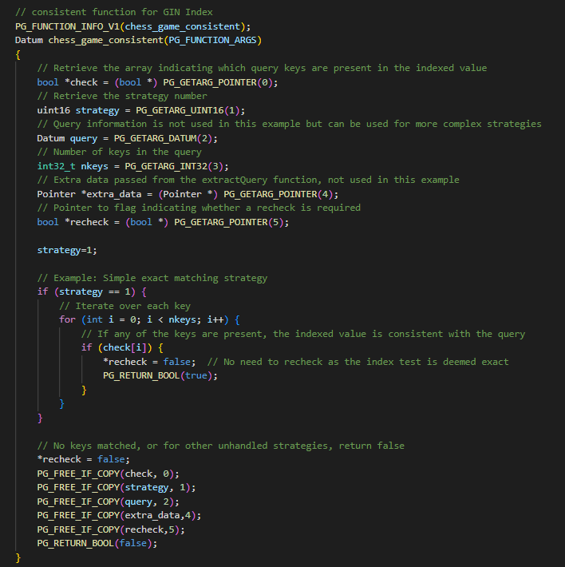
fig: Logic for consistent function

Slide 27
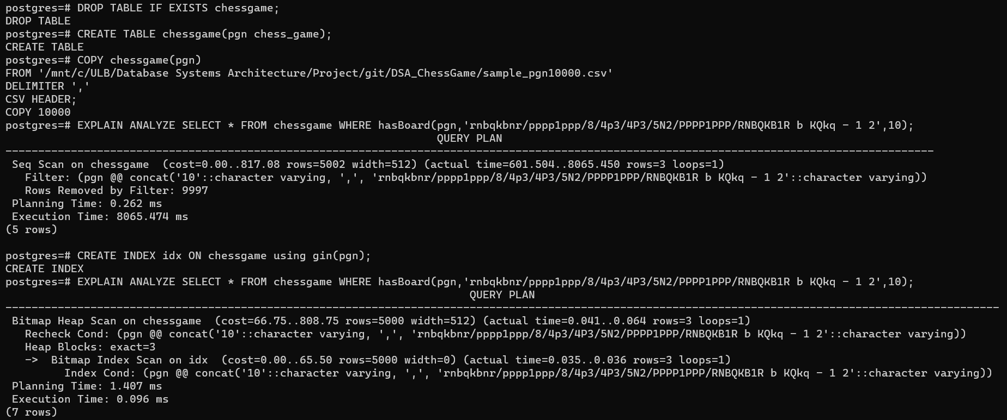
Index: GIN
Validation
Creation of GIN index was validated in following ways
Check if we are able to create GIN index on chess_game datatype
Check if GIN index is being picked by hasBoard() function
fig: Validation of creation of GIN index along with its use by hasBoard() function

Slide 28
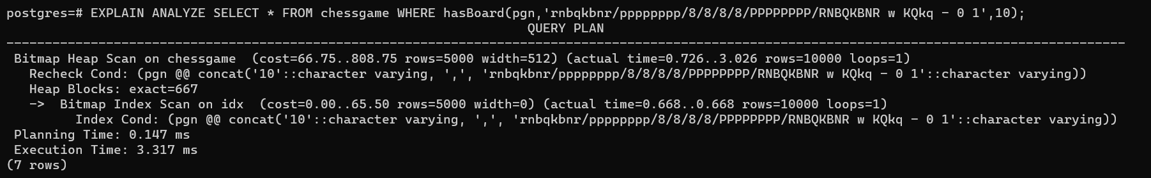
fig: Number of row returned should be same as number of rows in table in case initial board state is passed

Slide 29
Important Links
Github
https://github.com/SonyShrestha/DSA_ChessGame/tree/main
Test Cases
https://github.com/SonyShrestha/DSA_ChessGame/blob/main/sql_files/test_script.sql

Slide 30
THANK YOU

