Slide 1
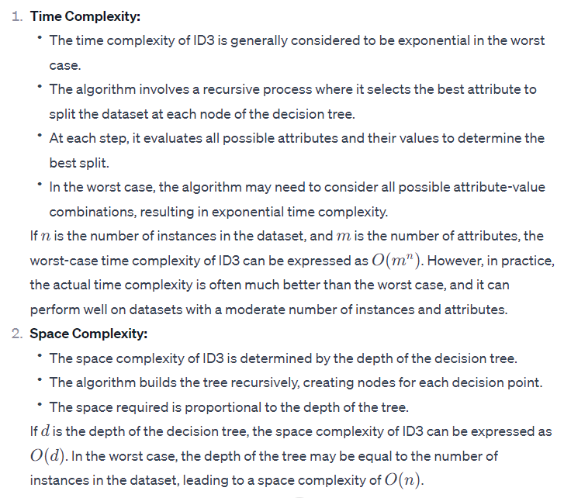
ID3 Complexity

Slide 2
K means, k median , k medoid complexity
Time Complexity:
The time complexity of the k-means algorithm is often expressed as O(t * k * n * d), where:
t is the number of iterations.
k is the number of clusters.
n is the number of data points.
d is the dimensionality of the data.
Space Complexity:
The space complexity of the k-means algorithm is typically O(k * d) for storing the centroids and O(n) for storing the cluster assignments. The memory required for the algorithm depends on the number of clusters and the dimensionality of the data.

Slide 3
K-Means and K-Median are both clustering algorithms, but they differ in how they compute the cluster centers and, consequently, in their sensitivity to outliers.
K-Means:
K-Means minimizes the sum of squared distances between data points and their assigned cluster centers.
The mean (average) is used to calculate the cluster center.
Because the mean is sensitive to extreme values (outliers), a single outlier can significantly affect the position of the cluster center.
Consider a scenario where there is a data point with an extremely large value. The mean is influenced by this large value, and the resulting cluster center may be shifted towards the outlier. This can distort the cluster assignments and lead to suboptimal results, particularly in the presence of outliers.
K-Median:
K-Median, on the other hand, minimizes the sum of absolute distances between data points and their assigned cluster centers.
The median is used to calculate the cluster center.
The median is less sensitive to extreme values compared to the mean. It is not affected by the magnitude of extreme values, only their relative ordering.
As a result, K-Median tends to be more robust in the presence of outliers. A single outlier may not have as much influence on the median as it would on the mean.
In summary, K-Means is more sensitive to outliers because it minimizes the sum of squared distances, which is influenced by extreme values. K-Median, by using the median and minimizing the sum of absolute distances, is less affected by outliers and is considered a more robust option in scenarios where outliers are a concern.

Slide 4
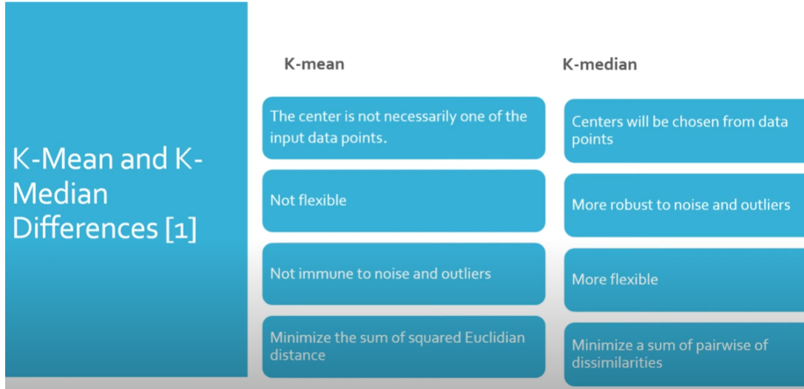

Slide 5
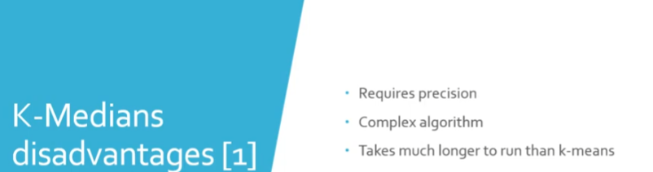

Slide 6
Median is less sensitive to outlier

Slide 7
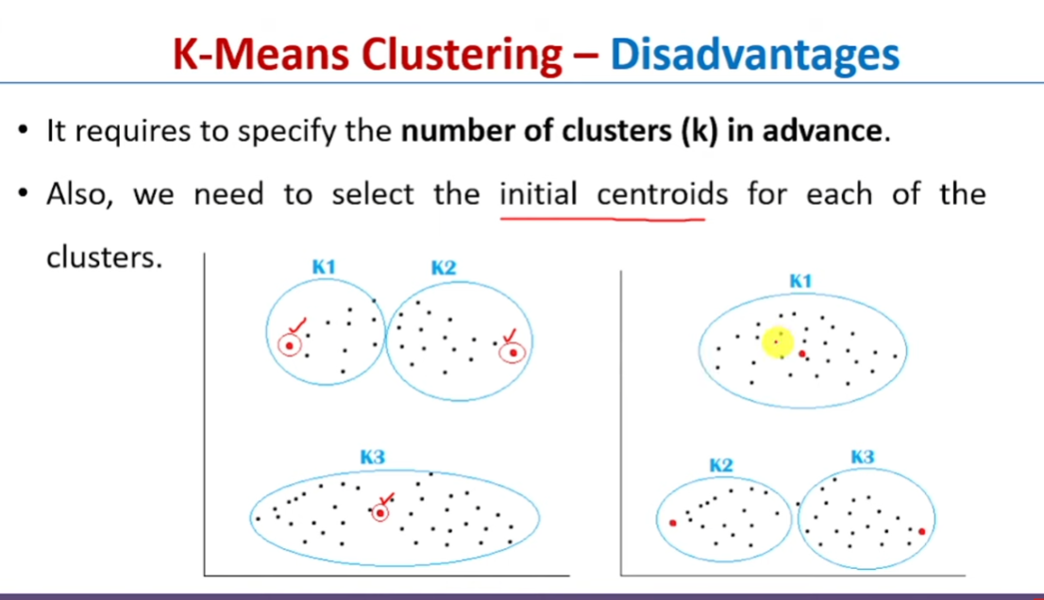

Slide 8
How to initialize the cluster representatives ? ○ Random. ○ Sample, then use another clustering method. ○ Sample k times, and use the centroid of each.
The initialization of cluster representatives (centroids) is a crucial step in clustering algorithms like K-Means. The choice of initialization method can impact the convergence and quality of the final clustering result. Here are the three mentioned options:
Random Initialization:
In this approach, you randomly select k data points from the dataset to serve as the initial cluster centroids. While this method is simple, it can be sensitive to outliers and may result in suboptimal clustering, especially if the initial centroids are not representative of the underlying clusters.
Sample, Then Use Another Clustering Method:
In this approach, you first sample a subset of points from the dataset, and then you apply another clustering method to this subset to obtain initial centroids. These centroids are then used as the starting points for the main clustering algorithm. This method is a bit more sophisticated than random initialization and can be useful when the dataset is large, as it reduces the computational cost of the initial clustering.
Sample k Times, and Use the Centroid of Each:
Here, you randomly sample k subsets from the dataset, and for each subset, you calculate the centroid. The resulting centroids are then used as the initial cluster representatives for the main clustering algorithm. This method aims to capture different aspects of the data by initializing centroids from multiple subsets.

Slide 9
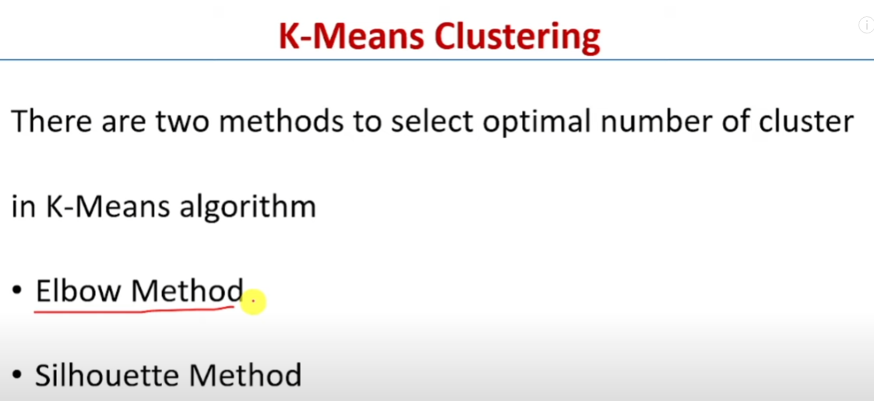
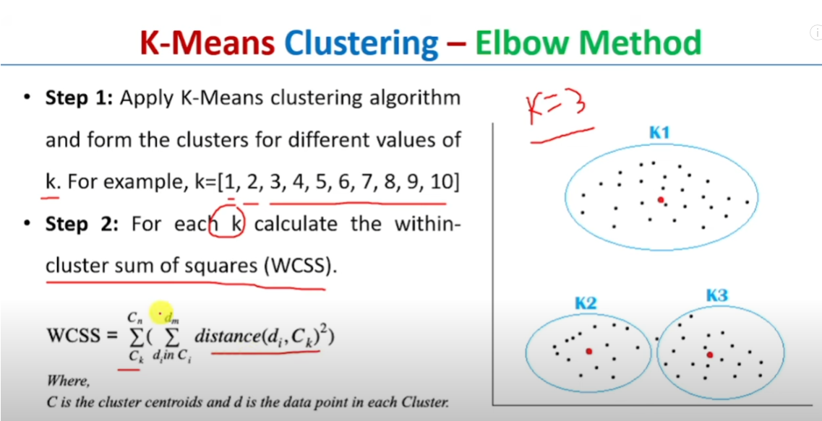
How to find optimal value of k?

Slide 10
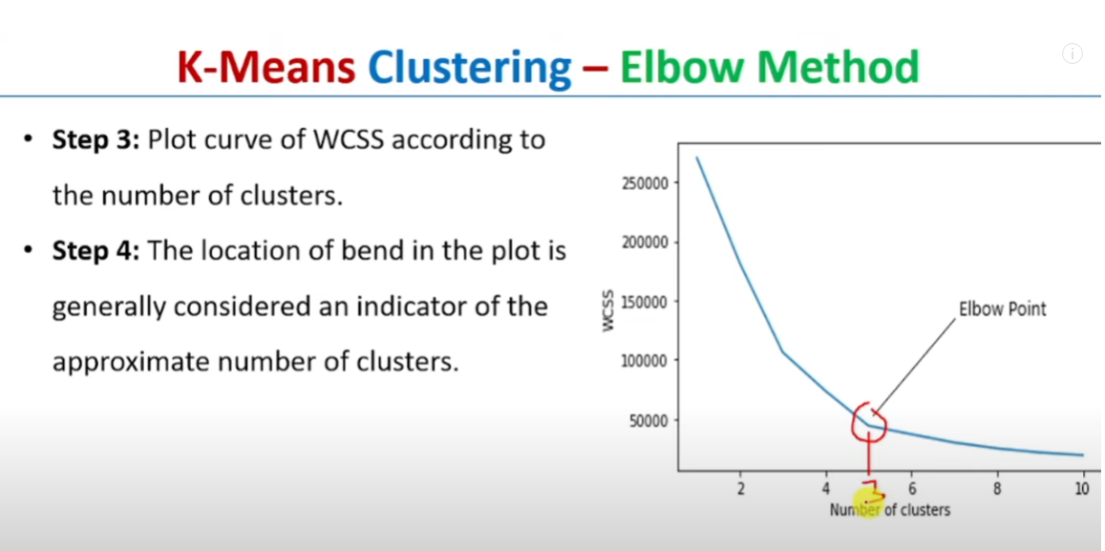

Slide 11
K-Means can get stuck with a singleton cluster if an outlier is used in initialization. What to do ?
ChatGPT
ChatGPT
The issue of K-Means getting stuck with a singleton cluster due to the influence of outliers in the initialization is a well-known problem.
This happens because the mean (average), which is used to compute cluster centers in K-Means, is sensitive to outliers, and outliers can
disproportionately affect the initial centroids. Here are several strategies to address this issue:
Choose a Robust Initialization Method:
Instead of using a simple random initialization, consider using a more robust initialization method. One such method is K-Means++,
which selects initial centroids in a way that reduces the likelihood of getting stuck with a bad initialization.
Remove Outliers Before Clustering:
Consider pre-processing your data by identifying and removing outliers before applying K-Means. There are various statistical methods to
detect outliers, and once they are removed, the algorithm may perform better.
Use a Different Clustering Algorithm:
If outliers are a significant concern, you might consider using a clustering algorithm that is less sensitive to outliers. For example,
DBSCAN (Density-Based Spatial Clustering of Applications with Noise) is less influenced by outliers because it identifies dense regions in the data.

Slide 12
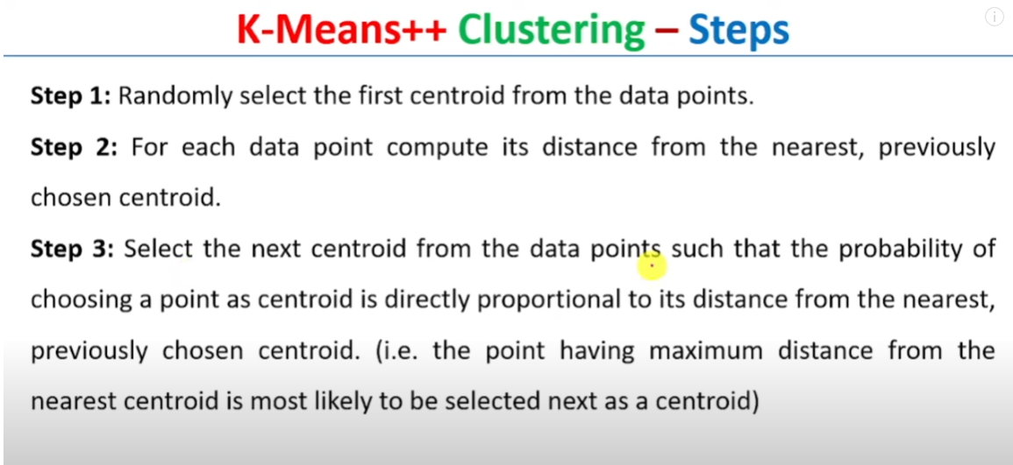

Slide 13
Complexity of grid based algorithm
Basic Grid-Based Clustering:
Time Complexity: O(N), where N is the number of data points. This is because each data point needs to be assigned to a grid cell.
Space Complexity: O(N), as it requires storing information about each data point and its associated grid cell.
Density-Based Spatial Clustering of Applications with Noise (DBSCAN):
While not strictly a grid-based algorithm, DBSCAN can be applied in a grid-based fashion by dividing the space into cells.
Time Complexity: O(N log N) in the worst case for a balanced kd-tree used for neighbor searches.
Space Complexity: O(N) for storing data points and their associated structures.

Slide 14
DENCLUE
Time Complexity:
The time complexity of DENCLUE is influenced by the density estimation step and the hill climbing process. The density estimation involves evaluating the kernel density function for each data point, which can result in a time complexity of O(N^2) in the worst case, where N is the number of data points. The hill climbing process for each point may involve multiple iterations, and the number of iterations can also impact the overall time complexity. Space Complexity:
The space complexity of DENCLUE is influenced by the data structures used to store information during the clustering process. In particular, the density estimation step requires storing density values for each data point, leading to a space complexity of O(N).

Slide 15
The choice depends on the seasonality of data, e.g., ○ Quarterly data with annual seasonality => 2 x 4-MA ○ Monthly data with annual seasonality ? ○ Daily data with weekly seasonality ?
Quarterly Data with Annual Seasonality:
As mentioned before, a 2 x 4-MA (two times four-quarter moving average) could be suitable for quarterly data with annual seasonality. This involves taking the average of adjacent quarters over two years, helping to smooth out seasonal variations.
Monthly Data with Annual Seasonality:
For monthly data with annual seasonality, a common approach is to use a 12-MA. This means taking the average of the corresponding month over the past 12 months, effectively smoothing out short-term fluctuations and capturing the annual seasonality.
Daily Data with Weekly Seasonality:
In the case of daily data with weekly seasonality, a 7-MA might be appropriate. This involves taking the average of the corresponding day over the past week. It helps in smoothing out daily fluctuations, especially if there is a consistent pattern repeating every week.

Slide 16
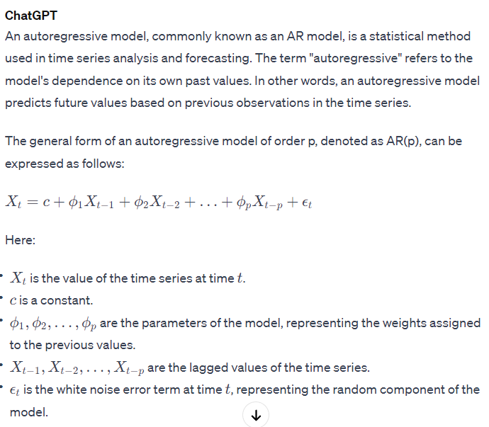
In the autoregressive model,
the value of y t at time t is defined as a
linear combination of the values in the
immediately preceding window of length p.

Slide 17
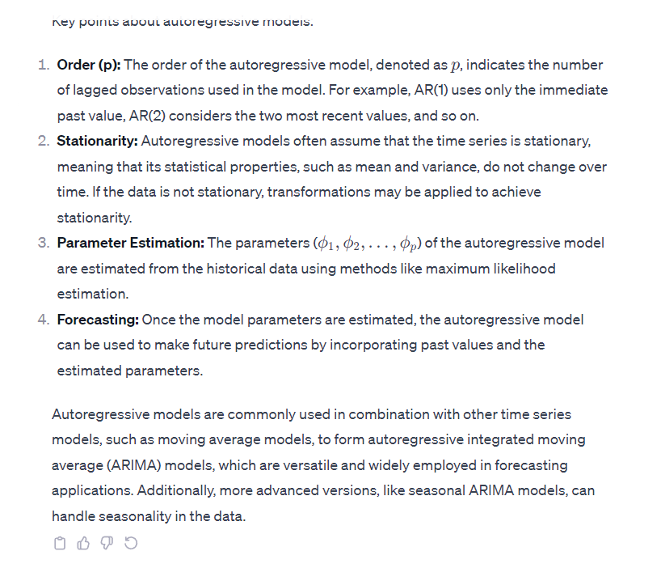

Slide 18
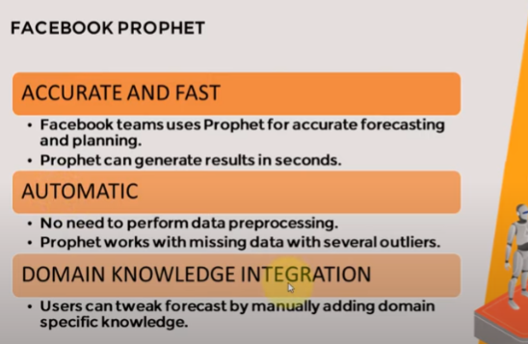
Prophet
Open source software released by Facebook
Time series forecasting tool
Useful for time series data with strong seasonal pattern and multiple seasonality
Implements additive regression model with four elements
Piecewise linear

Slide 19
Complexity of naïve bayes
Time Complexity:
Training Time:
The training time complexity is often linear with respect to the number of features and the size of the training dataset. It is O(N * M), where N is the number of instances in the training set, and M is the number of features.
Prediction Time:
The time complexity for making predictions is also linear, O(K * M), where K is the number of classes and M is the number of features.
Space Complexity:
Model Size:
The space complexity of the Naive Bayes model is relatively low. It depends on the number of classes, the number of features, and the data type used to represent probabilities. The space complexity is O(K * M), where K is the number of classes, and M is the number of features.
Data Storage:
The algorithm requires storing counts and probabilities for each class-feature pair during training. The space complexity for storing these probabilities is generally O(K * M), where K is the number of classes, and M is the number of features.

