Slide 1
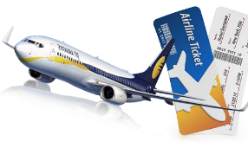
Project Title:
FLIGHT FARE PREDICTION SYSTEM USING MACHINE LEARNING ALGORITHMS

Slide 2
INTRODUCTION
Traveling via flights has become an integral part of today's lifestyle, as more and more people choose faster travel options. Airfare prices increase or decrease every day here and there depending on various factors such as flight timings, destination, duration of flights, various occasions such as holidays or holiday season. As a result, many people will save time and money by having a basic understanding of flights before making travel arrangements. A predictive model will be created in the proposed system by application of machine learning algorithms to collected historical data. This system will give people an idea of the trends the prices follow and provide the predicted value of the price they can check before booking flights to save money. This kind system or service can be provided to customers through flight booking companies to help customer book tickets. Thus, people can buy the ticket many days before the flight takes off to avoid the effects of the most extreme fees.

Slide 3
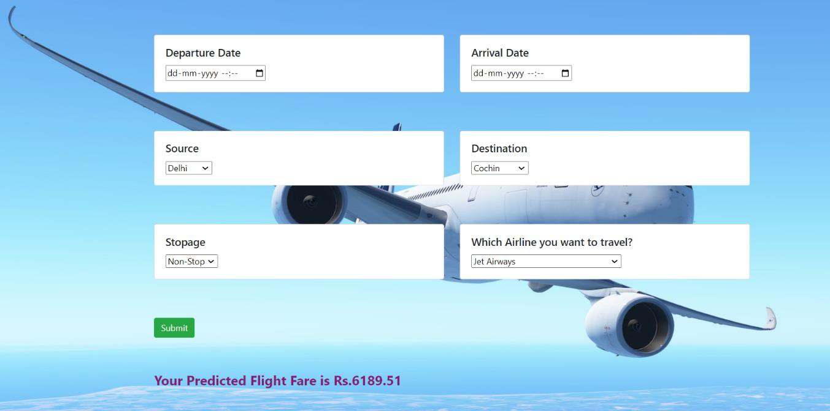
DEPLOYMENT LINK:
https://flight-fare-pridiction3.onrender.com/predict

Slide 4
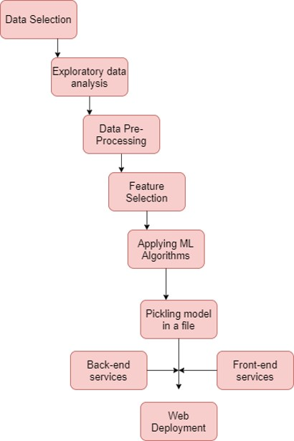
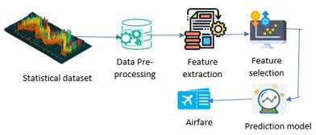

Slide 5
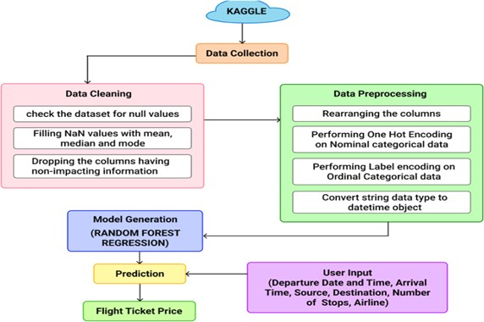
Data Source: https://www.kaggle.com/nikhilmittal/flight-fare-prediction- mh

Slide 6

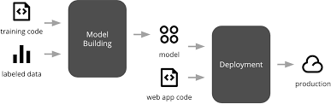
SEQUENCE DIAGRAM PROJECT FLOW
STAGE 1: Building Fare prediction Machine Learning Model
STAGE 2: Building a Web App and deploy it in live environment

Slide 7
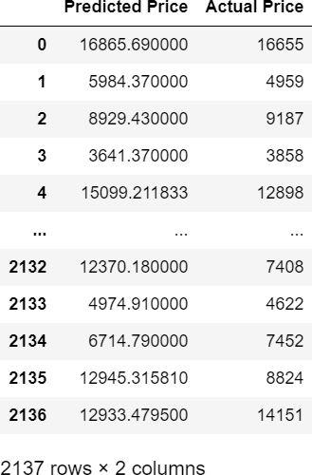
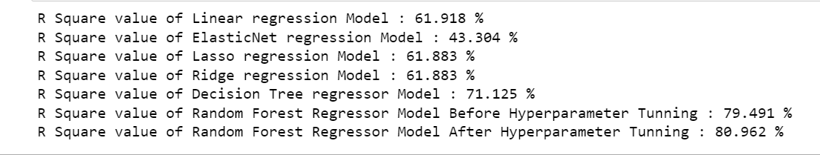
RESULTS
The accuracy (R Square) of different models employed:

Slide 8
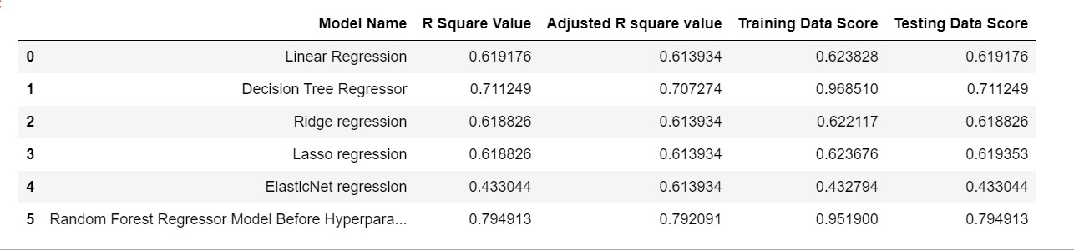
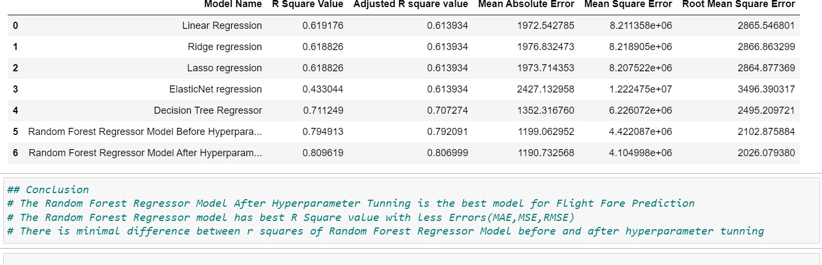
The accuracy of different models employed with Training and Test Data Scores

