Slide 1

Carpoolify
By
Soojung Kwak
Mainul Haque
Anand Kasote

Slide 2
Background
This is a mobile app which lets you find people going on the same route as you and allow you to connect with a car pooling community. After the user inputs the destination, this app will connect people with the app database and match their location and connect with users going to same destination

Slide 3
Problem Statement
To improve people mobility is one of the biggest challenge. People prefer to use their own vehicles because it is faster, more comfortable and convenient which creates a lot of additional traffic and increases pollution.

Slide 4
Business Benefit
Brands will have their logo exposed in the app;
The brands will be known as “greener”, what increases the customer perception that they are concerned about the environment;
Companies can choose this app to advertise their products.
Customer retention - the accumulation of points toward a reward retain existing customers.

Slide 5
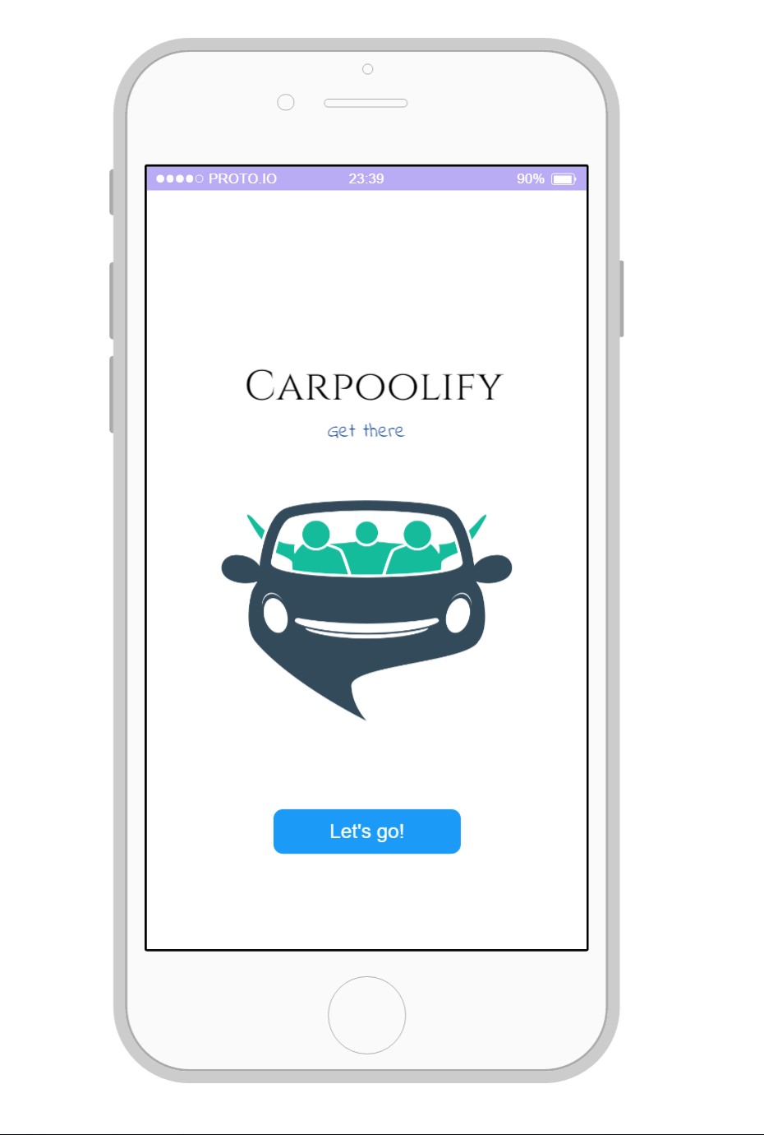
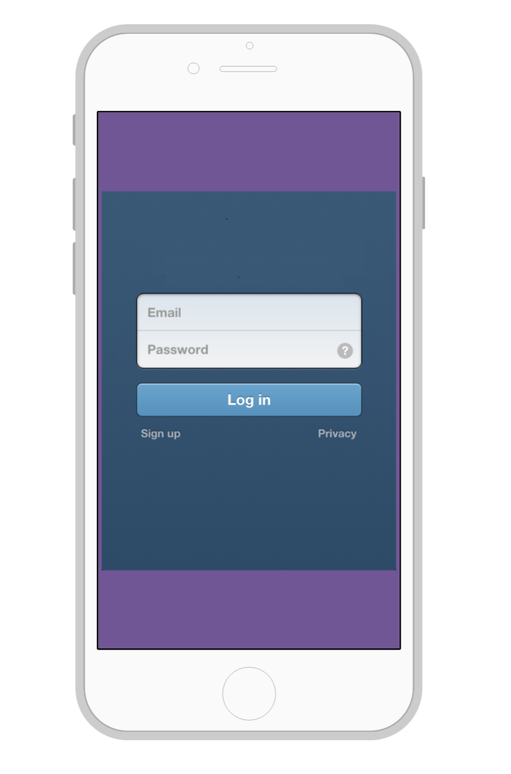
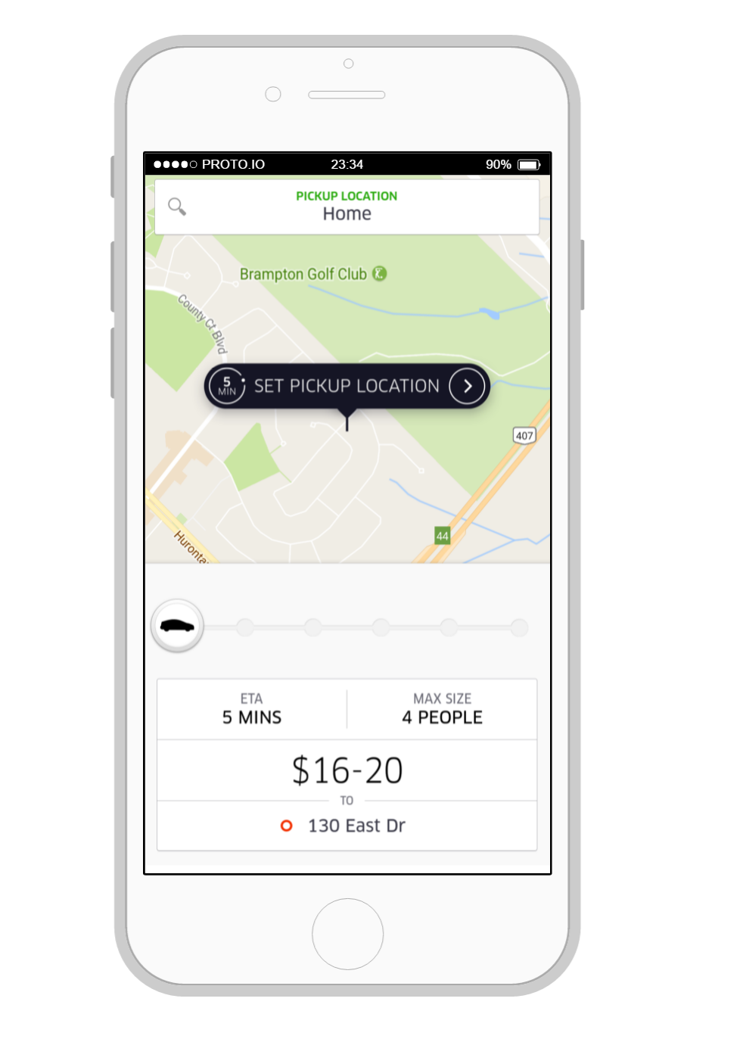

Slide 6
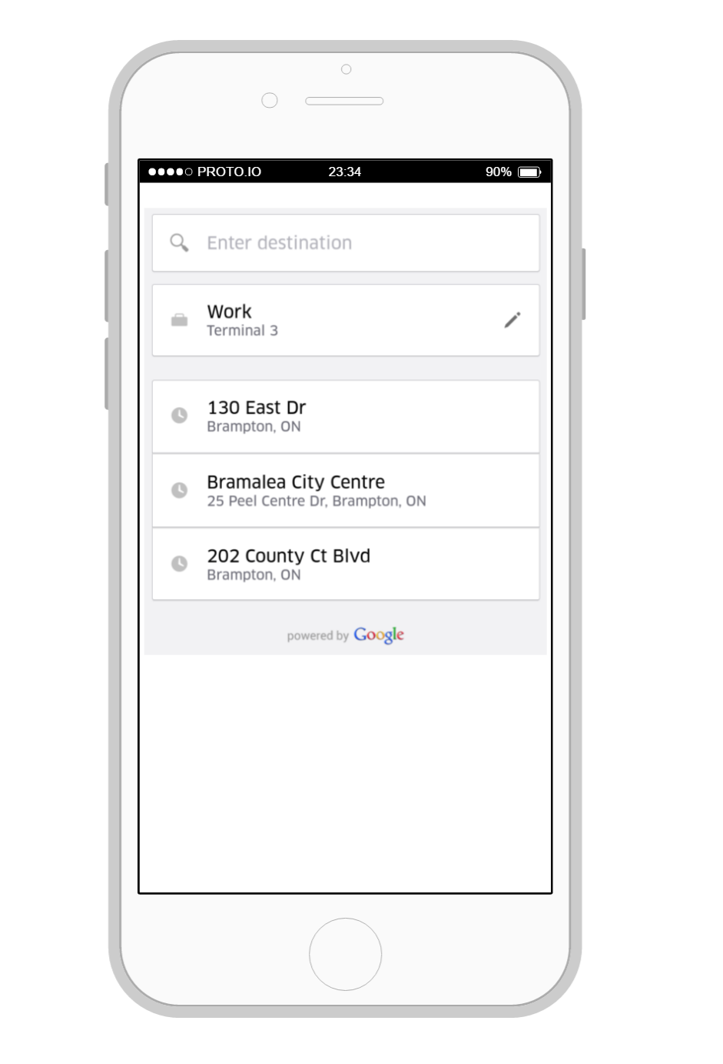
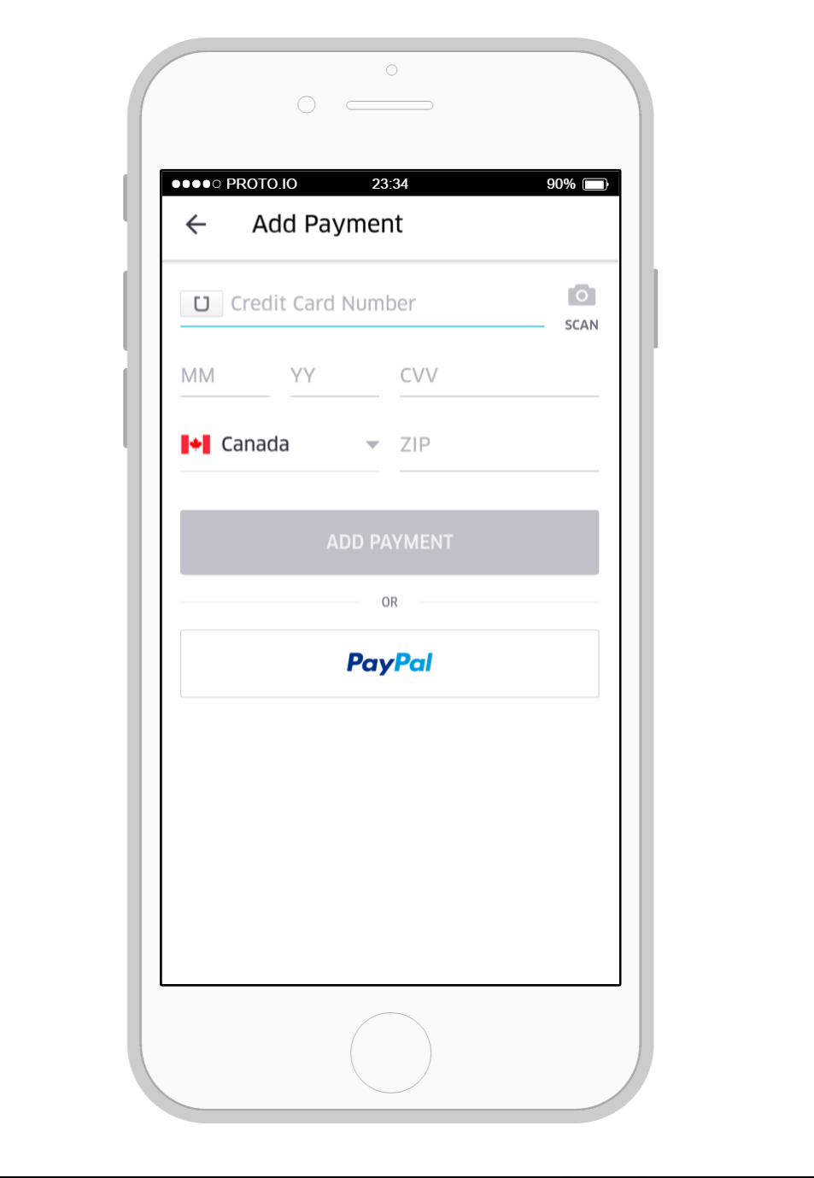

Slide 8
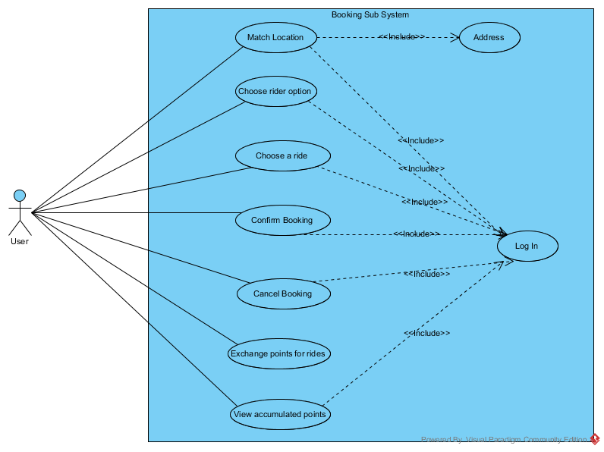
Performance Against Schedule
Customer
Booking
System

Slide 9
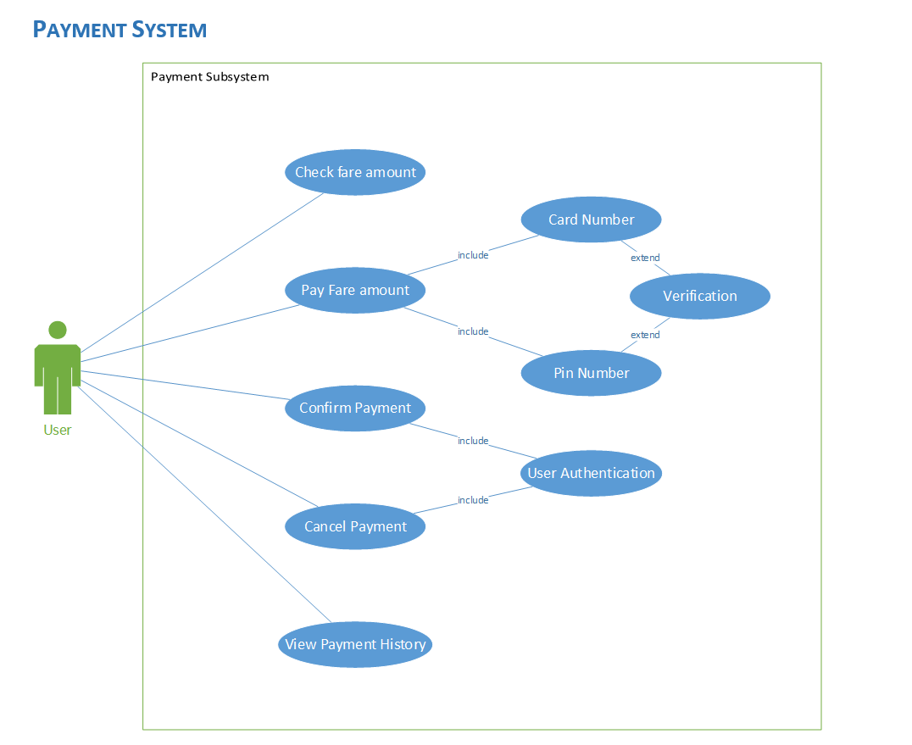
Payment
System

Slide 10
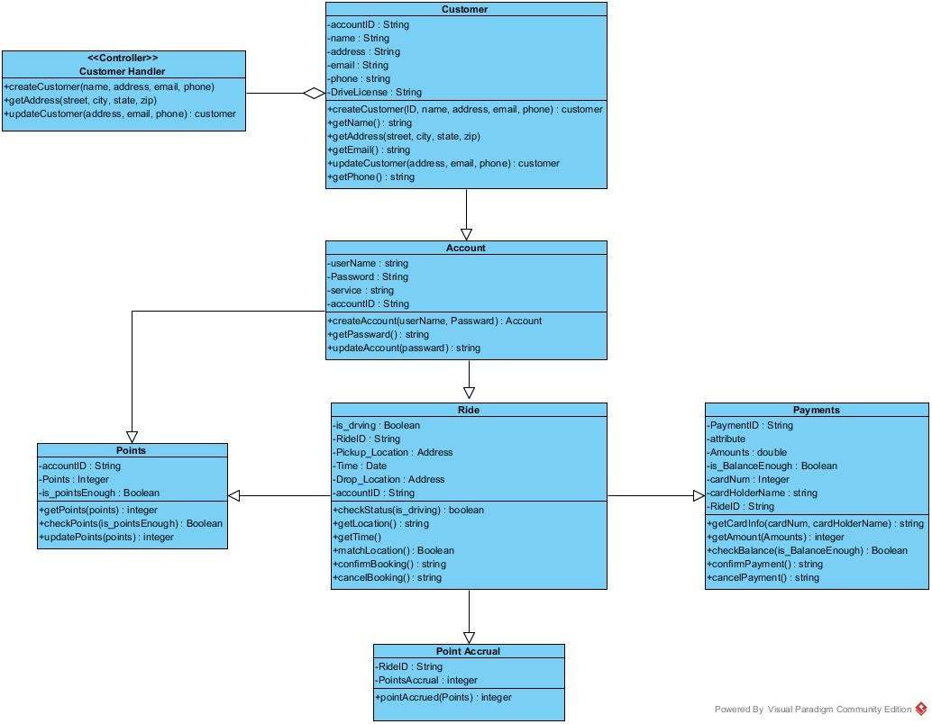
Design Class
Diagram

Slide 11
Registration Sequence Diagram

Slide 12
Booking State Machine diagram

Slide 13
Payment State Machine diagram

Slide 14
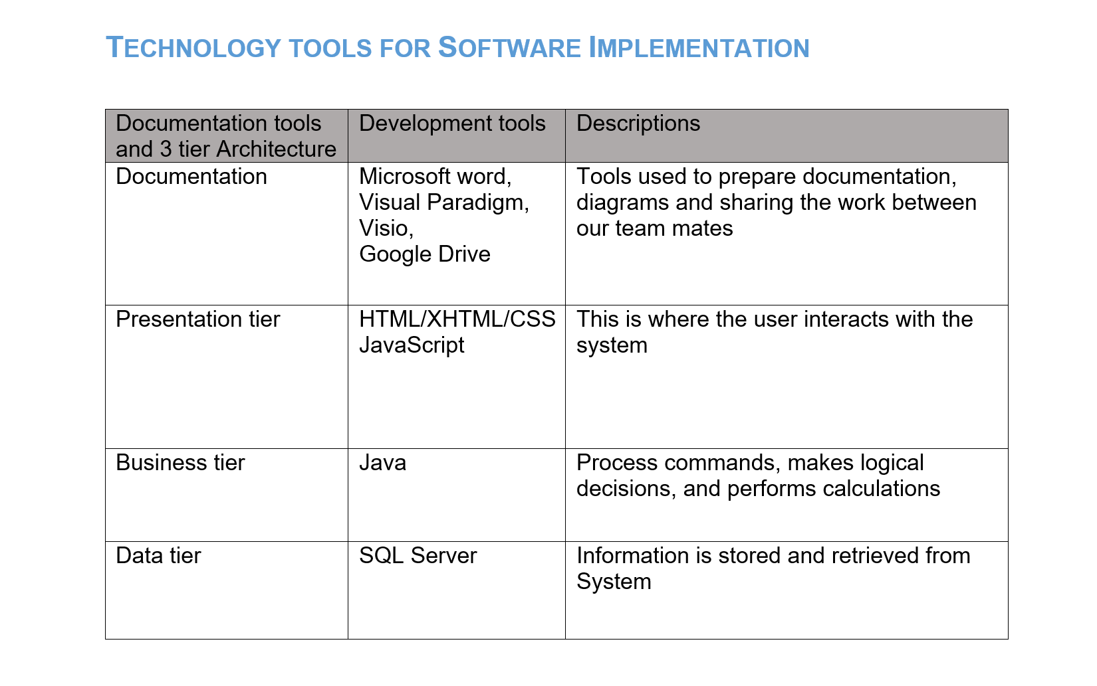

Slide 15


