Slide 1
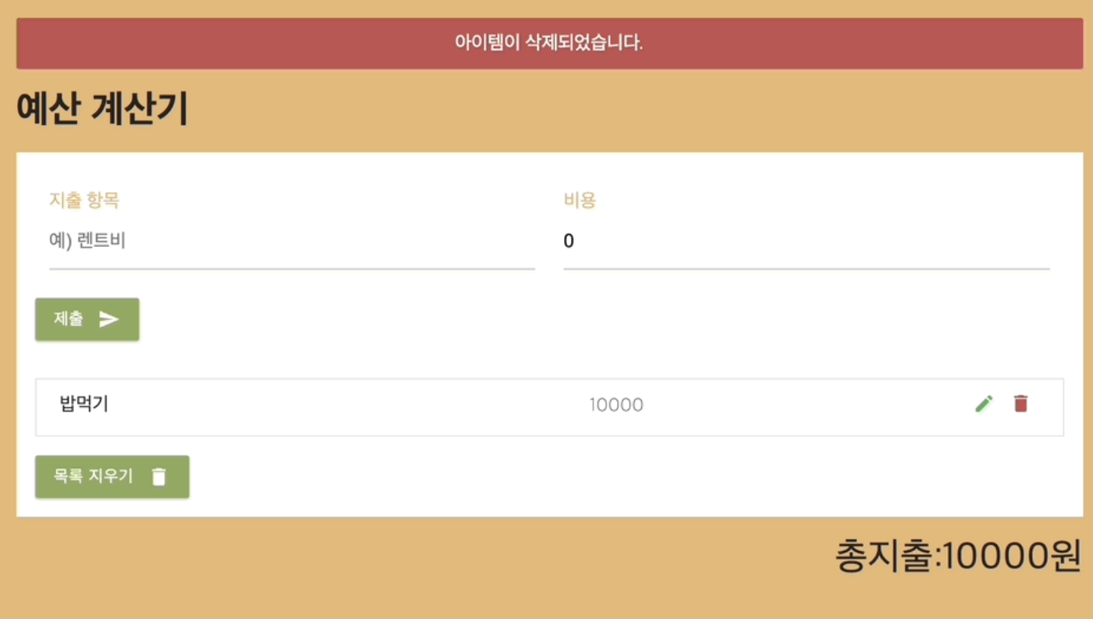
alert
InputListForm
InputForm:
Only type => alert, CREATE
input data => expensesLists, Expenses
ExpensesLists:
Delete : Only type => alert, DELETE
expensesLists => filter, Expenses
Edit : Only type => alert, EDIT
expensesLists => filter, Expenses

