Slide 1
Build a Blockchain & Cryptocurrency
Tech Stack: Python & Flask, JS & React
Github repo: https://github.com/SoochowRobin/python-blockchain
Guobin Chen
12/06/2022

Slide 2
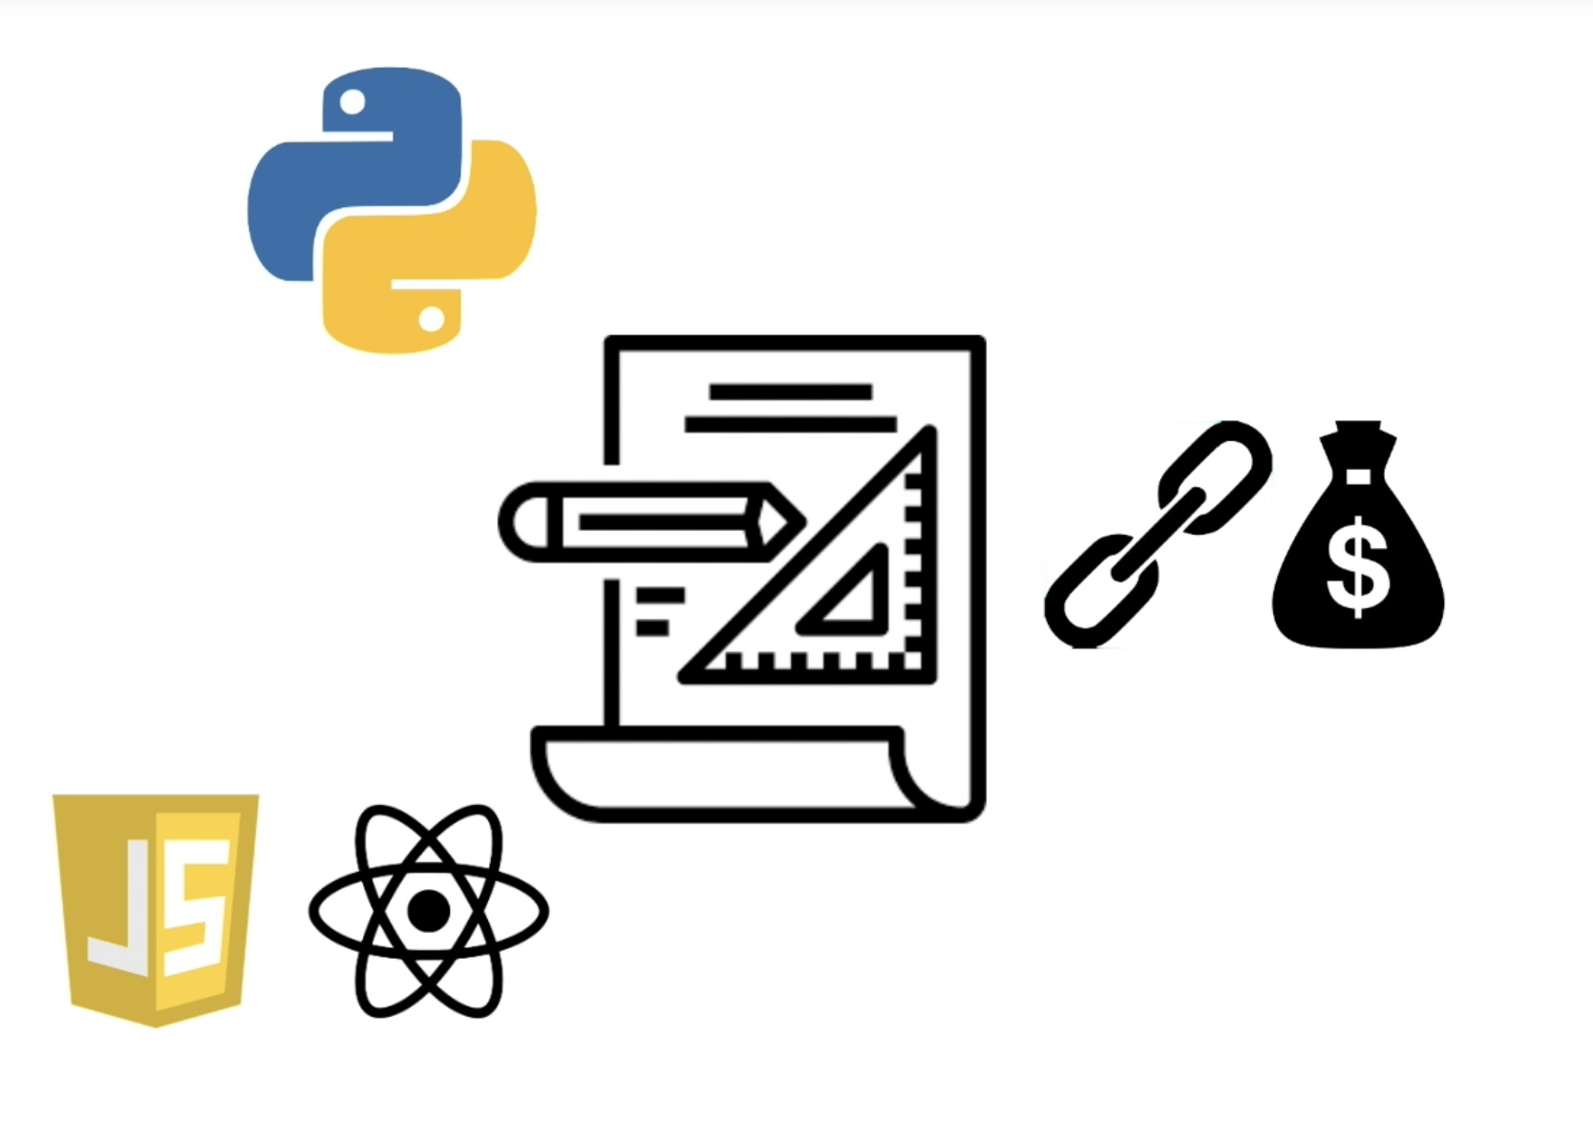
Project Goal
Learn Python Fundamentals and Flask framework
Build a Blockchain and Cryptocurrency
Learn Fronted Web Development, JavaScript, and React

Slide 3
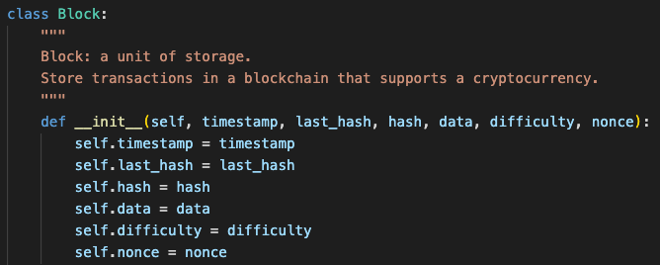
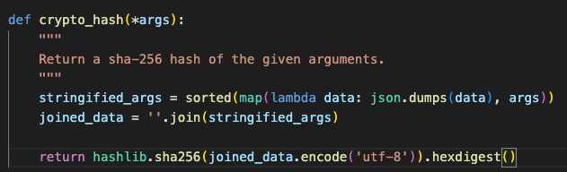
Python Fundamentals
Familiar with: variable, functions, while-loop, for-loop, lambda,
built-in data structures: lists, sets, dictionaries, classes, modules
Blockchain: a list of blocks where each block represents a unit of storage for data. The list is called a chain because each block references the block before it
Genesis block is the first block in the blockchain. And it serves as a hardcoded starter block for the chain
A hashing algorithm generates a unique output for every unique output. I used sha-256 algorithm, which produces a unique 256 characters hash in binary

Slide 4
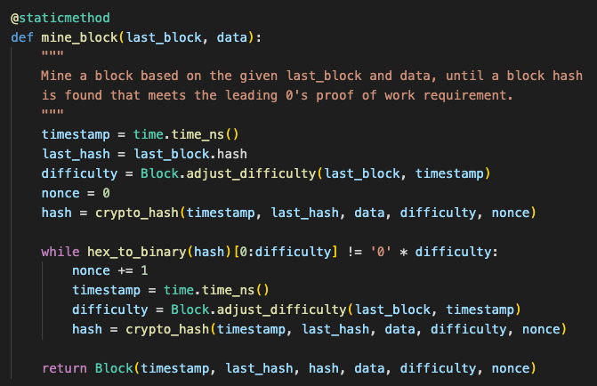
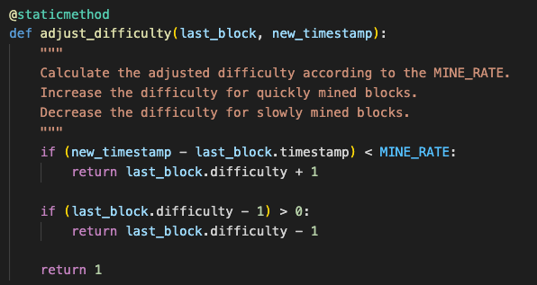
Proof of Work
Proof of work: it is a mechanism that requires miners to solve a computational puzzle in order to create valid blocks. Solving the puzzle requires a brute-force algorithm that demands CPU power(standard: leading 0’s requirement)
Dynamic difficulty: It is a mechanism that increases or decreases the difficulty of the next block based on how long it is taking to mine the new block

Slide 5
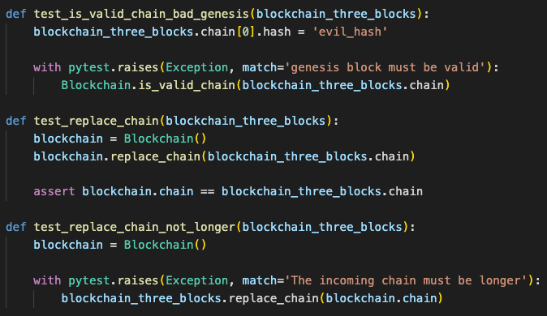
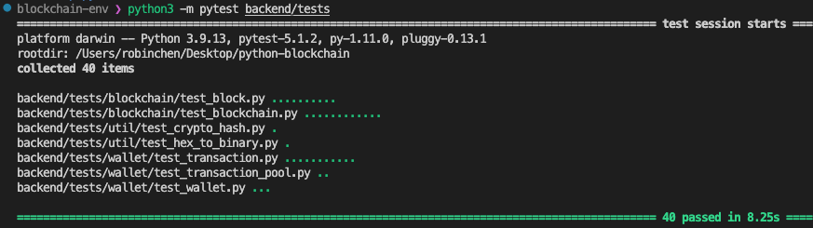
Test
The general approach to tests is to create a series of assert statements that verify whether or not a value is equal to some other value
40 tests, all pass

Slide 6
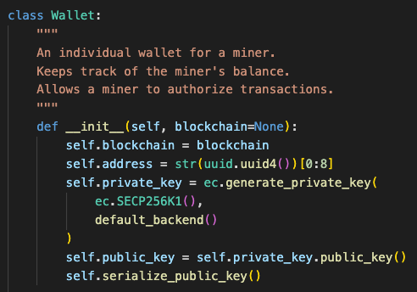
Cryptocurrency
Wallet: A wallet keeps track of an individual’s amount of currency. Each wallet has an address, and a pair of keys (private and public)
Signature: It is unique data object created using the private key of keypair and an original data object to sign. With the signature, public key, and the original data object can verify if the signature was generated by the true owner of the public key.
Transaction pool: It is an object that collects transactions that have been broadcasted across the network. It stores transaction according to their id.

Slide 7
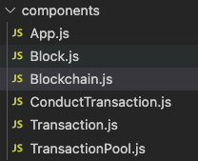
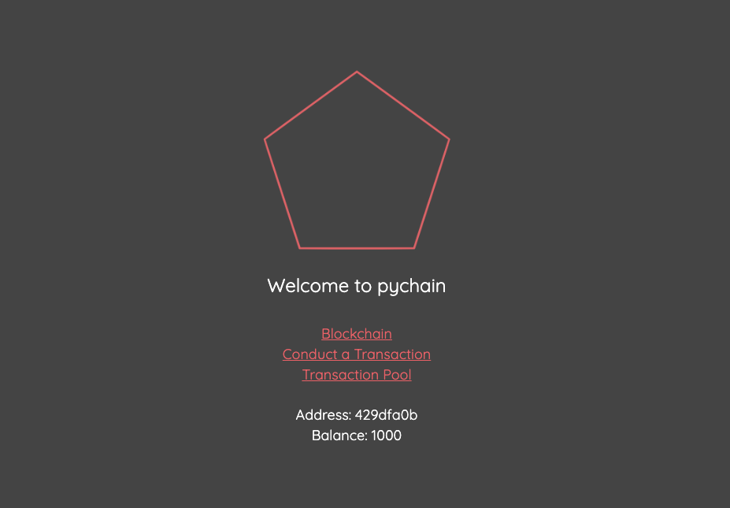
Fronted end
React is a JavaScript framework for web applications. React optimizes how JavaScript is used on the browser to make the web app dynamic and efficient.
Components represent reusable pieces of the UI within the React application.
Hooks could apply React functionality to components – like state, side effects.
Pagination is an approach to display long lists of data in a fronted web application.

Slide 8
Thank you for your time!

