Slide 1
Hall 9 Returning Scheme
2018/19

Slide 2
Returning Recommendation Committee
Residence Master
All Residence Tutors
Three Residents Representatives (Three Residence Association members.)

Slide 3
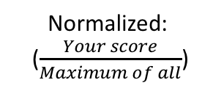
Key Returning Attributes
Normalized:
($\frac{Your score}{Maximum of all}$)
Attributes | Points
A. Academic Excellence | (0 to 15)
B. University Contributions (Normalized) | (0 to 10)
C. Hall-Based Contributions (Normalized) Professor Edmond Ko Cup Hall Activities Floor Performance Special Contribution | (0 to 80) 40 30 20
D. Discipline | Deduction (-100 to 0)
Total | A+B+C+D
A & D: Un-normalized Absolute, points will not be interfered by other applications
B & C: Normalized, points will be divided by the application with the highest score

Slide 4
A. Academic Excellence (0-15 Points)
Points are given based on the resident’s semester A GPA during his/her residential year.
cGPA if the resident is a returning outbound exchange student
From 0 points to 15 points (maximum) using the following chart:
GPA | Points Earned/Deducted
4.30~4.00 | 15
3.99~3.50 | 13
3.49~3.00 | 10
2.99~2.50 | 7.0
2.49~2.00 | 4.0
Below 2.00 | 0

Slide 5
B: University Contributions
“Score B”
Input in AIMS and evaluated by SRO.
Incomplete input for the Score B will be counted as incomplete application.

Slide 6
C: Hall-Based Contributions Prof. Edmond Ko Cup (0 – 40 points)
Role | Points for one event
PEK Game Player | The team member(s) can get 0 to 5 bonus points .
Helper | The team members can get 0 to 3 bonus points .
Cheering | The team members can get 0 up to 4.6 bonus points .

Slide 7
C: Hall-Based Contributions Prof. Edmond Ko Cup
PEK Players (0 to 5)
… with practices
… without practices
Individuals selected for participating in practices can have 2 points.
The team members on the Entry Form submitted to SRO can have an additional 3 points.
The team members can have bonus points according to the results and their performance.
The team members on the Entry Form submitted to SRO can have 5 basic points.
Result: | Bonus Points
Champion | The team members can get 0 to 5 bonus points .
1st Runner Up | The team members can get 0 to 4 bonus points .
2nd Runner Up | The team members can get 0 to 3 bonus points .
3rd Runner Up | The team members can get 0 to 2 bonus points .
Wins 1 match | The team members can get 0 to 1 bonus points .

Slide 8
C: Hall-Based Contributions Prof. Edmond Ko Cup
PEK Helpers (0 to 3)
- Helping in organization and preparation for PEK events

Slide 9
C: Hall-Based Contributions Prof. Edmond Ko Cup
Cheering Members (0 up to 4.6)
Stage | Maximum Possible points added at this stage | Cheering Member’s Total Points | Player’s Total Points
Group stage 1 | +1 | 0-1 | 5-6
Group stage 2 | +1 | 0-2 | 6-7
Quarter final | +0.6 | 0-2.6 | 7-8
Semi final | +0.8 | 0-3.4 | 8-9
Final/Bronze | +1.2 | 0-4.6 | 9-10
For one-match event or only one match in group stage, cheering members can get 0-2 points for this specific match. To encourage the residents to be more engaged, merely attendance will not guarantee full participation mark, but also based on the cheering performance.
For PEK athletes on marginal case list, they are considered more favorably if they have won awards during PEK events.

Slide 10
Apply for External Funds
Residents who propose a fund application to Hall Management Team and are selected to represent the hall should be awarded returning points of the same level as PEK events. If they win the proposal and organize it successfully, we will treat them as winning medals.
Students Activities Funds (SAF) – SDS – for both local & non-local student activities
Hang Seng Environmental Protection Support Fund – SDS – to support environmental protection programmes
Student-initiated Projects (SIP) – GSO – to promote internationalization
Career & Leadership Fund (CLF) – SDS – for career development-related projects
DIMSum Funds – Provost – for activities, conferences, community services, internships, or study tours that require traveling to Mainland China
Pilot Mainland Experience Scheme (PMES) – GSO – for activities, conferences, internships, community services or study tours that require traveling to Mainland China
Mainland 10000 Scheme – GSO – for activities, conferences, internships, community services or study tours that require traveling to Mainland China
Hsin Chong – K.N. Godfrey Yeh Education Fund for Joint Student Projects – SDS – for joint-university events

Slide 11
C: Hall-Based Contributions Hall Activities (0 - 30 points)
Role | Points
Participation | 2 points (Same weighting for any hall activities)
Helper (Non RA Activities) | 0 to 3 points according to their contribution, given by PIC tutor.
Helper (RA Activities) | 0 to 3 points according to their contribution, given by PIC RA member.

Slide 12
C: Hall-Based Contributions Floor Performance (0 – 20 Points)
Floor Performance Scores will be mainly given according to the Floor Performance Evaluation Reference (next slide).
Floor tutors may also consider the contents written on the returning application form.
Daily behavior is a critical measure to the overall floor scores.
If a resident keeps behaving badly and has a negative effect on other floor mates, floor tutor should make detailed records and send the records to the Disciplinary Tutor.
If a resident violates the hall rule seriously affecting others, floor tutor has the discretion to involve Security Office Staff.

Slide 13
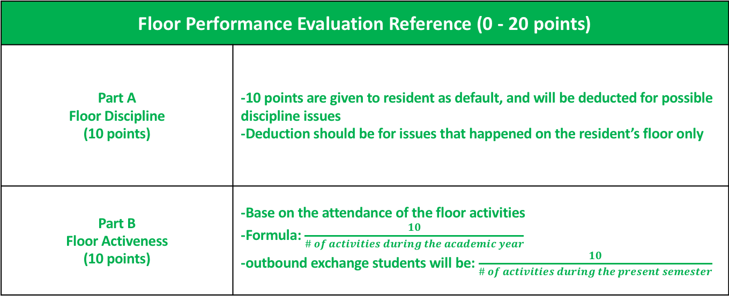
Floor Performance Evaluation Reference (0 - 20 points)
Part A Floor Discipline (10 points) | -10 points are given to resident as default, and will be deducted for possible discipline issues -Deduction should be for issues that happened on the resident’s floor only
Part B Floor Activeness (10 points) | -Base on the attendance of the floor activities -Formula: $\frac{10}{\# of activities during the academic year}$ -outbound exchange students will be: $\frac{10}{\# of activities during the present semester}$
- Daily behavior is a critical measure to the overall floor scores.
- Bad behavior will be recorded and send the records to the Disciplinary Tutor.
- Violation of hall rules may involve Security Office Staff.

Slide 14
Floor Performance Evaluation Reference
Very Bad | * Always behaved annoyingly and affecting others. * Rarely seen in the floor. * Rarely join floor activities.
Bad | * Sometimes behaved annoyingly and affecting others. * Rarely communicate with others. * Participation rate of floor activities lower than 50%; heavy late comer.
Average | * Only concern a small group of specific floor-mates. * Rarely communicate with different kinds of floor-mates. * Joined some floor activities, but sometimes late.
Good | * Good self-disciplined; * Able to communicate with different kinds of floor-mates. * Initiative to join most of the floor activities.
Very Good | * Good self-disciplined. * Being reliable. * Being optimistic. * Always help different kinds of floor-mates. * Help floor-mates with special need. * Enthusiastic and initiative to help floor activities.

Slide 15
C: Hall-Based Contributions Special Contribution (Extra Scores)
Post | Bonus | Decision
Fire Marshals | 0 – 2 scores | By Disciplinary Tutor
Floor Representatives | 0 – 5 scores | By floor RT
Media Team A (e.g., Facebook Content Creator, Photographer, Journalist,) | 0 – 3 scores | By the corresponding RT
Media Team B (e.g., Graphic Designer, Hall magazine editor,) | 0 – 7 scores | By the corresponding RT
RA Council Members | 0 – 10 scores | By Council
RA Members | 0 – 20 scores | By RA
Interview bonus to the marginal case | / | By Marginal Cases Interview Committee

Slide 16
D: Discipline (-100 to 0)
1st offence
No Deduction, verbal warning
2nd time or subsequent offences
1 - 20 scores deduction
General Disciplinary Case or
After second warning
(5-50 scores deduction+ suspension of stay)
Warning Letter from Tutor
Warning Letter from Hall Master
Serious Disciplinary Case
(20-100 scores deduction+ suspension of stay)
Reminder: Visitors checking out late will cause deduction on the scores and may cause visitor ban.

Slide 17
Scaling System
Prof. Edmond Ko Cup points will be scaled to maximum 40 scores.
Hall Activities points will be scaled to maximum 30 scores.
Score B scores will be scaled to maximum 10 scores.
Example: suppose in Prof. Edmond Ko Cup, resident A participate * Swimming (swim for our hall, get = 5 points) * Running (get champion = 10 points) * Table Tennis (get champion = 10 points), * Singing (be cheering member , get 2 points) Totally gets 27 points as the highest points among all residents. Then she will get 40 scores in Prof. Edmond Ko Cup.
If another resident B totally gets 25 points, then he will get 40 x (25 / 27) = 37.03 scores in Prof. Edmond Ko Cup.

Slide 18








Proportional System for Half Year Residents
Maximum PEK Pts: 40
Maximum Hall Activity: 30
(Example)
Residents | Sem A (PEK)+ (Hall Activities) (20) + (15) | Sem B (PEK) + (Hall Activities) (20) + (15) | Final Score
A. Highest Score (Full year) Become Max for all | (18) +(14) | (19)+(13)
B. Not Highest Score ( Full Year) | (13)+(12) | (17)+(12)
C. Exchange Student (Stay in Sem A) | (15)+(13) | /
D. Exchange Student (Stay in Sem B) | / | (18)+(13)
$\frac{18+19}{18+19}$ *40
=40
$\frac{14+13}{14+13}$ *30
=30
$\frac{13+17}{18+19}$ *40
=32.4
$\frac{12+12}{14+13}$ *30
=26.7
$\frac{15}{18}$ *40
=33.3
$\frac{13}{14}$ *30
=27.9
$\frac{18}{19}$ *40
=37.9
$\frac{13}{13}$ *30
=30

Slide 19
Interview for Marginal Residents
6 to 8 (5% to 10%) of applied residents whose scores are very close to the cut-off line will be invited to have an interview with Marginal Cases Interview Committee.
The Committee has the discretion to give them bonus points based on their interview performance.

Slide 20
Interview for Senior Residency (application for 3rd or 4th year residency)
For the best use of university resources and the best interest of all stakeholders, the committee has the discretion to review the selection criteria, weighing and means for senior resident applicants, including conducting interviewees with the returning applicants.
In addition to the normal returning procedure, the returning committee needs to review:
- Academic excellence (e.g., CGPA is expected to be 3.0 or above)
- Hall Citizenship (e.g., no disciplinary records)
- Community leadership (e.g., student body leadership roles)
Interview may be arranged and recommendations will be made in consultation with the university.

Slide 21
Reminder !!!!!!!!!!
Late Applicants (no matter how high the scores is) will only, at most, be placed on the Waiting List.
Applicants providing fake information will be automatically disqualified.

