Slide 1
HYDRA
H2O HACKATHON · HACKING THE SUPPLY
Hydra.
California water-supply intelligence —
three signals, one clear outlook.
Submission · Hacking the Supply
PARTHAV FULZELE

Slide 2
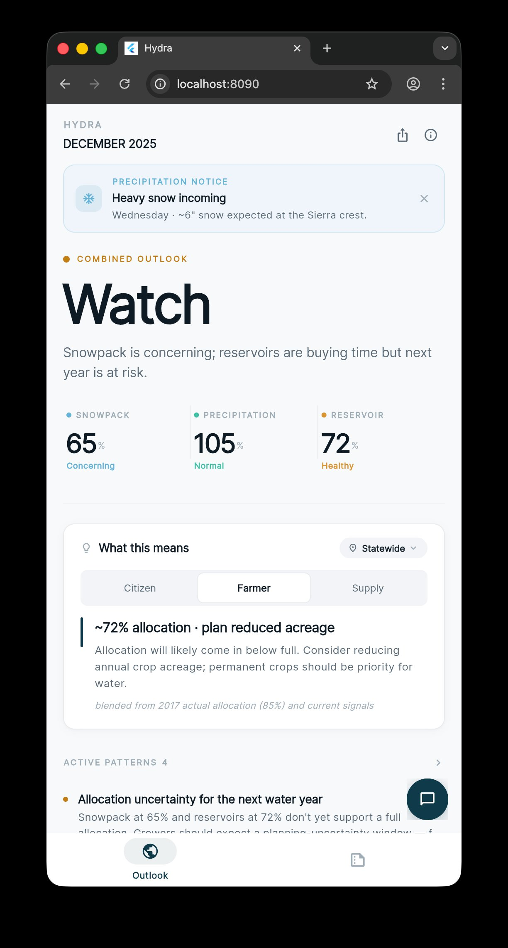
04 · THE SOLUTION
HYDRA
05 / 16
INTRODUCING
Hydra.
California's water supply at a glance — three signals, one clear outlook.
Flutter + FastAPI
Web · iOS · Android · single-page editorial dashboard
Three signals → one outlook
Strong · Stable · Watch · Concern (rule-based)
Audience-aware planning
Citizen · Farmer · Supply manager · 6 regions

Slide 3






05 · PRODUCT
HYDRA
06 / 16
PRODUCT PILLARS
Six pillars — each addresses something the brief or the expert called out.
01
02
03
Combined Outlook
Multi-Signal Alerts
Forward-Looking
Strong / Stable / Watch / Concern — rule-based, deterministic, captures real water-supply mechanics.
Five labeled patterns: drought stress · allocation uncertainty · future weak signal · flood pressure · mixed.
Next-event panel · 0–100 risk scores · 6-month projection with confidence bands · closest historical analog.
04
05
06
Planning Card
Explanation Layer
Multimedia Output
Three audience tabs · region picker · grounded farmer allocation estimate (e.g. 2017 → 85%, 2021 → 5%).
LLM for translation only — drift-guarded, ±5pt validation, deterministic fallback on every text surface.
Every view exports as a 1080×1350 editorial PNG share-card — rendered as a layout, not a screenshot.

Slide 4
06 · COMBINED OUTLOOK
HYDRA
07 / 16
PILLAR 01
Combined outlook — not an average. A rule.
Concerning snowpack with healthy reservoirs is Watch — today is OK, but next year is at risk. Each label maps to a distinct combination of signal bands, deterministically.
Strong
Stable
Watch
Concern
All three signals healthy. Buffer in place; plan normally.
Adequate today across most signals. Routine conditions.
Today is OK but a leading signal is weak — next cycle is exposed.
Multiple signals weak. Plan for restriction, fallow, or allocation cuts.
DEC 2025 LIVE READING
Watch · snowpack 65% concerning · precipitation 105% normal · reservoir 72% healthy

Slide 5
07 · MULTI-SIGNAL ALERTS
HYDRA
08 / 16
PILLAR 02
Five patterns no single metric reveals.
01
Drought stress
Formal precipitation shortage — restrictions likely.
02
Allocation uncertainty
Farmers' planning trigger — snowpack/reservoir below allocation floor.
03
Future weak signal
Adequate buffer today, but inputs for next year are weak.
04
Flood / overflow pressure
Reservoirs near capacity with storms incoming.
05
Mixed-signal watch
Fallback for ambiguous setups — reads the data, withholds the verdict.

Slide 6
08 · FORWARD-LOOKING
HYDRA
09 / 16
PILLAR 03
Forward-looking outlook — what's coming next.
NEXT-EVENT PANEL
Pulls the next significant precipitation event from the Sierra Nevada (Donner Summit) weather window.
PRECIPITATION NOTICE
Heavy snow incoming.
RISK SCORES
Wednesday · ~6" snow expected at the Sierra crest.
Drought / flood scored 0–100. Combines current state, recent trend, and the upcoming weather window.
6-MONTH PROJECTION
DROUGHT RISK
FLOOD RISK
Statistical model trained on the full 120-month dataset. Confidence bands widen with horizon.
58
22
/ 100
/ 100
HISTORICAL ANALOG
Closest analog year is surfaced — with what played out in the 6 months that followed.
Closest analog · 2017
Wet recovery year · 85% State Water Project allocation.

Slide 7


09 · PLANNING IMPLICATIONS
HYDRA
10 / 16
PILLAR 04
"What this means" — for the person reading.
Three audience tabs · region picker (six California regions, junior-priority districts adjusted to reflect contract priority).
CITIZEN
FARMER
SUPPLY
Conserve where you can.
~72% allocation · plan reduced acreage.
Adequate today · weak future signal.
Routine restrictions likely later this year. Replace high-volume fixtures, shorten outdoor watering windows.
Allocation will likely come in below full. Reduce annual crop acreage; prioritize water for permanent crops.
Reservoirs are buying time. Prepare allocation-cut messaging and lock in inter-agency exchanges before spring.
Statewide guidance
blended from 2017 actual (85%) + current signals
Sacramento Valley region

Slide 8


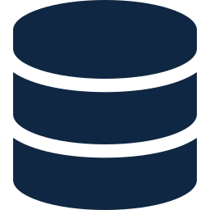
10 · ARCHITECTURE
HYDRA
11 / 16
UNDER THE HOOD
Strict separation: every number is deterministic.
The AI only speaks; it never decides. Even when it speaks, output is validated against the deterministic state.
FLUTTER · WEB / iOS / ANDROID
Riverpod · dio · fl_chart · Inter · Dashboard, Coming up, Trends, Alerts, Report, Share-card
⇅ JSON
FASTAPI · PYTHON 3.14 · DETERMINISTIC SERVICES
No AI in any of these · band classification, scoring, projection, planning — all auditable
supply · alert · historical · projection · planning · predictive · weather
TRANSLATION · Llama 3.3 70B (Groq) · drift-guarded · ±5pt validation · offline fallback
DATASET · 120 MONTHS (2016–2025)
Snowpack % · precipitation % · reservoir % — the brief's full decade of monthly readings

Slide 9
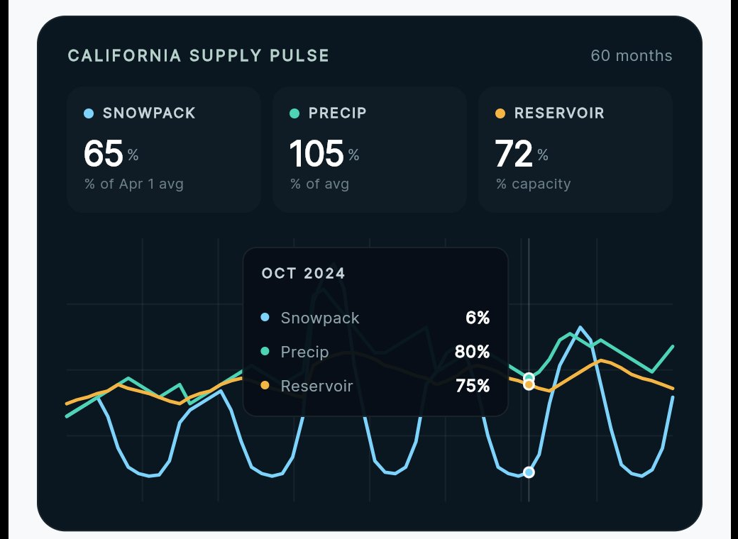
11 · THE MODEL
HYDRA
12 / 16
THE MATH
Honest time-series, not dressed-up ML.
Method: seasonal naïve + linear yearly trend. The card label says PATTERN MATCH so judges know we're not pretending.
01
Per-month historical mean
THE DATASET, VISUALIZED
Capture California's strong seasonality — snowpack peaks Apr 1, dries by fall.
02
Linear regression on yearly averages
Capture multi-year drift through drought / recovery cycles.
03
Project forward
value(target) = monthly_avg(target) + slope × years_ahead.
04
Confidence band
±1σ of per-month historical spread, attenuated by horizon.
It's not deep learning — the dataset doesn't support it. It is honest, defensible methodology over the data we have.

Slide 10
CLOSING
HYDRA
If snowpack alone
isn't enough,
here's what is.
HYDRA · THREE SIGNALS, ONE CLEAR OUTLOOK
PARTHAV FULZELE, SAM FULZELE, SOOJA KUMAR SATCHU DESHMUKH
Submitted to the H2O Hackathon · Hacking the Supply
Thank you.

