Slide 1
Square Jigsaw Puzzle Solver Literature Review
Prepared by: Zayd Hammoudeh
(zayd.hammoudeh@sjsu.edu)

Slide 2
Introduction
“Jigsaw Puzzle Problem”
Problem Statement: Reconstruct an image from a set of image pieces
Problem Complexity: NP-Complete (via the set partition problem) when pairwise affinity of pieces is unreliable [1]
Problem Formulation: Set of square, non-overlapping pieces
This specific type of puzzle is known as “jig swap” [7] or “Type 1” puzzles [19]
Type 2 Puzzles: Allow/disallow piece rotation [19]
A Key Difference with Standard Jigsaw Puzzle Solving: The source image you are trying to reconstruct is unknown.

Slide 3
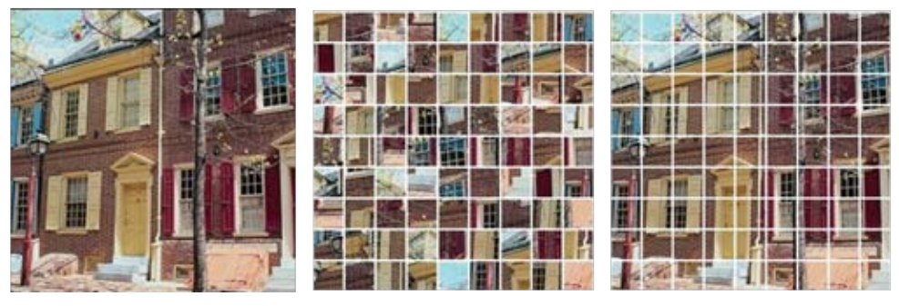
Square Jigsaw Puzzle Example
Source image (left) is divided into 81 (9x9) uniform, square pieces (center). The goal is to organize the pieces to reconstruct the source image (right).

Slide 4
Jigsaw Puzzle Solver Applicability
Possible and existing applications of the jigsaw puzzle problem include:
Computer Forensics: Reconstructing deleted JPEG, block-based images [2]
Document Investigation: Reconstruct shredded documents [3]
Bioinformatics: DNA/RNA modelling and reconstruction [4]
Archeology: Reconstruction of damaged relics [5]
Audio Processing: Voice descrambling [6]

Slide 5
Additional Variants of Problem
[9] proposes a list of additional variants to the jigsaw puzzle problem including:
Missing piece(s)
Extra piece(s)
Unknown piece orientation (type 2 puzzle)
Three dimensional puzzles
Unknown puzzle dimension

Slide 6
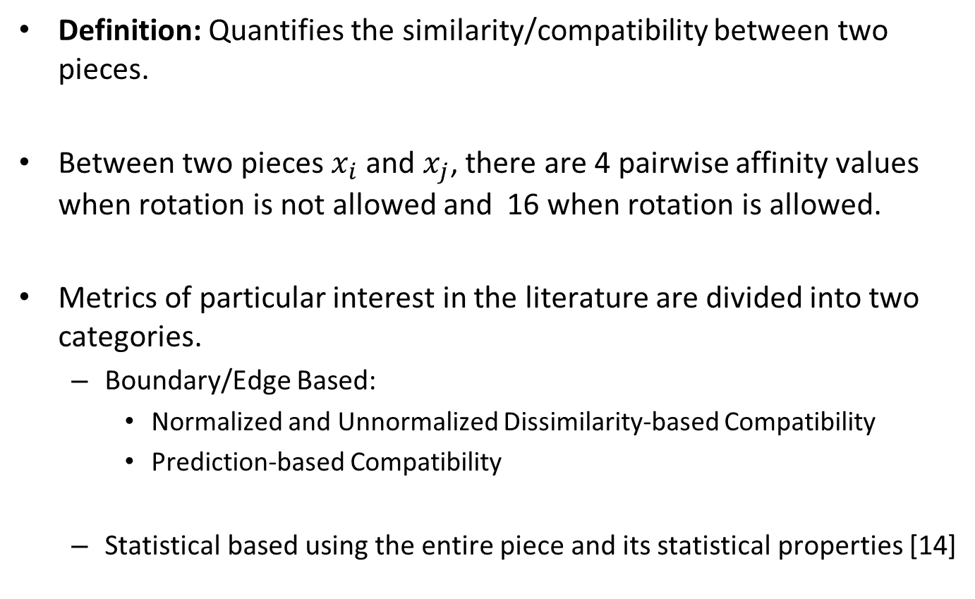
Pairwise Affinity
Definition: Quantifies the similarity/compatibility between two pieces.
Between two pieces $x_{i}$ and $x_{j}$, there are 4 pairwise affinity values when rotation is not allowed and 16 when rotation is allowed.
Metrics of particular interest in the literature are divided into two categories.
Boundary/Edge Based:
Normalized and Unnormalized Dissimilarity-based Compatibility
Prediction-based Compatibility
Statistical based using the entire piece and its statistical properties [14]

Slide 7
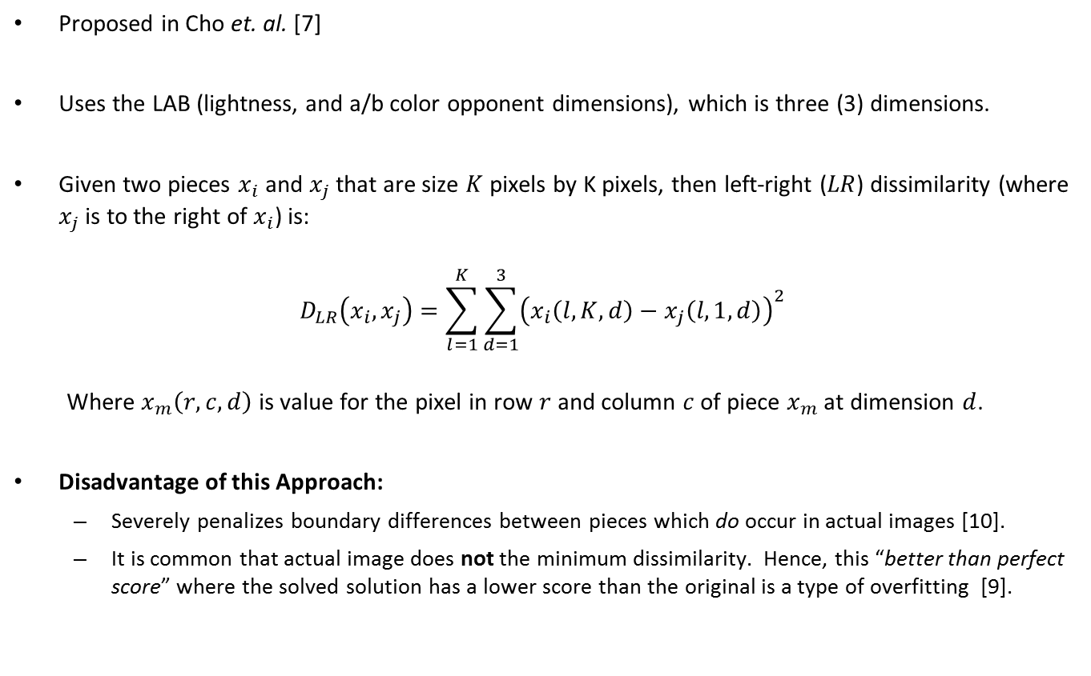
Dissimilarity-Based Compatibility
Proposed in Cho et. al. [7]
Uses the LAB (lightness, and a/b color opponent dimensions), which is three (3) dimensions.
Given two pieces $x_{i}$ and $x_{j}$ that are size $K$ pixels by K pixels, then left-right ($LR$) dissimilarity (where $x_{j}$ is to the right of $x_{i}$) is:
$$D_{LR}\left(x_{i},x_{j}\right)=\sum_{l=1}^{K}{\sum_{d=1}^{3}{{\left(x_{i}\left(l,K,d\right)−x_{j}\left(l,1, d\right)\right)}^{2}}}$$
Where $x_{m}\left(r,c,d\right)$ is value for the pixel in row $r$ and column $c$ of piece $x_{m}$ at dimension $d$.
Disadvantage of this Approach:
Severely penalizes boundary differences between pieces which do occur in actual images [10].
It is common that actual image does not the minimum dissimilarity. Hence, this “better than perfect score” where the solved solution has a lower score than the original is a type of overfitting [9].

Slide 8
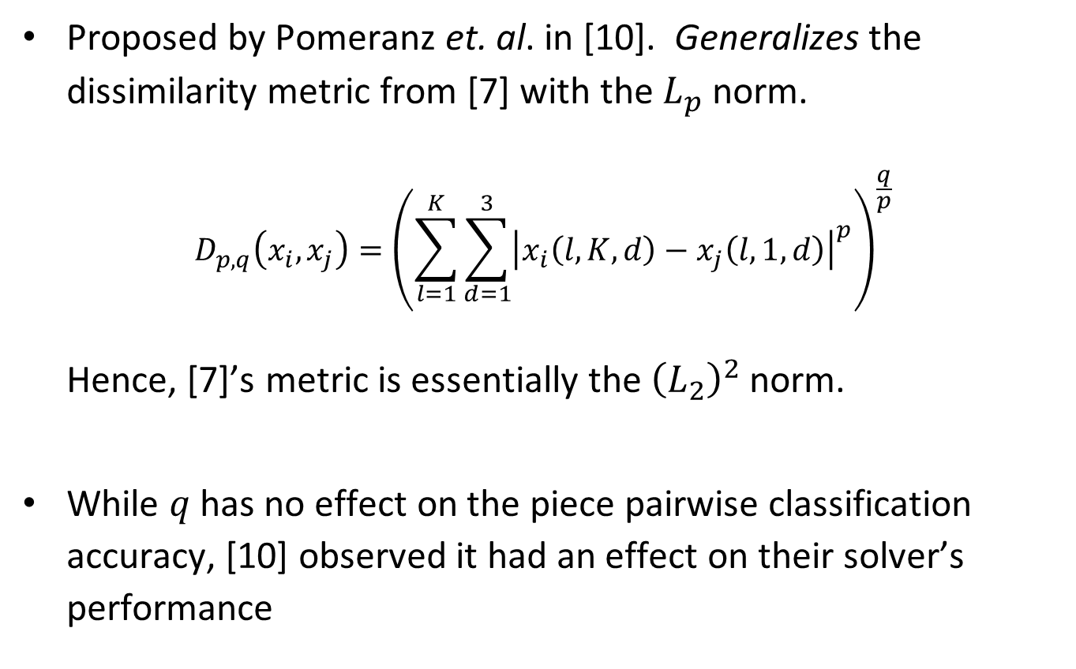
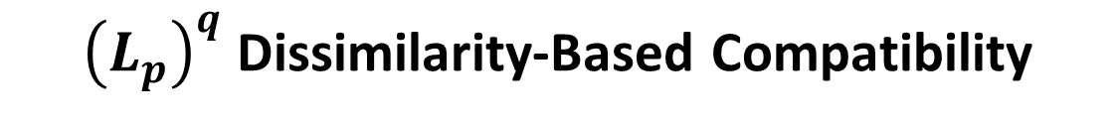
${\left(L_{p}\right)}^{q}$ Dissimilarity-Based Compatibility
Proposed by Pomeranz et. al. in [10]. Generalizes the dissimilarity metric from [7] with the $L_{p}$ norm.
$$D_{p,q}\left(x_{i},x_{j}\right)={\left(\sum_{l=1}^{K}{\sum_{d=1}^{3}{{\left|x_{i}\left(l,K,d\right)−x_{j}\left(l,1, d\right)\right|}^{p}}}\right)}^{\frac{q}{p}}$$
Hence, [7]’s metric is essentially the ${\left(L_{2}\right)}^{2}$ norm.
While $q$ has no effect on the piece pairwise classification accuracy, [10] observed it had an effect on their solver’s performance

Slide 9
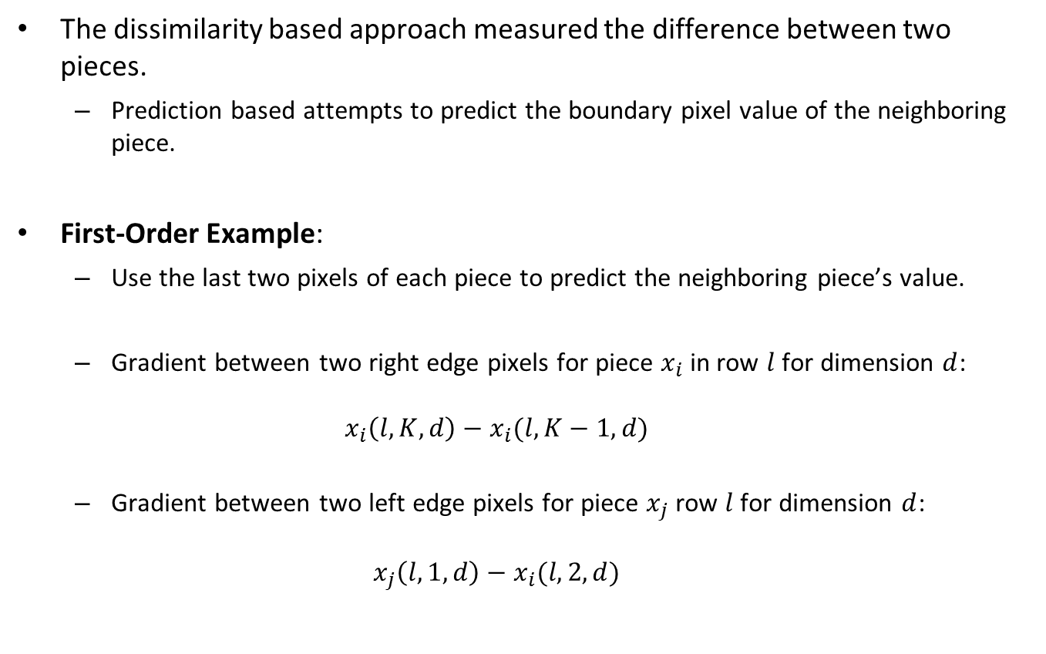
Prediction-Based Compatibility
The dissimilarity based approach measured the difference between two pieces.
Prediction based attempts to predict the boundary pixel value of the neighboring piece.
First-Order Example:
Use the last two pixels of each piece to predict the neighboring piece’s value.
Gradient between two right edge pixels for piece $x_{i}$ in row $l$ for dimension $d$:
$$x_{i}\left(l,K,d\right)−x_{i}(l,K−1,d)$$
Gradient between two left edge pixels for piece $x_{j}$ row $l$ for dimension $d$:
$$x_{j}\left(l,1,d\right)−x_{i}(l,2,d)$$

Slide 10
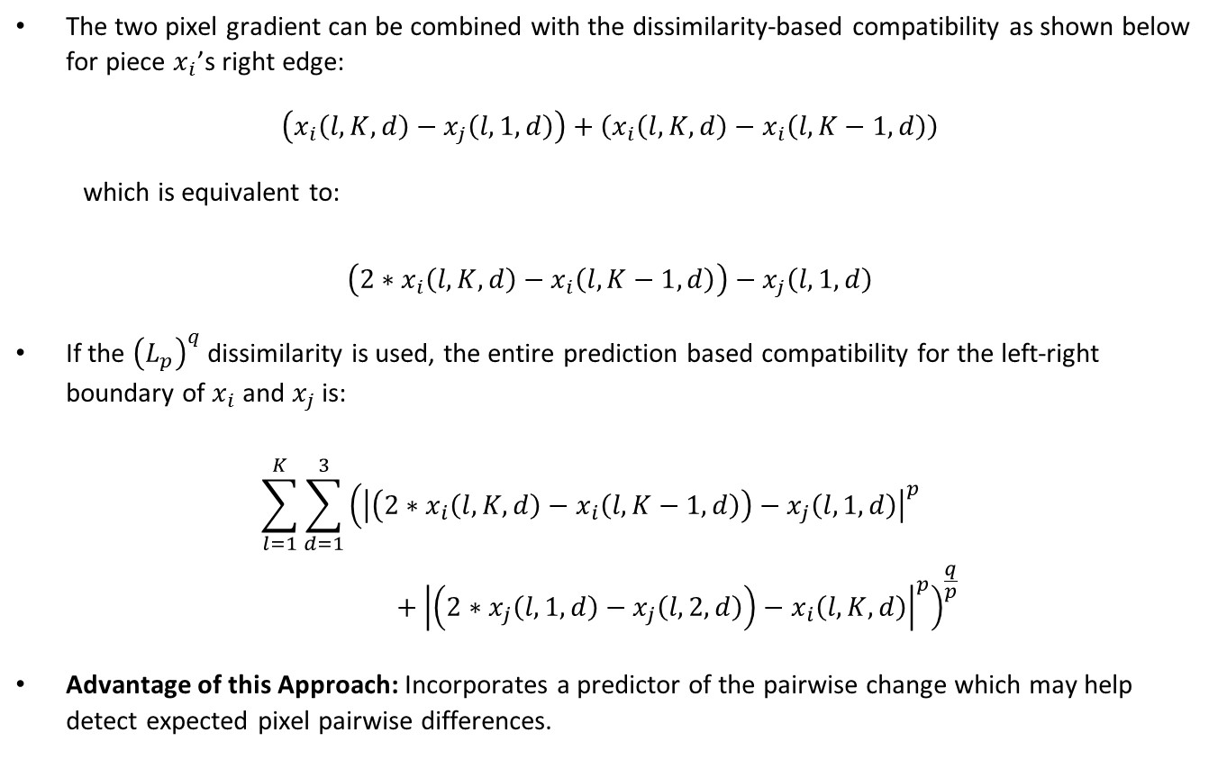
Prediction-Based Compatibility (Continued)
The two pixel gradient can be combined with the dissimilarity-based compatibility as shown below for piece $x_{i}$’s right edge:
$$\left(x_{i}\left(l,K,d\right)−x_{j}\left(l,1,d\right)\right)+\left(x_{i}\left(l,K,d\right)−x_{i}\left(l,K−1,d\right)\right)$$
which is equivalent to:
$$\left(2∗x_{i}\left(l,K,d\right)−x_{i}\left(l,K−1,d\right)\right)−x_{j}\left(l,1,d\right)$$
If the ${\left(L_{p}\right)}^{q}$ dissimilarity is used, the entire prediction based compatibility for the left-right boundary of $x_{i}$ and $x_{j}$ is:
$$\sum_{l=1}^{K}{\sum_{d=1}^{3}{{\left({\left|\left(2∗x_{i}\left(l,K,d\right)−x_{i}\left(l,K−1,d\right)\right)−x_{j}\left(l,1,d\right)\right|}^{p}+{\left|\left(2∗x_{j}\left(l,1,d\right)−x_{j}\left(l,2,d\right)\right)−x_{i}\left(l,K,d\right)\right|}^{p}\right)}^{\frac{q}{p}}}}$$
Advantage of this Approach: Incorporates a predictor of the pairwise change which may help detect expected pixel pairwise differences.

Slide 11
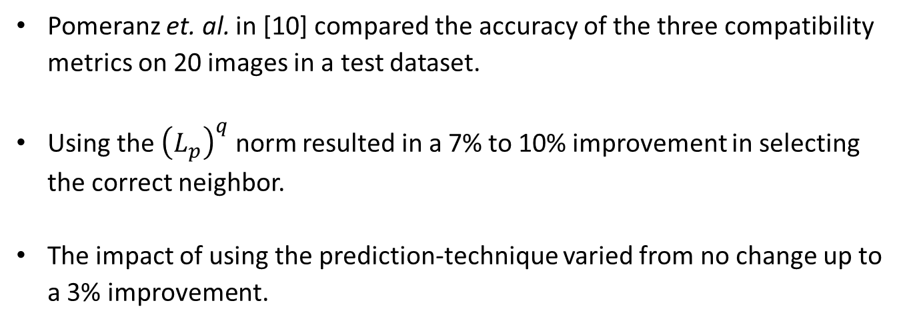
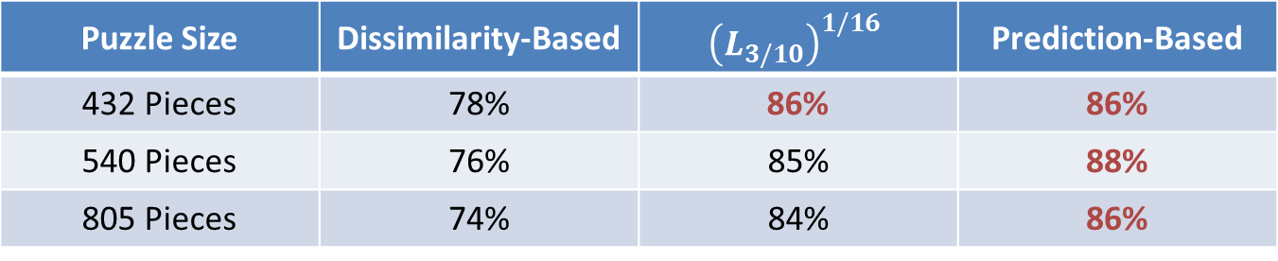
Accuracy Comparison of the Compatibility Metrics
Pomeranz et. al. in [10] compared the accuracy of the three compatibility metrics on 20 images in a test dataset.
Using the ${\left(L_{p}\right)}^{q}$ norm resulted in a 7% to 10% improvement in selecting the correct neighbor.
The impact of using the prediction-technique varied from no change up to a 3% improvement.
Puzzle Size | Dissimilarity-Based | $${\left(L_{3/10}\right)}^{1/16}$$ | Prediction-Based
432 Pieces | 78% | 86% | 86%
540 Pieces | 76% | 85% | 88%
805 Pieces | 74% | 84% | 86%
Comparison of Pairwise Similarity Metric Accuracy

Slide 12
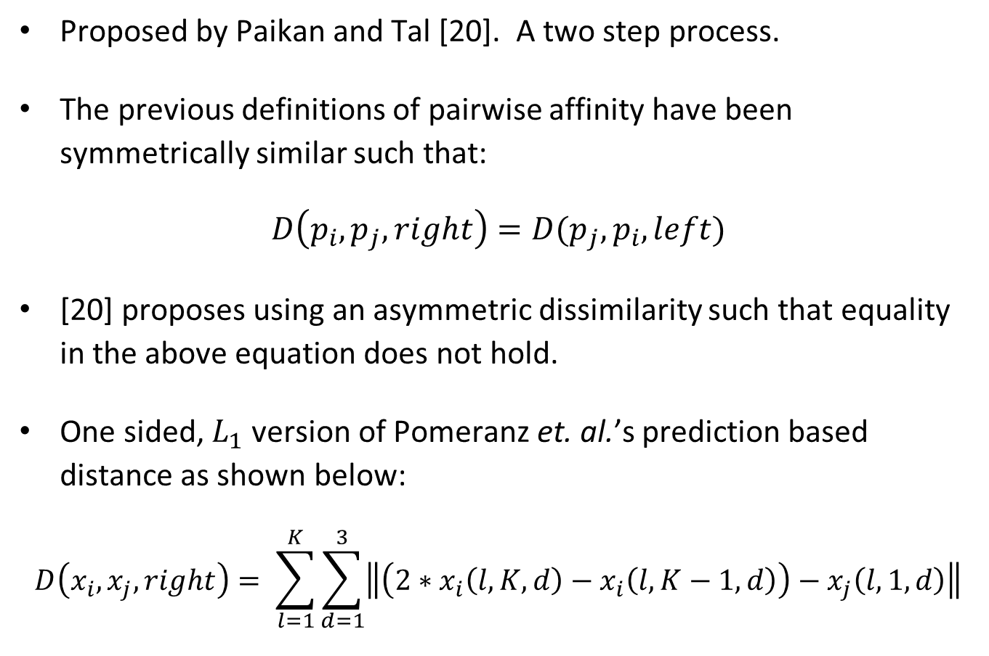
Asymmetric Dissimilarity
Proposed by Paikan and Tal [20]. A two step process.
The previous definitions of pairwise affinity have been symmetrically similar such that:
$$D\left(p_{i},p_{j},right\right)=D(p_{j},p_{i},left)$$
[20] proposes using an asymmetric dissimilarity such that equality in the above equation does not hold.
One sided, $L_{1}$ version of Pomeranz et. al.’s prediction based distance as shown below:
$$D\left(x_{i},x_{j},right\right)= \sum_{l=1}^{K}{\sum_{d=1}^{3}{\left\|\left(2∗x_{i}\left(l,K,d\right)−x_{i}\left(l,K−1,d\right)\right)−x_{j}\left(l,1,d\right)\right\|}}$$

Slide 13
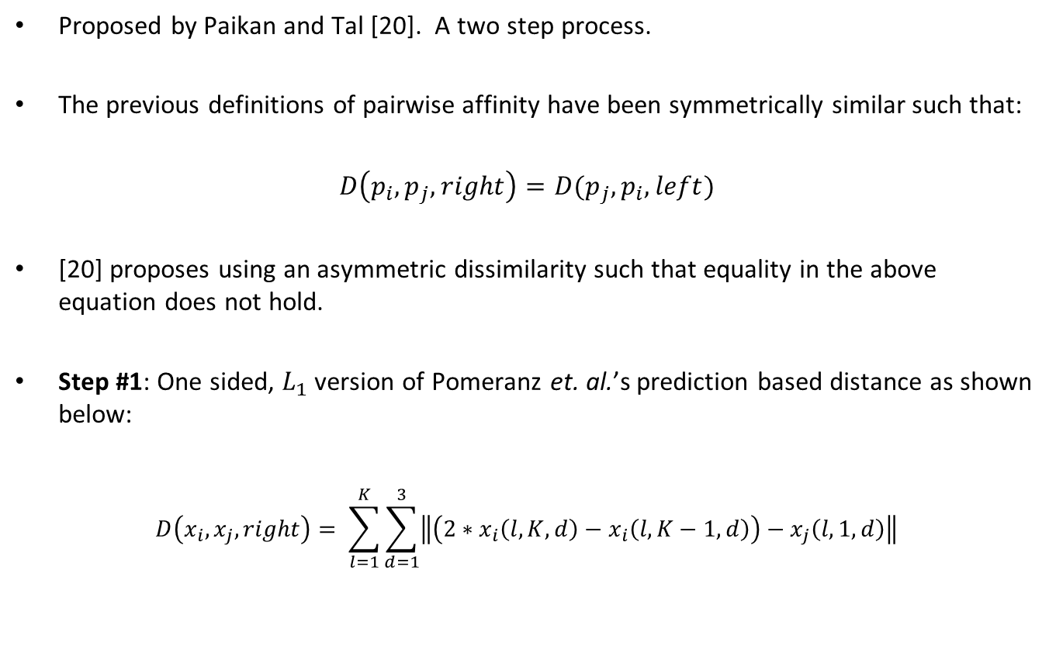
Asymmetric Dissimilarity
Proposed by Paikan and Tal [20]. A two step process.
The previous definitions of pairwise affinity have been symmetrically similar such that:
$$D\left(p_{i},p_{j},right\right)=D(p_{j},p_{i},left)$$
[20] proposes using an asymmetric dissimilarity such that equality in the above equation does not hold.
Step #1: One sided, $L_{1}$ version of Pomeranz et. al.’s prediction based distance as shown below:
$$D\left(x_{i},x_{j},right\right)= \sum_{l=1}^{K}{\sum_{d=1}^{3}{\left\|\left(2∗x_{i}\left(l,K,d\right)−x_{i}\left(l,K−1,d\right)\right)−x_{j}\left(l,1,d\right)\right\|}}$$

Slide 14
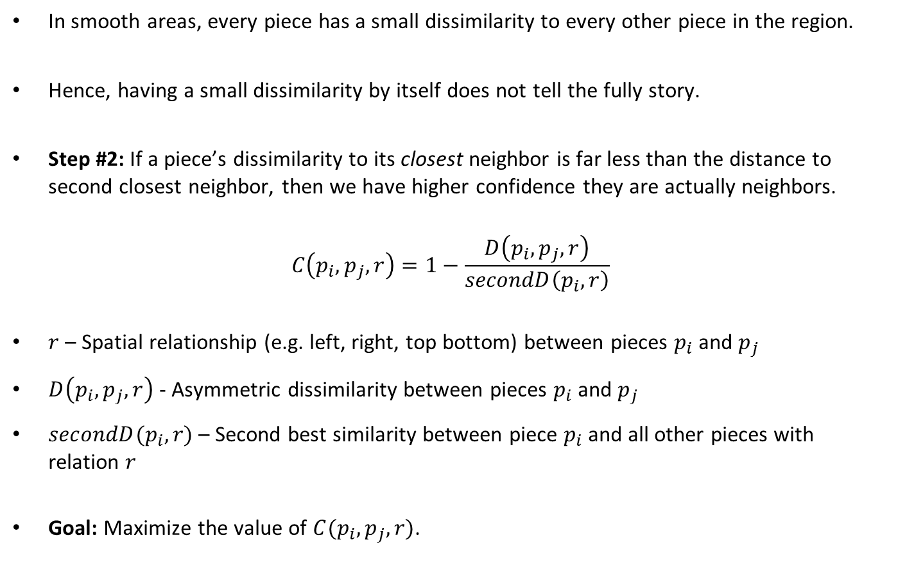
Confident Asymmetric Dissimilarity
In smooth areas, every piece has a small dissimilarity to every other piece in the region.
Hence, having a small dissimilarity by itself does not tell the fully story.
Step #2: If a piece’s dissimilarity to its closest neighbor is far less than the distance to second closest neighbor, then we have higher confidence they are actually neighbors.
$$C\left(p_{i},p_{j},r\right)=1−\frac{D\left(p_{i},p_{j},r\right)}{secondD\left(p_{i},r\right)}$$
$r$ – Spatial relationship (e.g. left, right, top bottom) between pieces $p_{i}$ and $p_{j}$
$D\left(p_{i},p_{j},r\right)$ - Asymmetric dissimilarity between pieces $p_{i}$ and $p_{j}$
$secondD(p_{i},r)$ – Second best similarity between piece $p_{i}$ and all other pieces with relation $r$
Goal: Maximize the value of $C(p_{i},p_{j},r)$.

Slide 15
Benefits of Asymmetric Dissimilarity
Three times faster due to the elimination of the exponent (80% of runtime is in distance calculations)
Additional speedup can be gained if when the asymmetric dissimilarity is sufficiently large (i.e. no chance of a pairing), the calculation is stopped and the distance set to infinity.
Number of correct “best buddies” increased
Number of incorrect decreased
Using the benchmark in [17], the number of correctly solved puzzles increased from 25 to 37.

Slide 16
Performance Metrics
Summary: Evaluate the performance of a jigsaw puzzle solver against the original (correct) image.
Cho et. al. proposed three performance metrics:
Direct Comparison Method: Most naïve approach. The ratio of the number of pieces in their correct locations versus the total number of pieces.
Disadvantage: Susceptible to shifts
Neighbor Comparison Method: For each piece, calculate the fraction of the four neighbors that are correct. The total accuracy is the average neighbor accuracy of all pieces.

Slide 17
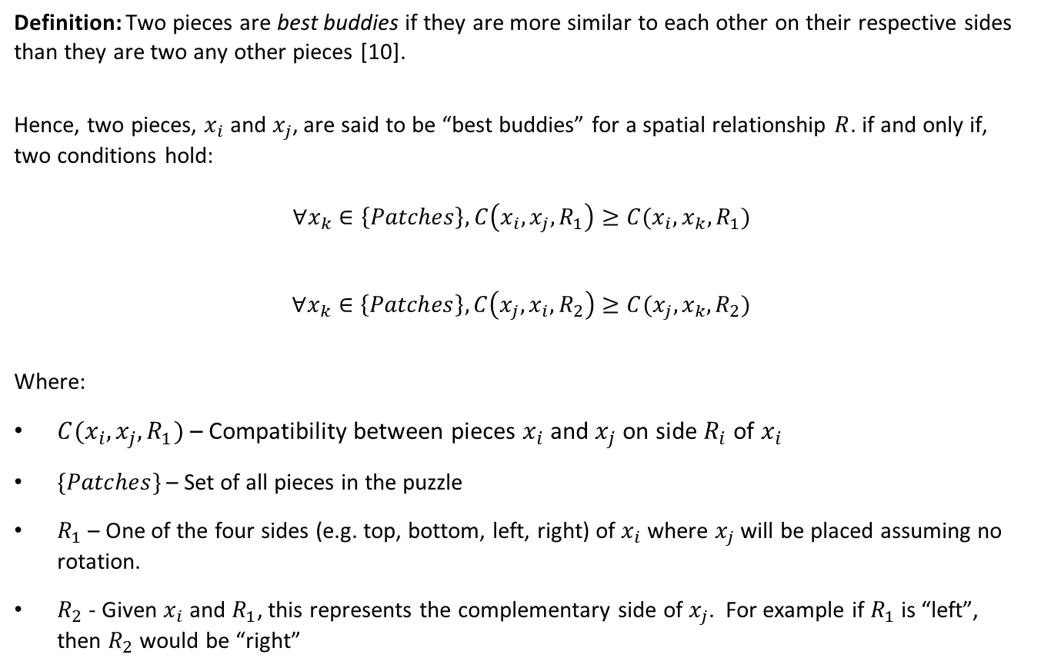
“Best Buddies”
Definition: Two pieces are best buddies if they are more similar to each other on their respective sides than they are two any other pieces [10].
Hence, two pieces, $x_{i}$ and $x_{j}$, are said to be “best buddies” for a spatial relationship $R$. if and only if, two conditions hold:
$$∀x_{k}∈\left\{Patches\right\}, C\left(x_{i},x_{j},R_{1}\right)≥C(x_{i},x_{k},R_{1})$$
$$∀x_{k}∈\left\{Patches\right\}, C\left(x_{j},x_{i},R_{2}\right)≥C(x_{j},x_{k},R_{2})$$
Where:
$C(x_{i},x_{j},R_{1})$ – Compatibility between pieces $x_{i}$ and $x_{j}$ on side $R_{i}$ of $x_{i}$
$\{Patches\}$ – Set of all pieces in the puzzle
$R_{1}$ – One of the four sides (e.g. top, bottom, left, right) of $x_{i}$ where $x_{j}$ will be placed assuming no rotation.
$R_{2}$ - Given $x_{i}$ and $R_{1}$, this represents the complementary side of $x_{j}$. For example if $R_{1}$ is “left”, then $R_{2}$ would be “right”

Slide 18
“Best Buddies” Estimation Metric
Definition: Ratio of the number of neighbors who are said to be “best buddies” to the total number of neighbors [10].
Correlation between the “Best Buddies” Estimation Metric and Cho et. al.’s two performance metrics:
Direct Comparison Metric: Little to no correlation since direct comparison method is not based on pairwise accuracy.
Neighbor Comparison Metric: Stronger correlation Graph below is for 20 images tested 10 times each (for 200 total points)
Scatterplot of “Best Buddy” Metric versus Neighbor Comparison Metric

Slide 19
Existing Square Jigsaw Puzzle Approaches
Dynamic Programming and the “Hungarian” Procedure [13]
Patch Transform using a Low Resolution “Solution Image” [8]
“Dense and Noisy” or “Sparse and Accurate” with Loopy Belief Propagation [7]
Particle Filter-Based Solver [11]
Greedy Algorithm [10]
Genetic Algorithm [9]
Variations of the Problem
Unknown orientation (i.e. rotation) and puzzle dimensions [12]

Slide 20
Cho et. al. – The Patch Transform and its Application to Image Editing (2008)

Slide 21
Patch Transform
Introduced by Cho et. al. in [8]
Overview of the Patch Transform: Segment a source image into a set of non-overlapping “patches” and rearrange these patches and reorganize the image in the “patch” domain.
Intended Usage: Image editing
“Inverse” Patch Transform: Reconstruct an image from a set of patches. This requires two components:
A patch compatibility function
An algorithm that places all patches
Uses a provided low resolution image as part of the patch placement algorithm.

Slide 22
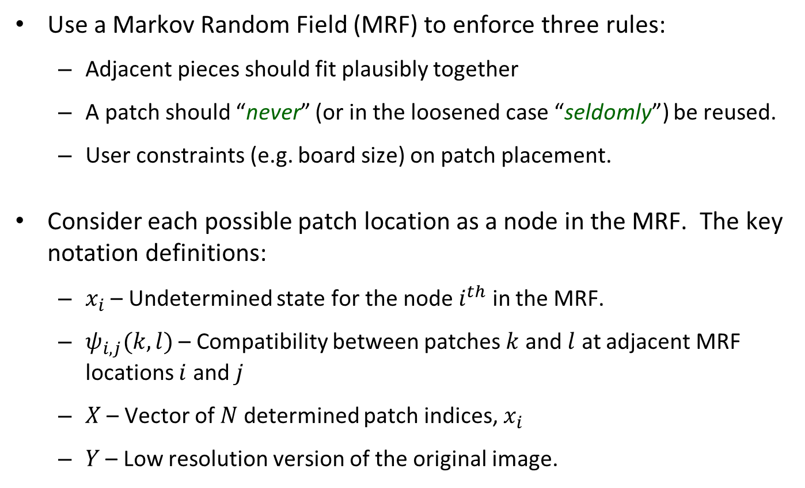
Markov Random Field
Use a Markov Random Field (MRF) to enforce three rules:
Adjacent pieces should fit plausibly together
A patch should “never” (or in the loosened case “seldomly”) be reused.
User constraints (e.g. board size) on patch placement.
Consider each possible patch location as a node in the MRF. The key notation definitions:
$x_{i}$ – Undetermined state for the node $i^{th}$ in the MRF.
$ψ_{i,j}(k,l)$ – Compatibility between patches $k$ and $l$ at adjacent MRF locations $i$ and $j$
$X$ – Vector of $N$ determined patch indices, $x_{i}$
$Y$ – Low resolution version of the original image.

Slide 23
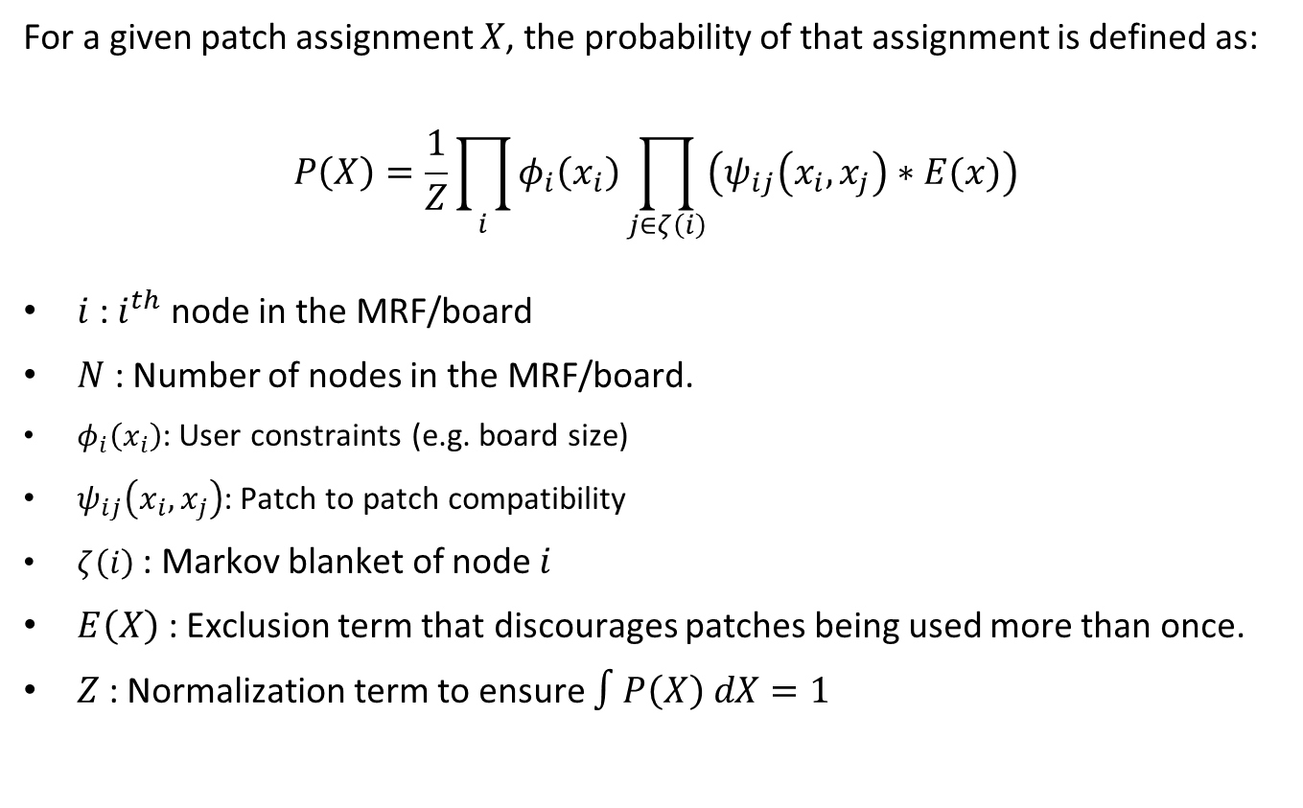
Maximizing the Patch Assignment Probability
For a given patch assignment $X$, the probability of that assignment is defined as:
$$P\left(X\right)=\frac{1}{Z}\prod_{i}{φ_{i}\left(x_{i}\right)\prod_{j∈ζ\left(i\right)}{\left(ψ_{ij}\left(x_{i},x_{j}\right)∗E(x)\right)}}$$
$i$ : $i^{th}$ node in the MRF/board
$N$ : Number of nodes in the MRF/board.
$φ_{i}\left(x_{i}\right)$: User constraints (e.g. board size)
$ψ_{ij}\left(x_{i},x_{j}\right)$: Patch to patch compatibility
$ζ\left(i\right)$ : Markov blanket of node $i$
$E\left(X\right)$ : Exclusion term that discourages patches being used more than once.
$Z$ : Normalization term to ensure $∫P\left(X\right) dX=1$

Slide 24
Loopy Belief Propagation Solver
Maximizes the preceding probability function using loopy belief propagation.
Susceptible to local maxima so random restarts may be performed.
Question: What if I do not have access to a low resolution version of the original image? Can I make one or use a substitute?

Slide 25
Cho et. al. – A Probabilistic Jigsaw Puzzle Solver (2010)

Slide 26
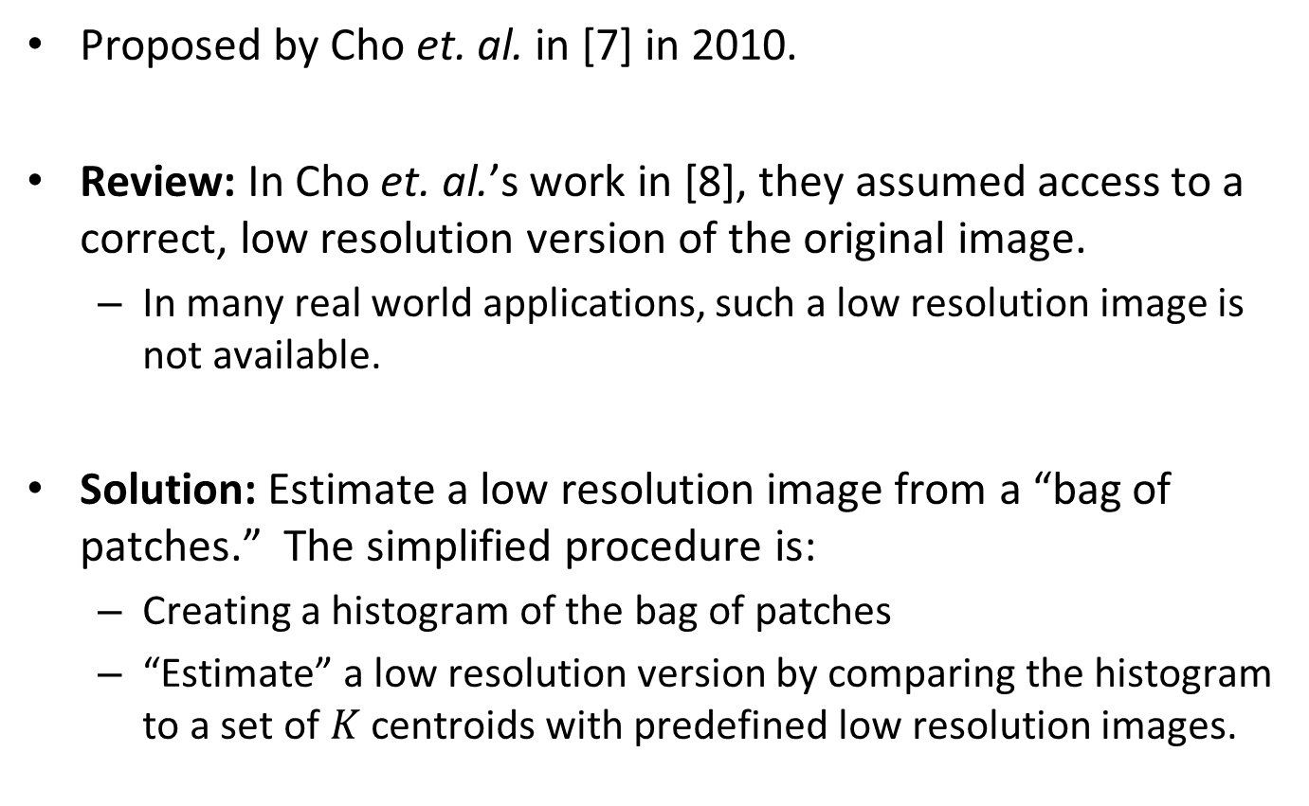
“Dense and Noisy” Estimation
Proposed by Cho et. al. in [7] in 2010.
Review: In Cho et. al.’s work in [8], they assumed access to a correct, low resolution version of the original image.
In many real world applications, such a low resolution image is not available.
Solution: Estimate a low resolution image from a “bag of patches.” The simplified procedure is:
Creating a histogram of the bag of patches
“Estimate” a low resolution version by comparing the histogram to a set of $K$ centroids with predefined low resolution images.

Slide 27
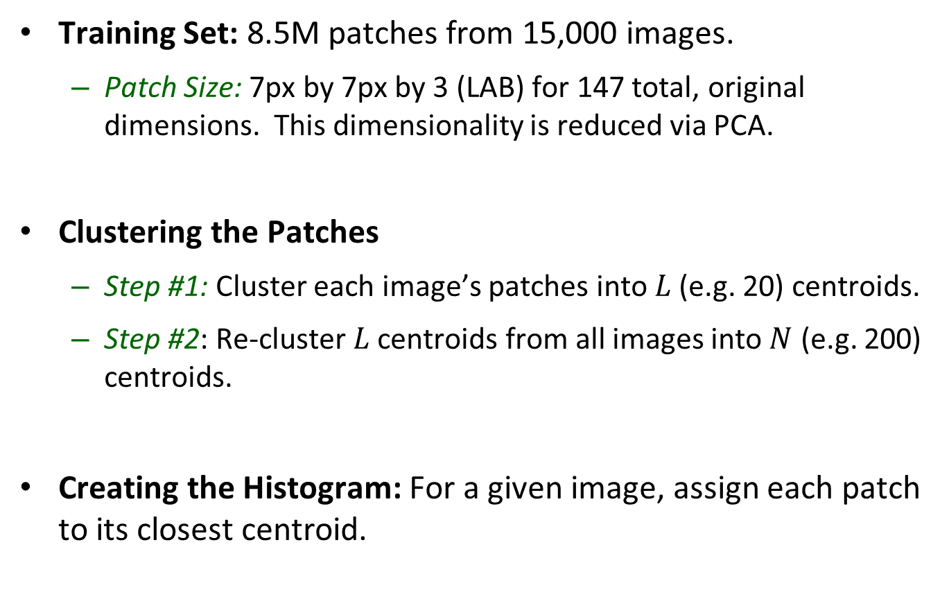
“Dense and Noisy” Clustering and Histogram Generation
Training Set: 8.5M patches from 15,000 images.
Patch Size: 7px by 7px by 3 (LAB) for 147 total, original dimensions. This dimensionality is reduced via PCA.
Clustering the Patches
Step #1: Cluster each image’s patches into $L$ (e.g. 20) centroids.
Step #2: Re-cluster $L$ centroids from all images into $N$ (e.g. 200) centroids.
Creating the Histogram: For a given image, assign each patch to its closest centroid.

Slide 28
“Dense and Noisy” – Generating the Low Res. Image
Theoretical Motivation: Different colors are more likely to be at different places in an image.
Example: Blue (sky) is more likely to be towards the top of the image while brown (soil) tends to be in the image foreground.
Mapping Bins to the Image: Use the training set to generate probability density maps for each histogram bin.
Using the Histogram to Create the Low Resolution Image: Use a trained, linear regression function to map a bag of pieces histogram to the training images (i.e. use prior knowledge).

Slide 29
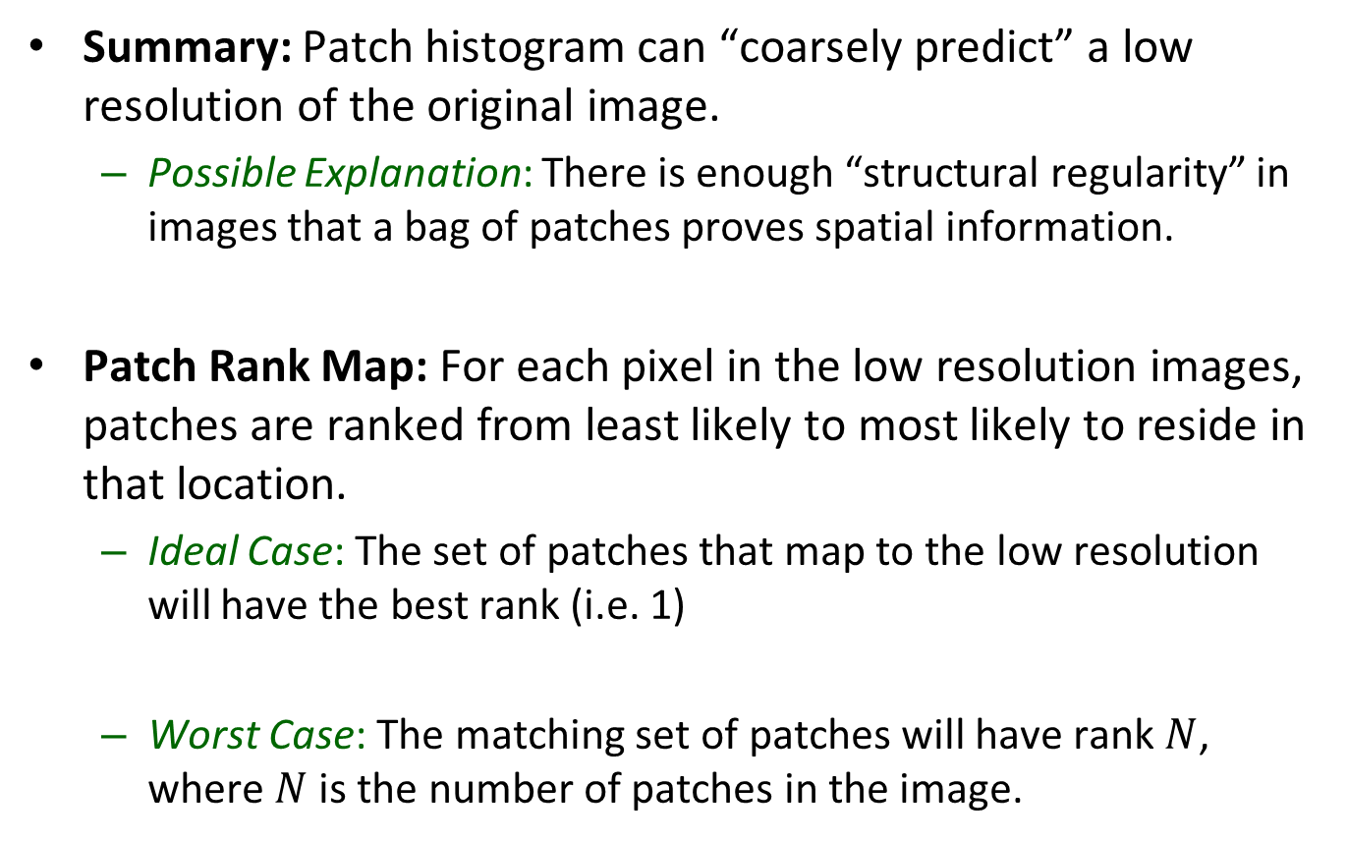
“Dense and Noisy” Results
Summary: Patch histogram can “coarsely predict” a low resolution of the original image.
Possible Explanation: There is enough “structural regularity” in images that a bag of patches proves spatial information.
Patch Rank Map: For each pixel in the low resolution images, patches are ranked from least likely to most likely to reside in that location.
Ideal Case: The set of patches that map to the low resolution will have the best rank (i.e. 1)
Worst Case: The matching set of patches will have rank $N$, where $N$ is the number of patches in the image.

Slide 30
“Dense and Noisy” End to End Example
Best Results
Worst Results
Confused
snow for sky

Slide 31
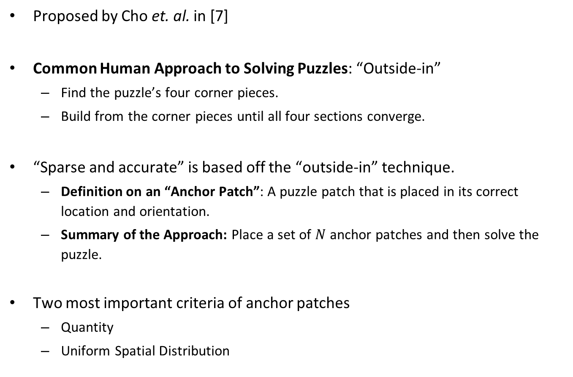
“Sparse and Accurate”
Proposed by Cho et. al. in [7]
Common Human Approach to Solving Puzzles: “Outside-in”
Find the puzzle’s four corner pieces.
Build from the corner pieces until all four sections converge.
“Sparse and accurate” is based off the “outside-in” technique.
Definition on an “Anchor Patch”: A puzzle patch that is placed in its correct location and orientation.
Summary of the Approach: Place a set of $N$ anchor patches and then solve the puzzle.
Two most important criteria of anchor patches
Quantity
Uniform Spatial Distribution

Slide 32
Pomeranz et. al. – A Fully Automated Greedy Square Jigsaw Puzzle Solver (2011)

Slide 33
Generalized Greedy Algorithm
Proposed by Pomeranz et. al. in [10] in 2011.
Goal: Provide a computational framework for handling square jigsaw puzzles in reasonable time that does not rely on any prior knowledge or human intervention.
Solver divides the puzzle reconstruction into three subproblems:
Placement: Given a single piece or partially-placed set of pieces, place the remaining pieces.
Segmentation: Given a fully-placed board, segment the board into subcomponents that are believed to be placed correctly.
Shifting: Given a set of trusted segments, relocate entire segments and individual pieces to improve solution quality.

Slide 34
Overview of the Greedy Placement Phase
Given a partially assembled board (either a single pieces or set of pieces), continue applying the greedy choice until all pieces are placed.
Overview of the Greedy Choice:
Board dimensions are known in advance and fixed
Board locations with a higher number of occupied neighbors are preferred as the choice of the next piece is more informed.
Piece selection criteria:
Primary Criteria: Prefer a “best buddy” first.
Secondary Criteria: If no or multiple pieces satisfy the primary criteria, select the piece with the highest compatibility score.
Question: Why is a placer not enough?
Answer: It works solely on local information. To get the best results, we must also look at the entire global solution.

Slide 35
Segmenter Phase
Definition of “Segments”: Areas of the puzzle that are (or “are believed to be”) assembled correctly.
Procedure: Using random seeds and a segmentation predicate based on the “best buddies” metric, grow the segments via “region growing segmentation algorithm” described in [15].
Accuracy of the Segmenter: 99.7%

Slide 36
Pomeranz’s Complete Algorithm
Step #1: Select a single puzzle piece as the seed to placement phase.
Step #2: Perform the placement phase around the seed.
Step #3: Use the segmenter to partition the board.
Step #4: Calculate the “best buddies” ratio. If you are at a local maximum, stop.
Step #5: Select the largest segment from step #3 and use it as the seed of the placement phase. Return to step #2.
Performing this step is similar to shifting the largest segment.

Slide 37
Sholomon et. al. – A Genetic Algorithm-Based Solved for Very Large Jigsaw Puzzles (2013)

Slide 38
Genetic Algorithm (GA) Solver
Proposed by Sholomon et. al. in 2013 [9].
A genetic algorithm puzzle solver was first proposed in [16] in 2002.
Genetic Algorithm Review
Based off the biological theory of natural selection.
Divided into a series of stages
Random generation of initial population
Successor selection
Reproduction
Mutation
Requires a “fitness function” that measures solution quality.

Slide 39
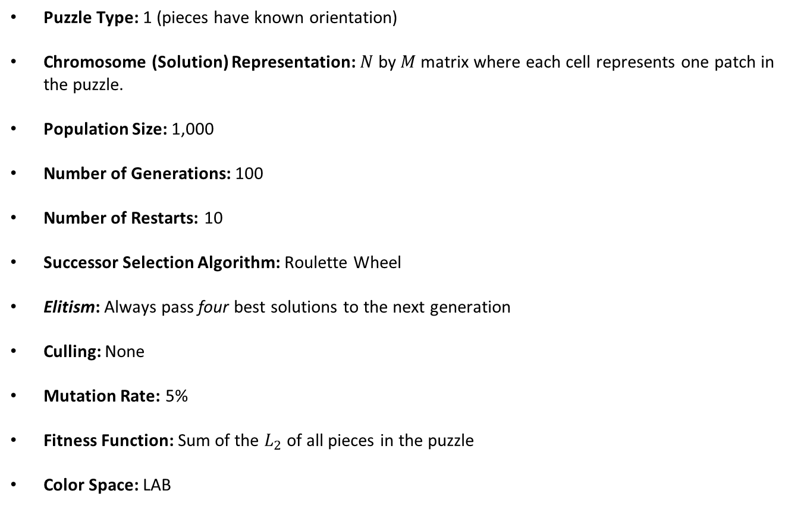
Sholomon’s GA Implementation
Puzzle Type: 1 (pieces have known orientation)
Chromosome (Solution) Representation: $N$ by $M$ matrix where each cell represents one patch in the puzzle.
Population Size: 1,000
Number of Generations: 100
Number of Restarts: 10
Successor Selection Algorithm: Roulette Wheel
Elitism: Always pass four best solutions to the next generation
Culling: None
Mutation Rate: 5%
Fitness Function: Sum of the $L_{2}$ of all pieces in the puzzle
Color Space: LAB

Slide 40
GA Crossover
Takes two “highly fit” parents and returns one child.
Non-trivial as the crossover must ensure there are no duplicate/missing pieces in the solution.
Correctly assembled segments may be at incorrect absolute locations. Hence, the crossover must allow for “position independence”, which is the ability to shift segments.
Sholomon et. al.’s Approach: Kernel-growing.

Slide 41
Sholomon’s Kernel Growing Algorithm
Start with a single puzzle piece that is “floating” in the board such that the puzzle can grow in any direction.
Boundary size (i.e. length by width) is fixed and known.
Piece Placement Algorithm: When deciding on the next piece to place, the algorithm iterates through up to three phases.
Phase #1: In an available boundary location, place the piece where both parents agree on the neighbor.
Phase #2: Place a “best buddy” that exists in one of the parents.
Phase #3: Select a location randomly and pick the piece with the best pairwise affinity.
If in any phase there is a tie, the tie is broken randomly.
After a piece is placed, the placement algorithm returns to phase #1 for the next piece.
Once a piece is placed, it can never be reused.

Slide 42
Kernel Growing with Mutation
Mutations in genetic algorithms are used to improve the quality of the final solution via increased population diversity.
Sholomon’s Mutation Strategy: During the first and third phase of placement, place a piece at random with some low probability (e.g. 5%)

Slide 43
A Possible Benchmark
Sholomon et. al. provide three large puzzle datasets as well as their results for comparative benchmarking [17].
Dataset Puzzle Sizes: 5,015, 10,375, and 22,834
Unfortunately the website seems to no longer exist. I will separately send an email to the authors about why the removed the content.
Used as a benchmark in [20].

Slide 44
Measuring Solution Quality
Problem Statement: There is no uniform technique for grading the final output of a square jigsaw puzzle solver.
Two Divergent Approaches:
Performance Metrics: Use the original image to grade solution quality.
Direct Comparison [7]
Neighbor Comparison [7]
Estimation Metrics: Evaluates the quality of a solution without reference to the original image [10].
“Best Buddies” Ratio

Slide 45
Algorithm Runtime Comparison
To improve execution time, Sholomon et. al. precompute and store all pairwise dissimilarity values.
# of Pieces | Sholomon et. al. | Pomeranz et. al.
432 | 48.3s | 1.2min
540 | 64.1s | 1.9min
805 | 116.2s | 5.1min
2,360 | 17.60min | N/A
3,300 | 30.24min | N/A
5,015 | 61.06min | N/A
10,375 | 3.21hr | N/A
22,834 | 13.19hr | N/A
Comparison of the Algorithm Execution Time
for Sholomon et. al. and Pomeranz et. al.

Slide 46
Son et. al. – Solving Square Jigsaw Puzzles with Loop Constraints (2014)

Slide 47
Solving Jigsaw Puzzles with Loop Constraints
Proposed by Son et. al. in [19].
Best buddies can be viewed as a loop of two pieces that agree on one boundary.
Son et. al. propose using a larger loop of 4 pieces (2x2) that agree on four boundaries.
Other work on the puzzle problem has either ignored or explicitly avoided cycles [12].
By using cycles, you are able to achieve a type of outlier rejection.

Slide 48
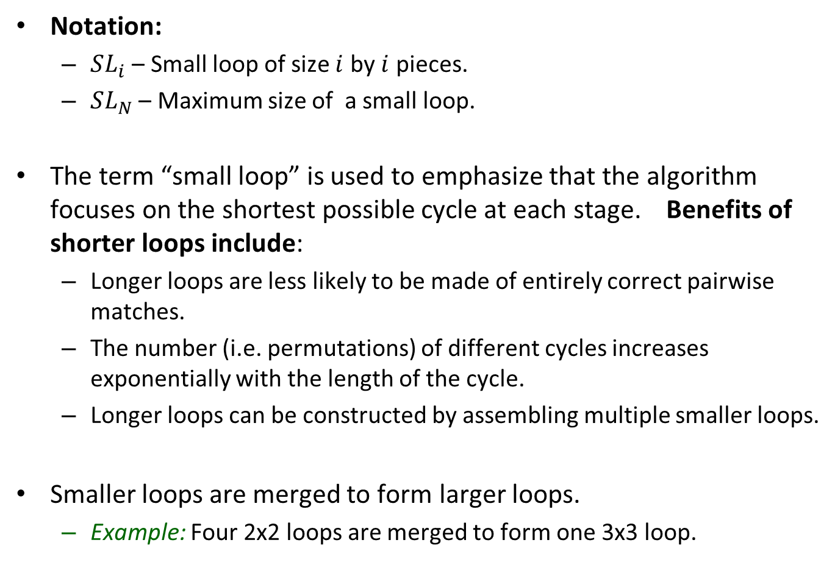
Small Loops
Notation:
$SL_{i}$ – Small loop of size $i$ by $i$ pieces.
$SL_{N}$ – Maximum size of a small loop.
The term “small loop” is used to emphasize that the algorithm focuses on the shortest possible cycle at each stage. Benefits of shorter loops include:
Longer loops are less likely to be made of entirely correct pairwise matches.
The number (i.e. permutations) of different cycles increases exponentially with the length of the cycle.
Longer loops can be constructed by assembling multiple smaller loops.
Smaller loops are merged to form larger loops.
Example: Four 2x2 loops are merged to form one 3x3 loop.

Slide 49
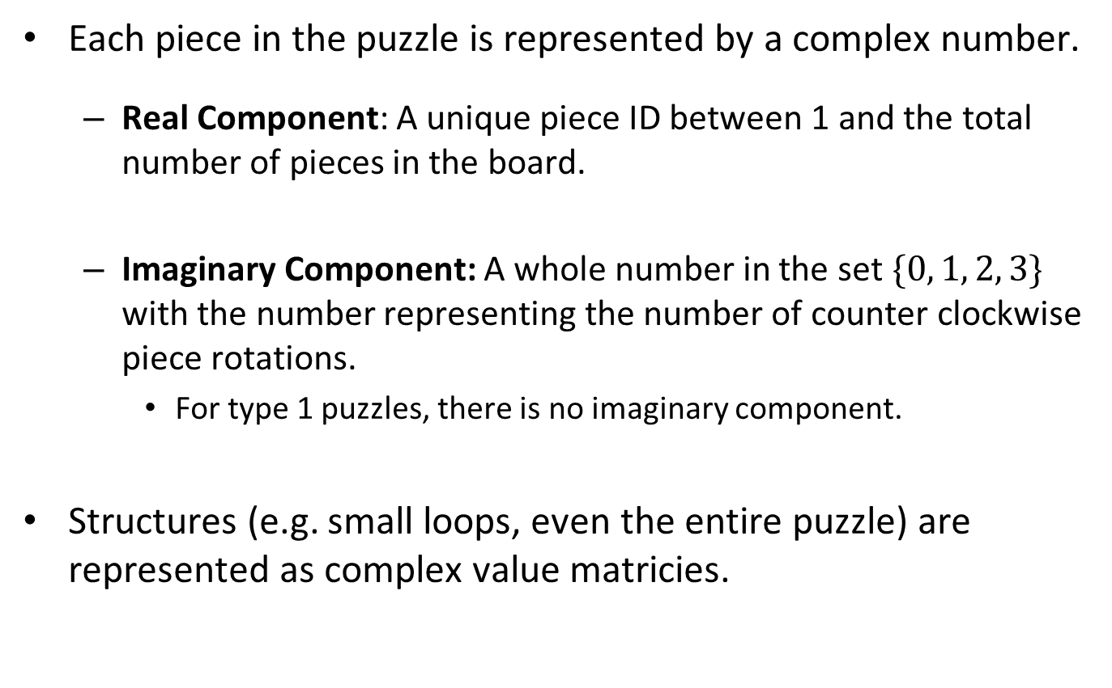
Representing Pieces and Puzzles
Each piece in the puzzle is represented by a complex number.
Real Component: A unique piece ID between 1 and the total number of pieces in the board.
Imaginary Component: A whole number in the set $\{0, 1, 2, 3\}$ with the number representing the number of counter clockwise piece rotations.
For type 1 puzzles, there is no imaginary component.
Structures (e.g. small loops, even the entire puzzle) are represented as complex value matricies.

Slide 50
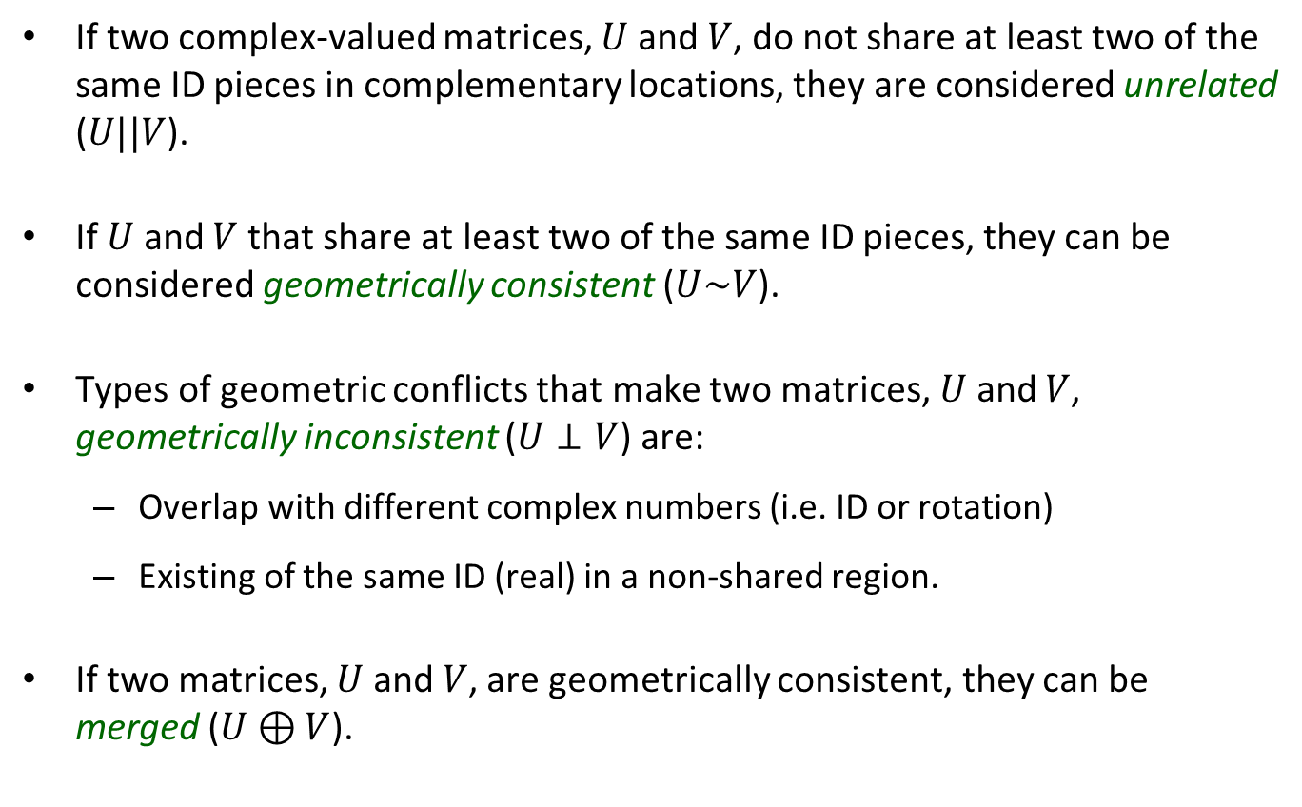
Relationships between the Complex Matrices
If two complex-valued matrices, $U$ and $V$, do not share at least two of the same ID pieces in complementary locations, they are considered unrelated ($U||V$).
If $U$ and $V$ that share at least two of the same ID pieces, they can be considered geometrically consistent ($U\sim V$).
Types of geometric conflicts that make two matrices, $U$ and $V$, geometrically inconsistent ($U⊥V$) are:
Overlap with different complex numbers (i.e. ID or rotation)
Existing of the same ID (real) in a non-shared region.
If two matrices, $U$ and $V$, are geometrically consistent, they can be merged ($U⊕V$).

Slide 51
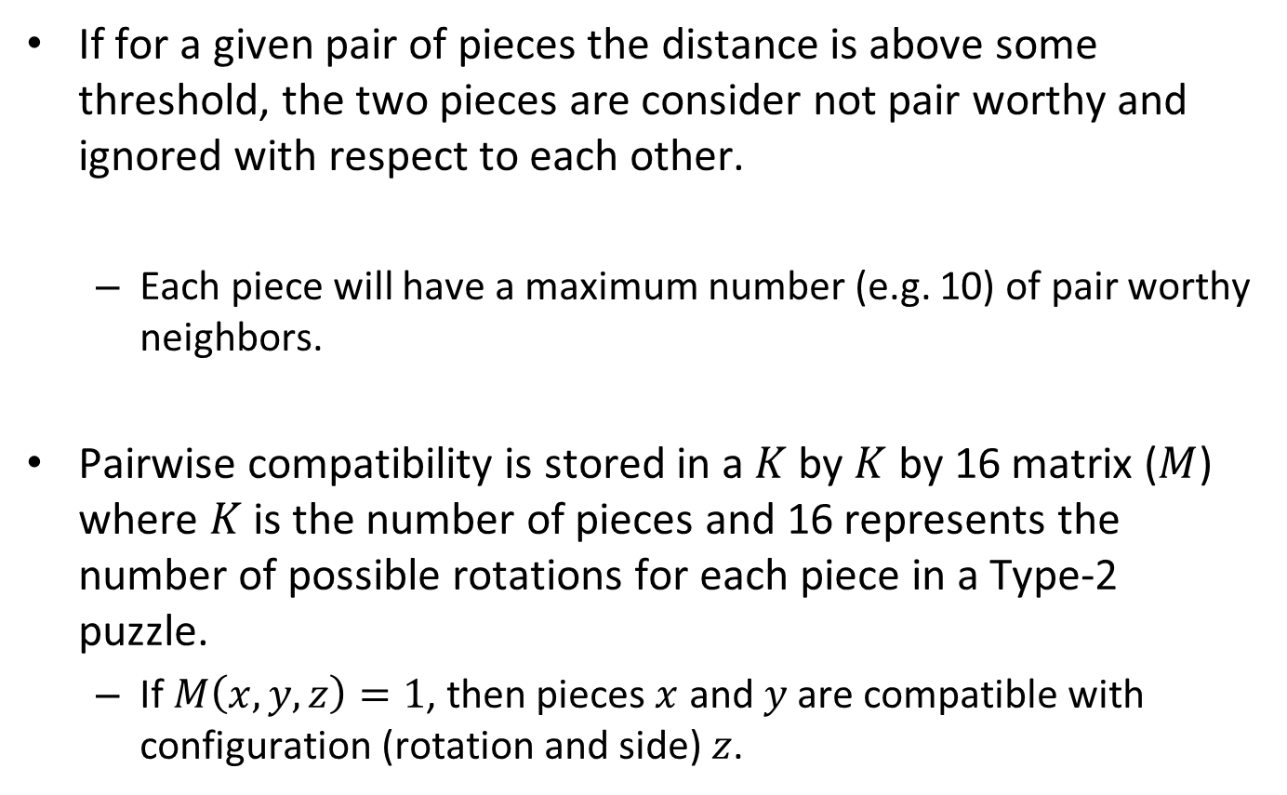
Managing Piece-wise Computations
If for a given pair of pieces the distance is above some threshold, the two pieces are consider not pair worthy and ignored with respect to each other.
Each piece will have a maximum number (e.g. 10) of pair worthy neighbors.
Pairwise compatibility is stored in a $K$ by $K$ by 16 matrix ($M$) where $K$ is the number of pieces and 16 represents the number of possible rotations for each piece in a Type-2 puzzle.
If $M\left(x,y,z\right)=1$, then pieces $x$ and $y$ are compatible with configuration (rotation and side) $z$.

Slide 52
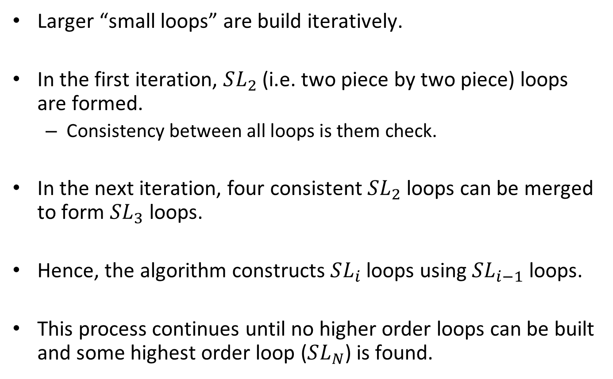
Creating Larger Small Loops
Larger “small loops” are build iteratively.
In the first iteration, $SL_{2}$ (i.e. two piece by two piece) loops are formed.
Consistency between all loops is them check.
In the next iteration, four consistent $SL_{2}$ loops can be merged to form $SL_{3}$ loops.
Hence, the algorithm constructs $SL_{i}$ loops using $SL_{i−1}$ loops.
This process continues until no higher order loops can be built and some highest order loop ($SL_{N}$) is found.

Slide 53
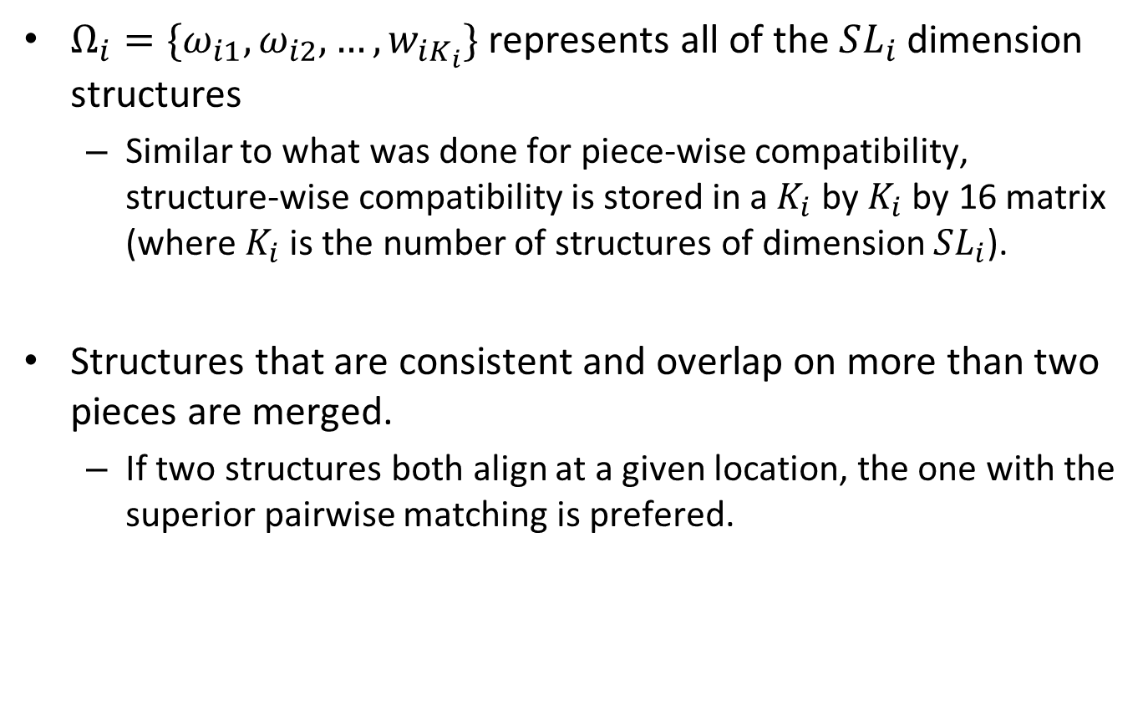
Managing Structure-Wise Computations
$Ω_{i}=\{ω_{i1},ω_{i2},…,w_{iK_{i}}\}$ represents all of the $SL_{i}$ dimension structures
Similar to what was done for piece-wise compatibility, structure-wise compatibility is stored in a $K_{i}$ by $K_{i}$ by 16 matrix (where $K_{i}$ is the number of structures of dimension $SL_{i}$).
Structures that are consistent and overlap on more than two pieces are merged.
If two structures both align at a given location, the one with the superior pairwise matching is prefered.

Slide 54
Paikan and Tal – Solving Multiple Square Jigsaw Puzzles with Missing Pieces

Slide 55
Managing Missing Pieces and Multiple Puzzles
Proposed by Paikin and Tal in [20].
Inspired by Pomeranz et. al.’s greedy algorithm [10] with three additional requirements:
New Requirement #1: A modified compatibility function
New Requirement #2: Superior initial seed selection.
New Requirement #3: Rather than making the “best”/ “closest matching” selection at each round, make the selection with the lowest chance of erring regardless of location.
This makes their algorithm deterministic eliminating the need for restarts.
Accuracy: 97.7% on dataset in [17]

Slide 56
Puzzle Problem Requirements
Paikan’s & Tal’s jigsaw puzzle problem definition is the most difficult presented to date. It is described below:
Size of the puzzle(s) is unknown and may be different
Orientation of the pieces is unknown
Pieces may missing
Input may contain pieces from multiple puzzles
Only Input to the Algorithm: Number of puzzles to be solved.

Slide 57
Overview of Paikan and Tal’s Algorithm
Similar to Pomeranz et. al., Paikan and Tal use a greedy strategy.
With greedy algorithms, early, suboptimal decisions can lead to major divergences in future decisions.
To mitigate such poor decisions, Paikan and Tal’s algorithm focuses on delaying potentially poor decisions.
Phase #1: Calculate and store all piece to piece the confident asymmetric dissimilarity values.

Slide 58
Phase #2 – Initial Piece Selection
Previous work by [9] and [10] selected a random piece as the seed for the their algorithm
This leads to the need to run their algorithm multiple times.
Paikan and Tal select the most distinctive piece in the most distinctive region as their algorithm’s initial seed.
Picking the Most Distinctive Piece: Select as the initial seed the piece that has four best buddies as its neighbors and whose neighbors also have four best buddies.
This approach address both the need for a distinctive piece in a distinctive region.
Note: Best buddies is defined based off the confident asymmetric dissimilarity unlike how it is defined in Pomeranz et. al. [10].

Slide 59
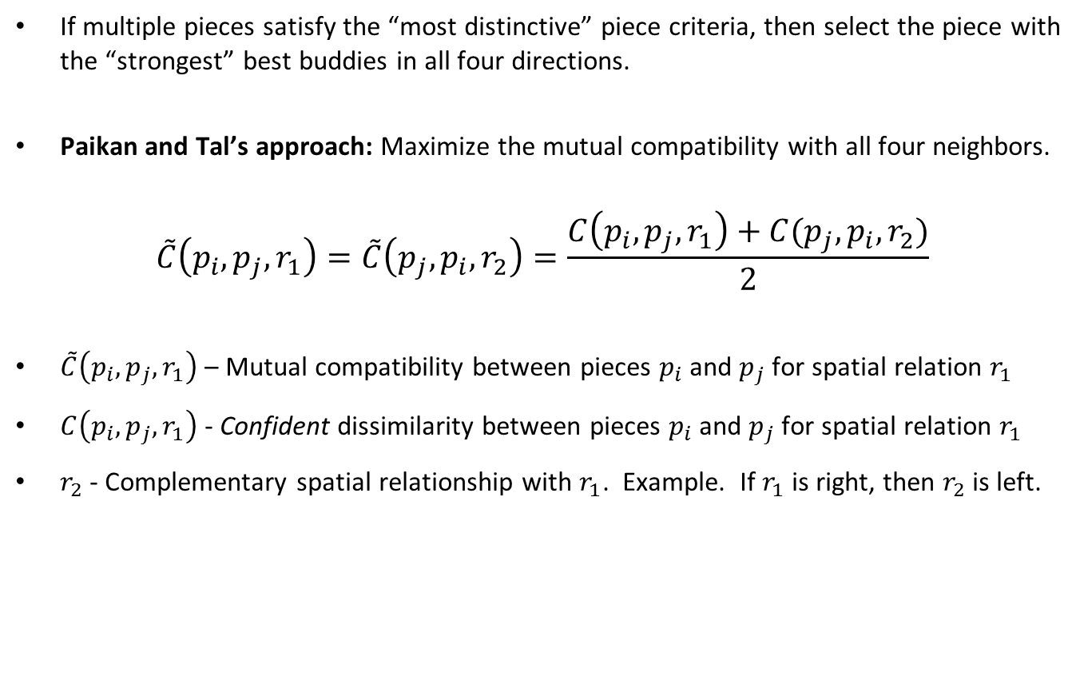
Phase #2 – Mutual Compatibility
If multiple pieces satisfy the “most distinctive” piece criteria, then select the piece with the “strongest” best buddies in all four directions.
Paikan and Tal’s approach: Maximize the mutual compatibility with all four neighbors.
$$\tilde{C}\left(p_{i},p_{j},r_{1}\right)=\tilde{C}\left(p_{j},p_{i},r_{2}\right)=\frac{C\left(p_{i},p_{j},r_{1}\right)+C(p_{j},p_{i},r_{2})}{2}$$
$\tilde{C}\left(p_{i},p_{j},r_{1}\right)$ – Mutual compatibility between pieces $p_{i}$ and $p_{j}$ for spatial relation $r_{1}$
$C\left(p_{i},p_{j},r_{1}\right)$ - Confident dissimilarity between pieces $p_{i}$ and $p_{j}$ for spatial relation $r_{1}$
$r_{2}$ - Complementary spatial relationship with $r_{1}$. Example. If $r_{1}$ is right, then $r_{2}$ is left.

Slide 60
Phase #3: Placement Algorithm
While there are unplaced pieces
if the pool is not empty
Extract the best candidate from the pool
else
Recalculate the compatibility function
Find the best neighbors (not best buddies)
Place the above best piece
Add the best buddies of the piece to the pool

Slide 61
Phase #3: Placement Overview
If the pool is not empty, then the “best candidate” is defined as the one with the highest mutual compatibility.
Unlike best buddies which used asymmetric dissimilarity, the greedy placed uses mutual compatibility.
If the pool is empty, the mutual compatibility values are recalculated using only the unplaced pieces and the border pieces in the puzzle.
The piece with the highest mutual compatibility is then placed onto the board
The newly placed piece’s best buddies (if any) are placed into the pool.

Slide 62
Phase #3: Handling Multiple Puzzles
Other than the pieces themselves, the only input into Paikin and Tal’s algorithm is the number of puzzles
If the “bag of pieces” is from multiple boards, only one small change is required to their algorithm.
Modified Approach: When the mutual compatibility between placed and unplaced pieces drops below a specified threshold (e.g. 0.5), the candidate pool is cleared, and a new puzzle is started.
The seed of the new puzzle uses the same approach that was used for the first puzzle.
New puzzles can be created up to the specified value.
Placement goes on simultaneously across all puzzles.

Slide 63
Phase #3: Handling Missing Pieces
Unlike previous attempts at the problem, Paikan and Tal never specifically try to fill a particular slot in the puzzle.
Rather Paikan and Tal always try to fill the slot in which they have the most confidence.
This allows their algorithm to handle missing puzzle pieces.

Slide 64
Puzzle Piece Size

Slide 65
Comparison of Piece Sizes
Reference | Piece Size
Cho et. al. (2010) | 7px by 7px
Pomeranz et. al. (2010) | 28px by 28px
Sholomon et. al. (2013) | 28px by 28px
Wu (SJSU Thesis) [20] | 25px by 25px

Slide 66
List of References
[1] | Erik D. Demaine and Martin L. Demaine, “Jigsaw Puzzles, Edge Matching, and Polyomino Packing: Connections and Complexity”, Graphs and Combinatorics, volume 23 (Supplement), June 2007, pages 195–208.
[2] | Simson L. Garfinkel. 2010. Digital forensics research: The next 10 years. Digital Investigation 7 (August 2010), S64-S73.
[3] | Liangjia Zhu, Zongtan Zhou, and Dewen Hu. 2008. Globally Consistent Reconstruction of Ripped-Up Documents. IEEE Trans. Pattern Anal. Mach. Intell. 30, 1 (January 2008), 1-13.
[4] | Marande, W., and Burger, G. 2007. Mitochondrial DNA as a genomic jigsaw puzzle. Science 318-415.
[5] | Benedict J. Brown, Corey Toler-Franklin, Diego Nehab, Michael Burns, David Dobkin, Andreas Vlachopoulos, Christos Doumas, Szymon Rusinkiewicz, and Tim Weyrich. 2008. A system for high-volume acquisition and matching of fresco fragments: reassembling Theran wall paintings. In ACM SIGGRAPH 2008 papers (SIGGRAPH '08).

Slide 67
List of References (Continued)
[6] | Yu-Xiang Zhao, Mu-Chun Su, Zhong-Lie Chou, and Jonathan Lee. 2007. A puzzle solver and its application in speech descrambling. In Proceedings of the 2007 annual Conference on International Conference on Computer Engineering and Applications (CEA'07), 171-176.
[7] | Cho, Taeg Sang, Avidan, Shai and Freeman, William T. "A probabilistic image jigsaw puzzle solver." Proc. IEEE Conf. Computer Vision and Pattern Recognition, 2010.
[8] | Cho, Taeg Sang, Avidan, Shai and Freeman, William T. "The Patch Transform and Its Applications to Image Editing," Proc. IEEE Conf. Computer Vision and Pattern Recognition, 2008.
[9] | Sholomon, D.; David, O. E.; and Netanyahu, “A genetic algorithm-based solver for very large jigsaw puzzles”. Proc. IEEE Conference on Computer Vision and Pattern Recognition, 2013.
[10] | Pomeranz, D.; Shemesh, M. & Ben-Shahar, O “A fully automated greedy square jigsaw puzzle solver,” Proc. IEEE Conf. Computer Vision and Pattern Recognition, 2011.

Slide 68
List of References (Continued)
[11] | Xingwei Yang, N. Adluru, and L. J. Latecki. 2011. Particle filter with state permutations for solving image jigsaw puzzles. In Proceedings of the 2011 IEEE Conference on Computer Vision and Pattern Recognition (CVPR '11). 2873-2880.
[12] | A. Gallagher, "Jigsaw Puzzles with Pieces of Unknown Orientation," IEEE Conference on Computer Vision and Pattern Recognition 2012.
[13] | N. Alajlan. Solving square jigsaw puzzles using dynamic programming and the Hungarian procedure. American Journal of Applied Sciences, 2009
[14] | Ture R. Nielsen, Peter Drewsen, and Klaus Hansen. 2008. Solving jigsaw puzzles using image features. Pattern Recognition Letters. 29, 14 (October 2008), 1924-1933.
[15] | Ioannis Pitas. 2000. Digital Image Processing Algorithms and Applications (1st ed.). John Wiley & Sons, Inc., New York, NY, USA.

Slide 69
List of References (Continued)
[16] | F. Toyama, Y. Fujiki, K. Shoji, and J. Miyamichi. Assembly of puzzles using a genetic algorithm. In IEEE Int. Conf. on Pattern Recognition, volume 4, pages 389–392, 2002.
[17] | D. Sholomon, O. David, and N. Netanyahu. Datasets of larger images and GA-based solver’s results on these and other sets. http://www.cs.biu.ac.il/∼nathan/Jigsaw.
[18] | Wu, Fengjiao, "Using Probabilistic Graphical Models to Solve NP-complete Puzzle Problems" (2015). Master's Projects. Paper 389.
[19] | Kilho Son, James Hays, David B. Cooper. Solving Square Jigsaw Puzzles with Loop Constraints. ECCV (6) 2014: 32-46. 2013.
[20] | Genady Paikin, Ayellet Tal. Solving multiple square jigsaw puzzles with missing pieces. CVPR 2015: 4832-4839

