Slide 1
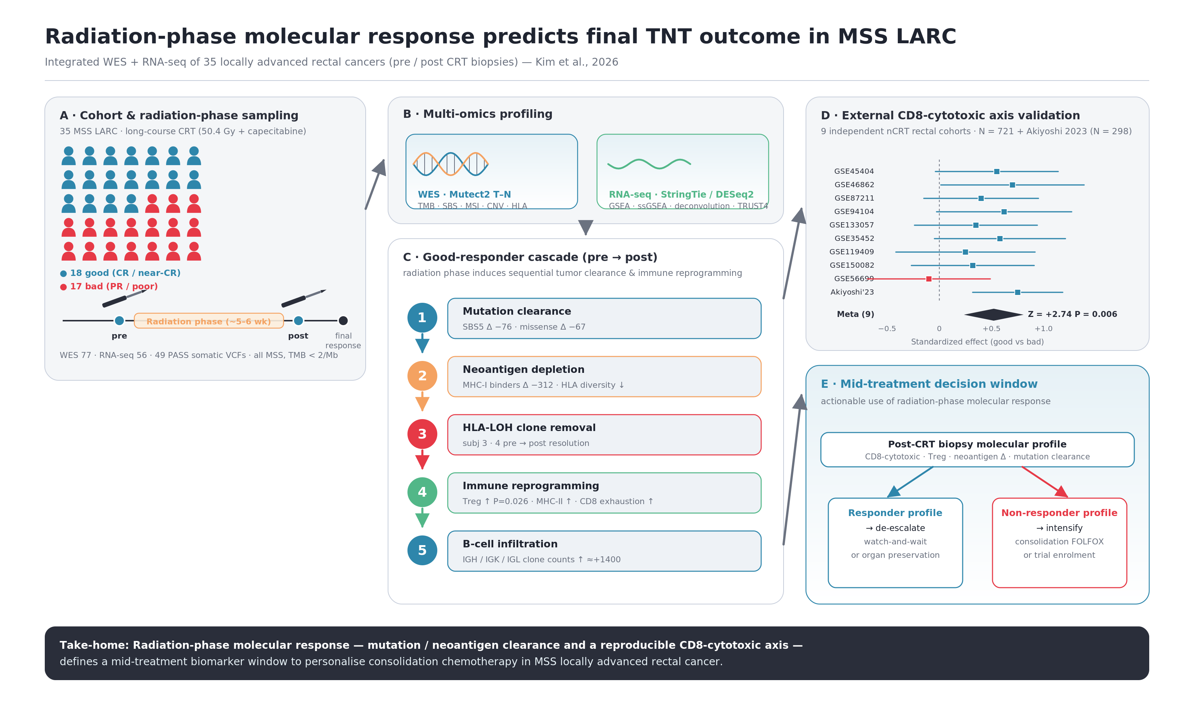
Radiation-phase molecular response predicts final TNT outcome in MSS LARC
Integrated WES + RNA-seq of 35 locally advanced rectal cancers (pre / post CRT biopsies) — Kim et al., 2026
Z = +2.74 P = 0.006
Take-home: Radiation-phase molecular response — mutation / neoantigen clearance and a reproducible CD8-cytotoxic axis — defines a mid-treatment biomarker window to personalise consolidation chemotherapy in MSS locally advanced rectal cancer.

