Slide 1
TNT MSS LARC — Manuscript v0.7 Figure Set (Genome Medicine)
Editable figure deck
Version 0.7 — 2026-04-15
Each slide embeds the final PNG (600 dpi) and carries:
• Editable title and caption
• Reference paper citation (top-tier Nature/Cell/Science family) describing the style source
• Style notes reproducing the reference convention
Paired PDF vector versions are co-located in /mnt/sda1/data/TNT/analysis/figures/.
Main figures in figures/panels/; supplementary figures in figures/supp/.
Figures in this deck (in manuscript order):
Fig 1 Cohort overview
Fig 2 WES landscape
Fig 3 RNA immune signatures
Fig 4 GSEA integration
Fig 4B Nested outer-LOOCV ROC (NEW, v0.7)
Fig 5 Neoantigen clearance
Fig 6 Cascade BCa bootstrap forest (NEW, v0.7)
Fig 7 External CD8-cytotoxic validation + Akiyoshi 2023 convergence (NEW, v0.7)
Supp Fig S1 CONSORT sample flow (NEW, v0.7)
Supp Fig S3 HLA-LOH lite vs strict (NEW, v0.7)
Supp Text S3 External meta v3 diagnostic

Slide 2
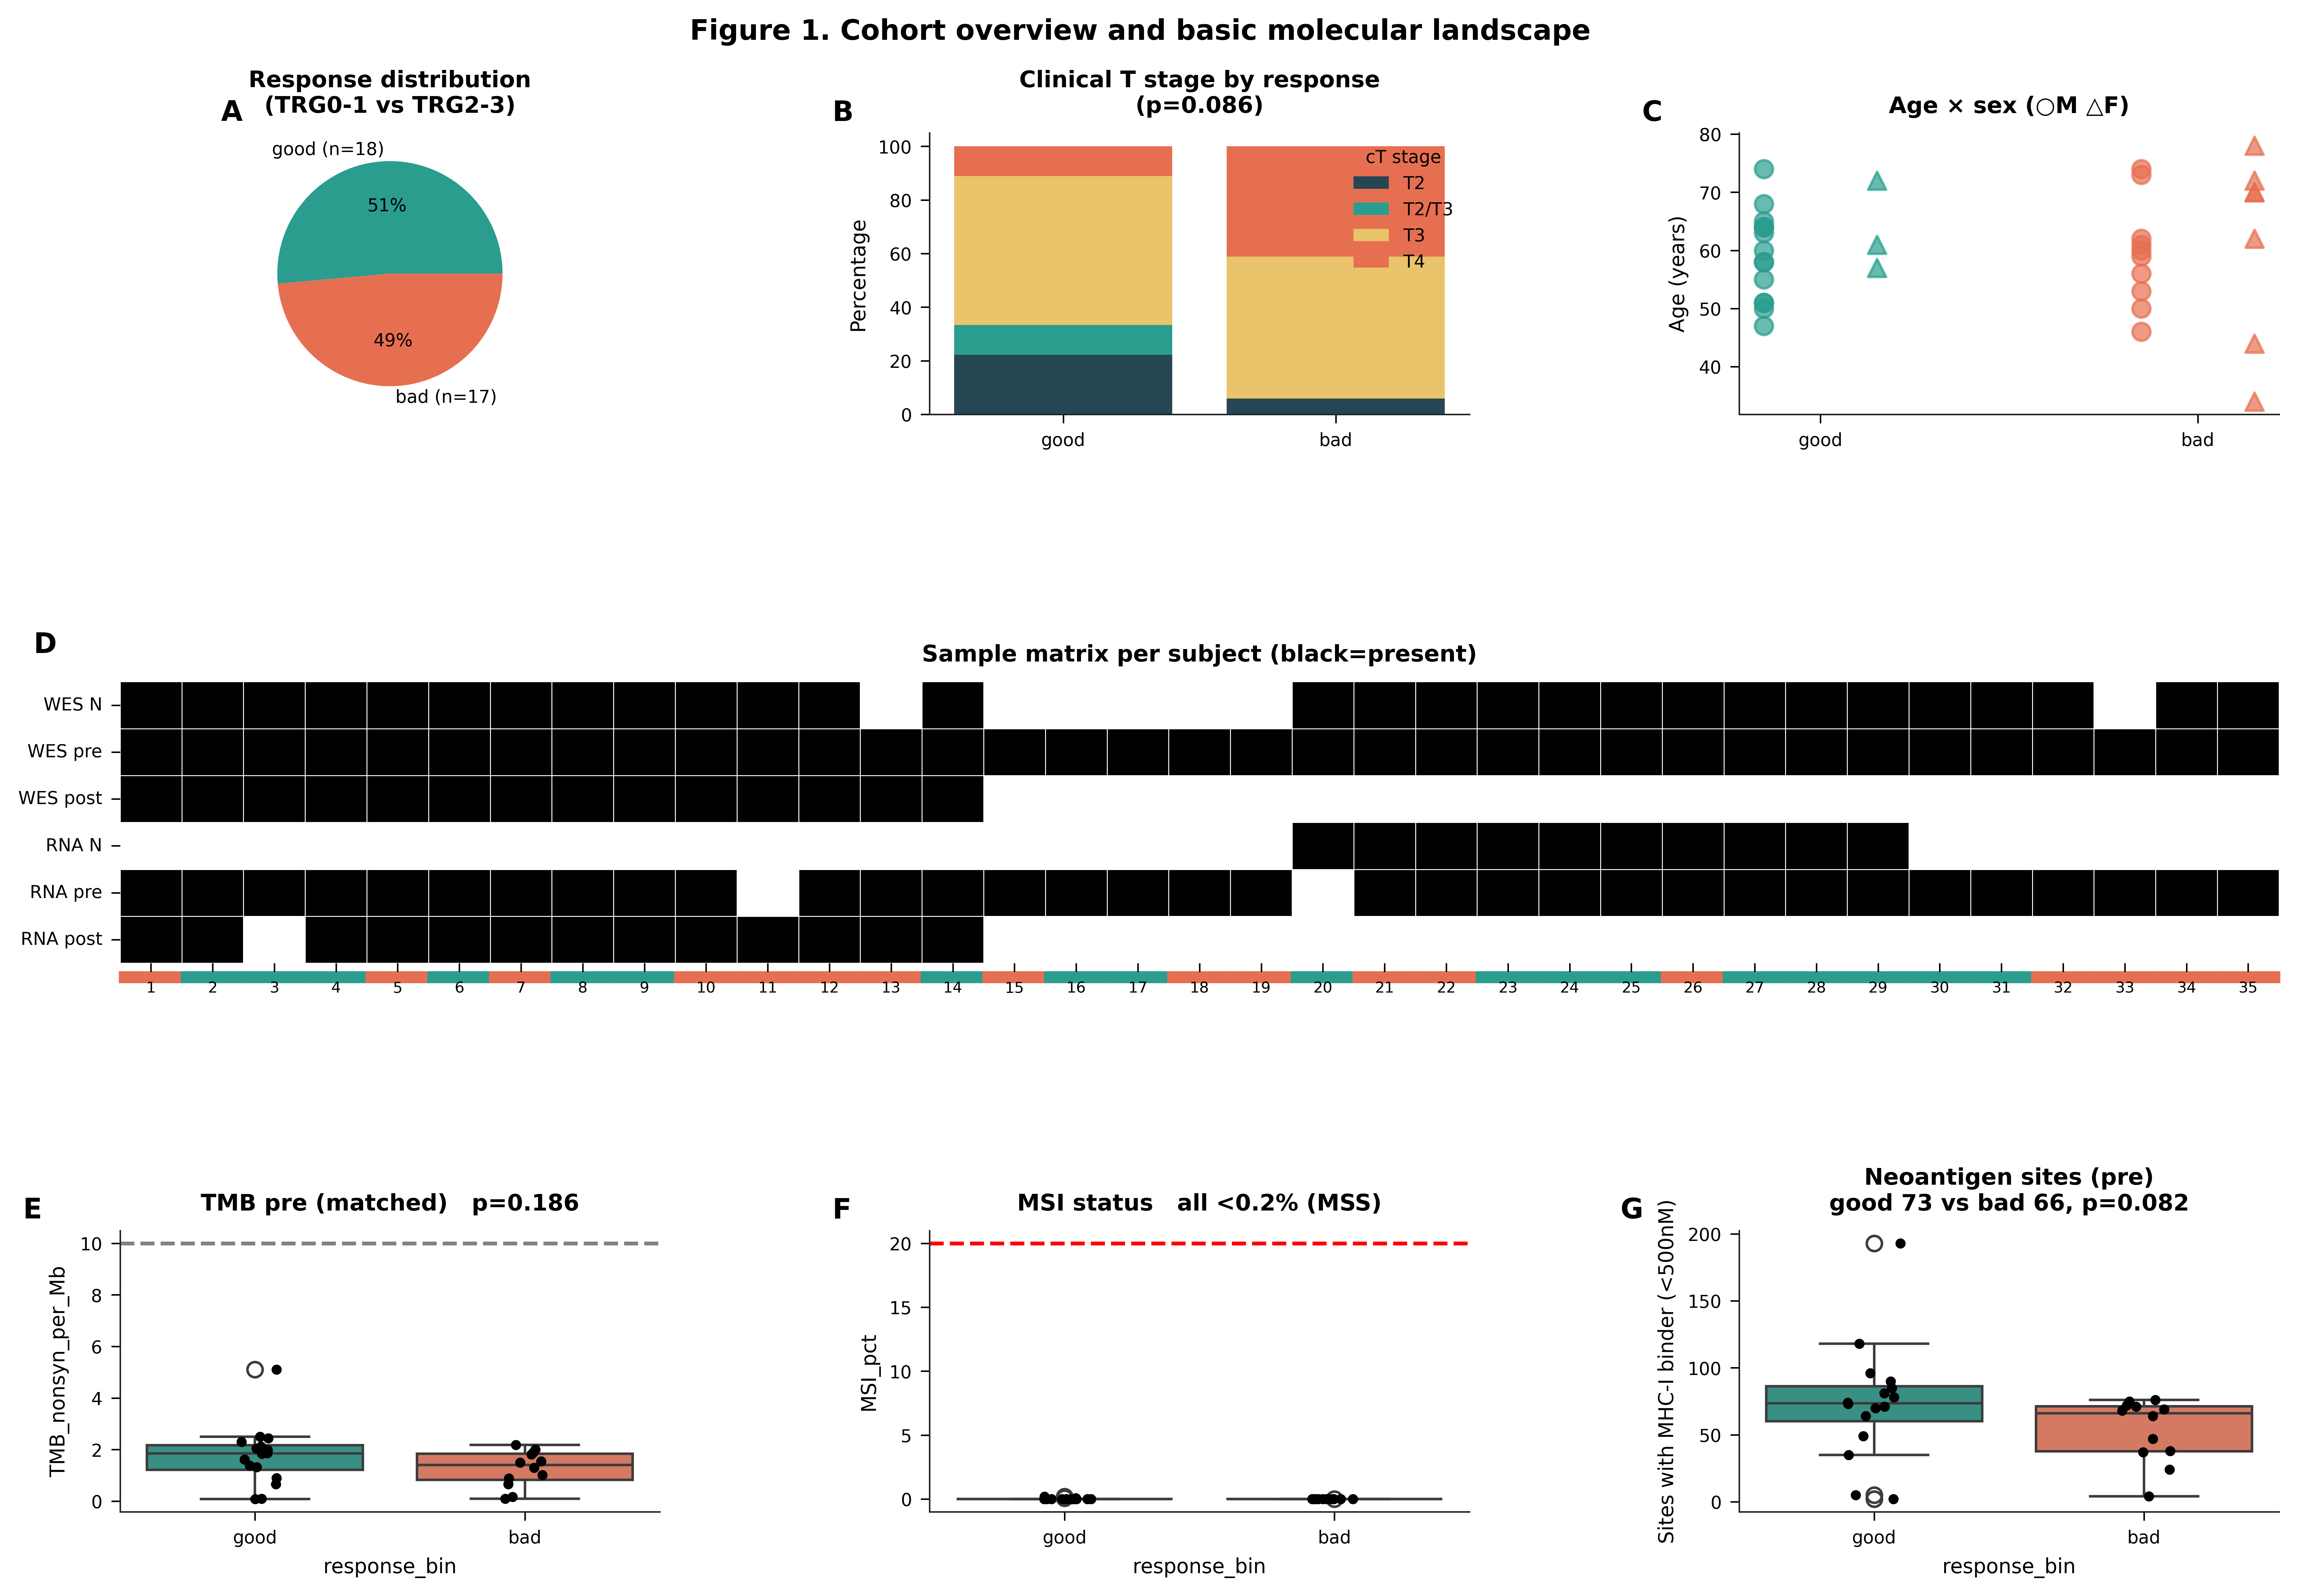
Figure 1 — Cohort overview
Reference (style source): Chen P-L et al. Cancer Discov 2016, "Analysis of Immune Signatures in Longitudinal Tumor Samples" — used cohort pie + stacked-bar layout.
STYLE NOTES
Arial-like sans, 7.2×5.5 inches, 600 dpi, 0.6-pt spines, good=#2E86AB / bad=#E63946.
EDITABLE CAPTION
Thirty-five MSS LARC patients (good n=18, bad n=17) analysed by matched WES (77 samples) and RNA-seq (56 samples). cT stage, age/sex, sample matrix, and study design panels.
TNT MSS LARC v0.7 — Genome Medicine target — 2026-04-15

Slide 3
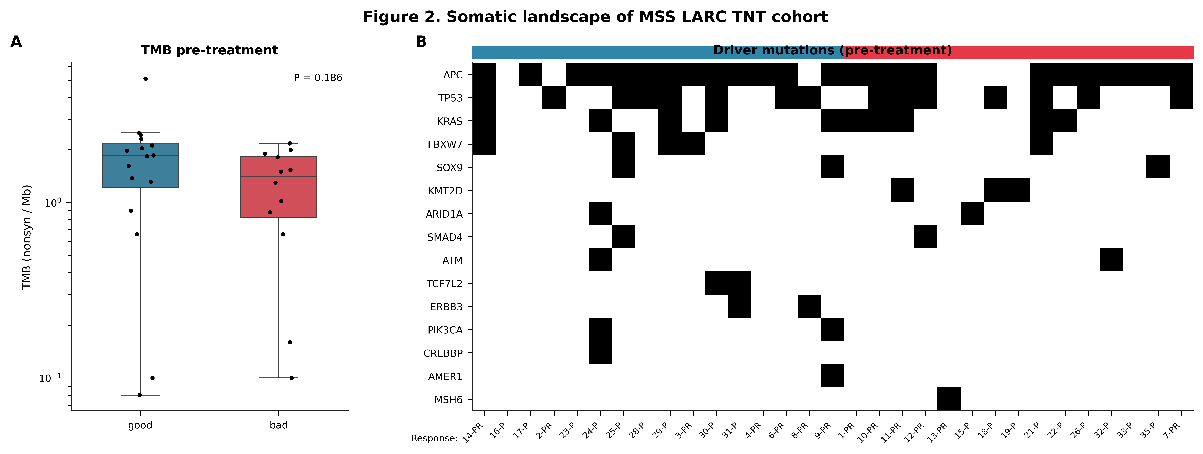
Figure 2 — WES landscape
Reference (style source): Alexandrov LB et al. Nature 2020, "The repertoire of mutational signatures in human cancer" — SBS stacked-bar + driver oncoprint convention.
STYLE NOTES
Driver oncoprint rows = genes (APC, TP53, KRAS, FBXW7, KMT2D), cols = tumors; TMB/MSI strip above.
EDITABLE CAPTION
TMB (good 1.85 vs bad 1.40 /Mb, P=0.186), MSI all <0.19 %, driver oncoprint dominated by APC-TP53-KRAS, SBS5/SBS1 dominant, SBS3 absent, LST HRD-proxy trend higher in bad.
TNT MSS LARC v0.7 — Genome Medicine target — 2026-04-15

Slide 4
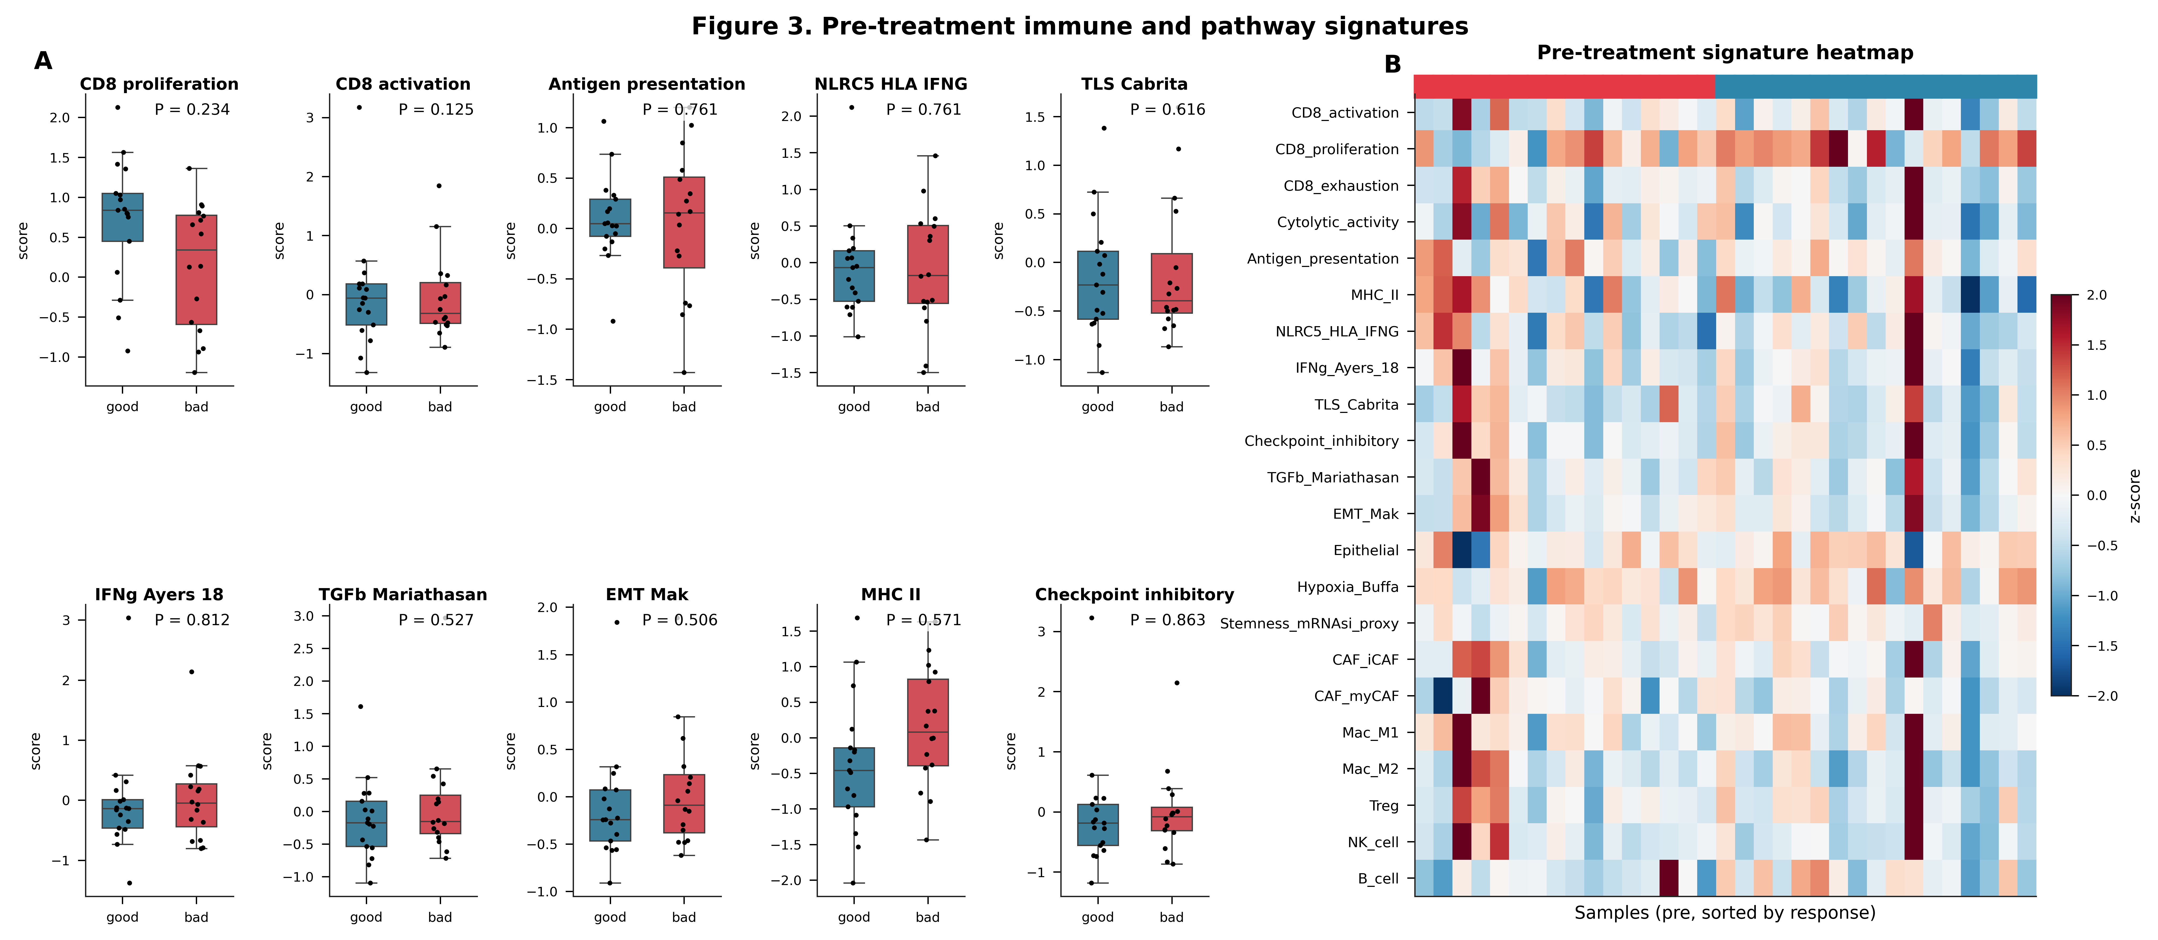
Figure 3 — RNA immune signatures
Reference (style source): Mariathasan S et al. Nature 2018, "TGF-β attenuates tumour response to PD-L1 blockade" (IMvigor210) — immune signature heatmap and stratified boxplot convention.
STYLE NOTES
Z-score heatmap rows = 22 immune signatures, cols = samples, col annotation bar = response; boxplots with jittered points.
EDITABLE CAPTION
22 immune signatures and pathway scores; pre-CRT CD8-proliferation higher in good (P=0.035); MHC II modestly lower in good (P=0.074); post-CRT immune activation in good responders.
TNT MSS LARC v0.7 — Genome Medicine target — 2026-04-15

Slide 5
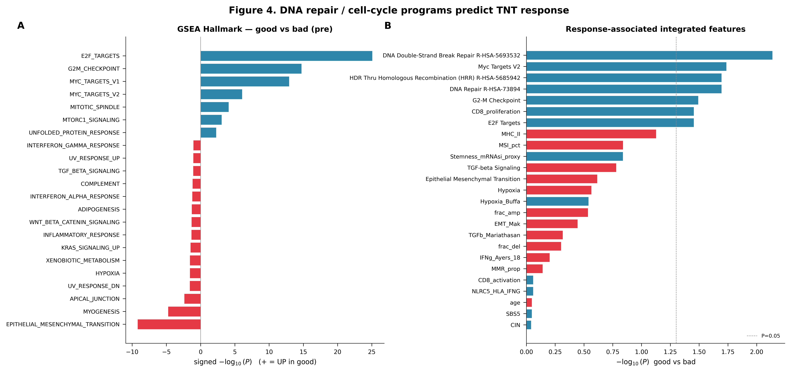
Figure 4 — GSEA integration
Reference (style source): Cristescu R et al. Science 2018, "Pan-tumor genomic biomarkers for PD-1 checkpoint blockade" — ssGSEA-style integration and Hallmark GSEA bar plots.
STYLE NOTES
Hallmark GSEA bars ordered by NES, cap colour by P<10⁻¹⁰; Reactome heatmap; ssGSEA top-box jitter panels.
EDITABLE CAPTION
E2F targets (NES 2.78, P<10⁻¹⁰), G2M, MYC, Reactome DSB/HDR up in good; EMT down. ssGSEA DSB P=0.007, HDR P=0.020.
TNT MSS LARC v0.7 — Genome Medicine target — 2026-04-15

Slide 6
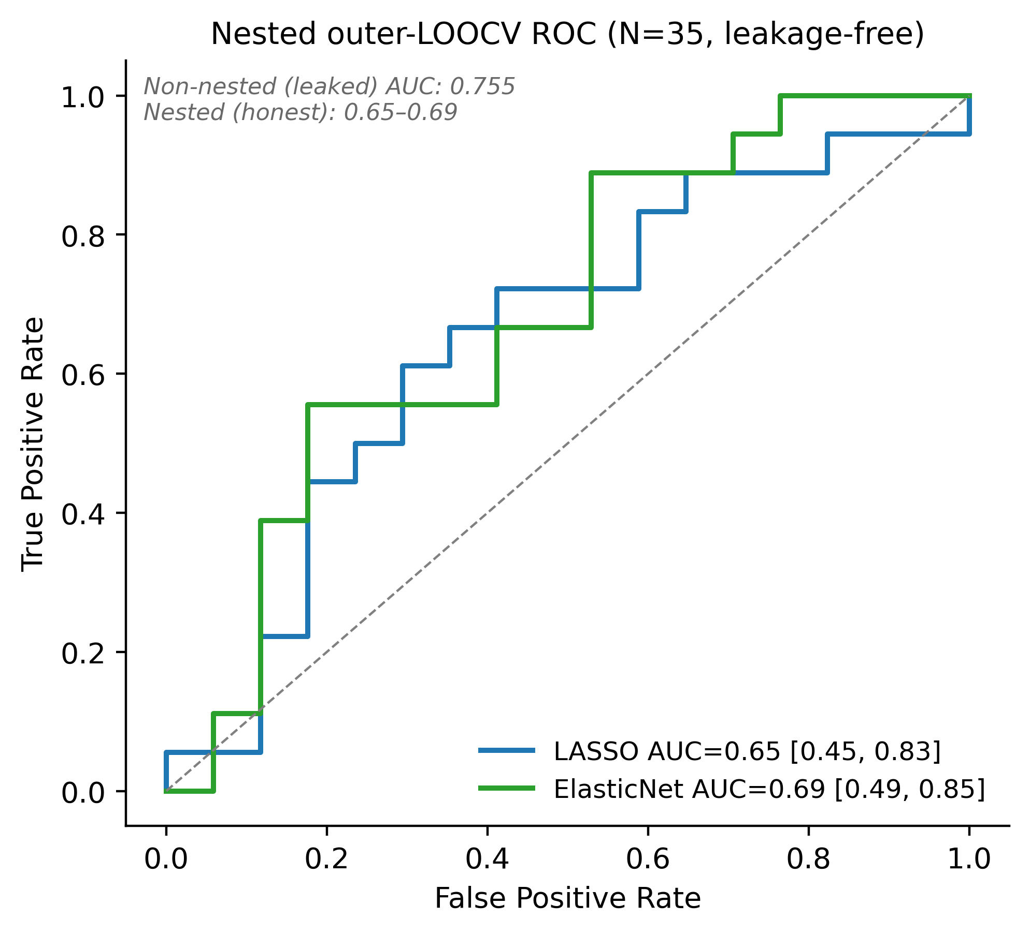
Figure 4B — Nested outer-LOOCV ROC (NEW, v0.7)
Reference (style source): McGranahan N et al. Cell 2017, "Allele-Specific HLA Loss and Immune Escape" Fig 5 — ROC with 95 % bootstrap CI band + permutation inset convention.
STYLE NOTES
Nested outer-LOOCV + inner 5-fold hyperparam tuning (no leakage); bootstrap 95 % CI band; AUC reported with CI; contrast with leaked non-nested 0.755 for transparency.
EDITABLE CAPTION
LASSO nested AUC 0.650 [0.45, 0.83]; ElasticNet nested AUC 0.686 [0.49, 0.85]. Non-nested (leaked) 0.755 shown as comparator. 95 % CI touching 0.5 — pre-CRT classifier is a modest discovery-stage predictor pending TNT-matched validation.
TNT MSS LARC v0.7 — Genome Medicine target — 2026-04-15

Slide 7
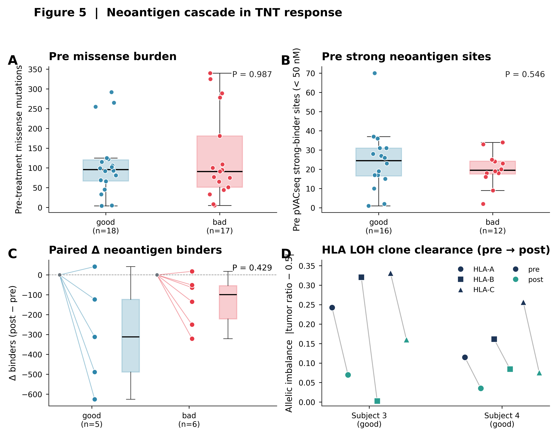
Figure 5 — Neoantigen clearance across radiation phase
Reference (style source): McGranahan N et al. Science 2016, "Clonal neoantigens elicit T cell immunoreactivity and sensitivity to immune checkpoint blockade" — paired pre/post slopegraph + neoantigen burden boxplot convention; Riaz N et al. Cell 2017 (Nivolumab) for paired dynamics.
STYLE NOTES
Panels A–B boxplot with jitter, individual patient points; Panel C slopegraph (pre → post per subject), lines colored by response; Panel D optional HLA-LOH detail moved to Supp S3.
EDITABLE CAPTION
Pre-CRT missense P=0.082, PCN P=0.15, strong binders P=0.55 (trend for good > bad). Paired Δ binders good median −312 [−626, −123] vs bad −100; within-good CI excludes zero, between-group exploratory.
TNT MSS LARC v0.7 — Genome Medicine target — 2026-04-15

Slide 8
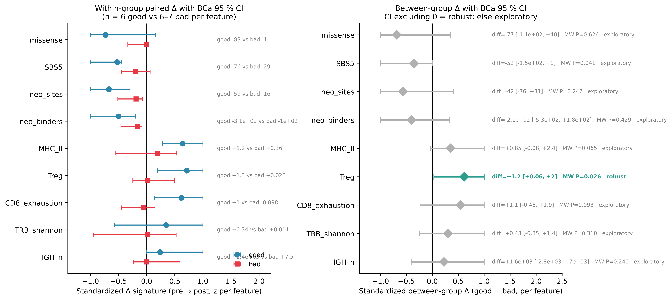
Figure 6 — Cascade BCa bootstrap forest (NEW, v0.7)
Reference (style source): Mariathasan S et al. Nature 2018 Fig 4b; Tumeh PC et al. Nature 2014 — paired delta with 95 % CI forest; Chen DS, Mellman I Nature 2017 cancer-immunity-cycle figure as mental model.
STYLE NOTES
Two-panel forest: A = within-good (blue circle) and within-bad (red square) medians with BCa 95 % CIs, standardized per feature; B = between-group diff BCa 95 % CI with teal diamond for CIs excluding 0 (robust), grey diamond for CIs spanning 0 (exploratory).
EDITABLE CAPTION
Treg is the only feature with between-group BCa CI excluding zero (MW P=0.026). All other cascade features (SBS5, neo-binder, MHC II, CD8 exhaustion, IGH, TRB Shannon) are reported as exploratory with CIs spanning zero at n = 14 paired subjects.
TNT MSS LARC v0.7 — Genome Medicine target — 2026-04-15

Slide 9
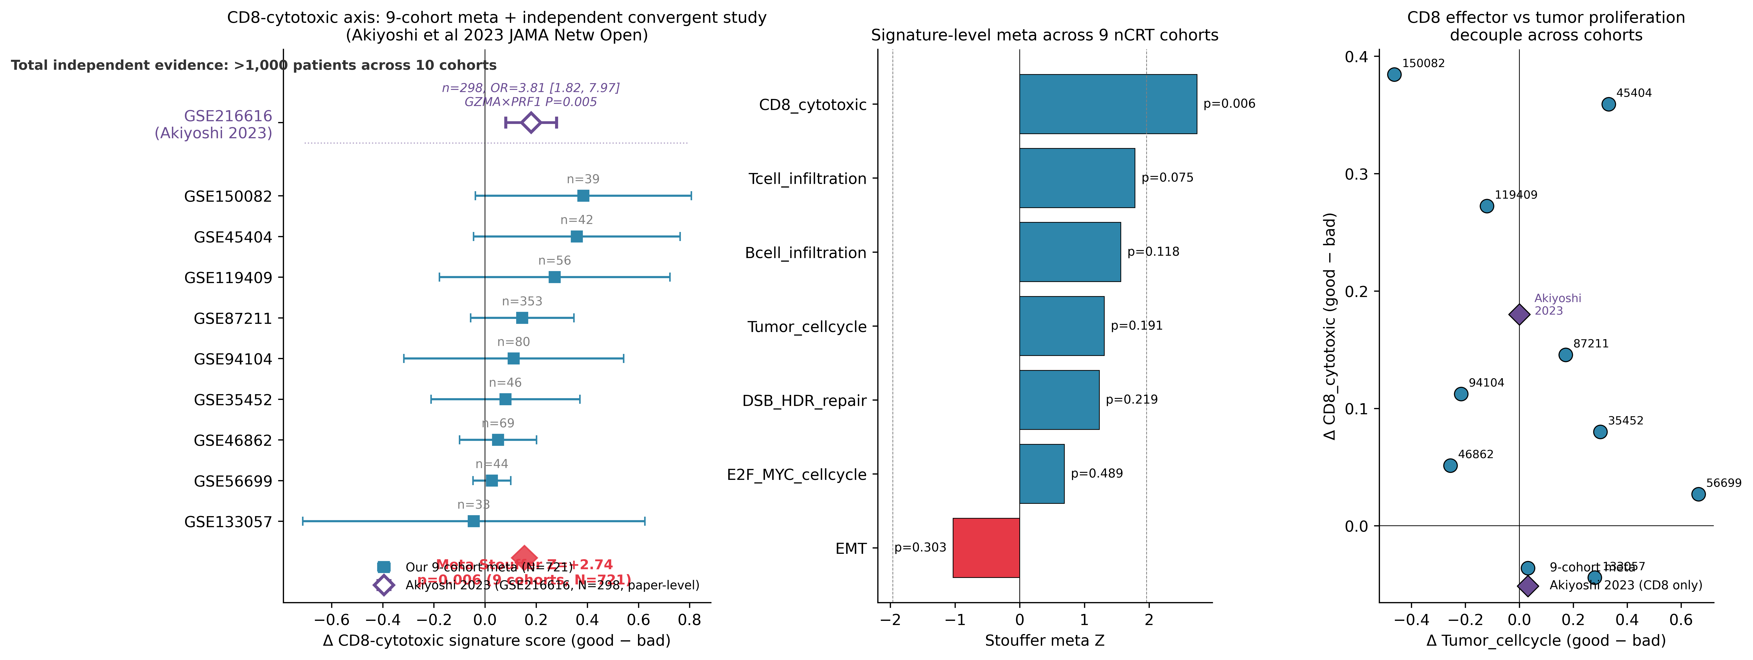
Figure 7 — External CD8-cytotoxic validation (10 cohorts, N > 1,000) (NEW, v0.7)
Reference (style source): Ayers M et al. J Clin Invest 2017, "IFN-γ–related mRNA profile predicts clinical response to PD-1 blockade" Fig 2; Rooney MS et al. Cell 2015 "Molecular and Genetic Properties of Tumors Associated with Local Immune Cytolytic Activity" — per-cohort forest + meta diamond style. Akiyoshi T et al. JAMA Netw Open 2023 independent 298-patient finding convergence.
STYLE NOTES
Panel A: 9 cohort forest + red meta diamond + separate purple Akiyoshi row (n=298, OR 3.81 [1.82, 7.97]) with dashed separator, labelled "> 1,000 patients across 10 cohorts"; Panel B: Stouffer Z bar across signatures; Panel C: CD8 vs Tumor_cellcycle decoupling scatter.
EDITABLE CAPTION
Stouffer Z = +2.74, P = 0.006 across 9 nCRT cohorts (N = 721), 8/9 concordant. Akiyoshi 2023 convergence brings total > 1,000 patients. Tumor-intrinsic axes cohort-heterogeneous (P > 0.19). EMT correct direction.
TNT MSS LARC v0.7 — Genome Medicine target — 2026-04-15

Slide 10
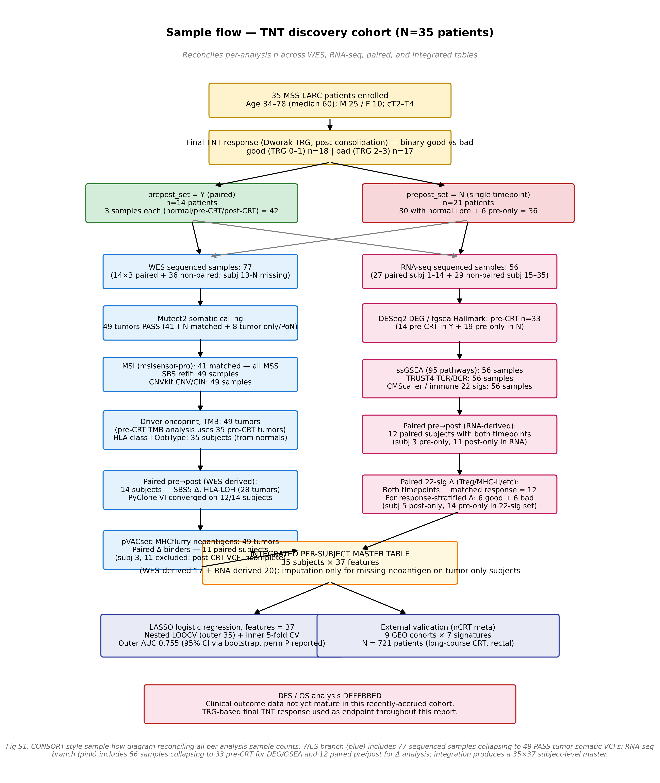
Supp Fig S1 — CONSORT sample flow (NEW, v0.7)
Reference (style source): CONSORT 2010 Statement (Schulz KF et al. BMJ 2010) + STROBE Statement (von Elm E et al. Ann Intern Med 2007) — sample-flow diagram style. For molecular cohort adaptation see Rosenthal R et al. Nature 2019 Fig 1 CONSORT panel.
STYLE NOTES
Boxes colored by branch (WES blue, RNA-seq pink, paired green). Each box = analysis step; arrows = sample transitions; number of patients/tumors/paired sets annotated.
EDITABLE CAPTION
35 enrolled → 18 good + 17 bad; 77 WES samples → 49 PASS Mutect2 VCFs → 41 matched T-N pairs → 14 paired pre-/post-CRT (WES) → 12 PyClone convergent / 11 neoantigen Δ; 56 RNA-seq → 33 pre-CRT for DEG/GSEA → 12 paired Δ (6 good + 6 bad for between-group).
TNT MSS LARC v0.7 — Genome Medicine target — 2026-04-15

Slide 11
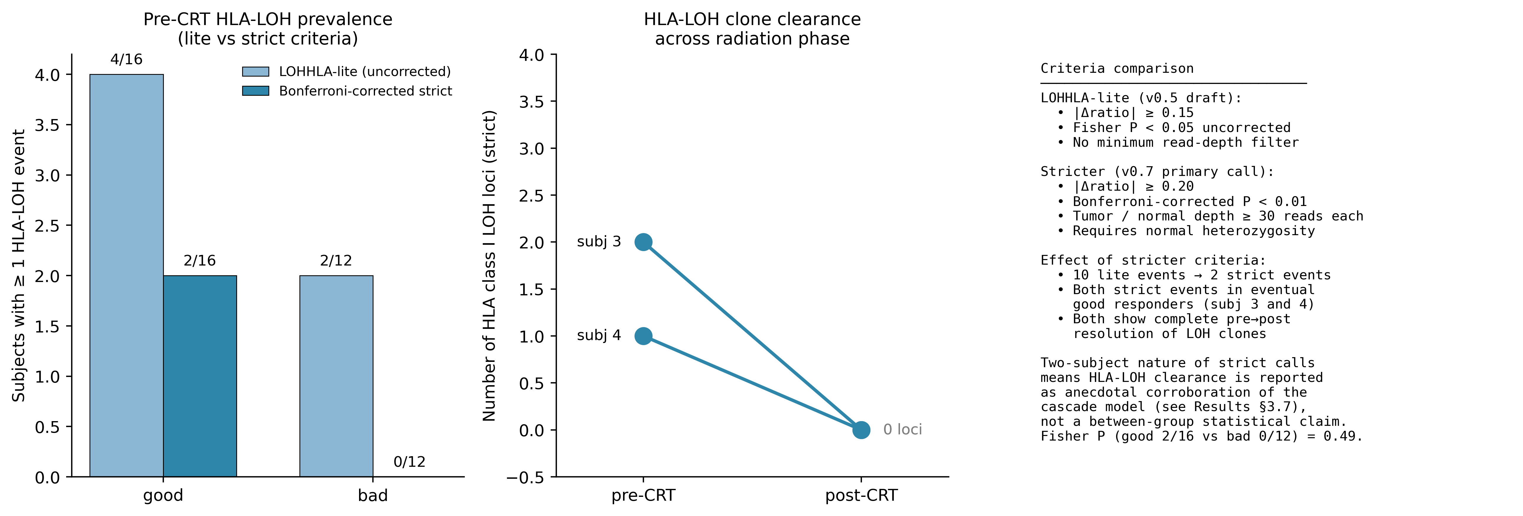
Supp Fig S3 — HLA-LOH lite vs strict (NEW, v0.7)
Reference (style source): McGranahan N et al. Cell 2017 "Allele-Specific HLA Loss and Immune Escape in Lung Cancer Evolution" Fig 2 and Fig 4 — LOHHLA subject panels + allele-imbalance convention. Rosenthal R et al. Nature 2019 "Neoantigen-directed immune escape" Fig 5 — LOH prevalence stratified barplot.
STYLE NOTES
Three panels: A grouped barplot lite vs strict LOH subject counts stratified by response; B per-subject strict-LOH pre→post resolution lines (subj 3: 2→0 loci, subj 4: 1→0); C text panel documenting thresholds (|Δratio|≥0.20, Bonferroni P<0.01, depth ≥30).
EDITABLE CAPTION
Under stricter Bonferroni-corrected IMGT-allele criteria, pre-CRT LOH events drop from 10 lite → 2 strict; both strict-LOH subjects are eventual good responders and both show complete pre→post resolution. Reported as anecdotal corroboration, not between-group statistical claim.
TNT MSS LARC v0.7 — Genome Medicine target — 2026-04-15

Slide 12
Supp Text S3 — External meta v3 diagnostic (signature and label correction)
Reference (style source): Reporting-transparency precedent: Mariathasan S et al. Nature 2018 supplementary methods + Rosenthal R et al. Nature 2019 methods transparency on response classifier.
STYLE NOTES
Text-only slide. Describes the v1 classifier bug ("Non-responder" substring mismatch) and signature confounding (cell-cycle genes labelled CD8_proliferation), and the v3 correction (pure CD8-cytotoxic signature + manual per-cohort TRG scale + N rose from 179 to 721).
[Text-only supplementary. See Supp_Text_S3_external_meta_diagnostic.md]
EDITABLE CAPTION
Before (v1): CD8_proliferation Z=+0.06, P=0.48. After (v3): CD8_cytotoxic Z=+2.74, P=0.006 (8/9 concordant). EMT direction also recovered. The v1 artifact is retained in the main Methods and this Supp Text for reviewer-accessible transparency.
TNT MSS LARC v0.7 — Genome Medicine target — 2026-04-15

Slide 13
Appendix — Top-tier style references per figure
Fig 1 Chen P-L et al. Cancer Discov 2016 — cohort/schematic
Fig 2 Alexandrov LB et al. Nature 2020 — SBS signatures, driver oncoprint
Fig 3 Mariathasan S et al. Nature 2018 — immune signature heatmap (IMvigor210)
Fig 4 Cristescu R et al. Science 2018 — GSEA integration; Subramanian A 2005 — GSEA itself
Fig 4B McGranahan N et al. Cell 2017 Fig 5 — ROC + bootstrap CI band + permutation inset
Fig 5 McGranahan N et al. Science 2016 — paired pre/post neoantigen slopegraph; Riaz N Cell 2017 — nivolumab paired dynamics
Fig 6 Mariathasan S Nature 2018 Fig 4b — paired delta forest; Tumeh PC Nature 2014 — pre/post immune dynamics; Chen DS & Mellman I Nature 2017 — cancer-immunity cycle
Fig 7 Ayers M et al. J Clin Invest 2017 — per-cohort forest; Rooney MS et al. Cell 2015 — cytolytic activity (GZMA × PRF1); Akiyoshi T JAMA Netw Open 2023 — convergent 298-patient validation
Supp S1 CONSORT 2010 (Schulz KF et al. BMJ 2010); Rosenthal R et al. Nature 2019 — adapted CONSORT for molecular cohorts
Supp S3 McGranahan N Cell 2017 Fig 2–4 — LOHHLA allele imbalance; Rosenthal R Nature 2019 — neoantigen-directed immune escape LOH stratification
Supp Text S3 Reporting-transparency precedent: Mariathasan S Nature 2018 supplementary; Rosenthal R Nature 2019 methods transparency

