Slide 1
TNT MSS LARC — v0.7 editable figure deck (v2, overlayed text)
v2 differences from v1:
• Key numeric strings (AUC, meta Z, OR, P values) are rendered as native PowerPoint text boxes OVERLAID on the figure image.
• The underlying figure PNG still carries the plot elements, but the "KEY STATISTICS" side panels and the big figure title are editable text.
• Edit by double-clicking any text box in PowerPoint — the image is untouched.
• For full in-plot text editability (axis labels, legend, data labels), the source PDFs are vector and can be opened in Illustrator / Affinity Designer.
Scope of v2 overlay treatment: Fig 4B nested ROC, Fig 6 cascade BCa forest, Fig 7 external CD8 validation (all three v0.7 additions). Fig 1–3, Fig 4A–F, Fig 5, and supplementary figures remain as in v1; their vector PDFs in /figures/panels_v3/ retain native text for editing.

Slide 2
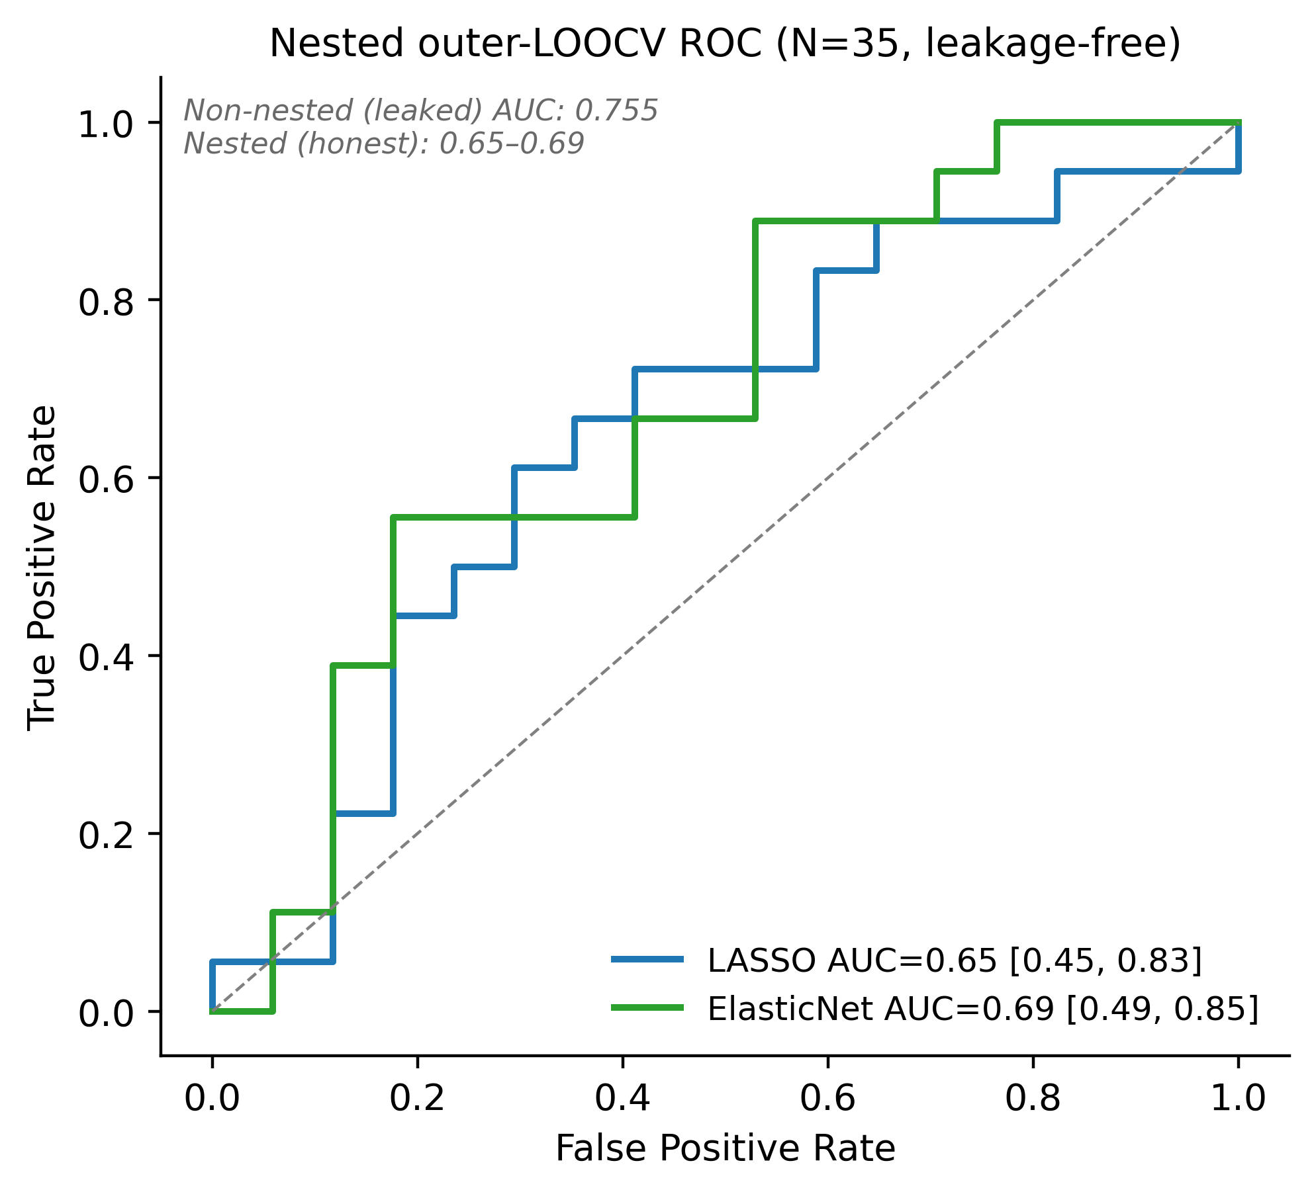
Figure 4B
Nested outer-LOOCV (leakage-free)
AUC summary (editable)
LASSO AUC = 0.650 [0.45, 0.83]
ElasticNet AUC = 0.686 [0.49, 0.85]
Non-nested (leaked) 0.755 — shown for transparency.
Permutation P — pending (time-prohibitive; 1000 × nested LOOCV).
Key message (editable):
Leakage-free AUC is modest with 95 % CI touching 0.5.
Pre-CRT tumor-intrinsic classifier = discovery-stage, awaits TNT-matched validation.
Immune (CD8-cytotoxic) axis is the externally-reproducible arm (Fig 7).
Reference (style source): McGranahan N et al. Cell 2017 Fig 5 — ROC with 95 % bootstrap CI band.

Slide 3
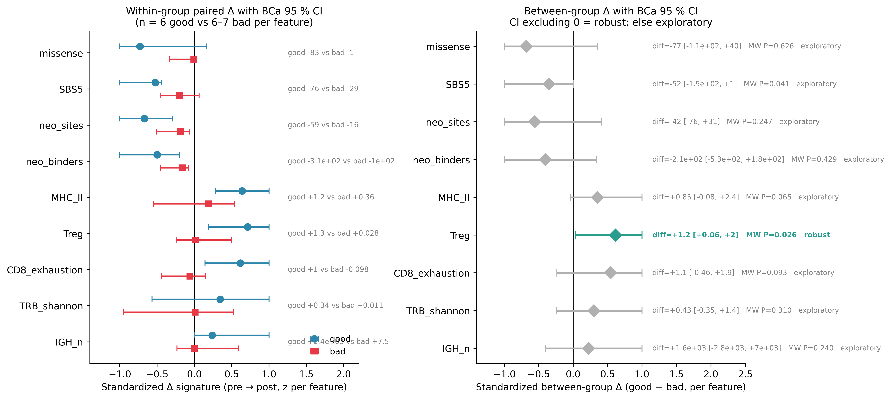
Figure 6
Within-group + between-group paired Δ with BCa 95 % CI (n = 14)
Robust (CI excludes 0)
• Treg diff = +1.21 [+0.06, +1.97]
MW P = 0.026
Exploratory (CI spans 0)
• MHC-II, CD8 exhaustion
• IGH clonotype count
• SBS5 mutation clearance
• Neoantigen binders / sites
• TRB Shannon diversity
Caveat (editable):
Between-group BCa CIs reflect n = 6–7 per group.
Within-good CI excludes 0 for SBS5, neo-binders, Treg — within-group robustness is consistent even where between-group inference is under-powered.
Reference (style source): Mariathasan S et al. Nature 2018 Fig 4b; Tumeh PC Nature 2014; Chen DS & Mellman I Nature 2017.

Slide 4
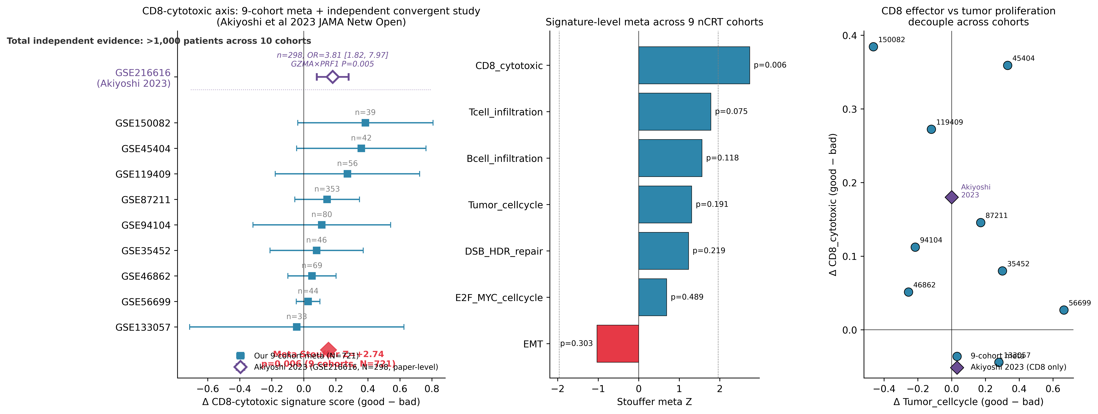
Figure 7
External validation — CD8-cytotoxic axis across 10 cohorts, N > 1,000
KEY STATISTICS
Our 9-cohort meta-analysis
Stouffer Z = +2.74, P = 0.006
N = 721 (8/9 cohorts concordant)
Akiyoshi 2023 (GSE216616)
n = 298, OR = 3.81 [1.82, 7.97]
GZMA × PRF1 P = 0.005
Hallmark IFN-γ enriched in good
Combined evidence
> 1,000 independent patients
across 10 cohorts
Key message (editable):
The CD8-cytotoxic effector axis (GZMA/B, PRF1, IFNG, CD8A/B, NKG7, CXCL9/10) is the externally -reproducible arm of our discovery. Tumor-intrinsic DSB/HDR/E2F axes are cohort-heterogeneous and remain discovery-stage pending TNT-matched validation.
Reference (style source): Ayers M et al. JCI 2017; Rooney MS et al. Cell 2015; Akiyoshi T et al. JAMA Netw Open 2023.

Slide 5
How to edit figure text in this deck
1. TITLE / KEY STATISTICS / CAPTION boxes = native PowerPoint text boxes.
→ Double-click to edit; all text, fonts, colors, and fills are editable.
2. IN-PLOT TEXT (axis labels, cohort names, legend) lives inside the image.
→ For in-plot editing, open the matching PDF in:
Adobe Illustrator (Open → File → commit changes → Save As PDF)
Affinity Designer (Open → edit text → Export PDF/PNG)
Inkscape (Open → Ctrl+T → edit → Save As PDF)
PDFs are vector and keep every text run as an editable object.
3. Source PDFs for v0.7 additions:
figures/panels_v3/Fig4B_ROC_nested.pdf
figures/panels/Fig6_cascade_BCa_forest.pdf
figures/panels/Fig7_external_CD8_validation_v4.pdf
figures/supp/SuppFig_consort_sample_flow.pdf
figures/supp/SuppFig_S3_HLA_LOH_lite_vs_strict.pdf
4. To re-render from scratch with new numbers, source matplotlib scripts are at:
scripts/33_v3_forest_plot.py (CD8 forest)
scripts/38_forest_plus_akiyoshi.py (forest + Akiyoshi row)
scripts/39_cascade_and_loh_figures.py (cascade BCa + HLA-LOH)
scripts/40_build_editable_ppt.py (this deck)

