Slide 1
TNT MSS LARC — v0.7 fully-editable figure deck
1 panel per slide. No figure titles.
All in-plot text (axis labels, ticks, legend, P-values, cohort names) is a NATIVE PowerPoint text run.
All embedded images are properly relocated to the master deck.
Double-click anywhere to edit text. Images are editable via crop/resize/replace.

Slide 2
Fig 1A — Study design (v0.7.1)
35 MSS LARC patients | good n=18 | bad n=17 | 14 paired pre/post
Pre-CRT biopsy
Post-CRT biopsy
Response endpoint
Baseline
Radiation phase
Post-CRT
Consolidation
Surgery or Watch-and-Wait
(pre-CRT)
long-course CRT
(before consolidation)
chemotherapy
(final TNT response by Dworak TRG)
50.4 Gy + capecitabine
(FOLFOX/CAPOX/Xeloda)
Time
Radiation-phase sampling window (this study)
Final TNT response (Dworak TRG 0–1 vs 2–3) is assessed after surgery, after the full TNT regimen. Molecular profiling is powered only by
the pre-CRT / post-CRT biopsy pair — this is the mid-treatment decision window.

Slide 3
Fig 1B — Cohort Sankey
Good
Paired
WES
(TRG 0-1)
pre+post
77 samples
(n=18)
(n=14)
(n=77)
LARC
enrolled
(n=35)
Poor
Unpaired
(TRG 2-3)
pre only
RNA-seq
(n=17)
(n=21)
56 samples
(n=56)

Slide 4

Fig 1C — Sample × assay matrix
Response
cT stage
Sex
Age
TMB/Mb
MSI %
WES normal
WES pre
WES post
RNA normal
RNA pre
RNA post
S2
S3
S4
S8
S9
S14
S16
S17
S20
S23
S24
S25
S27
S30
S31
S6
S28
S29
S1
S5
S7
S12
S15
S18
S19
S21
S22
S26
S33
S34
S10
S11
S13
S32
S35

Slide 5
Fig 1D — Headline 3-narrative preview
Headline summary of results
Narrative 1
LASSO AUC = 0.65 [0.45, 0.83] (nested LOOCV, n = 35)
Pre-CRT tumor-intrinsic
predictor (DSB/HDR/E2F)
Narrative 2
Treg Δ = +1.21 [+0.06, +1.97] (robust, MW P = 0.026)
Radiation-induced cascade
Other cascade features (exploratory, CIs span 0)
(exploratory, n = 14 paired)
Narrative 3
9-cohort meta Stouffer Z = +2.74, P = 0.006 (N = 721, 8/9 concordant)
External CD8-cytotoxic
Akiyoshi 2023 n = 298, OR = 3.81 [1.82, 7.97] → > 1,000 patients / 10 cohorts
reproducibility
-2
-1
0
+1
+2
+3
+4
Standardized effect size (log-scale for narratives 1 & 3)

Slide 6
Fig 2A — Driver oncoprint
300
200
(per sample)
Coding mutations
100
0
Response
cT stage
TMB/Mb
MSI %
Pathway / Function
APC
WNT
TP53
TP53
KRAS
RTK/RAS
FBXW7
Cell cycle
KMT2D
Chromatin
SOX9
Other
ARID1A
Chromatin
TCF7L2
WNT
PIK3CA
PI3K
ERBB3
RTK/RAS
ATM
DDR
SMAD4
TGFβ
AMER1
WNT
CTNNB1
WNT
GNAS
Other
MSH6
MMR
POLE
DDR
NRAS
Good
RTK/RAS
POLD1
Poor
DDR
Mutation type
0
50
Missense
Nonsense
Frameshift
Splice site
% mutated
Annotation tracks
good
T2
T3
TMB (gradient)
MSI (gradient)
bad
T2/T3
T4

Slide 7
Fig 2B — TMB raincloud by response
10
TMB-high (10/Mb)
8
6
p = 0.186
Nonsynonymous TMB (/Mb)
4
2
0
n=16
n=12
good
bad

Slide 8
SBS96 trinucleotide mutational context profiles (Alexandrov-style)
Fig 2B(alt) — SBS96 profile
C>A
C>G
C>T
T>A
T>C
T>G
40
30
1-PR
(n=283 mutations)
20
10
0
C>A
C>G
C>T
T>A
T>C
T>G
35
30
25
12-PR
(n=318 mutations)
20
15
10
5
0
C>A
C>G
C>T
T>A
T>C
T>G
20
15
5-PR
(n=209 mutations)
10
5
0
C>A
C>G
C>T
T>A
T>C
T>G
30
25
20
14-PR
(n=292 mutations)
15
10
5
0
AC>AA
AC>AC
AC>AG
AC>AT
CC>AA
CC>AC
CC>AG
CC>AT
GC>AA
GC>AC
GC>AG
GC>AT
TC>AA
TC>AC
TC>AG
TC>AT
AC>GA
AC>GC
AC>GG
AC>GT
CC>GA
CC>GC
CC>GG
CC>GT
GC>GA
GC>GC
GC>GG
GC>GT
TC>GA
TC>GC
TC>GG
TC>GT
AC>TA
AC>TC
AC>TG
AC>TT
CC>TA
CC>TC
CC>TG
CC>TT
GC>TA
GC>TC
GC>TG
GC>TT
TC>TA
TC>TC
TC>TG
TC>TT
AT>AA
AT>AC
AT>AG
AT>AT
CT>AA
CT>AC
CT>AG
CT>AT
GT>AA
GT>AC
GT>AG
GT>AT
TT>AA
TT>AC
TT>AG
TT>AT
AT>CA
AT>CC
AT>CG
AT>CT
CT>CA
CT>CC
CT>CG
CT>CT
GT>CA
GT>CC
GT>CG
GT>CT
TT>CA
TT>CC
TT>CG
TT>CT
AT>GA
AT>GC
AT>GG
AT>GT
CT>GA
CT>GC
CT>GG
CT>GT
GT>GA
GT>GC
GT>GG
GT>GT
TT>GA
TT>GC
TT>GG
TT>GT
Trinucleotide mutation context (5'-N[REF>ALT]N-3')

Slide 9
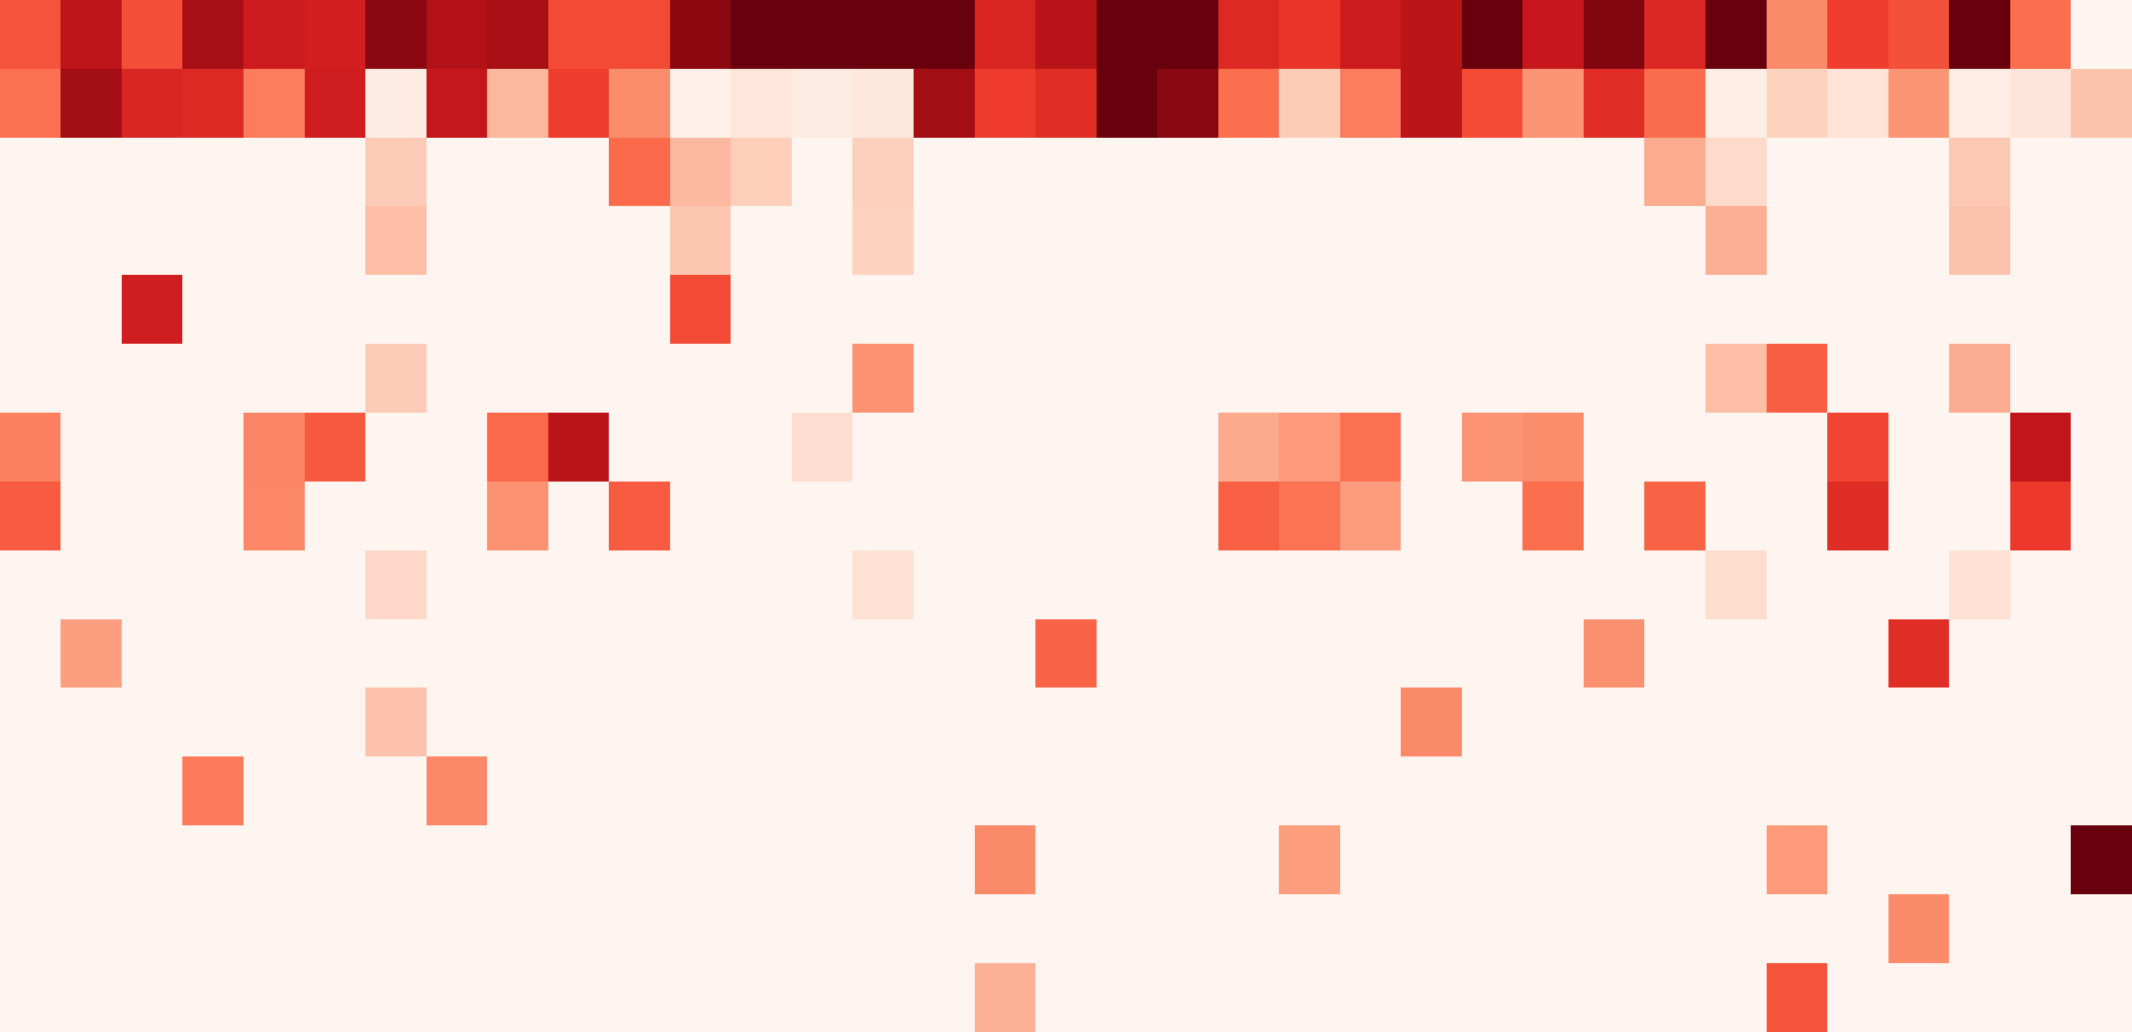
Mutational signature attribution (COSMIC v3.3) — pre-treatment samples sorted by response × mutation burden
Fig 2C — SBS signature attribution
black-bordered samples = prior MMR/HRD signature claims
2000
Total mutations
0
Response
cT stage
SBS5 (Aging (clock-like))
SBS1 (Aging (5-mC deamin.))
SBS6 (MMR deficiency)
SBS54 (Possible artefact)
0.5
SBS40 (Aging-like (unknown))
SBS39 (Unknown)
0.4
SBS15 (MMR deficiency)
0.3
Signature contribution
SBS87 (Thiopurine chemotherapy)
(proportion)
SBS30 (NTHL1 deficiency)
0.2
SBS24 (Aflatoxin (likely artefact))
0.1
SBS4 (Tobacco smoking)
SBS18 (ROS damage)
0.0
SBS29 (Tobacco chewing)
SBS9 (Polymerase eta)
SBS93 (Unknown)
11-PR
21-P
10-PR
12-PR
32-P
1-PR
18-P
22-P
26-P
35-P
7-PR
13-PR
15-P
19-P
33-P
34-P
5-PR
24-P
25-P
30-P
9-PR
14-PR
29-P
31-P
28-P
3-PR
6-PR
8-PR
17-P
2-PR
23-P
4-PR
16-P
20-P
27-P

Slide 10
0.8
Fig 2C(alt) — MSI × TMB scatter
good (n=23)
0.7
bad (n=18)
0.6
0.5
0.4
MSI percentage (%)
0.3
0.2
0.1
MSS zone
0.0
(TMB-low)
0
2
4
6
8
10
12
Nonsynonymous TMB (/Mb)

Slide 11
Sample-level MSI percentage (waterfall) with TMB overlay — all matched tumors are MSS (MSI < 1 %) and TMB-low (< 10 / Mb)
Fig 2D — TMB + MSI waterfall
Response
0.25
TMB 10/Mb
10
MSI-H clinical cutoff = 20 %
(all samples shown here are ≤ 0.19 %; axis rescaled)
0.20
0.19
8
0.15
6
MSI percentage (%)
TMB (nonsynonymous mutations / Mb)
0.10
4
0.07
0.05
2
0.01 0.01 0.01 0.01
0
0.00
3-PR
29-P
23-P
21-P
9-PR
4-PR
10-PO
1-PR
1-PO
14-PO
12-PR
12-PO
11-PR
11-PO
10-PR
20-P
2-PR
24-P
22-P
25-P
26-P
28-P
27-P
14-PR
2-PO
30-P
3-PO
34-P
31-P
35-P
4-PO
5-PO
32-P
5-PR
6-PO
7-PO
6-PR
7-PR
8-PO
8-PR
9-PO
Good (TRG 0–1)
Poor (TRG 2–3)
TMB (right axis)

Slide 12
5
Fig 2D(alt) — SBS reassessment
40
35
4
30
25
S1
3
(prior MMR claim)
MMR signature proportion (%)
Clinical MMR-d cutoff
SBS3 (HRD) proportion (%)
20
S9
2
15
(prior MMR claim)
10
1
5
S5
S14
S12
(prior SBS3 claim)
(prior SBS3 claim)
(prior MMR claim)
0
0
0
5
10
15
20
25
30
35
0
5
10
15
20
25
30
35
Subject ID (matched, pre)
Subject ID (matched, pre)

Slide 13
9
Fig 2E — CNV + HRD proxy
p = 0.659
p = 0.0374 *
p = 0.225
0.5
8
35
7
0.4
30
6
5
25
Fraction genome altered (CIN)
Large-scale transitions (LST)
HRD total score (LST+LOH+TAI)
0.3
4
20
0.2
3
15
2
0.1
1
10
good
bad
good
bad
good
bad

Slide 14
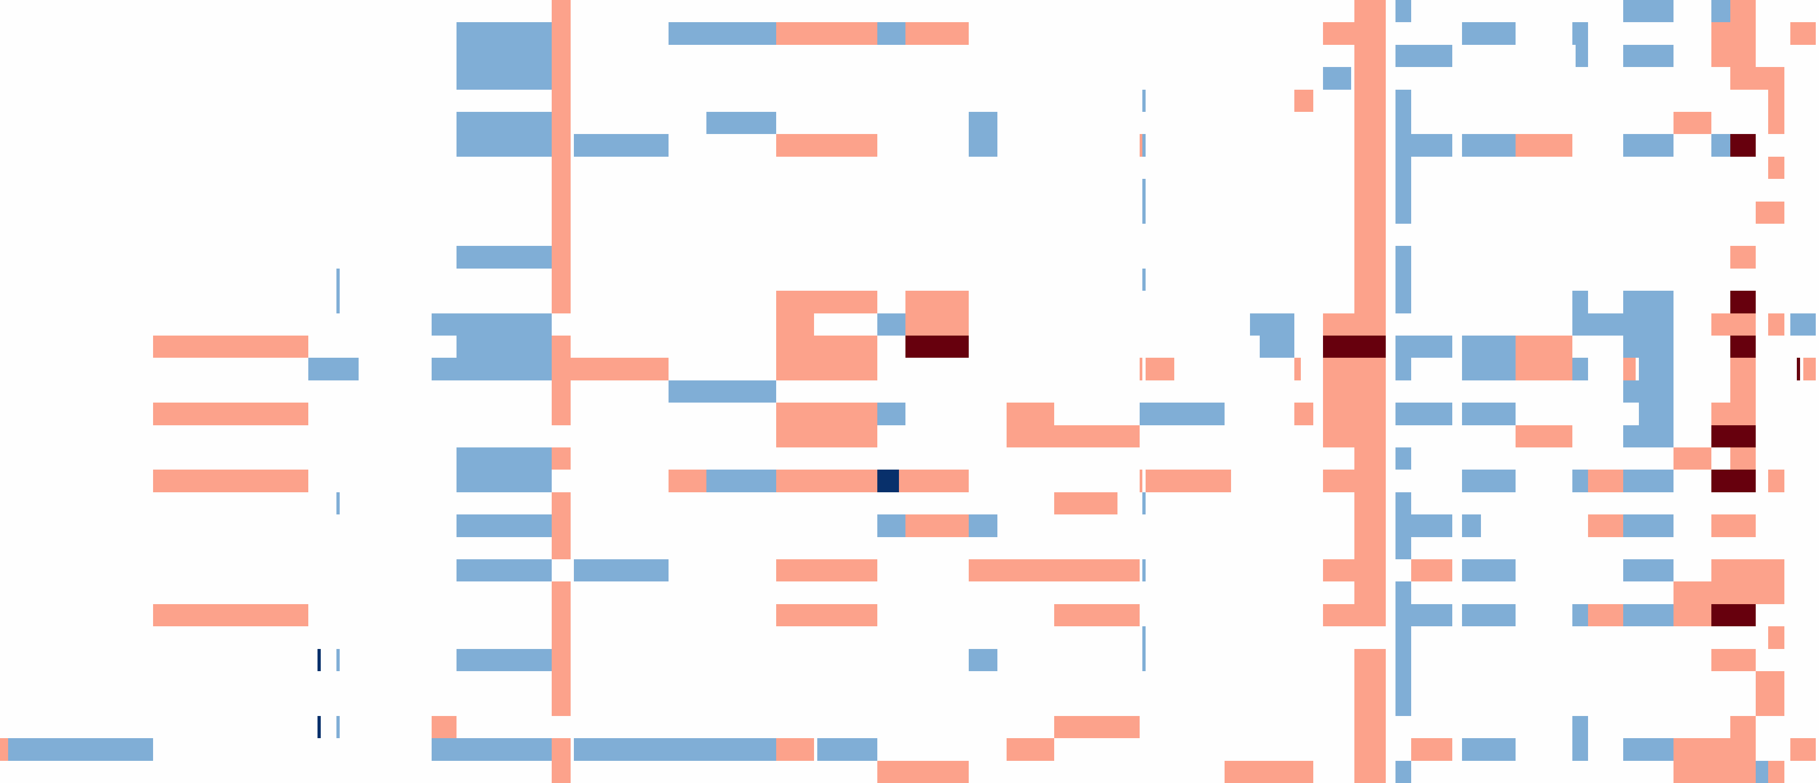
Genome-wide copy number landscape (samples × 5 Mb bins; chromosomes 1–22 + X)
Fig 2E(alt) — CNV genome view
1
2
3
4
5
6
7
8
9
10
11
12
13
14
15
16
17
18
19 20 21 22
Resp.
1-PR
26-P
32-P
33-P
34-P
22-P
21-P
35-P
18-P
19-P
4+
15-P
(amp)
7-PR
13-PR
12-PR
3
11-PR
(gain)
10-PR
5-PR
2
Copy number
30-P
(neutral)
4-PR
6-PR
31-P
1
3-PR
(loss)
25-P
28-P
0
27-P
(homo del)
8-PR
24-P
23-P
20-P
2-PR
17-P
16-P
14-PR
29-P
9-PR

Slide 15
HRD genomic scar breakdown (matched pre-treatment tumors)
Fig 2F — HRD breakdown
35
LST: good vs bad p = 0.037
30
Component
LST
25
LOH
TAI
20
HRD scar score (LST + LOH + TAI)
15
10
5
0
Resp.
29-P
21-P
3-PR
5-PR
28-P
26-P
8-PR
4-PR
11-PR
10-PR
22-P
23-P
12-PR
2-PR
32-P
7-PR
1-PR
34-P
14-PR
9-PR
25-P
31-P
30-P
24-P
20-P
35-P
6-PR
27-P

Slide 16
Good responders
Fig 3A — TME signature radar
CD8 proliferation *
Poor responders
EMT
CD8 activation
TGF-β
+0.5
Cytolytic activity
0
−0.5
Treg
MHC-I antigen pres.
NK cell
MHC-II †
B cell
IFN-γ (Ayers)
TLS (Cabrita)

Slide 17

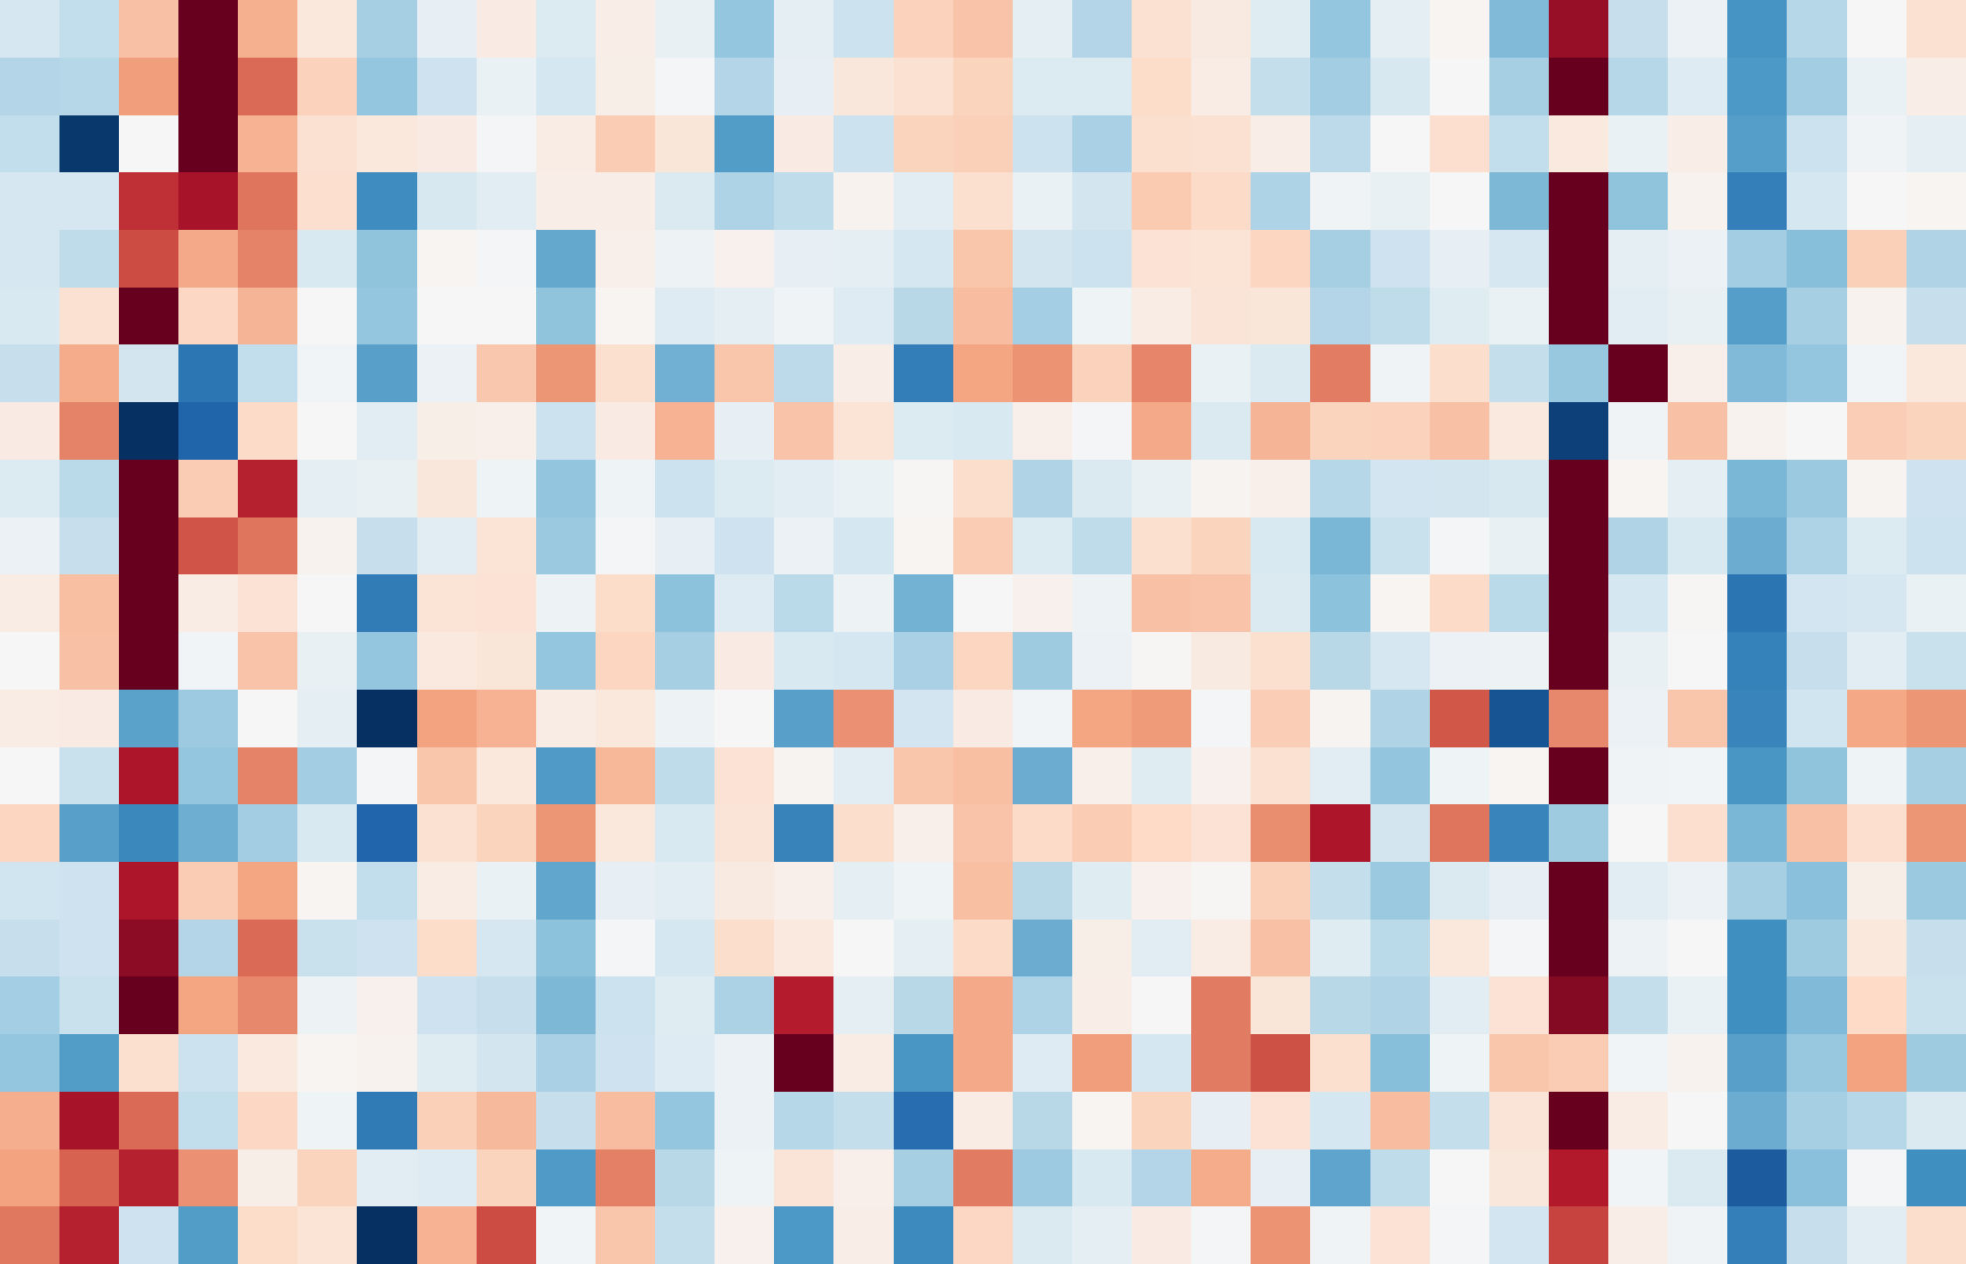
2.5
Fig 3B — 22-signature heatmap
Response
0.0
z-score
cT stage
−2.5
Sex
Age
Signature module
TMB / Mb
Antigen presentation
Antigen presentation
MHC II
B-cell / TLS
NLRC5 HLA IFNG
B cell
TLS Cabrita
Cytotoxic T-cell
CD8 activation
CD8 exhaustion
Hypoxia
CD8 proliferation
Cytolytic activity
IFN response
Hypoxia Buffa
IFNg Ayers 18
Mac M1
Innate
Mac M2
NK cell
Other
Epithelial
Stemness mRNAsi proxy
Checkpoint inhibitory
Regulatory
Treg
CAF iCAF
Stromal/EMT
CAF myCAF
EMT Mak
TGFb Mariathasan
good
T2
T3
Male
Age (gradient)
TMB (gradient)
bad
T2/T3
T4
Female

Slide 18
Fig 3C — DEG volcano
8
Up in Poor responders
Up in Good responders
7
6
5
−log10(p-value)
4
3
2
p = 0.01
Pathway category
Cell cycle
1
DNA repair
Immune
EMT/Stromal
0
−4
−2
0
2
4
log2 fold change (good vs poor)

Slide 19
Fig 3D — Forest lollipop of signatures
CD8 proliferation
p = 0.0351 *
MHC II
p = 0.0746 †
Stemness mRNAsi proxy
p = 0.145
B cell
p = 0.165
Mac M2
p = 0.201
CAF myCAF
p = 0.242
CD8 exhaustion
p = 0.288
Hypoxia Buffa
p = 0.288
Cytolytic activity
p = 0.305
EMT Mak
p = 0.358
NK cell
p = 0.358
Epithelial
p = 0.418
TGFb Mariathasan
p = 0.482
IFNg Ayers 18
p = 0.627
Checkpoint inhibitory
p = 0.653
Mac M1
p = 0.653
Treg
p = 0.653
CAF iCAF
p = 0.787
CD8 activation
p = 0.871
NLRC5 HLA IFNG
p = 0.871
−1.0
−0.5
0.0
0.5
1.0
1.5
2.0
Δ z-score (good − poor), 95 % bootstrap CI

Slide 20
Fig 3E — CD8 effector × exhaustion biaxial
Density
Cytolytic_activity
Cold &
Active &
Exhausted
Exhausted
CD8 exhaustion (z-score)
CD8_exhaustion
Cold tumor
Functional
cytotoxic
good (n=17)
bad (n=16)
CD8 cytolytic activity (z-score)
Density

Slide 21

TLS sig: good vs poor p = 0.957
Fig 3F — TLS Cabrita score
1
(z-score)
TLS sig.
0
−1
Response
MHC-II z
CXCL8
PTGDS
2
CCL18
MS4A1
1
CD79B
LAMP3
z-score
log2(TPM+1)
SELL
0
CXCR5
CCR7
−1
CXCL13
CCL21
−2
CCL19
TNT_RNA_63
TNT_RNA_46
TNT_RNA_38
TNT_RNA_14
TNT_RNA_35
TNT_RNA_50
TNT_RNA_29
TNT_RNA_49
TNT_RNA_44
TNT_RNA_55
TNT_RNA_45
TNT_RNA_57
TNT_RNA_26
TNT_RNA_8
TNT_RNA_52
TNT_RNA_58
TNT_RNA_23

Slide 22
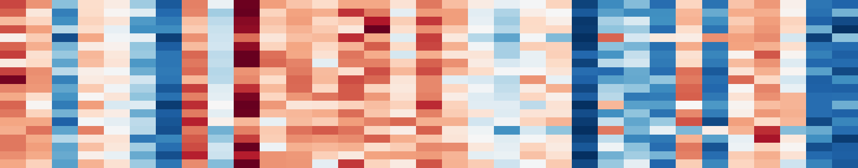

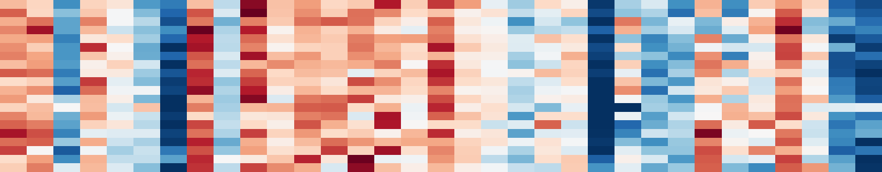

Fig 4A — GSEA running enrichment
E2F targets
0.6
G2M checkpoint
0.6
0.4
0.4
ES
ES
0.2
0.2
NES = +2.78
NES = +2.46
0.0
p = 8e-26
0.0
p = 1.7e-15
Leading
Leading
edge
edge
MKI67
EGF
ESPL1
CENPF
CDC20
MKI67
Top leading-edge
Top leading-edge
genes (n=20)
genes (n=20)
Response
Pre-treatment samples (good ← → poor)
Response
Pre-treatment samples (good ← → poor)
0.6
MYC targets V1
0.0
EMT (mesenchymal)
NES = -2.16
p = 6.1e-10
0.4
−0.2
ES
ES
0.2
−0.4
0.0
NES = +2.36
−0.6
p = 1.1e-13
Leading
Leading
edge
edge
CDC20
COL16A1
CCNA2
TIMP1
NOP56
THBS1
Top leading-edge
Top leading-edge
genes (n=20)
genes (n=20)
Response
Pre-treatment samples (good ← → poor)
Response
Pre-treatment samples (good ← → poor)

Slide 23
Fig 4B — Hallmark NES bubble
25
E2F Targets
Category
Proliferation
DNA repair
Immune
Stromal/EMT
Metabolism
20
Signaling
Apoptosis
Stress
TP53
Other
15
G2M Checkpoint
−log10(p-value)
Myc Targets V1
10
Epithelial Mesenchymal Transit
Myc Targets V2
5
Myogenesis
Mitotic Spindle
Mtorc1 Signaling
Gene set size
p = 0.05
25 genes
100 genes
0
200 genes
−2
−1
0
1
2
3
Normalized enrichment score (NES)
← UP in poor UP in good →

Slide 24
Fig 4C — Reactome pathway dotplot
Source
Epithelial Mesenchymal Transition
Source
Extracellular Matrix Organization
Hallmark
Dna Repair
Reactome
Mitotic Metaphase And Anaphase
M Phase
Mitotic Spindle Checkpoint
Category
Parasite Infection
Mitotic Prometaphase
Stromal/EMT
Dna Replication
DNA repair
Trna Processing
Proliferation
Fceri Mediated Nf Kb Activation
Processing Of Capped Intron Containing Pre Mrna
Other
S Phase
Transport Of Mature Transcript To Cytoplasm
G2 M Checkpoints
Cell Cycle Checkpoints
Fcgr3A Mediated Il10 Synthesis
Dna Double Strand Break Repair
Hdr Through Homologous Recombination Hrr
Homology Directed Repair
Myc Targets V2
Fcgr Activation
Myc Targets V1
G2M Checkpoint
E2F Targets
−2
−1
0
1
2
3
Normalized enrichment score (NES)

Slide 25
Fig 4D — GSEA enrichment map
Category / direction / overlap
E2F Targets
Proliferation
Xenobiotic Metabolism
DNA repair
Il6 Jak Stat3 Signaling
Spermatogenesis
Immune
Kras Signaling Dn
Stromal/EMT
Il2 Stat5 Signaling
Metabolism
Myogenesis
Signaling
Myc Targets V2
Peroxisome
Apoptosis
Pancreas Beta Cells
Stress
Adipogenesis
G2M Checkpoint
TP53
Other
Epithelial Mesenchymal Tr
UP in good (NES>0)
Oxidative Phosphorylation
Notch Signaling
UP in poor (NES<0)
Reactive Oxygen Species P
Myc Targets V1
Fatty Acid Metabolism
overlap = 0.12
overlap ≈ 0.45
Cholesterol Homeostasis
Coagulation
Apical Surface
overlap ≥ 0.65
Angiogenesis
Kras Signaling Up
Tnfa Signaling Via Nfkb
Complement
Glycolysis
Interferon Gamma Response
Interferon Alpha Response
Uv Response Up
Protein Secretion
Apical Junction
Allograft Rejection
Apoptosis
Hypoxia
Inflammatory Response
Heme Metabolism
Estrogen Response Early
Mitotic Spindle
Dna Repair
Tgf Beta Signaling
Mtorc1 Signaling
Bile Acid Metabolism
Wnt Beta Catenin Signalin
Estrogen Response Late
Androgen Response
Pi3K Akt Mtor Signaling
Uv Response Dn
Unfolded Protein Response
Hedgehog Signaling
P53 Pathway

Slide 26
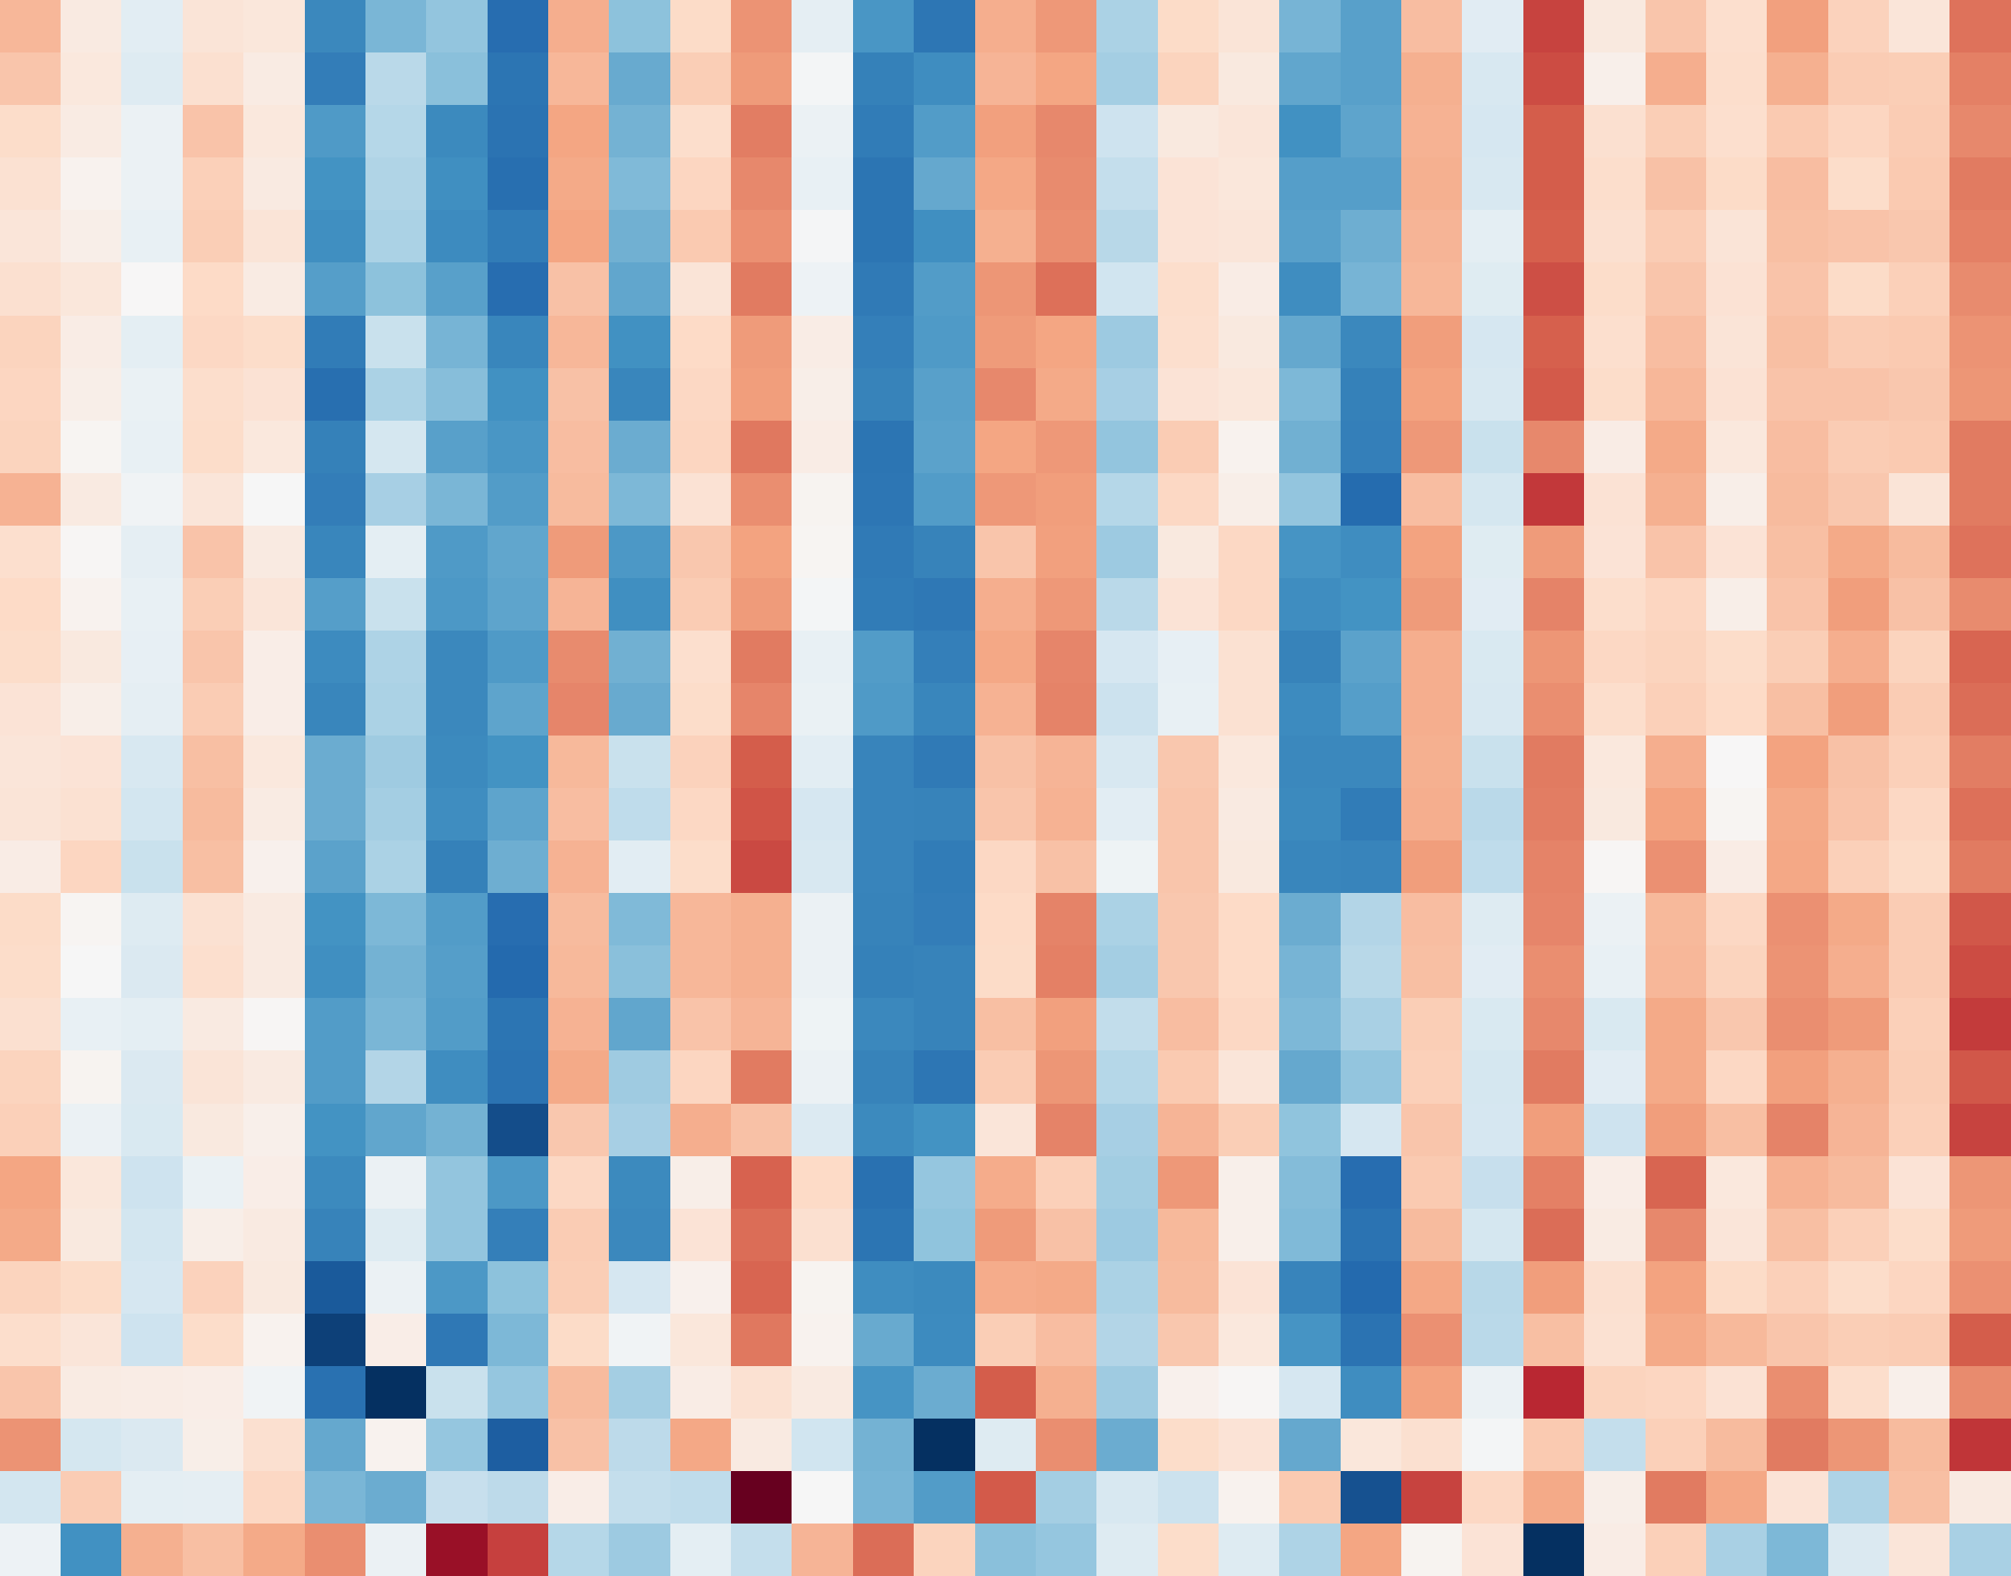

Response
Fig 4E — ssGSEA 95-set heatmap
Adipogenesis
2
Antigen Processing: Ubiquitination And Proteasom
Base Excision Repair
1
Mitotic Spindle
z-score
Myc Targets V2
0
Myc Targets V1
−1
APC/C-mediated Degradation Of Cell Cycle Protein
APC:Cdc20 Mediated Degradation Of Cell Cycle Pro
−2
Processing Of DNA Double-Strand Break Ends
DNA Repair
DNA Double-Strand Break Repair
Pathway category
HDR Thru Homologous Recombination (HRR) Or Singl
Other
Homology Directed Repair
Nucleotide Excision Repair
Immune
Transcription-Coupled Nucleotide Excision Repair
Gap-filling DNA Repair Synthesis And Ligation In
DNA repair
Mismatch Repair (MMR) Directed By MSH2:MSH6 (Mut
Mismatch Repair
Proliferation
Gap-filling DNA Repair Synthesis And Ligation In
PCNA-Dependent Long Patch Base Excision Repair
Mitotic G2-G2/M Phases
S Phase
G2-M Checkpoint
E2F Targets
Defective HDR Thru Homologous Recombination (HRR
HDR Thru Homologous Recombination (HRR)
Defective Homologous Recombination Repair (HRR)
Diseases Of DNA Repair
Cell Cycle Checkpoints
M Phase
Good
Poor

Slide 27
3
Fig 4F — Category-level NES box
NES > 0 ↑ Good
NES < 0 ↑ Poor
2
1
Normalized enrichment score (NES)
0
−1
−2
Proliferation
DNA repair
Apoptosis
Immune
Signaling
Metabolism
Stress
Stromal/EMT
Other
TP53

Slide 28
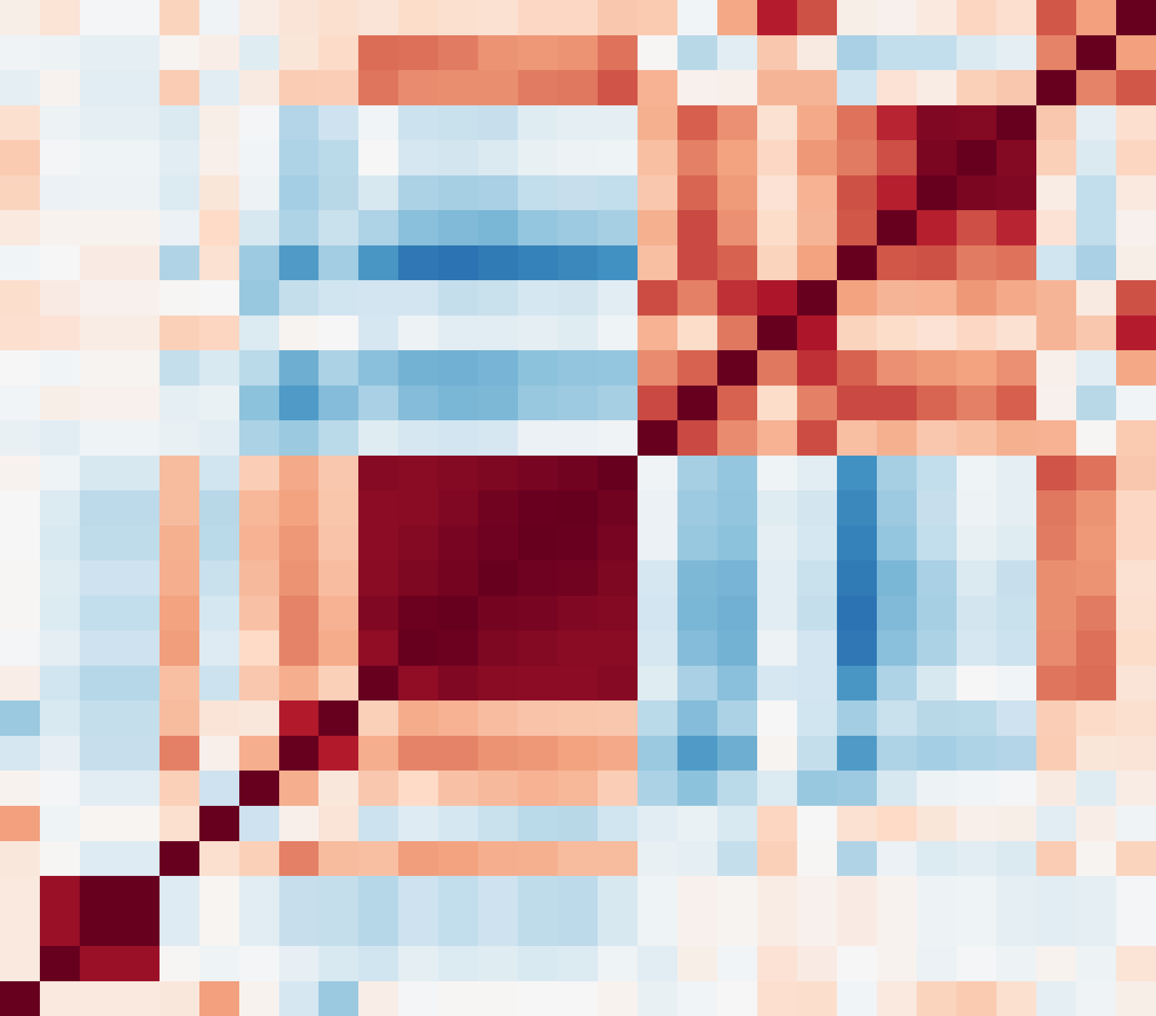
Fig 5A — Feature correlation
age
1.0
SBS5
TMB_nonsyn_per_Mb
0.5
n_nonsyn
MSI_pct
Spearman ρ
0.0
MMR_prop
frac_amp
−0.5
CIN
frac_del
−1.0
Myc Targets V2
DNA Double-Strand Break Repa
Omic group
DNA Repair R-HSA-73894
HDR Thru Homologous Recombin
Clinical
E2F Targets
G2-M Checkpoint
WES genomic
CD8_proliferation
CD8_activation
WES CNV
TLS_Cabrita
MHC_II
RNA pathway
NLRC5_HLA_IFNG
IFNg_Ayers_18
RNA immune
TGF-beta Signaling
Hypoxia
RNA stromal
Epithelial Mesenchymal Trans
TGFb_Mariathasan
Other
EMT_Mak
Hypoxia_Buffa
Stemness_mRNAsi_proxy
Antigen_presentation
age
SBS5
MSI_pct
CIN
frac_del
MHC_II
Hypoxia
n_nonsyn
frac_amp
EMT_Mak
MMR_prop
Myc Targets V2
E2F Targets
TLS_Cabrita
IFNg_Ayers_18
Hypoxia_Buffa
G2-M Checkpoint
CD8_activation
CD8_proliferation
NLRC5_HLA_IFNG
TGFb_Mariathasan
TMB_nonsyn_per_Mb
TGF-beta Signaling
Antigen_presentation
DNA Repair R-HSA-73894
Epithelial Mesenchymal Trans
Stemness_mRNAsi_proxy
DNA Double-Strand Break Repa
HDR Thru Homologous Recombin

Slide 29
Nested outer-LOOCV ROC (N=35, leakage-free)
Fig 5B — Nested LOOCV ROC (v0.7, leakage-free)
1.0
Non-nested (leaked) AUC: 0.755
Nested (honest): 0.65 0.69
0.8
0.6
True Positive Rate
0.4
0.2
LASSO AUC=0.65 [0.45, 0.83]
0.0
ElasticNet AUC=0.69 [0.49, 0.85]
0.0
0.2
0.4
0.6
0.8
1.0
False Positive Rate

Slide 30
Fig 5C — Feature forest with CI
DNA Double-Strand Break Repair R-HSA-5693532
p = 0.00728 **
↑ Good ↑ Poor →
Myc Targets V2
p = 0.0183 *
HDR Thru Homologous Recombination (HRR) R-HSA-5685
p = 0.0202 *
DNA Repair R-HSA-73894
p = 0.0202 *
G2-M Checkpoint
p = 0.0321 *
CD8_proliferation
p = 0.0351 *
E2F Targets
p = 0.0351 *
MHC_II
p = 0.0746 †
MSI_pct
p = 0.145
Stemness_mRNAsi_proxy
p = 0.145
TGF-beta Signaling
p = 0.165
Epithelial Mesenchymal Transition
p = 0.242
Hypoxia
p = 0.272
Hypoxia_Buffa
p = 0.288
frac_amp
p = 0.291
EMT_Mak
p = 0.358
TGFb_Mariathasan
p = 0.482
frac_del
p = 0.499
IFNg_Ayers_18
p = 0.627
MMR_prop
p = 0.72
−1.0
−0.5
0.0
0.5
1.0
1.5
2.0
2.5
Median Δ (good − poor), 95% bootstrap CI

Slide 31
Fig 5D — UMAP of features
good (n=18)
0
bad (n=17)
−2
S10
S32
S5
S21
S6
S24
S30
S2
S12
S4
−4
S27
S9
S3
S31
S25
S14
S28
S26
S29
UMAP dim 2
S1
S11
S33
S22
S20
−6
S23
S8
S15
S7
S19
S17
S13
S18
−8
S16
S35
S34
−10
1
2
3
4
5
6
7
8
UMAP dim 1

Slide 32
Fig 5E — SHAP beeswarm
Myc Targets V2
DNA Double-Strand Break Repair R-HSA-5693532
frac_del
HDR Thru Homologous Recombination (HRR) R-HSA-56
high
MHC_II
DNA Repair R-HSA-73894
frac_amp
Feature value
G2-M Checkpoint
(scaled)
CD8_proliferation
Hypoxia
TLS_Cabrita
E2F Targets
low
age
IFNg_Ayers_18
Antigen_presentation
−0.075
−0.050
−0.025
0.000
0.025
0.050
0.075
0.100
SHAP value (impact on predicted "good responder" probability)

Slide 33
Fig 5F — Per-subject predicted probability
1.0
LASSO LR LOOCV accuracy = 65.7%
True good (n=18)
(predicted good)
True poor (n=17)
Misclassified (n=12)
0.75
0.5
(decision)
0.25
0
(predicted poor)
S24
S3
S30
S26
S9
S4
S28
S2
S27
S14
S11
S31
S6
S29
S20
S7
S33
S1
S12
S32
S25
S21
S15
S17
S18
S13
S5
S22
S34
S23
S35
S8
S19
S16
S10
Subject (ranked by predicted good-responder probability)

Slide 34
Within-group paired
with BCa 95 % CI
Between-group
with BCa 95 % CI
Fig 6A — Cascade BCa forest (v0.7)
(n = 6 good vs 6 7 bad per feature)
CI excluding 0 = robust; else exploratory
missense
good -83 vs bad -1
missense
diff=-77 [-1.1e+02, +40] MW P=0.626 exploratory
SBS5
good -76 vs bad -29
SBS5
diff=-52 [-1.5e+02, +1] MW P=0.041 exploratory
neo_sites
good -59 vs bad -16
neo_sites
diff=-42 [-76, +31] MW P=0.247 exploratory
neo_binders
good -3.1e+02 vs bad -1e+02
neo_binders
diff=-2.1e+02 [-5.3e+02, +1.8e+02] MW P=0.429 exploratory
MHC_II
good +1.2 vs bad +0.36
MHC_II
diff=+0.85 [-0.08, +2.4] MW P=0.065 exploratory
Treg
good +1.3 vs bad +0.028
Treg
diff=+1.2 [+0.06, +2] MW P=0.026 robust
CD8_exhaustion
good +1 vs bad -0.098
CD8_exhaustion
diff=+1.1 [-0.46, +1.9] MW P=0.093 exploratory
TRB_shannon
good +0.34 vs bad +0.011
TRB_shannon
diff=+0.43 [-0.35, +1.4] MW P=0.310 exploratory
IGH_n
good
good +1.4e+03 vs bad +7.5
IGH_n
diff=+1.6e+03 [-2.8e+03, +7e+03] MW P=0.240 exploratory
bad
1.0
0.5
0.0
0.5
1.0
1.5
2.0
1.0
0.5
0.0
0.5
1.0
1.5
2.0
2.5
Standardized
signature (pre
post, z per feature)
Standardized between-group
(good
bad, per feature)

Slide 35
Fig 6B — Paired pre→post slopes
Good responders
Poor responders
Group median
8
Good (paired) p = 0.078
Good (paired) p = 0.12
12000
Good (paired) p = 0.062
3.0
Good (paired) p = 0.031
Poor (paired) p = 0.33
Poor (paired) p = 0.062
Poor (paired) p = 0.69
Poor (paired) p = 1
7
800
2.5
10000
6
2.0
600
8000
5
1.5
4
BCR (IGH) clonotypes (count)
Treg signature (z-score)
TMB (/Mb)
MHC-I binders (<500 nM)
6000
1.0
400
3
0.5
4000
2
0.0
200
2000
1
−0.5
0
0
0
pre
post
pre
post
pre
post
pre
post

Slide 36
Fig 6C — Δ forest
Missense mutations Δ
p = 0.201
Green = favorable in good
Coral = unfavorable
TMB Δ
p = 0.209
SBS5 mutations Δ
p = 0.0407 *
MHC-I neoantigens Δ
p = 0.429
HLA LOH events Δ
p = 0.336
Treg signature Δ
p = 0.026 *
MHC-II signature Δ
p = 0.0649 †
CD8 exhaustion Δ
p = 0.0931 †
IGH (BCR) clonotypes Δ
p = 0.24
−3
−2
−1
0
1
2
3
4
Normalized Δ (good − poor) 95% bootstrap CI

Slide 37
Fig 6D — Per-subject waterfall
Good responder
Poor responder
+26
20
Missense mutations Δ (post − pre)
0
−20
−40
-38
Missense Δ
−60
−80
-66
-83
-81
−100
-97
−120
-114
0
MHC-I neoantigens Δ (post − pre)
−100
−200
-135
Neoantigen Δ
-250
−300
-321
-312
−400
−500
-489
−600
-626
BCR (IGH) clonotypes Δ (post − pre)
+5992
+6296
6000
5000
+4696
4000
+3556
IGH Δ
3000
2000
+1949
1000
0
−1000
-1396
2.0
Treg signature Δ (post − pre)
+2.0
+1.7
+1.8
1.5
+1.5
1.0
+1.0
Treg Δ
0.5
+0.4
0.0
−0.5
-0.5
S7
S12
S1
S11
S5
S10
S13
S6
S9
S2
S8
S4
S14
S3
Subject

Slide 38
Fig 6E — Clonal fishplot
Good responder subjects
Poor responder subjects
S1
S5
S7
S10
k = 2
k = 2
k = 1
k = 2
↓1 ↑0
↓2 ↑0
↓0 ↑0
↓0 ↑0
S11
S12
S13
S2
k = 3
k = 3
k = 2
k = 1
↓0 ↑0
↓2 ↑0
↓0 ↑0
↓0 ↑0
Clonal composition (fraction of tumor cells)
S3
S6
S9
S14
k = 2
k = 3
k = 2
k = 3
↓2 ↑0
↓2 ↑0
↓1 ↑0
↓0 ↑1
pre
post
pre
post
pre
post
pre
post

Slide 39
Fig 6F — Cascade schematic
Pre-treatment LARC tumor
(proliferative · DNA-repair-proficient · HLA-LOH± · neoantigen-presenting)
TNT
(FOLFOX / CAPOX + CRT)
Good responders
Poor responders
Δ missense
Mutation
clearance
Good
Poor
-1
-81
Δ MHC-I binders
Minimal molecular change
Neoantigen
• Δ missense ≈ -1
clone loss
Good
Poor
• Δ neoantigens ≈ -100
-312
-100
• Δ SBS5 ≈ -29
• Δ Treg z ≈ +0.0
Δ SBS5
• Δ IGH ≈ +8
SBS5 mutation
→ Primary treatment
clearance
Good
Poor
insensitivity
-76
-29
+1.3
Δ Treg z
Treg / MHC-II
+0.0
reprogramming
Good
Poor
+1424
Δ IGH count
BCR (IGH)
+8
infiltration
Good
Poor
Partial / minimal response (TRG 2–3)
Complete / near-complete response (TRG 0–1)

Slide 40
CD8-cytotoxic axis: 9-cohort meta + independent convergent study
CD8 effector vs tumor proliferation
Fig 7A — CD8 meta + Akiyoshi (v0.7)
(Akiyoshi et al 2023 JAMA Netw Open)
Signature-level meta across 9 nCRT cohorts
decouple across cohorts
Total independent evidence: >1,000 patients across 10 cohorts
0.4
150082
n=298, OR=3.81 [1.82, 7.97]
45404
GSE216616
GZMA×PRF1 P=0.005
CD8_cytotoxic
p=0.006
(Akiyoshi 2023)
n=39
Tcell_infiltration
p=0.075
0.3
GSE150082
119409
GSE45404
n=42
bad)
n=56
Bcell_infiltration
p=0.118
GSE119409
0.2
n=353
Akiyoshi
GSE87211
Tumor_cellcycle
p=0.191
2023
GSE94104
n=80
CD8_cytotoxic (good
87211
GSE35452
n=46
94104
DSB_HDR_repair
p=0.219
0.1
n=69
35452
GSE46862
46862
GSE56699
n=44
E2F_MYC_cellcycle
p=0.489
56699
GSE133057
n=33
0.0
EMT
p=0.303
Meta Stouffer Z=+2.74
133057
Our 9-cohort meta (N=721)
9-cohort meta
p=0.006 (9 cohorts, N=721)
Akiyoshi 2023 (GSE216616, N=298, paper-level)
Akiyoshi 2023 (CD8 only)
0.6
0.4
0.2
0.0
0.2
0.4
0.6
0.8
2
1
0
1
2
0.4
0.2
0.0
0.2
0.4
0.6
CD8-cytotoxic signature score (good
bad)
Stouffer meta Z
Tumor_cellcycle (good
bad)

Slide 41

0.6
Fig 7B — Signature × cohort heatmap
GSE119409 (n=56)
-0.18
-0.10
-0.12
+0.34
p=0.30
p=0.67
p=0.55
p=0.02*
-0.41
-0.53
-0.48
+0.02
0.4
GSE150082 (n=33)
p=0.02*
p=0.01*
p=0.08
p=0.99
GSE35452 (n=46)
+0.21
+0.23
+0.26
+0.15
0.2
p=0.19
p=0.21
p=0.16
p=0.29
GSE45404 (n=42)
+0.34
+0.28
+0.35
+0.05
Δ z-score (good − bad)
p=0.03*
p=0.08
p=0.14
p=0.84
0.0
GSE68204 (n=43)
+0.07
+0.06
+0.02
-0.14
p=0.66
p=0.60
p=0.62
p=0.49
−0.2
GSE69657 (n=30)
-0.32
-0.37
-0.37
+0.50
p=0.21
p=0.21
p=0.24
p=0.02*
−0.4
GSE94104 (n=40)
-0.02
+0.04
-0.06
-0.07
p=0.94
p=0.51
p=0.94
p=0.63
EMT
−0.6
DSB/HDR repair
E2F/MYC cell cycle
CD8 proliferation

Slide 42
|Z|=1.96
Fig 7C — Meta Z-score across signatures
DSB/HDR repair
Z = -0.15 p = 0.56
E2F/MYC cell cycle
Z = +0.19 p = 0.43
CD8 proliferation
Z = +0.06 p = 0.48
EMT
Z = -1.83 p = 0.97
-3
-1.96
0
1.96
3
Stouffer Z (positive = supports discovery direction)

Slide 43
Fig 7D — Cohort concordance
GSE68204
4/4 (n=43)
GSE35452
3/4 (n=46)
GSE45404
3/4 (n=42)
GSE94104
2/4 (n=40)
GSE69657
0/4 (n=30)
GSE150082
0/4 (n=33)
GSE119409
0/4 (n=56)
0
25
50
75
100
Signatures matching discovery direction (%)

Slide 44
DSB/HDR repair
E2F/MYC cell cycle
Fig 7E — Funnel plot
0.00
0.00
0.05
0.05
0.10
0.10
0.15
0.15
0.20
0.20
Standard error
Standard error
0.25
0.25
0.30
119409
35452
45404
0.30
119409
35452
45404
68204
68204
0.35
150082
94104
0.35
150082
94104
69657
69657
0.40
pooled Δ = -0.02
0.40
pooled Δ = -0.03
Δ z-score (good − bad)
Δ z-score (good − bad)
CD8 proliferation
EMT
0.00
0.00
0.05
0.05
0.10
0.10
0.15
0.15
0.20
0.20
Standard error
Standard error
0.25
0.25
0.30
119409
35452
0.30
35452
119409
45404
45404
68204
68204
0.35
150082
94104
0.35
94104
69657
150082
69657
0.40
pooled Δ = -0.02
0.40
pooled Δ = +0.12
−1.0
−0.5
0.0
0.5
1.0
−1.0
−0.5
0.0
0.5
1.0
Δ z-score (good − bad)
Δ z-score (good − bad)
Cohort agrees with discovery
Cohort disagrees
95% pseudo-CI (null = 0)
Inverse-variance pooled Δ

Slide 45
Cohort-level effect sizes
Meta-analytic pooled effect
Concordance (cohorts · pooled)
Fig 7F — Discovery vs external effects
DSB/HDR repair
Δ = -0.02
3/7
✗
Z = -0.15
p = 0.56
E2F/MYC cell cycle
Δ = -0.03
4/7
✓
Z = +0.19
p = 0.43
CD8 proliferation
Δ = -0.02
3/7
✓
Z = +0.06
p = 0.48
EMT
Δ = +0.12
2/7
✓
Z = -1.83
p = 0.97
−1.0
−0.5
0.0
0.5
1.0
−1.0
−0.5
0.0
0.5
1.0
Per-cohort Δ z-score
Pooled Δ (inverse-variance)

Slide 46
HLA-A (top 10)
HLA-B (top 10)
HLA-C (top 10)
Fig 8A — HLA allele frequency
A*24:02:01:01
18
B*46:01:01
6
C*01:02:01
12
A*33:03:01
12
B*51:01:01
6
C*14:02:01
6
A*02:01:01:01
10
B*15:01:01:01
6
C*03:04:01:01
5
A*31:01:02
4
B*54:01:01
4
C*03:03:01
5
A*11:01:01
4
B*44:03:02
4
C*04:01:01:01
4
A*02:07:01
2
B*58:01:01
3
C*07:06
4
A*30:04:01
1
B*40:06:01:01
3
C*03:02:01
3
A*26:01:01
1
B*13:01:01
3
C*08:01:01
3
HLA03199_HLA00005
1
B*56:01:01
2
C*07:02:01:01
3
A*02:10
1
B*44:03:01
2
C*06:02:01:01
2
heterozygous allele count
from homozygous genotype
0.0
2.5
5.0
7.5
10.0
12.5
15.0
17.5
20.0
0
1
2
3
4
5
6
7
0
2
4
6
8
10
12
14
Allele count (2 × n_patients)
Allele count (2 × n_patients)
Allele count (2 × n_patients)

Slide 47
14
Fig 8B — HLA homozygosity by response
Mann–Whitney p = 0.04
12
(good mean=0.31, bad mean=0.00)
12
11
10
good (n=16)
bad (n=12)
8
Number of patients
6
5
4
2
0
0
1
2
3
# homozygous HLA class-I loci

Slide 48
Fisher p = 0.17
Fig 8C — HLA LOH
response
bad
2/36 (6%)
HLA-A
■
■
HLA-B
■
■■
■
■■
■
good
7/43 (16%)
HLA-C
S22S32S1 S5 S7S10S11S12S21S26S34S35S3 S4 S9S30S2 S6 S8S14S20S23S24S25S27S28S29S31
0
20
LOH
retained / biallelic
% loci with LOH

Slide 49
p = 0.08
p = 0.85
p = 0.15
Fig 8D — Pre-CRT neoantigen burden
200
120
200
100
150
150
80
# mutation sites with MHC-I binder (<500 nM)
# strong MHC-I binders (<50 nM)
PCN score (HLA-LOH adjusted)
100
60
100
40
50
50
20
0
0
0
good
bad
good
bad
good
bad

Slide 50
Fig 8E — Paired Δ neoantigen binders
100
good (n=5): p = 0.12
good (n=5): p = 0.12
bad (n=6): p = 0.03
good Δ̄ = -48.6
bad (n=6): p = 0.09
good Δ̄ = -23.6
S6
S14
bad Δ̄ = -21.7
bad Δ̄ = -12.7
S9
80
S12
S2
S1
S3
S10
S5
60
S11
S12
S6
# sites with MHC-I binder
# strong binders (<50 nM)
S9
40
S7
S7
S14
S5
S1
S2
S3
S10
20
S11
0
pre
post
pre
post

Slide 51
response
HLA zygosity
Fig 8F — Per-subject neoantigen lollipop
resp
A
B
C
het
het
het
S34
4
het
het
het
S35
24
het
het
het
S7
37
het
het
het
S22
38
het
het
het
S21
47
het
het
het
S11
64
het
het
het
S5
68
het
het
het
S10
69
het
het
het
S26
71
het
het
het
S1
72
het
het
het
S32
75
het
het
het
S12
76
hom
het
het
S20
2
HLA retained
hom
het
het
S27
5
HLA LOH
het
het
het
S31
35
strong binders (<50 nM)
het
het
het
S30
49
homozygous locus
het
hom
het
S8
64
het
het
het
S28
70
het
het
het
S3
71
hom
het
het
S23
73
het
het
het
S2
74
het
het
het
S25
78
het
het
het
S29
81
het
het
het
S9
85
hom
het
het
S14
90
het
het
het
S6
96
het
het
het
S4
118
het
het
het
S24
193
0
25
50
75
100
125
150
175
200
# mutation sites with MHC-I binder (pre)

Slide 52
S1 · bad · k=2
S5 · bad · k=2
S7 · bad · k=1
S10 · bad · k=2
Fig 9A — Clone trajectories
pre
post
pre
post
pre
post
pre
post
S11 · bad · k=3
S12 · bad · k=3
S13 · bad · k=2
S2 · good · k=1
pre
post
pre
post
pre
post
pre
post
S3 · good · k=2
S6 · good · k=3
S9 · good · k=2
S14 · good · k=3
pre
post
pre
post
pre
post
pre
post
Clone ribbon (height ∝ cellular prevalence)
Shrinking fate
Stable fate
Expanding fate

Slide 53
Fig 9B — CCF pre vs post
1.0
shrink: 5 stable: 5 expand: 1
shrink: 5 stable: 10 expand: 0
0.8
0.6
Post-TNT cellular prevalence
Post-TNT cellular prevalence
0.4
0.2
0.0
good · n=5 subjects · 11 clones
bad · n=7 subjects · 15 clones
0.0
0.2
0.4
0.6
0.8
1.0
0.0
0.2
0.4
0.6
0.8
1.0
Pre-TNT cellular prevalence
Pre-TNT cellular prevalence

Slide 54
Fig 9C — Cluster stacked composition
S5
2
S12
2
1
S1
1
1
S7
1
S10
2
S11
3
S13
2
S3
2
S6
2
1
S9
1
1
S2
1
S14
2
1
0.0
0.5
1.0
1.5
2.0
2.5
3.0
3.5
# PyClone clusters
Shrinking
Stable
Expanding

Slide 55
Mann–Whitney p = 0.34
Fig 9D — Dominant clone shrinkage
0.0
← no change
−0.2
(more negative = more clearance)
Min Δ CP (post − pre)
−0.4
−0.6
−0.8
good
bad

Slide 56
Fig 9E — Shrink vs expand scatter
good (n=5)
bad (n=7)
2
S14
# Expanding clusters (Δ CP > +0.2)
1
S10
S9
S5
S1
S3
S12
S13
S6
S2
S7
0
S11
0
1
2
3
# Shrinking clusters (Δ CP < −0.2)

Slide 57
Fig 9F — Fate composition by response
good (N=11 clones, 5 subj)
45%
45%
9%
(n=5)
(n=5)
(n=1)
χ² p = 0.35
(fate × response)
bad (N=15 clones, 7 subj)
33%
67%
(n=5)
(n=10)
0
20
40
60
80
100
% of clones
Shrinking
Stable
Expanding

Slide 58

Supp Fig S1 — Cohort QC
1400
0.5
normal
3
7
1200
0.4
1000
Total variants (WES)
0.3
post
7
6
800
Chromosomal instability (CIN)
600
0.2
400
200
0.1
pre
16
17
0
0
10
20
30
40
50
0.0
0
10
20
30
40
50
bad
good
WES samples (sorted)
WES samples (sorted)
response
WES-pre
WES-post
RNA-pre
RNA-post
S1
S2
S3
S4
S5
S6
S7
S8
S9
S10
S11
S12
S13
S14
S15
S16
S17
S18
S19
S20
S21
S22
S23
S24
S25
S26
S27
S28
S29
S30
S31
S32
S33
S34
S35

Slide 59
Supp Fig S2 — SBS signatures full
SBS5
SBS1
SBS6
SBS54
SBS40
SBS39
SBS15
SBS87
other
1.0
0.8
0.6
Relative SBS exposure
0.4
0.2
0.0
1-PO
1-PR
21-P
5-PO
35-P
10-PR
10-PO
11-PO
11-PR
12-PO
12-PR
13-PO
13-PR
15-P
18-P
19-P
22-P
26-P
32-P
33-P
34-P
5-PR
7-PR
7-PO
2-PO
27-P
20-P
3-PO
9-PO
2-PR
14-PO
14-PR
16-P
17-P
24-P
25-P
28-P
29-P
3-PR
30-P
31-P
4-PO
4-PR
6-PO
6-PR
8-PO
8-PR
9-PR
23-P
SBS5
SBS1
SBS6
SBS54
SBS40
SBS39
SBS15
SBS87
SBS30
SBS24
SBS4
SBS18
SBS29
SBS9
SBS93
SBS88
SBS7b
good (median)
SBS31
SBS10b
bad (median)
SBS50
0
10
20
30
40
50
60
70
80
Signature activity (mutations assigned)

Slide 60
Supp Fig S3 — CNV + HRD detail
35
LST
LOH
TAI
30
25
20
HRD proxy subscore
15
10
5
0
15-P
12-PO
13-PO
5-PO
35-P
18-P
19-P
13-PR
7-PO
1-PR
33-P
34-P
7-PR
1-PO
11-PO
10-PO
32-P
12-PR
22-P
10-PR
11-PR
26-P
5-PR
21-P
27-P
8-PO
16-P
17-P
20-P
4-PO
6-PR
2-PO
24-P
30-P
25-P
31-P
9-PO
6-PO
9-PR
14-PR
3-PO
14-PO
2-PR
23-P
4-PR
8-PR
28-P
3-PR
29-P
35
p = 0.62
35
ρ = 0.88, p = 1.3e-16
30
30
25
25
HRD sum (LST + LOH + TAI)
HRD sum
20
20
15
15
10
10
good
bad
good
bad
0.1
0.2
0.3
0.4
0.5
CIN (fraction genome altered)

Slide 61
Supp Fig S4 — Oncoprint + VAF detail
APC
TP53
KRAS
FBXW7
KMT2D
ARID1A
SOX9
SMAD4
AMER1
ATM
TCF7L2
PIK3CA
MSH6
ERBB3
CREBBP
ACVR2A
CTNNB1
GNAS
NOTCH1
POLE
NRAS
POLD1
11-PO
11-PR
21-P
10-PO
10-PR
12-PO
12-PR
22-P
26-P
32-P
1-PO
1-PR
18-P
35-P
7-PR
13-PO
13-PR
15-P
19-P
33-P
24-P
25-P
9-PR
29-P
30-P
14-PO
14-PR
3-PO
3-PR
31-P
28-P
6-PR
8-PR
16-P
17-P
2-PO
2-PR
23-P
4-PR
6-PO
APC
TP53
KRAS
FBXW7
KMT2D
ARID1A
SOX9
SMAD4
AMER1
ATM
TCF7L2
PIK3CA
good
MSH6
ERBB3
bad
CREBBP
0
2
4
6
8
10
12
14
# mutated samples

Slide 62
Supp Fig S5 — Full GSEA supplement
HALLMARK_EPITHELIAL_MESENCHYMAL_TRANSITION q=7.6e-09**
REACTOME_ASSEMBLY_OF_COLLAGEN_FIBRILS_AND_OTHER_MULTIME… q=0.00012**
REACTOME_ELASTIC_FIBRE_FORMATION q=0.00047**
REACTOME_FCERI_MEDIATED_MAPK_ACTIVATION q=0.00028**
REACTOME_FCERI_MEDIATED_CA_2_MOBILIZATION q=0.00026**
REACTOME_MITOTIC_SPINDLE_CHECKPOINT q=7e-05**
REACTOME_PARASITE_INFECTION q=6.1e-05**
REACTOME_SYNTHESIS_OF_DNA q=0.00012**
REACTOME_MITOTIC_PROMETAPHASE q=3.1e-06**
REACTOME_DNA_REPLICATION q=8.4e-06**
REACTOME_TRNA_PROCESSING q=8.1e-05**
REACTOME_FCERI_MEDIATED_NF_KB_ACTIVATION q=6.1e-05**
REACTOME_HDR_THROUGH_SINGLE_STRAND_ANNEALING_SSA q=0.0018**
REACTOME_ROLE_OF_PHOSPHOLIPIDS_IN_PHAGOCYTOSIS q=0.00029**
REACTOME_PROCESSING_OF_CAPPED_INTRON_CONTAINING_PRE_MRN… q=7.3e-08**
REACTOME_CYCLIN_A_B1_B2_ASSOCIATED_EVENTS_DURING_G2_M_T… q=0.0018**
REACTOME_S_PHASE q=8.4e-06**
REACTOME_SUMOYLATION_OF_DNA_REPLICATION_PROTEINS q=0.00059**
REACTOME_CREATION_OF_C4_AND_C2_ACTIVATORS q=0.00023**
REACTOME_CD22_MEDIATED_BCR_REGULATION q=0.00048**
REACTOME_RESOLUTION_OF_D_LOOP_STRUCTURES q=0.00074**
REACTOME_DNA_STRAND_ELONGATION q=0.00048**
REACTOME_TRANSPORT_OF_MATURE_TRANSCRIPT_TO_CYTOPLASM q=5.6e-05**
REACTOME_ACTIVATION_OF_ATR_IN_RESPONSE_TO_REPLICATION_S… q=0.00059**
REACTOME_ACTIVATION_OF_THE_PRE_REPLICATIVE_COMPLEX q=0.00083**
REACTOME_G2_M_CHECKPOINTS q=3e-06**
REACTOME_DISEASES_OF_DNA_REPAIR q=0.00038**
REACTOME_SCAVENGING_OF_HEME_FROM_PLASMA q=0.00011**
REACTOME_CELL_CYCLE_CHECKPOINTS q=7.3e-09**
REACTOME_FCGR3A_MEDIATED_IL10_SYNTHESIS q=2.3e-05**
REACTOME_ROLE_OF_LAT2_NTAL_LAB_ON_CALCIUM_MOBILIZATION q=0.0001**
REACTOME_HOMOLOGOUS_DNA_PAIRING_AND_STRAND_EXCHANGE q=0.00025**
REACTOME_DNA_DOUBLE_STRAND_BREAK_REPAIR q=4.5e-07**
REACTOME_HDR_THROUGH_HOMOLOGOUS_RECOMBINATION_HRR q=6.1e-05**
REACTOME_HOMOLOGY_DIRECTED_REPAIR q=4.5e-07**
HALLMARK_MYC_TARGETS_V2 q=8.1e-06**
REACTOME_FCGR_ACTIVATION q=2.6e-05**
HALLMARK_MYC_TARGETS_V1 q=1.9e-12**
HALLMARK_G2M_CHECKPOINT q=4.4e-14**
HALLMARK_E2F_TARGETS q=4e-24**
Hallmark
Reactome
−2
0
2
4
6
8
10
NES (good − bad)

Slide 63

χ² p = 0.91
Supp Fig S6 — ssGSEA and CMS
Allograft Rejection
100
Interferon Gamma Response
1.00
Inflammatory Response
25%
21%
TNF-alpha Signaling via NF-k
(n=4)
(n=3)
IL-6/JAK/STAT3 Signaling
0.75
80
Coagulation
0.50
Degradation Of Extracellular
Angiogenesis
0.25
29%
Epithelial Mesenchymal Trans
60
31%
(n=4)
Extracellular Matrix Organiz
(n=5)
Spearman ρ
% samples
Pancreas Beta Cells
0.00
TP53 Regulates Transcription
−0.25
Myc Targets V2
40
Defective Homologous Recombi
−0.50
Mismatch Repair (MMR) Direct
31%
43%
(n=5)
(n=6)
Defective HDR Thru Homologou
−0.75
20
Diseases Of DNA Repair
PCNA-Dependent Long Patch Ba
−1.00
E2F Targets
12%
7%
G2-M Checkpoint
(n=2)
(n=1)
0
bad
good
Coagulation
Angiogenesis
Myc Targets V2
E2F Targets
Allograft Rejection
Pancreas Beta Cells
G2-M Checkpoint
Inflammatory Response
Diseases Of DNA Repair
IL-6/JAK/STAT3 Signaling
Extracellular Matrix Organiz
Interferon Gamma Response
Degradation Of Extracellular
TP53 Regulates Transcription
TNF-alpha Signaling via NF-k
Epithelial Mesenchymal Trans
Mismatch Repair (MMR) Direct
Defective Homologous Recombi
PCNA-Dependent Long Patch Ba
Defective HDR Thru Homologou
CMS1
CMS2
CMS3
CMS4

Slide 64
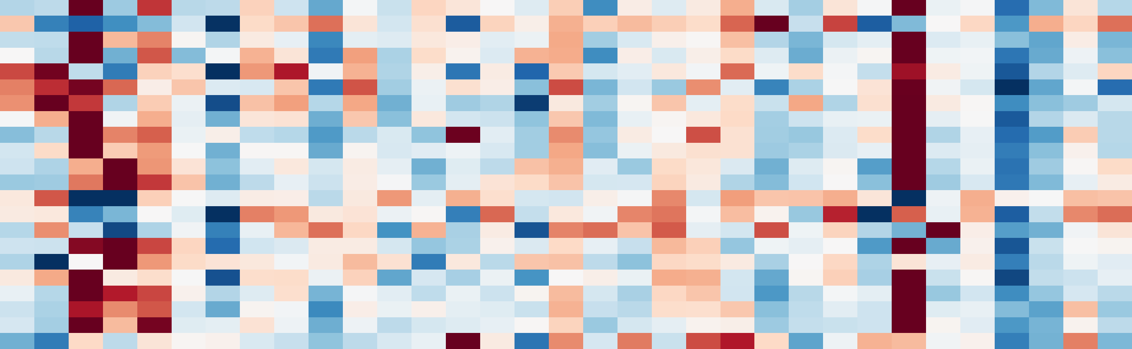
CD8_activation
Supp Fig S7 — TRUST4 immune repertoire
CD8_proliferation
CD8_exhaustion
2
Cytolytic_activity
Antigen_presentation
MHC_II
NLRC5_HLA_IFNG
1
IFNg_Ayers_18
TLS_Cabrita
Checkpoint_inhibitory
TGFb_Mariathasan
z-score
EMT_Mak
0
Epithelial
Hypoxia_Buffa
Stemness_mRNAsi_proxy
−1
CAF_iCAF
CAF_myCAF
Mac_M1
Mac_M2
−2
Treg
NK_cell
B_cell
TNT_RNA_49
TNT_RNA_2
TNT_RNA_5
TNT_RNA_8
TNT_RNA_50
TNT_RNA_63
TNT_RNA_47
TNT_RNA_46
TNT_RNA_43
TNT_RNA_38
TNT_RNA_35
TNT_RNA_54
TNT_RNA_60
TNT_RNA_61
TNT_RNA_20
TNT_RNA_62
TNT_RNA_14
TNT_RNA_29
TNT_RNA_55
TNT_RNA_58
TNT_RNA_57
TNT_RNA_56
TNT_RNA_59
TNT_RNA_11
TNT_RNA_52
TNT_RNA_51
TNT_RNA_45
TNT_RNA_44
TNT_RNA_41
TNT_RNA_26
TNT_RNA_23
TNT_RNA_17
TNT_RNA_53
good
6
bad
4
Value (n-metrics normalized to cohort max)
2
0
TRB clonotypes
TRB Shannon
IGH Shannon
TRB Gini

Slide 65
Supp Fig S8 — ML model comparison
LassoLR
AUC=0.755 Acc=0.66
Myc Targets V2
DNA Double-Strand Break Repair R-HSA-5693532
Hypoxia
HDR Thru Homologous Recombination (HRR) R-HSA-5685942
MHC_II
frac_del
DNA Repair R-HSA-73894
TLS_Cabrita
G2-M Checkpoint
ElasticNetLR
AUC=0.670 Acc=0.69
CD8_proliferation
NLRC5_HLA_IFNG
age
CIN
E2F Targets
frac_amp
IFNg_Ayers_18
MMR_prop
n_nonsyn
TGF-beta Signaling
RF
AUC=0.577 Acc=0.57
Stemness_mRNAsi_proxy
0.4
0.6
0.8
1.0
0.00
0.01
0.02
0.03
0.04
0.05
0.06
0.07
0.08
LOOCV AUC (95% Hanley CI)
RF feature importance (mean decrease Gini)

Slide 66
Supp Fig S9 — GEO cohorts overview
GSE119409
n=56 (15/41)
GSE69657
-0.32
-0.37
-0.37
+0.50
GSE35452
n=46 (24/22)
GSE150082
-0.41
-0.53
-0.48
+0.02
GSE68204
n=43 (12/31)
GSE94104
-0.02
+0.04
-0.06
-0.07
GSE45404
n=42 (19/23)
GSE45404
+0.34
+0.28
+0.35
+0.05
GSE94104
n=40 (12/28)
GSE68204
+0.07
+0.06
+0.02
-0.14
GSE150082
n=33 (13/20)
GSE35452
+0.21
+0.23
+0.26
+0.15
GSE69657
n=30 (13/17)
good
GSE119409
-0.18
-0.10
-0.12
+0.34
bad
0
10
20
30
40
50
DSB
E2F
CD8
EMT
# patients
HDR
MYC
proliferation
repair
cellcycle

Slide 67
Supp Fig S10 — HLA neoantigen detail
5
HLA retained (n=22)
2.8
HLA LOH (n=6)
4
2.6
3
2.4
# samples
% candidate peptides that bind (<500 nM)
2
2.2
2.0
1
1.8
0
4
5
6
7
8
9
good
bad
Neoantigens per mutation site
30
200
good
4 hom
1 hom
0 hom
bad
25
150
20
# patients
100
15
# sites with MHC-I binder
10
50
5
homozygous
heterozygous
0
0
HLA-A
HLA-B
HLA-C
0
1
2
3
# homozygous HLA class I loci

Slide 68
S6
S12
S11
S14
Supp Fig S11 — PyClone diagnostics
3.0
good
0.2
good
2.5
bad
bad
0.0
S9
S5
S3
S10
S1
S13
# PyClone clusters
Dominant Δ CP (expand)
2.0
1.5
−0.2
S7
1.0
S2
−0.4
0
100
200
300
400
500
600
700
−0.8
−0.7
−0.6
−0.5
−0.4
−0.3
−0.2
−0.1
0.0
# mutations fitted
Dominant Δ CP (shrink)
S1
S5
S7
S10
S11
S12
S13
S2
S3
S6
S9
S14
0.0
0.2
0.4
0.6
0.8
1.0
Cellular prevalence

Slide 69
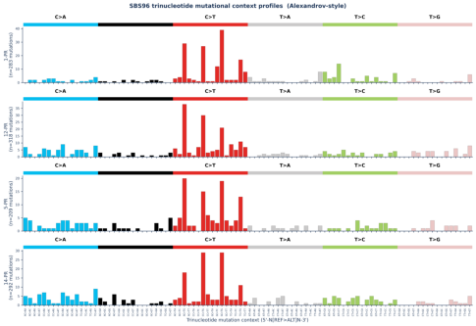
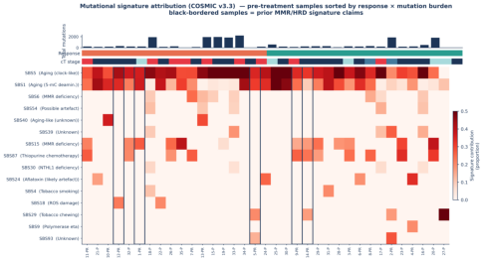
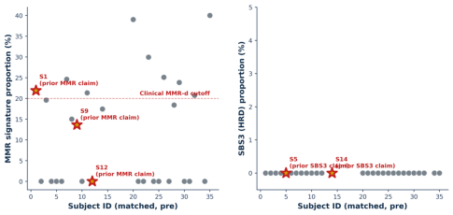
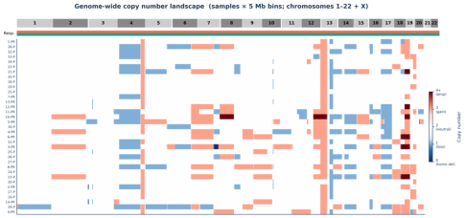
A
Supp Fig — SBS landscape cohort
B
C
D

Slide 70
Supplementary Figure | External validation forest plots (7 GEO cohorts, N=290)
Supp Fig — External cohort forest (legacy)
DSB HDR repair
E2F MYC cellcycle
CD8 proliferation
EMT
GSE119409
GSE150082
GSE35452
GSE45404
GSE68204
GSE69657
GSE94104
−1.5
−1.0
−0.5
0.0
0.5
1.0
−1.5
−1.0
−0.5
0.0
0.5
1.0
−1.5
−1.0
−0.5
0.0
0.5
1.0
−1.0
−0.5
0.0
0.5
1.0
1.5
Δ score (good − bad)
Δ score (good − bad)
Δ score (good − bad)
Δ score (good − bad)

Slide 71
GSE150082 | DSB/HDR repair signature
Supp Fig — GSE150082 DSB detail
0.4
0.2
0.0
−0.2
DSB_HDR_repair
−0.4
−0.6
−0.8
good
bad
(n=16)
(n=0)

Slide 72
Cross-cohort meta-analysis
Supp Fig — External meta Z-score
E2F_MYC_cellcycle
P=0.43
CD8_proliferation
P=0.48
DSB_HDR_repair
P=0.56
EMT
P=0.97
−2
−1
0
1
2
Stouffer's Z (meta, 7 cohorts)

Slide 73
Supp Fig (v0.7) — CONSORT sample flow
Sample flow
TNT discovery cohort (N=35 patients)
Reconciles per-analysis n across WES, RNA-seq, paired, and integrated tables
35 MSS LARC patients enrolled
Age 34 78 (median 60); M 25 / F 10; cT2 T4
Final TNT response (Dworak TRG, post-consolidation)
binary good vs bad
good (TRG 0 1) n=18 | bad (TRG 2 3) n=17
prepost_set = Y (paired)
prepost_set = N (single timepoint)
n=14 patients
n=21 patients
3 samples each (normal/pre-CRT/post-CRT) = 42
30 with normal+pre + 6 pre-only = 36
WES sequenced samples: 77
RNA-seq sequenced samples: 56
(14×3 paired + 36 non-paired; subj 13-N missing)
(27 paired subj 1 14 + 29 non-paired subj 15 35)
Mutect2 somatic calling
DESeq2 DEG / fgsea Hallmark: pre-CRT n=33
49 tumors PASS (41 T-N matched + 8 tumor-only/PoN)
(14 pre-CRT in Y + 19 pre-only in N)
MSI (msisensor-pro): 41 matched
all MSS
ssGSEA (95 pathways): 56 samples
SBS refit: 49 samples
TRUST4 TCR/BCR: 56 samples
CNVkit CNV/CIN: 49 samples
CMScaller / immune 22 sigs: 56 samples
Driver oncoprint, TMB: 49 tumors
Paired pre
post (RNA-derived):
(pre-CRT TMB analysis uses 35 pre-CRT tumors)
12 paired subjects with both timepoints
HLA class I OptiType: 35 subjects (from normals)
(subj 3 pre-only, 11 post-only in RNA)
Paired pre
post (WES-derived):
Paired 22-sig
(Treg/MHC-II/etc):
14 subjects
SBS5
, HLA-LOH (28 tumors)
Both timepoints + matched response = 12
PyClone-VI converged on 12/14 subjects
For response-stratified
: 6 good + 6 bad
(subj 5 post-only, 14 pre-only in 22-sig set)
pVACseq MHCflurry neoantigens: 49 tumors
Paired
binders
11 paired subjects
INTEGRATED PER-SUBJECT MASTER TABLE
(subj 3, 11 excluded: post-CRT VCF incomplete)
35 subjects × 37 features
(WES-derived 17 + RNA-derived 20); imputation only for missing neoantigen on tumor-only subjects
LASSO logistic regression, features = 37
External validation (nCRT meta)
Nested LOOCV (outer 35) + inner 5-fold CV
9 GEO cohorts × 7 signatures
Outer AUC 0.755 (95% CI via bootstrap, perm P reported)
N = 721 patients (long-course CRT, rectal)
DFS / OS analysis DEFERRED
Clinical outcome data not yet mature in this recently-accrued cohort.
TRG-based final TNT response used as endpoint throughout this report.
Fig S1. CONSORT-style sample flow diagram reconciling all per-analysis sample counts. WES branch (blue) includes 77 sequenced samples collapsing to 49 PASS tumor somatic VCFs; RNA-seq
branch (pink) includes 56 samples collapsing to 33 pre-CRT for DEG/GSEA and 12 paired pre/post for
analysis; integration produces a 35×37 subject-level master.

Slide 74
Pre-CRT HLA-LOH prevalence
HLA-LOH clone clearance
Supp Fig (v0.7) — HLA-LOH lite vs strict
(lite vs strict criteria)
4.0
across radiation phase
4.0
4/16
LOHHLA-lite (uncorrected)
Criteria comparison
Bonferroni-corrected strict
3.5
LOHHLA-lite (v0.5 draft):
3.5
| ratio| 0.15
Fisher P < 0.05 uncorrected
3.0
No minimum read-depth filter
3.0
Stricter (v0.7 primary call):
1 HLA-LOH event
2.5
| ratio| 0.20
Bonferroni-corrected P < 0.01
2.5
Tumor / normal depth 30 reads each
2.0
subj 3
Requires normal heterozygosity
2/16
2/12
Effect of stricter criteria:
2.0
Number of HLA class I LOH loci (strict)
10 lite events 2 strict events
1.5
Both strict events in eventual
good responders (subj 3 and 4)
1.5
subj 4
Both show complete pre post
Subjects with
1.0
resolution of LOH clones
1.0
Two-subject nature of strict calls
0.5
means HLA-LOH clearance is reported
as anecdotal corroboration of the
cascade model (see Results §3.7),
0.5
0 loci
not a between-group statistical claim.
0.0
0 loci
Fisher P (good 2/16 vs bad 0/12) = 0.49.
0.0
0/12
0.5
good
bad
pre-CRT
post-CRT

