Slide 1
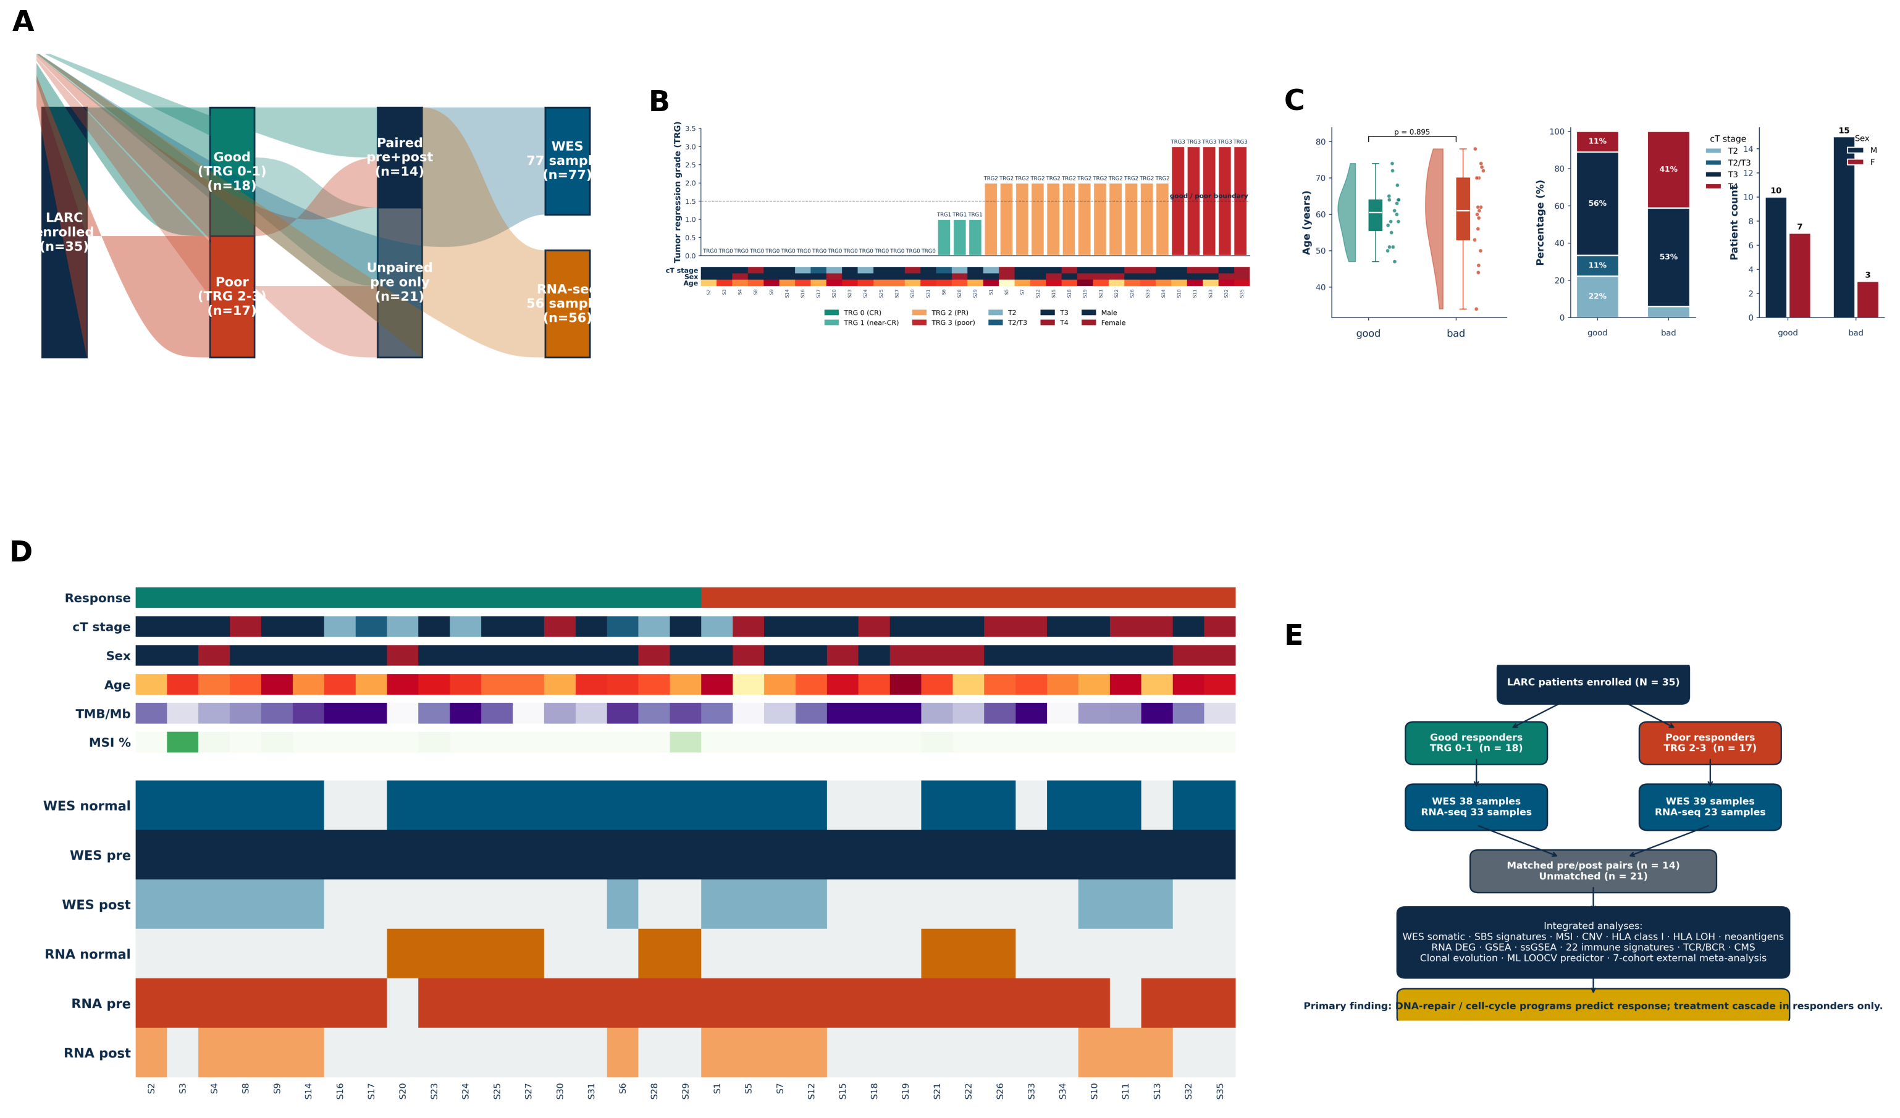
Fig1_cohort

Slide 2
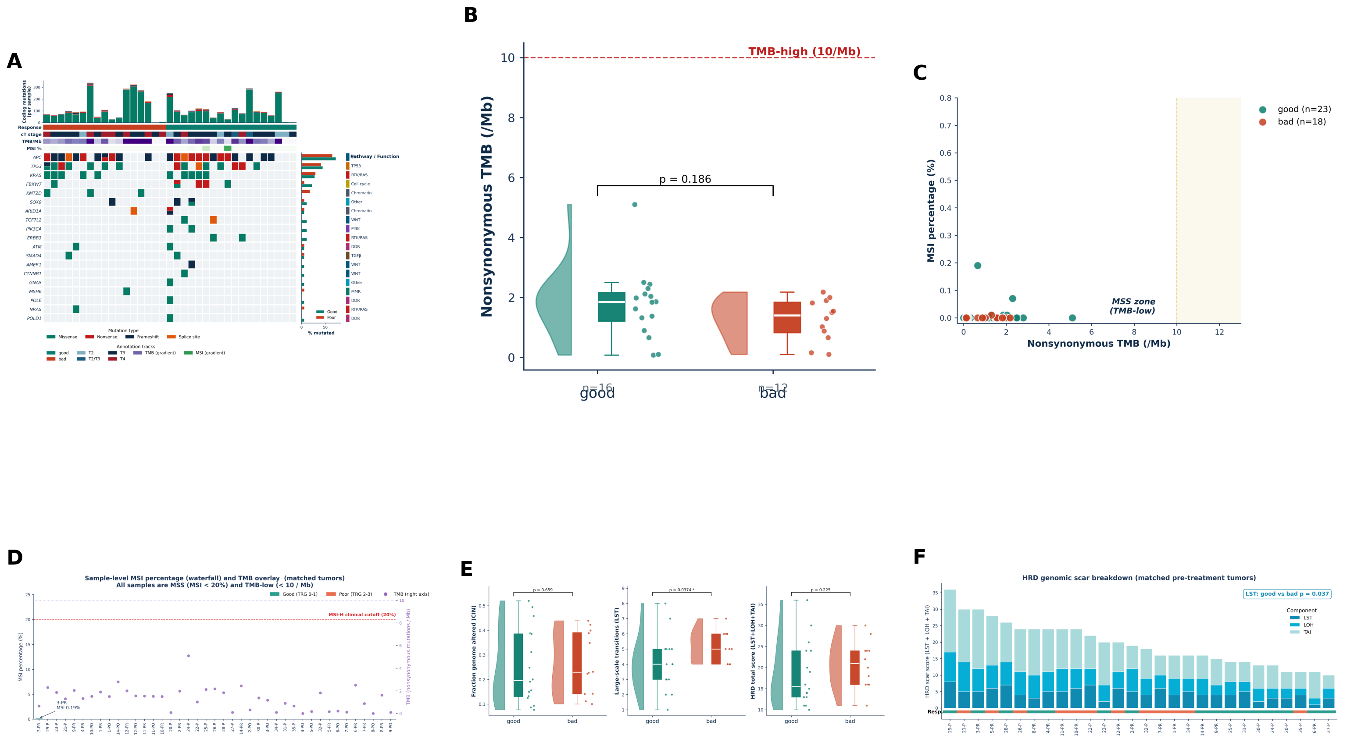
Fig2_WES_landscape

Slide 3
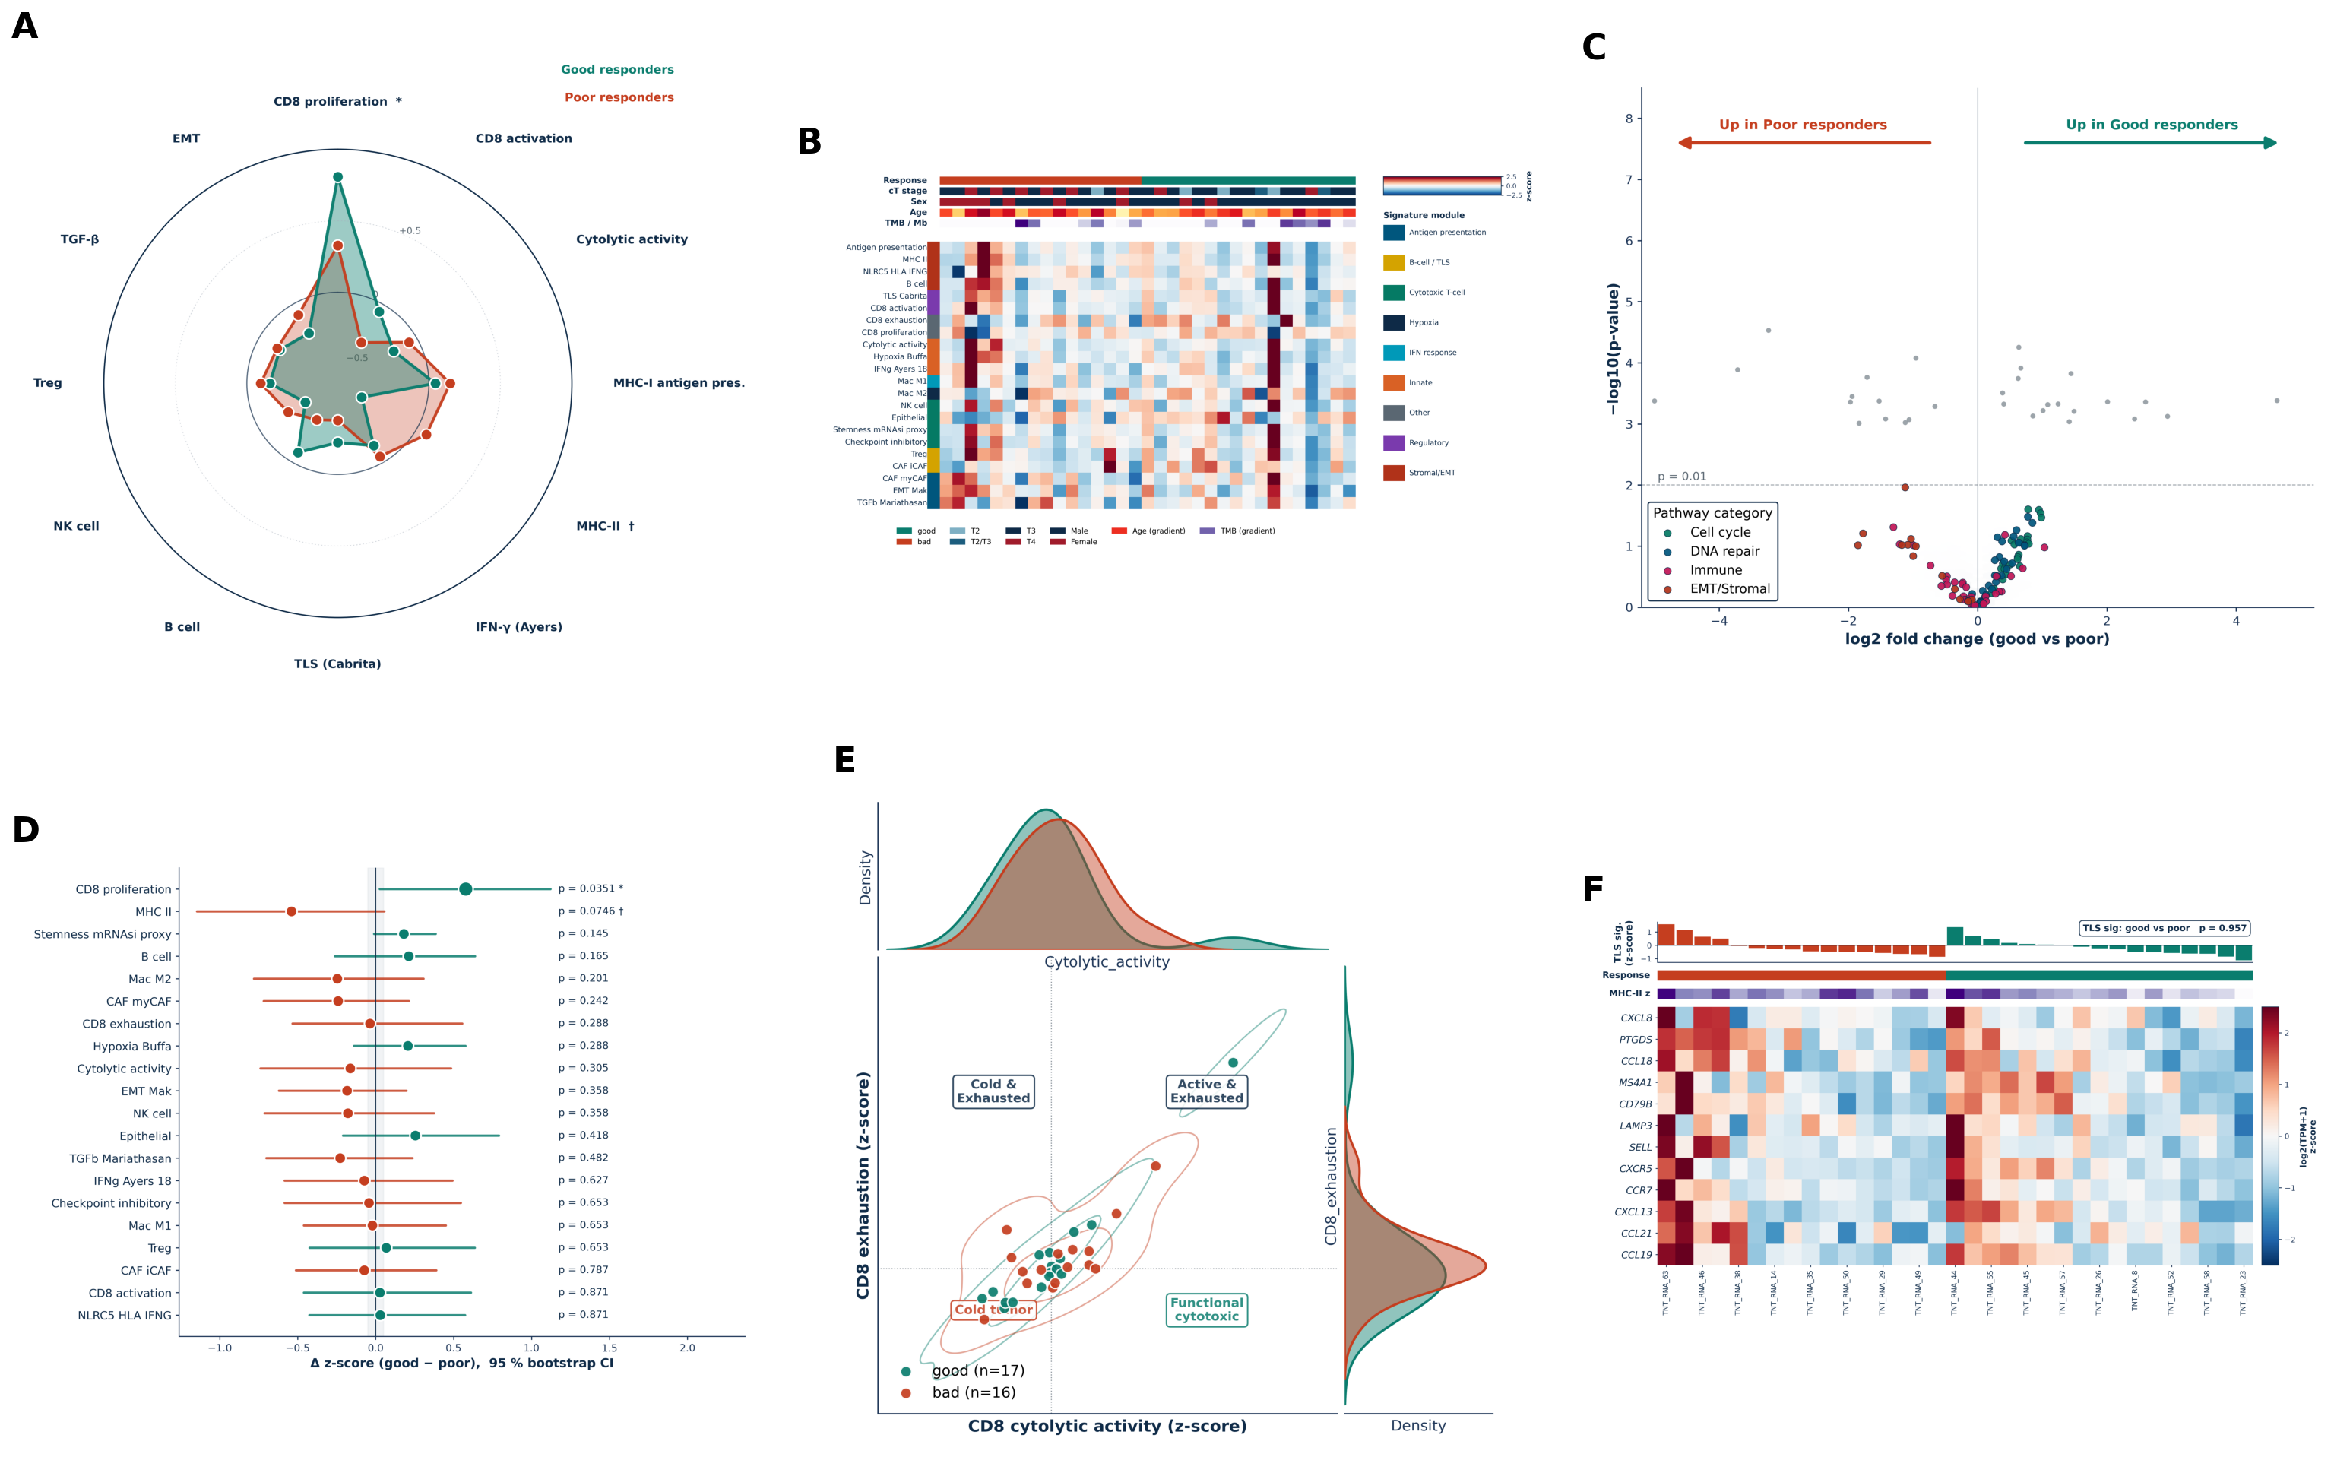
Fig3_RNA_signatures

Slide 4
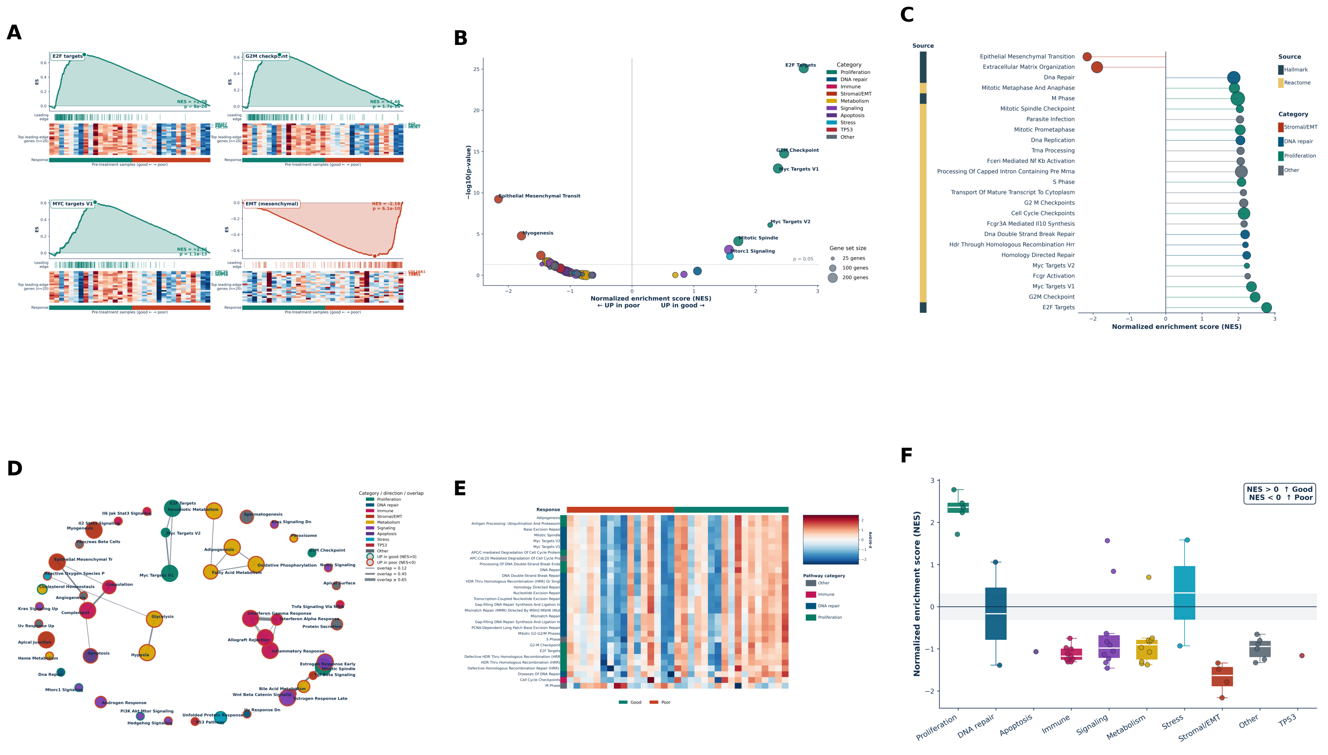
Fig4_GSEA

Slide 5
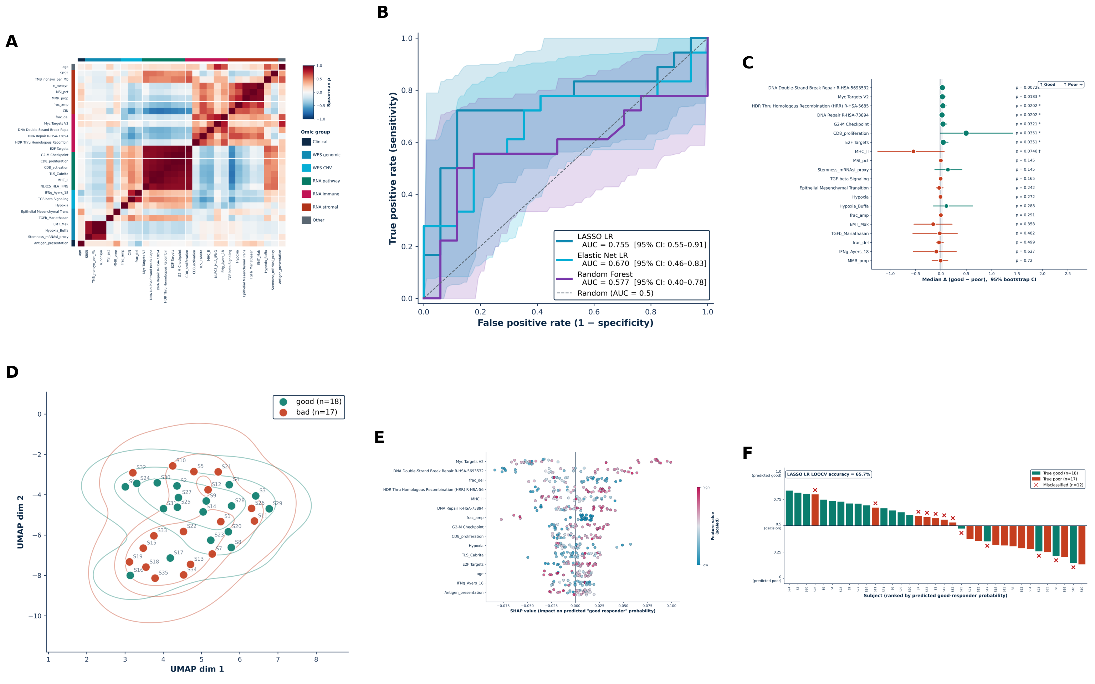
Fig5_ML_predictor

Slide 6
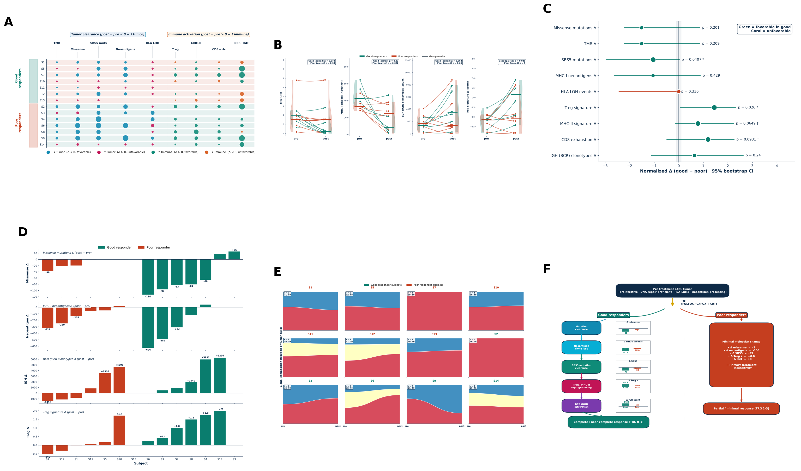
Fig6_paired_delta

Slide 7
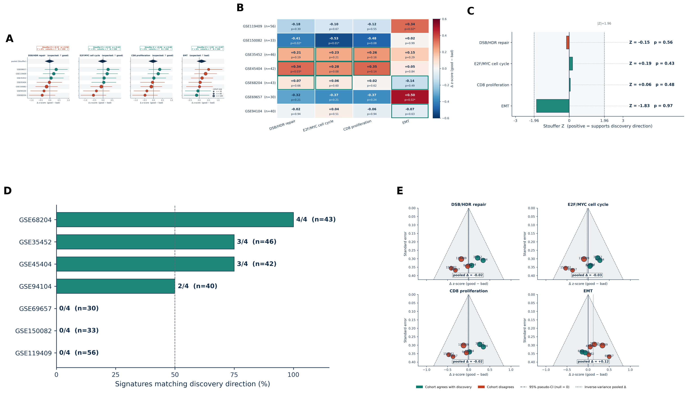
Fig7_external_validation

Slide 8
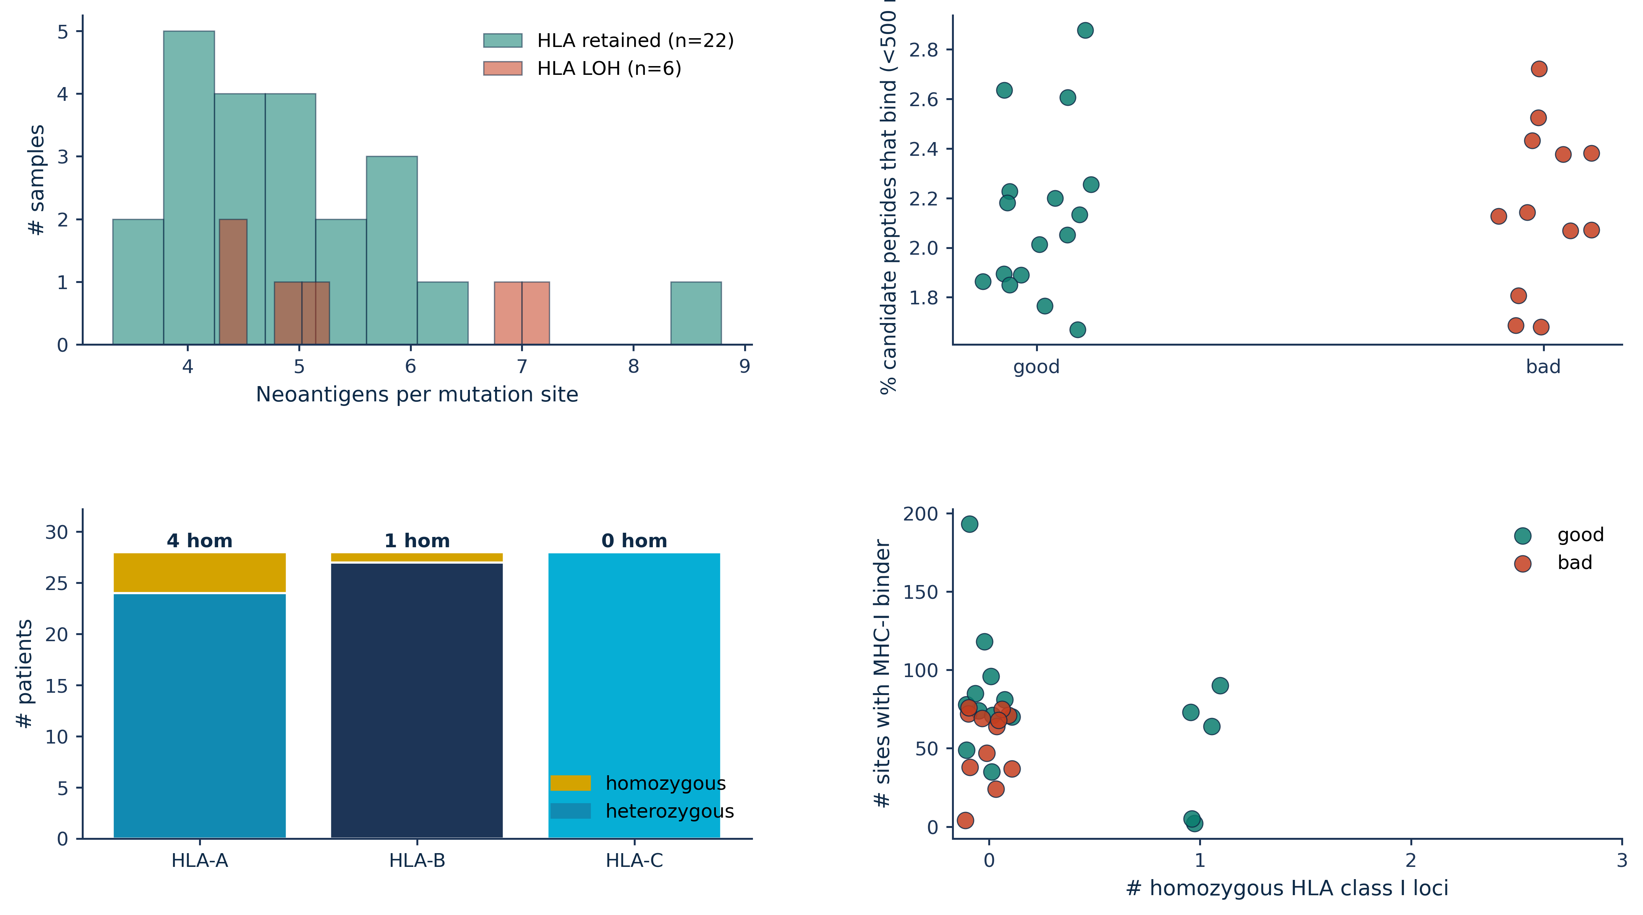
FigS10_HLA_neoantigen_detail

Slide 9
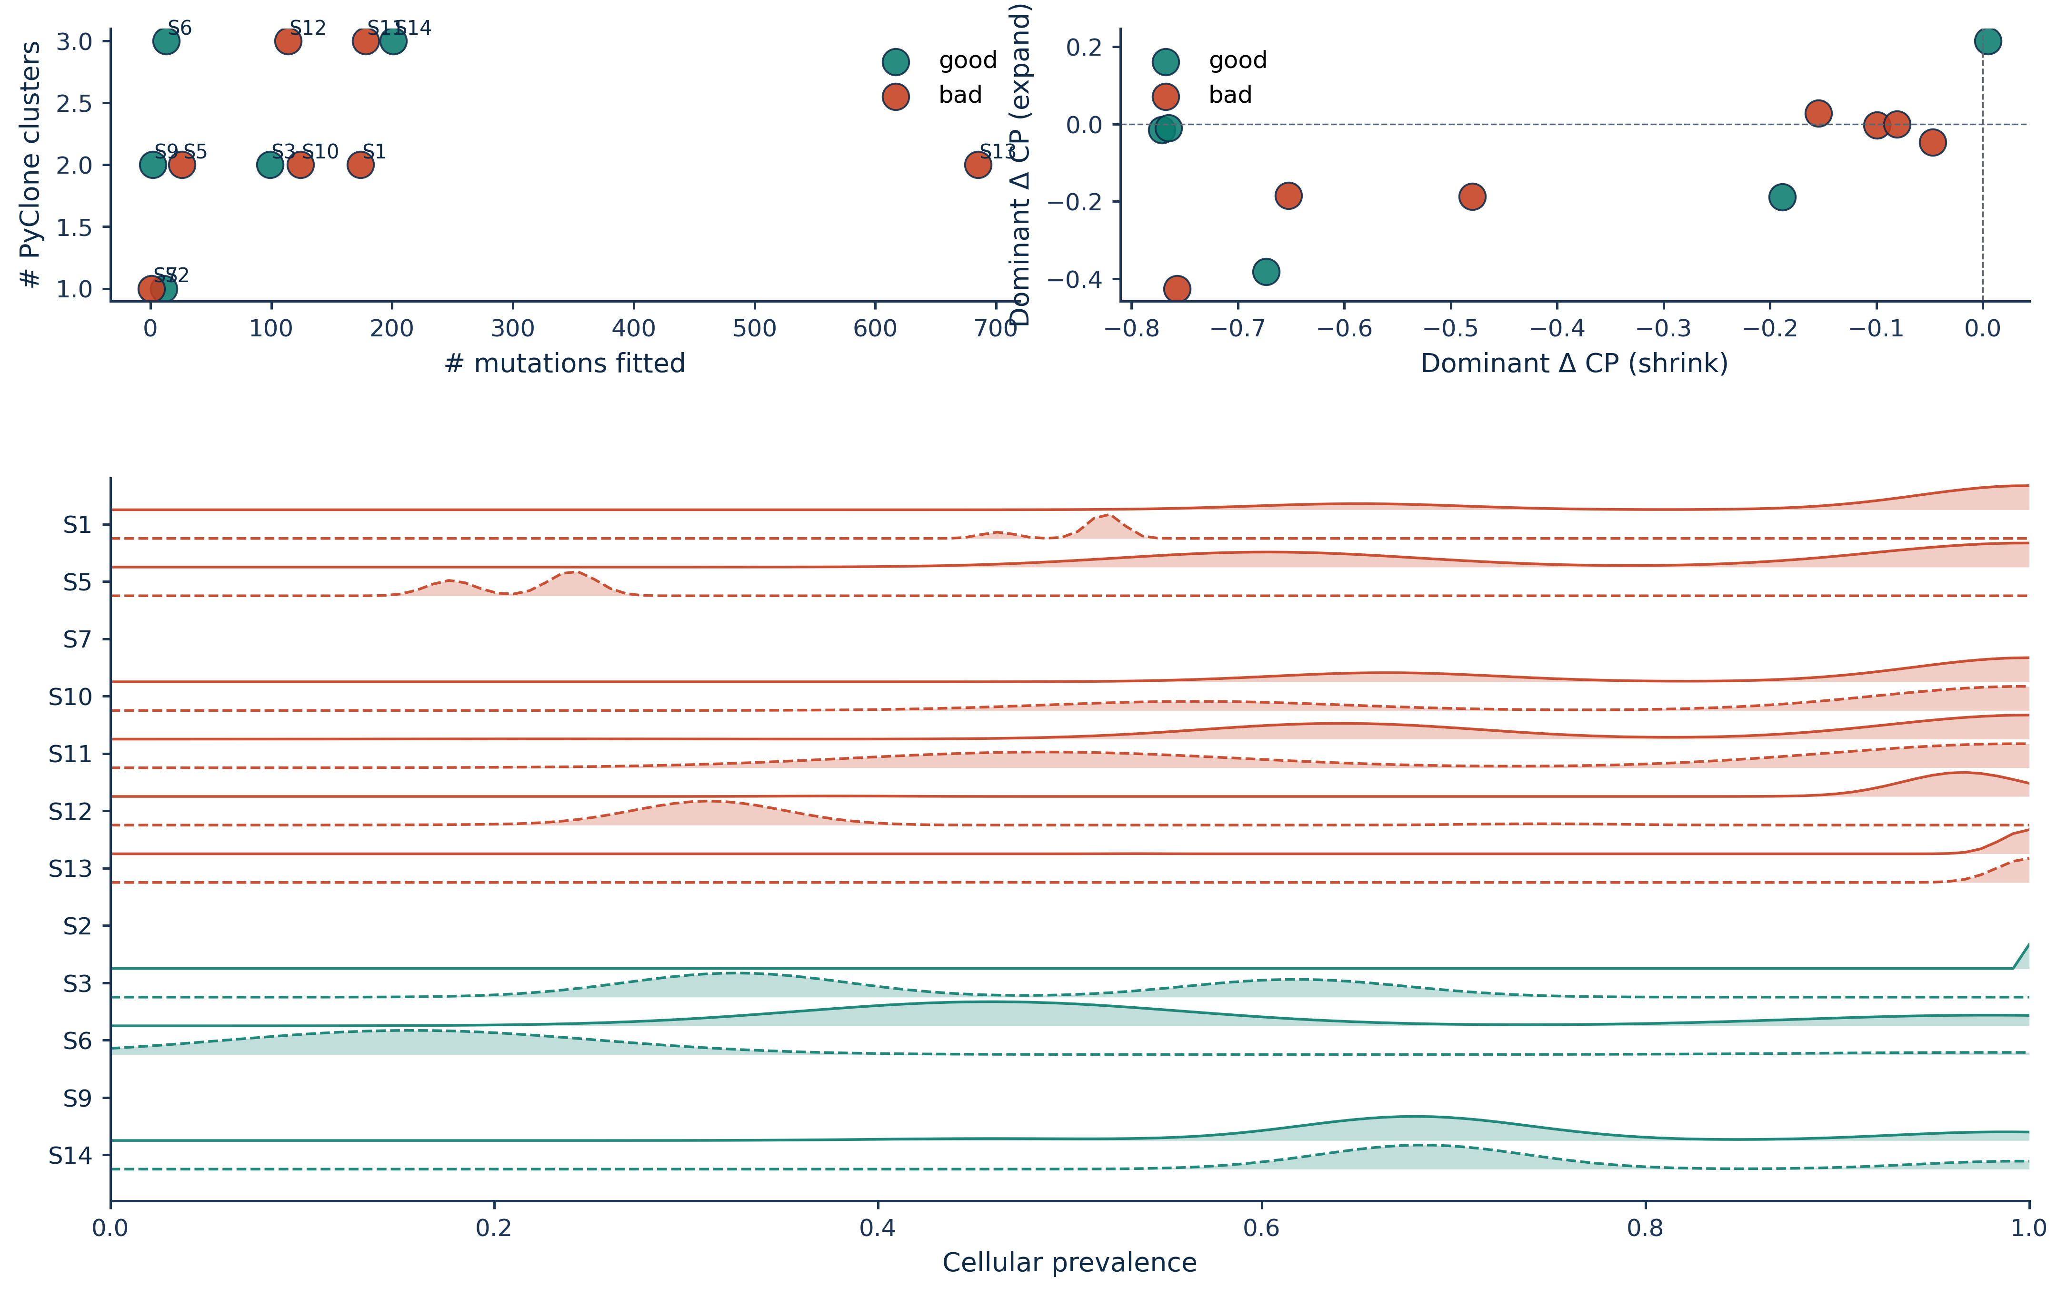
FigS11_pyclone_diagnostics

Slide 10
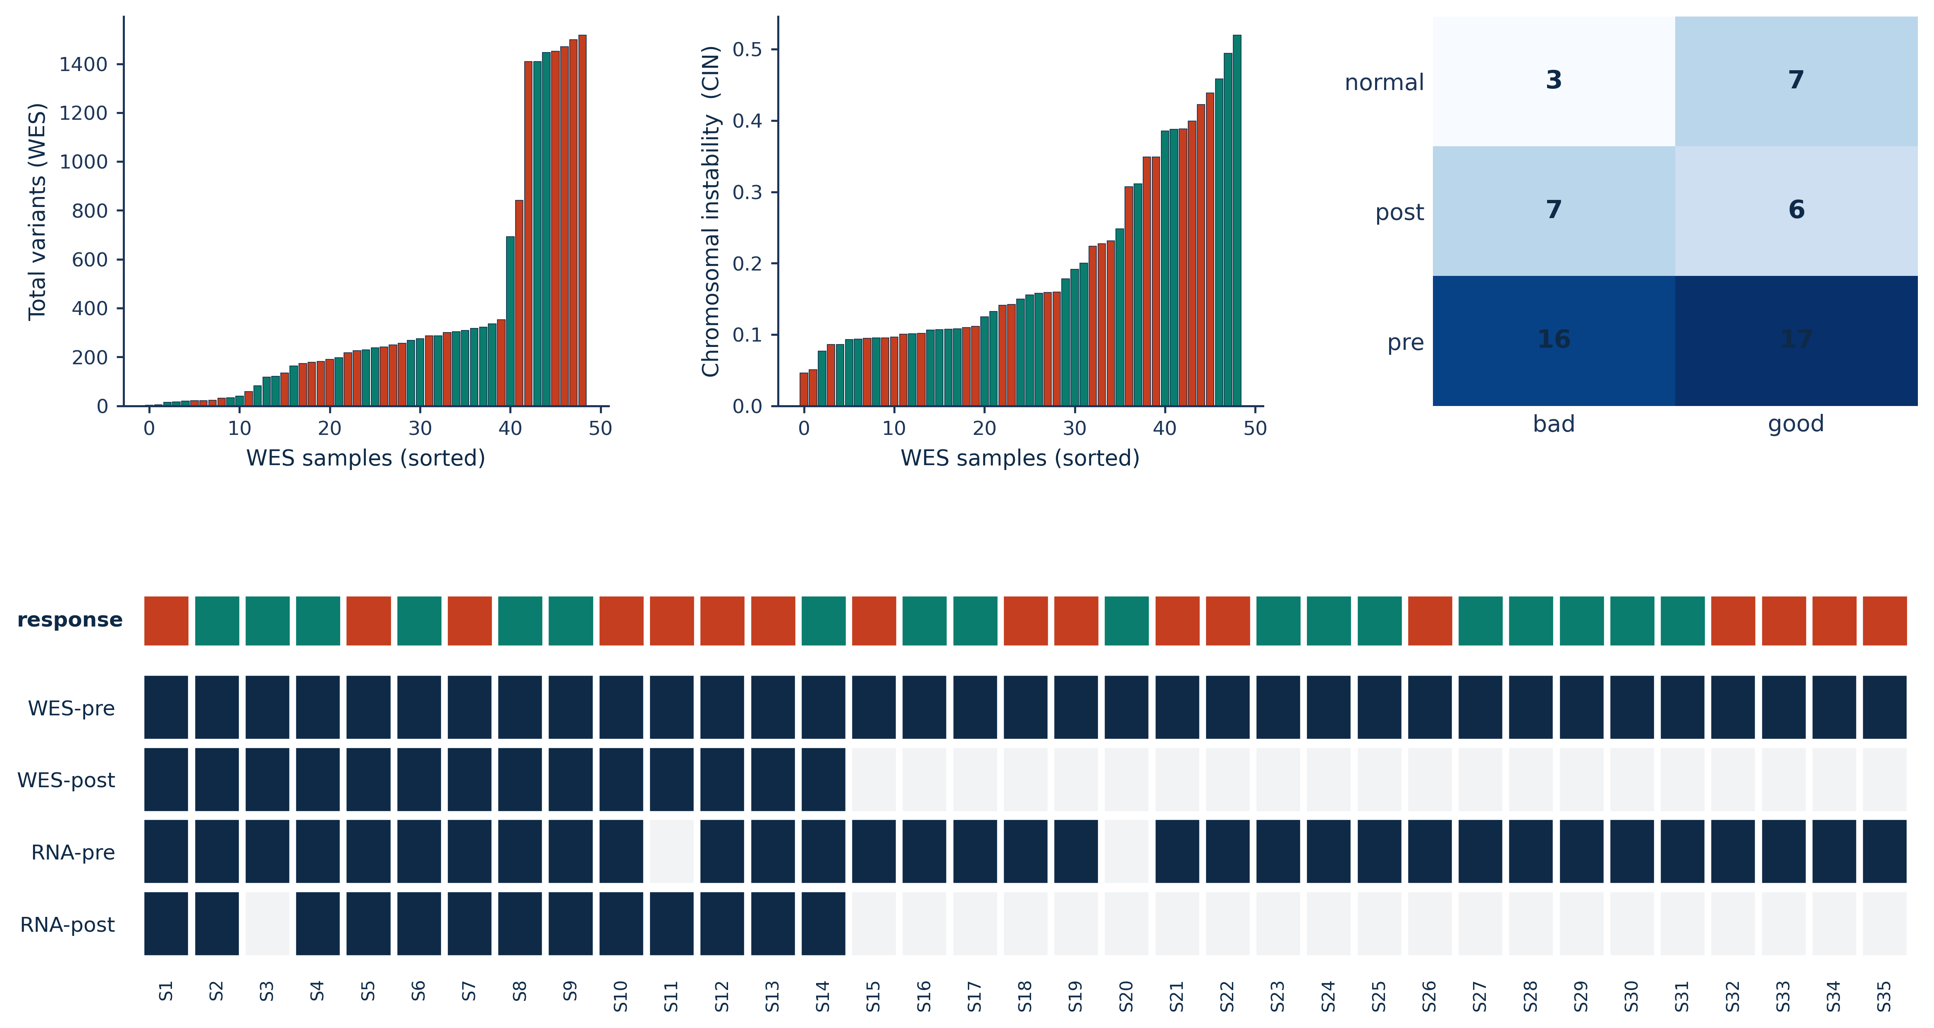
FigS1_cohort_QC

Slide 11
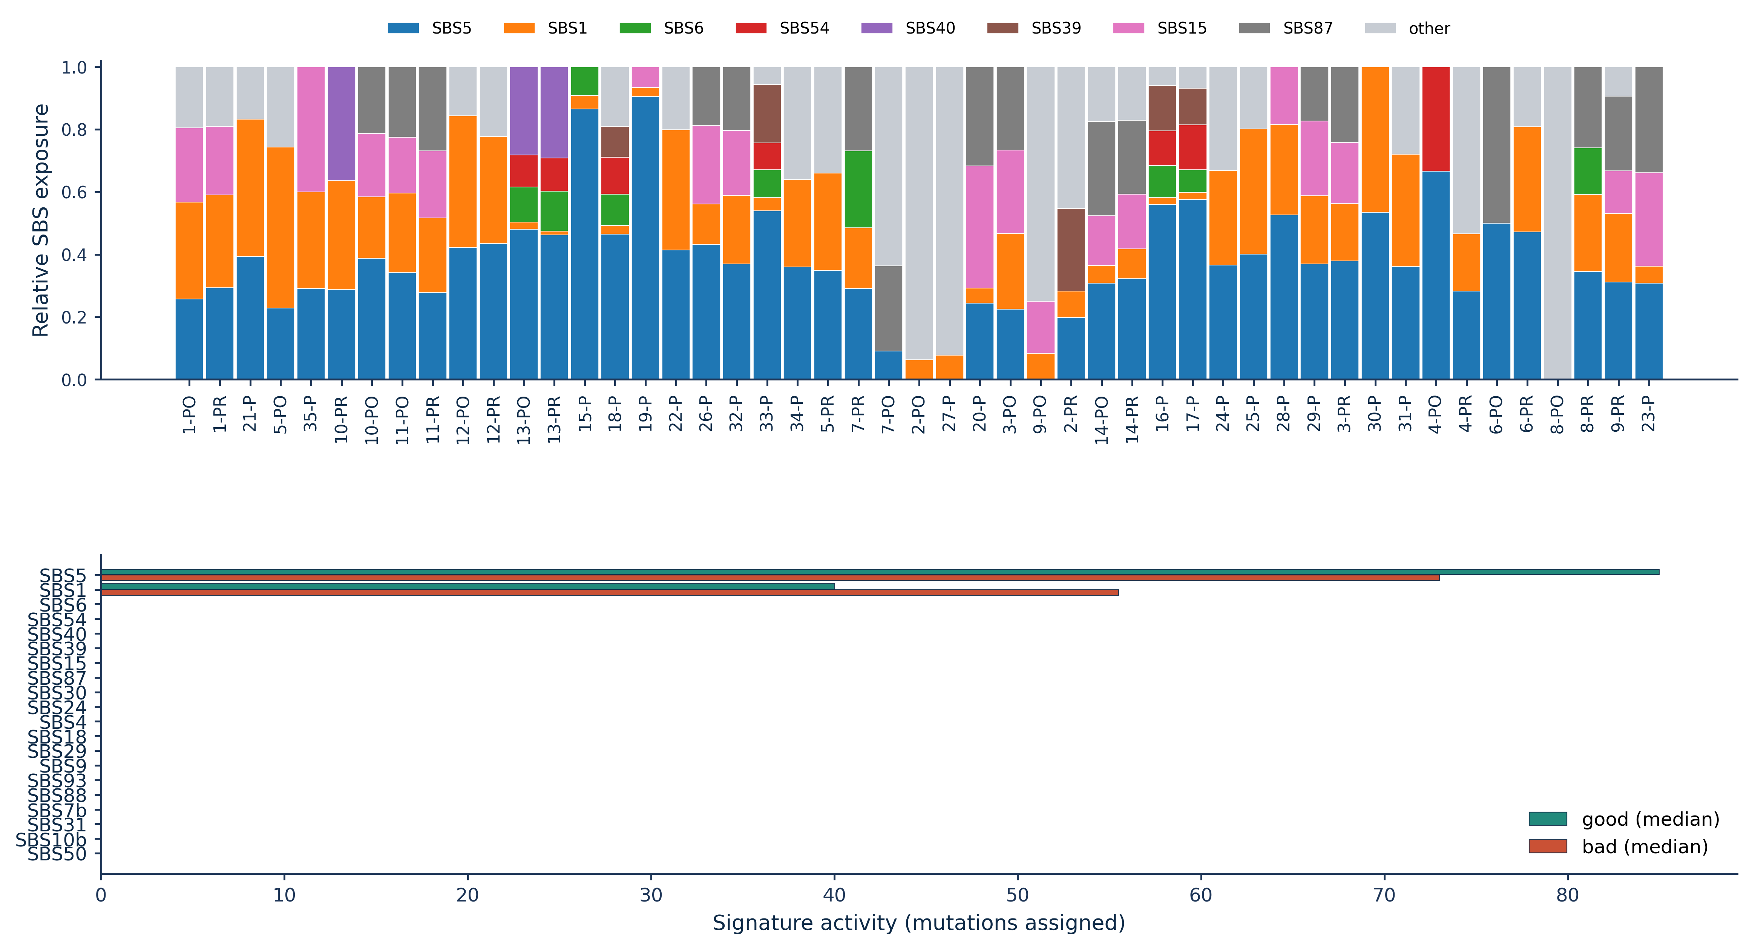
FigS2_SBS_signatures

Slide 12
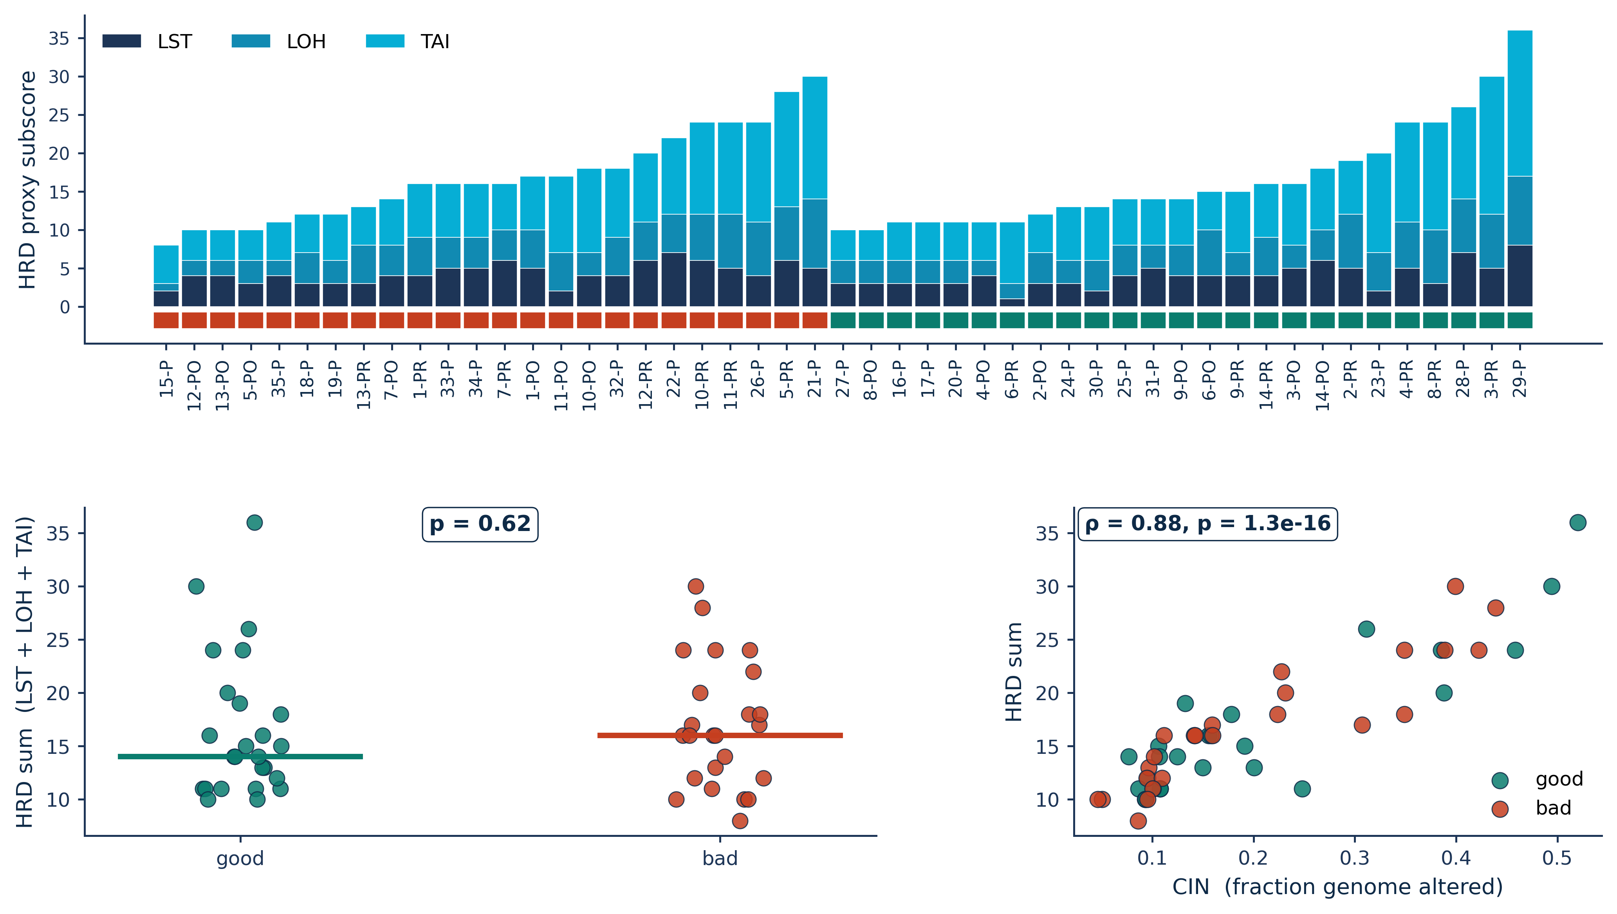
FigS3_CNV_HRD

Slide 13
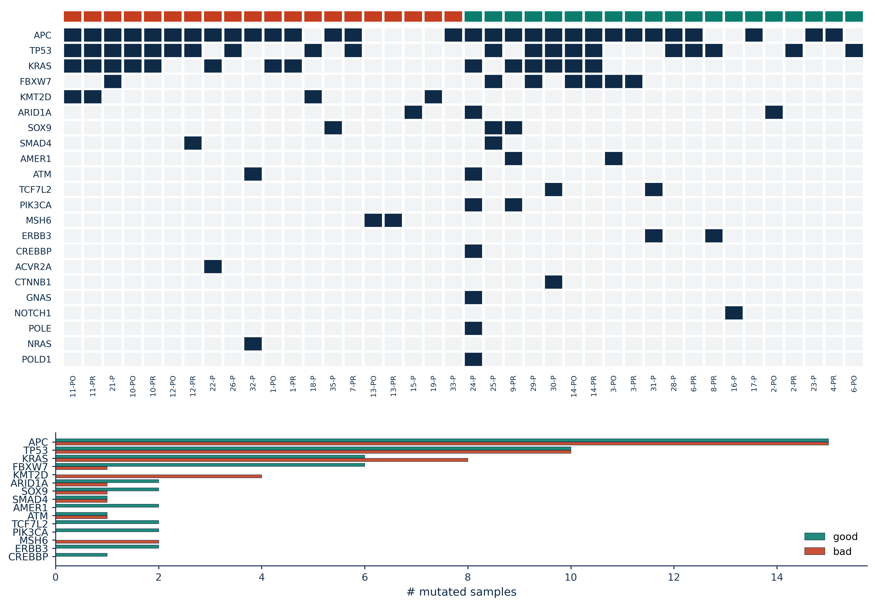
FigS4_oncoprint_VAF

Slide 14
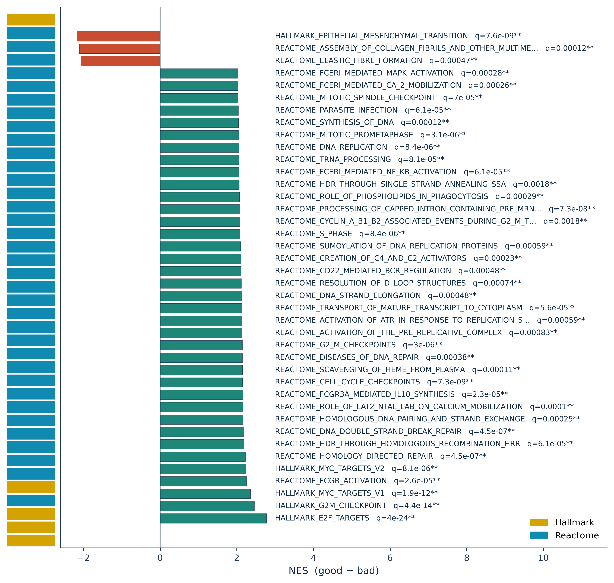
FigS5_GSEA_full

Slide 15
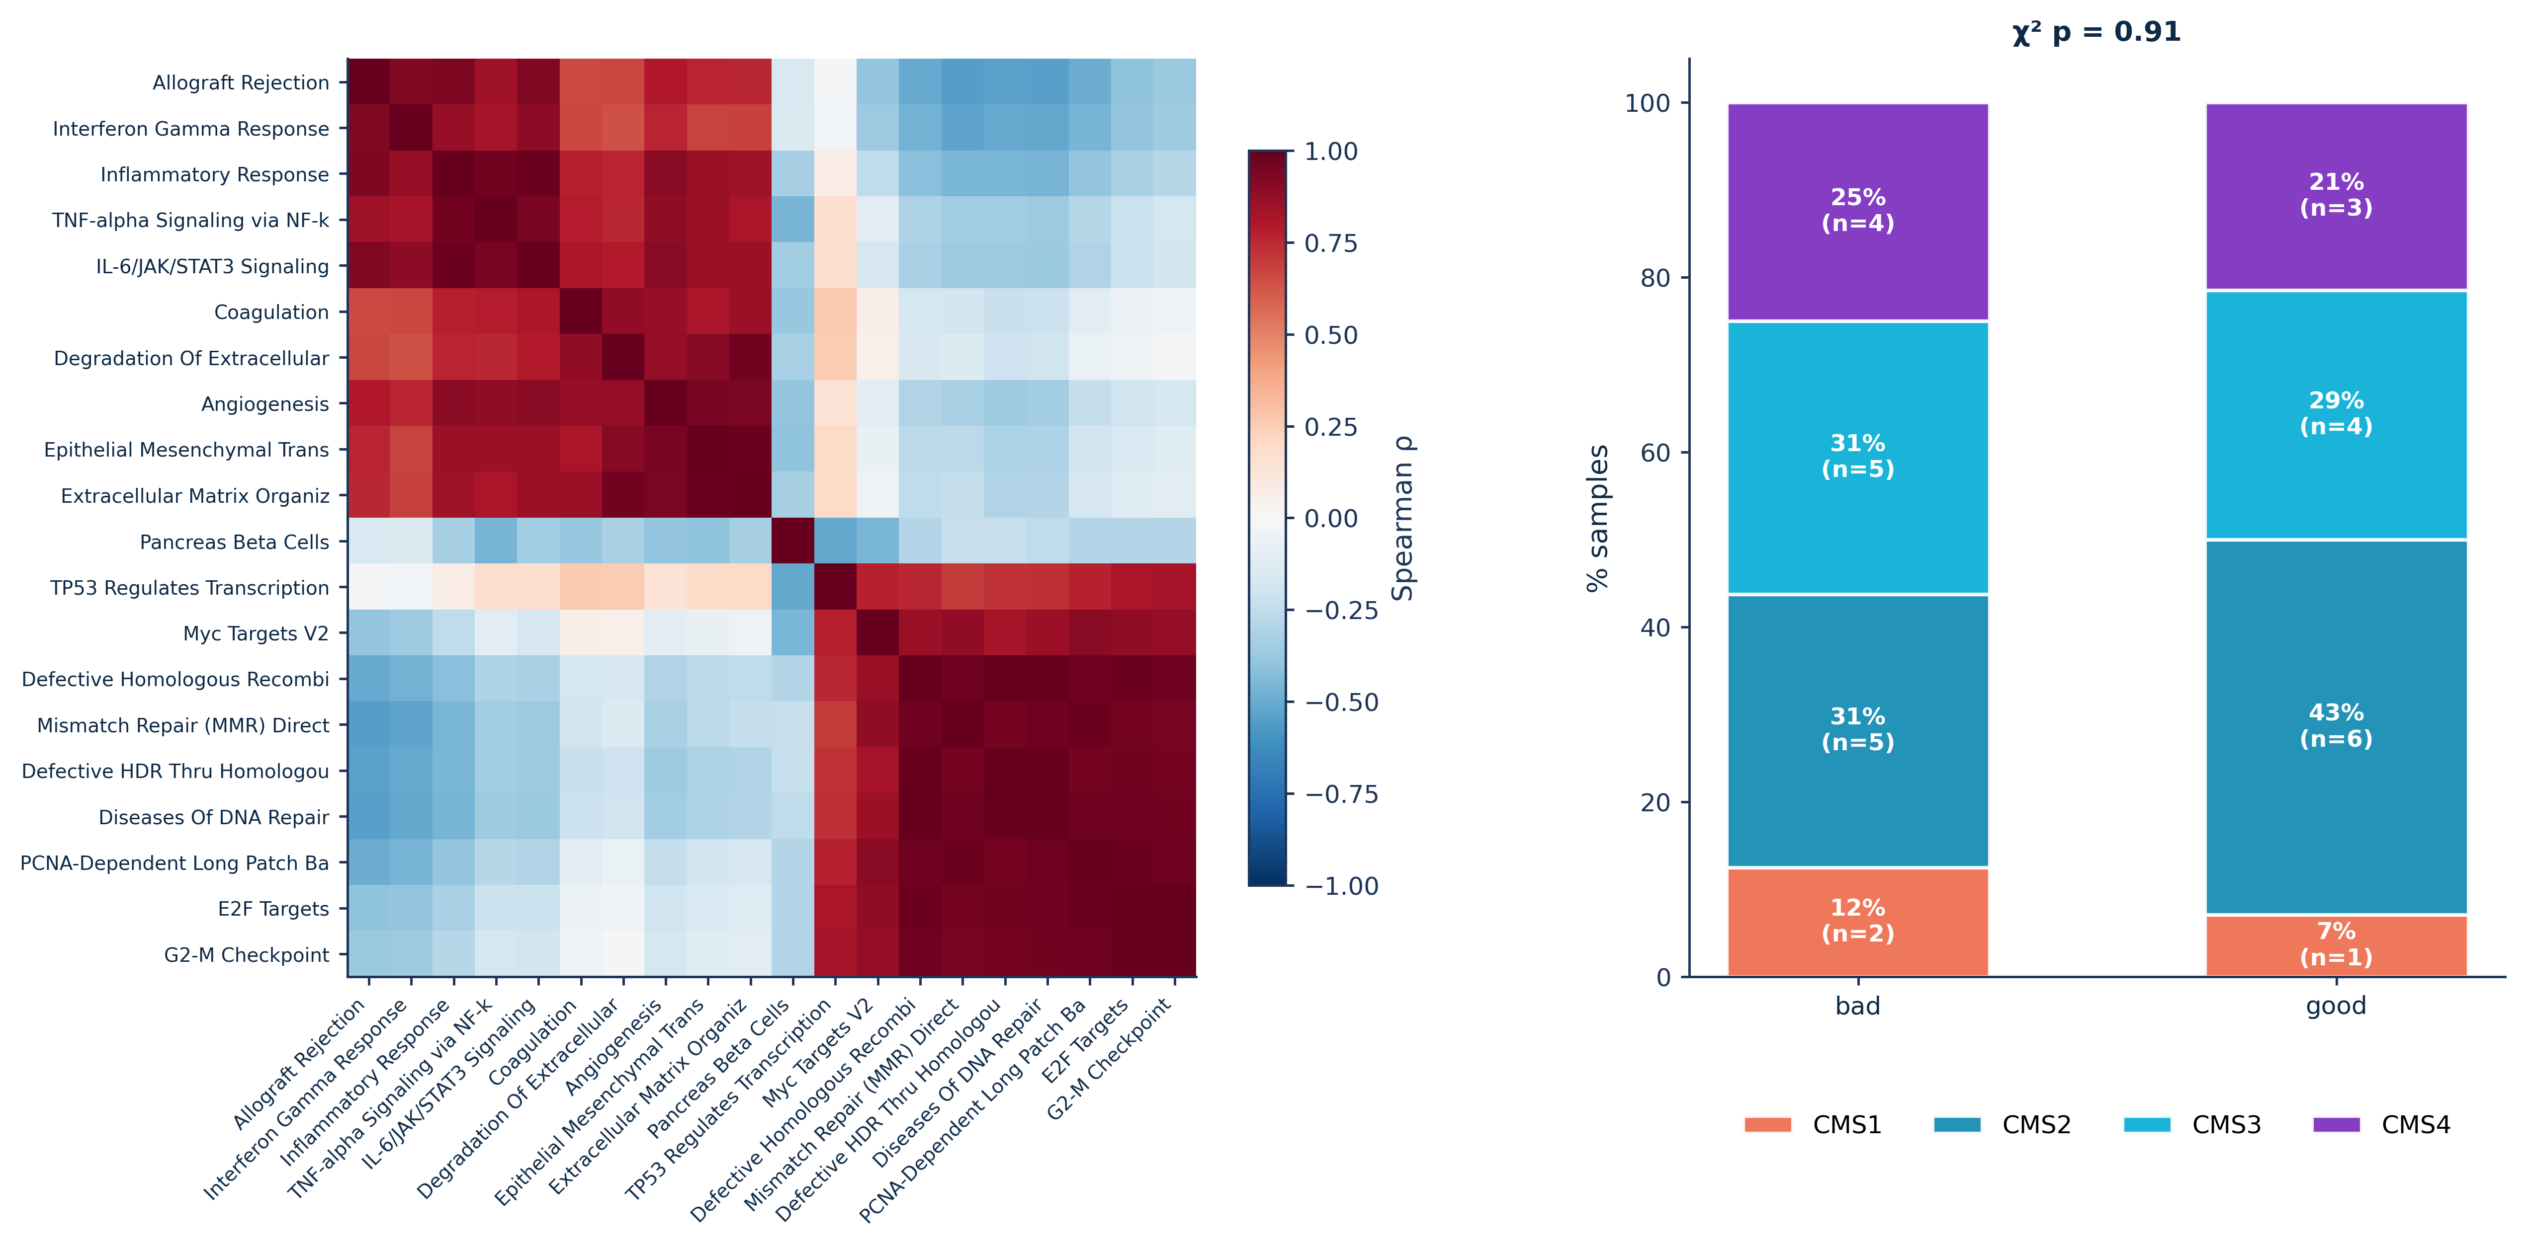
FigS6_ssGSEA_CMS

Slide 16
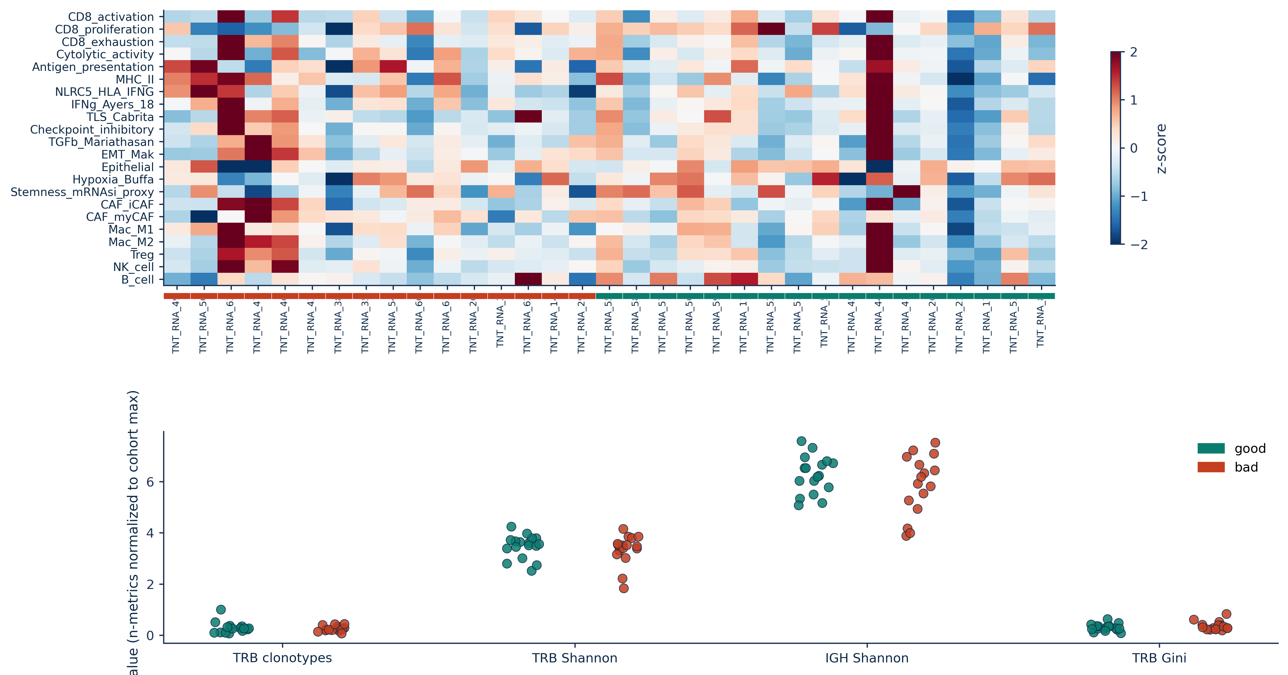
FigS7_immune_TRUST4

Slide 17
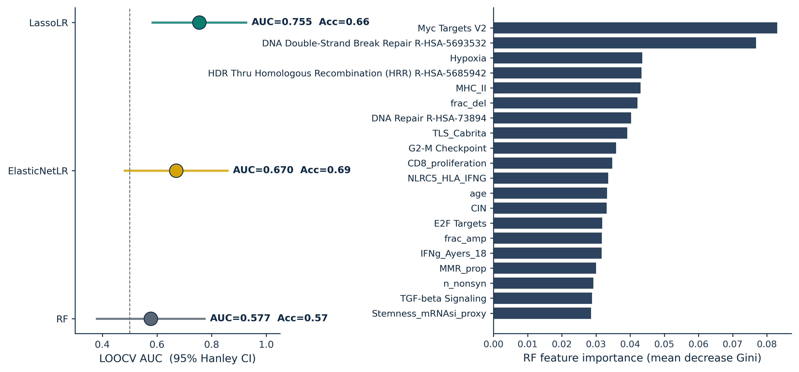
FigS8_ML_model_comparison

Slide 18
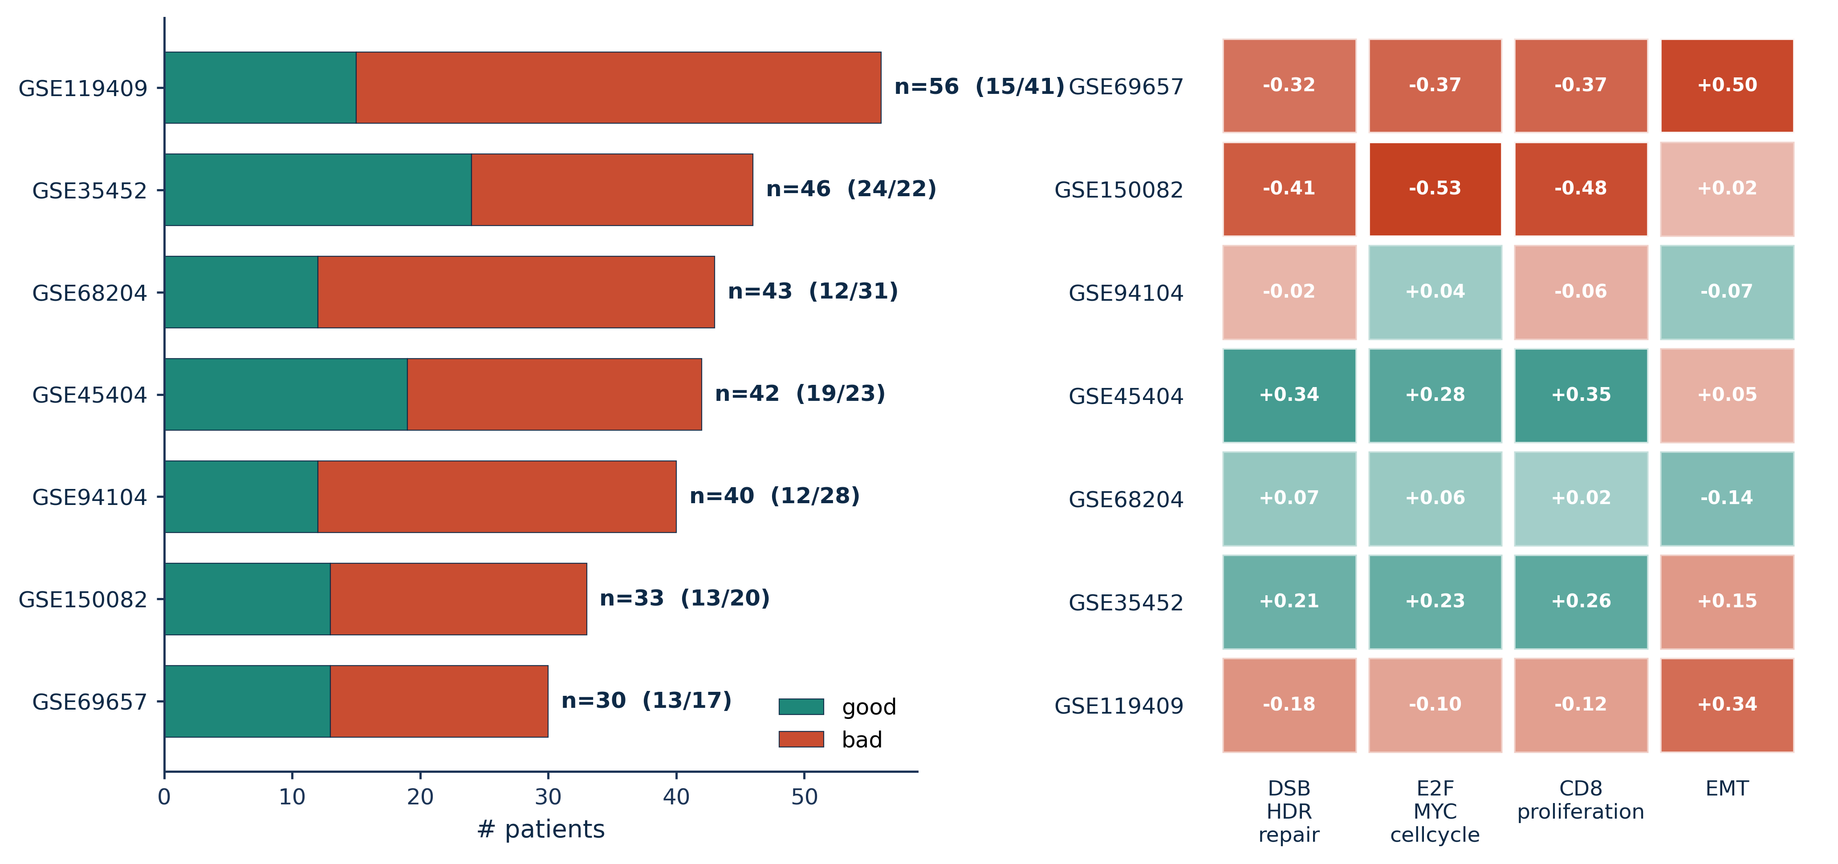
FigS9_GEO_cohorts

Slide 19
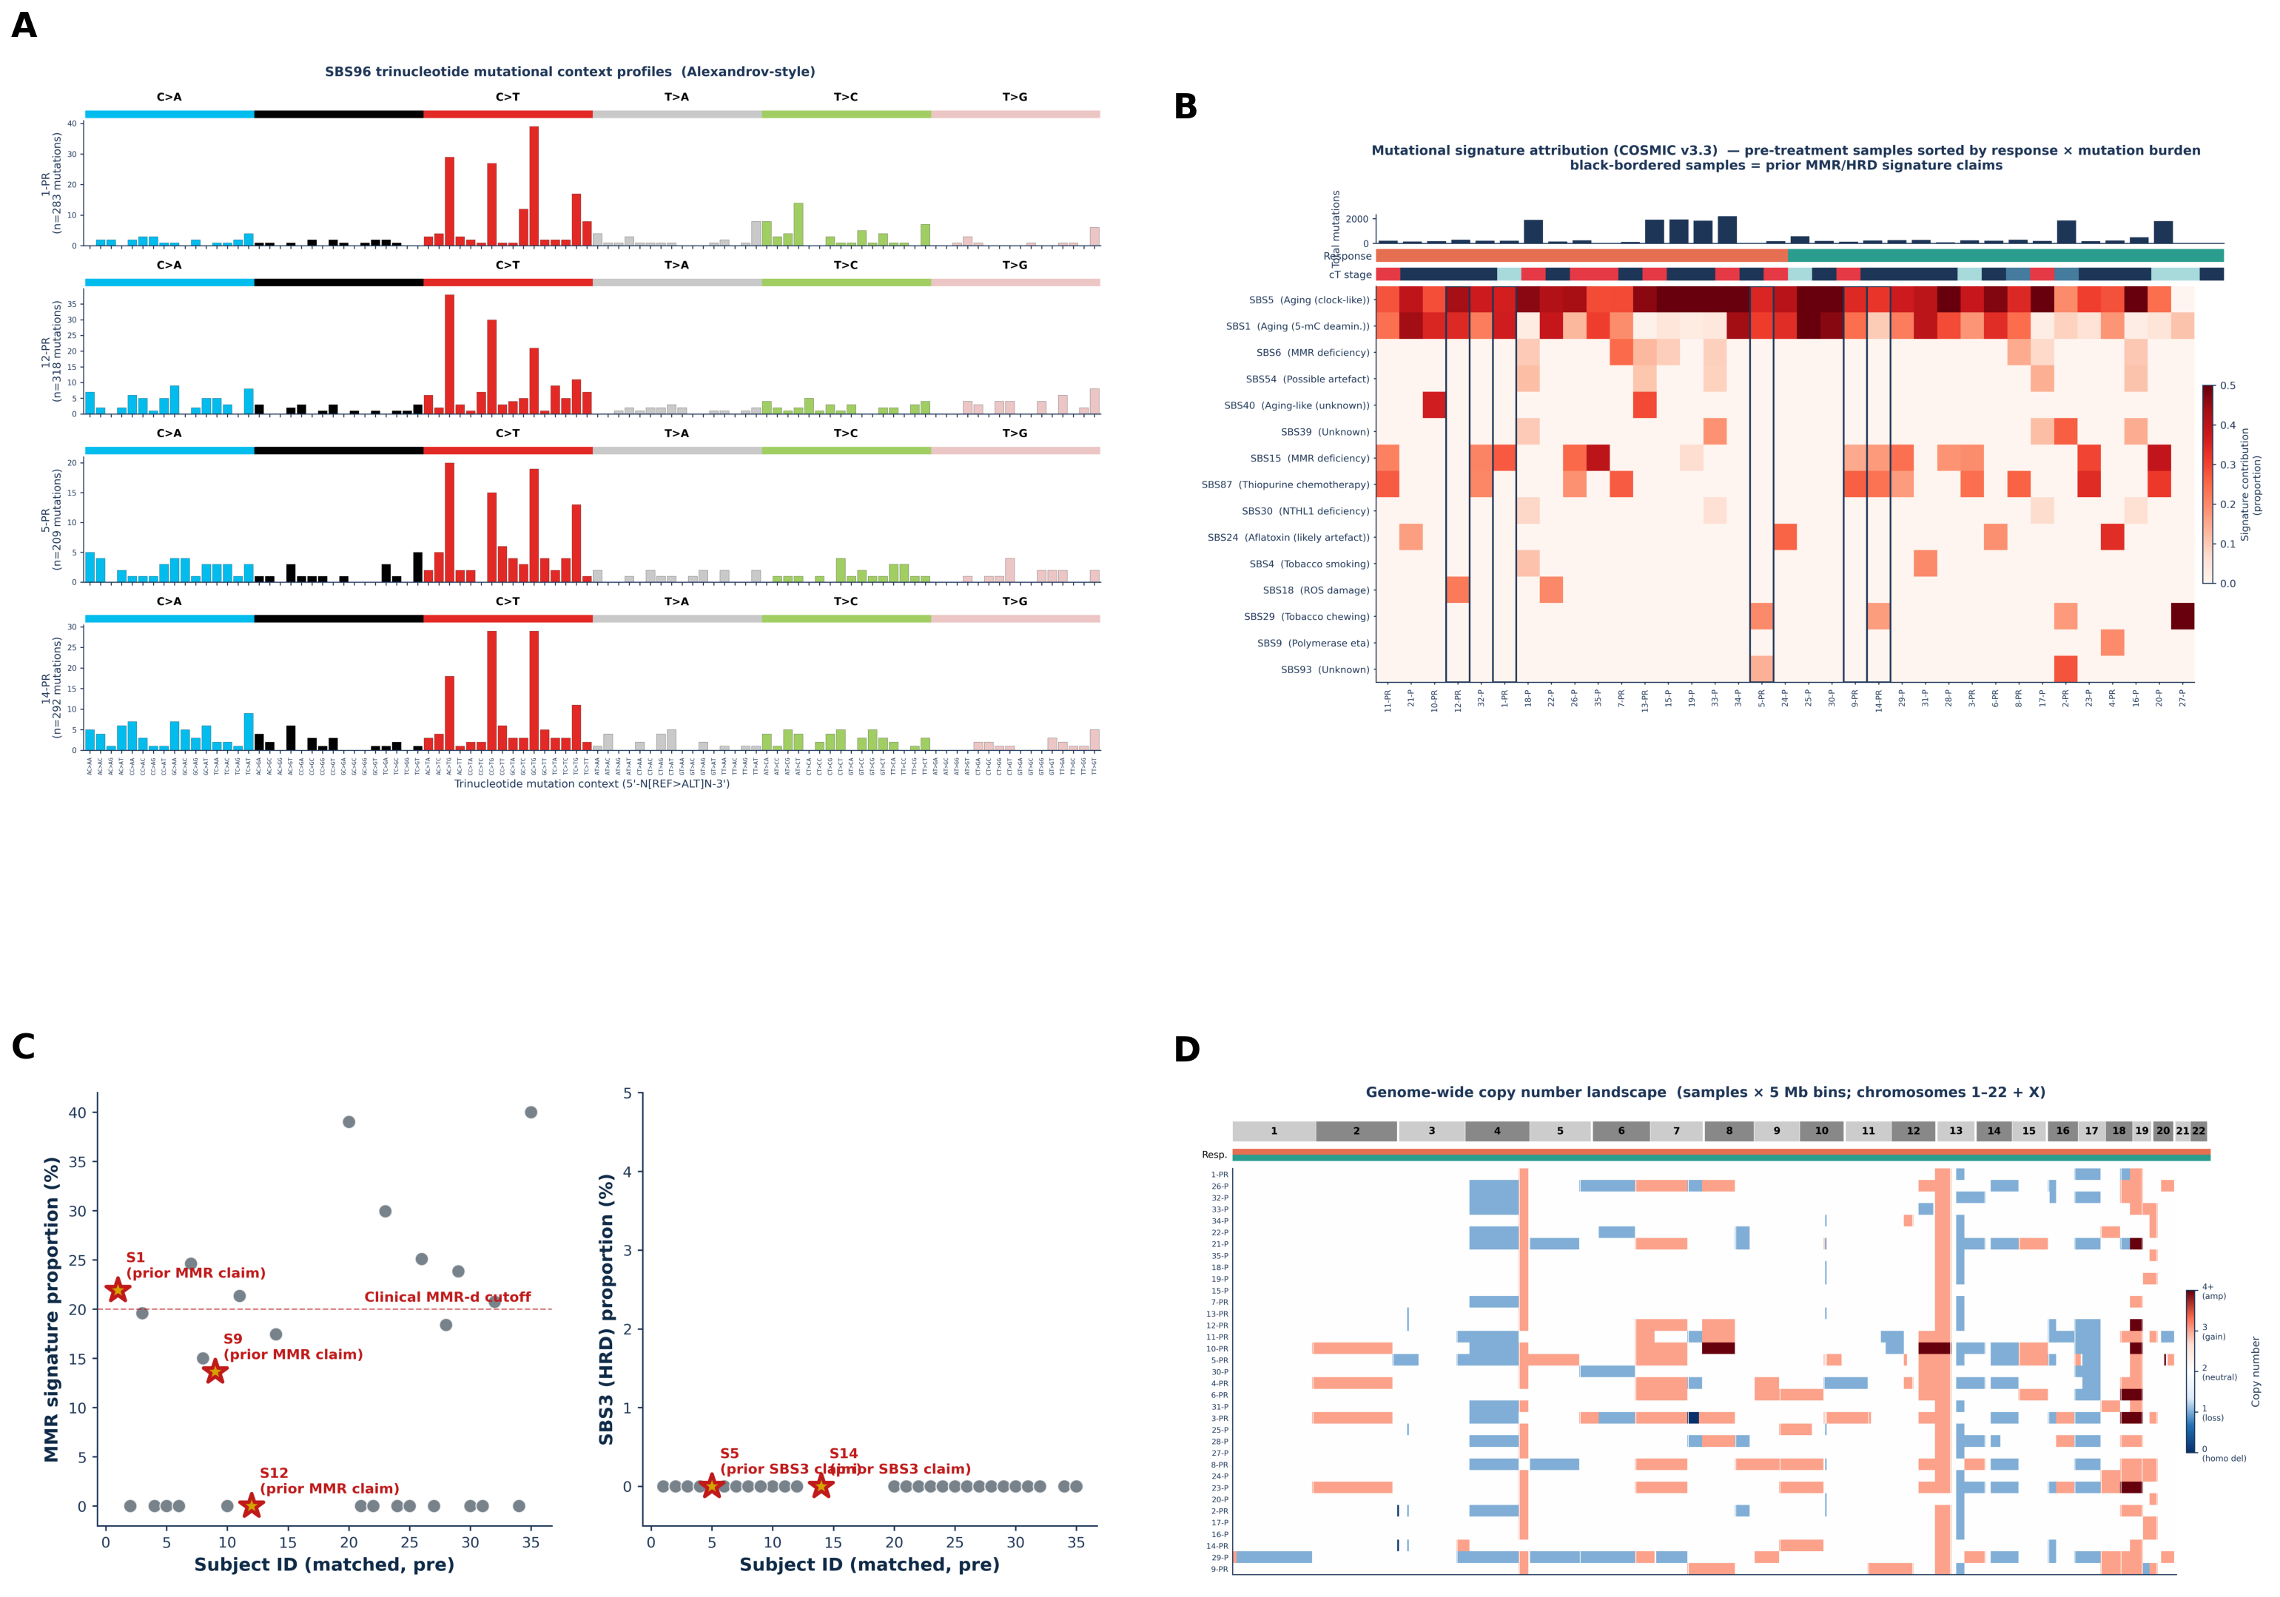
FigS_SBS_landscape

Slide 20
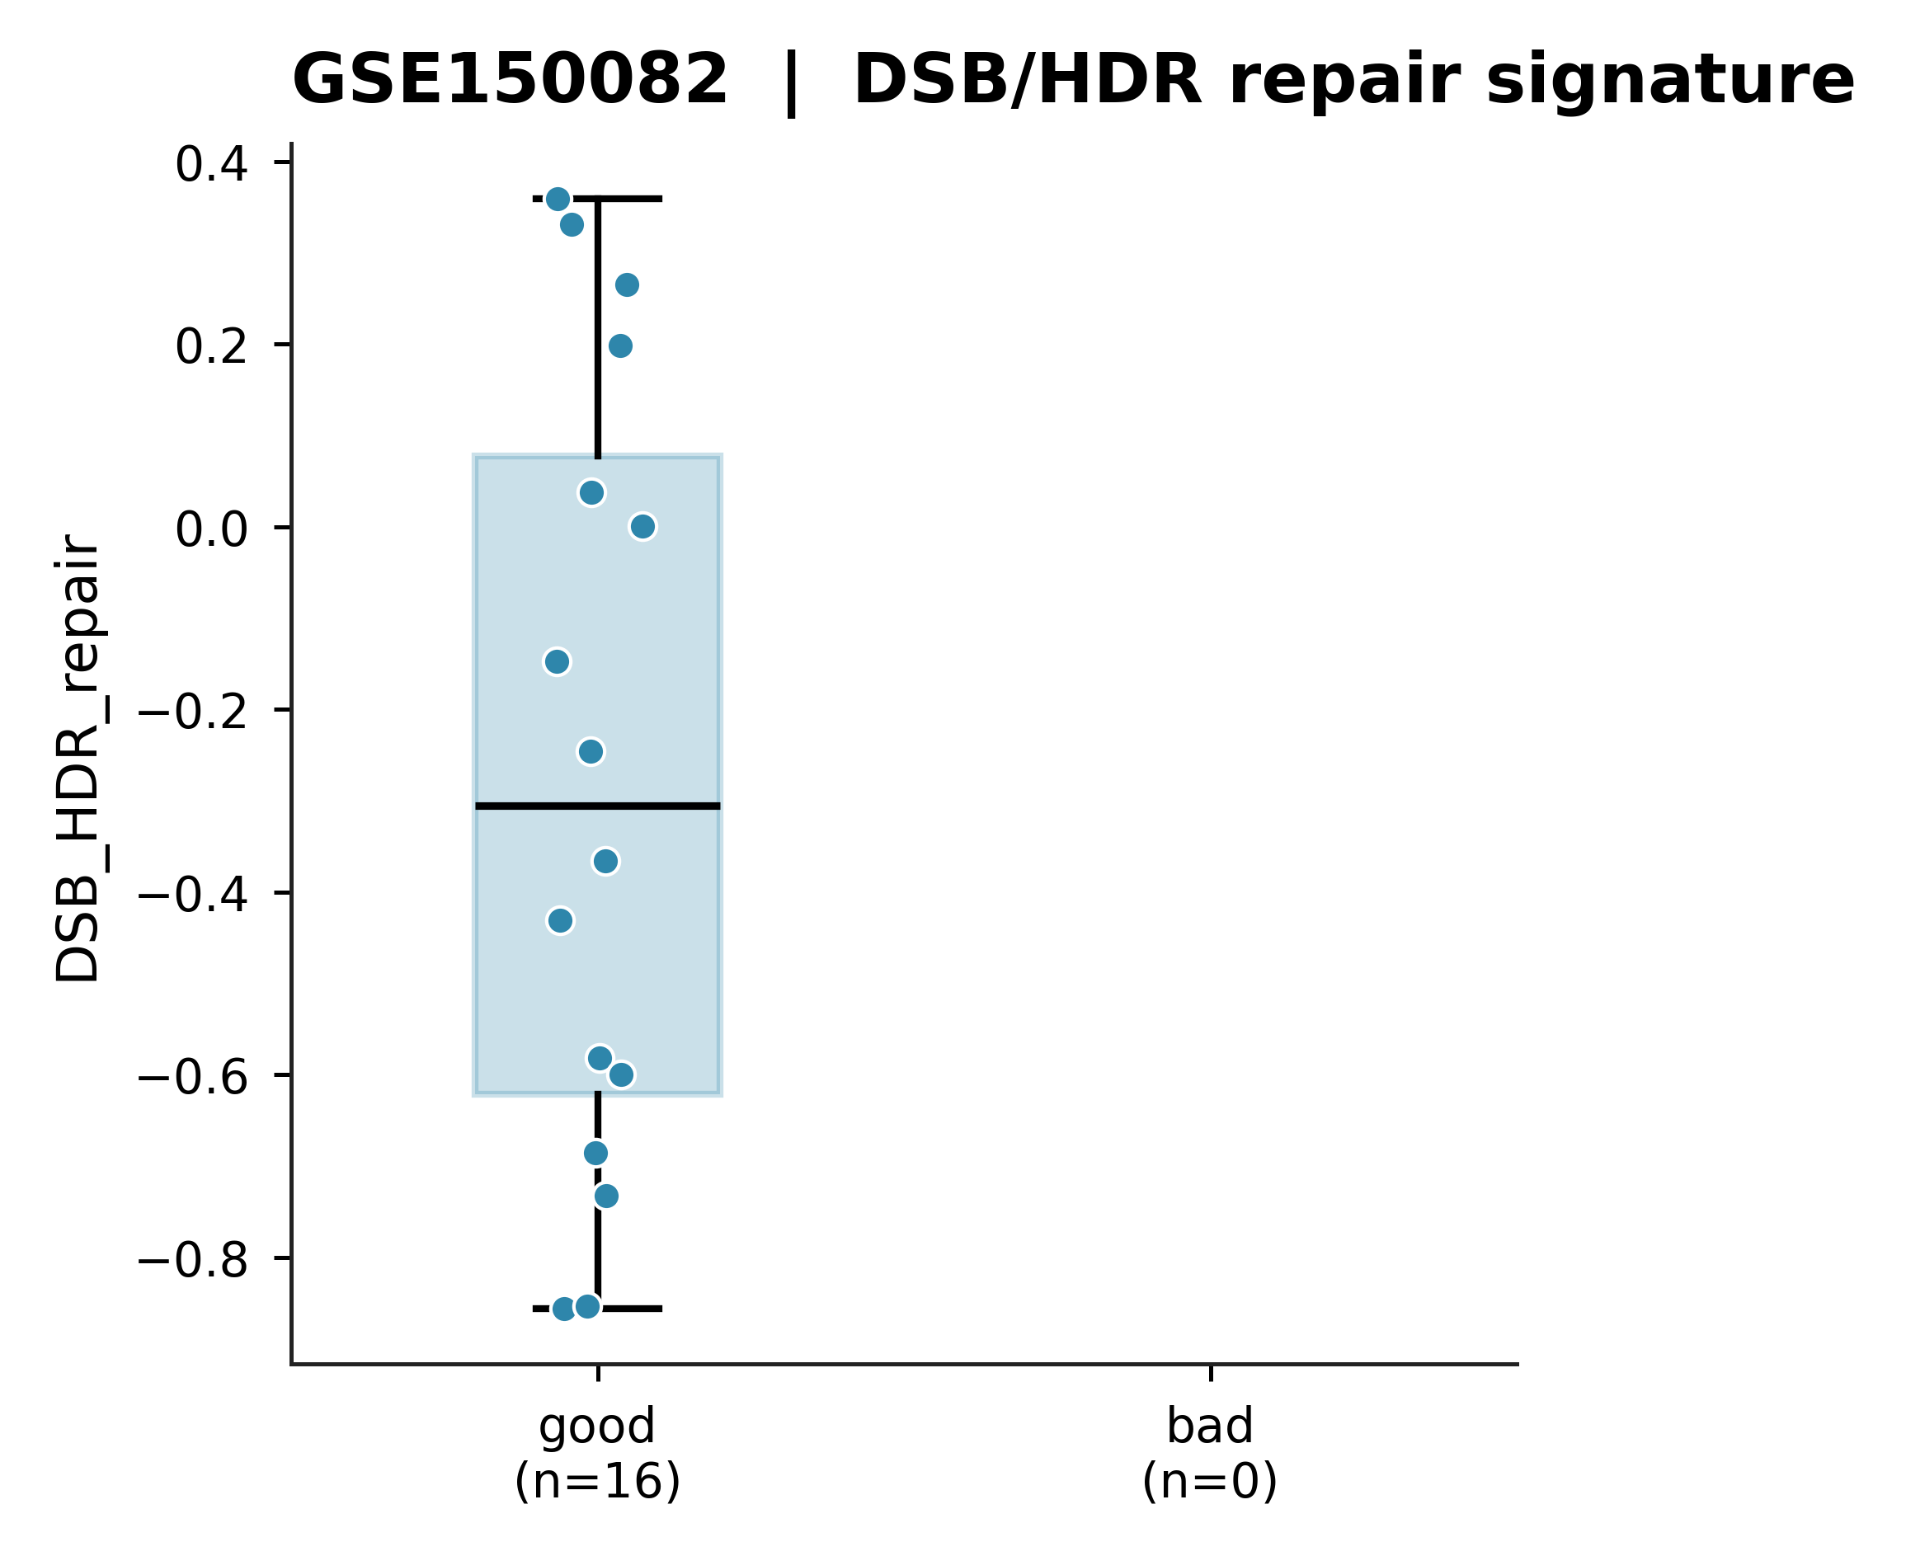
SuppFig_GSE150082_DSB

Slide 21
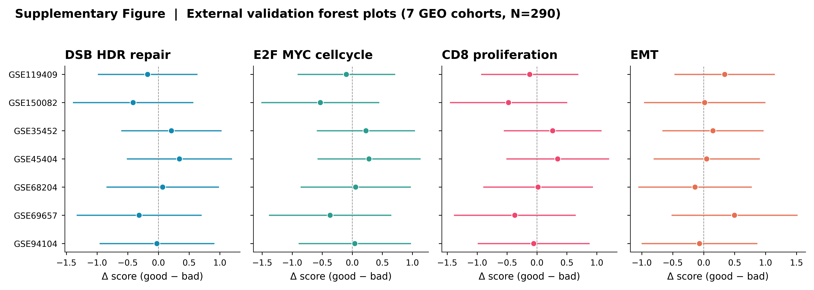
SuppFig_external_forest

Slide 22
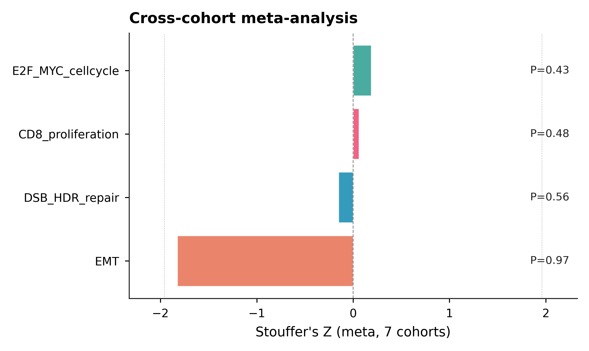
SuppFig_meta_zscore

