Slide 1
Lobachevsky State University of Nizhny Novgorod
Institute of Information Technology, Mathematics and Mechanics
Programming for AI-accelerators
Introduction To CUDA C++
Anton Gorshkov
anton.v.gorshkov@gmail.com

Slide 2
Contents
NVidia GPU Architecture
Introduction to CUDA C++
CUDA Toolkit
Function Types
Threads Hierarchy
Memory Hierarchy & Atomics
CUDA Host API
CUDA Streams & Events
Unified Memory

Slide 3
Nvidia GPU Architecture

Slide 4
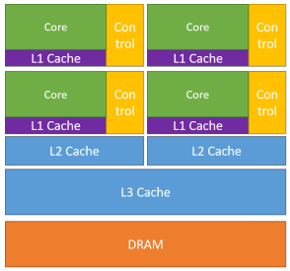

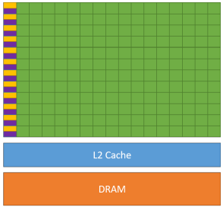
CPU vs. GPU*
CPU
GPU
Large cache → “cache oriented”
Software thread scheduling
Best single-thread performance
Multiple cores: ~(4 – 64)
SIMD programming model
Small cache → “cache-miss oriented”
Hardware thread scheduling
Poor single-thread performance
Many cores: ~(1024 – 16896)
SIMT programming model
* NVIDIA CUDA C++ Programming Guide 12.3

Slide 5
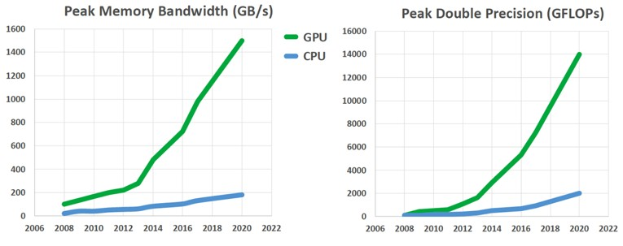
CPU vs. GPU: Performance*
* V. Natoli, A decade of accelerated computing augurs well for GPUs, -2019 [URL]
Modern GPUs are much fast and energy efficient than CPUs, but are harder to program
and have limited applicability for the real-world tasks

Slide 6
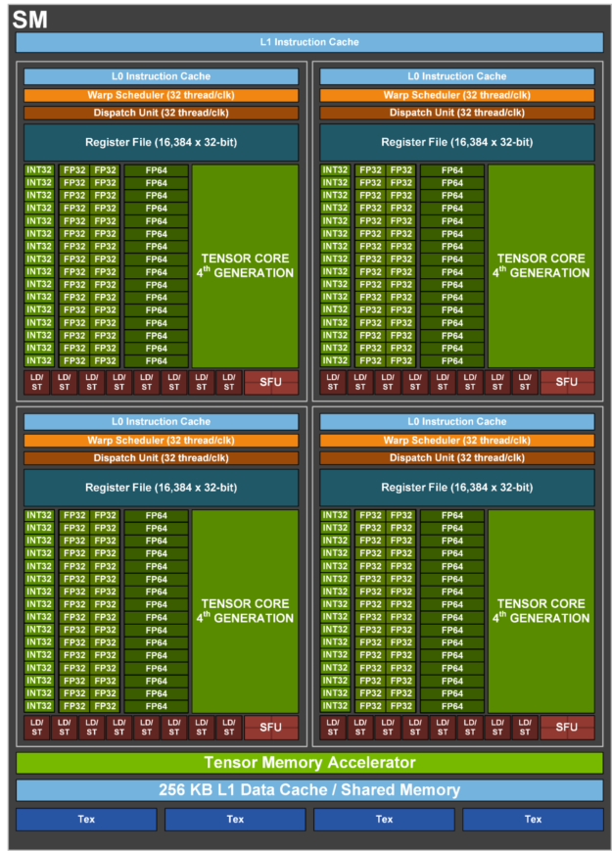
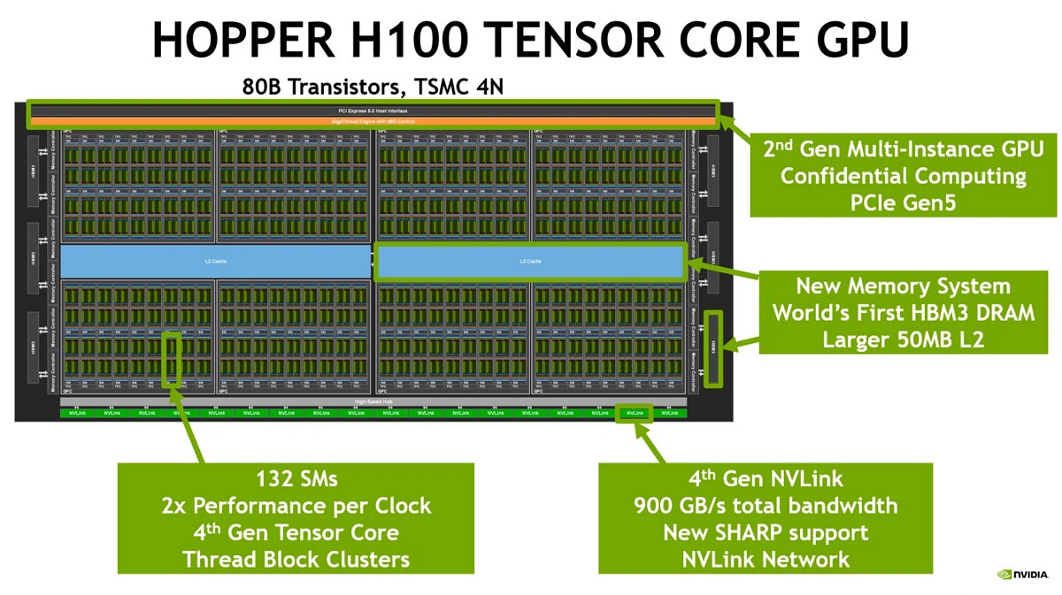
NVidia Hopper (2022): Overview

Slide 7
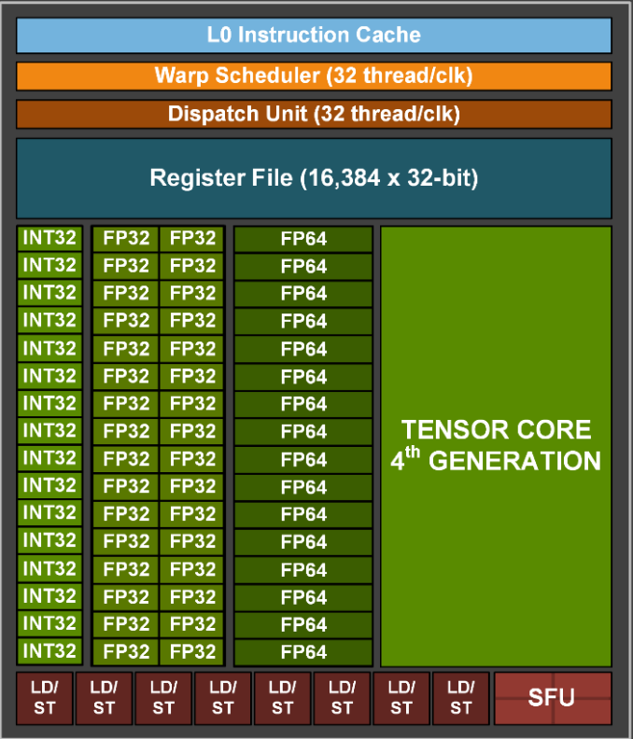
NVidia Hopper (2022): Streaming Multiprocessor (SM)

Slide 8
Introduction to CUDA C++

Slide 9

CUDA Toolkit Overview
NVidia CUDA Toolkit* provides development environment to make, optimize and deploy applications for NVidia GPUs, including:
Compiler (NVCC)
CUDA C++ Libraries & Runtime
Performance Libraries (cuBLAS, cuFFT, …)
Profiling Tools (Nsight Compute & Systems)
Linux/Windows Drivers
…
* Last Version: https://developer.nvidia.com/cuda-downloads Archive: https://developer.nvidia.com/cuda-toolkit-archive

Slide 10
CUDA Kernels: SIMT* Model
// Kernel definition
__global__ void VecAdd(float* A, float* B, float* C)
{
int i = threadIdx.x;
C[i] = A[i] + B[i];
}
int main()
{
...
// Kernel invocation with N threads
VecAdd<<<1, N>>>(A, B, C);
...
}
__global__ key word is used to define CUDA kernel
Current thread index
Kernel invocation with N parallel threads
(CUDA thread ≠ OS thread)
* SIMT – Single Instruction Multiple Threads

Slide 11
Function Types
__host__ float HostSquare(float a)
{
return a * a;
}
__device__ float DeviceSquare(float a)
{
return a * a;
}
__global__ void KernelSquare(float a)
{
float a2 = DeviceSquare(a);
}
int main()
{
...
HostSquare(4.0f);
KernelSquare<<<1, 1>>>(4.0f);
...
}
__host__ function is called from CPU (from host) and executing on CPU (normal C++ function)
__device__ function is called from GPU (from device) and executing on GPU
__global__ function is called from CPU (from host) and executing on GPU (on device)
It is possible to declare function as __host__ and __device__ simultaneously (function will be compiled twice – for CPU and for GPU)

Slide 12
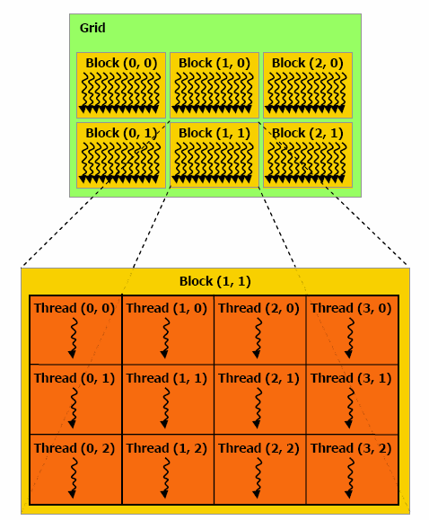
Threads Hierarchy…
CUDA thread executes a kernel from start to end
Nearby threads belong to a warp
Warp is the minimum unit of HW scheduling & execution
Current warp size is 32 (provided by warpSize variable)
Threads are combined into blocks
Each block is executed on a single SM
Threads & blocks have 3 dimensions (x, y, z)
One block contains at most 1024 threads
All blocks must have the thread count
For 2-dimensional block of size (Dx, Dy), the linear thread index of a thread (x, y) is (x + y Dx)
Blocks are combined into grid
While launching a kernel, exact grid should be provided
Grid may utilize the whole GPU
NVIDIA CUDA C Programming Guide v3.2

Slide 13
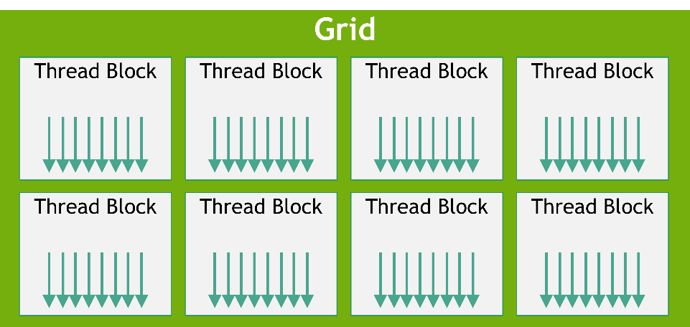
Threads Hierarchy
Thread index in grid
// Kernel definition
__global__ void MatAdd(
float A[N][N], float B[N][N], float C[N][N])
{
int i = blockIdx.x * blockDim.x + threadIdx.x;
int j = blockIdx.y * blockDim.y + threadIdx.y;
if (i < N && j < N)
C[i][j] = A[i][j] + B[i][j];
}
int main()
{
...
// Kernel invocation
dim3 threadsPerBlock(16, 16);
dim3 numBlocks(N / threadsPerBlock.x, N / threadsPerBlock.y);
MatAdd<<<numBlocks, threadsPerBlock>>>(A, B, C);
...
}
CUDA C++ Programming Guide v12.3
Structure of 3 unsigned integers (x, y, z)
CUDA C++ built-in variables:
threadIdx – thread index in a block
blockDim – size of block (in threads)
blockIdx – block index in a grid
gridDim – size of grid (in blocks)
warpSize – size of warp (in threads)
Kernel Grid

Slide 14
Memory Hierarchy…
Thread
Per thread registers & local memory
Thread Block
Per block shared memory
Shared Memory
Grid
Thread Block
Thread Block
Thread Block
Thread Block
Shared Memory
Shared Memory
Shared Memory
Shared Memory
Global Memory
Per grid global memory

Slide 15
Memory Hierarchy
// Kernel definition
__global__ void StaticReverse(int* d, int n)
{
__shared__ int s[64];
int t = threadIdx.x;
int tr = n - t - 1;
s[t] = d[t];
__syncthreads();
d[t] = s[tr];
}
int main()
{
...
// Kernel invocation
StaticReverse<<<1, n>>>(D, n);
...
}
Global memory buffer
Shared memory buffer (with static size)
Local variables (registers)
Parallel copy from global to shared memory
Parallel copy from shared to global memory
Block-level barrier synchronization
!

Slide 16
Dynamic Shared Memory
// Kernel definition
__global__ void DynamicReverse(int* d, int n)
{
extern __shared__ int s[];
int t = threadIdx.x;
int tr = n-t-1;
s[t] = d[t];
__syncthreads();
d[t] = s[tr];
}
int main()
{
...
// Kernel invocation
int sharedMemSize = n * sizeof(int);
DynamicReverse<<<1, n, sharedMemSize>>>(D, n);
...
}
Dynamic shared memory buffer
Block-level barrier synchronization
!
Size of dynamically allocated shared memory

Slide 17
Atomics
__global__ void GlobalIncrement(int* buffer)
{
atomicAdd(&buffer[0], 1); // buffer <- 8 * N
}
__global__ void SharedIncrement(int* buffer)
{
__shared__ int local[1];
if (threadIdx.x == 0) local[0] = 0;
__syncthreads();
atomicAdd(&local[0], 1);
__syncthreads();
if (threadIdx.x == 0) buffer[0] = local[0]; // buffer <- N
}
int main()
{
...
GlobalIncrement<<<8, N>>>(dev_buffer);
...
SharedIncrement<<<1, N>>>(dev_buffer);
...
}
1. Load value from memory
value += 1
2. Increment value
3. Store value to memory
Thread 0:
Thread 1:
Thread 0:
Thread 1:
Load(0)
Load(0)
Load(0)
Increment(1)
Increment(1)
Store(1)
Increment(1)
Load(1)
Store(1)
Increment(2)
Store(1)
Store(2)
value == 1
value == 2

Slide 18
CUDA Host API

Slide 19
CUDA Runtime & Driver APIs
Device management
Error handling
Stream management
Event management
Execution control
Memory management
Graphics interoperability
CUDA Host API
CUDA Driver API
cuSomething()
CUDA Runtime API
cudaSomething()
More complex and fine-grain API
More simple and lightweight API

Slide 20
Example: Vector Add
// Device code
__global__ void VecAdd(float* A, float* B, float* C, int N) {
int i = blockDim.x * blockIdx.x + threadIdx.x;
if (i < N) C[i] = A[i] + B[i];
}
// Host code
int main() {
int N = 1024;
size_t size = N * sizeof(float);
// Allocate input vectors h_A and h_B in host memory
float* h_A = (float*)malloc(size);
float* h_B = (float*)malloc(size);
float* h_C = (float*)malloc(size);
// Initialize input vectors
for (int i = 0; i < N; ++i) {
h_A[i] = 1.0f;
h_B[i] = 2.0f;
h_C[i] = 0.0f;
}
Parallel vectors addition
Host-side memory allocation
Vectors initialization

Slide 21
Device Management & Error Handling
Error Handling:
cudaError_t – error code returned by API calls
const char* cudaGetErrorString(cudaError_t error) – get error text description by code
cudaError_t cudaGetLastError()
– get last error code from runtime API, code will be reset to cudaSuccess
CUDA Host API header
#include <cuda.h>
#define CHECK_ERROR(X) \
error = X; \
if (error != cudaSuccess) { \
const char* s = cudaGetErrorString(error); \
printf("Error: %s\n", s); \
exit(0); \
}
int main() {
…
cudaError_t error = cudaSuccess;
// Choose device #0
CHECK_ERROR(cudaSetDevice(0));
}
Device Management:
cudaError_t cudaGetDeviceCount(int* count) – get number of CUDA devices
​cudaError_t cudaGetDevice(int* device) – returns current device index
cudaError_t cudaSetDevice(int device) – choose GPU device to work with, index starts from 0 (0 device is used by default)
cudaError_t cudaChooseDevice(int* device, const cudaDeviceProp* prop) – choose device that satisfies needed properties
cudaError_t cudaGetDeviceProperties(cudaDeviceProp* prop, int device) – get device properties, includes SM count, clock rate, memory sizes, etc.

Slide 22
Memory Management
int main() {
…
// Allocate vectors in device memory
float* d_A;
CHECK_ERROR(cudaMalloc(&d_A, size));
float* d_B;
CHECK_ERROR(cudaMalloc(&d_B, size));
float* d_C;
CHECK_ERROR(cudaMalloc(&d_C, size));
// Copy vectors from host to device memory
CHECK_ERROR(cudaMemcpy( d_A, h_A, size, cudaMemcpyHostToDevice));
CHECK_ERROR(cudaMemcpy( d_B, h_B, size, cudaMemcpyHostToDevice));
//// Call the kernel
// Copy result from device to host memory
CHECK_ERROR(cudaMemcpy( h_C, d_C, size, cudaMemcpyDeviceToHost));
Memory Management:
​cudaError_t cudaMalloc(void** devPtr, size_t size) – allocate buffer in device memory
​​cudaError_t cudaFree(void* devPtr) – release buffer in device memory
cudaError_t cudaMemcpy( void* dst,
const void* src,
size_t count,
cudaMemcpyKind kind) – transfer memory between host and device (kind can be
cudaMemcpyHostToHost,
cudaMemcpyHostToDevice,
cudaMemcpyDeviceToHost,
cudaMemcpyDeviceToDevice)

Slide 23
Execution Control & Device Management
int main() {
… //// Call the kernel
int threadsPerBlock = 256;
int blocksPerGrid = (N + threadsPerBlock - 1) / threadsPerBlock;
VecAdd<<<blocksPerGrid, threadsPerBlock>>>(d_A, d_B, d_C, N);
CHECK_ERROR(cudaDeviceSynchronize());
… // Free device memory
CHECK_ERROR(cudaFree(d_A));
CHECK_ERROR(cudaFree(d_B));
CHECK_ERROR(cudaFree(d_C));
// Check result correctness
for (int i = 0; i < N; ++i) {
assert(h_C[i] == 3.0f);
}
// Free host memory
free(h_A); free(h_B); free(h_C); }
Execution Control & Device Management:
​Kernel<<<blocksPerGrid, threadsPerBlock, sharedMemSize>>>(…) – invoke the kernel on device, this call is asynchronous (it just places kernel into the queue)
​​cudaError_t cudaDeviceSynchronize() – wait for all tasks in a queue to be completed

Slide 24
Example: Vector Add
#include <cuda.h>
#include <stdio.h>
#include <assert.h>
#define CHECK_ERROR(X) \
error = X; \
if (error != cudaSuccess) { \
const char* s = cudaGetErrorString(error); \
printf("Error: %s\n", s); \
exit(0); \
}
__global__ void VecAdd(float* A, float* B, float* C, int N) {
int i = blockDim.x * blockIdx.x + threadIdx.x;
if (i < N)
C[i] = A[i] + B[i];
}
int main() {
int N = 1024;
size_t size = N * sizeof(float);
float* h_A = (float*)malloc(size);
float* h_B = (float*)malloc(size);
float* h_C = (float*)malloc(size);
for (int i = 0; i < N; ++i) {
h_A[i] = 1.0f;
h_B[i] = 2.0f;
h_C[i] = 0.0f;
}
cudaError_t error = cudaSuccess;
CHECK_ERROR(cudaSetDevice(0));
float* d_A;
CHECK_ERROR(cudaMalloc(&d_A, size));
float* d_B;
CHECK_ERROR(cudaMalloc(&d_B, size));
float* d_C;
CHECK_ERROR(cudaMalloc(&d_C, size));
CHECK_ERROR(cudaMemcpy(d_A, h_A, size, cudaMemcpyHostToDevice));
CHECK_ERROR(cudaMemcpy(d_B, h_B, size, cudaMemcpyHostToDevice));
int threadsPerBlock = 256;
int blocksPerGrid =
(N + threadsPerBlock - 1) / threadsPerBlock;
VecAdd<<<blocksPerGrid, threadsPerBlock>>>(d_A, d_B, d_C, N);
CHECK_ERROR(cudaDeviceSynchronize());
CHECK_ERROR(cudaMemcpy(h_C, d_C, size, cudaMemcpyDeviceToHost));
CHECK_ERROR(cudaFree(d_A));
CHECK_ERROR(cudaFree(d_B));
CHECK_ERROR(cudaFree(d_C));
for (int i = 0; i < N; ++i) {
assert(h_C[i] == 3.0f);
}
free(h_A);
free(h_B);
free(h_C);
}

Slide 25
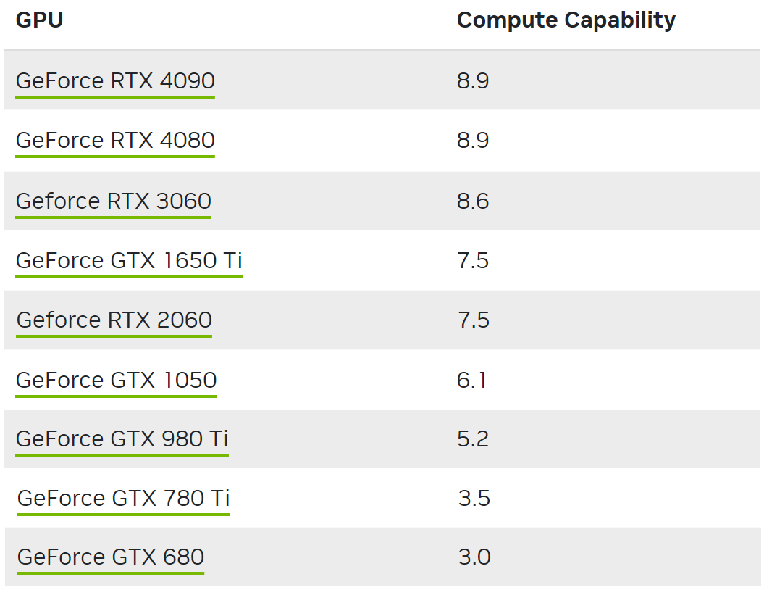
CUDA Compute Capability
Compute capability* defines general specifications and features of a compute device, e.g.:
64-bit float atomics (6.0+)
Dynamic parallelism (5.0+)
Unified memory (5.0+)
Tensor cores (7.0+)
Distributed shared memory (9.0+)
https://developer.nvidia.com/cuda-gpus
int main() {
int deviceCount = 0;
cudaGetDeviceCount(&deviceCount);
for (int device = 0; device < deviceCount; ++device) {
cudaDeviceProp deviceProp;
cudaGetDeviceProperties(&deviceProp, device);
printf("Device %d has compute capability %d.%d.\n",
device, deviceProp.major, deviceProp.minor);
}
* More information can be found here: https://docs.nvidia.com/cuda/cuda-c-programming-guide/index.html#compute-capabilities

Slide 26
CUDA Streams & Events

Slide 27
Example: Matrix Sum
__global__ void MatSum(
const float* a, const float* b, float* c, int n) {
int i = threadIdx.x + blockIdx.x * blockDim.x;
int j = threadIdx.y + blockIdx.y * blockDim.y; c[i * n + j] = a[i * n + j] + b[i * n + j];
}
int main() {
constexpr int N = 2048; // Matrix size (N x N)
float *a, *b, *c; // Host buffers float *dev_a, *dev_b, *dev_c; // Device buffers
…
cudaMemcpy(dev_a, a, N*N*sizeof(float), cudaMemcpyHostToDevice);
cudaMemcpy(dev_b, b, N*N*sizeof(float), cudaMemcpyHostToDevice);
dim3 threadsPerBlock(16, 16);
dim3 blockCount(N / 16, N / 16);
MatSum<<<blockCount, threadsPerBlock>>>(dev_a, dev_b, dev_c, N);
cudaMemcpy(c, dev_c, N*N*sizeof(float), cudaMemcpyDeviceToHost);
…
}
A
B
C
+
=
Copy A to device
Copy B to device
Compute С=A+B
Copy C to host
Stream 0
(default stream)

Slide 28
CUDA Steams
int main() {
…
dim3 threadsPerBlock(16, 16);
dim3 blockCount(N / 2 / 16, N / 16);
int half = N * N / 2, half_bytes = half * sizeof(float);
cudaStream_t s[2]; cudaStreamCreate(&s[0]); cudaStreamCreate(&s[1]);
// Stream 1 ========================================================
cudaMemcpyAsync(dev_a, a, half_bytes, cudaMemcpyHostToDevice, s[0]);
cudaMemcpyAsync(dev_b, b, half_bytes, cudaMemcpyHostToDevice, s[0]); MatSum<<<blockCount, threadsPerBlock, 0, s[0]>>>(
dev_a, dev_b, dev_c, N); cudaMemcpyAsync(c, dev_c, half_bytes,cudaMemcpyDeviceToHost, s[0]);
// Stream 2 ========================================================
cudaMemcpyAsync(dev_a + half, a + half, half_bytes, cudaMemcpyHostToDevice, s[1]);
cudaMemcpyAsync(dev_b + half, b + half, half_bytes, cudaMemcpyHostToDevice, s[1]); MatSum<<<blockCount, threadsPerBlock, 0, s[1]>>>(
dev_a + half, dev_b + half, dev_c + half, N); cudaMemcpyAsync(c + half, dev_c + half, half_bytes, cudaMemcpyDeviceToHost, s[1]);
// Wait for completion =============================================
cudaStreamSynchronize(s[0]); cudaStreamSynchronize(s[1]); cudaStreamDestroy(s[0]); cudaStreamDestroy(s[1]);
…
}
A
B
C
+
=
Copy A to device
Copy B to device
Compute С=A+B
Copy A to device
Copy B to device
Copy C to host
Compute С=A+B
Copy C to host
Stream 1
Stream 2

Slide 29

CUDA Events & Time Measurement
int main() {
… cudaEvent_t start, stop;
cudaEventCreate(&start);
cudaEventCreate(&stop);
cudaEventRecord(start, 0);
dim3 threadsPerBlock(16, 16);
dim3 blockCount(N / 16, N / 16);
MatSum<<<blockCount, threadsPerBlock>>>(dev_a, dev_b, dev_c, N);
cudaEventRecord(stop, 0);
cudaEventSynchronize(stop);
float elapsedTime = 0.0f;
cudaEventElapsedTime(&elapsedTime, start, stop);
printf("MatSum exectuion time: %f\n ms", elapsedTime);
cudaEventDestroy(start);
cudaEventDestroy(stop);
… }
Event creation
Start region recording
End region recording
Wait for region completion
Get region elapsed time
Event destroy

Slide 30
Unified Memory

Slide 31
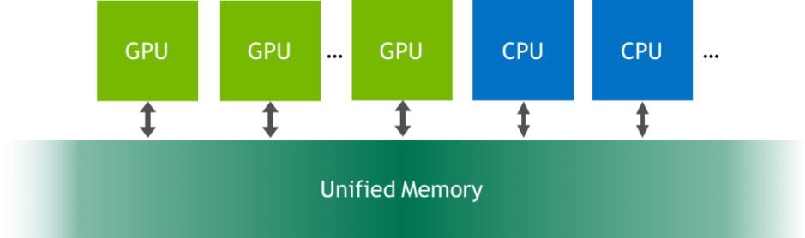
Unified Memory
__global__ void Add(int n, float *x, float *y) {
int i = blockIdx.x * blockDim.x + threadIdx.x;
if (i < n) y[i] = x[i] + y[i];
}
int main(void) {
int N = (1 << 20) // 1 MB;
float *x, *y;
cudaMallocManaged(&x, N*sizeof(float));
cudaMallocManaged(&y, N*sizeof(float));
for (int i = 0; i < N; i++) {
x[i] = 1.0f; y[i] = 2.0f;
}
int blockSize = 256, numBlocks = (N + blockSize - 1) / blockSize;
add<<<numBlocks, blockSize>>>(N, x, y);
cudaDeviceSynchronize();
for (int i = 0; i < N; i++) assert(y[i] == 3.0f);
cudaFree(x);
cudaFree(y);
}
Allocate unified memory
Initialize vectors (CPU side)
Run computations (GPU side)
no explicit data copy is needed
Verify results (CPU side)
Release unified memory

Slide 32
References
M. Andersch, G. Palmer, R. Krashinsky, N. Stam, V. Mehta, G. Brito, S. Ramaswamy, NVIDIA Hopper Architecture In-Depth, -2022 [URL]
NVidia Corporation, CUDA C++ Programming Guide v12.3 [URL]
M. Harris, How to Implement Performance Metrics in CUDA C/C++, -2012 [URL]
M. Harris, Unified Memory for CUDA Beginners, -2017 [URL]

Slide 33
Team
Anton Gorshkov, Ph.D., Associate Professor at Lobachevsky State University, Principal Engineer at Huawei
Arseniy Obolenskiy, Senior Engineer at Huawei
Mikhail Lychkov, Senior Engineer at Huawei
Oleg Maslov, Ph.D., Expert at Huawei

