Slide 1
Lobachevsky State University of Nizhny Novgorod
Institute of Information Technology, Mathematics and Mechanics
Programming for AI-accelerators
CUDA For AI-Programming
Anton Gorshkov
anton.v.gorshkov@gmail.com

Slide 2
Contents
CUDA Performance Optimization
NVIDIA Tensor Cores
NVIDIA CUTLASS

Slide 3
CUDA PERFORMANCE OPTIMIZATION

Slide 4

Basic Tips: Know Your Application
Massive parallelism
focus on highly parallel code regions to fully utilize compute resources
remember Amdahl's Law
if only 50% of code can be parallelized – 2x is the maximum speed-up even for 1000 cores
strict data dependencies may prevent massive parallelization
Low ratio of memory accesses to computation
compute bound applications is typically easier to parallelize
memory bound applications requires another (specific) approaches
Right data access patterns
sequential data accesses are preferable over random
data locality matters

Slide 5
Basic Tips: Massive Parallelism & Overlapping
Best performance on multicore devices may be achieved with:
computations overlap between devices (heterogeneous calculations)
use CPU & GPU or multiple GPUs simultaneously
overlap between compute kernels and memory transfers
use streams and asynchronous memory copy
massive parallelism across SMs* and warps (device utilization)
make sure your kernel has enough parallelism or run multiple kernels in parallel
eliminate branching inside a warp
overlap between compute operations and memory accesses (memory/compute ratio)
calculate easy-to-compute values instead of storing them
use sequential memory access pattern
utilize shared memory and thread registers as a cache
request needed data from memory earlier
* SM – Streaming Multiprocessor

Slide 6
Basic Tips: Levels Of Optimization
Higher
Inter-node communications (including NCCL, NVSHMEM)
Host-side performance libraries (e.g., cuBLAS, cuFFT, cuDNN, etc.)
Host-device and inter-devices communications (including NCCL, NVSHMEM)
Device-side performance libraries (e.g., CUTLASS, CUB, etc.)
Kernel-level optimizations (compute & memory aspects, GPU occupancy)
Instruction-level optimizations (micro-architectural tricks, inline assembly)
Lower
Optimization efforts on higher level normally give better performance easier
(as well as using performance libraries instead of custom code)

Slide 7
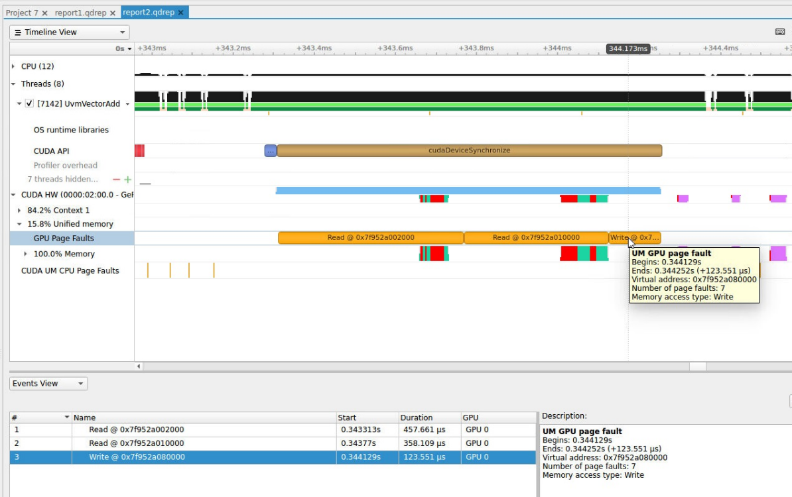
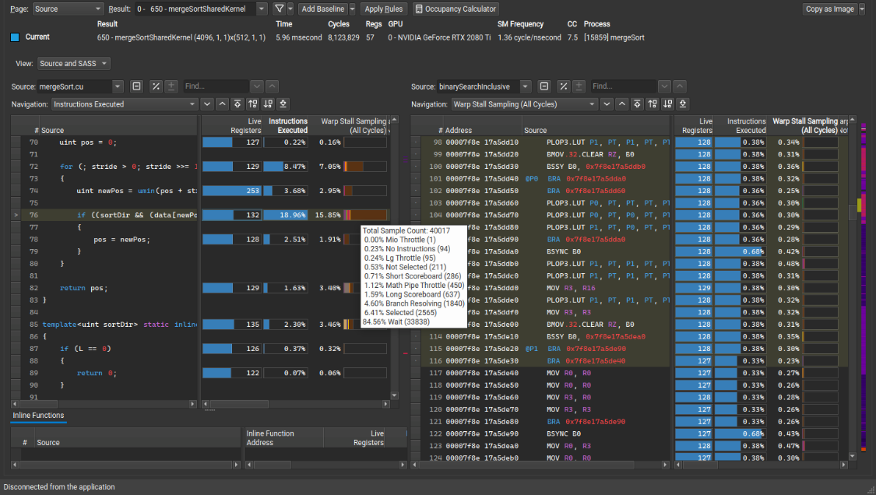
Basic Tips: Profiling Tools
NVIDIA Nsight Systems
(system-wide performance analysis tool)
NVIDIA Nsight Compute
(kernel-level interactive profiler)

Slide 8
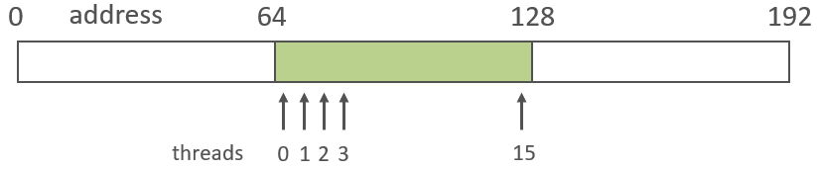
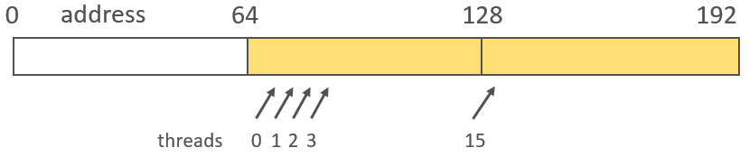

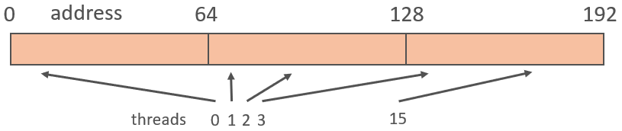
Global Memory: Effective Accesses
The most effective access into global memory should:
work with aligned memory region
most common region alignment is 64 bytes (cache line size for modern architectures)
in a way nearby threads treat nearby memory elements
threads within a single warp should touch minimal number of cache lines

Slide 9

Example: Matrix Sum…
#define N 1024
__global__ void MatSum(const float* a, float* c) {
int i = threadIdx.x + blockIdx.x * blockDim.x;
int j = threadIdx.y + blockIdx.y * blockDim.y;
c[i * N + j] = a[i * N + j] + a[i * N + j];
}
int main() {
float *a, *c;
cudaMallocManaged(&a, N * N * sizeof(float));
cudaMallocManaged(&c, N * N * sizeof(float));
for (int i = 0; i < N * N; ++i) {
a[i] = 1.0f; c[i] = 0.0f;
}
MatSum<<<dim3(N / 16, N / 16), dim3(16, 16)>>>(a, c);
cudaDeviceSynchronize(); cudaFree(a); cudaFree(c);
}
A
+
A
Is this code fast enough?
=
C

Slide 10
Example: Matrix Sum
#define N 1024
__global__ void MatSum(const float* a, float* c) {
int i = threadIdx.y + blockIdx.y * blockDim.y;
int j = threadIdx.x + blockIdx.x * blockDim.x;
c[i * N + j] = 2 * a[i * N + j];
}
int main() {
float *a, *c;
cudaMallocManaged(&a, N * N * sizeof(float));
cudaMallocManaged(&c, N * N * sizeof(float));
for (int i = 0; i < N * N; ++i) {
a[i] = 1.0f; c[i] = 0.0f;
}
MatSum<<<dim3(N / 16, N / 16), dim3(16, 16)>>>(a, c);
cudaDeviceSynchronize(); cudaFree(a); cudaFree(c);
}
threadIdx.x
A
(0, 0) | (1, 0) | … | (15, 0)
(0, 1) | (1, 1) | … | (15, 1)
… | … | … | …
(0, 15) | (1, 15) | … | (15, 15)
Warp 0
threadIdx.y
+
Linear components should correspond to linear thread index
A
Sequential global memory access instead of strided
One memory access instead of two
=
“The allocated memory is suitably aligned for any kind of variable” CUDA Toolkit Documentation
C

Slide 11
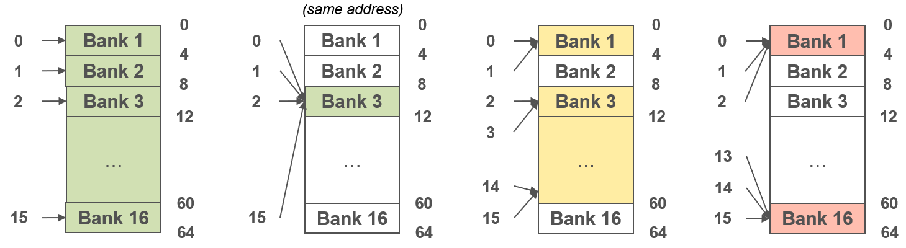
Shared Memory: Effective Memory Accesses
Shared memory may be used as a cache for global memory
it makes sense only if one will access an element in global memory multiple times
Effective access into shared memory implies the usage of different memory banks
consecutive 4 (or 8) bytes belong to different banks
threads within a warp should treat unequal banks to avoid bank conflicts
it’s ok to access single element by all the threads

Slide 12
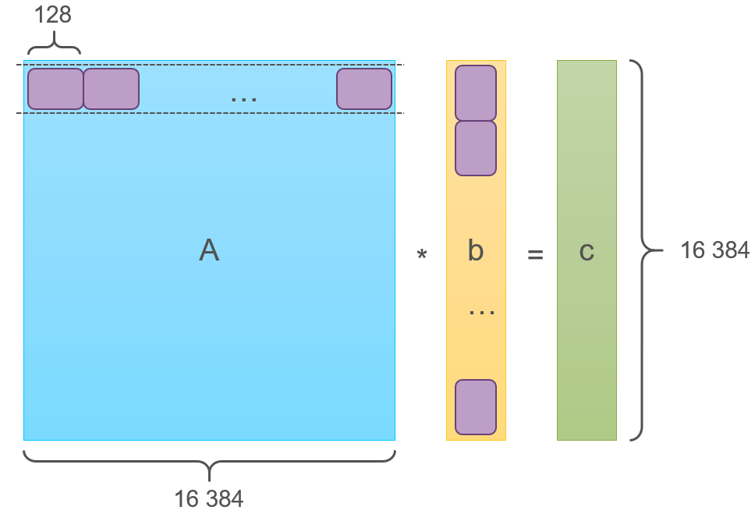
Example: Matrix Vector Multiplication…
__global__ void GEMV(const float* a, const float* b, float* c) {
int i = threadIdx.x + blockIdx.x * blockDim.x;
float sum = 0.0f;
for (int j = 0; j < N; ++j) {
sum += a[i * N + j] * b[j];
}
c[i] = sum;
}
int main() {
float *a, *b, *c;
cudaMallocManaged(&a, N * N * sizeof(float));
cudaMallocManaged(&b, N * sizeof(float));
cudaMallocManaged(&c, N * sizeof(float));
for (int i = 0; i < N * N; ++i) a[i] = 1.0f; for (int i = 0; i < N; ++i) b[i] = 2.0f;
GEMV2<<<N / BLOCK_SIZE, BLOCK_SIZE>>>(a, b, c);
cudaDeviceSynchronize(); cudaFree(a); cudaFree(b); cudaFree(c);
}
Vector b will be read N times from global memory
16 384
128

Slide 13
Example: Matrix Vector Multiplication
__global__ void GEMV(const float* a, const float* b, float* c) {
int i = threadIdx.x + blockIdx.x * blockDim.x;
float sum = 0.0f;
__shared__ float cache[BLOCK_SIZE];
// Loop over blocks
for (int k = 0; k < N / BLOCK_SIZE; ++k) {
// Read vector block to shared memory cache
cache[threadIdx.x] = b[k * BLOCK_SIZE + threadIdx.x];
__syncthreads();
// Compute partial sum
for (int j = 0; j < BLOCK_SIZE; ++j) {
sum += a[i * N + k * BLOCK_SIZE + j] * cache[j];
}
__syncthreads();
}
c[i] = sum;
}
Programmable cache in shared memory
Vector b will be read N / BLOCK_SIZE times from global memory
Is global memory access good enough?
All threads access the same bank with same address

Slide 14
Nvidia Tensor Cores

Slide 15
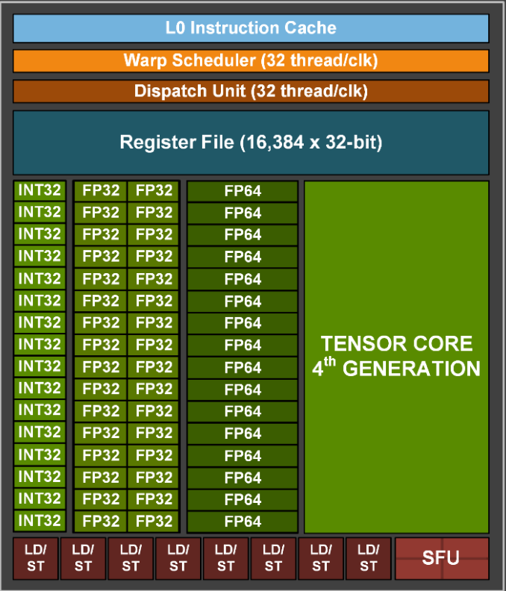
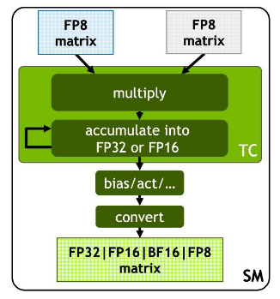
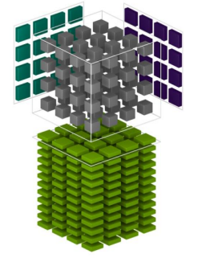
NVidia Hopper (2022): Tensor Core
Matrix Multiply & Accumulate (MMA) operations support in HW for small matrices (e.g., 16x16)
FP8, FP16, BF16, TF32, FP64 and INT8 MMA data types (depends on architecture)
Tesla V100 and newer (compute capability 7.0+)
High performance and low power consumption

Slide 16
Example: Matrix Multiplication (Host Side)
dim3 block_count(N / BLOCK_SIZE, N / BLOCK_SIZE);
dim3 block_size(BLOCK_SIZE, BLOCK_SIZE);
GEMM<<<block_count, block_size>>>(a, b, c);
cudaDeviceSynchronize();
auto start = std::chrono::system_clock::now();
GEMM<<<block_count, block_size>>>(a, b, c);
cudaDeviceSynchronize();
auto end = std::chrono::system_clock::now();
std::chrono::duration<float> elapsed =
end - start;
std::cout << "Time: " << elapsed.count() <<
" sec" << std::endl;
for (int i = 0; i < N * N; ++i) {
assert(c[i] == 2.0f * 3.0f * N);
}
cudaFree(a); cudaFree(b); cudaFree(c);
}
#include <assert.h>
#include <cuda.h>
#include <chrono>
#include <iostream>
#define N 4096
#define BLOCK_SIZE 16
int main() {
half *a, *b;
float *c;
cudaMallocManaged(&a, N * N * sizeof(half));
cudaMallocManaged(&b, N * N * sizeof(half));
cudaMallocManaged(&c, N * N * sizeof(float));
for (int i = 0; i < N * N; ++i) {
a[i] = 2.0f; b[i] = 3.0f; c[i] = 0.0f;
}
Half-float data type (16 bits)

Slide 17
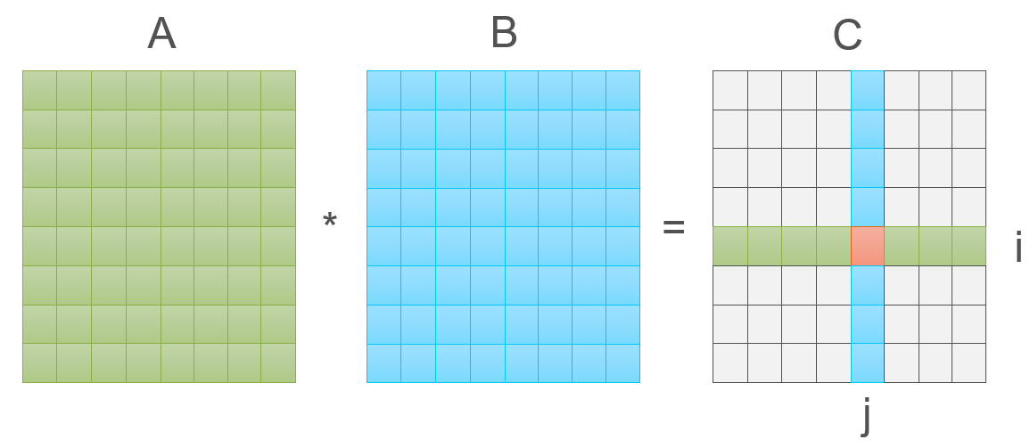
Example: Matrix Multiplication (Naïve Kernel)
Version | Time, sec
GEMMv1 | 1.14
__global__ void GEMMv1(const half* a, const half* b, float* c) {
int i = threadIdx.x + blockIdx.x * blockDim.x;
int j = threadIdx.y + blockIdx.y * blockDim.y;
float sum = 0.0f;
for (int k = 0; k < N; ++k) {
sum += a[i * N + k] * b[k * N + j];
}
c[i * N + j] = sum;
}
Constant memory access
N-strided memory access
N-strided memory access

Slide 18
Example: Matrix Multiplication (Global Memory Optimization)
Version | Time, sec
GEMMv1 | 1.14
GEMMv2 | 0.25
__global__ void GEMMv2(const half* a, const half* b, float* c) {
int j = threadIdx.x + blockIdx.x * blockDim.x;
int i = threadIdx.y + blockIdx.y * blockDim.y;
float sum = 0.0f;
for (int k = 0; k < N; ++k) {
sum += a[i * N + k] * b[k * N + j];
}
c[i * N + j] = sum;
}
Sequential memory access
Constant memory access
Constant memory access
Can we benefit from shared memory?

Slide 19
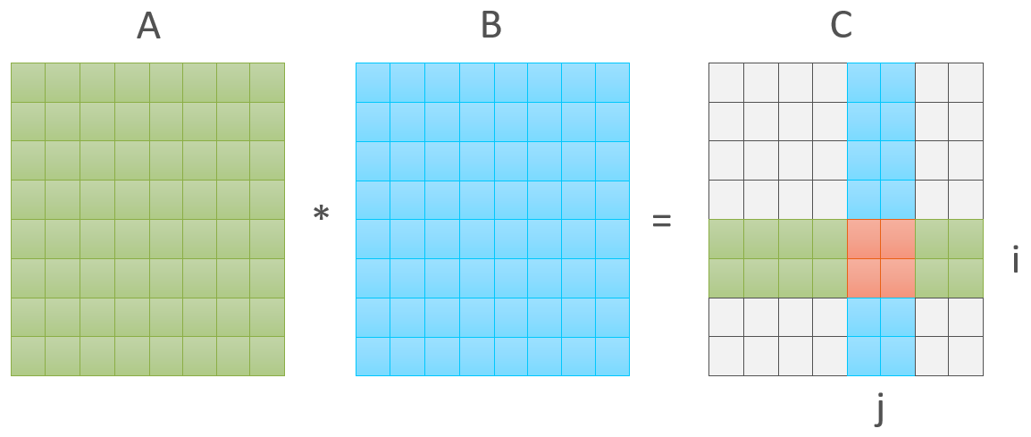
Example: Matrix Multiplication (Block Version)
__global__ void GEMMv3(const half* a, const half* b, float* c) {
int local_row = threadIdx.y;
int local_col = threadIdx.x;
int global_row = threadIdx.y + blockIdx.y * blockDim.y;
int global_col = threadIdx.x + blockIdx.x * blockDim.x;
float sum = 0.0f; __shared__ half block_a[BLOCK_SIZE * BLOCK_SIZE];
__shared__ half block_b[BLOCK_SIZE * BLOCK_SIZE];
// Loop per blocks
for (int block = 0; block < gridDim.x; ++block) {
// Read current block for A and B
block_a[local_row * BLOCK_SIZE + local_col] = a[global_row * N + (block * BLOCK_SIZE + local_col)];
block_b[local_row * BLOCK_SIZE + local_col] = b[(block * BLOCK_SIZE + local_row) * N + global_col];
__syncthreads();
// Calculate current block
for (int k = 0; k < BLOCK_SIZE; ++k) {
sum += block_a[local_row * BLOCK_SIZE + k] * block_b[k * BLOCK_SIZE + local_col];
}
__syncthreads();
}
// Store result into C
c[global_row * N + global_col] = sum;
}
Is global memory access good enough?
Version | Time, sec
GEMMv1 | 1.14
GEMMv2 | 0.25
GEMMv3 | 0.14
Constant memory access (no bank conflicts)
Sequential memory access (no bank conflicts)

Slide 20
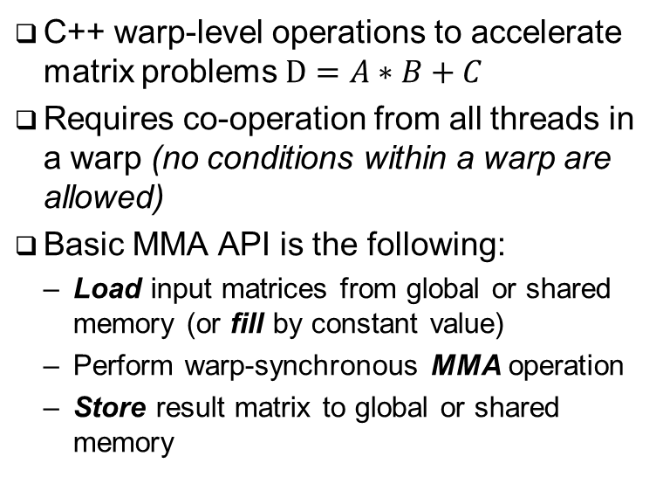
Warp Matrix Functions*
C++ warp-level operations to accelerate matrix problems $D=A∗B+C$
Requires co-operation from all threads in a warp (no conditions within a warp are allowed)
Basic MMA API is the following:
Load input matrices from global or shared memory (or fill by constant value)
Perform warp-synchronous MMA operation
Store result matrix to global or shared memory
#include <mma.h>
namespace nvcuda::wmma {
template<typename Use, int m, int n, int k,
typename T, typename Layout=void>
class fragment;
void load_matrix_sync(
fragment<...> &a, const T* mptr, unsigned ldm);
void load_matrix_sync(
fragment<...> &a, const T* mptr, unsigned ldm,
layout_t layout);
void store_matrix_sync(
T* mptr, const fragment<...> &a, unsigned ldm,
layout_t layout);
void fill_fragment(fragment<...> &a, const T& v);
void mma_sync(
fragment<...> &d, const fragment<...> &a,
const fragment<...> &b, const fragment<...> &c,
bool satf=false);
}
* CUDA C++ Programming Guide v12.3, 7.24. Warp Matrix Functions

Slide 21
Example: Matrix Multiplication (wmma version)…
#include <mma.h>
#define WARP_SIZE 32
#define WMMA_SIZE 16
using namespace nvcuda;
__global__ void GEMMv4(const half* a, const half* b, float* c) {
int warp_i = (blockIdx.x * blockDim.x + threadIdx.x) / warpSize;
int warp_j = (blockIdx.y * blockDim.y + threadIdx.y);
// Declare matrix fragments
wmma::fragment<
wmma::matrix_a, WMMA_SIZE, WMMA_SIZE, WMMA_SIZE,
half, wmma::row_major> a_frag;
wmma::fragment<
wmma::matrix_b, WMMA_SIZE, WMMA_SIZE, WMMA_SIZE,
half, wmma::row_major> b_frag;
wmma::fragment<
wmma::accumulator, WMMA_SIZE, WMMA_SIZE, WMMA_SIZE,
float> acc_frag;
// Fill result with zeros
wmma::fill_fragment(acc_frag, 0.0f);
1 warp (32 threads) computes 16x16 elements of C (result) matrix
Input matrix fragments
(matrices A and B are stored by rows)
Accumulator (result) matrix fragment
Initialize accumulator with zeros

Slide 22
Example: Matrix Multiplication (wmma version)…
// Loop over 16x16 fragments of A and B for a warp
for (int k = 0; k < N; k += WMMA_SIZE) {
int a_row = warp_i * WMMA_SIZE;
int a_col = k;
int b_row = k;
int b_col = warp_j * WMMA_SIZE;
// Load matrix fragments
wmma::load_matrix_sync(a_frag, a + a_row * N + a_col, N);
wmma::load_matrix_sync(b_frag, b + b_row * N + b_col, N);
// Perform matrix multiplication
wmma::mma_sync(acc_frag, a_frag, b_frag, acc_frag);
}
int c_row = warp_i * WMMA_SIZE;
int c_col = warp_j * WMMA_SIZE;
// Store the result
wmma::store_matrix_sync(
c + c_row * N + c_col, acc_frag, N, wmma::mem_row_major);
}
Load matrix fragment for A and B from global memory to tensor core
Compute intermediate result for 16x16 fragments and sum it into accumulator
(acc_frag = a_frag * b_frag + acc_frag)
Store final result for 16x16 fragment from tensor core to global memory

Slide 23
Example: Matrix Multiplication (wmma version)
blockDim.x must be a multiple of warpSize
int main() {
half *a, *b;
float *c;
cudaMallocManaged(&a, N * N * sizeof(half));
cudaMallocManaged(&b, N * N * sizeof(half));
cudaMallocManaged(&c, N * N * sizeof(float));
… dim3 block_size( 4 * WARP_SIZE,
4);
dim3 block_count( (N / block_size.x) * (WARP_SIZE / WMMA_SIZE),
(N / block_size.y) / WMMA_SIZE;
auto start = std::chrono::system_clock::now();
GEMMv4<<<block_count, block_size>>>(a, b, c);
cudaDeviceSynchronize();
auto end = std::chrono::system_clock::now();
std::chrono::duration<float> elapsed = end - start;
std::cout << "Time: " << elapsed.count()
<< " sec" << std::endl; …
}
X dimension: 32 threads (warp) responsible for 16 elements
(2x more blocks is needed)
Y dimension: 1 “thread” responsible for 16 elements
(16x less blocks is needed)
x
Version | Time, sec
GEMMv1 | 1.14
GEMMv2 | 0.25
GEMMv3 | 0.14
GEMMv4 | 0.06
16x16
y

Slide 24
Nvidia CUTLASS

Slide 25

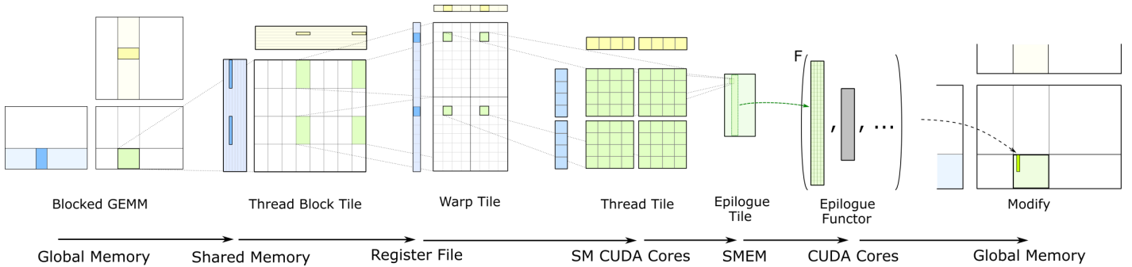
NVIDIA CUTLASS
CUDA Templates for Linear Algebra Subroutines and Solvers (CUTLASS):
Header-only open-source library for programming tensor cores
C++ template abstractions for high-performance GEMM and related computations
Model aware but architecture agnostic programming model
Support for mixed-precision computations:
FP16 (half-precision), BF16 (bfloat16), TF32 (tensor float), FP32 (single-precision), FP64 (double-precision), Int8, Int4, Int1
Python interface that is friendly for AI developers
J. Bai-Cheng, CUTLASS: CUDA template library for dense linear algebra at all levels and scales, GTC 2018, -2018 [URL]

Slide 26
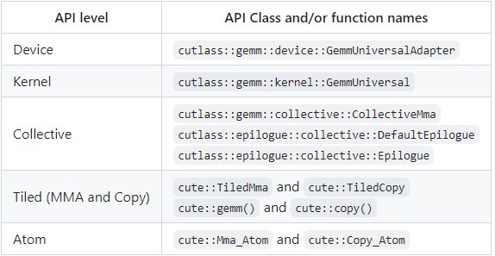
CUTLASS 3.0 GEMM API
CUTLASS presents a uniform programming model for matrix multiply-accumulate (MMA) operations at different levels of the GPU system hierarchy (from lowest to highest):
Device Layer (host-side)
host side setup & interface
Kernel Layer (≈grid)
launch API, grid planning logic, load balancing schedules, kernel thread marshalling
Collective Layer (≈block)
micro-kernel describing the complete temporal tiling (pipeline) of a math/copy operation
Tiled MMA/Copy Layer (≈warp)
micro-kernel describing the complete spatial tiling of a math/copy operation
Atom Layer (HW instructions)
the fewest number of threads for hardware-accelerated math/copy operation

Slide 27

Example: Matrix Multiplication (CUTLASS version)…
cudaError_t CutlassGEMM(const cutlass::half_t* a, const cutlass::half_t* b, float* c) {
using RowMajor = cutlass::layout::RowMajor;
using OpClassTensorOp = cutlass::arch::OpClassTensorOp;
using Sm75 = cutlass::arch::Sm75;
using CutlassGemm =
cutlass::gemm::device::Gemm<cutlass::half_t, // Data-type of A matrix
RowMajor, // Layout of A matrix
cutlass::half_t, // Data-type of B matrix
RowMajor, // Layout of B matrix
float, // Data-type of C matrix
RowMajor, // Layout of C matrix
float, // Element Accumulator
OpClassTensorOp, // Tag indicating Tensor Cores
Sm75>; // SM architecture
CutlassGemm::Arguments args({N, N, N},// Gemm Problem dimensions
{a, N}, // Tensor-ref for source matrix A
{b, N}, // Tensor-ref for source matrix B
{c, N}, // Tensor-ref for source matrix C
{c, N}, // Tensor-ref for destination matrix D
{1, 0}); // Scalars used in the Epilogue
CutlassGemm gemm_operator;
cutlass::Status status = gemm_operator(args);
return status == cutlass::Status::kSuccess ? cudaSuccess : cudaErrorUnknown;
}
Problem description
$$D=alpha∗A∗B+beta∗C$$
Problem arguments
Device-side computations (asynchronous)

Slide 28
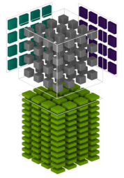
Example: Matrix Multiplication (CUTLASS version)
#include "cutlass/gemm/device/gemm.h"
int main() {
cutlass::half_t *a, *b;
float *c;
cudaMallocManaged(&a, N * N * sizeof(cutlass::half_t));
cudaMallocManaged(&b, N * N * sizeof(cutlass::half_t));
cudaMallocManaged(&c, N * N * sizeof(float));
…
cudaError_t status = CutlassGEMM(a, b, c);
cudaDeviceSynchronize();
auto start = std::chrono::system_clock::now();
status = CutlassGEMM(a, b, c);
cudaDeviceSynchronize();
auto end = std::chrono::system_clock::now();
std::chrono::duration<float> elapsed = end - start;
std::cout << "Time: " << elapsed.count() << " sec" << std::endl; …
}
CUTLASS header
CUTLASS-specific data type
~160x faster!
Warming-up
Version | Time, sec
GEMMv1 | 1.14
GEMMv2 | 0.25
GEMMv3 | 0.14
GEMMv4 | 0.06
CutlassGEMM | 0.007
Host-side function call

Slide 29
References
NVIDIA Corporation, NVIDIA H100 Tensor Core GPU Architecture [URL]
NVIDIA Corporation, CUDA C++ Programming Guide v12.3 [URL]
NVIDIA Corporation, The user manual for NVIDIA Nsight Compute v2023.3.1, -2023 [URL]
NVIDIA Corporation, NVIDIA Nsight Systems user guide v2024.1, -2024 [URL]
J. Appleyard, S. Yokim, Programming Tensor Cores in CUDA 9, -2017 [URL]
NVIDIA Corporation, NVIDIA CUTLASS v3.4 Documentation, -2024 [URL]
V. Thakkar, C. Cecka, R. Vuduc, A Generalized Micro-kernel Abstraction for GPU Linear Algebra, -2023 [URL]

Slide 30
Team
Anton Gorshkov, Ph.D., Associate Professor at Lobachevsky State University, Principal Engineer at Huawei
Arseniy Obolenskiy, Senior Engineer at Huawei
Mikhail Lychkov, Senior Engineer at Huawei
Oleg Maslov, Ph.D., Expert at Huawei

