Slide 1
Lobachevsky State University of Nizhny Novgorod
Institute of Information Technology, Mathematics and Mechanics
Programming for AI-accelerators
Ascend Hardware Programming
Using Ascend C
Arseniy Obolenskiy, Anton Gorshkov
anton.v.gorshkov@gmail.com

Slide 2
Contents
Ascend C Overview
Principles
API levels (level 0, level 2, high-level API)
API documentation (how to read, key points)
Ascend C kernel types (vector, cube, mixed)
Cube Kernel Example: Matrix Multiplication (MatMul)
Mixed Kernel Example: MatMul + Leaky ReLU

Slide 3
Ascend C OVERVIEW

Slide 4
CUBE kernel example OVERVIEW Matrix multiplication

Slide 5
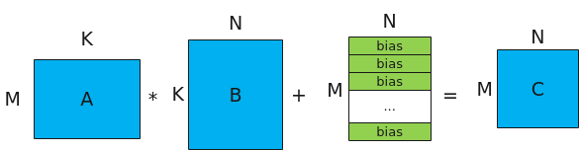
Matrix Multiplication
The calculation formula of MatMul is: C = A * B + Bias, and its schematic diagram is as follows.
A and B are the source operands, A is the left matrix with the shape [M, K]; B is the right matrix with the shape [K, N].
C is the destination operand, which stores the matrix of the matrix multiplication result. The shape is [M, N].
Bias is the matrix multiplication bias, and its shape is [N].

Slide 6
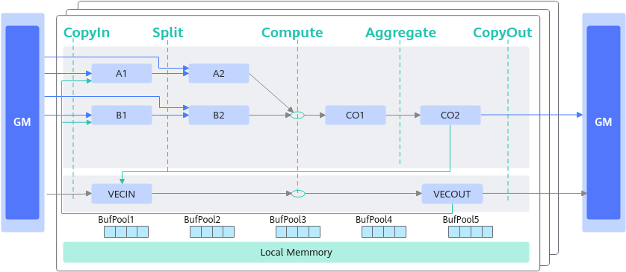
Ascend Buffer Names
Before understanding the matrix multiplication data flow, we need to review several important concepts of storage logical locations:
A1 is used to store the entire A matrix, which can be compared to the second-level cache in the CPU multi-level cache;
B1 is used to store the entire B matrix, which can be compared to the second-level cache in the CPU multi-level cache;
A2 is used to store the segmented small blocks of the A matrix, which can be compared to the first-level cache in the CPU multi-level cache;
B2 is used to store the segmented small B matrix, which can be compared to the first-level cache in the CPU multi-level cache;
CO1 is used to store the small result C matrix
CO2 is used to store the entire result C matrix
VECCALC is generally used when temporary variables are needed for calculations.

Slide 7
MatMul: Data Flow
5 steps computation: CopyIn, Split, Compute, Aggregate, CopyOut

Slide 8
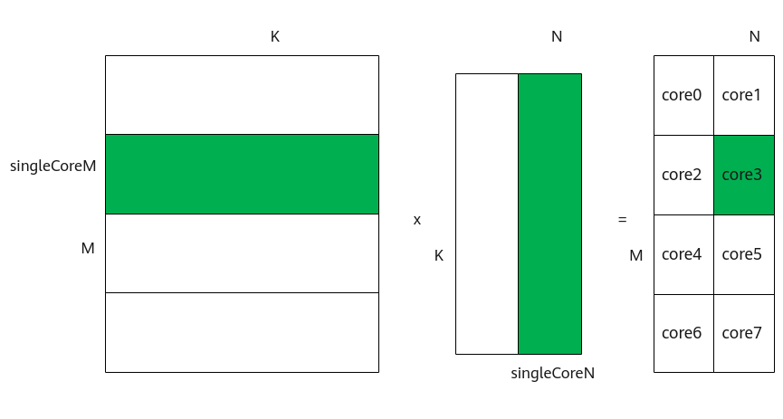
MatMul: Tiling Problem
Tiling
Multi core tiling
In core tiling
Split workloads between multiple cores
Split matrix into several tiles to fit hardware buffers limitation

Slide 9

MatMul: High-Level API
The tiling problem is too hard so it was decided to hide this under high-level API for the end users
Sample implementation:
https://gitee.com/ascend/samples/tree/master/operator/ascendc/0_introduction/11_matmul_kernellaunch/MatmulInvocationNeo
Run instructions:
$ bash run.sh

Slide 10
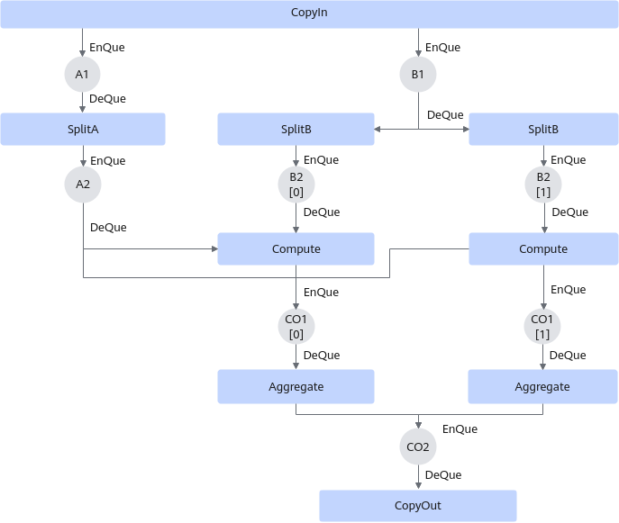
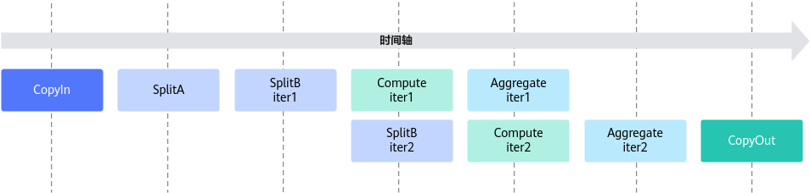
MatMul: How It Works Under The Hood?
High-level API provided by Ascend C is an abstraction to hide low level details of MatMul implementation
MatMul still follows pipelining paradigm from vector only kernels

Slide 11

MatMul: How To Implement Using Basic API?
Implementation:
https://www.hiascend.com/document/detail/zh/CANNCommunityEdition/800alpha002/devguide/opdevg/ascendcopdevg/atlas_ascendc_10_0038.html
Detailed guide:
https://www.hiascend.com/document/detail/zh/CANNCommunityEdition/800alpha002/devguide/opdevg/ascendcopdevg/atlas_ascendc_10_0037.html

Slide 12
MIXED kernel example OVERVIEW Matrix multiplication + LEAKY RELU

Slide 13
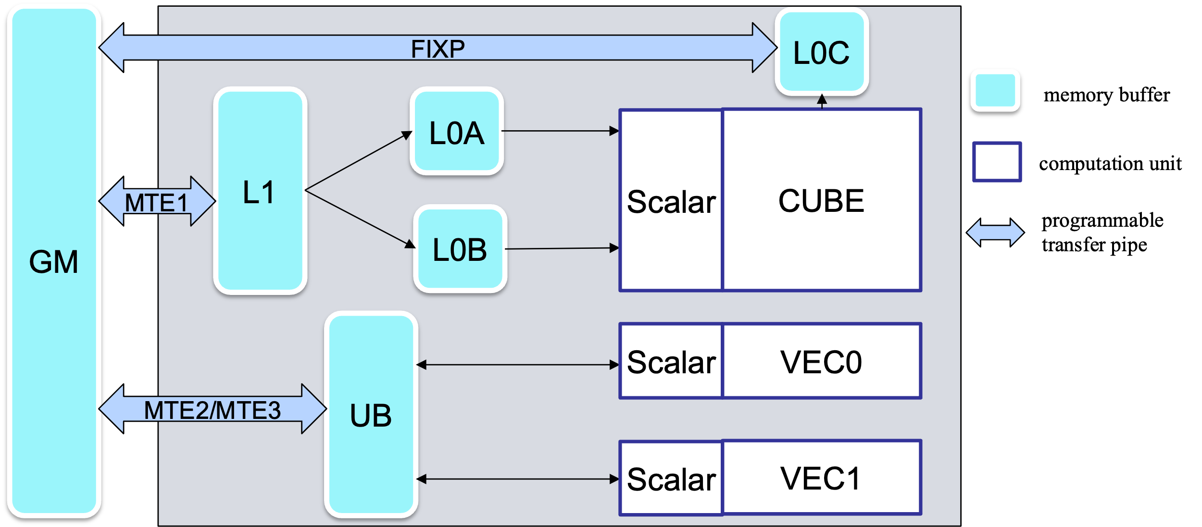
Mixed Kernels
What is so special about mixed kernels?
?
How to transfer the data
between VEC and CUBE?

Slide 14
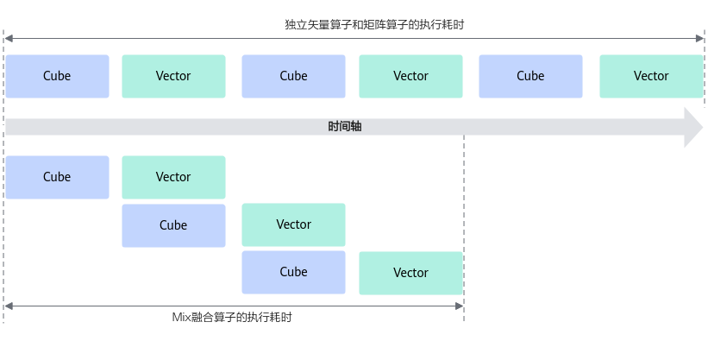
Mixed Kernels: Motivation & Pipelines
Motivation:
Execution of fused vector and cube workloads

Slide 15
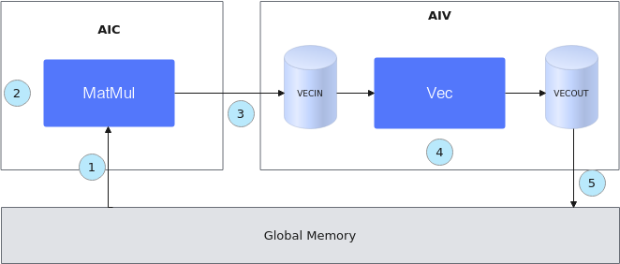
Mixed Kernels: Data Transfer
Data transfer between CUBE unit and vector unit is implemented through copying L0 <-> GM <-> UB
Initialize a MatMul object and transfer the input data from Global Memory to the Cube core.
Perform calculations internal to MatMul.
Transfer the calculation results of MatMul to the Vector core.
Perform Vector calculations.
Move the output results to Global Memory.

Slide 16
Mixed Kernels: Data Transfer (Implementation Sketch)
template<typename aType, typename bType, typename cType, typename biasType>
__aicore__ inline void MatmulLeakyKernel<aType, bType, cType, biasType>::Process()
{
// Step 1: Initialize a MatMul object and transfer the input data from Global Memory to the Cube core.
uint32_t computeRound = 0;
REGIST_MATMUL_OBJ(&pipe, GetSysWorkSpacePtr(), matmulObj);
matmulObj.Init(&tiling);
matmulObj.SetTensorA(aGlobal);
matmulObj.SetTensorB(bGlobal);
matmulObj.SetBias(biasGlobal);
while (matmulObj.template Iterate< true >()) { // Step 2: Perform the internal calculation of MatMul.
// Step 3: Transfer the calculation results of MatMul to the Vector core.
reluOutLocal = reluOutQueue_.AllocTensor<cType>();
matmulObj.template GetTensorC<true>(reluOutLocal, false , true );
// Step 4: Perform Vector calculation.
AscendC::LeakyRelu(reluOutLocal, reluOutLocal, (cType)alpha, tiling.baseM * tiling.baseN);
reluOutQueue_.EnQue(reluOutLocal);
// Step 5: Move the output results to Global Memory
reluOutQueue_.DeQue<cType>();
...
AscendC::DataCopy(cGlobal[startOffset], reluOutLocal, copyParam);
reluOutQueue_.FreeTensor(reluOutLocal); computeRound++;
}
matmulObj.End();
}

Slide 17
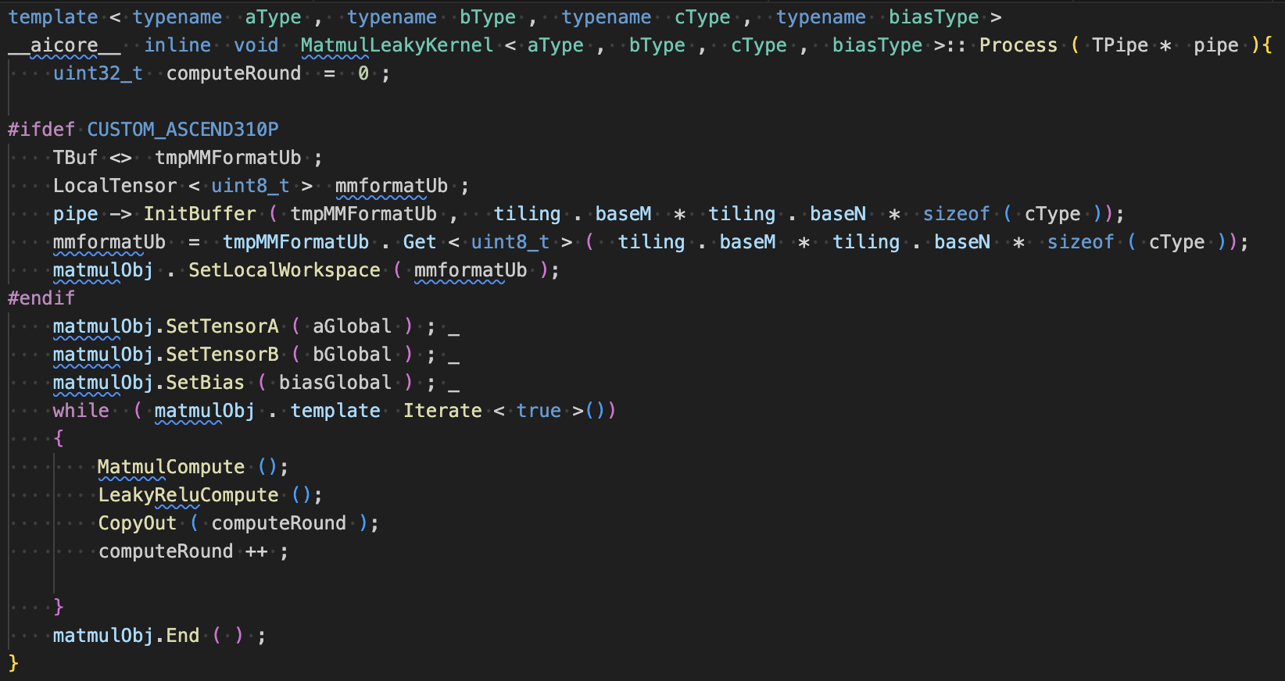
MatMul + LeakyReLU: Algorithm Overview
High-level API implementation

Slide 18
MatMul + LeakyReLU: How To Implement Using Basic API?
Implementation:
https://www.hiascend.com/document/detail/zh/CANNCommunityEdition/800alpha002/devguide/opdevg/ascendcopdevg/atlas_ascendc_10_0047.html
Detailed guide:
https://www.hiascend.com/document/detail/zh/CANNCommunityEdition/800alpha002/devguide/opdevg/ascendcopdevg/atlas_ascendc_10_0043.html

Slide 19
MatMul And Leaky ReLU
Sample implementation:
https://gitee.com/ascend/samples/tree/master/operator/ascendc/0_introduction/13_matmulleakyrelu_kernellaunch/MatmulLeakyReluInvocation
Run instructions:
$ bash run.sh

Slide 20
References
Ascend C: https://www.hiascend.com/ascend-c
Ascend C Samples: https://gitee.com/ascend/samples/
Ascend C Programming Guide: https://www.hiascend.com/document/detail/zh/CANNCommunityEdition/80alpha002/devguide/opdevg/ascendcopdevg/atlas_ascendc_10_0001.html
Huawei CANN Community Edition: https://www.hiascend.com/zh/developer/download/community/result?module=cann

Slide 21
Team
Anton Gorshkov, Ph.D., Associate Professor at Lobachevsky State University, Principal Engineer at Huawei
Arseniy Obolenskiy, Senior Engineer at Huawei
Mikhail Lychkov, Senior Engineer at Huawei
Oleg Maslov, Ph.D., Expert at Huawei

