Slide 1
Lobachevsky State University of Nizhny Novgorod
Institute of Information Technology, Mathematics and Mechanics
Programming for AI-accelerators
Practice #1 Programming Models
Anton Gorshkov
anton.v.gorshkov@gmail.com

Slide 2
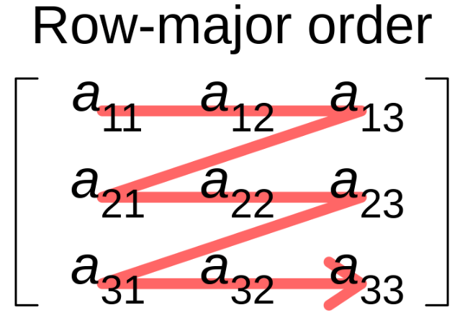
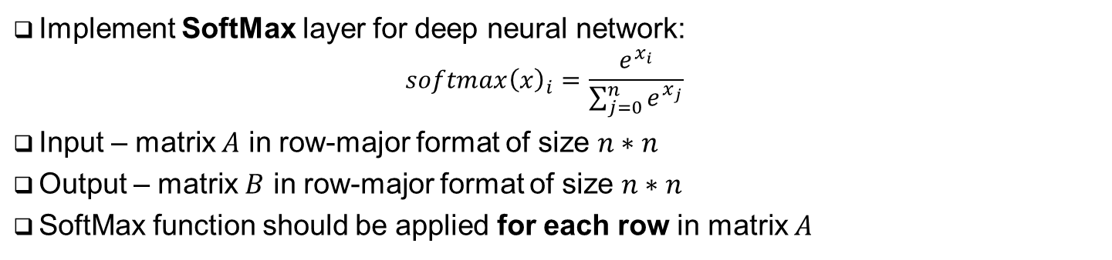


Problem Statement
Implement SoftMax layer for deep neural network:
$$softmax{\left(x\right)}_{i}=\frac{e^{x_{i}}}{\sum_{j=0}^{n}{e^{x_{j}}}}$$
Input – matrix $A$ in row-major format of size $n∗n$
Output – matrix $B$ in row-major format of size $n∗n$
SoftMax function should be applied for each row in matrix $A$
Apply SoftMax transformation
for each row
$$\left[\begin{matrix}a_{11} & ⋯ & a_{1n} \\ ⋮ & ⋱ & ⋮ \\ a_{n1} & ⋯ & a_{nn}\end{matrix}\right]$$
SoftMax
$$\left[\begin{matrix}b_{11} & ⋯ & b_{1n} \\ ⋮ & ⋱ & ⋮ \\ b_{n1} & ⋯ & b_{nn}\end{matrix}\right]$$

Slide 3
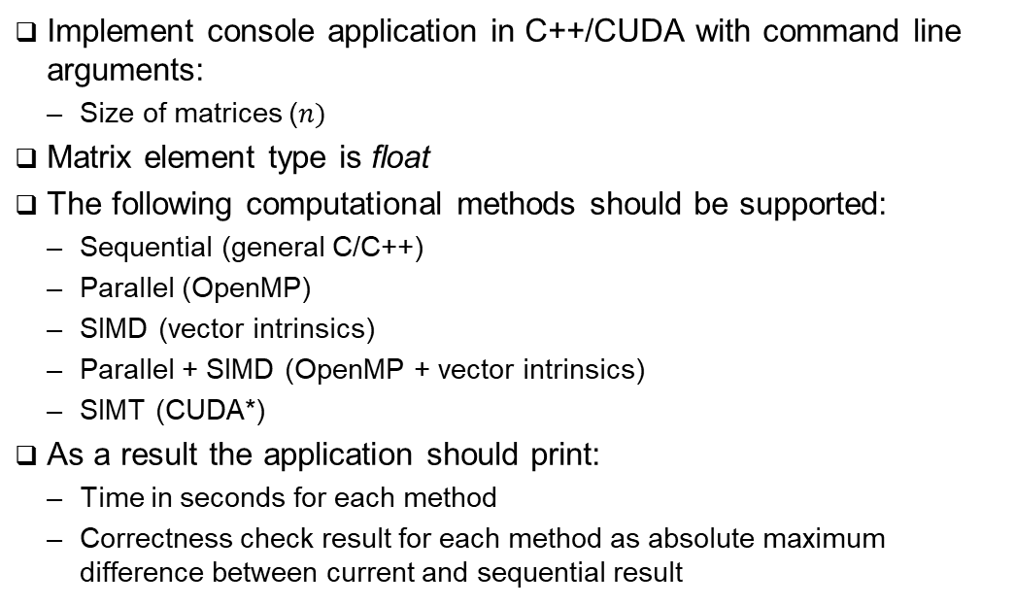
Task Details
Implement console application in C++/CUDA with command line arguments:
Size of matrices ($n)$
Matrix element type is float
The following computational methods should be supported:
Sequential (general C/C++)
Parallel (OpenMP)
SIMD (vector intrinsics)
Parallel + SIMD (OpenMP + vector intrinsics)
SIMT (CUDA*)
As a result the application should print:
Time in seconds for each method
Correctness check result for each method as absolute maximum difference between current and sequential result
Application Output Example:
$ ./softmax 1024
Sequential: 2.34 sec
Parallel: 1.12 sec (diff: 0.0)
SIMD: 1.65 sec (diff: 0.1e-5)
Parallel+SIMD: 0.75 sec (diff: 0.1e-05)
SIMT: 0.34 sec (diff: 0.23e-4)
* Implementation Hint: let CUDA block processes a row of matrix, and CUDA thread – an element

Slide 4
References
Wikipedia, Softmax Function, -2024 [URL]
OpenMP Architecture Review Board, OPENMP API Specification v5.2, -2021 [URL]
Intel Corporation, Intel Intrinsics Guide v3.6.7, -2023 [URL]
NVidia Corporation, CUDA C++ Programming Guide v12.3 [URL]

Slide 5
Team
Anton Gorshkov, Ph.D., Associate Professor at Lobachevsky State University, Principal Engineer at Huawei
Arseniy Obolenskiy, Senior Engineer at Huawei
Mikhail Lychkov, Senior Engineer at Huawei
Oleg Maslov, Ph.D., Expert at Huawei

