Slide 1
Lobachevsky State University of Nizhny Novgorod
Institute of Information Technology, Mathematics and Mechanics
Programming for AI-accelerators
Practice #2 Convolutional Layer in CUDA
Anton Gorshkov
anton.v.gorshkov@gmail.com

Slide 2
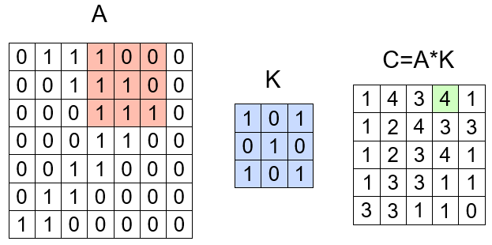
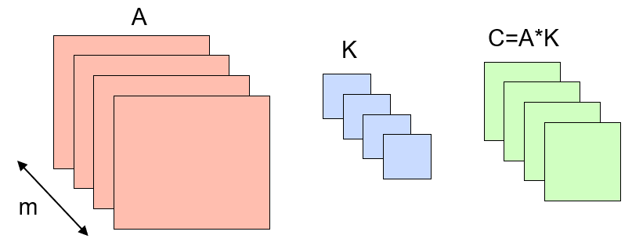
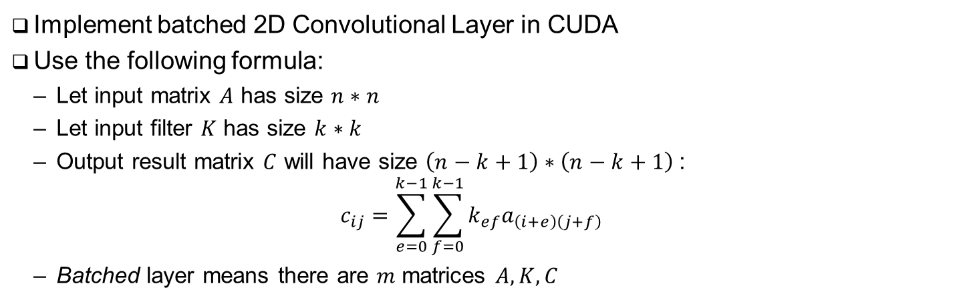
Problem Statement
Implement batched 2D Convolutional Layer in CUDA
Use the following formula:
Let input matrix $A$ has size $n∗n$
Let input filter $K$ has size $k∗k$
Output result matrix $C$ will have size $\left(n−k+1\right)∗\left(n−k+1\right)$:
$$c_{ij}=\sum_{e=0}^{k−1}{\sum_{f=0}^{k−1}{k_{ef}a_{\left(i+e\right)\left(j+f\right)}}}$$
Batched layer means there are $m$ matrices $A,K, C$

Slide 3
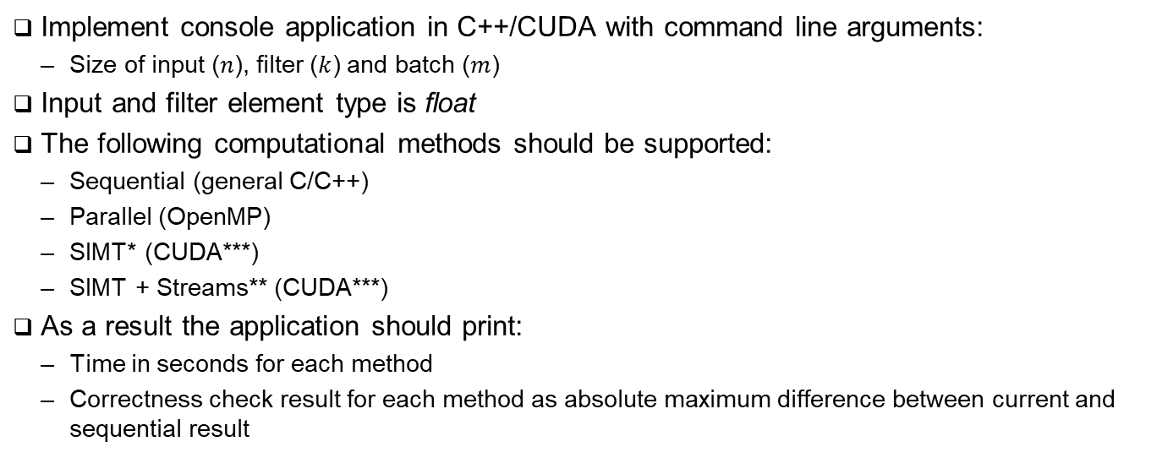
Task Details
Implement console application in C++/CUDA with command line arguments:
Size of input ($n$), filter ($k$) and batch ($m$)
Input and filter element type is float
The following computational methods should be supported:
Sequential (general C/C++)
Parallel (OpenMP)
SIMT* (CUDA***)
SIMT + Streams** (CUDA***)
As a result the application should print:
Time in seconds for each method
Correctness check result for each method as absolute maximum difference between current and sequential result
Application Output Example:
$ ./conv 2048 7 32
Sequential: 2.34 sec
Parallel: 1.12 sec (diff: 0.0)
SIMT: 0.34 sec (diff: 0.23e-4)
Streams: 0.23 sec (diff: 0.23e-4)
* Implementation Hint: let a thread block processes a row of result matrix, and a thread – an element. Loop over batches should be outer loop
** Implementation Hint: use approach described above. Introduce CUDA streams to overlap data transfers and computations ***Optimization Hint: use shared memory to store filter matrix

Slide 4
References
Wikipedia, Convolution, -2024 [URL]
OpenMP Architecture Review Board, OPENMP API Specification v5.2, -2021 [URL]
NVidia Corporation, CUDA C++ Programming Guide v12.3 [URL]

Slide 5
Team
Anton Gorshkov, Ph.D., Associate Professor at Lobachevsky State University, Principal Engineer at Huawei
Arseniy Obolenskiy, Senior Engineer at Huawei
Mikhail Lychkov, Senior Engineer at Huawei
Oleg Maslov, Ph.D., Expert at Huawei

