Slide 1
Lobachevsky State University of Nizhny Novgorod
Institute of Information Technology, Mathematics and Mechanics
Programming for AI-accelerators
Practice #3 Convolution Through Matrix Multiplication
Anton Gorshkov
anton.v.gorshkov@gmail.com

Slide 2
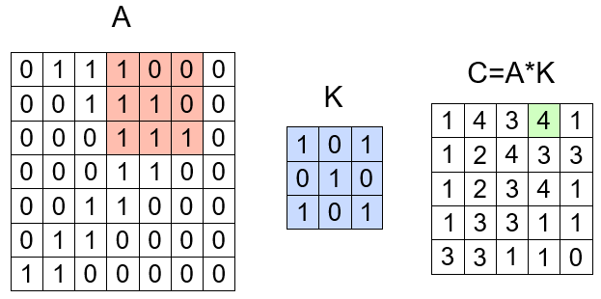
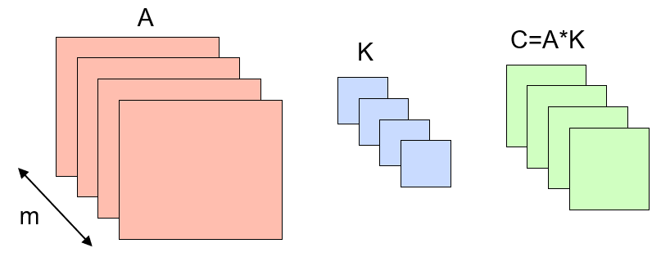
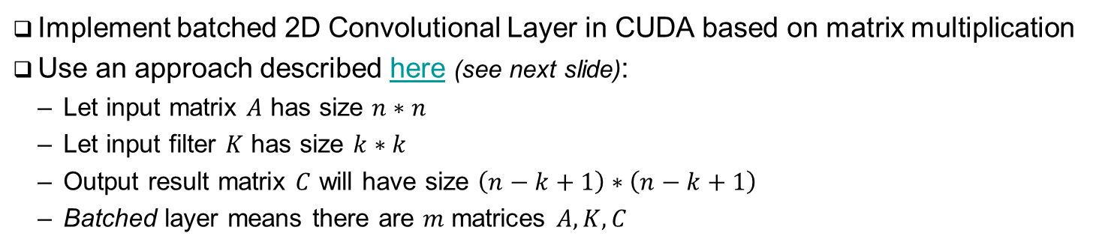
Problem Statement…
Implement batched 2D Convolutional Layer in CUDA based on matrix multiplication
Use an approach described here (see next slide):
Let input matrix $A$ has size $n∗n$
Let input filter $K$ has size $k∗k$
Output result matrix $C$ will have size $\left(n−k+1\right)∗\left(n−k+1\right)$
Batched layer means there are $m$ matrices $A,K, C$

Slide 3
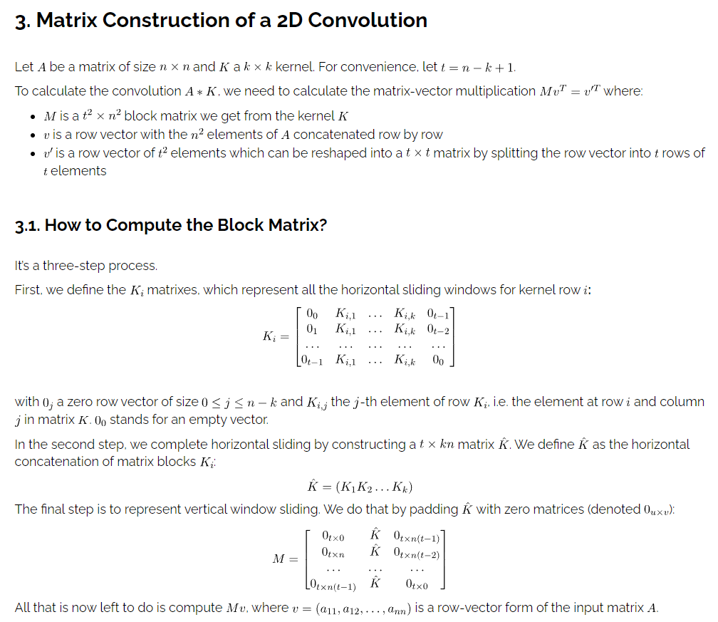
Problem Statement
https://www.baeldung.com/cs/convolution-matrix-multiplication

Slide 4
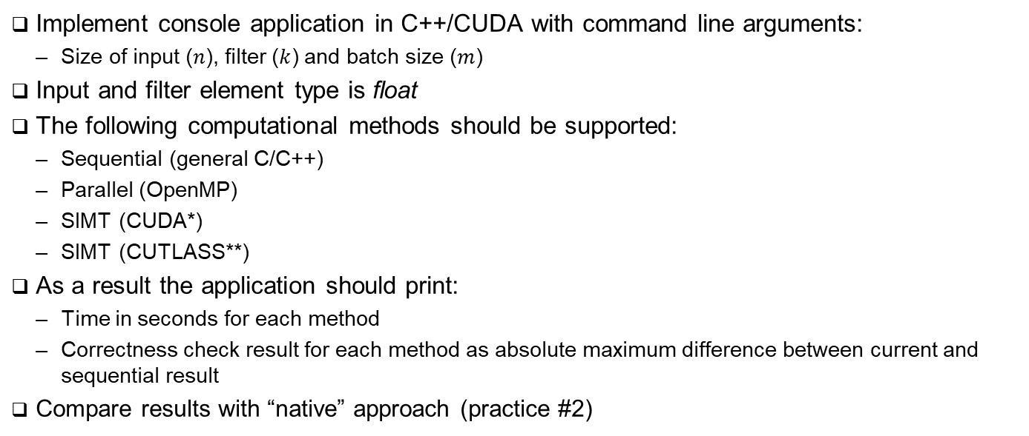
Task Details
Implement console application in C++/CUDA with command line arguments:
Size of input ($n$), filter ($k$) and batch size ($m$)
Input and filter element type is float
The following computational methods should be supported:
Sequential (general C/C++)
Parallel (OpenMP)
SIMT (CUDA*)
SIMT (CUTLASS**)
As a result the application should print:
Time in seconds for each method
Correctness check result for each method as absolute maximum difference between current and sequential result
Compare results with “native” approach (practice #2)
Application Output Example:
$ ./mconv 2048 7 16
Sequential: 2.34 sec
Parallel: 1.12 sec (diff: 0.0)
CUDA: 0.34 sec (diff: 0.23e-4)
CUTLASS: 0.23 sec (diff: 0.23e-4)
* Implementation Hint: use WMMA instruction to implement matrix multiplication
** Implementation Hint: use host-side CUTLASS convolution API

Slide 5
References
Wikipedia, Convolution, -2024 [URL]
Baeldung, 2D Convolution as a Matrix-Matrix Multiplication, -2023 [URL]
NVIDIA Corporation, CUTLASS Convolution, -2024 [URL]
OpenMP Architecture Review Board, OPENMP API Specification v5.2, -2021 [URL]
NVIDIA Corporation, CUDA C++ Programming Guide v12.3 [URL]

Slide 6
Team
Anton Gorshkov, Ph.D., Associate Professor at Lobachevsky State University, Principal Engineer at Huawei
Arseniy Obolenskiy, Senior Engineer at Huawei
Mikhail Lychkov, Senior Engineer at Huawei
Oleg Maslov, Ph.D., Expert at Huawei

