Slide 1
Lobachevsky State University of Nizhny Novgorod
Institute of Information Technology, Mathematics and Mechanics
Programming for AI-accelerators
Practice #4
Programming for Ascend hardware.
Ascend C
Arseniy Obolenskiy
Anton Gorshkov

Slide 2
Contents
CANN package installation
Running basic Ascend C sample (vector add)

Slide 3
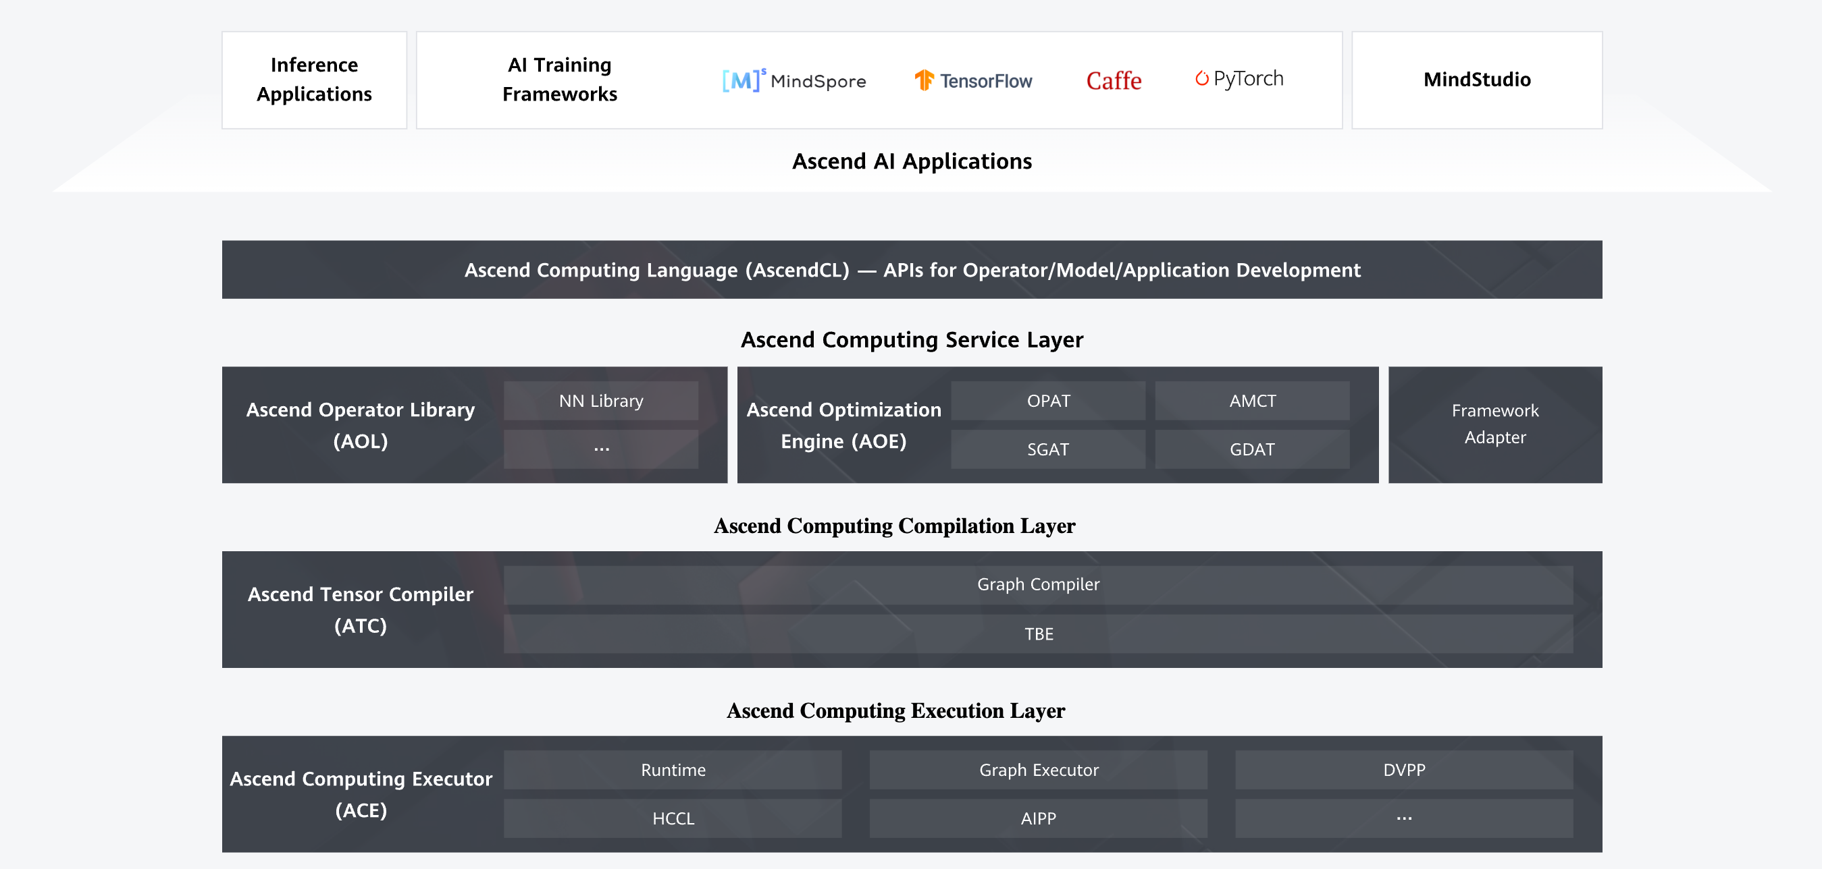
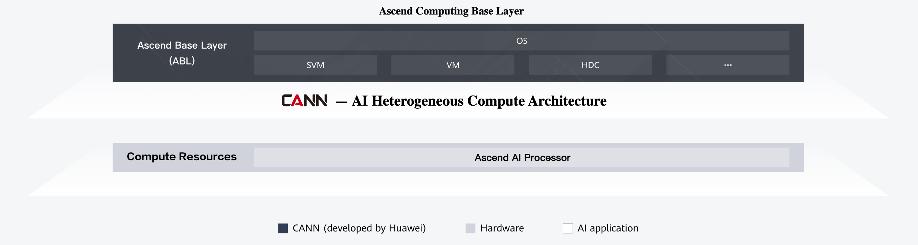
CANN package

Slide 4
CANN Community Download
https://www.hiascend.com/en/software/cann/community (EN)
https://www.hiascend.com/zh/developer/download/community/result?module=cann (中文)
Version on Chinese version of the website is newer quite often, it is recommended to use this

Slide 5
Samples for CANN
Official repository with samples:
https://gitee.com/ascend/samples/
Note: GitHub also has this repository (https://github.com/Ascend/samples), but the version is outdated

Slide 6
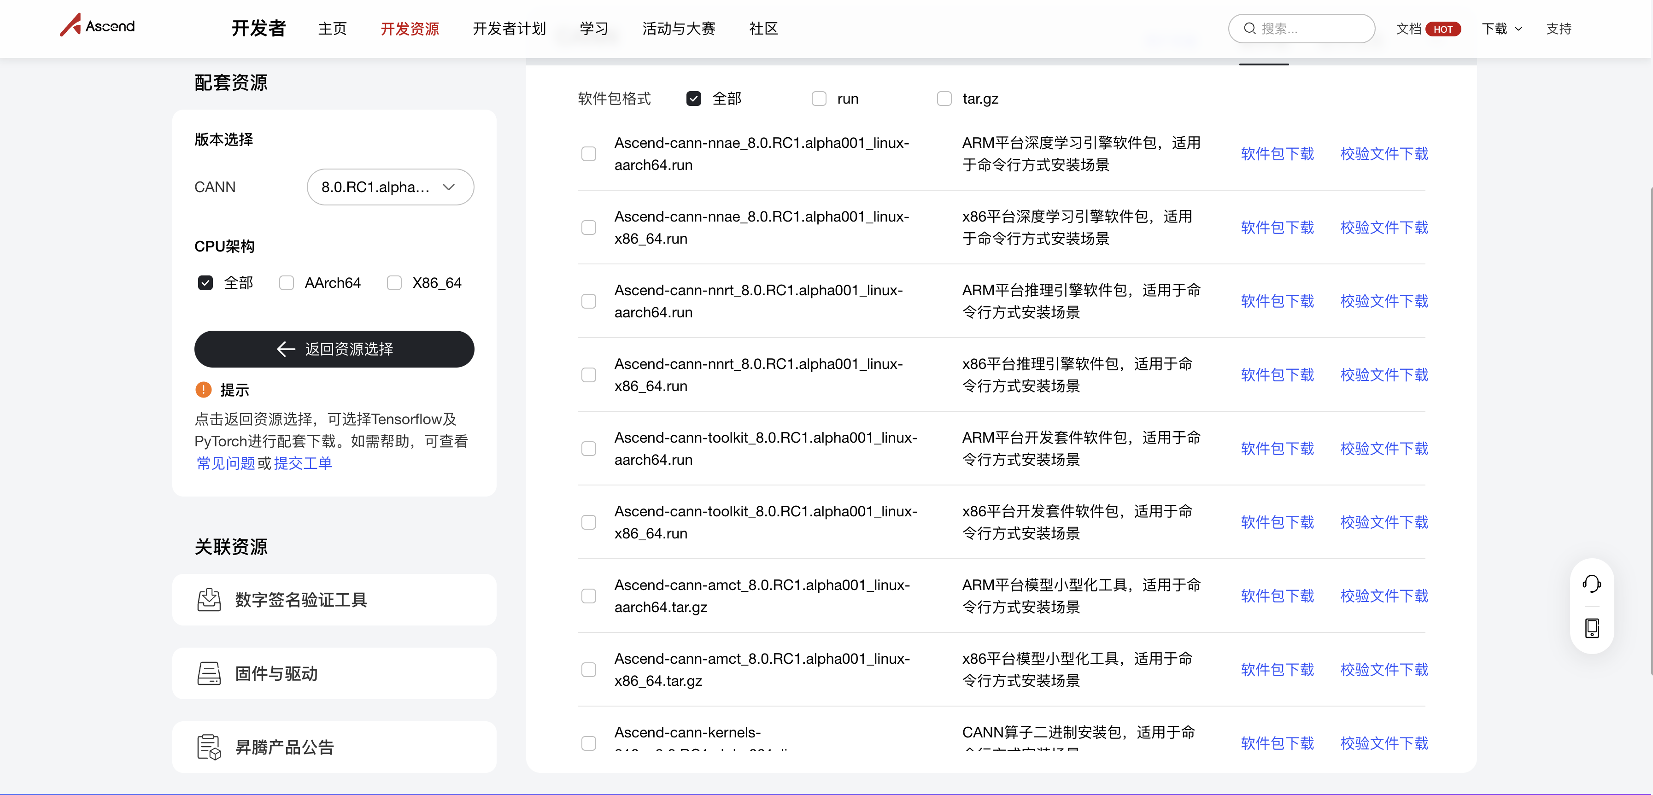
CANN installation: download CANN
Go to CANN Community Download website: https://www.hiascend.com/zh/developer/download/community/result?module=cann
Choose HW architecture
siutable for your
environment

Slide 7
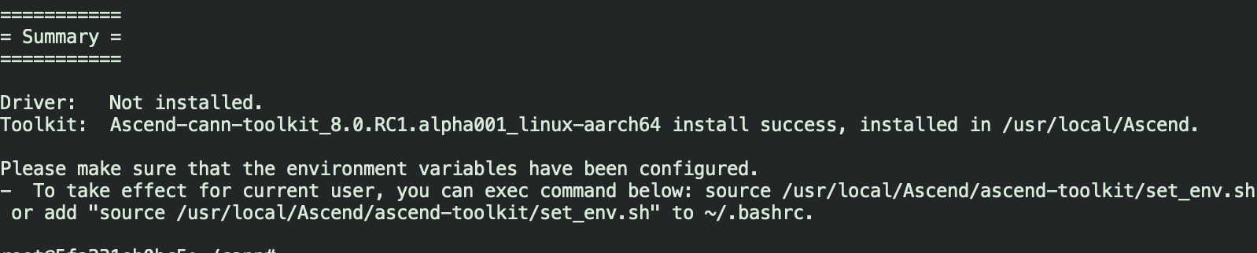
CANN installation: unpack & install
Download Ascend-cann-toolkit_8.0.RC1.alpha001_linux-aarch64.run file
Install dependencies for CANN (for Ubuntu):
sudo apt-get install -y python3 python3-pip git cmake
Unpack & install
chmod +x Ascend-cann-toolkit_8.0.RC1.alpha001_linux-aarch64.run
sudo ./Ascend-cann-toolkit_8.0.RC1.alpha001_linux-aarch64.run --full
During the process accept EULA
Do you accept the EULA to install CANN?[Y/N]Y
Successful result looks like this:
* version may differ

Slide 8
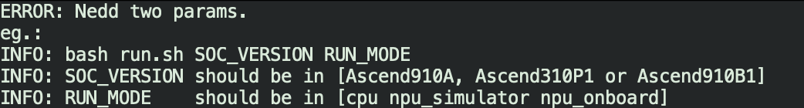
Run sample
Clone samples repository:
git clone https://gitee.com/ascend/samples/
Set up environment:
source /usr/local/Ascend/ascend-toolkit/set_env.sh
Run sample:
cd samples/operator/AddCustomSample/KernelLaunch/AddKernelInvocation
bash run.sh
Run for Ascend910B1 on CPU and NPU simulator:
bash run.sh Ascend910B1 cpu
bash run.sh Ascend910B1 npu_simulator

Slide 9
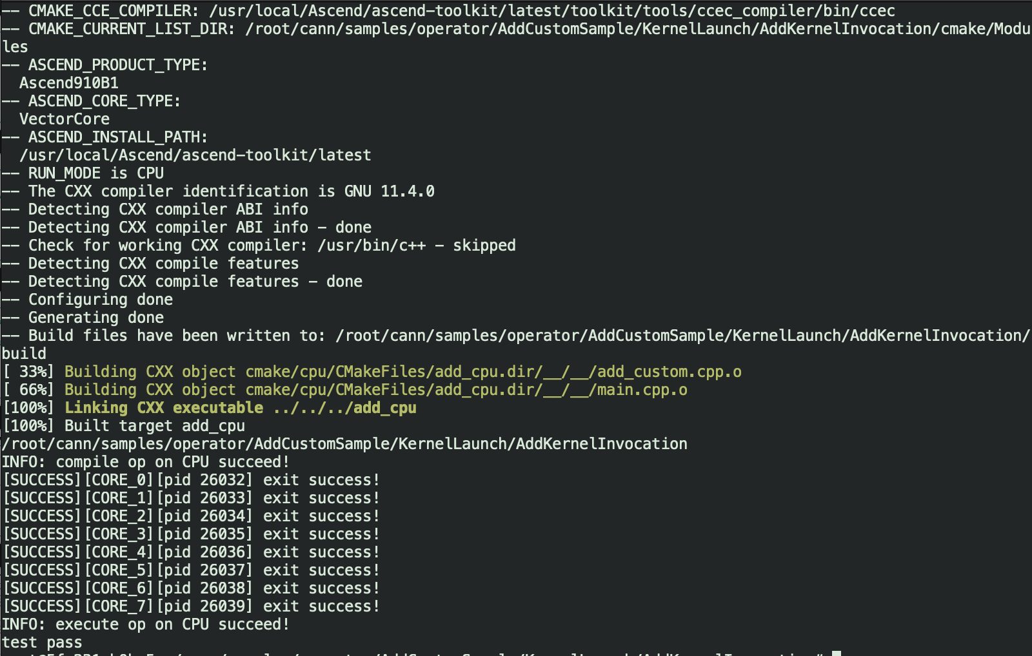
Vector add: CPU run for Ascend910B1

Slide 10
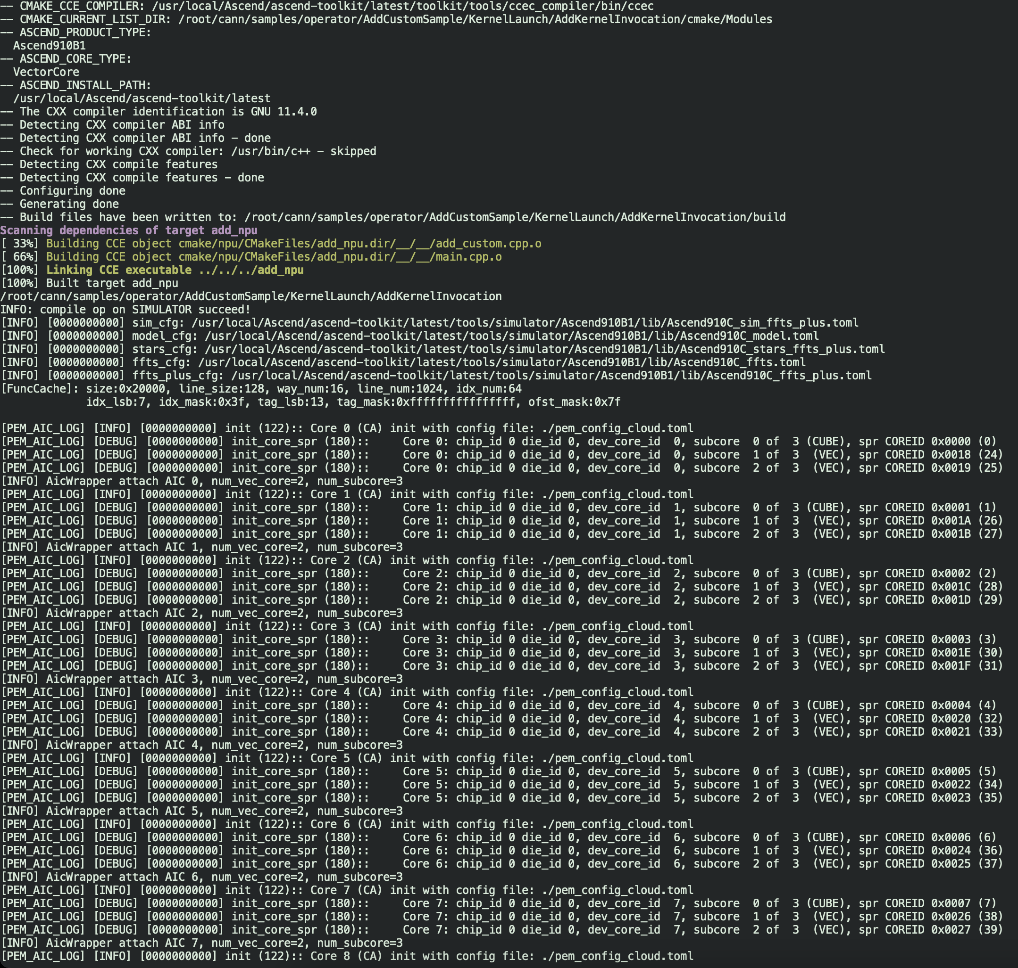
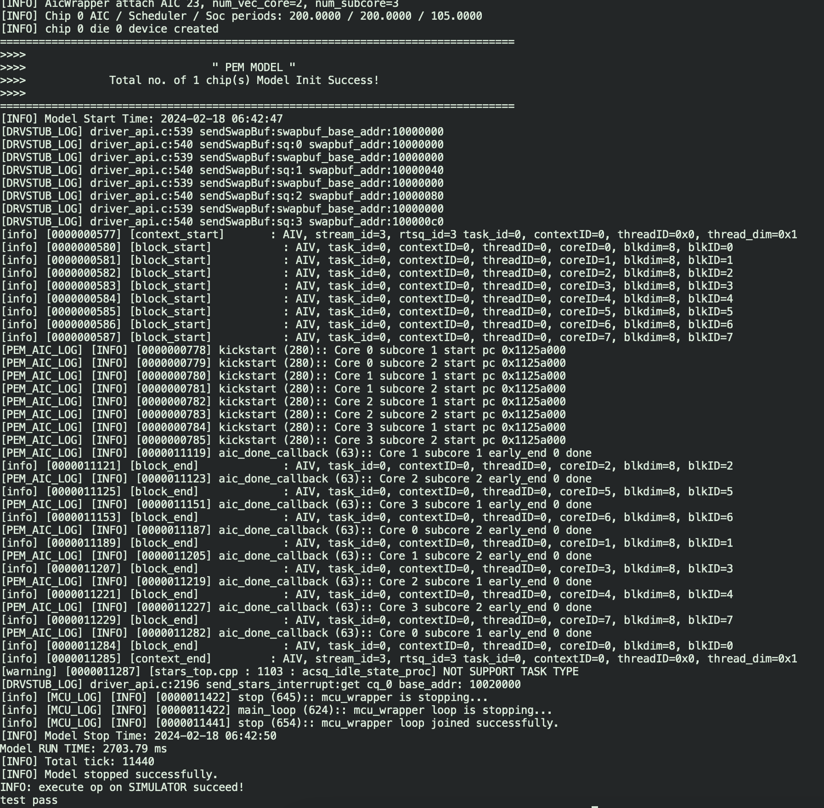
Vector add: NPU simulator run for Ascend910B1

Slide 11
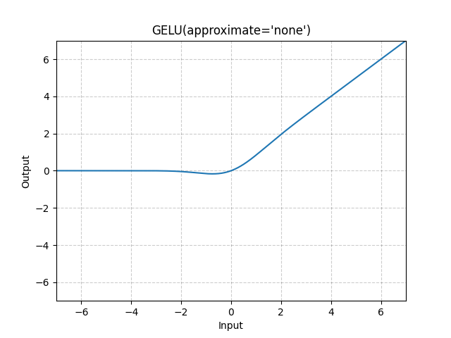
Task
Implement GeLU vector kernel
Materials for reference:
What is GeLU: https://paperswithcode.com/method/gelu
PyTorch GeLU: https://pytorch.org/docs/stable/generated/torch.nn.GELU.html
Ascend C API reference for Erf function: https://www.hiascend.com/document/detail/zh/CANNCommunityEdition/800alpha002/apiref/ascendcopapi/atlasascendc_api_07_0544.html
What solution should include
Kernel implementation
Tests that verify computation validity
Time measurement for your implementation
Note: Ascend C built-in GeLU function should not be used

Slide 12
References
Huawei Ascend: https://www.hiascend.com/
CANN package:
https://www.hiascend.com/zh/developer/download/community/result?module=cann
https://www.hiascend.com/en/software/cann/community
Ascend samples: https://gitee.com/ascend/samples/

Slide 13
Team
Anton Gorshkov, Ph.D., Associate Professor at Lobachevsky State University, Principal Engineer at Huawei
Arseniy Obolenskiy, Senior Engineer at Huawei
Mikhail Lychkov, Senior Engineer at Huawei
Oleg Maslov, Ph.D., Expert at Huawei

