Slide 1
Lobachevsky State University of Nizhny Novgorod
Institute of Information Technology, Mathematics and Mechanics
Programming for AI-accelerators
Practice #5
Programming for Ascend hardware.
Ascend C
Advanced level: mixed kernels
Arseniy Obolenskiy
Anton Gorshkov

Slide 2
Contents
Running advanced Ascend C samples
Matrix multiplication
Mixed kernels

Slide 3
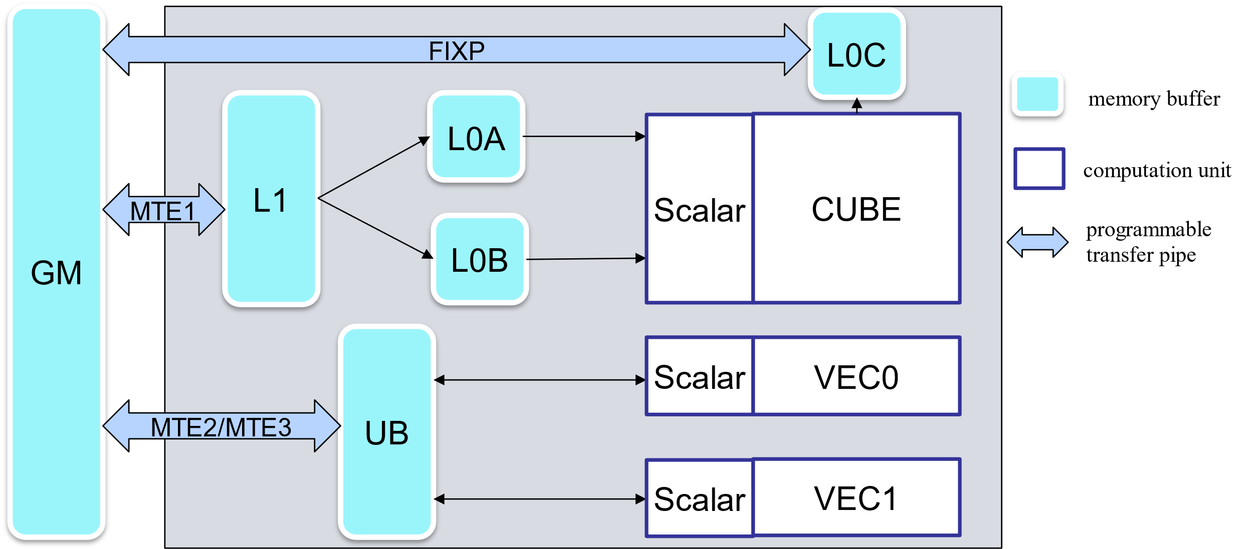
Available execution modes
Vector core
Cube core
Mixed core

Slide 4
Task
Implement Matmul + GeLU mixed kernel
What solution should include
Kernel implementation
Tests that verify computation validity
Time measurement for your implementation
Note: Ascend C built-in GeLU function should not be used

Slide 5
References
Huawei Ascend: https://www.hiascend.com/
CANN package:
https://www.hiascend.com/zh/developer/download/community/result?module=cann
https://www.hiascend.com/en/software/cann/community
Ascend samples: https://gitee.com/ascend/samples/

Slide 6
Team
Anton Gorshkov, Ph.D., Associate Professor at Lobachevsky State University, Principal Engineer at Huawei
Arseniy Obolenskiy, Senior Engineer at Huawei
Mikhail Lychkov, Senior Engineer at Huawei
Oleg Maslov, Ph.D., Expert at Huawei

