Slide 1
LIBRARY MANAGEMENT SYSTEM

Slide 2
TEAM
P.Ashritha - 2403A52229
A.Niharika - 2403A52234
B.Sathvika - 2403A52250

Slide 3
Project Objectives
1. Digitize manual library book issuance & return process at SR University
2. Reduce waiting time and human errors in library operations
3. Track issued books, due dates, and overdue status in real-time
4. Provide instant digital receipts on book return 5. Enable search by book title, author, or student

Slide 4
Stakeholders
1. Librarians → Faster issuance, return tracking, overdue alerts
2. Students → Easy search, instant issue/return, digital receipts
3. Faculty & Admin → Monitor library usage, generate reports
4. SR University Library Department → Reduce paperwork, improve efficiency

Slide 5
Programming Languages, Tools, and Software
Frontend:
• HTML5 – Structure
• CSS3 – Styling (Custom + Font Awesome)
• JavaScript (Vanilla) – Logic & Interactivity
Tools & Libraries:
• Google Fonts – Poppins •
Font Awesome 6.5 – Icons
• Canvas API – Confetti Animation •
Browser Print & Blob – Receipt Download

Slide 6
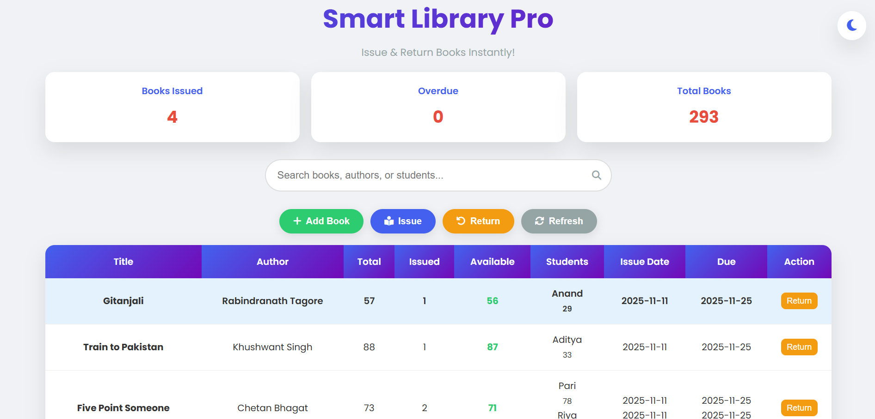
Front-end View of Web Application

Slide 7
THANK YOU

