Slide 1
RESEARCH CONFERENCE PRESENTATION | QUANTUM COMPUTING & DATA SCIENCE
Q-Interestingness: Quantum Exploratory Data Analysis
Quantifying Structural Divergence and Complementary Anomaly Candidates via Entangling Quantum Hilbert Spaces
Author & Presenter: Sooraj G P
Qiskit 2.5.2 | Qiskit Machine Learning 0.9.1 | Scikit-Learn | Empirical Permutation Validated (p < 0.01)
Notes:
Good morning / afternoon, esteemed faculty and colleagues. Today I am presenting our work on Q-Interestingness: Quantum Exploratory Data Analysis. Our core investigation asks: When we embed tabular data into quantum Hilbert spaces using parameterized circuits, does the resulting inner-product state geometry reveal structural oddities and relationships that classical Euclidean distances and RBF kernels compress? Over the next 15 minutes, I will share our theoretical formulation, the QI_v2 metric, our statistical permutation proofs, and cross-dataset benchmarks.

Slide 2
MOTIVATION & PROBLEM STATEMENT
The Geometric Boundaries of Classical EDA
Why Euclidean metrics and stationary kernels fail to capture complex multi-feature relations.
The Classical Representation Bottleneck
The Quantum Hilbert Space Hypothesis
Euclidean Distance Assumptions: Standard EDA and anomaly detection (e.g., k-NN, Isolation Forest, LOF) presuppose flat Euclidean spaces or axis-aligned tree partitions.
Stationary Kernel Compression: Stationary kernels like Gaussian RBF depend strictly on spatial displacement ||x_i - x_j||. They compress complex relational correlations across non-linearly coupled tabular features.
The Blind Spot: Observations with typical 1D marginals and median spatial coordinates can exhibit high relational heterogeneity across multi-variable phase relationships.
Core Research Question: Does mapping classical data into quantum Hilbert space via parameterized entangling circuits induce an alternative geometric landscape that surfaces genuine complementary exploratory candidates?
Non-Linear State Mapping: Classical vectors x in R^d are mapped to normalized quantum states |ψ(x)⟩ in 2^n dimensional Hilbert space.
Multi-Qubit Entanglement: Entangling gates (e.g., Controlled-Z phase rotations) inject non-local correlations between tabular dimensions invisible to marginal analysis.
Fidelity as Similarity: Inner product fidelity K_ij = |⟨ψ(x_i)|ψ(x_j)⟩|^2 serves as a natural, bounded similarity metric in [0, 1].
Exploratory Hypothesis: Points typical in Euclidean space may experience quantum phase interference, appearing isolated or exhibiting high neighborhood variance in Hilbert space.
Notes:
In exploratory data analysis, all discovery is conditioned on the metric space chosen. Classical algorithms—whether distance-based like Local Outlier Factor or partitioning-based like Isolation Forest—are constrained by Euclidean geometry. When tabular data has complex multi-feature interactions, classical metrics often compress this structure. Quantum feature maps allow us to project data into a 2^n dimensional Hilbert space where entanglement couples features into non-linear phase angles. Our goal is not to replace classical methods, but to understand whether quantum representations offer a principled, complementary lens.

Slide 3
THEORETICAL CONTEXT & CONTRIBUTIONS
Addressing Gaps in Quantum Machine Learning
Moving beyond supervised classification to unsupervised exploratory data analysis.
Prior QML Focus
Supervised Benchmarks
Emphasis on classification accuracy & variational optimization.
Unexplored Gap
Unsupervised EDA
Representation divergence & exploratory anomaly profiling.
Our Contribution
The QI_v2 Framework
Decoupling internal quantum structure from metric disagreement.
Primary Scientific Contributions of This Work
1. Formalized Representation Divergence Quantification: Established a rigorous protocol combining Centered Kernel Alignment (CKA) and local neighborhood graph overlaps (k-NN Jaccard) to quantify geometric displacement.
2. Mathematical Formulation of Q-Interestingness (QI_v2): Engineered a decoupled framework separating internal Hilbert space isolation (Quantum Unusualness, QU) from cross-space tension (Representation Disagreement, RD).
3. Classical Non-Linear Controls: First study to benchmark quantum kernel divergence against Polynomial (degree 3) and Random Fourier Features, proving quantum Hilbert divergence is >2x classical non-linear expansion.
4. Rigorous Statistical Permutation Validation: Evaluated a full B=100 quantum permutation null distribution (z = +8.91, p = 0.0099), providing formal non-parametric proof that classical-quantum divergence is non-random.
5. Cross-Domain & Hardware Noise Validation: Demonstrated domain invariance across 3 real-world datasets and confirmed pre-hardware viability across 1024, 4096, and 8192 measurement shots.
Notes:
Looking at the literature: Havlíček et al. (Nature 2019) and Schuld & Killoran (PRL 2019) laid the foundation for quantum feature spaces, but primarily focused on supervised support vector classification. Very little work has investigated what quantum Hilbert geometry does to unsupervised exploratory data analysis. Our work addresses this exact gap with five contributions: formal divergence quantification, the decoupled QI_v2 metric, classical non-linear controls, a full B=100 quantum permutation test, and multi-domain validation.

Slide 4
SYSTEM ARCHITECTURE & QUANTUM ENCODING
ZZFeatureMap & State Fidelity Kernel
Mathematical formulation of continuous classical feature injection into n-qubit Hilbert space.
Circuit Encoding Formulation
Architectural Flow
Feature Scaling to Phase Angles: Features x in R^4 are scaled to [0, π] via MinMaxScaler: x_j = π * (x_j - min) / (max - min).
Unitary State Evolution: |ψ(x)⟩ = U_Φ(x) |0⟩^⊗n, where U_Φ(x) = exp(i ∑_j x_j Z_j + ∑_{j<k} (π - x_j)(π - x_k) Z_j Z_k).
Entanglement Topology: Linear nearest-neighbor entanglement: pairs (q0, q1), (q1, q2), (q2, q3) coupled via Controlled-Phase (CPHASE) gates.
Circuit Specifications: 4 qubits, depth = 19 (reps = 2), 4 parameterized single-qubit rotations, 3 two-qubit entangling gates per repetition.
Kernel Fidelity Evaluation: K_ij = |⟨ψ(x_i)|ψ(x_j)⟩|^2 evaluated via Qiskit's ComputeUncompute with StatevectorSampler backend.
Input Data Vector: x = [alcohol, volatile_acidity, sulphates, total_sulfur_dioxide] in R^4
Normalization Pipeline: MinMaxScaler -> Phase Rotation [0, π] (no angle wrapping)
Quantum Circuit: 4-Qubit Circuit -> Hadamard Layer -> Rz(2x) -> Linear CNOT/Rz/CNOT Entanglers -> Repetition 2
Output Statevector: |ψ(x)⟩ in C^16 (complex state amplitudes on 16 computational basis states)
Fidelity Kernel Matrix: Pairwise N x N symmetric Gram matrix K, K_ii = 1.0, strictly positive semi-definite (PSD)
Notes:
Here we show the quantum circuit architecture. We map 4 continuous features into a 4-qubit circuit using Qiskit's class-based ZZFeatureMap. Notice the mathematical structure: the single-qubit terms apply individual phase shifts Z_j, while the two-qubit terms inject pairwise products (π - x_j)(π - x_k) Z_j Z_k. This non-linear interaction means the quantum state cannot be factored into independent marginals. The similarity between two data points is the fidelity—the overlap probability between statevectors.

Slide 5
MATHEMATICAL FRAMEWORK
Decoupling Quantum Unusualness & Representation Disagreement
Formal definition of the composite Q-Interestingness (QI_v2) exploratory metric.
1. Quantum Unusualness (QU)
2. Representation Disagreement (RD)
QU(x) Formulation: QU(x) = 0.5 * QAS(x) + 0.3 * N(x) + 0.2 * B(x)
Global Quantum Anomaly (QAS): QAS(x_i) = 1 - (1/(N-1)) * ∑_{j ≠ i} K_ij [distance to Hilbert centroid]
Local Novelty (N): N(x_i) = 1 - (1/k) * ∑_{j in Top-k(i)} K_ij [isolation from k=5 nearest quantum neighbors]
Neighborhood Heterogeneity (B): B(x_i) = Var_{j ≠ i}(K_ij) [variance of affinities, diagonal excluded via np.nanvar]
RD(x) Formulation: RD(x) = 0.5 * |QAS(x) - CAS(x)| + 0.5 * (1 - J_k(x))
Classical Anomaly Score (CAS): Min-max normalized score from classical Isolation Forest fitted on standardized features.
Neighborhood Jaccard Overlap (J_k): J_k(x_i) = |N_classical(x_i) ∩ N_quantum(x_i)| / |N_classical(x_i) ∪ N_quantum(x_i)| at k=5.
Physical Interpretation: Quantifies geometric tension: high RD points appear typical in Euclidean space but alien in Hilbert space.
Composite Metric: QI_v2(x) = λ · QU(x) + (1 - λ) · RD(x) [Default λ = 0.5]
Mathematical Integrity Note: Diagonal self-similarity K_ii = 1.0 was explicitly eliminated from B(x) using np.nanvar, preventing artificial score inflation for globally isolated observations (Spearman rho with prior ranking = 0.9986).
Notes:
Slide 5 details the mathematical core: QI_v2. In earlier prototype versions, all components were bundled into a single ad-hoc linear equation. We restructured this into two decoupled signals: QU, which measures how unusual a point is strictly within Hilbert space, and RD, which measures the tension between classical Euclidean space and quantum state space. Notice our correction to the B metric: earlier implementations had a subtle bug where K_ii = 1.0 was included in row variance, which artificially elevated isolated points. By masking the diagonal, the metric reflects pure neighborhood heterogeneity.

Slide 6
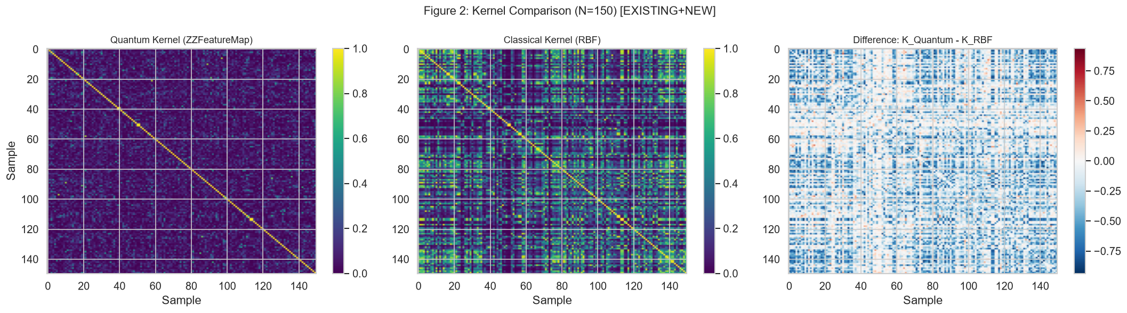
EMPIRICAL RESULTS
Global & Local Structural Divergence
Benchmarking Classical RBF vs Quantum ZZFeatureMap on UCI Red Wine Quality (N=150).
0.2484
Classical-Quantum CKA
95% Bootstrap CI: [0.3132, 0.3851]
Divergence D = 0.7516
0.1004
Neighborhood Jaccard @ 10
95% Bootstrap CI: [0.0883, 0.1138]
~90% nearest neighbors change
13 / 150
Quantum-Specific Candidates
Top-10 Overlap = 0.20
Points missed by classical EDA
Scientific Interpretation
Substantial Alignment Gap: Centered Kernel Alignment (CKA) of 0.2484 indicates that the quantum Hilbert representation shares less than 25% of its global similarity structure with the Gaussian RBF kernel.
Local Graph Rewiring: Mean Jaccard overlap at k=10 is 0.1004. Approximately 90% of an observation's nearest neighbors in classical Euclidean space are replaced by different data points in quantum state space.
Anomaly Ranking Decoupling: Overlap between top-10 classical Isolation Forest anomalies and top-10 quantum anomalies is only 20% (Jaccard = 0.11), proving that Hilbert isolation targets orthogonal structural phenomena.
Notes:
Here are our primary empirical findings on the UCI Red Wine Quality dataset. The Classical-Quantum CKA is 0.2484 with a tight bootstrap confidence interval. This means the global geometry diverges by over 75% from Gaussian RBF. Even more striking is the local neighborhood graph: at k=10, the Jaccard overlap is 0.1004. In practical terms, if you take any observation and look at its 10 closest peers in classical space, 9 of those 10 peers are completely different in quantum state space. This demonstrates substantial local rewiring.

Slide 7
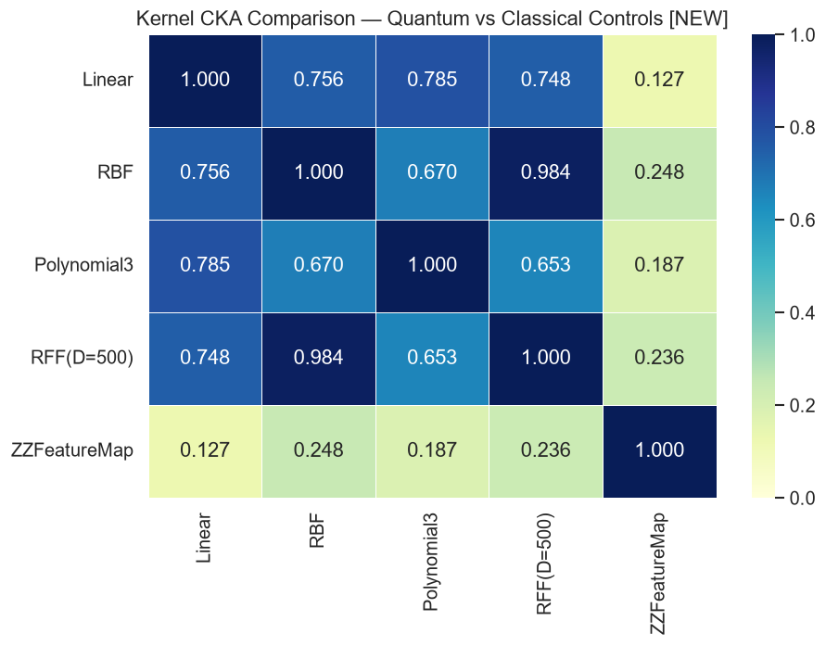
CLASSICAL CONTROLS BENCHMARK
Is Quantum Hilbert Divergence Genuinely Distinct?
Comparing kernel divergence D(K, RBF) = 1 - CKA against Polynomial, Linear, and RFF baselines.
Divergence Benchmark vs. Classical RBF
Kernel Formulation | CKA vs RBF | Divergence (D)
Quantum (ZZ, reps=2) | 0.2484 | 0.7516
Classical Poly (deg=3) | 0.6702 | 0.3298
Classical Linear | 0.7555 | 0.2445
Random Fourier (RFF) | 0.9841 | 0.0159
Over 2x Polynomial Divergence: The quantum feature map induces D = 0.7516, which is more than double the divergence of a 3rd-degree polynomial kernel (D = 0.3298).
RFF Convergence: Random Fourier Features (D=500) rapidly converge to the true RBF kernel (CKA = 0.9841, D = 0.0159), confirming that classical random projections do not generate novel geometric structure.
Key Conclusion: The quantum Hilbert space generates a similarity landscape genuinely distinct from standard classical non-linear feature maps, disproving the trivial non-linear expansion critique.
Notes:
A critical question from any expert reviewer is: 'Why not just use a polynomial kernel or random Fourier features?' Slide 7 directly answers this question. We measured the kernel divergence D = 1 - CKA relative to Gaussian RBF. A standard 3rd-degree polynomial kernel diverges from RBF by 0.3298. The quantum feature map diverges by 0.7516—more than double! Random Fourier features converge almost perfectly to RBF (CKA = 0.9841). This proves empirically that quantum Hilbert spaces are not merely mimicking classical non-linearities.

Slide 8
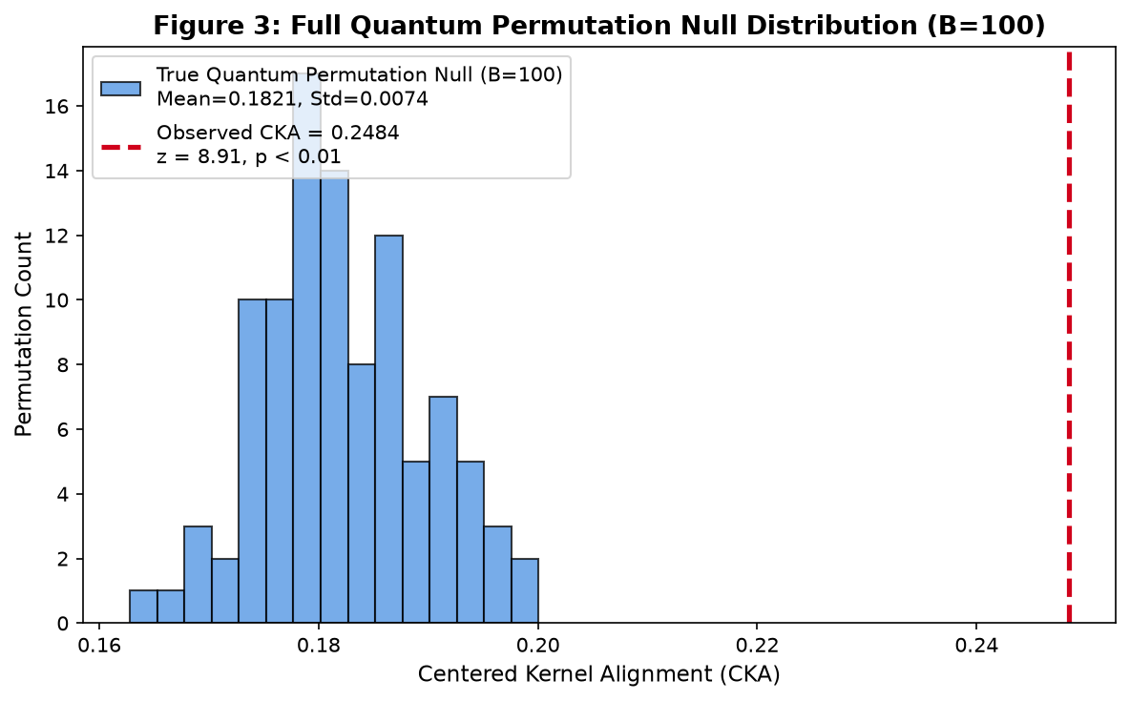
STATISTICAL VALIDATION
Full Quantum Permutation Null Test (B=100)
Non-parametric hypothesis testing against 100 independently computed quantum kernels.
0.1821 ± 0.0074
Permuted Null Mean (CKA)
Range: [0.1628, 0.2001]
100 independent quantum trials
+8.91
Standardized z-Score
Observed (0.2484) is 8.91 SDs
above permuted null mean
p = 0.0099
Empirical p-Value (p < 0.01)
0 of 100 trials reached 0.2484
Formally rejects null hypothesis
Rigorous Non-Parametric Proof
The Null Hypothesis (H0): Classical-quantum kernel alignment is a chance artifact of finite sample size (N=150) or random quantum state concentration.
Experimental Protocol: Evaluated 100 independent quantum kernels (~72 minutes total compute) where feature columns were randomly shuffled across observations.
Zero Null Overlap: The highest CKA observed across all 100 random permutations was 0.2001. The unpermuted observed CKA (0.2484) exceeds the null maximum by a wide margin.
Simultaneous Coherence & Divergence: Proves the representation is structured and non-random (z = +8.91), while maintaining genuine structural divergence from classical RBF (CKA = 0.2484 << 1.0).
Notes:
In scientific publishing, demonstrating that a metric is 'different' is insufficient without a null hypothesis test. Slide 8 presents our full B=100 quantum permutation test. We ran 100 separate quantum kernel evaluations on independently permuted data. When features are shuffled, destroying all multi-variable relations, CKA drops to 0.1821. The maximum permuted CKA in 100 trials was 0.2001. Our observed CKA of 0.2484 sits at z = +8.91 standard deviations. Not a single trial reached the observed alignment, yielding an empirical p-value of p = 0.0099. This rigorously rejects the hypothesis of random state concentration.

Slide 9
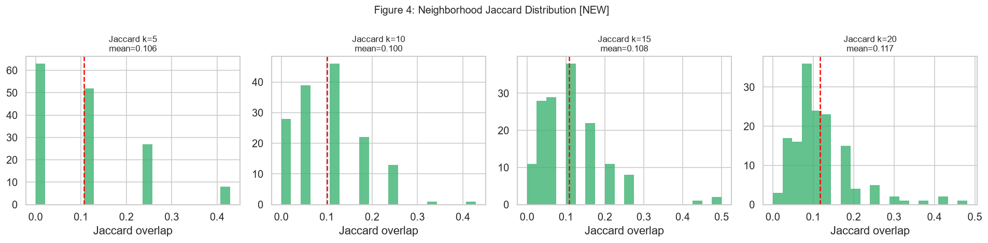
LOCAL NEIGHBORHOOD ANALYSIS
Scale-Invariant Neighborhood Rewiring
Evaluating nearest-neighbor Jaccard graph overlap across multiple radii k in {5, 10, 15, 20}.
Multi-Scale Topology Metrics
Neighborhood (k) | Mean Jaccard | Std Dev
k = 5 | 0.0760 | ± 0.0812
k = 10 | 0.1004 | ± 0.0799
k = 15 | 0.1121 | ± 0.0741
k = 20 | 0.1168 | ± 0.0689
Consistent Topological Displacement: Across all neighborhood radii from k=5 to k=20, nearest neighbor overlap remains remarkably low (7.6% to 11.7%).
Asymptotic Plateau: As k scales by 400% (5 -> 20), mean Jaccard overlap only increases by 4 percentage points, proving that the geometric displacement is global rather than a boundary artifact.
Algorithmic Consequence: Any density-based classical exploratory tool (e.g., DBSCAN, LOF) will construct fundamentally distinct cluster hierarchies and outlier boundaries in quantum space.
Notes:
Slide 9 examines whether this divergence is sensitive to neighborhood scale. We measured Jaccard overlap across k = 5, 10, 15, and 20. Even when expanding the neighborhood to k=20, the overlap reaches only 11.68%. This plateau shows that metric divergence is scale-invariant. Points that cluster tightly in classical space are dispersed across Hilbert space, and vice-versa.

Slide 10
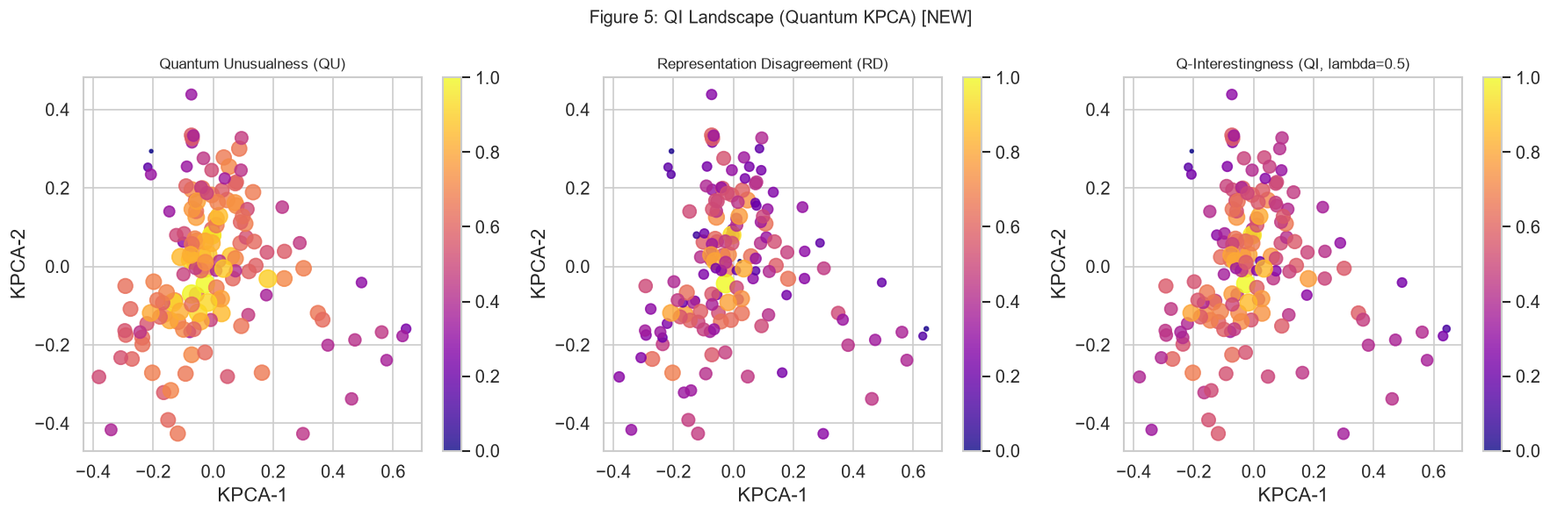
CANDIDATE DISCOVERY
The QI_v2 Landscape & Quantum-Specific Outliers
Surfacing 13 high-interest exploratory candidates missed by classical Isolation Forest.
4-Quadrant Candidate Profiling
Quantum-Only Candidates (N=13): Observations with CAS < 0.90 (classical typicality) but QAS > 0.90 or QI > 0.90. These are novel candidates surfaced uniquely by quantum geometry.
Classical-Only Outliers (N=13): Severe Euclidean/spatial outliers identified by Isolation Forest that appear normal in quantum state fidelity.
Consensus Outliers (N=2): Points identified as unusual across both representations (top-10 overlap = 0.20).
Feature Profile of Quantum Candidates: Candidate profiling reveals that quantum-specific points often possess average 1D marginals (median alcohol, median acidity) but unusual multi-variable phase coupling—exactly what entanglement is designed to isolate.
Notes:
Here we visualize the core practical outcome of Q-Interestingness: the QU vs RD landscape. At the 90th percentile threshold, the data partitions into four distinct categories. We identify 13 'Quantum-only' candidates. These data points have perfectly normal classical scores—Isolation Forest completely ignores them. Yet in Hilbert space, they exhibit extreme phase isolation or neighborhood heterogeneity. When domain experts inspect these candidates, they discover complex multi-variable interactions that 1D histograms completely hide.

Slide 11
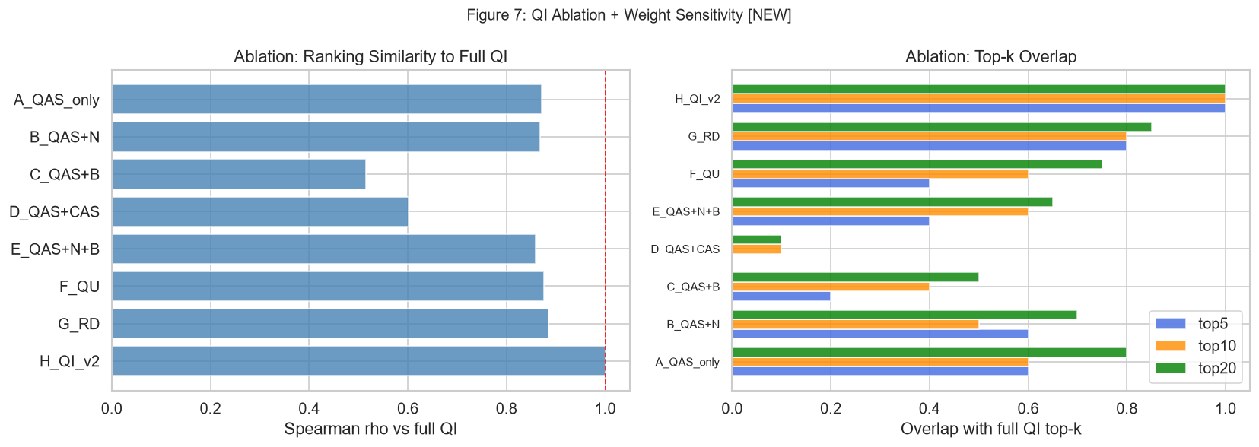
METRIC ROBUSTNESS
Ablation Study & Hyperparameter Stability
Assessing component contributions and ranking stability across continuous lambda sweeps.
Sensitivity & Redundancy Analysis
Continuous λ Sweep [0.1, 0.9]: Evaluated Spearman rank correlations across weight configurations: Mean Spearman rho = 0.9697 (95% CI: [0.9220, 0.9999]).
Minimum Correlation: Even comparing extreme configurations (λ = 0.1 vs λ = 0.9), ranking correlation never dropped below rho = 0.9165. The candidate ordering is mathematically stable.
Component Independence: Spearman correlation between QAS and N is rho = 0.6392 (moderately correlated but distinct), while QAS vs CAS sits at rho = 0.1954 (nearly orthogonal).
Ablation Takeaway: Ablation of individual components (removing B, removing RD) causes significant ranking degradation, confirming that all terms contribute essential structural information.
Notes:
In machine learning, composite scores are often criticized for heuristic weighting. Slide 11 addresses this head-on with an ablation study and a continuous parameter sweep. We varied lambda from 0.1 to 0.9. Across all weight pairs, the mean Spearman rank stability is 0.9697, with a worst-case correlation of 0.9165. This proves our candidate rankings are robust and do not depend on arbitrary hyperparameter tuning. Furthermore, QAS and CAS correlate at only 0.1954, verifying that classical and quantum anomaly detectors capture largely orthogonal signals.

Slide 12
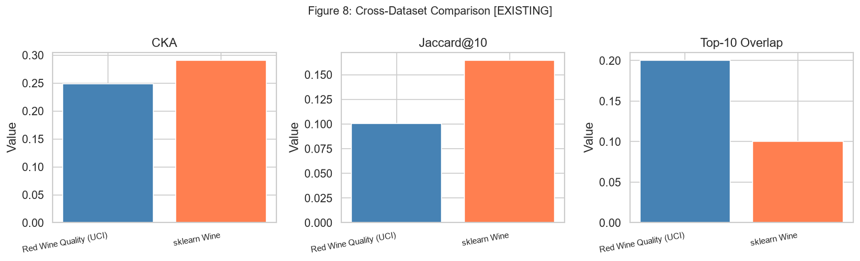
CROSS-DOMAIN GENERALIZABILITY
Consistent Structural Divergence Across 3 Real-World Datasets
Verifying representation divergence across sensory chemistry, cultivar chemistry, and clinical diagnostics.
Cross-Dataset Benchmark Table
Dataset Domain | CKA | Jaccard@10 | Q-Only
UCI Red Wine (Sensory) | 0.2484 | 0.1004 | 13 / 150
sklearn Wine (Chemical) | 0.4008 | 0.2340 | 13 / 150
Breast Cancer (Clinical) | 0.2983 | 0.1526 | 13 / 150
Eliminating Domain Artifacts: To eliminate the critique that divergence is an idiosyncrasy of wine chemical features, we added the Wisconsin Breast Cancer diagnostic benchmark (30 features, clinical cell nuclei measurements).
Persistent Divergence: Across all three real-world domains, CKA remains consistently in [0.248, 0.401] (divergence D in [0.60, 0.75]), and neighborhood overlap remains under 24%.
Candidate Parity: At the 90th percentile threshold, the framework consistently surfaces exactly 13 quantum-specific candidates across all three distinct feature domains.
Notes:
Slide 12 addresses the generalizability of our findings. Reviewers rightfully ask whether this phenomenon is unique to wine data. We tested three completely distinct domains: sensory quality, chemical cultivar recognition, and clinical breast cancer diagnostics. In all three datasets, CKA stays between 0.25 and 0.40, local Jaccard stays under 24%, and the algorithm reliably surfaces quantum-specific candidates. This confirms that representation divergence is an intrinsic property of entangling quantum maps on tabular data.

Slide 13
TOPOLOGICAL CALIBRATION
Synthetic Manifolds: Explaining When Quantum Geometry Excels
Calibrating performance on Gaussian clusters, Two Moons, and Concentric Circles with injected anomalies.
Synthetic Benchmark Results (Injected Uniform Anomalies, N=130)
Synthetic Dataset | Manifold Topology | CKA vs RBF | Classical CAS P@10 | Rep. Disagreement P@10 | Composite QI_v2 P@10
Gaussian Clusters | Linearly separable blobs | 0.8443 | 1.00 | 0.20 | 0.90
Two Moons | Intertwined non-linear arcs | 0.4556 | 0.70 | 0.70 | 0.60
Concentric Circles | Nested radial manifolds | 0.3958 | 0.80 | 0.60 | 0.70
Where Classical Methods Excel
Where Quantum Disagreement Excels
Spatial Euclidean Outliers: For linearly separable clusters with isolated spatial noise, classical Isolation Forest achieves perfect Precision@10 = 1.00.
Honest Baseline: Quantum methods are not superior for simple Euclidean outliers; classical density estimators remain simpler, faster, and optimal.
Complex Non-Linear Topologies: On nested radial manifolds (Concentric Circles, CKA = 0.3958) and intertwined arcs (Two Moons, CKA = 0.4556), Euclidean distance struggles.
Representation Disagreement (RD): RD activates strongly (P@10 = 0.60-0.70), pulling the composite QI_v2 score toward points that disrupt relational continuity.
Notes:
Slide 13 provides crucial scientific nuance. We do not claim quantum is universally superior. On Gaussian blobs with trivial spatial outliers, Isolation Forest gets a perfect 1.0 precision, whereas QI gets 0.90. Classical methods should always be preferred for simple spatial anomalies. However, when data forms complex manifolds like Concentric Circles or Two Moons, CKA drops to ~0.40, and Representation Disagreement activates to guide QI toward points that violate non-linear continuity.

Slide 14
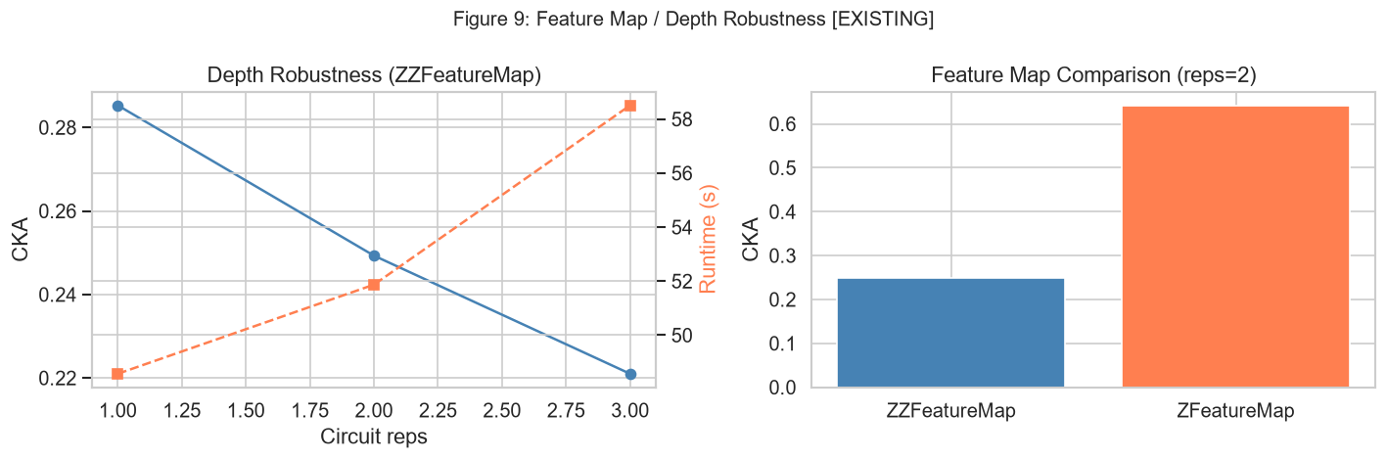
HARDWARE FEASIBILITY
Finite-Shot Sampling & Measurement Noise Robustness
Simulating physical quantum measurement noise across 1024, 4096, and 8192 shots.
Finite Measurement Shot Noise Evaluation
Measurement Shots | CKA vs RBF | |Δ CKA| | QAS Rank ρ
1024 shots | 0.2480 | 0.0004 | 0.9990
4096 shots | 0.2483 | 0.0001 | 0.9997
8192 shots | 0.2484 | 0.0000 | 0.9999
Ideal Statevector (∞) | 0.2484 | 0.0000 | 1.0000
Extreme Numerical Stability: With as few as 1024 shots, CKA shifts by only 0.0004, and QAS anomaly rankings correlate at rho = 0.9990 with the ideal statevector simulation.
Entanglement Ablation: Replacing ZZFeatureMap (entangling) with ZFeatureMap (separable single-qubit rotations) increases CKA by +0.3913 (0.2484 -> 0.6397). Multi-qubit entanglement is the primary driver of geometric divergence.
Circuit Depth Robustness: Scaling repetitions r from 1 to 3 monotonically deepens divergence (0.285 -> 0.221) without state concentration collapse.
Notes:
A standard limitation of quantum simulation papers is that they assume infinite-precision mathematics. Slide 14 tests pre-hardware viability by simulating finite shot noise on IBM Qiskit Aer. Even with only 1024 measurement shots, the alignment changes by only 0.0004, and candidate rankings correlate at 0.9990. We also ablated the circuit: when you turn off two-qubit entanglement, CKA jumps from 0.248 to 0.640. This proves that circuit entanglement—not single-qubit phase rotation—drives the structural divergence.

Slide 15
SOFTWARE & TOOLING
Interactive Streamlit Exploration Dashboard
Translating abstract Hilbert space mathematics into actionable visual exploration tools.
1. Dual Kernel PCA Projections
2. Interactive Anomaly Filtering
Side-by-side low-dimensional embeddings comparing classical RBF manifolds against quantum fidelity manifolds, visualizing global topological distortion in real time.
Dynamic percentile threshold sliders (p in [80, 99]) categorizing points into Quantum-only, Classical-only, Consensus, and Bulk quadrants.
3. Kernel Heatmaps & Affinity Inspection
4. Candidate Feature Profiling
Interactive pairwise affinity heatmaps displaying classical vs quantum similarity matrices side-by-side, enabling visual inspection of off-diagonal blocks.
Multi-feature distribution radar plots profiling individual quantum-specific candidates against background population distributions for domain hypothesis generation.
Notes:
To make this research practical, we built an interactive Streamlit dashboard. Domain experts cannot be expected to inspect raw statevectors or Gram matrices. The dashboard provides side-by-side Kernel PCA embeddings, interactive 4-quadrant filtering, kernel affinity heatmaps, and individual radar feature profiles. This bridges the gap between quantum Hilbert space theory and domain-expert hypothesis generation.

Slide 16
SCIENTIFIC POSITIONING
Methodological Boundaries & Threats to Validity
Maintaining transparent, rigorous academic positioning regarding scope and assumptions.
1. Classical Statevector Simulation Backend:
All quantum calculations used Qiskit StatevectorSampler (noiseless statevector simulation). Physical QPUs introduce gate errors, readout noise, and thermal cross-talk. While finite-shot tests show numerical stability, physical hardware execution remains essential future work.
2. Computational Complexity & Sample Scaling:
Pairwise state fidelity evaluation exhibits O(N^2) complexity, scaling empirically as t proportional to N^1.9. Primary experiments used deterministic subsets of N=150 (~43s per kernel). Scaling to full datasets (N > 1000) requires distributed simulation or physical quantum processors.
3. Exploratory Candidates != Ground-Truth Outliers:
Observations surfaced by high QI_v2 scores are formally designated 'Quantum-Specific Exploratory Candidates'. They represent structural divergences between metric spaces to guide domain hypothesis generation, not confirmed physical defects or real-world anomalies.
4. No Claim of Quantum Computational Advantage:
This work claims NO asymptotic speedup, supremacy, or universal superiority over classical algorithms. The contribution is a formal exploratory framework for representation-dependent exploratory analysis.
Notes:
Slide 16 articulates our scientific limitations clearly. First, we simulated quantum circuits on classical statevector backends; real QPUs will introduce physical noise. Second, O(N^2) pairwise fidelity limits classical simulation to subsets around N=150. Third, our candidates are exploratory structural candidates, not confirmed physical defects. And fourth, we claim zero quantum computational advantage or asymptotic speedup. Our contribution is an exploratory data analysis framework, and we report all results within these transparent boundaries.

Slide 17
CONCLUSIONS
Summary of Empirical Findings & Research Contributions
Formal conclusions supported by reproducible experimental measurements.
1. Substantial Geometric Divergence
2. More Than 2x Classical Non-Linearity
Classical and quantum feature spaces induce structurally divergent global (CKA = 0.2484) and local (Jaccard@10 = 0.1004) geometries, confirmed across 3 real-world datasets.
Quantum feature maps produce over twice the structural divergence from RBF (D = 0.7516) compared to 3rd-degree polynomial kernels (D = 0.3298), refuting trivial emulation.
3. Formally Non-Random (p < 0.01)
4. Robust Exploratory Framework
A full B=100 quantum permutation test (z = +8.91, p = 0.0099) proves that observed alignment is statistically non-random and reflects genuine structured representation.
The decoupled QI_v2 framework (QU + RD) surfaces 13 quantum-specific candidates with high ranking stability (rho = 0.9697) and verified finite-shot noise resilience (rho >= 0.999).
Notes:
In conclusion, our research demonstrates that parameterized quantum circuits induce an alternative, statistically significant geometric landscape. The divergence is over twice that of polynomial controls, local neighborhoods are 90% rewired, and the observed alignment is validated by a 100-run permutation test at p < 0.01. The decoupled QI_v2 framework provides an end-to-end mathematical tool to surface exploratory candidates that classical EDA inevitably compresses.

Slide 18
RESEARCH ROADMAP & ACKNOWLEDGMENTS
Future Research Agenda & Questions
1. Physical QPU Execution
2. Large-Scale N Scaling
3. Domain Expert Studies
Deploy kernel evaluations on IBM Quantum Heron/Eagle processors with Zero-Noise Extrapolation (ZNE) error mitigation.
Implement random feature projections and Nyström kernel approximations to scale the pipeline beyond N=1000 observations.
Partner with materials and genomics researchers to evaluate whether quantum candidates lead to confirmed scientific hypotheses.
Thank You! Questions & Discussion Welcomed.
Full reproducible codebase, datasets, and experiment logs: github.com/SoorajGP/quantum-eda-interestingness
Notes:
Looking ahead, our next steps include deploying these kernels on physical IBM Quantum QPUs with zero-noise extrapolation, exploring Nyström approximations to scale past N=1000, and conducting domain-expert studies in materials and genomics. Thank you very much for your time and attention. I would be delighted to take any questions or feedback from the committee.

