Slide 1
Software Testing
1.Difference between Manual and Automation.
2. What is Automation Testing, Why do we need?
3. Introduction to Selenium
4. Selenium 3 vs Selenium 4

Slide 2
Software Testing
The primary goal of software testing is to ensure that the software meets specified requirements and functions correctly.
Testing helps in identifying and fixing bugs before the software is released to end-users, ensuring a higher level of quality and reliability.
Types of Testing:
Manual Testing: Testers manually execute test cases without using any automation tools.
Automated Testing: Testers use automation tools to execute test scripts and compare actual outcomes with expected outcomes.

Slide 3
Choosing Between Manual and Automated Testing:
Type of Application: For applications with frequently changing requirements and user interfaces, manual testing may be more suitable.
For large, complex applications with stable requirements, automated testing can be more efficient.
Budget and Time Constraints: Manual testing may be quicker to implement initially, but automated testing can save time in the long run,
especially for regression testing and large-scale projects.
Skill Sets: Manual testing relies on human intuition, while automated testing requires programming skills.
The skill sets of the testing team may influence the choice between manual and automated testing.
Test Goals: The goals of testing, such as user experience evaluation or performance testing, can influence the choice of manual or automated testing.

Slide 4
Selenium

Slide 5
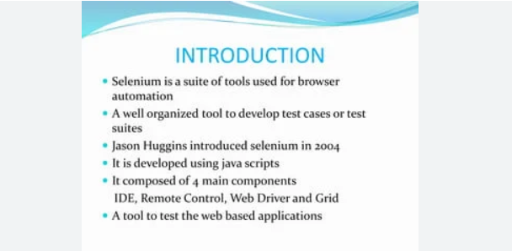

Slide 6
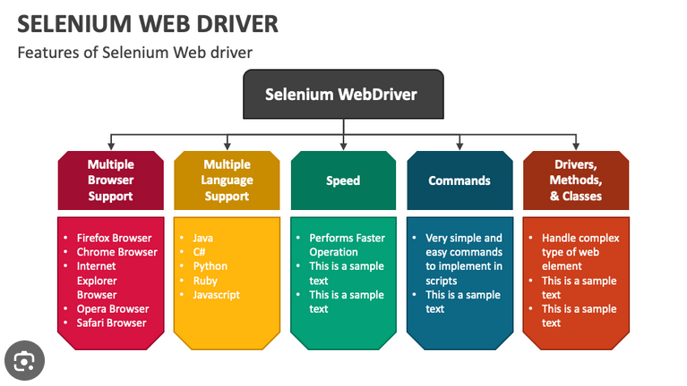

Slide 7
Selenium 3 vs Selenium 4
The architecture for Selenium 3 includes the JSON Wire Protocol.
However, Selenium 4 does not include the JSON Wire Protocol, and that’s the contrast between Selenium 3 and Selenium 4. JSON stands for JavaScript Object Notation.

Slide 8
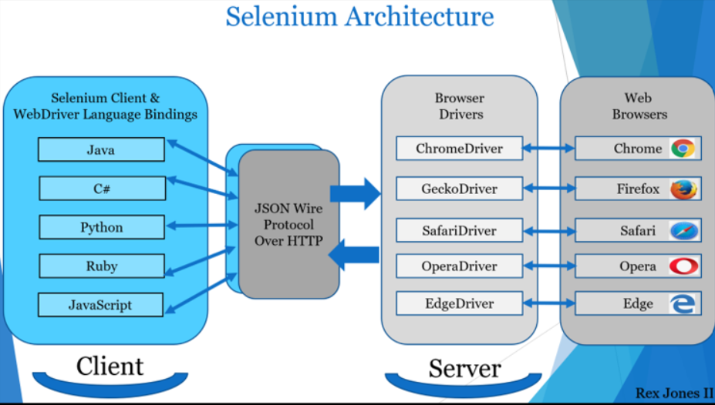
Selenium3: Selenium with JSON Wire Protocol
The JSON Wire Protocol has an assignment to transfer information from the client to the server over HTTP.
The main drawback of this protocol was that there was no direct communication between the client libraries (Java, Ruby, Python, etc..) and the browser driver. JSON wire protocol acts as a mediator between client libraries and webdriver.

Slide 9
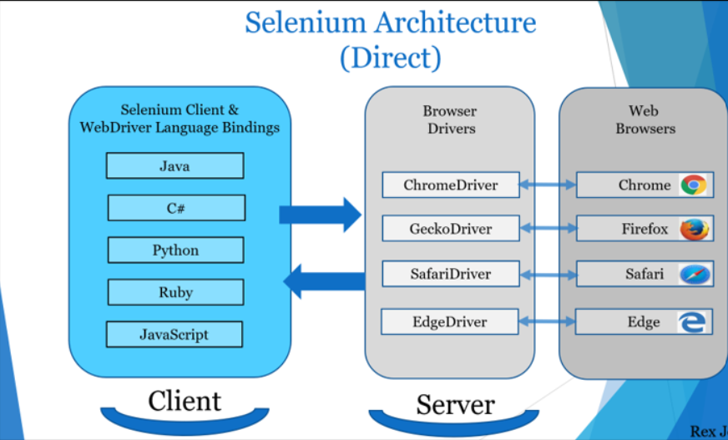
Selenium 4 Architecture
Unlike Selenium 3, Selenium 4 has direct communication between the client and server. The client still has 2 parts (Selenium Client & WebDriver Language Bindings) while Browser Drivers are the server.
Selenium Client sends out a request to perform a command.
The WebDriver Language Bindings is a code library designed to drive actions.
Browser Drivers receive the request and then return a response after an automation Test Script executes on the Web Browser:

Slide 10
JAVA Introduction
Introduction to Java:
1. Overview:
Java is a general-purpose, object-oriented programming language.
Developed by James Gosling and Mike Sheridan at Sun Microsystems in the early 1990s.
Known for its portability, performance, and security features.
2. Platform Independence:
Write Once, Run Anywhere (WORA) philosophy.
Java applications can run on any device with the Java Virtual Machine (JVM).
3. Object-Oriented Nature:
Everything in Java is treated as an object.
Encapsulation, Inheritance, Polymorphism, and Abstraction are fundamental principles.

Slide 11
Java Architecture:
1. Java Virtual Machine (JVM):
The heart of Java's platform independence.
Converts Java bytecode into machine-specific code during runtime.
2. Java Development Kit (JDK):
Includes the Java Compiler (javac), Java Virtual Machine (JVM), and other tools.
Used for developing, compiling, and running Java applications.
3. Java Runtime Environment (JRE):
Includes the JVM and libraries necessary for running Java applications.
JRE is a subset of JDK.

Slide 12
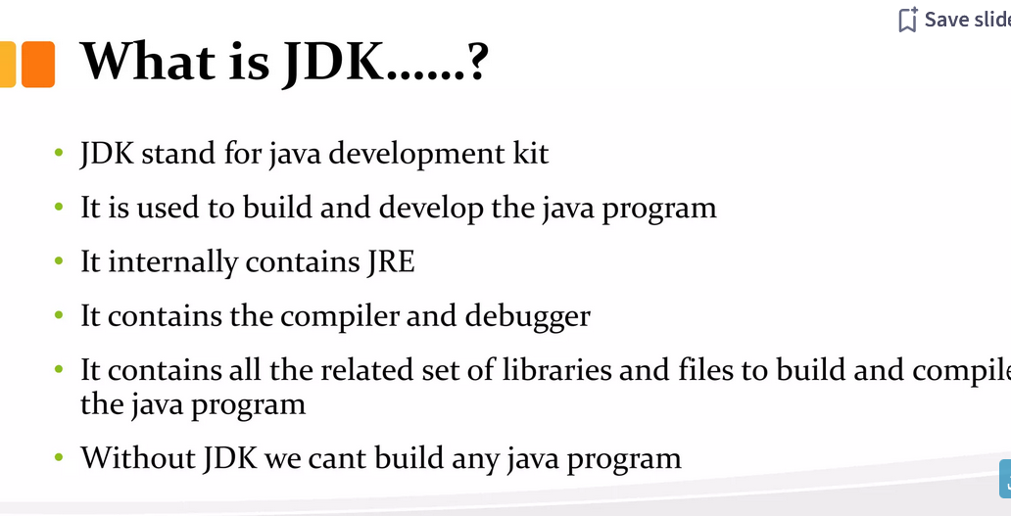

Slide 13
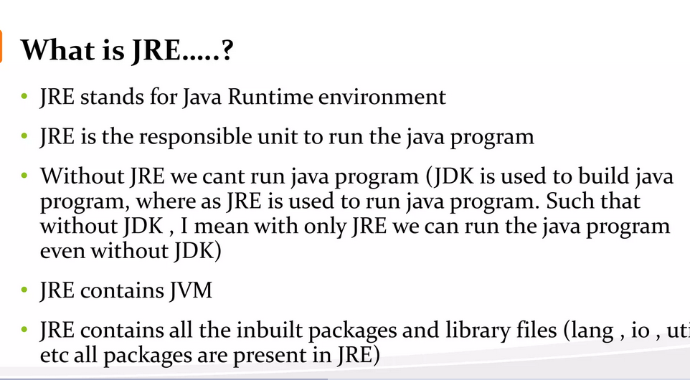

Slide 14
Step 1: Install Java SDK - Download and install the Java Software Development Kit (JDK) here
Step 2: Install Eclipse - Download the latest version of “Eclipse IDE for Java Developers” here.
Step 3: Install Selenium Webdriver Files - You can download Selenium Webdriver for Java Client Driver here
Step 4: Configure Eclipse IDE with WebDriver

Slide 15
Configure Eclipse IDE with WebDriver
Create a new java project, package and class
Now, selenium WebDriver’s into Java Build Path
Right-click on “newproject” and select Properties.
On the Properties dialog, click on “Java Build Path”.
Click on the Libraries tab, and then
Click on “Add External JARs..”
Select all files inside and outside lib folder

Slide 16
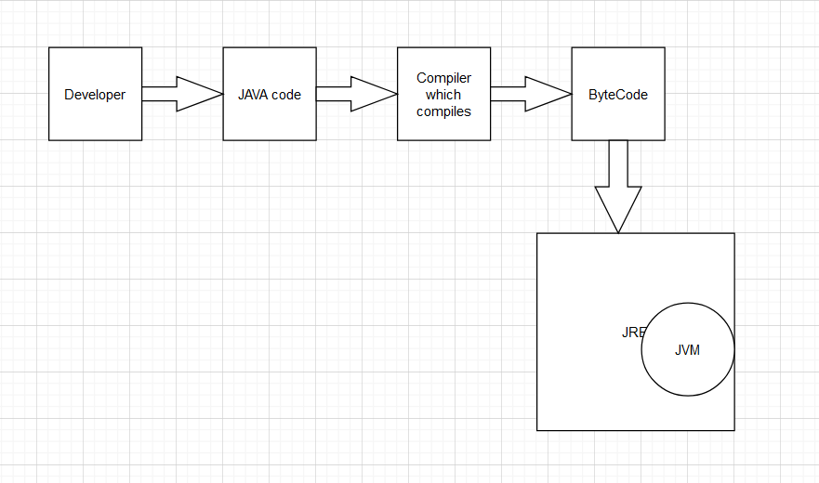
JAVA
Why Use Java?
Java works on different platforms (Windows, Mac, Linux, Raspberry Pi, etc.)
It is one of the most popular programming language in the world
It has a large demand in the current job market
It is easy to learn and simple to use
It is open-source and free
It is secure, fast and powerful
It has a huge community support (tens of millions of developers)
JVM look for main method

Slide 17
Java Syntax
Public class Example(){
public static void main(String[] args) {
System.out.println(“Hello World”)
}
}
Every line of code that runs in Java must be inside a class. In our example, we named the class Example.
A class should always start with an uppercase first letter.
The name of the java file must match the class name.

Slide 18
Java Comments - //
Java Variables
Variables are containers for storing data values.
In Java, there are different types of variables, for example:
String =“Hello world”
Int
float = 11.2f
char = ‘h’
Boolean = true
Creating Variable
Type variableName = value
String institute = “Harvard”
Decalre multiple variable
Ask candidate to perform

Slide 19
Data Types
As discussed in prev chapter, Variable in java must be specific data type
From Prev Slide
String institute = “Harvard”
String is a data type

Slide 20
Primitive Data Types
A primitive data type specifies the size and type of variable values, and it has no additional methods
Data Type |  | Description
byte | 1bytes | Stores whole numbers from -128 to 127
short | 2 bytes | Stores whole numbers from -32,768 to 32,767
int | 4 bytes | Stores whole numbers from -2,147,483,648 to 2,147,483,647
long | 8 | Stores whole numbers from -9,223,372,036,854,775,808 to 9,223,372,036,854,775,807
float |  | Stores fractional numbers. Sufficient for storing 6 to 7 decimal digits
double |  | Stores fractional numbers. Sufficient for storing 15 decimal digits
boolean |  | Stores true or false values
char |  | Stores a single character/letter or ASCII values

Slide 21
Non Primitive Data Types
Non Primitive data types are defined by programmer except String
Primitive |  | Non Primitive
Primitive types are predefined (already defined) in Java |  | Non Primitive data types are defined by programmer except String
Non-primitive types can be used to call methods to perform certain operations |  | Non Primitive cannot
A primitive type has always a value |  | Non Primitive can be null
Primitive type starts with a lowercase letter eg(int, char etc) |  | Starts with upper case eg(String)

Slide 22
Java TypeCasting
Widening Casting (automatically) - converting a smaller type to a larger type size
byte -> short -> char -> int -> long -> float -> double
Narrowing Casting (manually) – converting a larger type to a smaller size type
double -> float -> long -> int -> char -> short -> byte
byte val = 10;
Widening
int int_val = val;
System.out.println(int_val);
Narrowing
byte con = (byte)int_val;
System.out.println(con);

Slide 23
Loops and Control Statements and functions:
For -
While
Do while
Swicth case
If-else
Functions
Scanner
Assignment:
Iterate 1 to 100, print the number if its divisible only by 2 and print the number if its divisible only by 3 else print “not divisible by 2 or 3”
Create a function with parameter for above assignment. Eg:- instead of 100, n can be any number
Create a int function with parameter, capture the return value in a variable and check if the value is divisible by 5

Slide 24
Introduction to Strings
Definition of strings in Java - Strings are used for storing text.
Immutability of strings – use concat for better understanding
String Declaration and Initialization
Declaring a string variable
Initializing strings with literals
Using the new keyword for string objects
String Concatenation
Concatenating strings using the + operator
Using the concat() method
Importance of StringBuilder for concatenating large strings
String Methods
length(): Finding the length of a string
charAt(): Accessing individual characters
substring(): Extracting substrings
indexOf() and lastIndexOf(): Finding the position of a character or substring
startsWith() and endsWith(): Checking prefixes and suffixes
toUpperCase() and toLowerCase(): Changing case
String Comparison
equals(): Comparing strings for content equality
equalsIgnoreCase(): Case-insensitive comparison
String Manipulation
replace(): Replacing characters or substrings
trim(): Removing leading and trailing whitespaces
split(): Breaking a string into an array of substrings
7. String and StringBuilder Performance
Brief discussion on the performance differences between String and StringBuilder

Slide 25
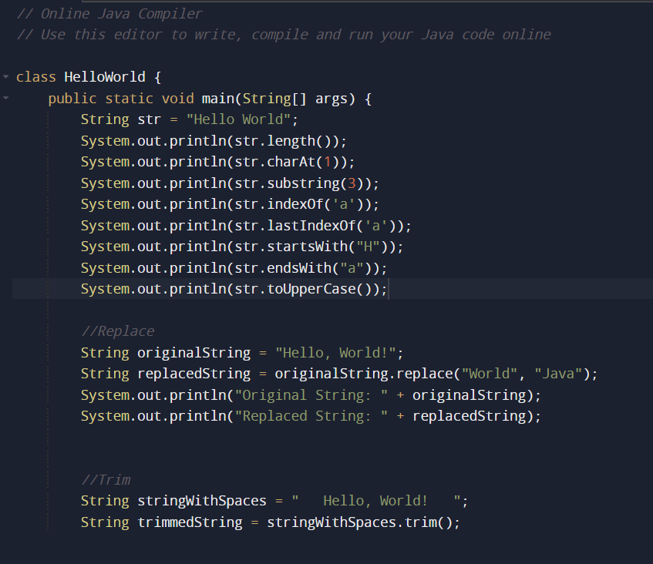

Slide 26
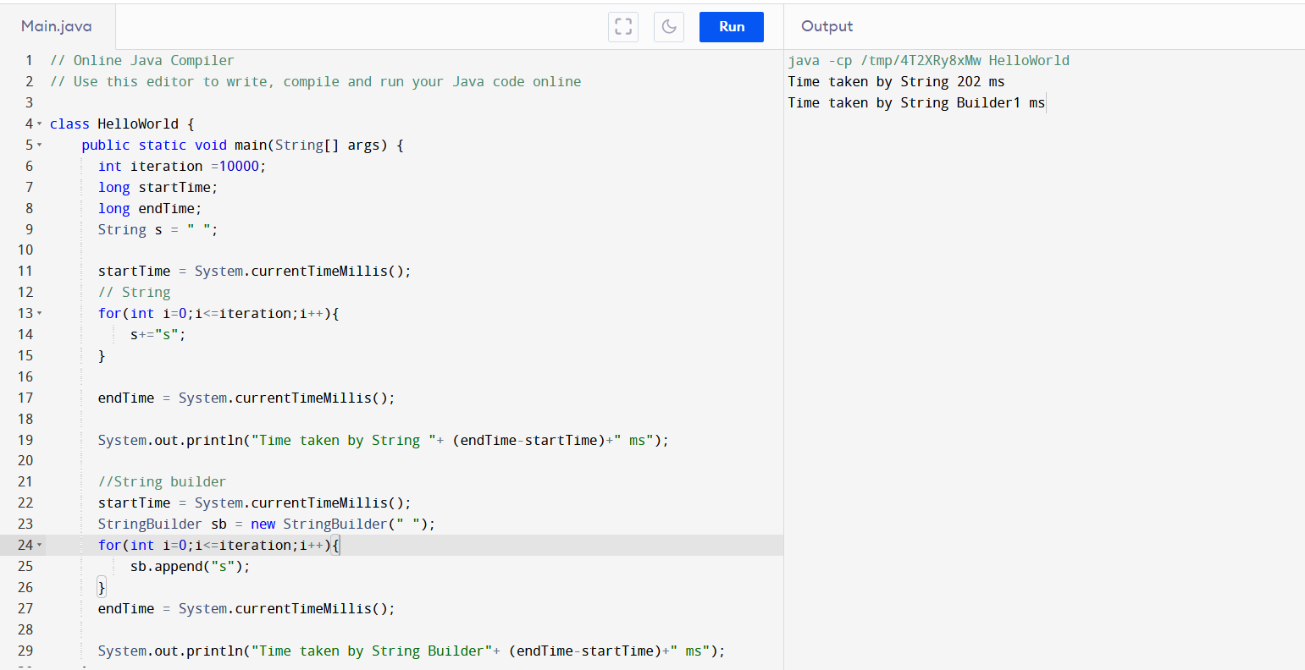

Slide 27
ARRAYS:
arrays are used to store multiple values of the same type under a single name.
arrays are zero-indexed, meaning the first element is at index 0
Decleration:
Int[] arr = new int[6];
Int[] arr = {1,2,3,4,5};
Accesing the element:
Arr[0] -> first element
Retrieve length
Arr.length;
Iteration

Slide 28
OOPS JAVA

Slide 29
Access Modifier | within class | within package | outside package by subclass only | outside package
Private | Y | N | N | N
Default | Y | Y | N | N
Protected | Y | Y | Y | N
Public | Y | Y | Y | Y

Slide 30
Static Variables:
A static variable belongs to the class rather than any specific instance of the class. It is shared among all instances of the class.
public class MyClass {
public static int staticVariable = 10;
public static void main(String[] args) {
System.out.println(staticVariable); // Accessing static variable
} }
Static Methods:
A static method belongs to the class rather than an instance.
It can be called without creating an object of the class.
public class MathUtils {
public static int add(int a, int b) {
return a + b;
}
public static void main(String[] args) {
int result = MathUtils.add(5, 3); // Calling static method System.out.println(result);
}
}

Slide 31
Default Constructor:
If a class doesn't explicitly define a constructor, Java provides a default constructor with no parameters.
public class MyClass {
public static void main(String[] args) {
MyClass obj = new MyClass(); // Creating an instance, calls the default constructor
}
Parameterized Constructor:
A constructor with parameters allows initializing object properties during object creation.
public class Person {
String name;
int age;
// Parameterized constructor
public Person(String n, int a) {
name = n;
age = a;
}
public static void main(String[] args) {
Person person1 = new Person("John", 25); // Creating an instance with parameters
System.out.println(person1.name + " is " + person1.age + " years old.");
}
}

Slide 32
Inheritance: A class can inherit properties and behaviors
from only one superclass in Java.
public class Animal {
public void eat() {
System.out.println("Animal is eating");
}
}
// Subclass inheriting from Animal
public class Dog extends Animal {
public void bark() {
System.out.println("Dog is barking");
}
}

Slide 33
Encapsulation:
Definition: Encapsulation is the concept of bundling data (attributes) and methods (functions). It involves hiding the internal state of an object and requiring all interactions to occur through an object's methods.
public class encapsulation {
public static void main(String[] args) {
classa obj = new classa();
obj.setstudentName("Suraj");
System.out.println(obj.getstudentName());
}
}
class classa{
private String studentName;
public void setstudentName(String studentName) {
this.studentName = studentName;
}
public String getstudentName() {
return studentName;
}
}

Slide 34
Polymorphism:
Definition: Polymorphism allows objects of different types to be treated as objects of a common type. There are two types of polymorphism in Java: compile-time (method overloading) and runtime (method overriding).
public class polymorph {
public static void main(String[] args) {
String data = "123";
int i = 10;
System.out.println(i+123);
polymorph poly = new polymorph();
poly.getData();
polymorph info = new infosys();
info.getData();
}
//method overloading
public void getData() {
System.out.println("This is my data");
}
public void getData(int data) {
System.out.println("This is my data");
}
public void getData(String data) {
System.out.println("This is my data");
}
}
class infosys extends polymorph{
public void getData() {
System.out.println("This is my friend's data");
}
}

Slide 35
abstract class car {
final static int age = 10; //not final and not static
public static void main(String[] args) {
car obj1 = new benz();
obj1.engine("Benz");
obj1.breakFunction();
obj1.doors();
car obj2 = new audi();
obj2.engine("Benz");
obj2.breakFunction();
obj2.doors();
System.out.println(age);
}
abstract void engine(String carname);
abstract void breakFunction() ;
abstract void doors() ;
}
class benz extends car{
void engine(String carname) {
System.out.println("Engine is implemented by BENZ");
}
void breakFunction() {
System.out.println("breakFunction is implemented by BENZ");
}
void doors() {
System.out.println("doors is implemented by BENZ");
}
}
class audi extends car{
void engine(String carname) {
System.out.println("Engine is implemented by audi");
}
void breakFunction() {
System.out.println("breakFunction is implemented by audi");}
}
Abstraction is the process of hiding the complex implementation details and showing only the essential features of an object. Abstract classes and interfaces are used to achieve abstraction in Java.

Slide 36
interface carInterface {
int age=10; //final and static
public static void main(String[] args) {
carInterface obj = new benzInterface();
obj.breakFunction();
obj.doors();
obj.engine();
System.out.println(age);
}
void engine();
void breakFunction() ;
void doors() ;
}
class benzInterface implements carInterface{
public void engine() {
System.out.println("Engine is implemented by BENZ");
}
public void breakFunction() {
System.out.println("breakFunction is implemented by BENZ");
}
public void doors() {
System.out.println("doors is implemented by BENZ");
}
}
interface is a reference type that is similar to a class. It is a collection of abstract methods. When a class implements an interface, it inherits the abstract methods defined by the interface.

Slide 37
Exceptions are events that occur during the execution of a program that disrupt the normal flow of instructions.
Unchecked Exceptions (RuntimeException):
These exceptions are not checked at compile time; they occur at runtime.
Checked Exceptions:
These are exceptions that are checked at compile time.
import java.io.FileReader;
import java.io.IOException;
public class Example {
public static void main(String[] args) {
try {
FileReader file = new FileReader("example.txt");
// Code that may throw IOException
} catch (IOException e) {
// Handle the exception
e.printStackTrace();
}
}
}
public class Example {
public static void main(String[] args) {
int[] array = {1, 2, 3};
System.out.println(array[5]); // This will throw ArrayIndexOutOfBoundsException
}
}

Slide 38
The Collection in Java is a framework that provides an architecture to store and manipulate the group of objects.
Java Collection framework provides many interfaces (Set, List, Queue) and classes (ArrayList, Vector,LinkedList,hashset).
Map – HashMap and HashTable, Queue

Slide 39
Exceptional Handling
public class ExceptionalHandling {
public static void main(String[] args) throws IOException {
test();
}
public static void test() throws IOException {
try {
File file= new File("\\src\\test112.csv");
FileInputStream fis = new FileInputStream(file);
Workbook wb = new XSSFWorkbook(fis);
}catch(IOException e) {
System.out.println(e);
}
System.out.println("Test Exception Handling");
}
}

Slide 40
public static void read() throws IOException {
File file = new File(Readpath);
FileInputStream fis = new FileInputStream(file);
Workbook workbook = new XSSFWorkbook(fis);
Sheet sheet = workbook.getSheetAt(0);
for(Row row:sheet) {
for(Cell cell:row) {
System.out.print(cell.getStringCellValue()+" ");
}
System.out.println();
}
}
public static void write() throws IOException {
File file = new File(Writepath);
FileOutputStream fos = new FileOutputStream(file);
Workbook workbook = new XSSFWorkbook();
Sheet sheet = workbook.createSheet("Sheet 1");
Row row = sheet.createRow(0);
Cell cell = row.createCell(0);
cell.setCellValue("This input is from Write method");
workbook.write(fos);
}
Read Write Excel

Slide 41
Selenium IDE
Open source record and playback test automation for the web
Introduction to Selenium IDE:
Selenium IDE is an integrated development environment for Selenium scripts. It's a Firefox and Chrome plugin that facilitates the recording and playback of interactions with a web application. Selenium IDE is user-friendly, making it an excellent tool for beginners to start with automated testing.
Installation and setup:
Chrome Download - https://chrome.google.com/webstore/detail/selenium-ide/mooikfkahbdckldjjndioackbalphokd
FireFox Download - https://addons.mozilla.org/en-GB/firefox/addon/selenium-ide/
Basic features and interface:
Selenium IDE provides a simple interface with various features like record and playback, script editing, and debugging. Different panels, such as the
Test Case Pane, Menu Bar etc

Slide 42
FEATURES OF SIDE
Menu Bar
Tool Bar
Address Bar
Test Case Pane
Test Script Editor Box
Start/Stop Recording Button
Log, Reference Pane
Recording and playback of test scripts:
Selenium IDE allows you to record user interactions with a web application and play them back as a test script. This feature simplifies the process of creating automated test cases without the need for extensive programming knowledge.

Slide 43
COMMANDS OF SIDE
essential commands such as open, click, type, and verify in Selenium IDE.
Understanding how these commands work is crucial for creating effective and reliable test scripts.
Demo: Creating a Simple Test Case
Live demonstration of creating a basic test case using Selenium IDE:
I'll demonstrate how to record a simple test case using Selenium IDE. We'll cover the process of navigating to a website, interacting with elements, and verifying expected outcomes.

Slide 44
What is Maven?
Maven is a build and project management tool that provides a consistent way to build projects. It simplifies tasks such as dependency management, building, testing, and packaging. Maven uses a project object model (POM) to manage project configuration.
Why use Maven in Selenium automation?
Using Maven in Selenium automation brings advantages such as dependency management, project structure standardization, and easy integration with continuous integration tools. Maven helps manage project dependencies and ensures a standardized project layout for better collaboration among team members.
Maven project structure:
We'll explore the typical structure of a Maven project, including the src directory, the pom.xml file, and how Maven organizes resources and compiled code.
Download:
https://maven.apache.org/download.cgi
https://dlcdn.apache.org/maven/maven-3/3.9.6/binaries/apache-maven-3.9.6-bin.zip
Extract and set system variable

Slide 45
Goal: clean
Purpose: Cleans the project by removing all files generated by the previous build. Command Example: mvn clean
Goal: compile
Purpose: Compiles the source code, generating the bytecode. Command Example: mvn compile
Goal: test
Purpose: Runs the unit test Command Example: mvn test
Goal: install
Purpose: Installs the packaged artifact into the local repository for use by other local projects. Command Example: mvn install
Goal: package
Purpose: Packages the compiled code into a distributable format, such as JAR etc Command Example: mvn package
Goal: deploy
Purpose: Copies the packaged artifact to a remote repository, making it available to other developers or projects. Command Example: mvn deploy

Slide 46
Understanding POM (Project Object Model):
The POM file, pom.xml, is the heart of a Maven project.
It contains project configuration details, dependencies, plugins, and other settings.
Key Maven commands (e.g., clean, compile, test):
We'll delve into key Maven commands, such as mvn clean, mvn compile, and mvn test.
These commands play a vital role in tasks like cleaning the project, compiling source code, and executing tests.

Slide 47
Locators
Locators are used in web automation to identify and interact with HTML elements on a webpage.
Types of Locators:
ID: These are commonly used locators and are usually unique identifiers for elements.
Name, Class Name: Identifying element based on name and class name
Link Text and Partial Link Text: Used for locating links by their visible text.
CSS Selectors: A powerful way to select elements using CSS syntax.
XPath: A versatile and powerful locator strategy.

Slide 48
XPath Basics:
Definition and purpose: XPath is a language for navigating XML documents, and in the context of web automation, it's used to navigate HTML documents.
Absolute vs. Relative XPath:
Relative : starts with // and it’s a shortest path
Absolute : starts with / and it’s a longest path (Not recommended
Sample Xpath Relative:

Slide 49
WebDriver
WebDriver drives a browser natively, learn more about it.
WebDriver drives a browser natively, as a user would, either locally or on a remote machine using the Selenium server, marks a leap forward in terms of browser automation.
Selenium WebDriver refers to both the language bindings and the implementations of the individual browser controlling code. This is commonly referred to as just WebDriver.
WebDriver is designed as a simple and more concise programming interface.
WebDriver is a compact object-oriented API.
It drives the browser effectively.

Slide 50
locators are used to identify and interact with web elements on a web page.
]Different types of locators are available, and the choice of locator depends on the attributes and structure of the HTML code.
Here are some common locators in Selenium:
ID:
Uses the id attribute of an element.
Example: driver.findElement(By.id("elementId"));
Name:
Uses the name attribute of an element.
Example: driver.findElement(By.name("elementName"));
Class Name:
Uses the class attribute of an element.
Example: driver.findElement(By.className("elementClass"));
Tag Name:
Uses the HTML tag name of an element.
Example: driver.findElement(By.tagName("tagName"));
Link Text:
Used for locating hyperlinks by the exact text of the link.
Example: driver.findElement(By.linkText("Link Text"));
Partial Link Text:
Used for locating hyperlinks by a portion of their text.
Example: driver.findElement(By.partialLinkText("Partial Link"));
XPath:
Provides a way to navigate the XML structure of an HTML document.
Example: driver.findElement(By.xpath("//div[@id='example']"));
CSS Selector:
Uses CSS syntax to locate elements.
Example: driver.findElement(By.cssSelector("input#username"));

Slide 51
XPath (XML Path Language) is a powerful language used to navigate XML documents, including HTML documents, in Selenium. It provides a way to traverse the elements and attributes in XML-like structures.
1. Absolute XPath:
An absolute XPath specifies the complete path from the root element to the target element. It begins with a single forward slash / and follows the hierarchy of
elements.
/html/body/div[1]/form/input[2]
2. Relative XPath:
A relative XPath is more flexible and concise. It doesn't start from the root element and is specified based on the current context
//input[@name='username']
Common XPath Syntax:
XPath expressions can use various conditions and functions to locate elements. Here are some commonly used syntax elements:
Element Selection:
tagname: Selects all elements with the specified tag name.
*: Selects all child elements.
Attribute Selection:
[@attribute='value']: Selects elements with a specific attribute and value.
Text Content:
text()='some text': Selects elements with the specified text content.
Positional Selectors:
[index]: Selects the element at the specified index.
Functions:
contains(): Checks if an attribute contains a specific value.
starts-with(): Checks if an attribute starts with a specific value.
last(): Selects the last matching element.

Slide 52
Handling Web Elements:
1. Input boxes - uname and pwd
2. Buttons - submit
3. CheckBox
4. Dropdown
5. Radio button --
6. Iframe
7. File upload using AWT/Robot --
Handling Interactions:
1. Enter
2. DragAndDrop
Implicit waits and assertion – wedriver
TestNG framework

Slide 53
//Initialize driver and launch web app Orange HRM
driver = new FirefoxDriver();
driver.get("https://opensource-demo.orangehrmlive.com/");
driver.manage().timeouts().implicitlyWait(Duration.ofSeconds(10));
//Login to application
driver.findElement(By.name("username")).sendKeys("Admin");
driver.findElement(By.name("password")).sendKeys("admin123");
driver.findElement(By.xpath("//button[@type='submit']")).click();
driver.manage().timeouts().implicitlyWait(Duration.ofSeconds(10));
//Navigate to Admin page
driver.findElement(By.xpath("//span[text()='Admin']")).click();
//Handling Dropdown
driver.findElement(By.xpath("//div[text()='-- Select --']")).click();
driver.findElement(By.xpath("//span[text()='ESS']")).click();
driver.findElement(By.xpath("//div[text()='-- Select --']")).click();
driver.findElement(By.xpath("//span[text()='Enabled']")).click();
//Submit
driver.findElement(By.xpath("//button[@type='submit']")).click();
//CheckBox - Handle Checkbox (store it in a list since its list of webelement)
List<WebElement> checkBox = driver.findElements(By.xpath("//i[@class='oxd-icon bi-check oxd-checkbox-input-icon']"));
System.out.println(checkBox.size());
for(int i=1;i<checkBox.size();i=i+2) {
checkBox.get(i).click();
}

Slide 54
//Check box - Single Element click based on xpath indexing
driver.findElement(By.xpath("(//i[@class='oxd-icon bi-check oxd-checkbox-input-icon'])[4]")).click();
//Navigate to Jquery UI
driver.get("https://jqueryui.com/checkboxradio/");
driver.manage().timeouts().implicitlyWait(Duration.ofSeconds(2));
//Handling IFrame - switch the focus to Iframe
WebElement iframe = driver.findElement(By.xpath("//iframe[@class='demo-frame']"));
driver.switchTo().frame(iframe);
//Click radio button which is inside iframe
driver.findElement(By.xpath("(//label[contains(@class,'radio-label')]//span)[1]")).click();
//Handling KeyBoard Functions
driver.get("https://google.com");
driver.findElement(By.id("APjFqb")).sendKeys("java");
driver.findElement(By.id("APjFqb")).sendKeys(Keys.ENTER);

Slide 55
Upload a FILE using Robot Class
public void uploadFile() throws AWTException {
driver.get("https://jumpshare.com/file-sharing/txt");
driver.manage().timeouts().implicitlyWait(Duration.ofSeconds(15));
// file path passed as parameter to StringSelection
driver.findElement(By.xpath("//label[@for='guest-file-upload']")).click();
driver.manage().timeouts().implicitlyWait(Duration.ofSeconds(15));
StringSelection ss = new StringSelection("C:\\Users\\suraj\\OneDrive\\Desktop\\Practice\\Training\\com.demo.acte\\test.txt");
Toolkit.getDefaultToolkit().getSystemClipboard().setContents(ss, null);
//imitate mouse events like ENTER, CTRL+C, CTRL+V
Robot robot = new Robot();
robot.delay(300);
robot.keyPress(KeyEvent.VK_ENTER);
robot.keyRelease(KeyEvent.VK_ENTER);
robot.keyPress(KeyEvent.VK_CONTROL);
robot.keyPress(KeyEvent.VK_V);
robot.keyRelease(KeyEvent.VK_V);
robot.keyRelease(KeyEvent.VK_CONTROL);
robot.keyPress(KeyEvent.VK_ENTER);
robot.delay(90);
robot.keyRelease(KeyEvent.VK_ENTER);
}

Slide 56
DRAG and DROP in Selenium:
Use Action class for mouse keyboard actions
driver.get("https://jqueryui.com/droppable/");
driver.manage().window().maximize();
Actions a=new Actions(driver);
WebElement w=driver.findElement(By.xpath("//iframe[@class='demo-frame']"));
driver.switchTo().frame(w);
WebElement draggable = driver.findElement(By.xpath("//div[@id='draggable']"));
WebElement droppable = driver.findElement(By.xpath("//div[@id='droppable']"));
a.dragAndDrop(draggable, droppable).build().perform();

Slide 57
IMPLICIT WAITS: waits a specified time before throwing an exception if the element is not found.
driver.manage().timeouts().implicitlyWait(Duration.ofSeconds(2)); all webelement
EXPLICIT WAITS: wait that allows us to wait for a specific condition to be met before continuing test execution
Wait<WebDriver> wait = new WebDriverWait(driver, Duration.ofSeconds(10));
WebElement title = driver.findElement(By.xpath("(//input[@type='submit'])[4]"));
wait.until(d -> title.isDisplayed());
Selected web element
FLUENT WAITS: Each FluentWait instance defines the maximum amount of time to wait for a condition, as well as the frequency with which to check the condition.
Wait<WebDriver> wait = new FluentWait<WebDriver>(driver)
.withTimeout(Duration.ofSeconds(10))
.pollingEvery(Duration.ofSeconds(2));

Slide 58
TestNG Annotation | Description
@BeforeSuite | The @BeforeSuite annotated method will run before the execution of all the test methods in the suite.
@AfterSuite | The @AfterSuite annotated method will run after the execution of all the test methods in the suite.
@BeforeTest | The @BeforeTest annotated method will be executed before the execution of all the test methods of available classes belonging to that folder.
@AfterTest | The @AfterTest annotated method will be executed after the execution of all the test methods of available classes belonging to that folder.
@BeforeClass | The @BeforeClass annotated method will be executed before the first method of the current class is invoked.
@AfterClass | The @AfterClass annotated method will be invoked after the execution of all the test methods of the current class.
@BeforeMethod | The @BeforeMethod annotated method will be executed before each test method will run.
@AfterMethod | The @AfterMethod annotated method will run after the execution of each test method.
@BeforeGroups | The @BeforeGroups annotated method run only once for a group before the execution of all test cases belonging to that group.
@AfterGroups | The @AfterGroups annotated method run only once for a group after the execution of all test cases belonging to that group.
@Parameteres, @depends on, group, enable, @dataprovider,
Parallel execution

Slide 59
package Tests;
public class TestNGDemo {
@org.testng.annotations.AfterSuite
public void AfterSuite() {
System.out.println("Inside After Suite");
}
@Test(groups = {"smoke"})
public void TestRun() {
System.out.println("In test runner no 1");
}
@Test(groups = {"regression"})
public void TestRun1() {
System.out.println("In test runner no 2");
}
@BeforeGroups(groups={"regression"})
public void beforeGroup() {
System.out.println("This is inside before group");
}
@AfterGroups(groups={"regression"})
public void afterGroup() {
System.out.println("This is inside after group");
}
@BeforeSuite
public void Beforesuite() {
System.out.println("Inside Before suite");
}
@BeforeTest
public void beforetest() {
System.out.println("Inside before test");
}
@AfterTest
public void Aftertest() {
System.out.println("Inside after test");
}
@BeforeClass
public void beforeClass() {
System.out.println("Before class");
}
@AfterClass
public void afterClass() {
System.out.println("After class");
}
}
DATA PROVIDERS:
public class DP
{
@DataProvider (name = “demoACTE")
public Object[][] dpMethod(){
return new Object[][] {{"Value1"}, {“Value2"}};
}
@Test (dataProvider = " demoACTE ")
public void myTest (String val) {
System.out.println("Passed Parameter Is : " + val);
}
}
Parallel and Param
<?xml version="1.0" encoding="UTF-8"?>
<!DOCTYPE suite SYSTEM "https://testng.org/testng-1.0.dtd">
<suite parallel="methods" name="Suite">
<test thread-count="3" parallel="methods" name="Test">
<parameter name ="a" value="150"></parameter>
<parameter name ="b" value="100 "></parameter>
<classes>
<class name="Tests.TestNGDemo"/>
</classes>
</test> <!-- Test -->
</suite> <!-- Suite -->

Slide 60
FRAMEWORK
A data-driven framework is a test automation framework where test data is kept separate from the test script, allowing for more flexibility and reusability of test cases.
Advantages of a Data-Driven Framework:
Increased Reusability
Faster Test Execution
Adaptability to Changes
DD – framweok where it takes care of fetching the data from external resources
SRC/MAIN/JAVA
-Utils (initialize the driver and open the app) - Done
-Pages (Loginpage – all page element) --
SRC/TEST/JAVA
-Tests (login) run the code

Slide 61
Design Patterns in Selenium:
Design Pattern are reusable solutions that can be reused on to problems that frequently arise in software design.
They serve as a common vocabulary and a shared understanding of best practices among the developers.
Types:
POM (Page Object Model)
POM stands for Page Object Model, and it is a design pattern used in test automation to enhance the maintainability and
readability of test scripts. It is particularly popular in Selenium WebDriver-based frameworks.
The main idea behind the Page Object Model is to represent the web pages of an application as objects in the test code,
with each page having a corresponding class.
PageFactory – class that help us to implement the POM

Slide 62
• Create a GitHub Account (if you haven't already): Go to GitHub and sign up for a new account if you don't have one.
• Set Up Git: If you haven't configured Git with your username and email yet, open Git Bash and run the following commands, replacing "Your Name" and "your.email@example.com" with your actual name and email address:
git config --global user.name "Your Name"
git config --global user.email "your.email@example.com"

Slide 63
GIT – Central Repository
UPLOAD
One-time setup git init (Initialize the repo in local) git remote add origin <repoURL>
Process to push the changes git status (to check the updated file) git add <updated file> git commit -m "commit message" git push origin <branchname>
Download
One-time setup git clone <repouri>
Cd <reponame>
Process to pull changes
Git pull origin master
Switch Branch
Git checkout <branchname>

Slide 64
OTHERS :
TestNG, Maven, Git, Github, Jenkins

